Slide 1
Learning Objectives
HOP 2.1
Your First Web Page
HOP 2.2
Heading Element
HOP 2.3
Paragraph Element
HOP 2.4
Line Break Element
HOP 2.5
Blockquote Element
HOP 2.6 & 2.7
Phrase Elements & Un/Ordered Lists
HOP 2.8
Description Lists
HOP 2.9
Special Characters
HOP 2.10 & 2.11
Structural Elements
HOP 2.12
Aside Element
HOP 2.13
Anchor Elements
HOP 2.14
Anchor Elements
(Continued)
HOP 2.15
Anchor Elements
(Continued)
HOP 2.16
HTML Validation

Slide 2
Chapter 2
HTML Basic
Credits: © 2011, 2014, 2015 – 2023 Pearson Education
Copyright (c) 2012 Prentice-Hall. All rights reserved.
Expanded by J. Goetz, 2025
Credits: Parts of the slides are based on slides created by textbook,
Essentials for Design XHTML

Slide 3

Learning Objectives
In this chapter, you will learn about:
2.1 Describe HTML, XHTML, and HTML 5
2.2 Identify the markup language in a web page document
2.3 Use the html, head, body, title, and meta elements to code a template for a web page
2.4 Configure the body of a web page with headings, paragraphs, line breaks, div, lists, and blockquotes
2.5 Configure text with phrase elements
2.6 Configure a web page using new HTML 5 header, nav, main, and footer elements
2.7 Configure special characters
2.8 Use the anchor element to link from page to page
2.9 Create absolute, relative, and e-mail hyperlinks
2.10 Code, save, and display a web page document
2.11 Test a web page document for valid syntax.

Slide 4
What is HTML?
The World Wide Web is composed of files containing Hypertext Markup Language (HTML)
HTML is based on SGML Standard Generalized Markup Language
Describes the general structure of the document
HTML describes the Structure of a Page
It defines a set of common styles for Web pages
headings
paragraphs
lists
tables
forms and more
Each of these common styles has a tag associated with it to define the element
HTML
Made up of tags and attributes
The set of markup symbols or codes placed in a file intended for display on a Web browser page.

Slide 5
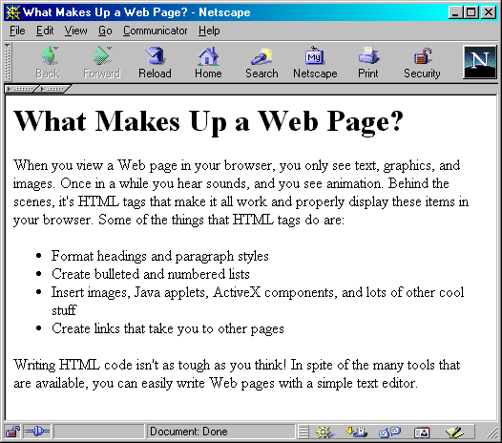
What HTML Is -- and What It Isn’t
Heading
Paragraph
Bulleted List
Paragraph

Slide 6
What is HTML?
The text of the page
Adds special code (tags - formatting instructions) around words and paragraphs
each individual markup code is referred to as an element or tag. Each tag has a purpose.
Tags are enclosed in angle brackets, "<" and ">" symbols – referred to as container tags
<body> </body>
Most tags come in pairs; an opening tag and a closing tag.
horizontal line: <hr align=“right” > is a stand-alone or self-contained tag and doesn’t have a closing tag.

Slide 7
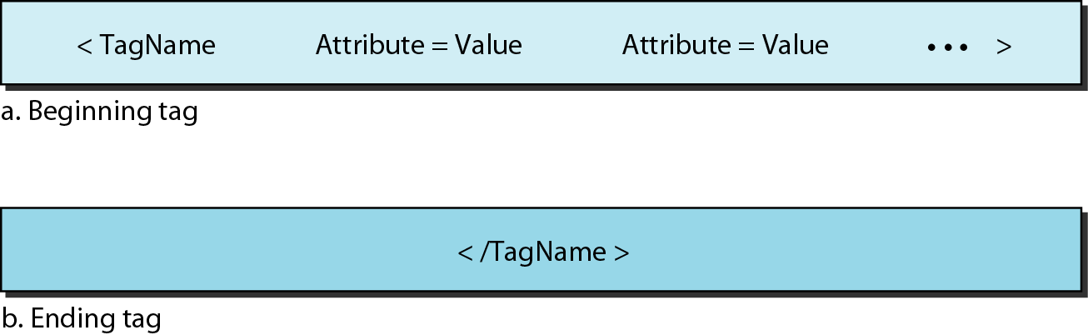
HTML
Whereas the text is the actual information contained in a page, the tags define the appearance of the document.
Every HTML tag is a name followed by an optional list of attributes, all enclosed between less-than and greater-than symbols (< and >).
An attribute, if present, is followed by an equals sign and the value of the attribute.
<hr align=“right” >
Some tags can be used alone; others must be used in pairs.
Those that are used in pairs are called beginning and ending tags.
The beginning tag can have attributes and values and starts with the name of the tag.
The ending tag cannot have attributes or values but must have a slash before the name of the tag.
The browser makes a decision about the structure of the text based on the tags, which are embedded into the text.

Slide 8
What is HTML?
HTML tags that indicate:
page elements
structure
formatting
hypertext links
HTML tags are not case sensitive
XHTML tags are case sensitive
all tags and attributes must be written in lowercase
browsers ignore:
extra spaces
tabs
returns
tags are the only way to format an HTML page

Slide 9
What is XHTML?
The World Wide Web Consortium http://w3c.org
sets the standards for HTML and its related languages.
The version of HTML 4.01 is actually XHTML – eXtensible HyperText Markup Language.
XHTML uses the tags and attributes of HTML along with the syntax of XML (eXtensible HyperText Markup Language).

Slide 10
What HTML is
The individual browsers map the tag to how it will be viewed
different browsers can display the same tag element in different ways
what this means is that a Web page may look perfect on your system and may be unreadable on someone else's
In addition to the HTML tags defined in the various versions of HTML:
browser vendors defined their own browser-specific extensions
The World Wide Web - www is composed of files containing Hypertext Markup Language (HTML)
Scripting language that instructs a Web browser how to display a Web page
Less powerful than other computer languages
Runs within a browser, not stand-alone
One of the version: HTML 4.01
Is being replaced with XHTML

Slide 11
History of HTML
A Brief History of HTML Tags
HTML 2.0
HTML 2.0 (RFC 1966) was developed by the IETF's HTML Working Group, which closed in 1996.
It sets the standard for core HTML features based upon current practice in 1994.
HTML 3.2
W3C's recommendation for HTML which represented the consensus on HTML features for 1996.
HTML 3.2 added widely-deployed features such as
tables,
applets,
text-flow around images,
superscripts and
subscripts,
while providing backwards compatibility with the existing HTML 2.0 Standard.
HTML 4.0
First released as a W3C Recommendation on 18 December 1997.
A second release was issued on 24 April 1998 with changes limited to editorial corrections.
This specification has been superseded by HTML 4.01.
HTML 4.01
The HTML 4.01 Recommendation released on 24th December 1999, fixes a number of bugs in the HTML 4.0 specification.

Slide 12
Extensible Markup Language (XML)
Here's an example of the data in XML:
<Customers>
<Customer>
<LastName>JONES</LastName>
<FirstName>JOHN</FirstName>
<Telephone>5555551212</Telephone>
<Address>9902 BROADWAY</Address>
<City>NEW YORK</City>
<State>NY</State>
<Zip>10010</Zip>
</Customer>
<Customer>
<LastName>SMITH</LastName>
<FirstName>MABEL</FirstName>
<Telephone>5555559999</Telephone>
<Address>674 ANYSTREET</Address>
<City>CHICAGO</City>
<State>IL</State>
<Zip>60614</Zip>
</Customer>
</Customers>

Slide 13
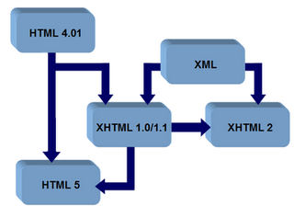
What is HTML5 ? p. 647
HTML 5 (modern interface)
The next version of (classic interface)
HTML 4 and XHTML 1
There are 28 additional tags and a few new techniques
Firefox, Chrome, Internet Explorer, Safari, and Opera can all use HTML5 today
http://www.w3.org/html/
Supported by modern browsers
Safari, Google Chrome, Firefox, Internet Explorer, Edge
Intended to be backwards compatible
Adds new elements
Adds new functionality
Edit form data
Native video and audio
And more!

Slide 14
Programs to Help You Write HTML
Many programs available to help create HTML files
3 flavors of editors:
HTML-based text editors
WYSIWYG (What You See What You Get) editors
Combination of HTML-based and WYSIWYG editors
Dreamweaver
There are also converters that generate an HTML file from an existing document.
For now use Notepad then Notepad++

Slide 15
XHTML
What is XHTML and Why Use It?
eXtensible HyperText Markup Language.
XHTML is the transition from HTML 4.0 to XML (Extensible Markup Language)
XHTML was developed by the W3C World Wide Web Consortium to be the reformulation of HTML as an application of XML.
Purpose:
Provide a more structured alternative to non-standard HTML
Provide ways to extend HTML and add new features
Separate content from presentation (>=XHTML 2.0)
XHTML combines
the formatting strengths of HTML and
the data structure and extensibility strengths of XML.
allows for custom tags

Slide 16
What is XHTML and Why Use It?
XHTML Syntax
Use lowercase tags and attributes
Place attribute values in quotes
All container tags must use their opening and closing tags. All tags are enclosed in angle brackets.
4. Terminate all non-empty single elements
add the closing slash (/) preceded by a space just before the ending greater symbol than (>)
<br> and <hr> become <br /> and <hr />
5. Tags shouldn’t be overlapped (html and xhtml)
nested -- <b><i>Bold and Italic</i></b>
overlapping -- <b><i>Bold and Italic</b></i>

Slide 17
1- 4. Whole XHTML with <head> and <body> tags
<?xml version="1.0" encoding="UTF-8"?>
<!DOCTYPE html PUBLIC "-//W3C//DTD XHTML 1.0 Transitional//EN"
"http://www.w3.org/TR/xhtml1/DTD/xhtml1-transitional.dtd">
<html xmlns=http://www.w3.org/1999/xhtml>
<head> .... Header info goes here
</head>
<body>
.... Body info goes here </body>
</html>
An XML document must be well-formed i.e. adheres to the syntax rules
Use lowercase
Use opening and closing tags
<body> </body>
Close stand-alone tag with special syntax
<hr />
XML documents begin with an XML declaration as a directive. The basic form of this directive is
<?xml version="1.0" encoding="UTF-8"?>
UTF-8 a form of Unicode

Slide 18
2. Document Type Definition (DTD)
W3C Recommendation: Use a Document Type Definition DTD to identify the type of markup language used in a web page:
Declares the document type
Required in XHTML
HTML 4.01 specifies three DTDs:
<!DOCTYPE HTML PUBLIC "-//W3C//DTD HTML 4.01//EN" "http://www.w3.org/TR/html4/strict.dtd">
Strict (XHTML 2.0)
Must follow complete XML coding rules
Must separate content from presentation
Presentation via Cascading Style Sheets (CSS)
<!DOCTYPE HTML PUBLIC "-//W3C//DTD HTML 4.01 Transitional//EN"
"http://www.w3.org/TR/html4/loose.dtd">
Transitional (XHTML 1.0, 1.1)
Reformulation of HTML 4.01
Presentation and content tags exist
<!DOCTYPE HTML PUBLIC "-//W3C//DTD HTML 4.01 Frameset//EN"
"http://www.w3.org/TR/html4/frameset.dtd">
Frameset
Enable window-in-a-window effect

Slide 19
2. XHTML 1.0 Transitional DTD
Document Type Definition DTD tag
commonly called the
DOCTYPE
We use mainly XHTML 1.0 version
sometimes XHTML 1.1
<?xml version="1.0" encoding="UTF-8"?>
<!DOCTYPE html PUBLIC "-//W3C//DTD XHTML 1.0 Transitional//EN"
"http://www.w3.org/TR/xhtml1/DTD/xhtml1-transitional.dtd">
<html xmlns=http://www.w3.org/1999/xhtml>
<head> .... Header info goes here
</head>
<body>
.... Body info goes here </body>
</html>
This DTD module is identified by the PUBLIC and SYSTEM identifiers:
PUBLIC "-//W3C//DTD XHTML 1.0 Transitional//EN"
SYSTEM "http://www.w3.org/TR/xhtml1/DTD/xhtml1-transitional.dtd"

Slide 20
3. namespace
<?xml version="1.0" encoding="UTF-8"?>
<!DOCTYPE html PUBLIC "-//W3C//DTD XHTML 1.0 Transitional//EN"
"http://www.w3.org/TR/xhtml1/DTD/xhtml1-transitional.dtd">
<html xmlns=http://www.w3.org/1999/xhtml>
<head> .... Header info goes here
</head>
<body>
.... Body info goes here </body>
</html>
xmlns=http://www.w3.org/1999/xhtml>
The location of the documentation for the elements being used
http://www.w3.org/1999/xhtml/
This is an XML namespace defined in the XHTML™ 1.0: The Extensible HyperText Markup Language specification, and
is shared across XHTML Family document types

Slide 21
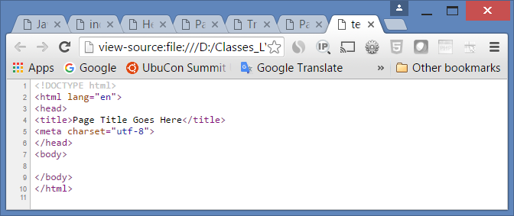
4. Head & Body Sections
Head Section (description) -- Contains information that describes the web page document.
<head>
…head section info goes here
</head>
Body Section (contents) -- Used for text and tags that do show directly on the web page.
<body>
…body section info goes here
</body>

Slide 22
The Relationship between HTML5 and XHTML
HTML5 is not really a rejection of XHTML; it has some of the best features of both HTML 4 and XHTML:
Simple doctype: The doctype definition (the boilerplate code that begins every web page) for XHTML was really complicated.
Even people who taught classes and wrote books about it never memorized the doctype, but had to copy and paste it every time. HTML5 has a very simple and clean document definition, and it's once again possible to write a page from memory.
Separation of content and style: HTML5 does not include the style tags from HTML 4 (font, center, and so on), instead requiring developers to use CSS for all styling. Likewise, frames and table-based layout are discouraged in favor of CSS-style layout.
Validation support: Validation turned out to be a very useful tool, so HTML5 can be validated just like XHTML.
The W3C validator currently supports HTML5, and other validation tools are coming online. Validation is an easy way to eliminate goofy coding mistakes and can greatly simplify your coding after you start adding programming support to your documents.
Strict tradition: The coding standards of HTML5 are more like XHTML than HTML 4. Although it's still possible to use sloppy coding in HTML5, most developers use the XHTML strict standards to make the code easier to read and more predictable.
Tighter integration of CSS and programming languages: Perhaps the most important feature of HTML5 is its humility. While HTML is still the central language of the Internet, HTML5 is really about distributing control to other languages. HTML5 is designed as a central glue that ties together many other technologies: CSS for visual layout, JavaScript for client-side programming, server-side languages like PHP for server control, and databases.
New capabilities: Many of the new features of HTML5 are not technically HTML but advances in the various other related technologies (integrated databases, new JavaScript syntax, new CSS features, and so on).

Slide 23

Hands-On Practice
HOP 2.1 Hello World
Follow the directions in your book for the HOP.
START-UP File | n/a
SAVE SOLUTION AS | index.html

Slide 24
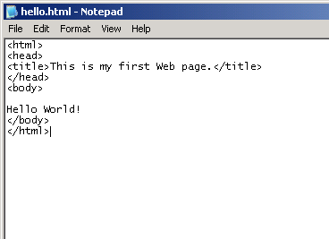
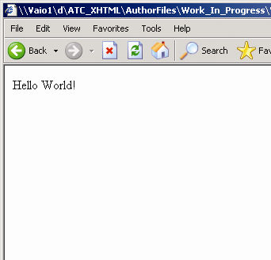
HTML Code in Notepad and Browser Results
<title> tag
gives a page a title
used in bookmarks
used by search engines
appears in browser title bar
goes inside the page header (<head>)
Title goes in Title bar of browser
Body goes in content area of browser
Copyright (c) 2006 Prentice-Hall. All rights reserved.
24
Notes:
24
Note in this case that "Hello World" was not part of any tag, except that it was included in the body. In most cases, however, text is displayed as part of a specific element, as will be seen in later slides.

Slide 25
Saving an XHTML File from Notepad
By default, files from Notepad are saved with a .txt extension
If you try to save as filename.html, then the saved file name will be filename.html.txt
You can avoid this by either:
Making sure that the Save As Type entry is set as All Files *.* instead of *.txt or
Saving with the name in quotes, like this: "filename.html"
Copyright (c) 2006 Prentice-Hall. All rights reserved.
25
Notes:
25
Problems with file extensions may be a frequent difficulty encountered by students. One way to deal with this is to switch folder options. In the Tools menu of a folder, select Folder Options. In the View tab of the Folder Options dialog box, uncheck the Hide extensions for known file types box. This will ensure that all extensions are visible, making it easier to change file names appropriately.

Slide 26
Checkpoint 2.1
1. Describe the origin, purpose, and features of HTML.
-Developed by Tim Berners-Lee at CRN using SGML.
-Is set of markup symbols or codes placed in a file intended for display on a Web browser.
-Each markup code is referred to an element ( or tag)
2. Describe the software needed to create and test web pages.
-May use windows or Mac editors
3. Describe the purpose of the header and body sections of a web page.

Slide 27
HTML <body> tag attributes
The <body> tag can be used to set attributes (properties) for entire Web page, such as
Background color
Background image
Text color and
Link color
1. bgcolor
Configures the background color of a web page
<body bgcolor=“#000066”> // dark navy blue
<body bgcolor=“white”>
2. text
Configures the color of the text on the web page <body bgcolor=“#000066” text=“#CCCCCC”> <body bgcolor=“white” text=“red”>
Check the HTML 5 Quick Reference p.647 in the textbook for more body tag attributes

Slide 28
Hands-On Practice
HOP 2.2
Follow the directions in your book for the HOP.
START-UP File | template.html
SAVE SOLUTION AS | heading.html

Slide 29
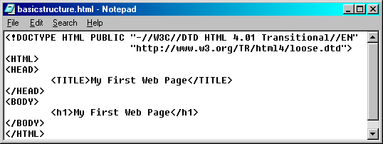
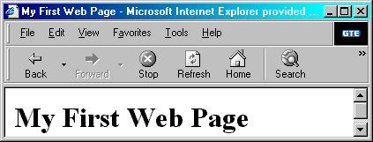
Headings
Heading tags
Six levels:
<h1>, <h2>, <h3>, <h4>, <h5>, and <h6>
used to divide sections -- similar to a book
displayed either in larger or bolder text
can be centered, underlined, capitalized
common to use a heading to duplicate the title

Slide 30
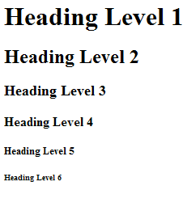
Heading Tags
<h1>Heading Level 1</h1>
<h2>Heading Level 2</h2>
<h3>Heading Level 3</h3>
<h4>Heading Level 4</h4>
<h5>Heading Level 5</h5>
<h6>Heading Level 6</h6>
<h1> is largest
<h6> is smallest

Slide 31
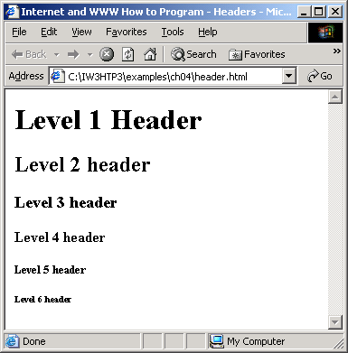

Slide 32
Hands-On Practice
HOP 2.3
Follow the directions in your book for the HOP.
START-UP File | heading.html
SAVE SOLUTION AS | paragraph.html

Slide 33
HTML <p> tag
Enter/Return key does not provide this in HTML documents
Can use paragraph tag
<p> …paragraph goes here </p>
Used to group sentences and sections of text together.
Text that is contained by <p> and </p> tags will have a blank line above and below it.

Slide 34
Closing Container Tags
HTML rules require tags have closing tags
Opening tag has tag code:
e.g. <p>
Closing tag has forward slash in front of code
e.g. </p>
Content is placed between opening and closing tags
<p> CONTENT </p>
Browsers are forgiving, but HTML rules are strict
Copyright (c) 2006 Prentice-Hall. All rights reserved.
34
Notes:
34
In HTML, all opening tags must have corresponding closing tags. This is not true in HTML. For example, the line break tag in HTML <br> has no corresponding closing tag. Many empty tags in HTML (i.e. tags with no text content) have no closing tags, but this is not true in XHTML.
It is, however, possible to make an opening tag also be a closing tag, by placing a slash before the end bracket <br />. This will be shown in subsequent slides.

Slide 35
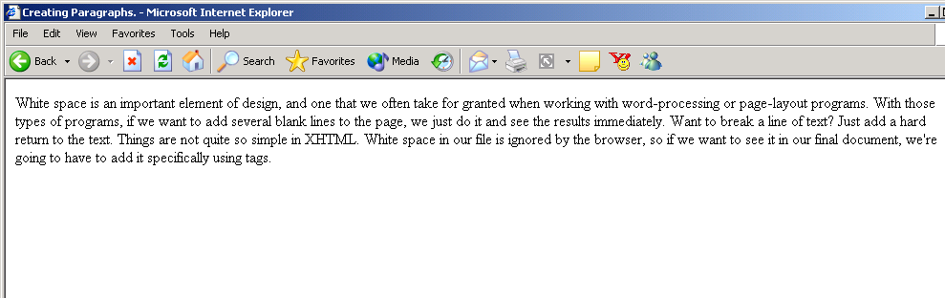
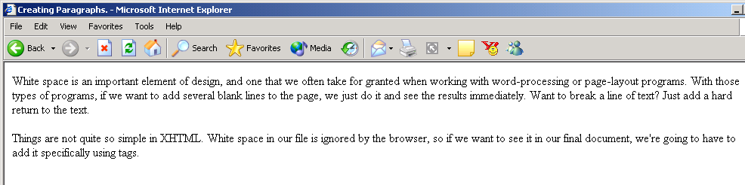
Effects of <p> Tags
Without <p> tag, Enter/Return has no effect on browser display
<p> tag inserts white space and separates lines of text
Copyright (c) 2006 Prentice-Hall. All rights reserved.
35

Slide 36
Body and Text Basics
Structural elements, called
block-level tags (elements) control blocks of the text such as
Heading tags <h1>, …,<h6>
Paragraph - <p>
<blockquote>
<div>
<span>
<table>
Tags that effect individual section of text called text-level tags
=> HOP 2.2
=> HOP 2.3
=> HOP 2.5

Slide 37
Hands-On Practice
HOP 2.4
Follow the directions in your book for the HOP.
START-UP File | paragraph.html
SAVE SOLUTION AS | linebreak.html

Slide 38
Self-contained <br> tag
Line Break tag
Used to force a new line when the text on the web page document is displayed by a browser.
Stand alone tag in HTML
…text goes here <br > This starts on a new line….
the line break tag in HTML <br> has no corresponding closing tag.
Many empty tags in HTML (i.e. tags with no text content) have no closing tags
to make an opening tag in XHML also be a closing tag, by placing a slash before the end bracket
<br />.

Slide 39
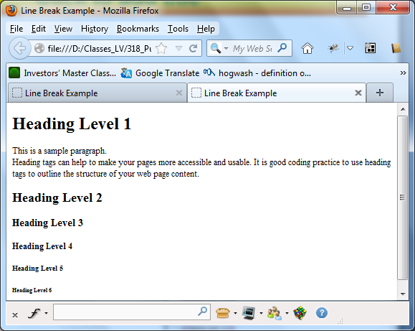
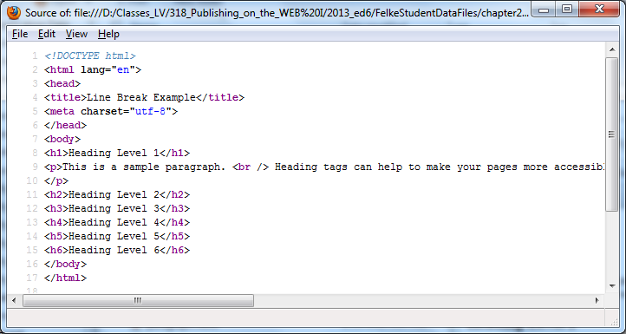
HOP 2.4 in HTML
HOP 2.4:

Slide 40
Attributes
Most tags can have attributes
Attribute is:
Information in the opening tag
Additional information that defines a tag
Attribute syntax:
attributename = “value”
Attribute – value pair
Example:
<p align = “center”> CONTENT </p>
Specifies how text within the paragraph should be aligned
Options include: left, center, right, justify
Copyright (c) 2006 Prentice-Hall. All rights reserved.
40
Notes:
40
An attribute is to a tag what a field is to a record. Think of elements are records in a file, and attributes as fields of the records.
Attributes are characteristics that the tags will take on.

Slide 41
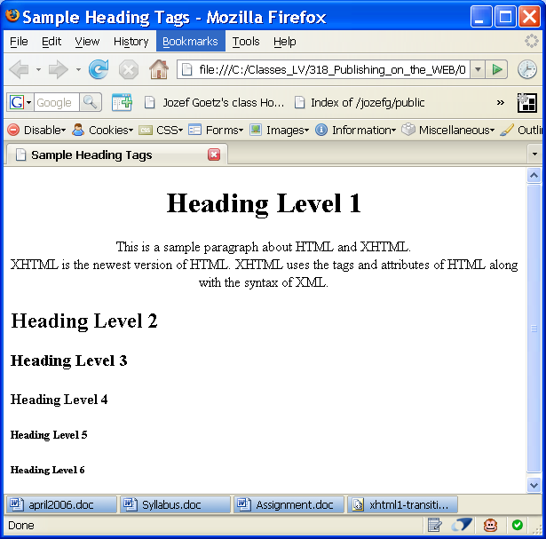
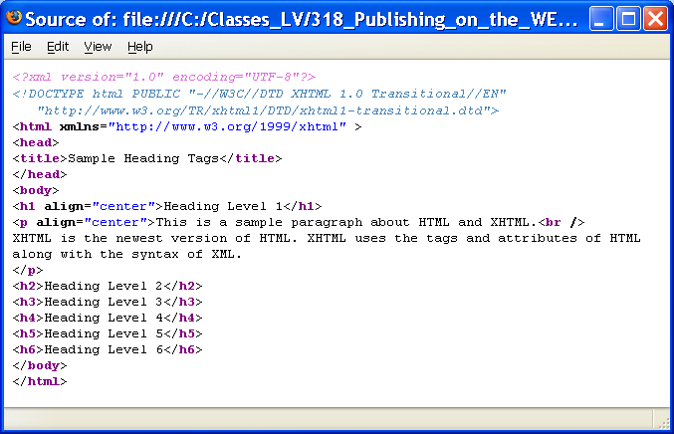
Heading in HTML
=> HOP 2.2 – 2.4

Slide 42
HTML <pre> tag
Preformatted Text tag
The preformatted text tag preserves your formatting and displays the text in a fixed-width or monospace font.
<pre>
…text goes here
Line breaks and formatting are preserved
</pre>
NOTE: Usually is used for listing programming or scripting code

Slide 43
Hands-On Practice
HOP 2.5
Follow the directions in your book for the HOP.
START-UP File | template.html
SAVE SOLUTION AS | blockquote.html

Slide 44
Blockquote Tag – HOP 2.5
Used to indent a block of text for special emphasis.
<blockquote>
…text goes here
</blockquote>
Indents contained text
Indentation from left and right margins and a line break is placed before and after the text
Nest blockquote tags to increase indentation
HOP 2.5
Copyright (c) 2006 Prentice-Hall. All rights reserved.
44

Slide 45
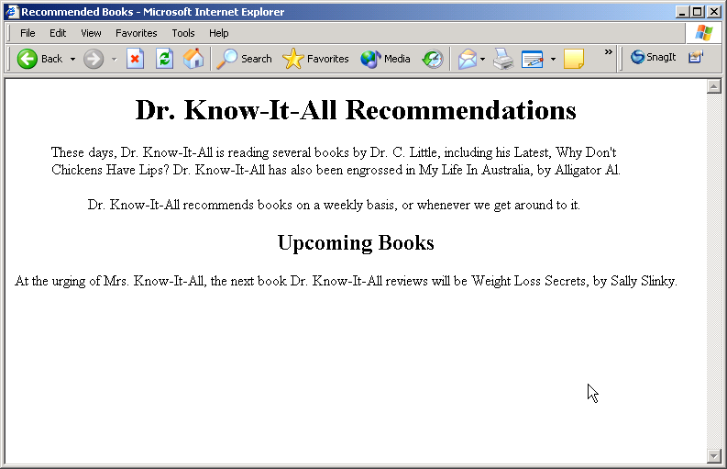
Effects of Blockquote Tag
<blockquote> tag causes this indentation
HOP 2.5
Nested <blockquote> causes more indentation
Copyright (c) 2006 Prentice-Hall. All rights reserved.
45

Slide 46
2.11 HTML Logical Style Tags
Logical Tags used to display the text in between the container tags according to the logical (general) style.
Common Logical Style Tags <strong></strong>
To cause text to be emphasized or to "stand out" from surrounding text. Usually displayed in bold. <strong> This is important</strong>
<em></em>
To cause text to be emphasized in relation to other text on the page. Usually displayed in italics.
<em> Please note</em>

Slide 47
2.11 Phrase Elements
Indicate the context and meaning of the text between the container tags
Element | Example | Usage
<b> | bold text | Text that has no extra importance but is styled in bold font by usage and convention
<em> | emphasized text | Causes text to be emphasized in relation to other text; usually displayed in italics
<i> | italicized text | Text that has no extra importance but is styled in italics by usage and convention
<mark> | mark text | Text that is highlighted in order to be easily referenced (HTML5 only)
<small> | small text | Legal disclaimers and notices (“fine print”) displayed in small font-size
<strong> | strong text | Strong importance; causes text to stand out from surrounding text; usually displayed in bold
<sub> | _{sub} text | Displays a subscript as small text below the baseline
<sup> | ^{sup} text | Displays a superscript as small text above the baseline

Slide 48
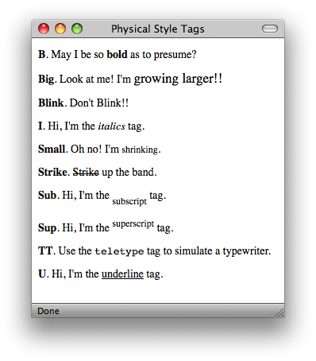
2.11 HTML Physical Style Tags
Provide specific font instructions for the browser
Physical Tags are used in HTML to provide actual physical formatting to the text.
Logical Style tags are preferred by the W3C
Physical Style tags are covered here b/c many Web pages use them
They provide specific fonts instructions for the browser
are discussed because some web developers still use them
Common Physical Style Tags
<b></b>
To display as bold text <b>This is important</b>
<i></i>
To display text in italics
<i>Please note</i>
Logical Style Tags provides a wider range of Web access

Slide 49
Hands-On Practice
HOP 2.6-2.7
Follow the directions in your book for the HOP.
START-UP File | template.html
SAVE SOLUTION FOR HOP 2.6 AS | ol.html
SAVE SOLUTION FOR HOP 2.7 AS | ul.html

Slide 50
HTML List Basics
List Tags Common Elements
opening and closing tag
1. ordered list <ol> and </ol> HOP 2.6
list items <li>
2. unordered list <ul> and </ul> HOP 2.7
list items <li>
3. definition list <dl> and </dl> HOP 2.8
definition term <dt> and
definition data <dd>
list items have their own tag <li>

Slide 51
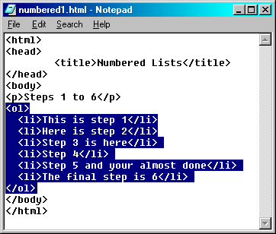
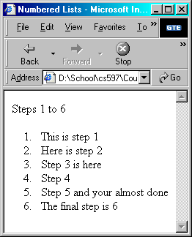
1. Ordered Lists
Used to convey information in an ordered fashion

Slide 52
1. Ordered List
Type attribute can take one of five values
“1” Specifies standard Arabic numerals
1, 2, 3, 4,5
“a” Specifies lowercase letters
a, b, c, d, e
“A” Specifies uppercase letters
A, B, C, D, E
“i” Specifies lowercase Roman numerals
i, ii, iii, iv, v
“I” Specifies uppercase Roman numerals
I, II, III, IV, V

Slide 53
1. HTML Ordered List
<ol> Contains the ordered list
Two main ways to customize ordered lists
how they are numbered
type attribute
default is numerals: 1, 2,…
the number with which the list starts
start attribute
Ex: <ol start=“100” type=“I”>
<li> Contains an list item

Slide 54
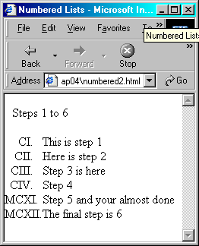



1. Ordered List
Both the start and type attributes are used in the <ol> tag
<ol start=101 type=“I”>
start=“1” is the default value
type=“1” is the default value
By using the value attribute in the <li> tag, numbering can be reassigned at any point
<li value=1111> Step 5 and …=>
So, it will start from MCXI.

Slide 55
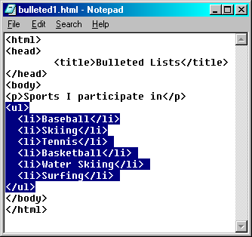
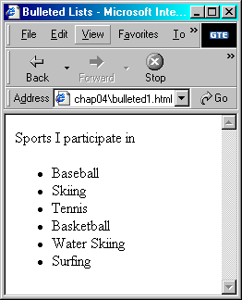
2. Unordered Lists
Used to display information in bullet points

Slide 56
HTML Unordered List
HTML 3.2 provided ways to customize unordered lists
They have been deprecated (disapproved) in HTML 4.0 in favor of using style sheets
<ul> Contains the unordered list
The type attribute customizes unordered lists
the type attribute is used in the <ul> tag
<ul type=“square”>
the type attribute has 3 possible values
disc – default (or use style: <ul style="list-style-type:disk;">
square (or use style: <ul style="list-style-type:square;">
circle (or use style: <ul style="list-style-type:circle;">
<li> Contains an list item

Slide 57
Hands-On Practice
HOP 2.8
Follow the directions in your book for the HOP.
START-UP File | template.html
SAVE SOLUTION AS | description.html

Slide 58
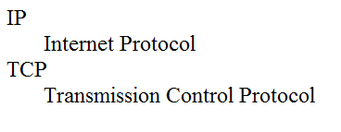
3. HTML Definition List
Useful to display a list of terms an definitions or a list of FAQ and answers
<dl> tag
Contains the definition list
<dt> tag Contains a defined term
<dd> tag Contains a data definition
<dl>
<dt>IP</dt>
<dd>Internet Protocol</dd>
<dt>TCP</dt>
<dd>Transmission Control Protocol</dd>
</dl>
HOP 2.8

Slide 59
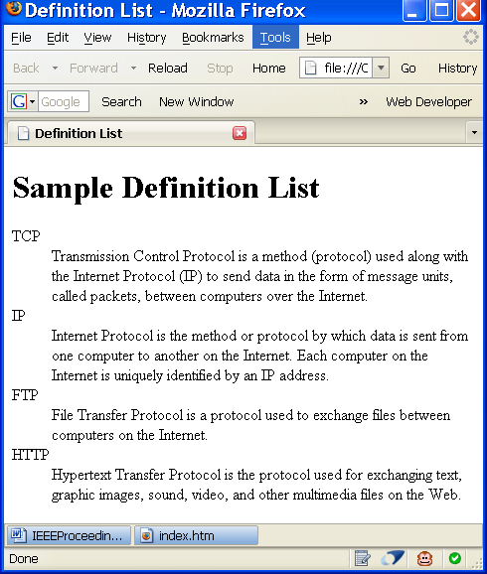
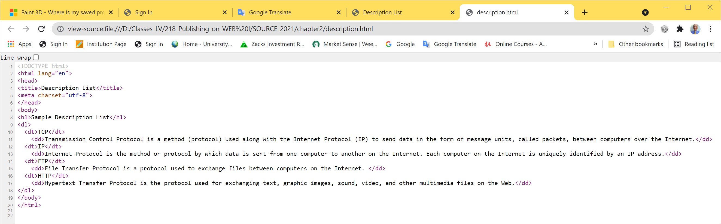

3. Definition Lists <dl> HOP 2.8

Slide 60
Comments
Comment
<!-- text inside here is ignored -->
It’s a good rule of thumb not to include “--”, “<“, “>”, or HTML tags within comments

Slide 61
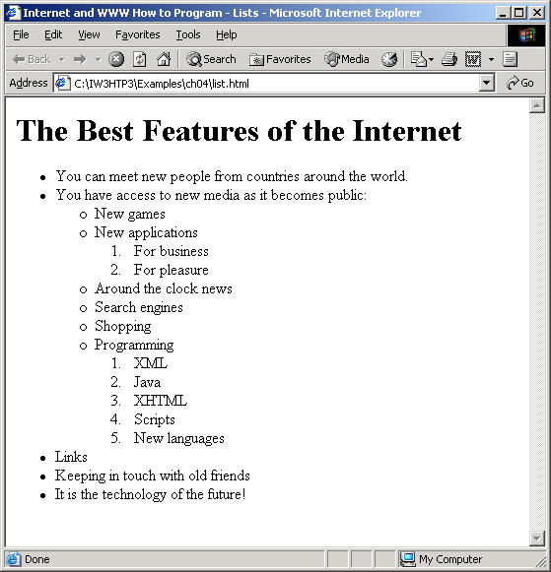
list.html (1 of 3)
Nested and Ordered Lists

Slide 62
list.html (2 of 3)
Nested and Ordered Lists

Slide 63
list.html (3 of 3)
Nested and Ordered Lists

Slide 64
Checkpoint 2.2
Describe the features of a heading element and how it configures the text.
Describe the difference between ordered lists and unordered lists.
Describe the purpose of the blockquote element.

Slide 65
Hands-On Practice
HOP 2.9
Follow the directions in your book for the HOP.
START-UP File | template.html
SAVE SOLUTION AS | design.html

Slide 66
HTML Special Characters
Used to display special characters such as quotes, copyright symbol, etc.
See the Special Characters section textbook for a detailed list – appendix B p.651
Numeric character references (e.g. &#169;)
Character entity – a code in HTML that produces a symbol in the form &code;
Descriptive Code - begins with & symbol and ends with a semicolon.
Not a tag or attribute
&copy;
Numeric Code Character Descriptive Code
&#169 © &copy;
&#60 < &lt;
&#62 > &gt;
&#38 & &amp;

Slide 67
The &nbsp; Character Entity
&nbsp; represents a space character
create space in Web page
Must be all lowercase characters
Putting spaces in HTML document does not create spaces in Web page !
67

Slide 68
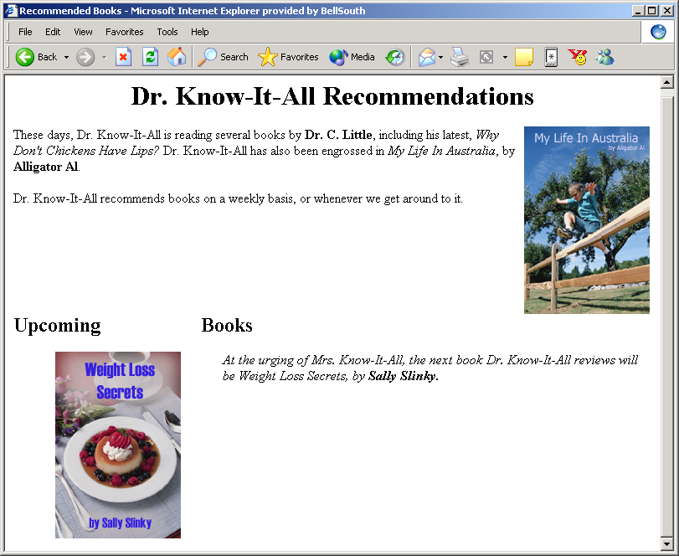
Effect of Non-Breaking Space
<h2>Upcoming &nbsp; &nbsp; &nbsp; &nbsp; &nbsp; &nbsp; &nbsp; &nbsp; &nbsp; &nbsp; Books</h2>
10 non-breaking spaces
Copyright (c) 2006 Prentice-Hall. All rights reserved.
68
Notes:
68
Remind students of other spacing techniques that were used previously, including the <br> tag (which creates line breaks), and the <p> tag (which separates paragraphs of text). The &nbsp; character entity inserts a space between elements. If you want to insert several spaces, you must enter several &nbsp; entities.

Slide 69
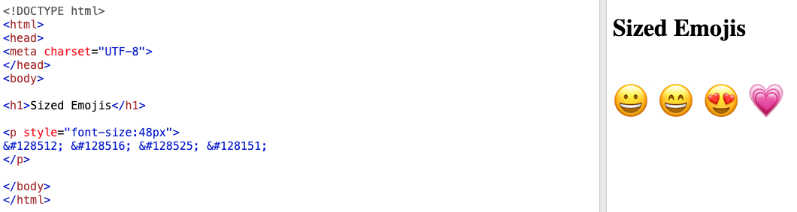



Emoji Characters
Since Emojis are characters, they can be copied, displayed, and sized just like any other character in HTML.

Slide 70
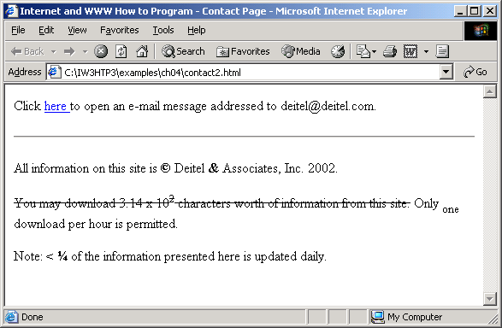
contact2.html (1 of 2)

Slide 71
contact2.html (2 of 2)
HOP 2.9. Show/highlight
&copy;

Slide 72
Hands-On Practice
HOP 2.10 & 2.11
Follow the directions in your book for the HOP.
START-UP File | template.html
SAVE SOLUTION 2.10 AS | structure.html
SAVE SOLUTION 2.11 AS | casita.html

Slide 73
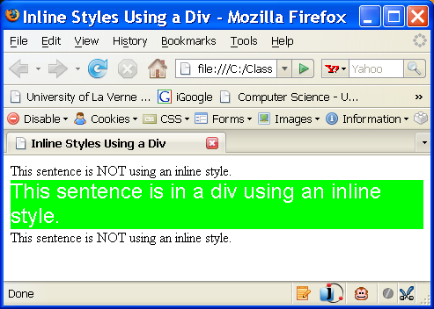
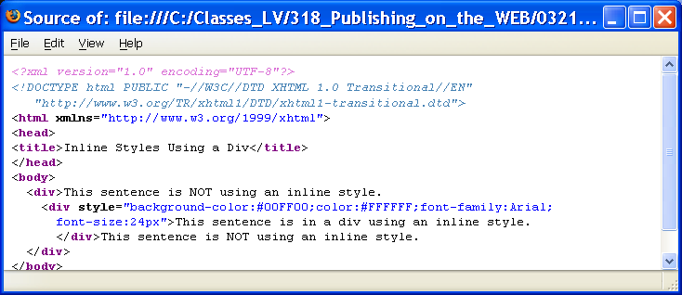
HTML <div> tag
The <div> tag
A container tag
Used to create a specially formatted division or area of a web page.
It can be used to format that area and places a line break before and after the division.
Use the <div> tag when you need to format an area that is separated from the rest of the web page by line breaks.
The <div> tag is also useful to define an area that will contain other block-level tags (such as <p>, <ul>, <ol>, <blockquote> or <span>) within it.

Slide 74
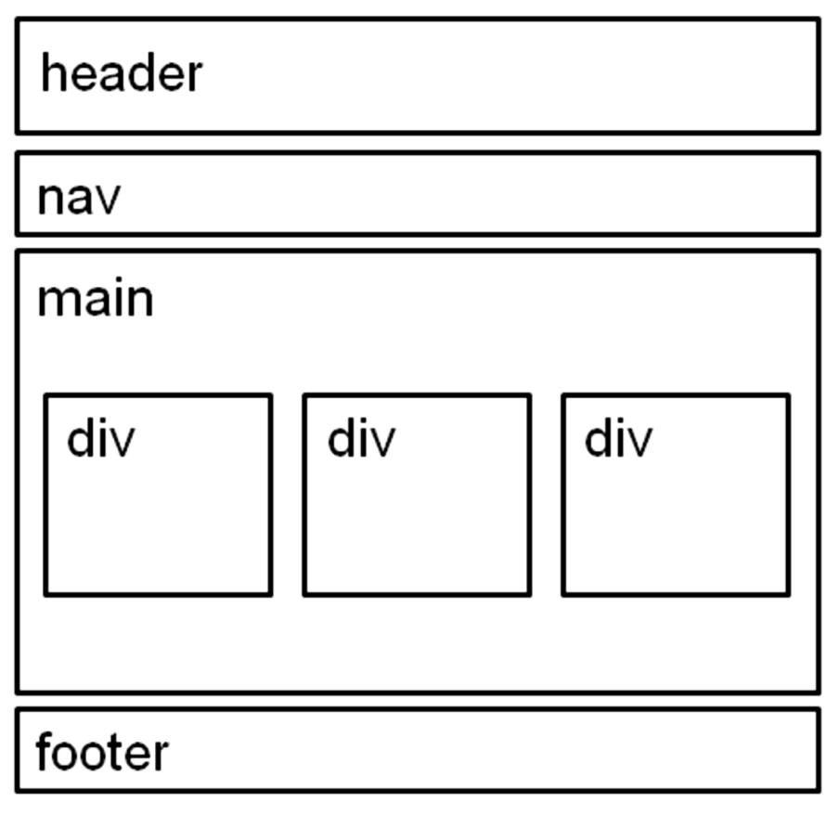
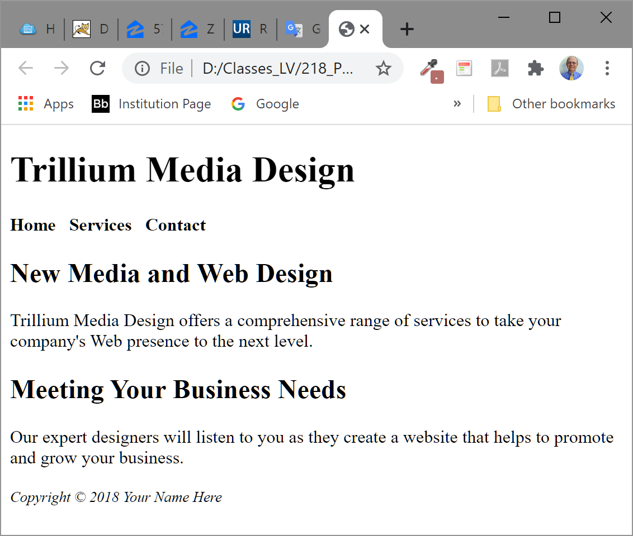

HTML5 Structural Elements - wireframe
header Element
<header></header> Contains the web page document’s headings
nav Element
<nav></nav> Contains web page document’s main navigation
main Element <main></main> Contains the web page document’s main content
footer Element
<footer></footer> Contains the web page document’s footer
HOP 2.10

Slide 75
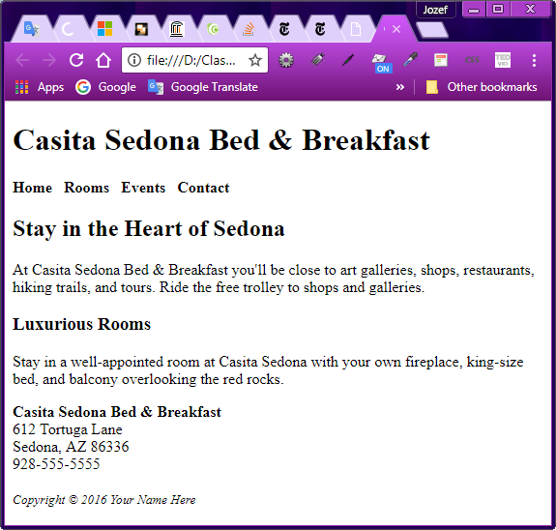
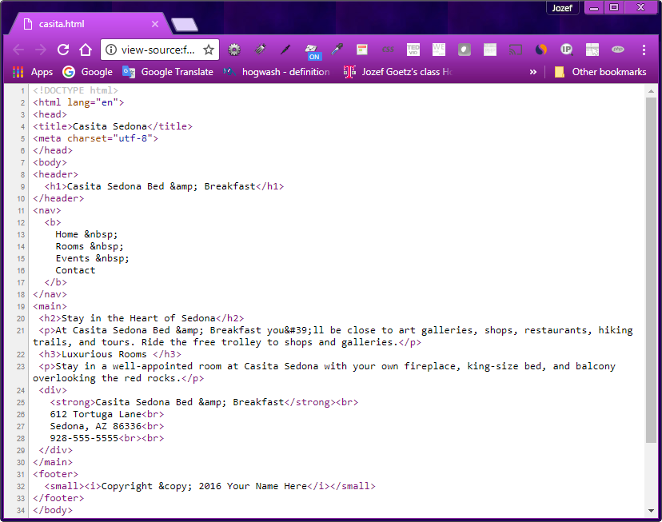
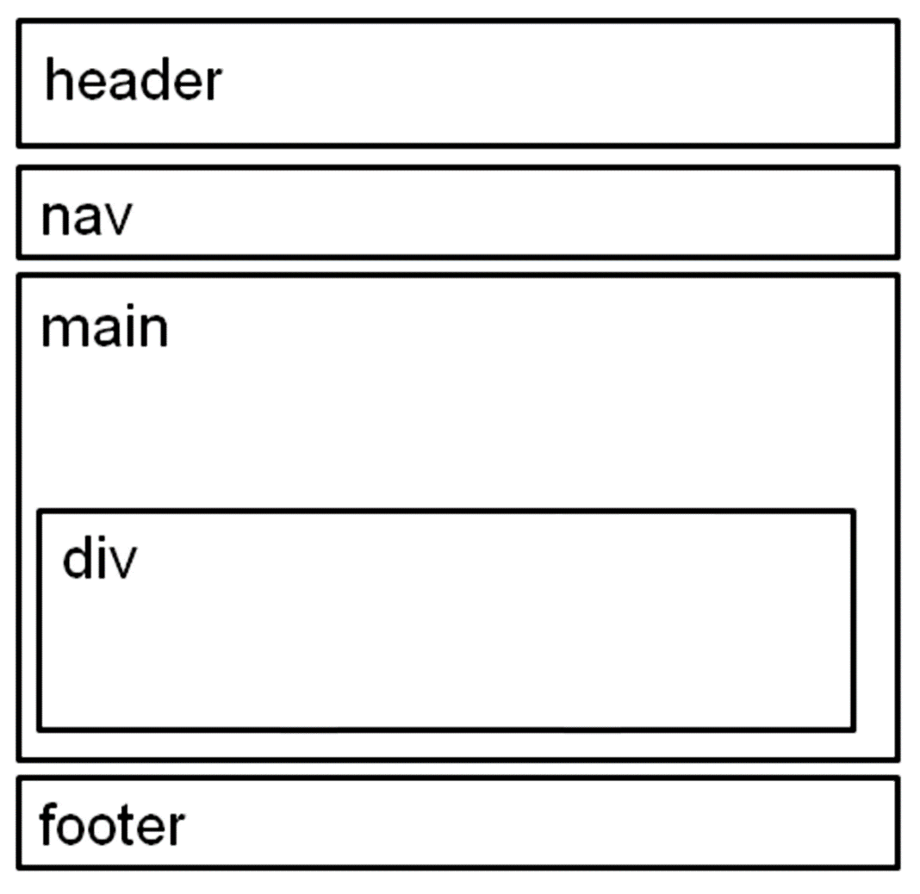

Wireframe HOP 2.11 - Figure 2.20 Wireframe for Casita Sedona

