Slide 1
Learning Objectives
HOP 2.12
Aside Element
HOP 2.13
Anchor Elements
HOP 2.14
Anchor Elements
(Continued)
HOP 2.15
Anchor Elements
(Continued)
HOP 2.16
HTML Validation

Slide 2
Chapter 2
HTML Basic
Part II
Credits: © 2011, 2014, 2015 – 2025 Pearson Education
Copyright (c) 2012 Prentice-Hall. All rights reserved.
Expanded by J. Goetz, 2025
Credits: Parts of the slides are based on slides created by textbook,
Essentials for Design XHTML

Slide 3

Learning Objectives
In this chapter, you will learn about:
2.1 Describe HTML, XHTML, and HTML 5
2.2 Identify the markup language in a web page document
2.3 Use the html, head, body, title, and meta elements to code a template for a web page
2.4 Configure the body of a web page with headings, paragraphs, line breaks, div, lists, and blockquotes
2.5 Configure text with phrase elements
2.6 Configure a web page using new HTML 5 header, nav, main, and footer elements
  2.7 Configure special characters
  2.8 Use the anchor element to link from page to page
  2.9 Create absolute, relative, and e-mail hyperlinks
  2.10 Code, save, and display a web page document
  2.11 Test a web page document for valid syntax.

Slide 4

Hands-On Practice
HOP 2.12
Follow the directions in your book for the HOP.
START-UP File | starter.html
SAVE SOLUTION AS | block.html

Slide 5
More Structural Elements
Aside Element
block display contains a <sidebar> ; a note, or other tangential content
Section Element
contains a <section> of a document, such as a chapter or topic, header, footer, article, aside, figure, div
block display
Article Element
contains an independent entry, such as a blog posting, comment, article that could stand on its own, footer, article, aside, figure, div
block display
Time Element
represents a date or a time
could be useful to date articles or blog posts
inline display

Slide 6
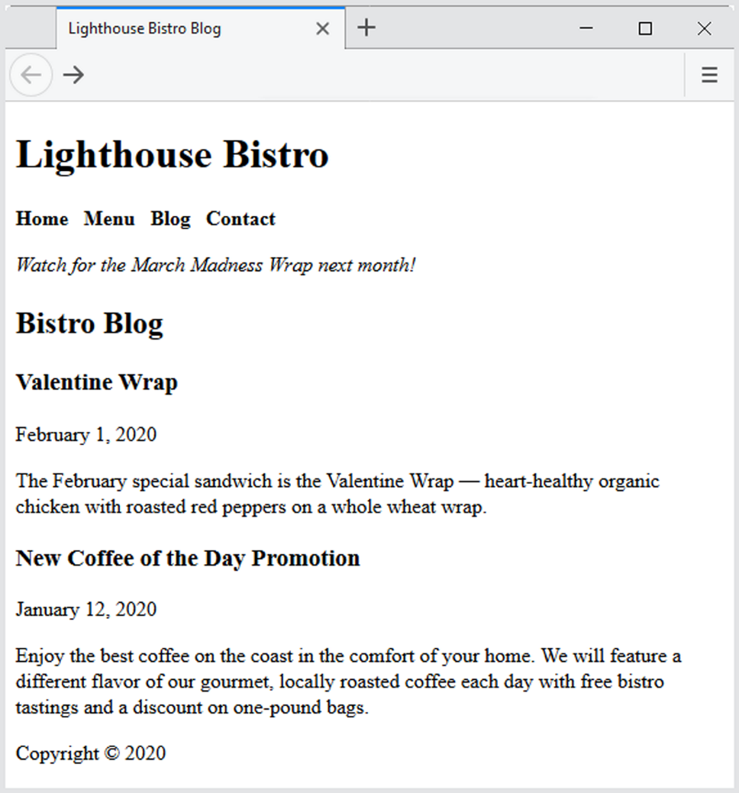
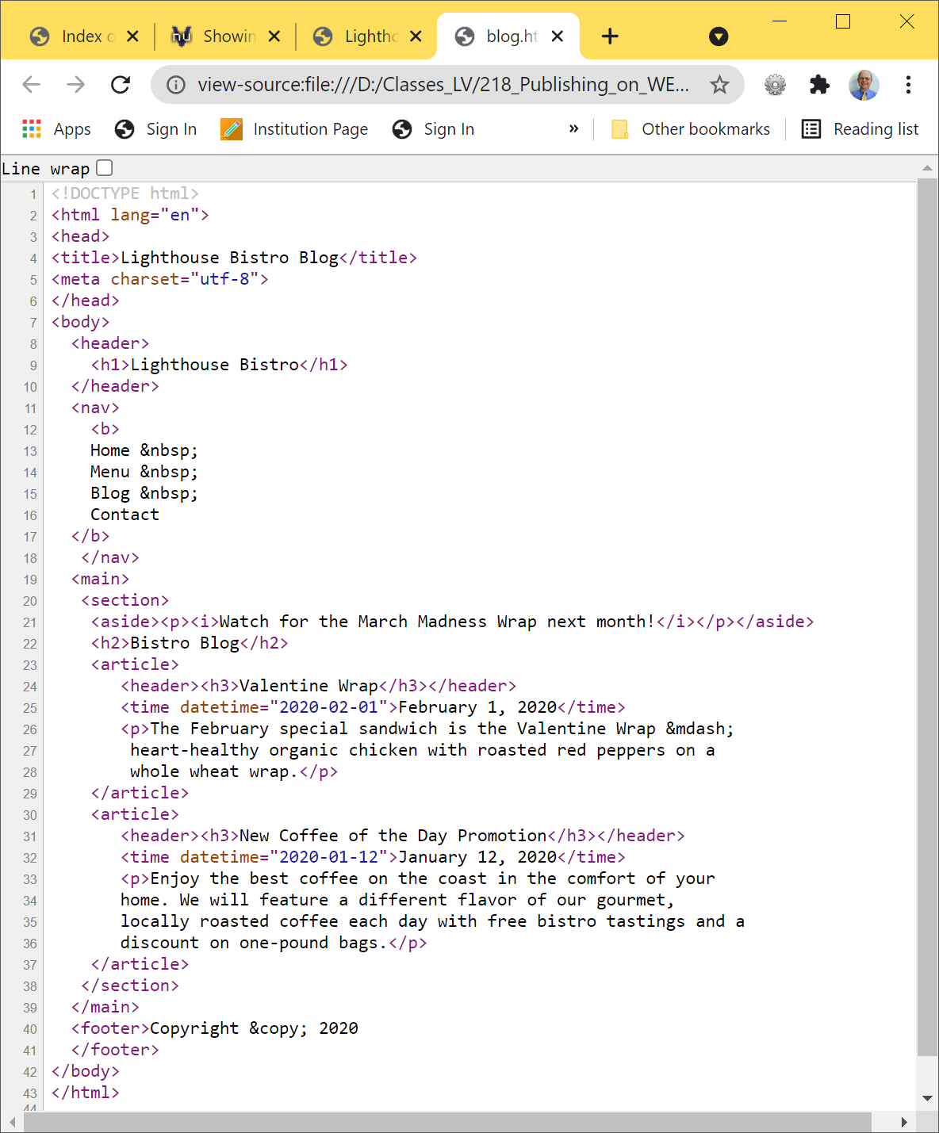
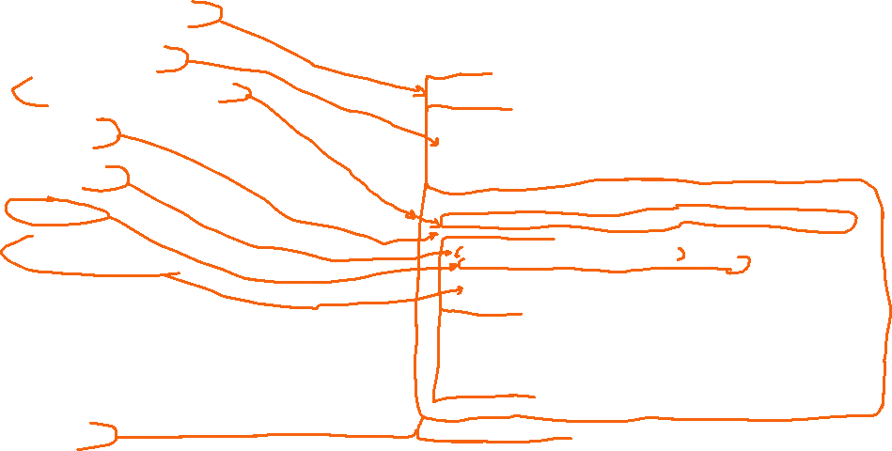
Figure 2.22 The blog page. – HOP 2.12

Slide 7
Hands-On Practice
HOP 2.13
Follow the directions in your book for the HOP.
START-UP File | template.html
SAVE SOLUTION AS | anchor.html

Slide 8
HTML <a> tag
The anchor element <a>
href (hypertext reference)
  Indicates the target – destination page or location of the link
  Text between the <a> and </a> is displayed on the web page.
  <a href="contact.html">Contact Us</a>
  href Attribute
    Indicates the file name or URL
    Web page document, photo, pdf, etc.

Slide 9
Absolute and relative links
HTTP – hypertext transfer protocol
Web server – the computer hosting a Web site
Uniform Resource Locator (URL) – the Web address of a resource
  Relative URL – relative to the current page’s location e.g. local file or folder (it doesn’t include the http://)
    Relative link
      Link to pages on your own site
      <a href="index.htm">Home</a>
  Absolute URL – a full web address that contains all the information needed to locate a resource (can be an address on another Web server)
    Typically begins with the http://
    Absolute link
      Link to other Web sites
    <a href="http://yahoo.com">Yahoo</a>

Slide 10
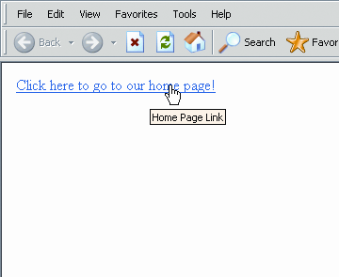
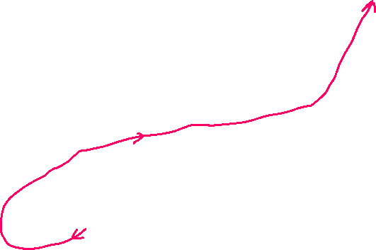
Effects of <a>, href, and title
title: Provides text that can appear in a tool tip when the mouse hovers over the link
Mouse pointer changes when hovered over the link
Tool tip generated by
title="Home Page Link"
Displayed text generated by
text between the <a> tag and the </a> tag
When user clicks, the page opened will be based on href=“http://www.laverne.edu"
<a href=“http://www.laverne.edu"
title="Home Page Link">Click here to go to our home page!</a>
Copyright (c) 2006 Prentice-Hall. All rights reserved.
10
Notes:
10
In this example, and others in the project, the files specified in the hyperlinks are .htm files. But it is also possible to provide links to files of other sorts, such as Word documents (.doc) or even Excel files (.xls). Browsers can be set up to recognize which software should be invoked based on the file extension of the file linked to. For example, Internet Explorer will use Windows' recognized file extensions to call the appropriate application program for a file. For example, a URL like "http://mywebsite.com/myfile.doc" will cause Microsoft Word to run in order to display a document.

Slide 11
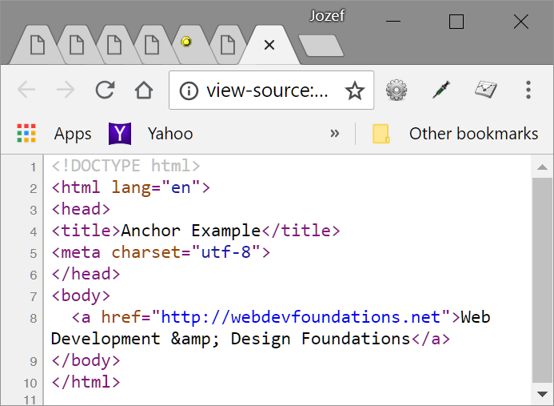
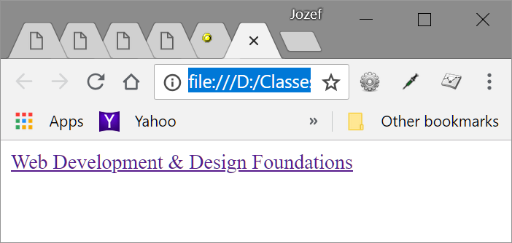
Hyperlinks - HOP 2.13

Slide 12
Hands-On Practice
HOP 2.14
Follow the directions in your book for the HOP.
START-UP File | Follow HOP directions
SAVE SOLUTION AS | Follow HOP directions

Slide 13
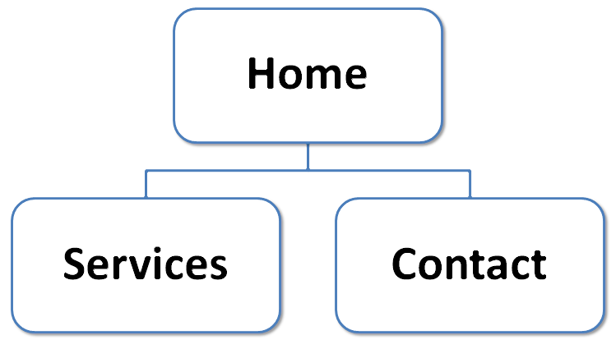
Hyperlinks - HOP 2.14
Hands-On Practice 2.14 – the anchor tag
Create folder mypractice containing 3 files as follows (see next slide for the solution):

Slide 14
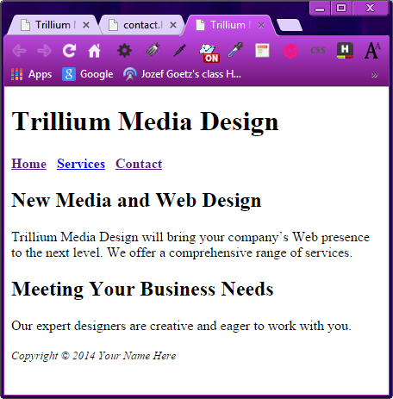
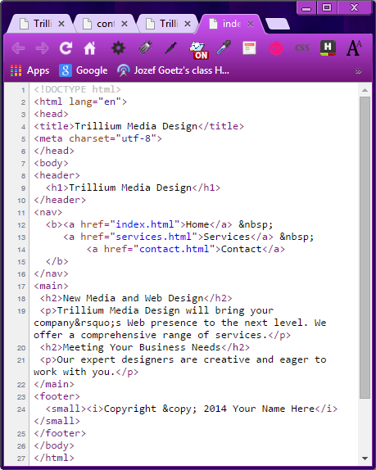
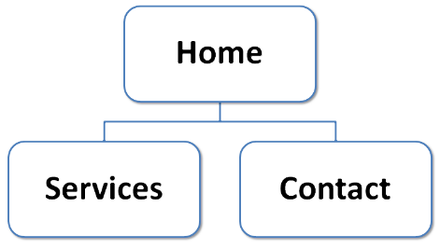
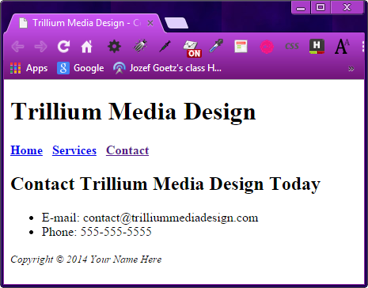
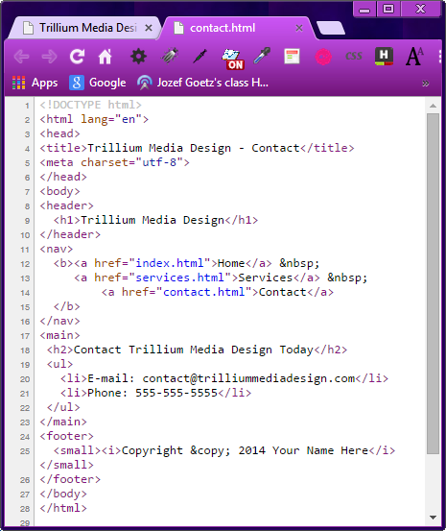

index.html HOP 2.14
contact.html HOP 2.14

Slide 15
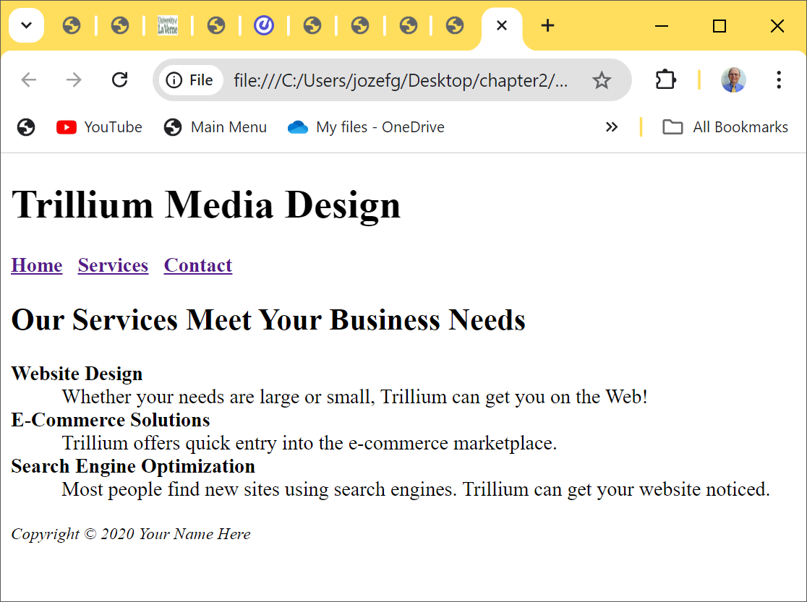
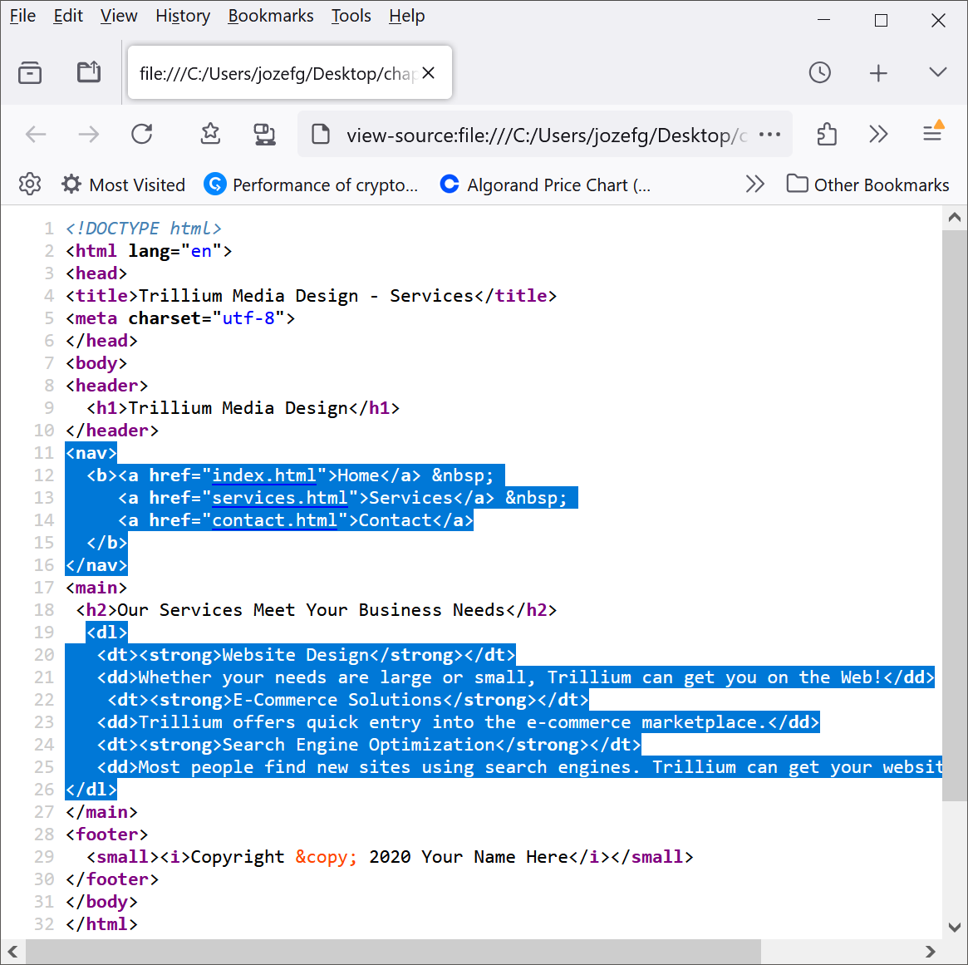
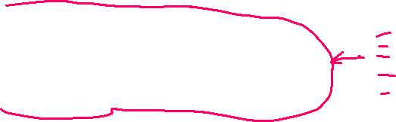

Con’t HOP 2.14 – services.html

Slide 16
Hands-On Practice
HOP 2.15
Follow the directions in your book for the HOP.
START-UP File | contact.html (from 2.14)
SAVE SOLUTION AS | contact.html

Slide 17
HTML Email Links using the <a> tag
Automatically launch the default mail program configured for the browser
If no browser default is configured, a message is displayed
<a href=“mailto:me@hotmail.com”>me@hotmail.com</a>
  See:
  http://www.w3schools.com/html/tryit.asp?filename=tryhtml_form_mail
Hands-On Practice 2.15 – an e-mail link in HOP 2.14

Slide 18
Checkpoint 2.3
1. Describe the purpose of special characters.
  Entity ch-rs, displays items such as quotation marks, <, >, the copyright symbol: © => &copy; etc.
Describe when to use an absolute link.
Is the http protocol used in the href value?
Yes, it is used.
Describe when to use a relative link. Is the http protocol used in the href value?
No, it isn’t used.

Slide 19
Hands-On Practice
HOP 2.16
It uses HOP 2.9. Follow the directions in your book for the HOP.
W3C Markup Validation Service (file upload page)
Additional Tools
HTML5 Validator
HTML & CSS Validation Service
START-UP File | design.html

Slide 20
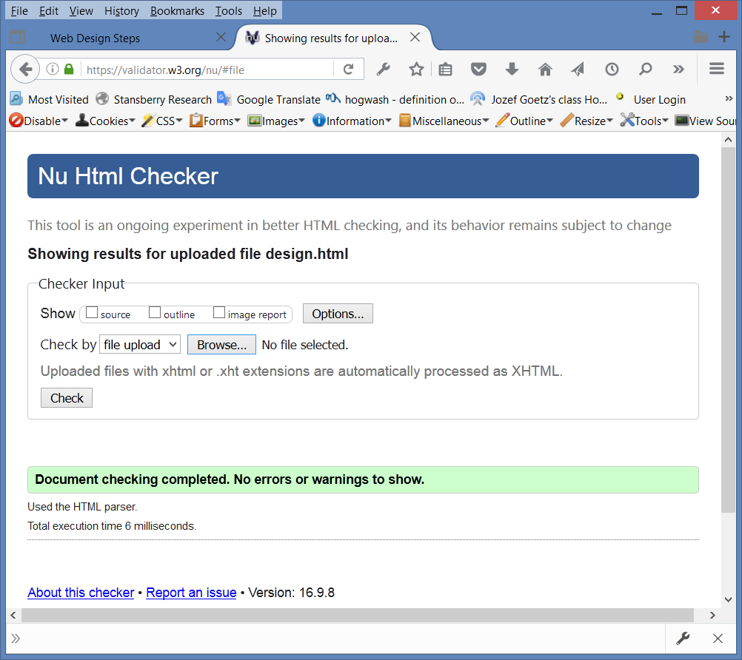
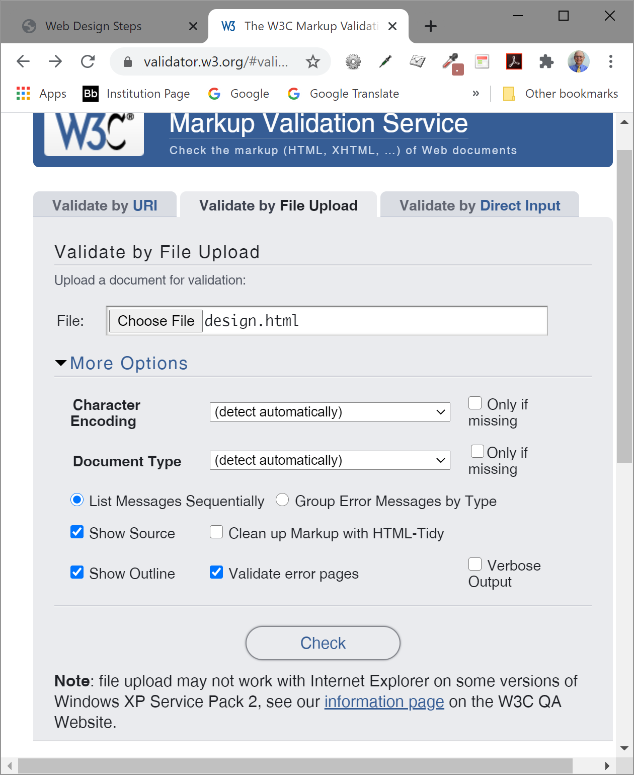
  Hands-On Practice 2.16 – validate a Website from HOP 2.9
1. W3C HTML Validation Tool
  http://validator.w3.org
2. Check your code for
introducing errors –
delete 1st </strong> tag) in design.html from HOP 2.9
3. Remove errors => No errors reported =>
<= circle it in each project

Slide 21
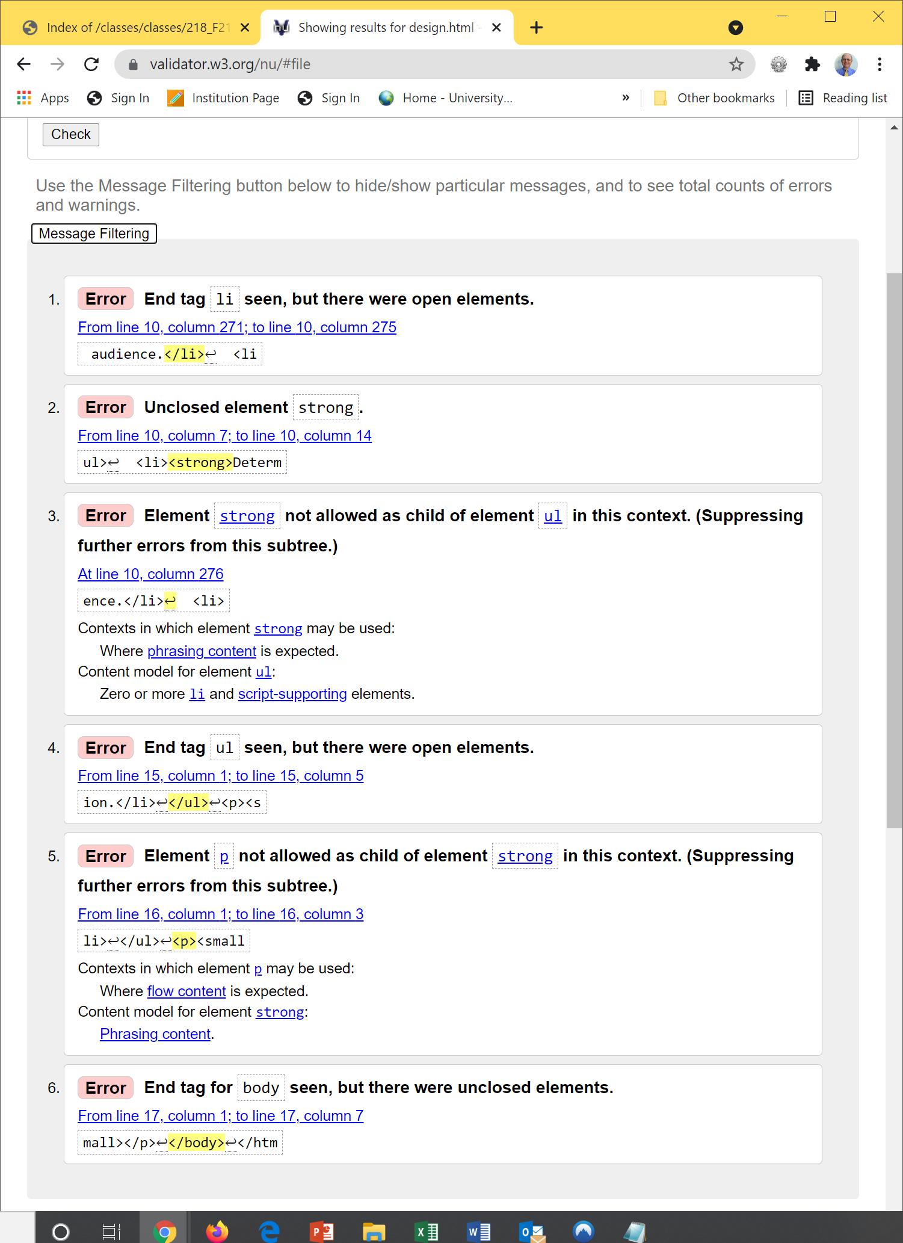
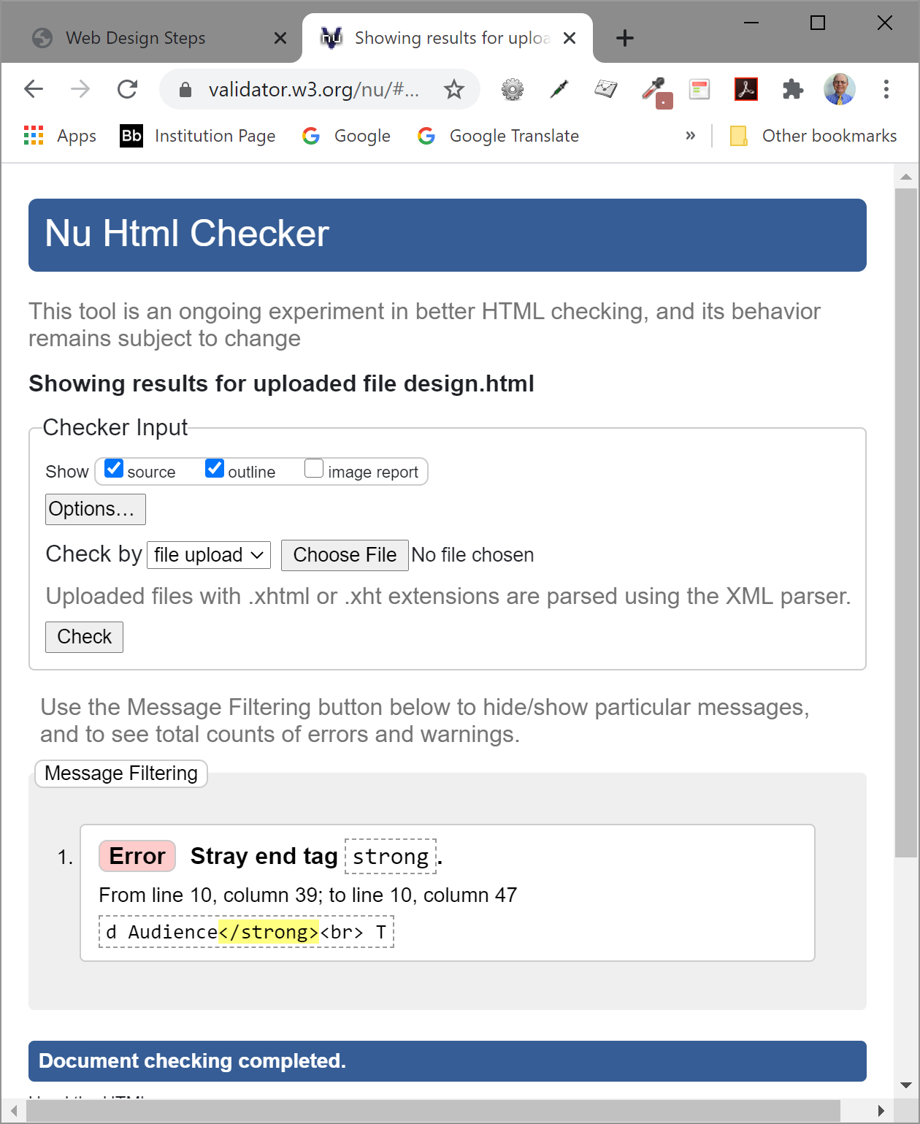
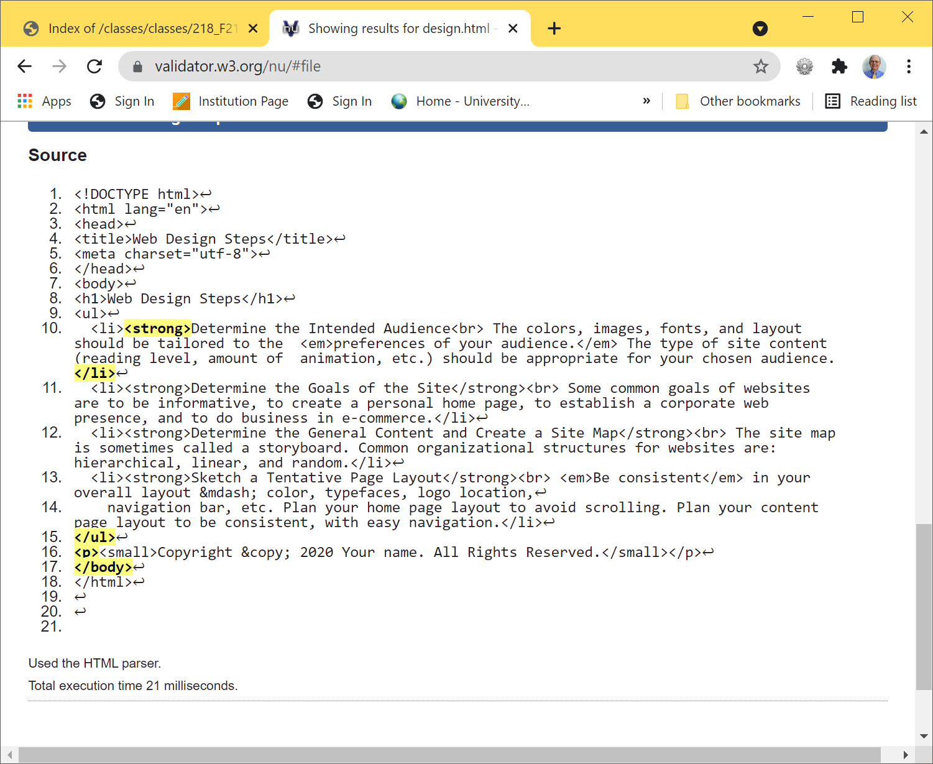
  Hands-On Practice 2.16 – validate a Website from HOP 2.9
1. W3C HTML Validation Tool
  http://validator.w3.org
2. Check your code for
introducing errors –
delete 1st <strong> tag) in design.html from HOP 2.9 p.47
3. Remove the 1st error first => No errors reported =>
<= circle it in each project

Slide 22
Web Resources
www.w3.org/TR/xhtml11
www.xhtml.org
http://validator.w3.org
hotwired.lycos.com/webmonkey/00/50/index2a.html
wdvl.com/Authoring/Languages/XML/XHTML
www.w3.org/TR/2001/REC-xhtml11-20010531

Slide 23
Summary
This chapter provided an introduction to HTML.
  It began with
  an introduction to the XHTML and HTML,
  continued with the anatomy of a web page, and
  introduced inline and block-level formatting, and
  demonstrated the HTML techniques used to create hyperlinks.
You will use these skills over and over again as you create Web pages.
http://stackoverflow.com/questions/3008593/html-include-or-exclude-optional-closing-tags:
Note: Not to be confused with closing tags that are forbidden to be included, i.e.:
</IMG>
</INPUT>
</BR>
</HR>
</FRAME>
</AREA>
</BASE>
</BASEFONT>
</COL>
</ISINDEX>
</LINK>
</META>
</PARAM>
Note: xhtml is different from HTML. xhtml is a form of xml, which requires every element have a closing tag. A closing tag can be forbidden in html, yet mandatory in xhtml.

Slide 24
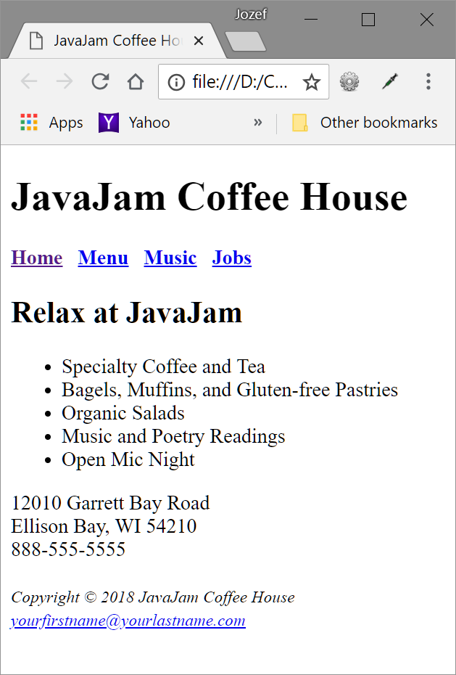
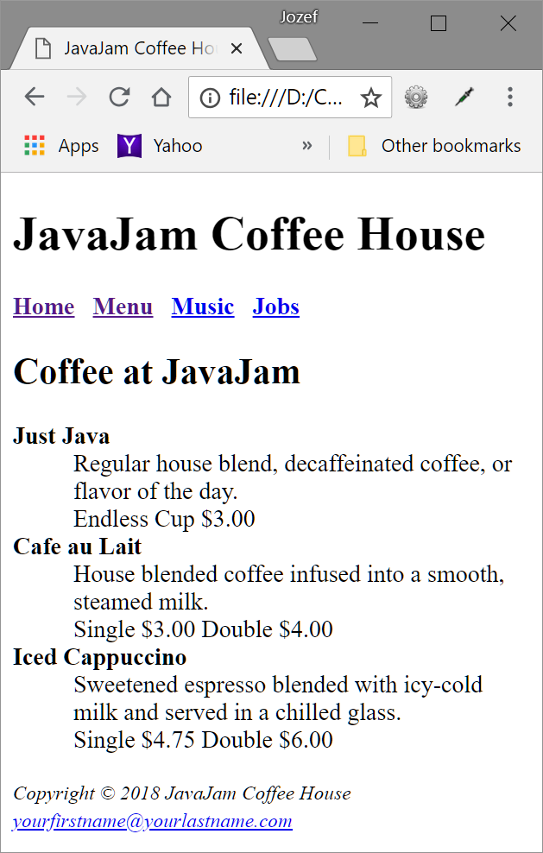
Home Project – JavaJam Cofee Bar p.68-72

Slide 25
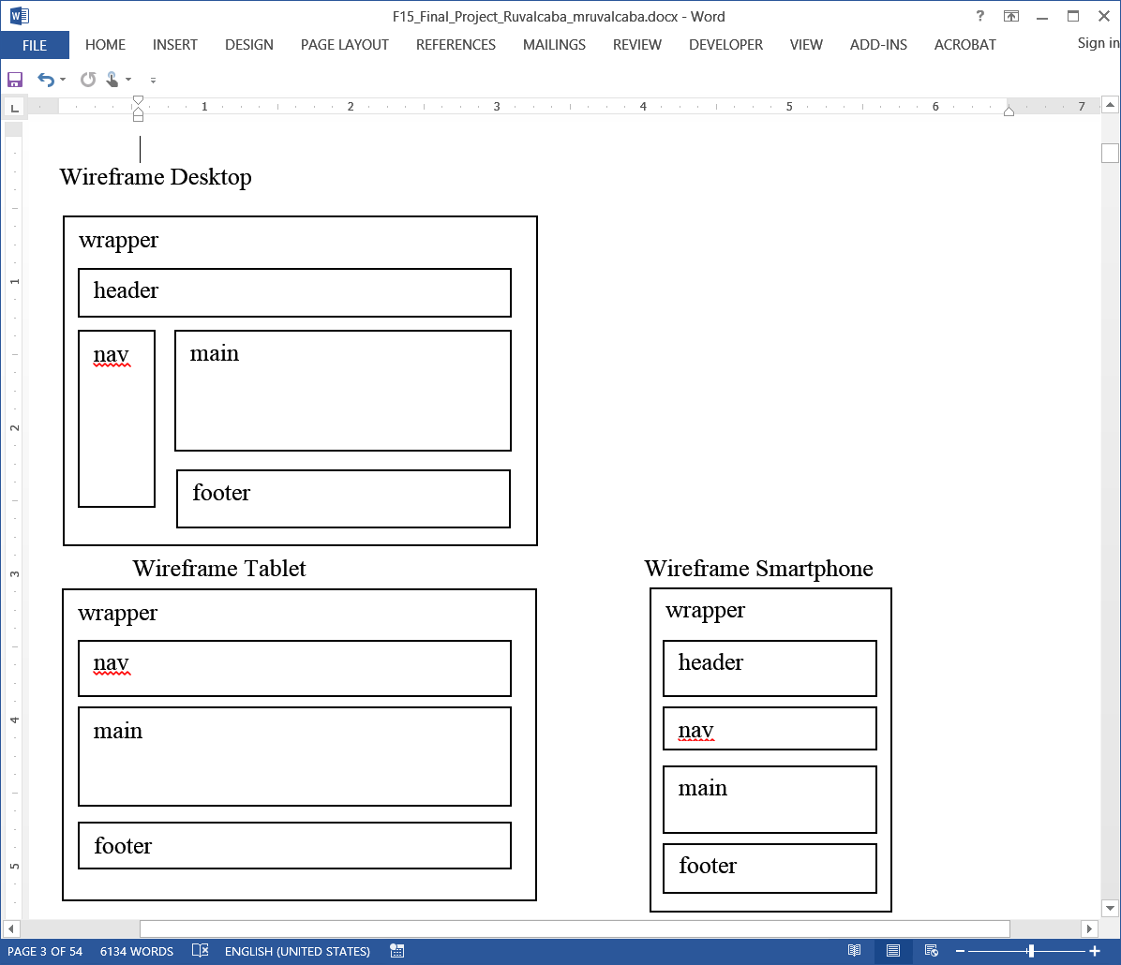
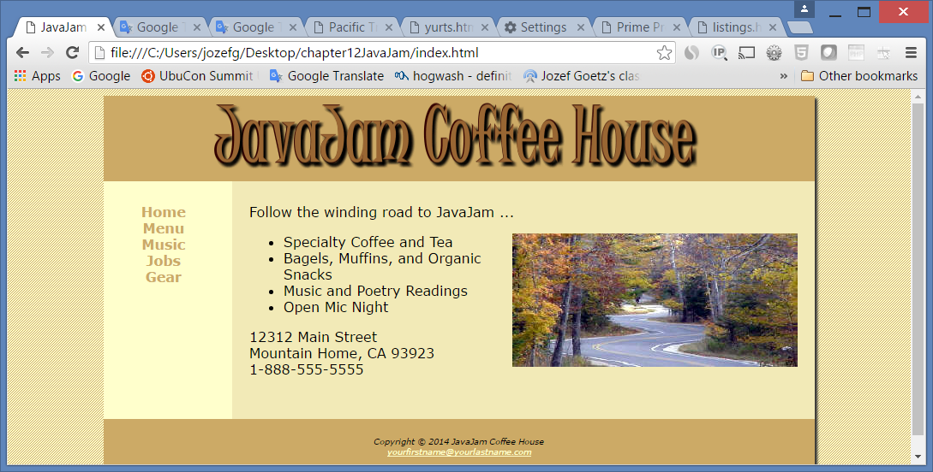
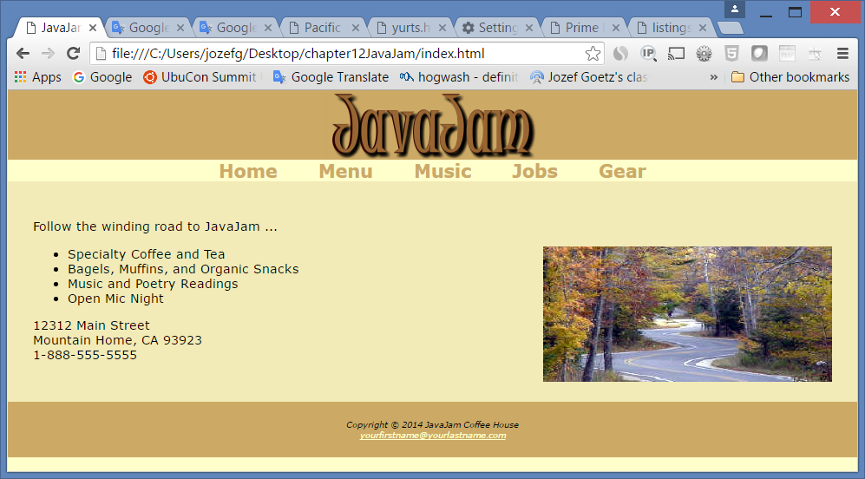
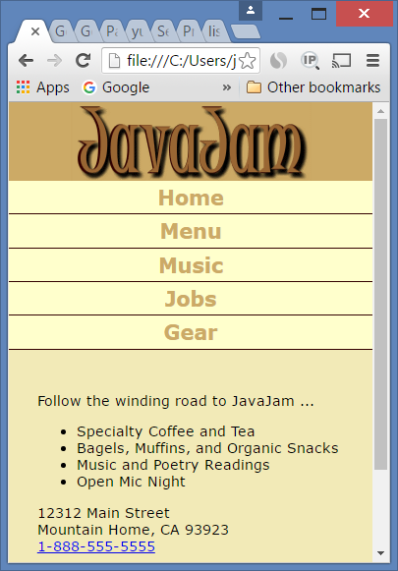
Three Wireframes => see the next chapters
Desktop
Tablet
<= Smart Phone

Slide 26
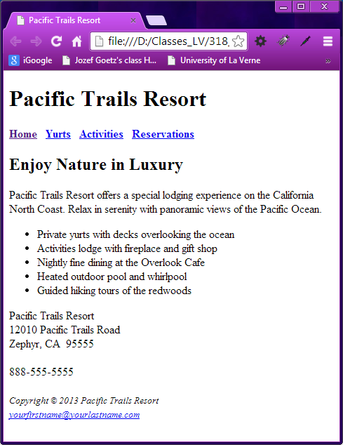
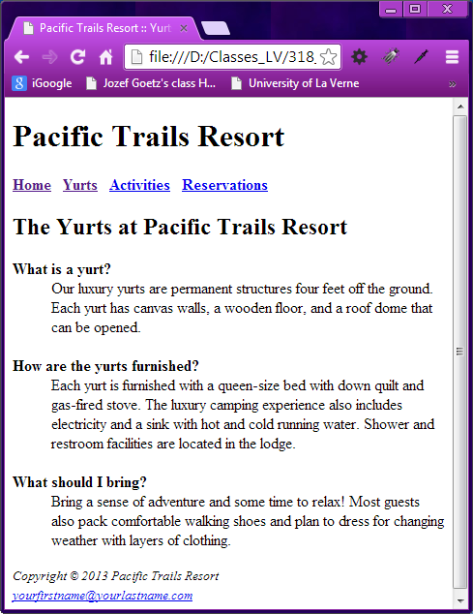
Home Project – Pacific Trails Resort

Slide 27
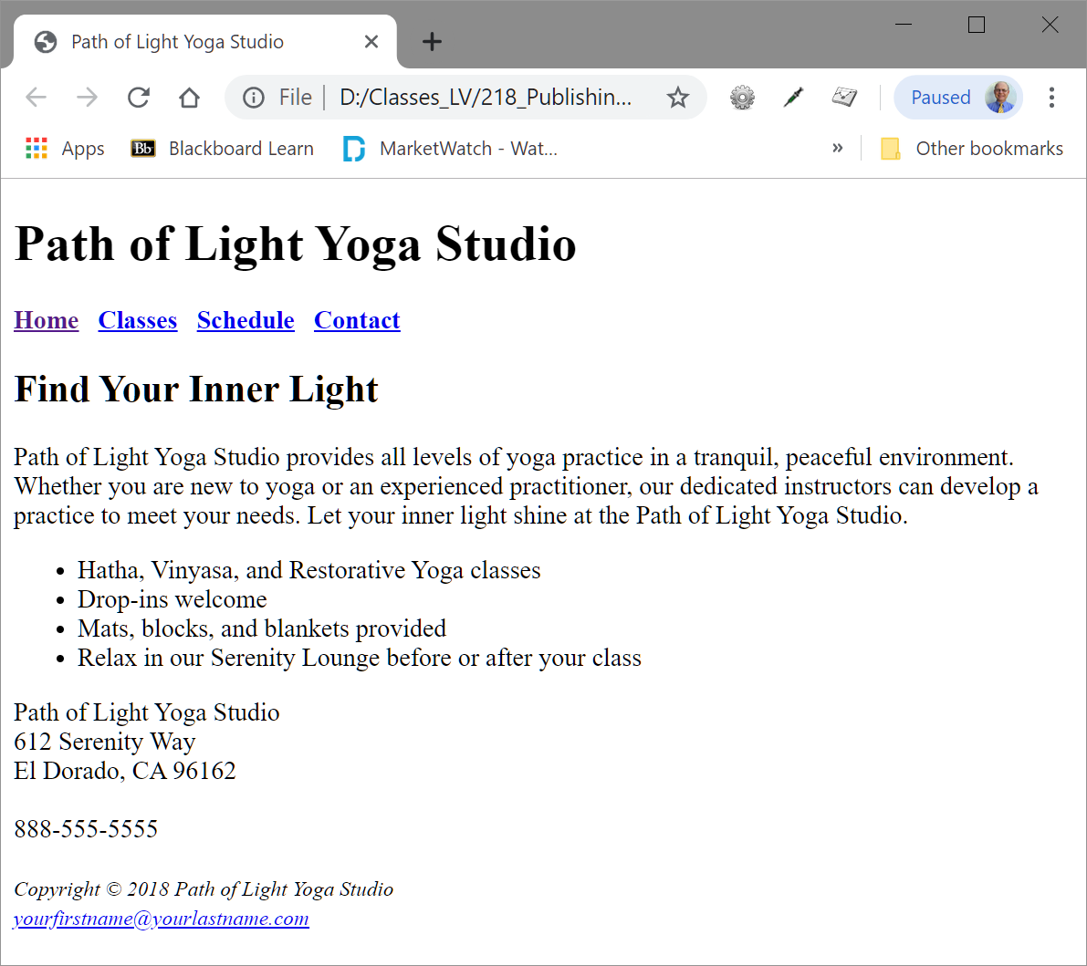
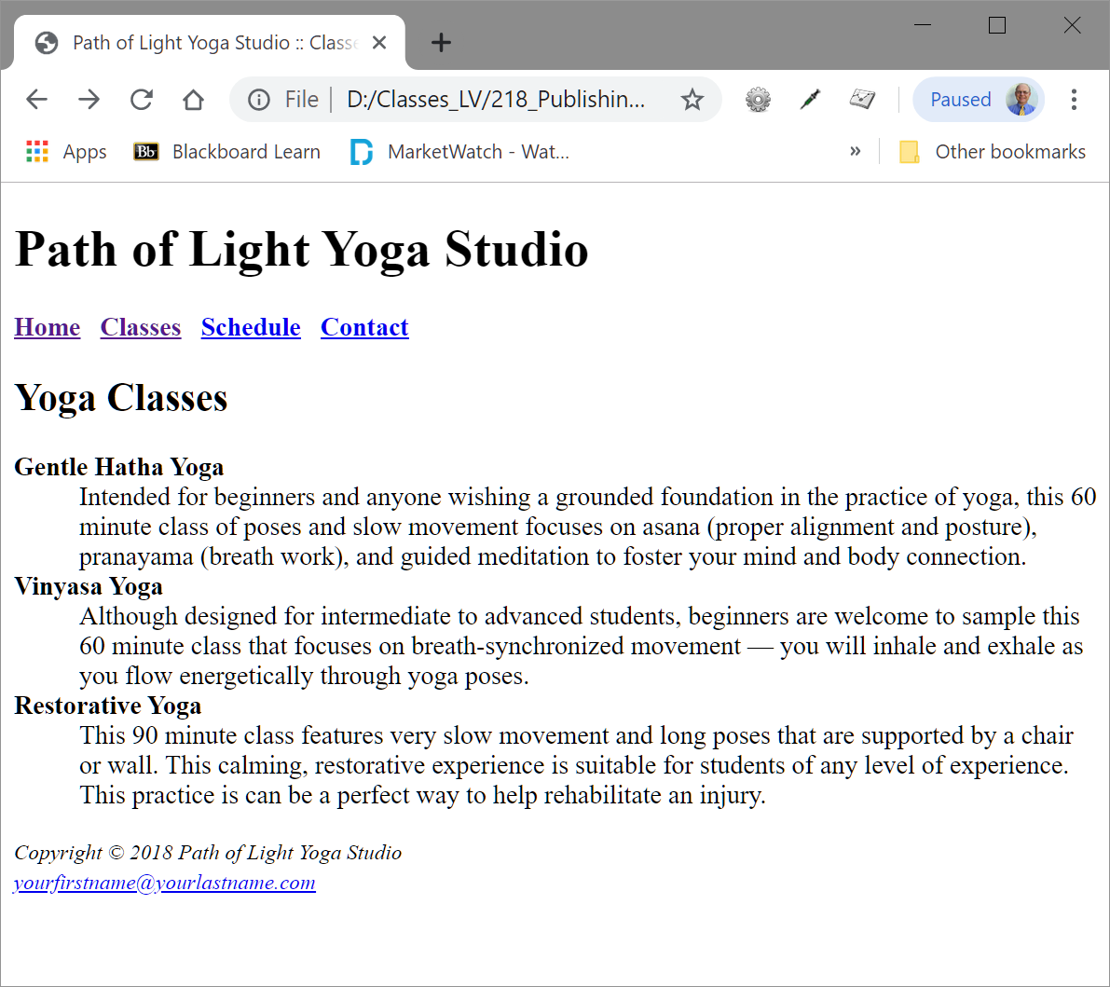
Home Project – Path of Light Yoga Studio

Slide 28
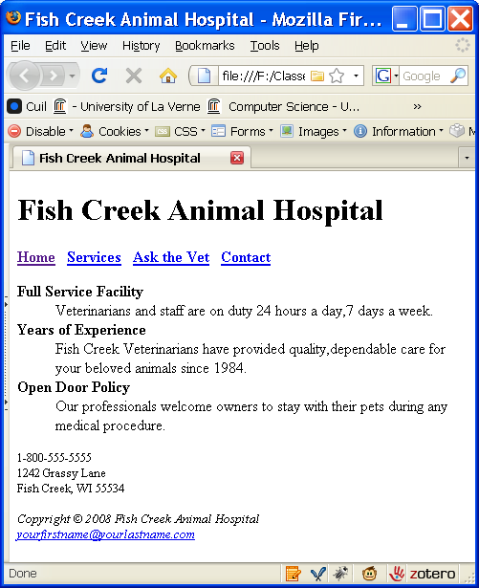
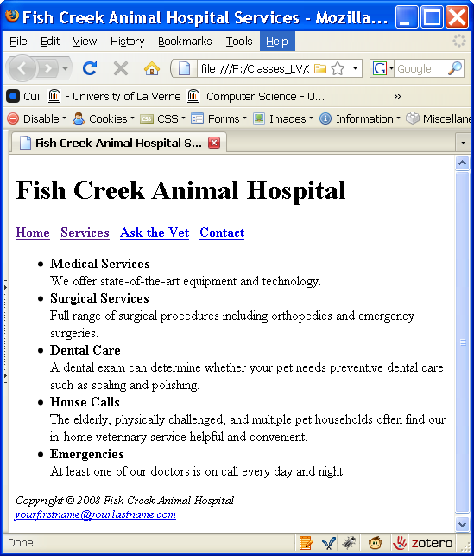
Home Project – Fish Creek Animal Hospital

