Slide 1
Learning Outcomes
HOP 3.1
The Style Attribute
HOP 3.2
Embedded CSS with Style Element
HOP 3.3
Configuring Text with CSS
HOP 3.4
Configuring Text with CSS (Continued)
HOP 3.5
CSS Class, ID, and Descendant Selectors
HOP 3.6
Span Element
HOP 3.7
Using External Style Sheets
HOP 3.8
Using External Style Sheets (Continued)
HOP 3.9
Center HTML Elements with CSS
HOP 3.10
The “Cascade”
HOP 3.11
CSS Validation

Slide 2
Chapter 3
Configuring Color
and
Text with CSS
Credits:
Copyright (c) 2007 Prentice-Hall. All rights reserved.
© 2011 2022 Pearson Education
expanded by J. Goetz, 2025

Slide 3

Learning Outcomes
In this chapter, you will learn how to:
Describe the evolution of style sheets from print media to the web
List advantages of using cascading style sheets
Create style sheets that configure common page and text properties
Use inline styles
Use embedded style sheets
Use external style sheets
Create CSS class and id selectors
Validate CSS

Slide 4
The Concept of Style Sheets
style - the way in which something is said, done, expressed, or performed
The World Wide Web Consortium’s approach to formatting and design
Cascading Style Sheets (CSS)
CSS style rules format the content of a Web page instead of using HTML/XHTML tag attributes

Slide 5
Overview of Cascading Style Sheets
Style Sheets (e.g. fonts, colors, spacing) have been used for years in Desktop Publishing to apply typographical styles and spacing to printed media.
Cascading Style Sheets (CSS) provides this functionality (and much more) for web developers.
CSS level 2 in 2011 – CSS2
CSS3 proposal
CSS is
a flexible,
cross-platform,
standards-based language
widely implemented in browsers.
developed by the W3C (www.w3.org/Style).

Slide 6
Overview of Cascading Style Sheets
Cascading Style Sheets (CSS) is a stylesheet language used to describe the presentation of a document written in a markup language.
Its most common application is to style web pages written in HTML and XHTML, but the language can be applied to any kind of XML document, including SVG and XUL.
CSS is used to help readers of web pages to define colors (for the text, background), fonts, layout, and other aspects of document presentation.
It is designed primarily to enable the separation of document content from style

Slide 7
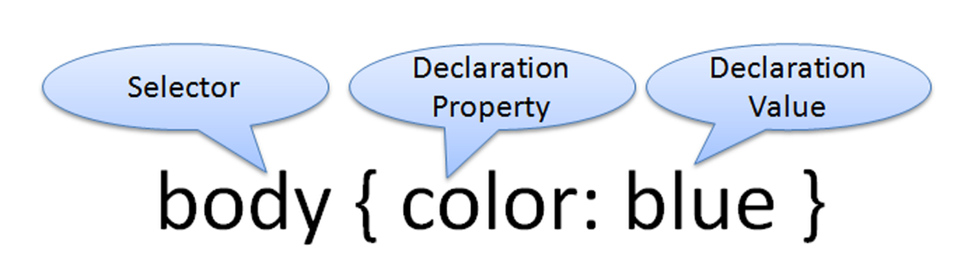
The Concept of Style Sheets
Each CSS style rule consists of 2 parts:
a selector, which can be an HTML tag such as h1 or p
a declaration, which defines the
property : value of the selector
ex:
body { color: blue;
background-color: yellow; }

Slide 8
CSS Advantages
Typography and page layout can be controlled
includes: font size, letter spacing, indents, margins, and element positioning
Style is separated from structure
Styles can be stored in a separate document and linked from the body of the Web page
when the styles are modified, the HTML remains intact
Potentially smaller documents
No need for <font> tags
Easier site maintenance
A feature is well-supported by browsers
This textbook concentrates on using CSS for formatting.

Slide 9
CSS Disadvantages
There is one large disadvantage -- CSS technology is considered an emerging technology, and not yet uniformly (the same way) supported by browsers.
This text will focus on features that are well supported by popular browsers.
This current disadvantage will be less of an issue in the future as the browsers comply with standards.

Slide 10
Types of Cascading Style Sheets
1. Inline Styles
Inline styles are coded in the body of the web page as an attribute of an HTML tag.
The style only applies to the specific element that contains it as an attribute
<h1 style="color:#FF0000">This is displayed as a red heading with gray background</h1>
2. Embedded Styles
Embedded styles are defined in the header of a web page.
These style instructions apply to the entire web page document.

Slide 11
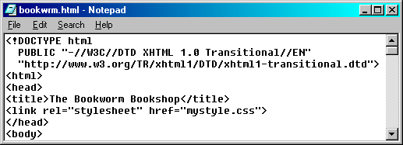
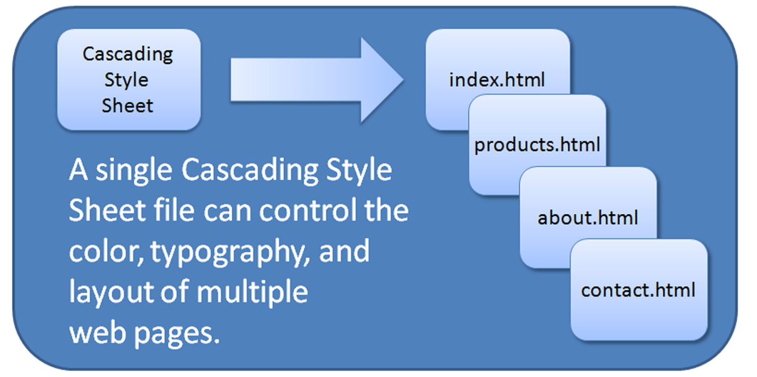

Types of Cascading Style Sheets
3. External Styles
External Styles are coded in a separate text file.
This web page file is linked to the web page by using a <link> tag in the header section.
The <link> tag is used to link the style sheet to a Web page
A style sheet document is an ASCII text document with

Slide 12
Types of Cascading Style Sheets
4. Imported Styles
Imported Styles are similar to External Styles in that they are coded in a separate text file.
An external style sheet can be imported into embedded styles or into another external style sheet using the @import directive
We’ll concentrate on the other types of styles in this text.

Slide 13
CSS Syntax
Style sheets are composed of "Rules" that describe the styling to be applied.
Each Rule contains
a Selector –
an HTML element or
a class name (that you create yourself) or
an id name (that you create yourself) and
a Declaration – is the property : value

Slide 14
CSS Syntax Sample
body { color: blue;
background-color: yellow; }
This could also be written using hexadecimal color values as shown below:
body { color: #0000FF;
background-color: #FFFF00; }
http://www.w3schools.com/css/css_syntax.asp

Slide 15
Common Formatting CSS Properties
See Table 3.1 p.87, Tab 3.2 p.89, 653
Common CSS Properties, including:
background-color
background-image
value: url(imagename.gif)
border
border-color
border-style
border-width
color
display - how if the element will display
values: none (hidden), block, inline, list-item, inline-flex, table,
table-row, table-cell
font-family
font-size
font-weight
font-style
line-height
margin
text-align
text-decoration
white-space
width

Slide 16
Steps to represent decimal as a sum :
Multiply every digit with 10 power of digit location.
zero based, 728:
8 location is 0,
2 location is 1 and
7 location is 2
Sum all the multipliers:
7 x 10^2 + 2 x 10^1 + 8 x 10^0

Slide 17
Steps to convert hex to decimal:
Here are the steps to convert hex to decimal:
Get the decimal equivalent of hex from table:
Multiply every digit with 16 power of digit location.
zero based, 728: 8 location is 0,
2 location is 1 and
the 7 location is 2
Sum all the multipliers:
7 x 16^2 + 2 x 16^1 + 8 x 16^0

Slide 18
Each color use one byte ( = 8 bits ),
0 1 1 0 0 0 1 1
HOW MANY DIFFERENT NUMBERS CAN BE REPRESENTED USING 0’s and 1’s?
Each bit can hold either a 0 or a 1. So there are just two choices for each bit, and there are 8 bits.
2 x 2 x 2 x 2 x 2 x 2 x 2 x 2 = 2⁸ = 256

Slide 19
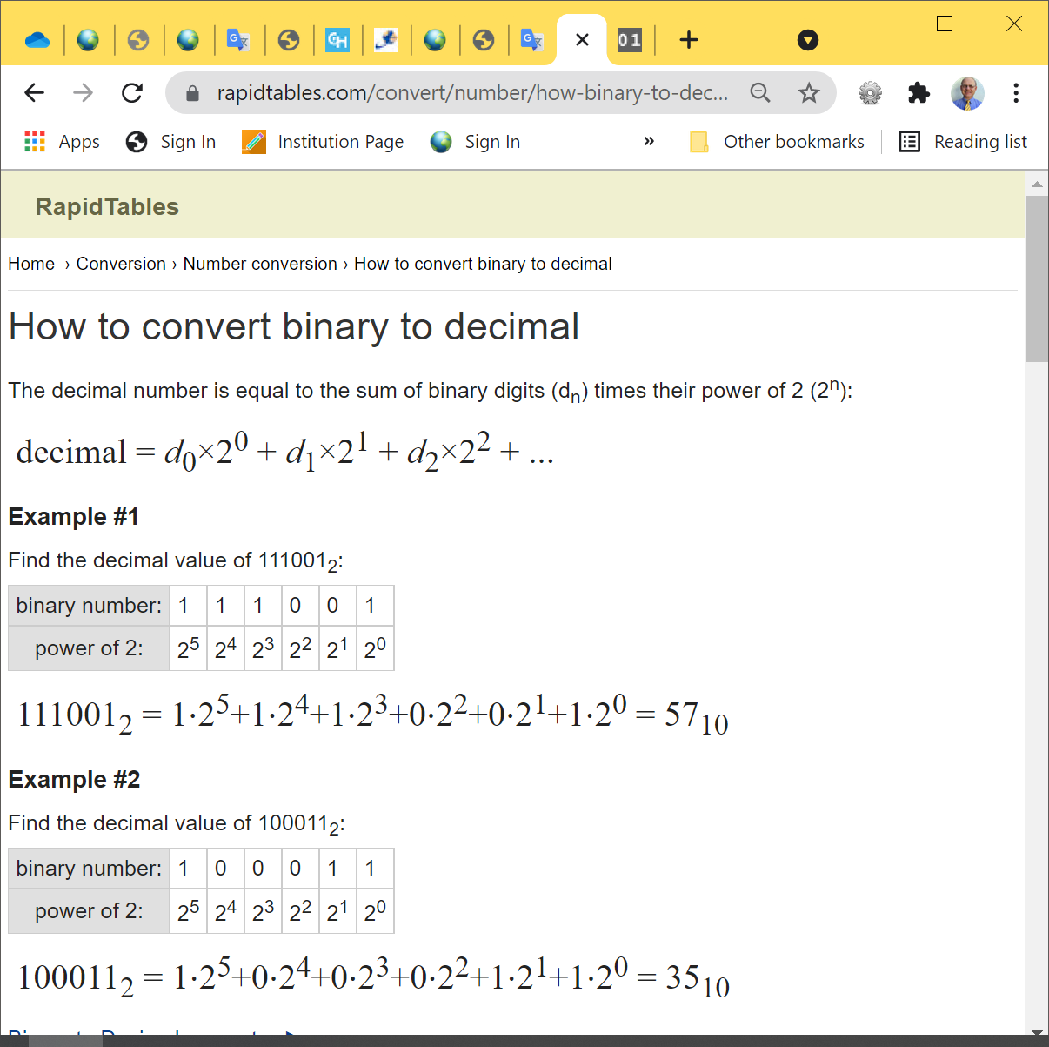
Conversion
Step 1: Write down the binary number.
Step 2: Starting with the least significant digit (LSB - the rightmost one), multiply the digit by 2 power of digit position/location. Continue doing this until you reach the most significant digit (MSB - the leftmost one).
Step 3: Add the results and you will get the decimal equivalent of the given binary number.
Now, let's apply these steps to, for example, the binary number above, which is (1010)₂
Step 1: Write down (1010)₂ and determine the positions, namely the powers of 2 that the digit belongs to.
Step 2: Represent the number in terms of its positions. (1 * 2³) + (0 * 2²) + (1 * 2¹) + (0 * 2⁰)
Step 3: (1 * 8) + (0 * 4) + (1 * 2) + (0 * 1) = 8 + 0 + 2 + 0 = 10
Therefore, (1010)₂ = (10)₁₀
https://www.rapidtables.com/convert/number/how-binary-to-decimal.html:

Slide 20
Conversion
https://ascii.cl/conversion.htm:
Decimal
Hex
Oct
Bin
0 1 2 3 4 5 6 7 8 9 10 11 12 13 14 15 | 0 1 2 3 4 5 6 7 8 9 A B C D E F | 000 001 002 003 004 005 006 007 010 011 012 013 014 015 016 017 | 0000 0001 0010 0011 0100 0101 0110 0111 1000 1001 1010 1011 1100 1101 1110 1111
Convert binary 1101100₂ to hex:
Convert every 4 binary bits (from bit0) to hex digit:
110 1100₂ = 110 1100 = 6 C = 6C₁₆

Slide 21




monitor displays have 3 colors only
Monitors display color as a combination of different intensities of
red, green, and blue
Red
Green
Blue

Slide 22
“True Color”
Only 8 bits worth of Red, Green, Blue intensity
0
8
16
24
32
Unused (or α)
Syntax: #RGB triplet
The hexadecimal value RGB contains 3 numeric value pairs written from 00 to FF (0 to 255)
# symbol – the value is in hexadecimal
Hexadecimal numbers (base 16) are used to represent these colors.

Slide 23
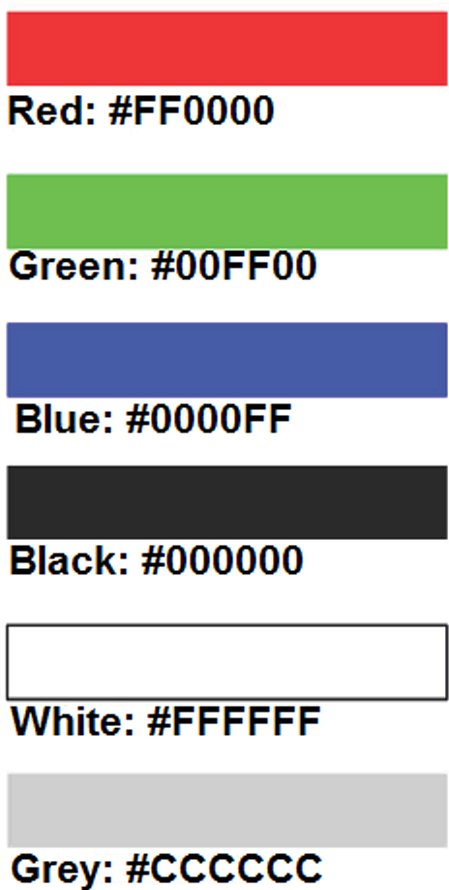
Using Color on Web Pages
Computer monitors display color as intensities of red, green, and blue light
RGB Color
The values of red, green, and blue vary from 0 to 255.
Hexadecimal numbers (base 16) represent these color values.

Slide 24
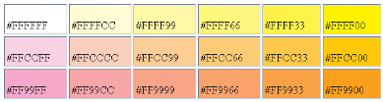
Hexadecimal Color Values
Hex value pairs range from 00 to FF
Three hex value pairs are used to describe a #RGB color
#000000 black #FFFFFF white
#FF0000 red #00FF00 green
#0000FF blue
Monitors display color as intensities of red, green, and blue

Slide 25
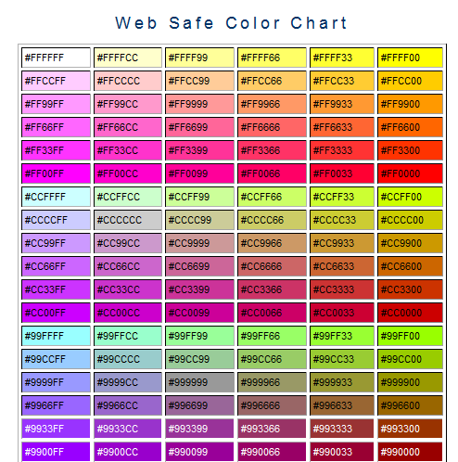

Web Color Palette
A collection of Web safe 216 colors that display the same on both the Mac and PC platforms.
Hex values includes only:
00, 33, 66, 99, CC, FF
See the Color Chart =>
or p.669 App G

Slide 26
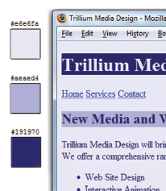
Choose Color
When you choose colors for text and background, sufficient contrast is needed so that the text is easy to read.
Use one of the following online tools to verify contrast:
http://webaim.org/resources/contrastchecker/++ - Color Contrast Checker
WCAG 2.0 level AA requires a contrast ratio of 4.5:1 for normal text and 3:1 for large text.
Level AAA requires a contrast ratio of 7:1 for normal text and 4.5:1 for large text.
Large text is defined as 14 point (typically 18.66px) and bold or larger, or 18 point (typically 24px) or larger.
http://snook.ca/technical/colour_contrast/colour.html +++
http://juicystudio.com/services/luminositycontrastratio.php

Slide 27
Making Color Choices
How to choose a color scheme?
Monochromatic - go
=> http://meyerweb.com/eric/tools/color-blend++
Choose from a photograph or other image
Begin with a favorite color
Use one of the sites below to choose other colors
http://colorschemedesigner.com/+
http://colorsontheweb.com/colorwizard.asp++
http://wellstyled.com/tools/colorscheme2/index-en.html

Slide 28
Accessibility & Color
Everyone is not able to see or distinguish between colors
Information must be conveyed even if color cannot be viewed
https://www.toptal.com/designers/colorfilter+
1 out of 20 people experience some type of color deficiency
Color choice can be crucial
Avoid using red, green, brown, gray, or purple next to each other
Choose bgcolor and text color with a high amount of contrast
White, black, and shades of blue and yellow are easier for individuals with color deficiencies to differentiate
Simulation: http://www.color-blindness.com/coblis-color-blindness-simulator/+

Slide 29
HTML <body> tag color attributes
bgcolor Attribute
Configures the background color of the web page
text Attribute
Configures the color of the text on the web page
link Attribute
Configures the color of the hyperlinks on the web page, use
default = blue
vlink Attribute
Configures the color of the visited hyperlinks on the web page, use default = purple
alink Attribute
Configures the color of the active hyperlinks on the web page, use default = red
<body bgcolor=“#CCCCCC” text=“#000099”>

Slide 30


Configuring Color with Inline CSS (1)
Inline CSS
Configured in the body of the Web page
Use the style attribute of an HTML tag
Apply only to the specific element
The Style Attribute
Value: one or more style declaration property and value pairs
Example: configure red color text in an <h1> element:
<h1 style="color:#ff0000">Heading text is red</h1>

Slide 31
Using Inline Styles Attributes
Inline Styles are coded as attributes on HTML tags.
The following code will set the text color of a <h1> tag to a shade of red:
<h1 style="color:#FF0000; background-color:#cccccc">This is displayed as a red heading with gray background</h1>
The following code sets the text in the heading to red and italic.
<h1 style="color:#CC0000;
font-style:italic">This is displayed as a red heading in italic style</h1>
or color:rgb(204,0,0)

Slide 32
Using Inline Styles
Inline Style Sheets
The style rules are included in the HTML file
The style rule is attached to a page element rather than across the entire page itself
The main attributes that apply are style and class

Slide 33
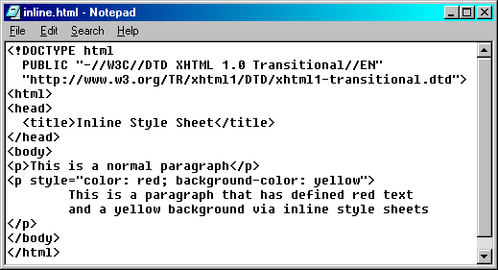
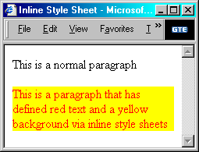
Using Inline Styles
The style Attribute
enables attaching a style rule to a single element
style rules are separated by a semicolon within quotes

Slide 34

Hands-On Practice
HOP 3.1
Follow the directions in your book for the HOP.
START-UP File | template.html
SAVE SOLUTION AS | inelinep.html

Slide 35
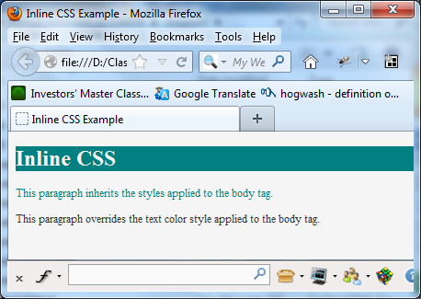
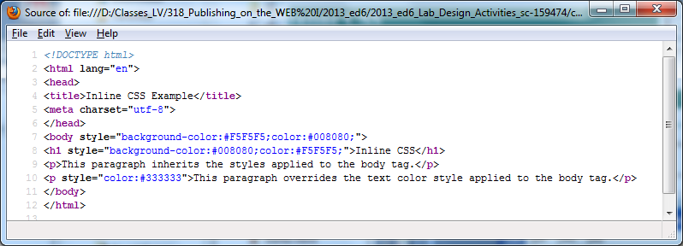



Using Inline Styles
HOP 3.1
inline.html

Slide 36
3.4 Embedded Styles
<style>
body { background-color: #000000;
color: #FFFFFF;
font-family:Arial,sans-serif;
}
</style>
Apply to an entire web page.
Placed within a <style> tag located in the header section of a web page.
The opening <style> tag begins the embedded style rules.
The closing </style> tag ends the area containing embedded style rules.
When using the <style> tag, there is no need for the style attribute.

Slide 37
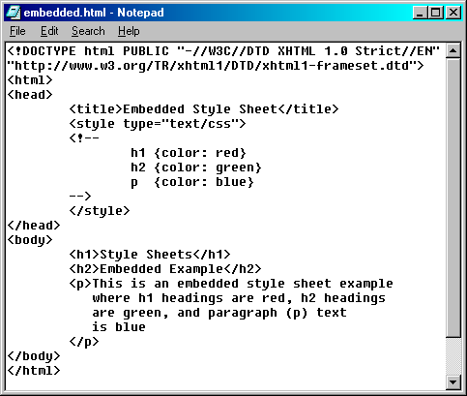
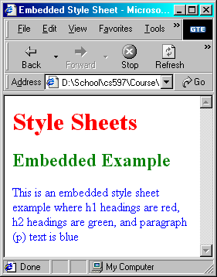


Embedded Styles
<= surround the style rules with comment tags, so older browsers won’t get confused.

Slide 38
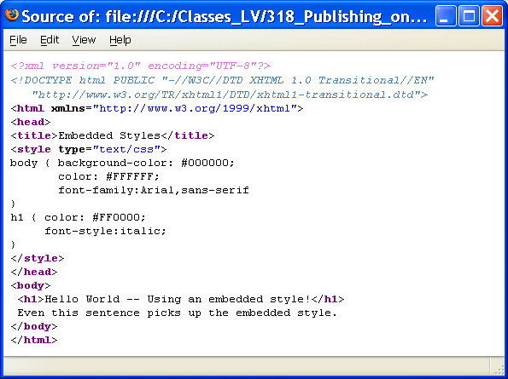
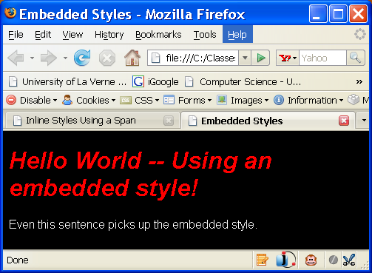


Embedded Styles

Slide 39
Hands-On Practice
HOP 3.2
Follow the directions in your book for the HOP.
START-UP File | starter.html
SAVE SOLUTION AS | embedded.html

Slide 40

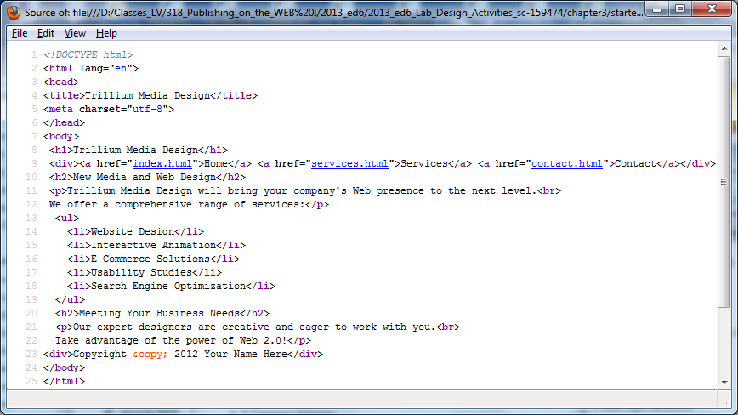
Embedded Styles
HOP 3.2
starter.html

Slide 41
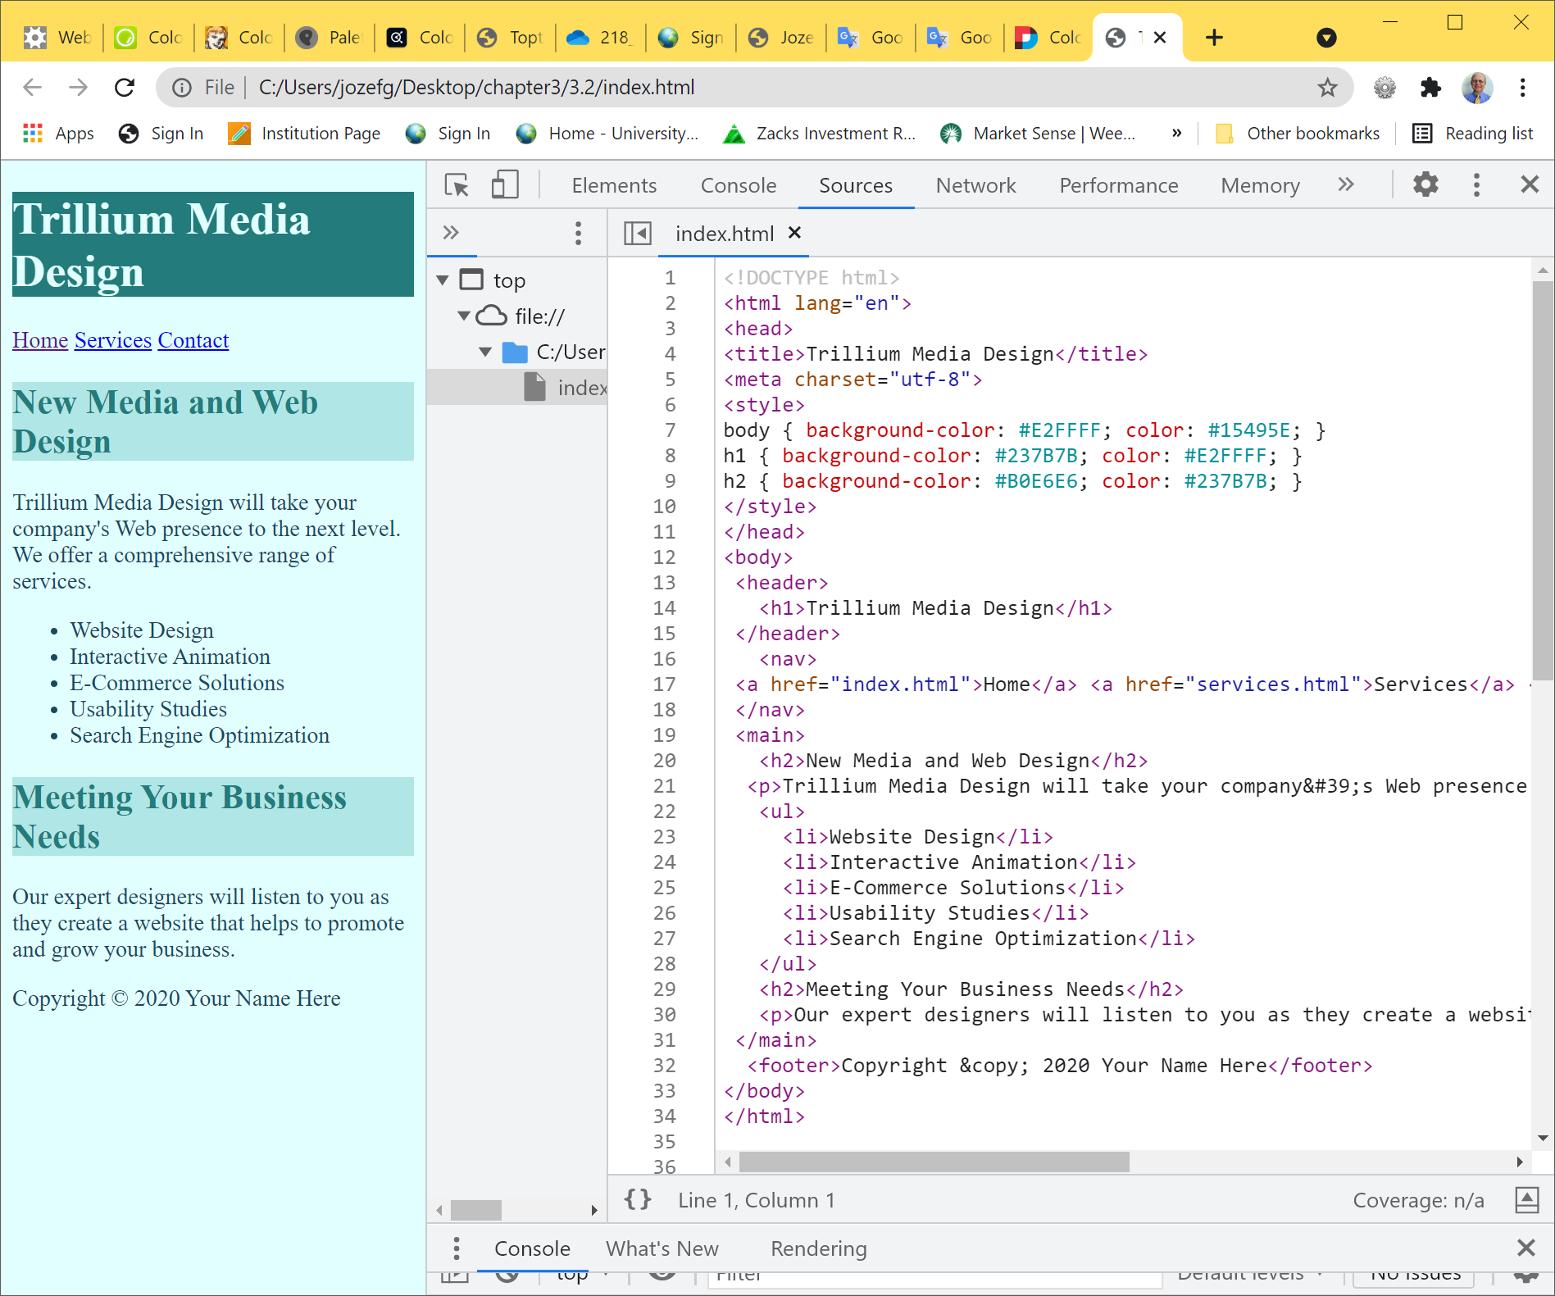





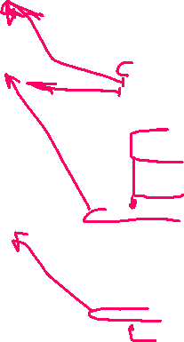


CSS Embedded Styles
The body selector sets the global style rules for the entire page.
These global rules are overridden for <h1> and <h2> elements by the h1 and h2 style rules.
+
HOP 3.2
embedded.html

Slide 42
Hands-On Practice
HOP 3.3
Follow the directions in your book for the HOP.
START-UP File | starter2.html
SAVE SOLUTION AS | index.html

Slide 43

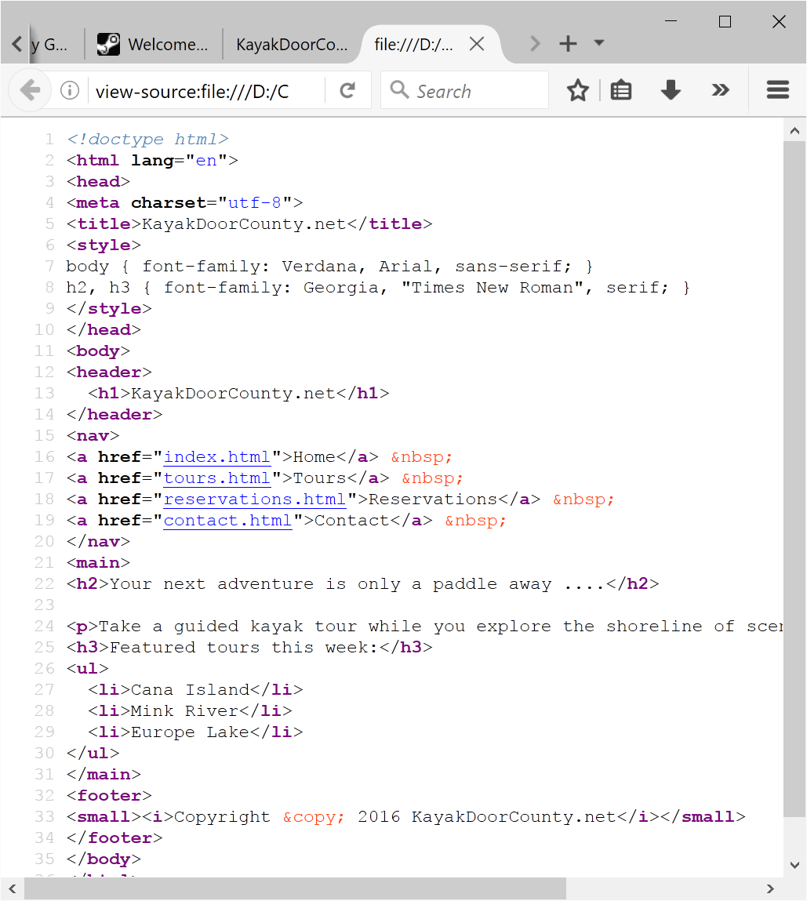



HOP 3.3 from starter2.html

Slide 44
Checkpoint 3.1
1. List three reasons to use CSS on a Web page.
greater control of topography and page layout,
separation of style from structure,
smaller Web page docs,
no need to use <font> tags,
easier site maintenance
2. When designing a page that uses colors other than the default colors for text and background, explain why it is a good reason to configure style rules for both text color and background color.
b/c keeping of contrast
To verify contrast => http://webaim.org/resources/contrastchecker/
3. Describe one advantage to using embedded styles instead of inline styles.
More efficient b/c it applies to the entire page

Slide 45
Configuring Text with CSS p.87
CSS properties for configuring text:
font-family
Configures the font typeface of the text
font-size
Configures the size of the text
font-style
Configures text to an normal, italic or oblique style
font-weight
Configures the boldness of text

Slide 46
More CSS TEXT Properties p.87
line-height
Configures the height of the line of text (use the value 200% to appear double-spaced)
text-align
Configures alignment of text within a block display element
text-decoration
Modifies the appearance of text with none, underline, overline, or line-through
text-indent
Configures the indentation of the first line of text
text-transform
Configures the capitalization of text
h3 { text-transform:uppercase; }
letter-spacing
Configures space between text characters
word-spacing
Configures space between words
text-shadow – not all browser support the new CSS3
Configures a drop shadow on text
text-shadow: 3px 3px 5px #666
horizontal offset, vertical offset, blur radius, shadow – a dark grey

Slide 47
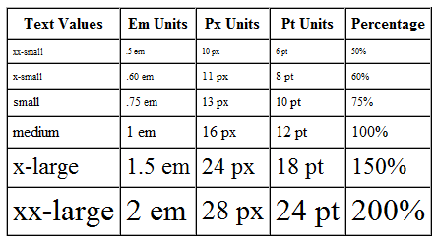
The font-size Property p.97
The em unit is a relative font unit, the width of a square block of type – typically the uppercase M for particular font and type size
The px (pixel) unit is monitor resolution dependent and looks different depending on the screen resolution used – may not scale in every browser
The text value and the pt (point) are browser dependent - may not scale in every browser
The percentage values work in a similar manner to em units
1em = 100% should render the same in a browser
Accessibility Recommendation:
Use em or percentage font sizes ; these can be easily enlarged in all browsers by users
They scale when text is resized in browser

Slide 48
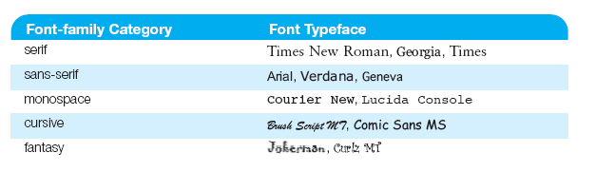



The font-family Property p.95
Not everyone has the same fonts installed in their computer
Configure a list of fonts
Default installed inmost browsers is Times New Roman font
Configure the p element Arial if installed, Helvetica if installed,
or the default installed sans-serif font
p {font-family: Arial, Helvetica, sans-serif;}
A collection of free fonts is at www.google.com/webfonts+

Slide 49
Hands-On Practice
HOP 3.4
Follow the directions in your book for the HOP.
START-UP File | index.html (HOP 3.2)
SAVE SOLUTION AS | embedded1.html

Slide 50
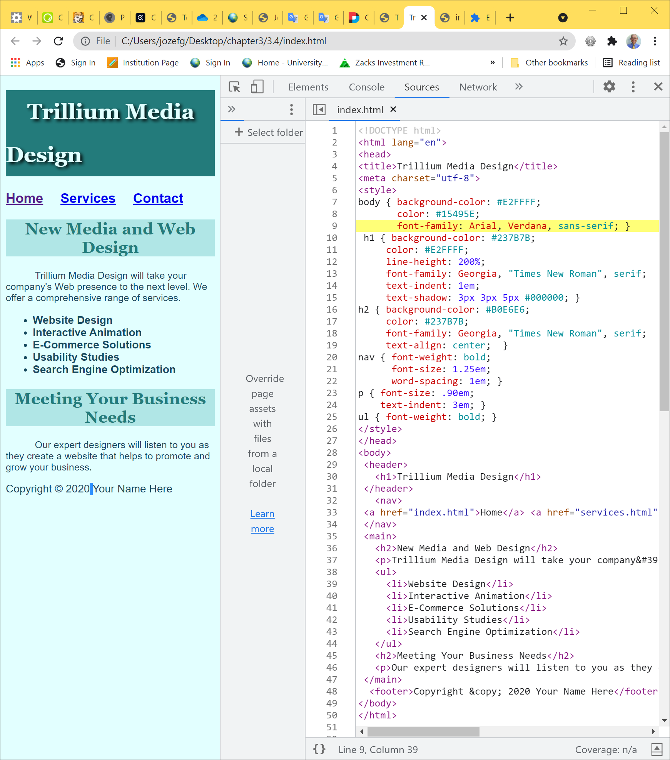





Embedded Styles HOP 3.4
horizontal offset, vertical offset,
blur radius, shadow

Slide 51
CSS Selectors
CSS style rules can be configured for an:
HTML element selector
class selector
id selector

Slide 52
Using CSS with “class”
class Selector
Use to apply a CSS rule to a certain "class" of elements on a web page and not necessarily tie the style to a particular HTML tag.
A CSS class is indicated by .classname
Use short descriptive names
Avoid space in class names
The sample above creates a class called “new” with red italic text.
To use the class, code the following HTML:
<p class=“new”>This is text is red and in italics</p>
<style type="text/css">
.new { color:#FF0000;
font-style:italic;
}
</style>

Slide 53
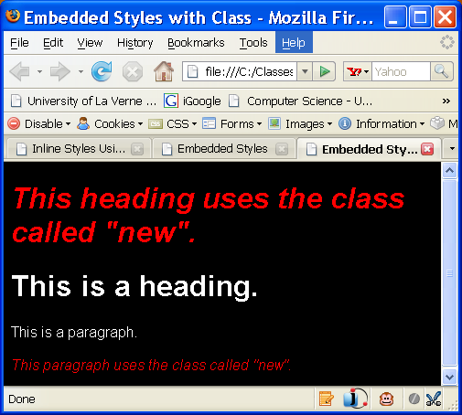
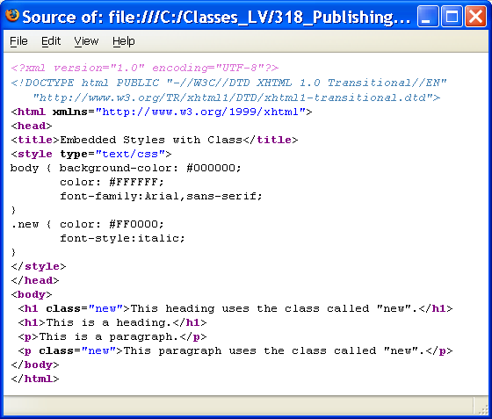
Using CSS with “class”

Slide 54

Using CSS with “id” p.103
<style type="text/css">
#new { color:#FF0000;
font-size:2em;
font-style:italic;
}
</style>
id Selector
Use to apply a CSS rule to a certain ONE element on a web page and not necessarily tie the style to a particular HTML tag.
A CSS id is indicated by #idname
The sample above creates an id called “new” with red italic text.
To use the id, code the following HTML:
<p id=“new”>This is text is red and in italics</p>

Slide 55
Hands-On Practice
HOP 3.5
Follow the directions in your book for the HOP.
START-UP File | index.html (HOP 3.4)
SAVE SOLUTION AS | index.html

Slide 56
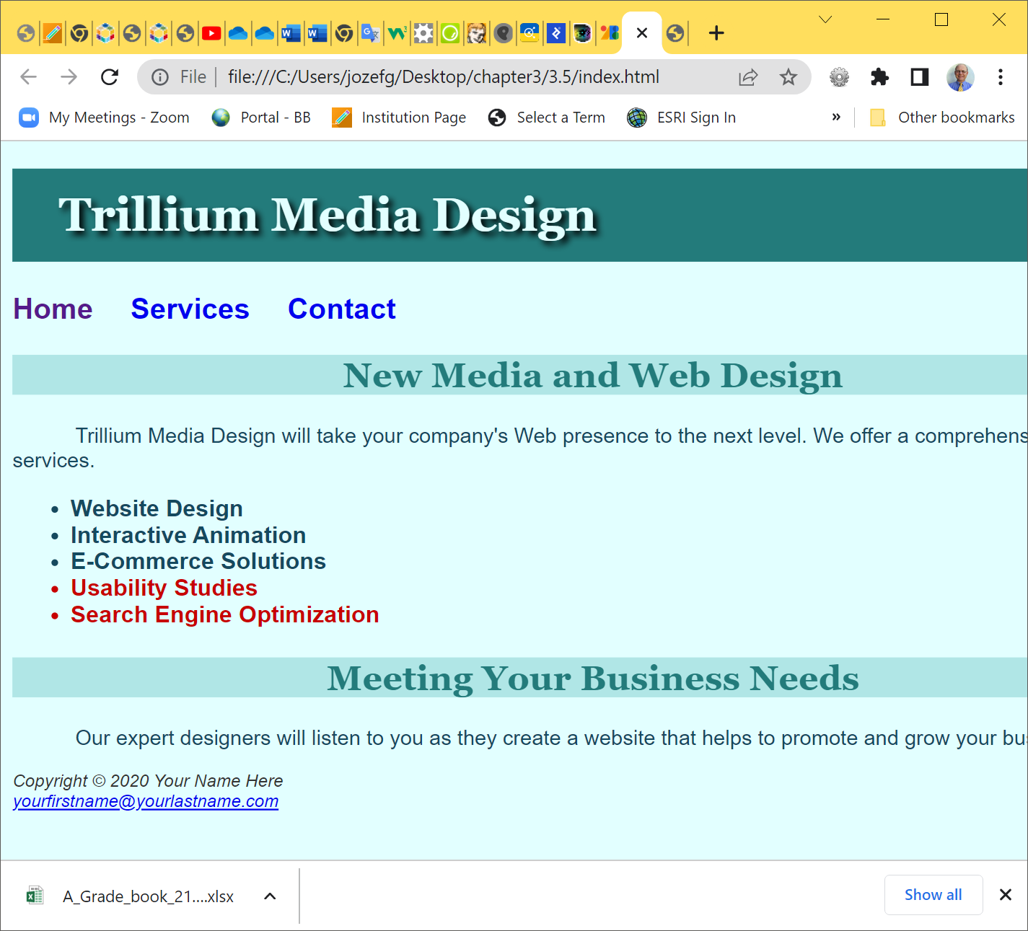




Using CSS with “class” and “id”
.feature { color: #C70000; }
nav a { text-decoration: none;}
footer {color: #333333; font-size: .75em; font-style: italic; }
================= HTML ===============================
<nav><a href="index.html">Home</a> <a href="services.html">Services</a> <a href="contact.html">Contact</a><nav>
<footer>Copyright &copy; 2020Your Name Here<br>
<a href="mailto:yourfirstname@yourlastname.com">
yourfirstname@yourlastname.com</a>
</footer>
<li class="feature">Usability Studies</li>
<li class="feature">Search Engine Optimization</li>
HOP 3.5

Slide 57
CSS Descendant Selector
Specify an element within the context of its container (parent) element.
AKA (Also Known As) contextual selector
The example configures a green text color only for p tags located within an element (main) assigned to the id named content
Advantage of contextual selectors: Reduces the number of classes and ids you need to apply in the HTML
<style>
main p { color: #00ff00; }
</style>

Slide 58
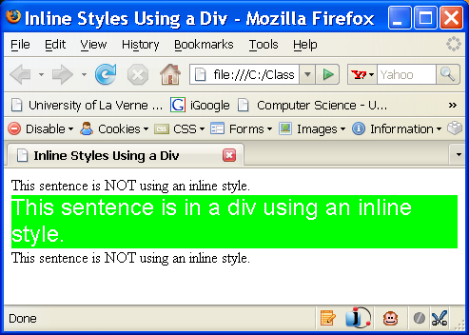
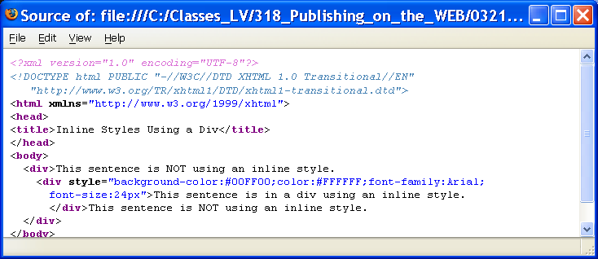
HTML <div> tag
The <div> tag
A container tag
Used to create a specially formatted division or area of a web page.
It can be used to format that area and places a line break before and after the division.
Use the <div> tag when you need to format an area that is separated from the rest of the web page by line breaks.
The <div> tag is also useful to define an area that will contain other block-level tags (such as <p>, <ul>, <ol>, <blockquote> or <span>) within it.

Slide 59
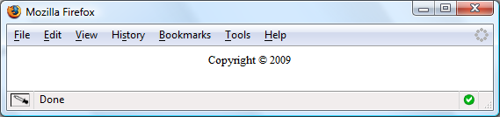
HTML <div> Element Example
Configure a page footer area
Embedded CSS:
<style type="text/css">
.footer { font-size:small;
text-align:center; }
</style>
HTML:
<div class=“footer">Copyright &copy; 2009</div>

Slide 60
Hands-On Practice
HOP 3.6
Follow the directions in your book for the HOP.
START-UP File | index.html (HOP 3.5)
SAVE SOLUTION AS | index.html

Slide 61
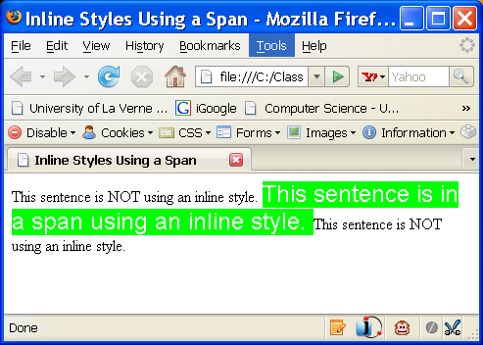
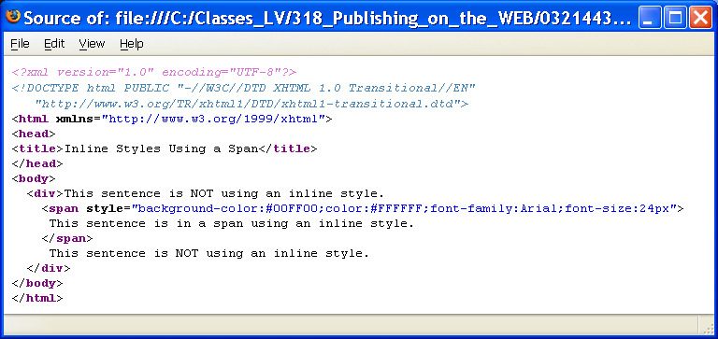
3.7 HTML <span> tag
Purpose:
Use the <span> tag if you need to format an area that is contained within another, such as within a paragraph.
The <span> tag
A container tag
The <span> tag will format an area on the page that is NOT physically separated from others by line breaks.
There is no additional empty space above or below a span – it is inline display.

Slide 62
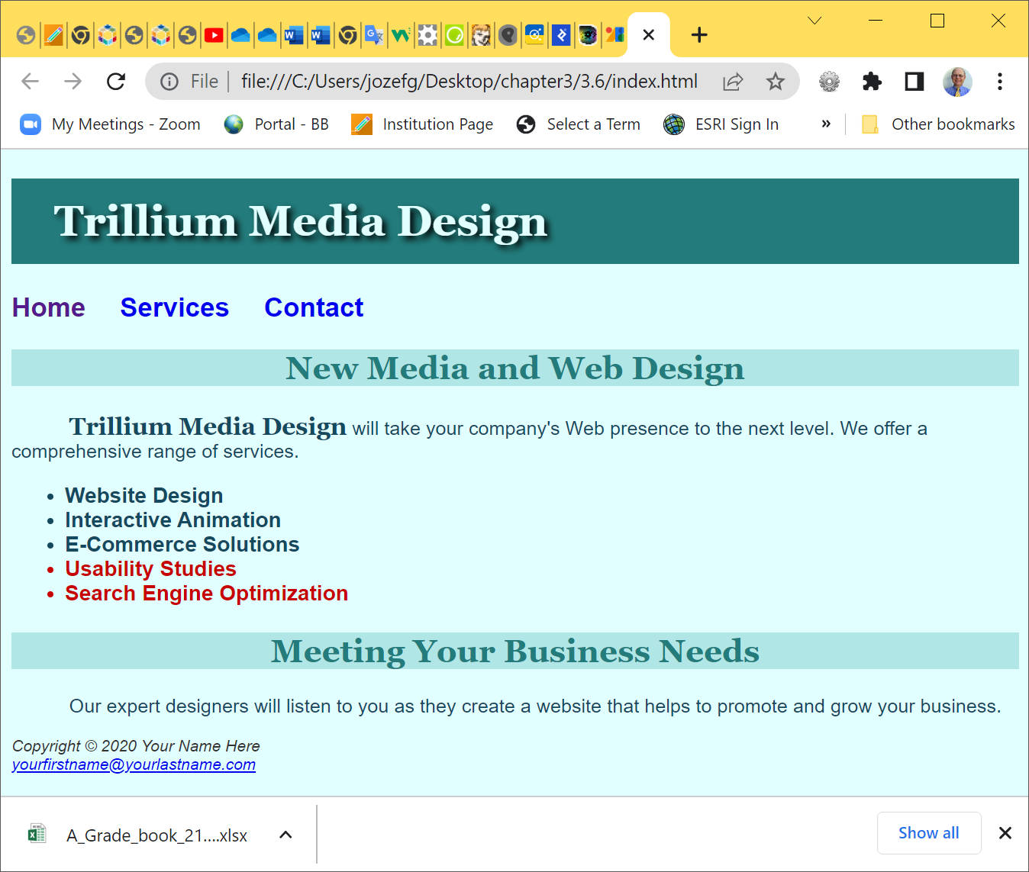






3.7 HTML <div> and <span>
.companyname { font-weight:bold;
font-family:Georgia, "Times New Roman", serif;
font-size:1.25em; }
<p><span class="companyname">Trillium Media Design</span> will bring your company's Web presence to the next level.<br />
HOP 3.6

Slide 63
Hands-On Practice
HOP 3.7
Follow the directions in your book for the HOP.
START-UP File | template.html
SAVE SOLUTION AS | external.html color.css

Slide 64
External Style Sheets
External Style Sheets are contained in a text file separate from the HTML documents.
The <link> tag is
is a self-contained tag
is used in the header section of an HTML document to "link" the style sheet with the web page
associates the external style sheet file with the web page
<link rel="stylesheet" href="color.css“>
Multiple web pages can link to the same external style sheet file.
+’s: The External Style Sheet text file is
saved with the file extension ".css" and
contains only style rules.
It does not contain any HTML tags.

Slide 65
Using an External Style Sheet
External Style Sheet color.css as follows:
body { background-color: #0000FF;
color: #FFFFFF;
}
A style sheet document is an ASCII text document with a .css extension
The <link> tag is used to link the style sheet to a Web page
To link to the external style sheet called color.css, the HTML code placed in the header section is:
<link rel="stylesheet" href="color.css”>

Slide 66
External Style Sheets
Multiple web pages can associate with the same external style sheet file.
site.css
index.htm
body {background-color:#E6E6FA;
color:#000000;
font-family:Arial, sans-serif;
font-size:90%; }
h2 { color: #003366; }
.nav { font-size:16px;
font-weight:bold; }
clients.htm
<= links
about.htm
Etc…

Slide 67
Using an External Style Sheet
The rel attribute to specify a relationship between two documents, allows you to choose if your style sheet is mandatory or optional
rel values:
“stylesheet” -- means the stylesheet is always used
if a title property is added with the rel=“stylesheet” property/value pair, the style can be disabled after it is initially loaded
<link rel="stylesheet" href="color.css”>
rel=“alternate stylesheet” -- the user has the option to use the style
This allows some styles to be mandatory but others to be optional for the same page.

Slide 68
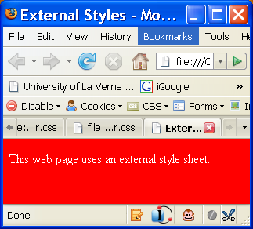
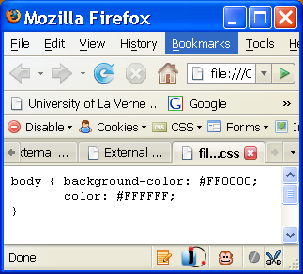
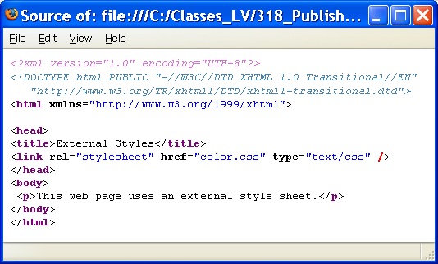


Using an External Style Sheet
HOP 3.7
color.css =>
HOP 3.7
<= external.htm

Slide 69
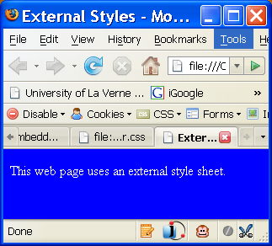
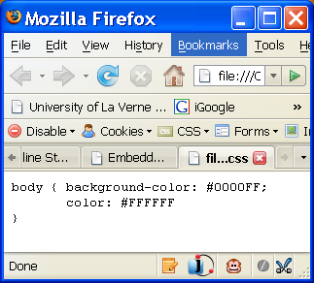
Using an External Style Sheet
color.css =>
HOP 3.7
Fig 3.18
external.html

Slide 70
Hands-On Practice
HOP 3.8
Follow the directions in your book for the HOP.
START-UP File | index.html (HOP 3.6) services.html
SAVE SOLUTION AS | trilliumext folder index.html trillium.css

Slide 71
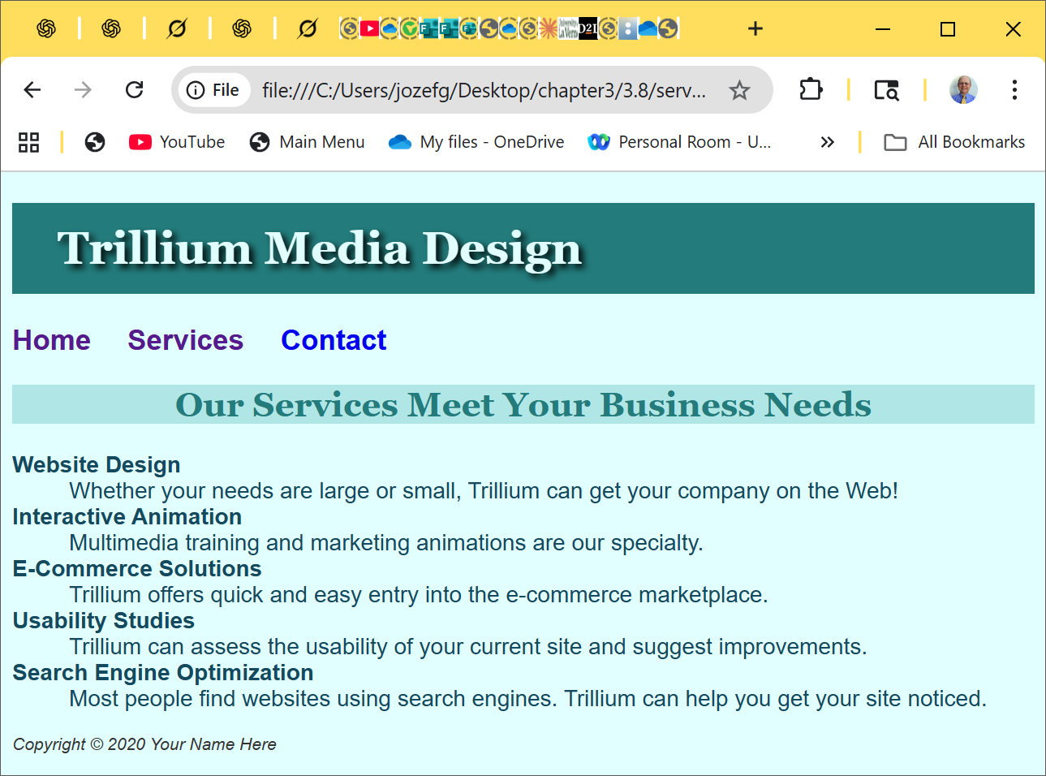
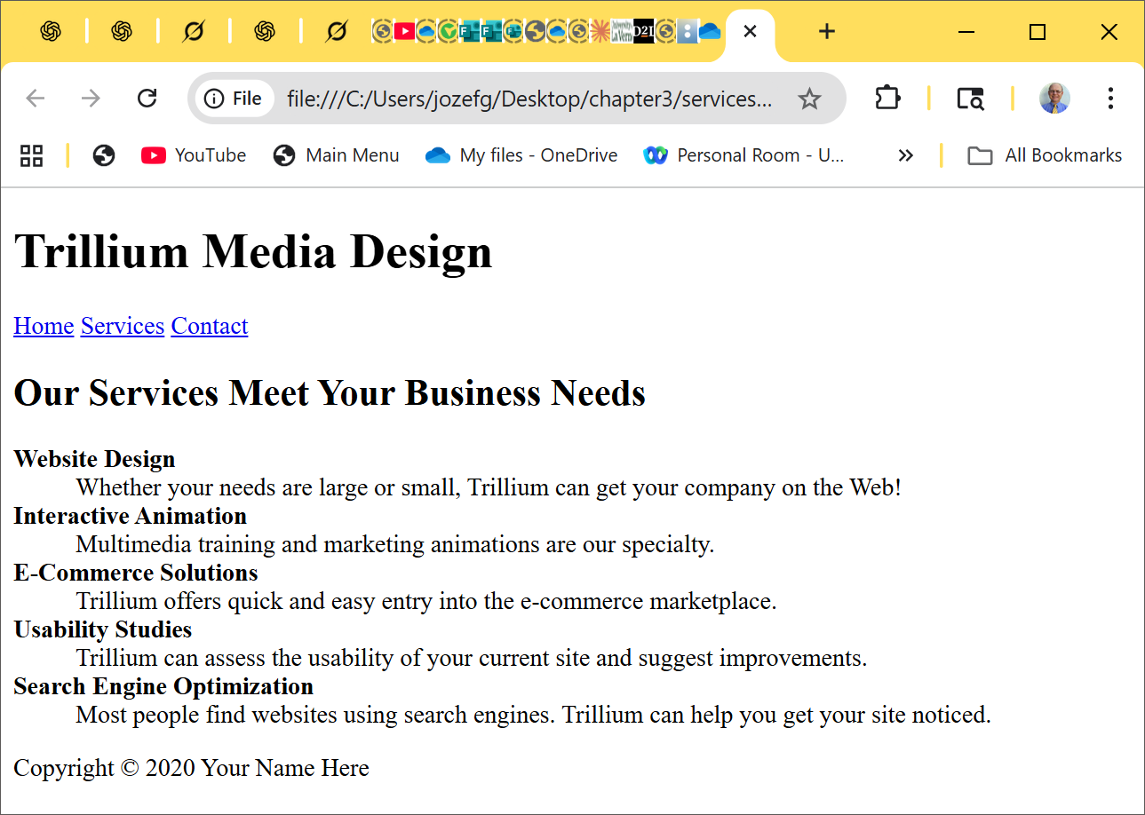
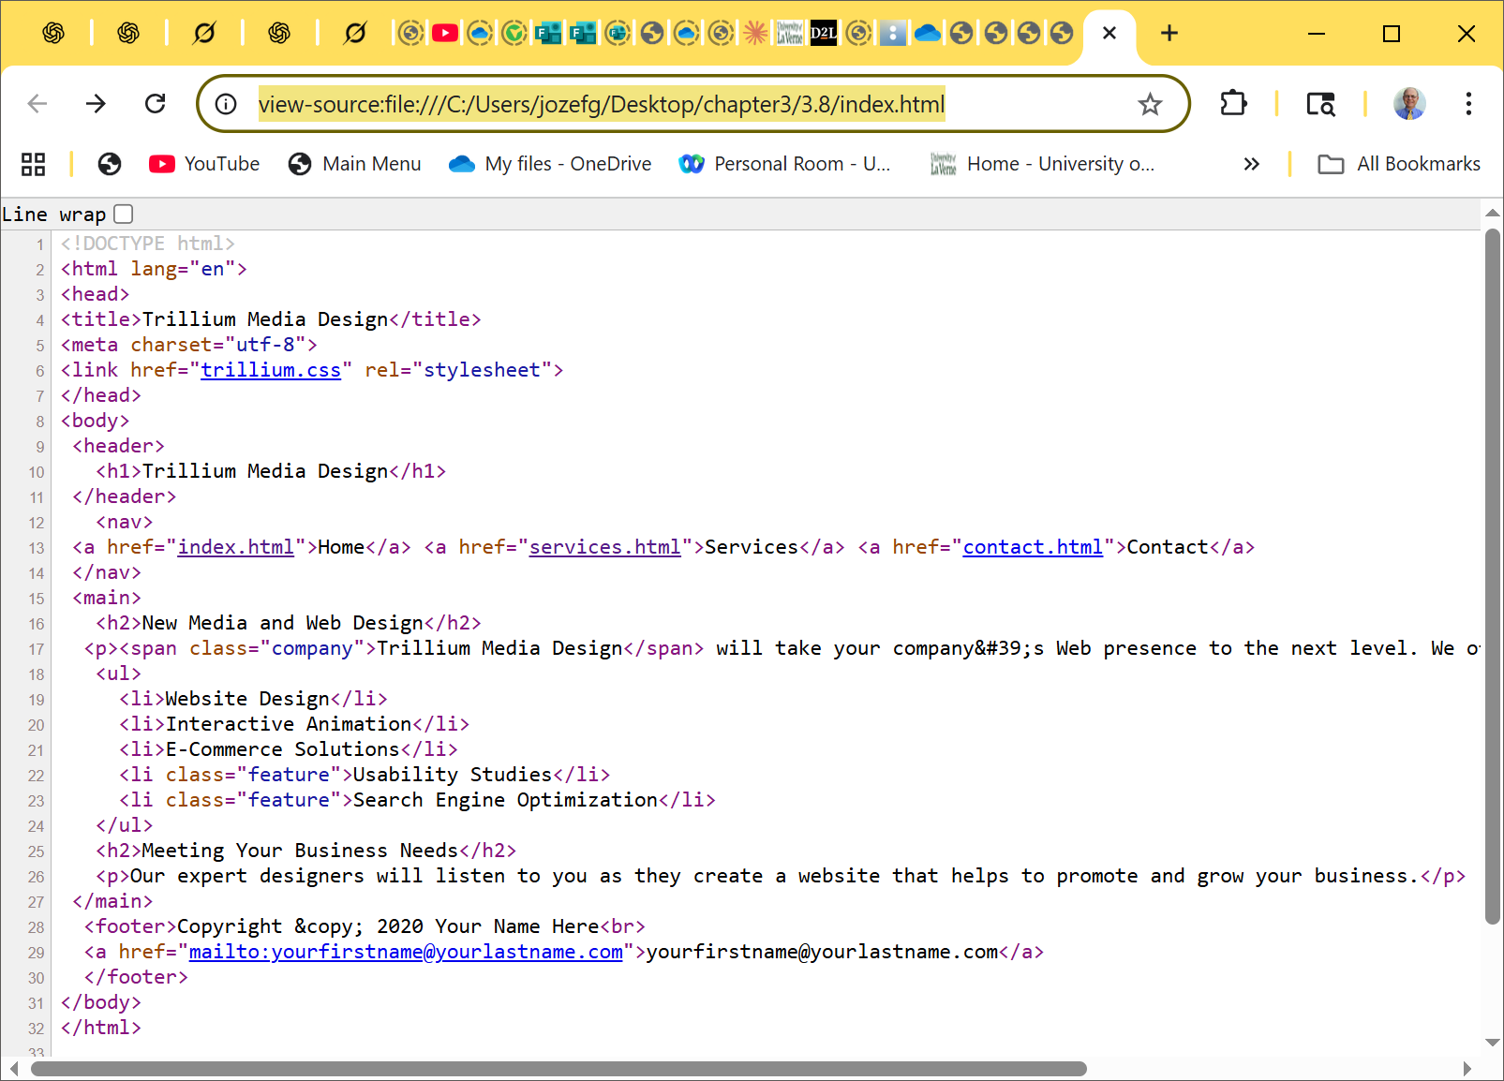
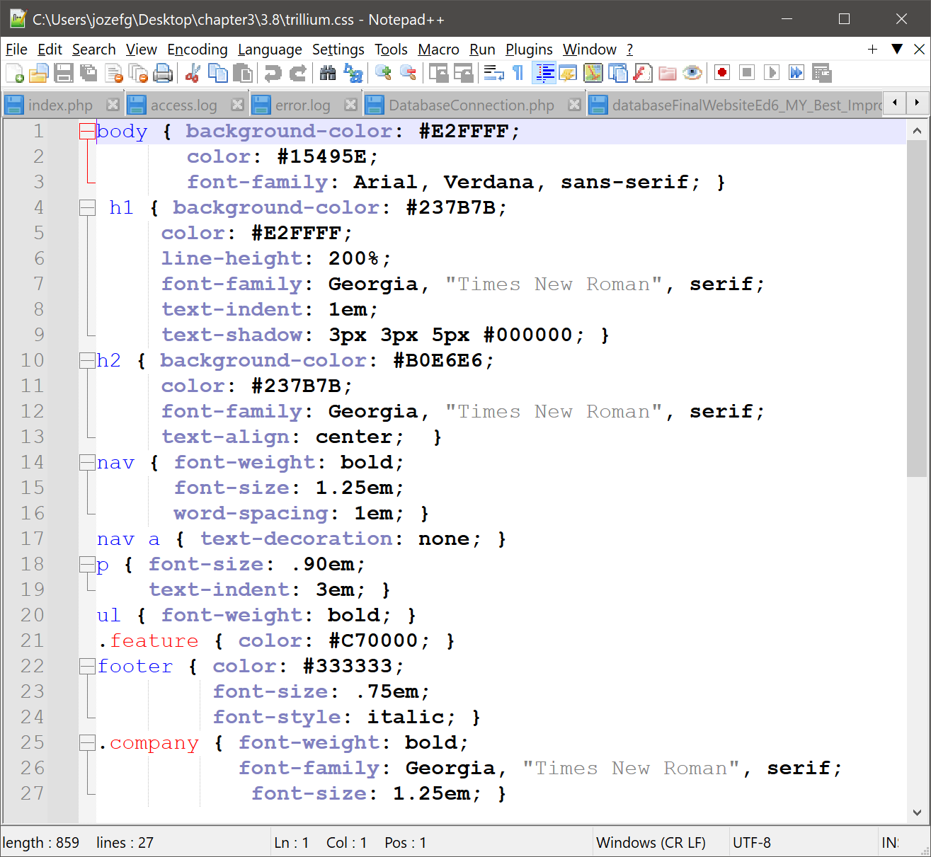







Using an External Style Sheet – HTML 5
original
services.html
services.html
without link to
trillium.css =>
HOP 3.8
<=services.html
with linked
trillium.css
+
<=trillium.css

Slide 72
Checkpoint 3.2
Describe a reason to use embedded styles. Explain where embedded styles are placed on a web page. - to configure the text and color formatting for a SINGLE Web page without using font tags.
Describe a reason to use external styles. Explain where external styles are placed and how web pages indicate they are using external styles.
- to configure the text and color formatting for SOME or ALL of the pages on a Web site.
- External styles are placed in a separate text file using a .css file extension.
- Web pages uses the <link> to indicate that uses a .css file.
3. Write the code to configure a web page to use an external style sheet called “mystyles.css”.
<link rel=stylesheet” href=“…” >
Guidelines for configuring css => p.112 – see further slides
HOP 3.6-3.8

Slide 73
Hands-On Practice
HOP 3.9
Follow the directions in your book for the HOP.
START-UP File | index.html, services.html, and trillium.css (HOP 3.8)
SAVE SOLUTION AS | trilliumcenter folder

Slide 74



3.9 Centering Page Content with CSS p.113
# wrapper { margin-left: auto;
margin-right: auto;
width:80%; }
HOP 3.9
index.html +
trillium.css
HOP 3.8

Slide 75
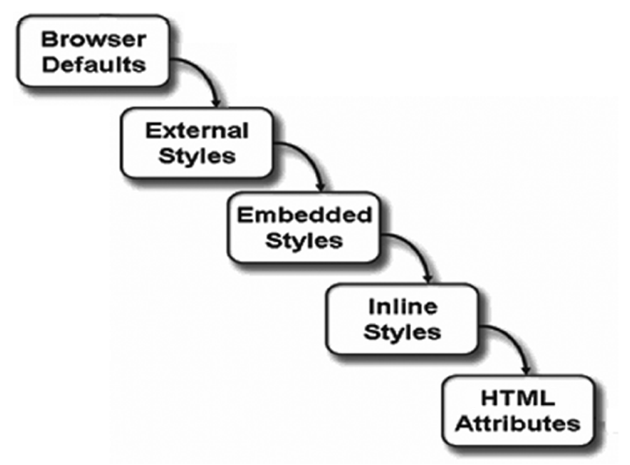
The Cascade
This “cascade” applies the styles in order from outermost (Browser Defaults then External Styles) to innermost (actual HTML coded on the page).
This way site-wide styles can be configured but overridden when needed by more granular (or page specific) styles.

Slide 76
About Cascading
When more than one style approach is used there is a precedence for which style gets used
browser’s internal style sheet applied/accessed first
user-defined styles if available
external styles are applied/accessed next
embedded styles are applied next and override previously defined styles where applicable
inline styles are applied last and override previously defined styles where applicable
HTML attributes
and user-defined styles,
if available

Slide 77
Hands-On Practice
HOP 3.10
Follow the directions in your book for the HOP.
START-UP File | n/a
SAVE SOLUTION AS | site.css mypage1.html

Slide 78
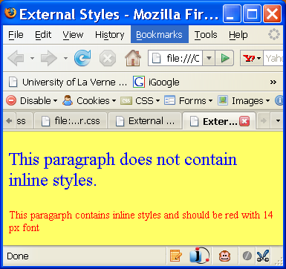
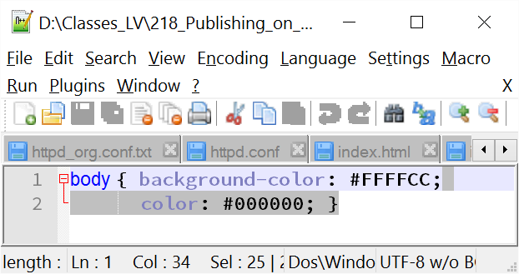
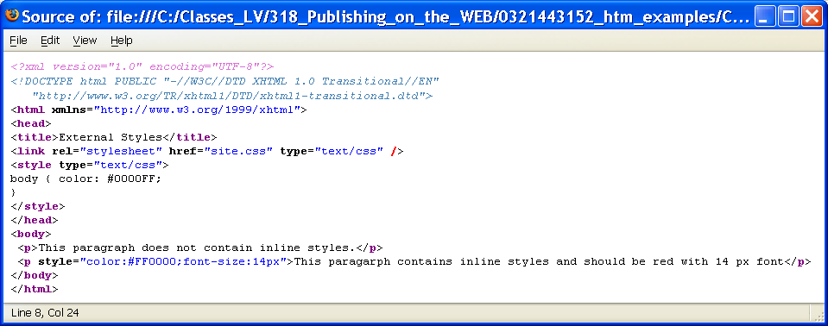

HOP 3.10
mypage1.html
site.css
Certain CSS properties are passed down to elements
nested within a container element, such as a <p> is
nested within a <body> element

Slide 79
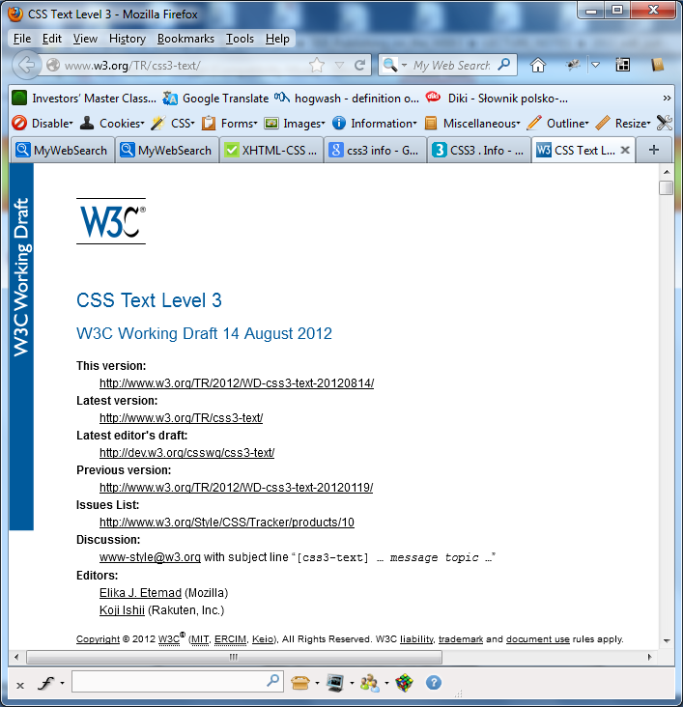
Commonly Used Style Sheet Properties and Values
More information for CSS1, CSS2 and CSS3 at:
http://www.w3.org/TR/REC-CSS1.html
http://www.w3.org/TR/REC-CSS2
http://www.css3.info/

Slide 80
Hands-On Practice
HOP 3.11
Follow the directions in your book for the HOP.
START-UP File | color.css (HOP 3.7)
SAVE SOLUTION AS | n/a

Slide 81
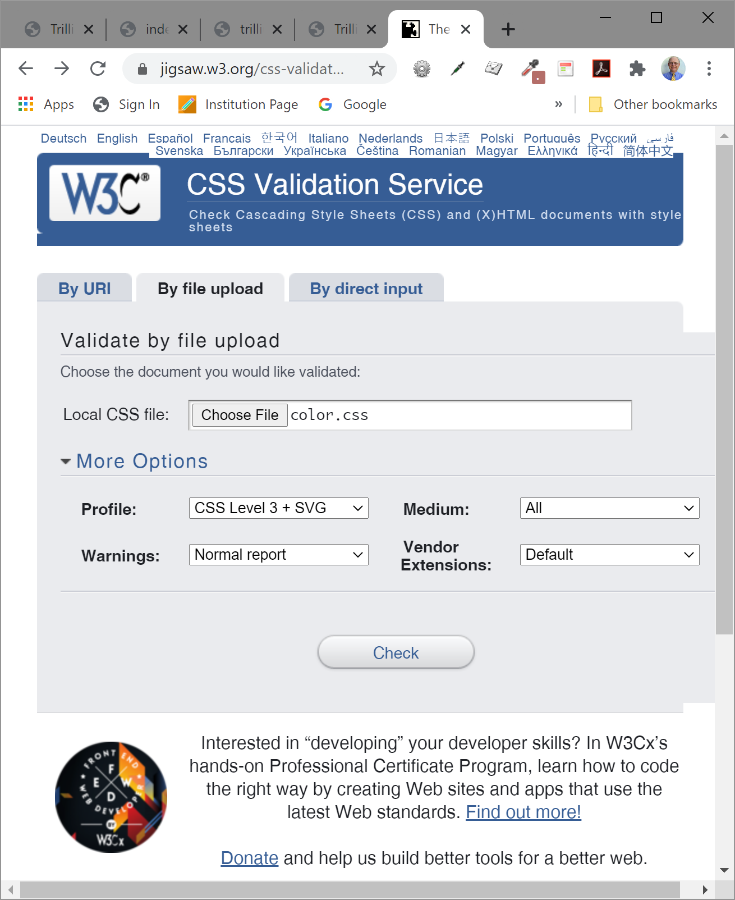
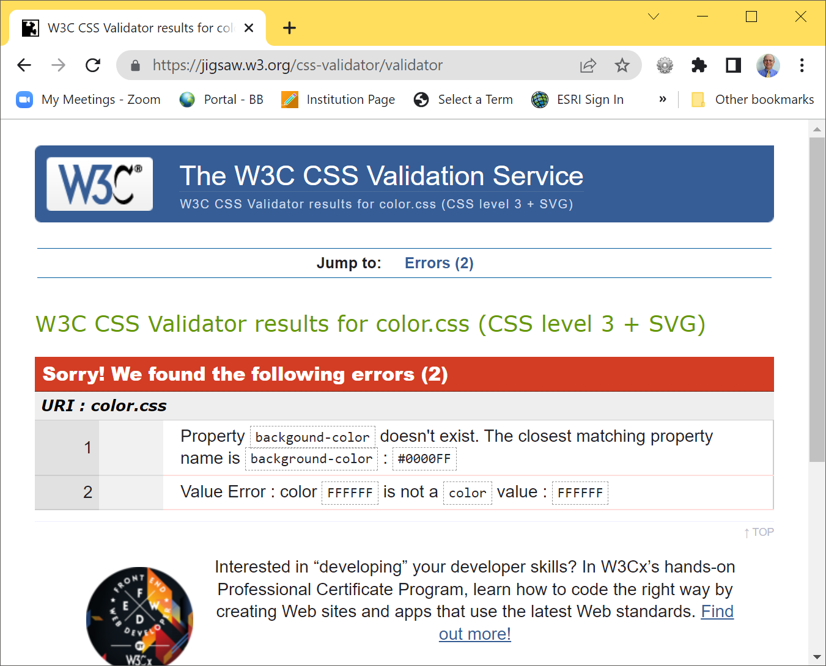
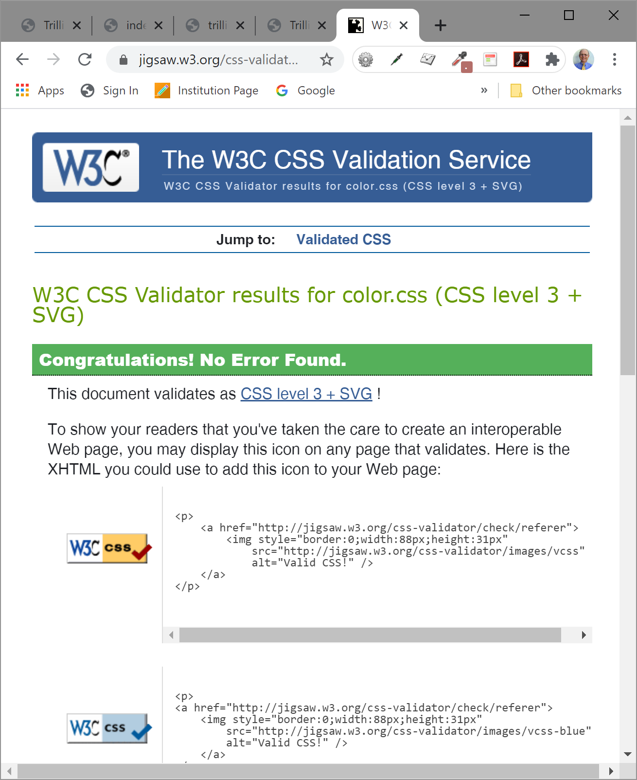
W3C CSS Validation
It is a good practice to validate your CSS style rules using the tool here
http://jigsaw.w3.org/css-validator/
Validate color.css from HOP 3.7=>
HOP 3.11
body { background-color: #0000FF;
color: #FFFFFF;} =>
by removing symbols in red
and see two errors are displayed
<= circle it in each project =>

Slide 82
CSS Troubleshooting Tips p.93-94
1. Verify you are using the : and ; symbols in the right spots - they are easy to confuse.
2. Check that you are not using = signs instead of : between each property and its value
3. Verify that the { and } symbols are properly placed
4. Check the syntax of your selectors, their properties, and property values for correct usage.
5. If part of your CSS works, and part doesn’t:
Review your CSS
Determine the first rule that is not applied. Often the error is in the rule above the rule that is not applied.
6. Validate your CSS at http://jigsaw.w3.org/css-validator
<style>
body { background-color: #000000;
color: #FFFFFF;
font-family:Arial,sans-serif;
}
</style>

Slide 83
Design Guidelines – Getting Started
A. Review the design of the Web page
1. Configure global font and color properties for the body selector
2. Identify typical elements (such as <h1>, <h3>, and so on) and declare style rules for these if needed.
3. Identify page areas such as logo, navigation, footer, and so on – configure an appropriate class or id for each.
B. Create one prototype page that contains most of the elements you plan to use and test.
Revise your CSS as needed.
Once your design is set – move styles to an external .css file
C. Planning and testing are important activities when designing a Web site

Slide 84
CSS Design Strategies(1)
1. Always include end tags (even though browsers usually display the page, anyway) for all HTML container tags.
2. Design and code the page to look "OK" or "Acceptable" -- then use style sheets for extra-special effects and formatting.
3. Use style sheet components that will degrade gracefully for other browsers
4. Check the compatibility charts and test, test, test, test, test....
Use the W3C CSS Validator – http://jigsaw.w3.org/css-validator

Slide 85
CSS Design Strategies(2)
5. Use <div> and <span> tags to create logical page sections.
6. Use style sheets in Intranet environments -- you know exactly what browsers your visitors will be using.
7. Consider using a browser detection JavaScript (discussed in Chapter 14) to test for a specific browser and link to the style sheet coded specifically for that browser.

Slide 86
Summary
This chapter introduced you to Cascading Style Sheet Rules associated with color and text on web pages.
You configured inline styles, embedded styles, and external styles.
You applied CSS style rules to HTML, class, and id selectors.
You are able to submit your CSS to the W3C CSS validation test.
5. There is much more that you can do with CSS –
positioning,
hiding and
showing page areas,
formatting margins,
formatting borders, etc.
6. As you continue your study of web development in future courses you will study these additional uses.
To learn more now about CSS check out the tutorials at http://echoecho.com/css.htm, http://www.mako4css.com, or the W3C site for official specifications.

Slide 87
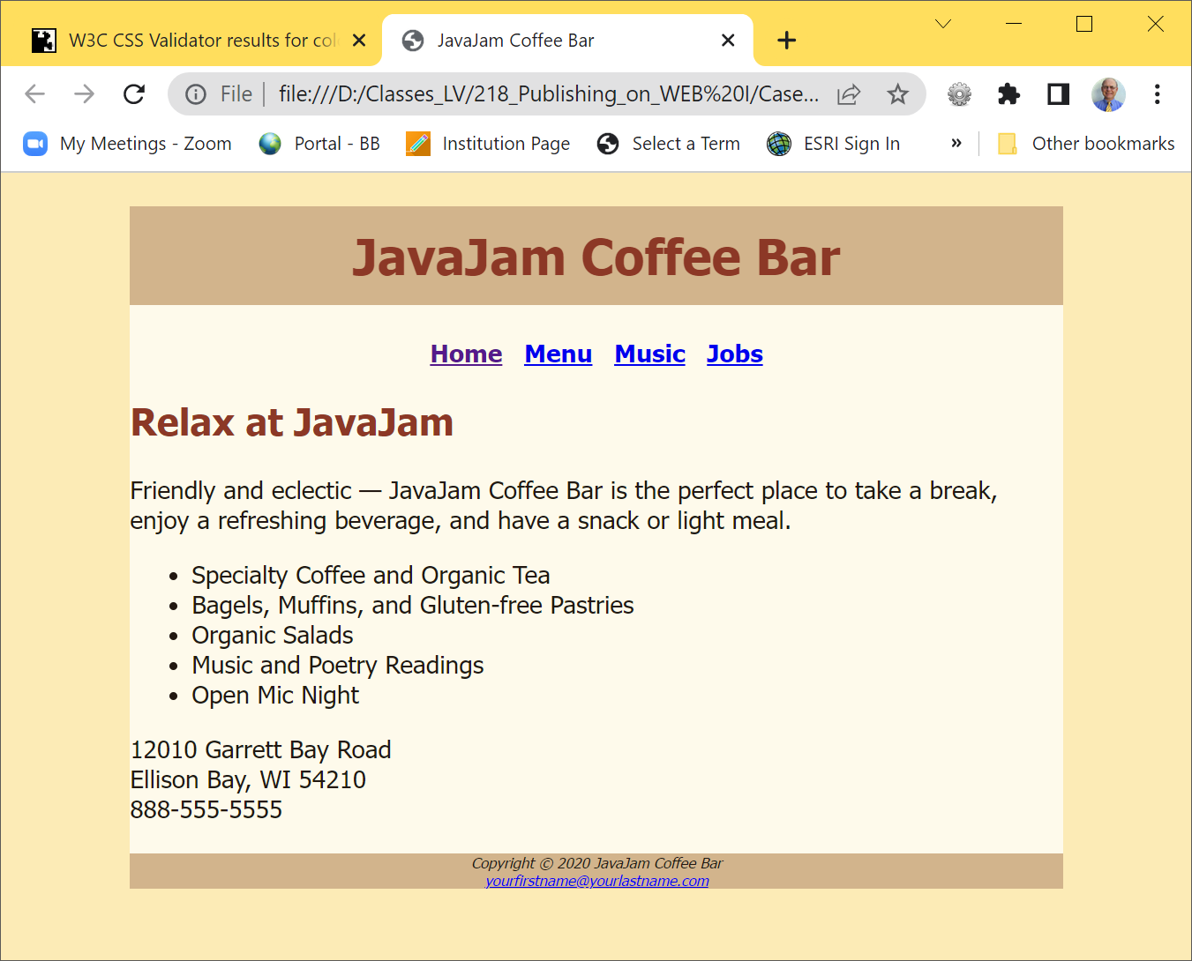

Project chapter 3 Java Coffe House
Goal: create a new version of Project ch2 that uses an external CSS styles to configure text and color.
Read the specification on page 125-127.

Slide 88


Project chapter 3 Pacific Trails Resort
Goal: create a new version of Project ch2 that uses an external CSS styles to configure text and color.
Read the specification on page 130.

Slide 89


Project chapter 3 Path of Light Yoga Studio
Goal: create a new version of Project ch2 that uses an external CSS styles to configure text and color.
Read the specification on page 132-135.

Slide 90


Project chapter 3 Fish Animal Hospital
Goal: create a new version of Project ch2 that uses an external CSS styles to configure text and color.
Read the specification on page 125.

