Slide 1
Learning Outcomes
HOP 4.1
Configuring Lines and Borders
HOP 4.2
Configuring Lines and Borders (Continued)
HOP 4.3
Image Element
HOP 4.4
Image Element
HOP 4.5
HTML5 Visual Elements
HOP 4.6
HTML5 Visual Elements
HOP 4.7
Background Images

Slide 2
Chapter 4
Visual Elements
And
Graphics
Part I
Credits: © 2011 - 2022 Pearson Education
Copyright (c) 2011 Prentice-Hall. All rights reserved.

Slide 3

Learning Outcomes
In this chapter, you will learn to how to:
Create and format lines and borders on Web pages
Create and format horizontal lines on web
Decide when to use the most appropriate types of graphics on web pages
Use the image tag to add graphics to web pages
Use images as backgrounds on tables and web pages
Use images as hyperlinks
Configure visual effects with CSS3 including multiple background images, rounded corners, box shadow, text shadow, opacity, and gradients
Configure RGBA and HSLA color with CSS3
Use HTML5 elements to caption a figure
Use the HTML5 meter and progress elements
Find both free and fee-based sources of graphics
Follow recommended web design guidelines when using graphics on web pages

Slide 4

Hands-On Practice
HOP 4.1
Follow the directions in your book for the HOP.
START-UP File | chapter4/starter1.html
SAVE SOLUTION AS | hr.html

Slide 5
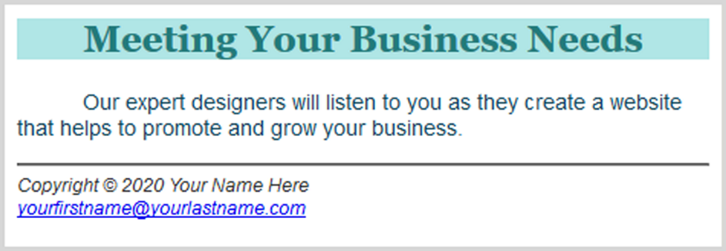
HTML <hr> tag p.138
Horizontal Rule - stand alone tag XHTML:<hr /> HTML :<hr>
straight line that goes from the left to right side of screen
Is used alone
An empty tag
Useful for dividing a web page into sections but a more modern technique is to use CSS to configure a border for elements.
Design Hint: when tempted to use an <hr > tag,
try adding more blank space around the web page elements
often this will result in a less cluttered, better designed web page.
Common Attributes:
color, width, align, size, noshade
Noshade – indicator of shading
e.g. <hr noshade=“noshade” >

Slide 6
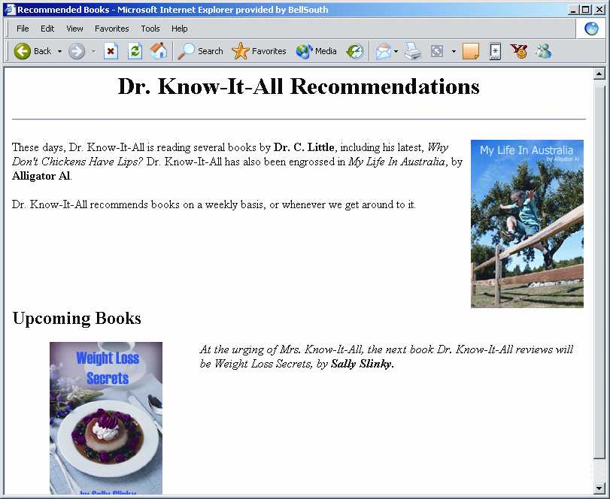
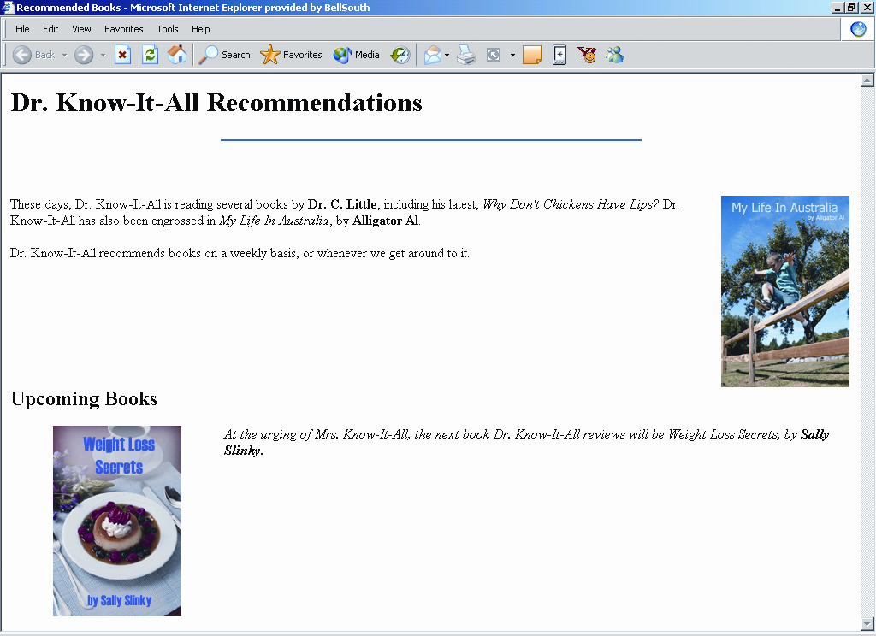
Effects of Horizontal Rule Attributes
Grey bar displays as a result of <hr>
Unshaded, shorter, blue bar displays as a result of
<hr width="50%" noshade="noshade" color="blue”>
Copyright (c) 2006 Prentice-Hall. All rights reserved.
6

Slide 7
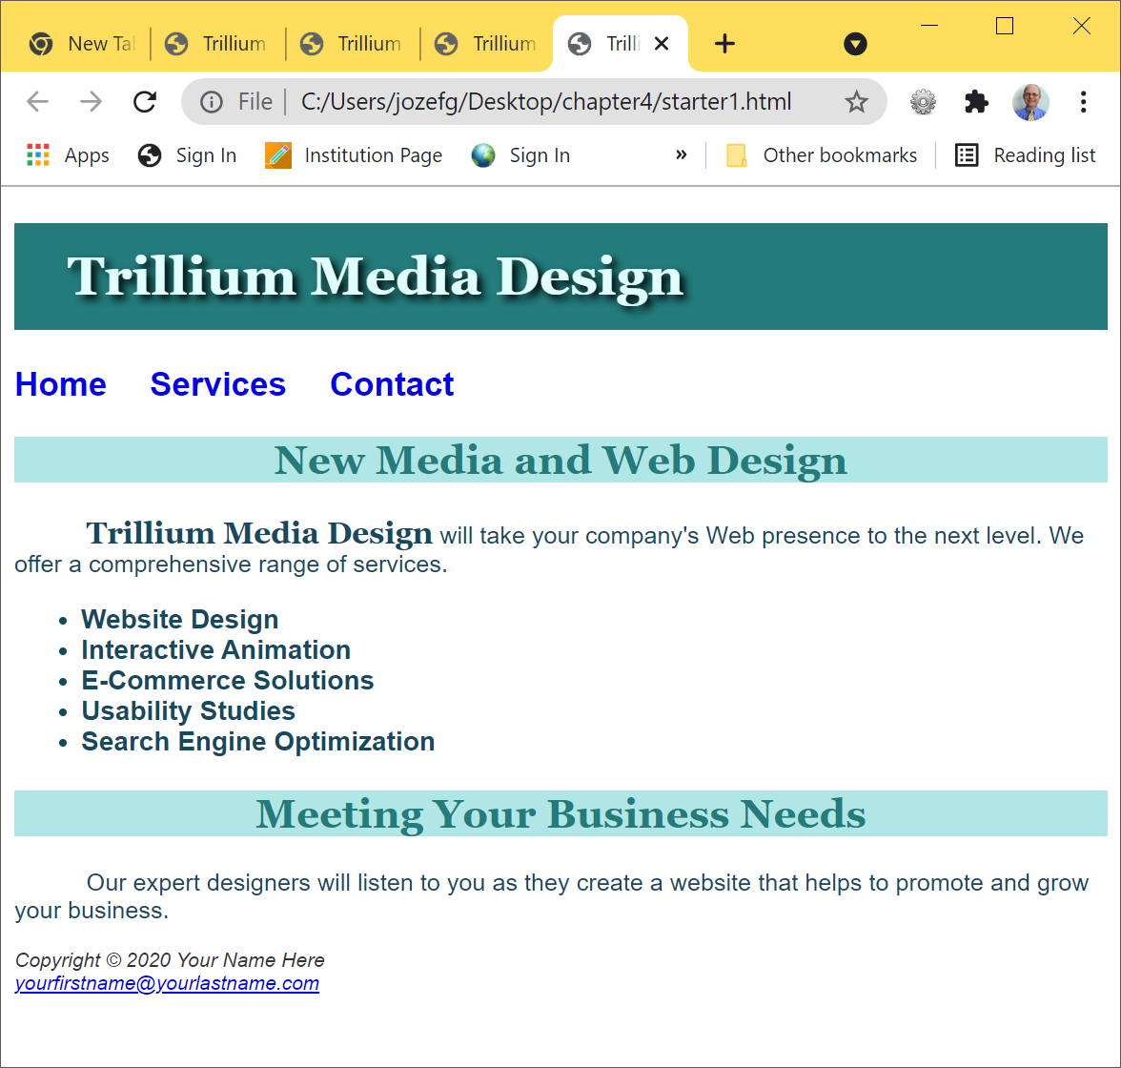
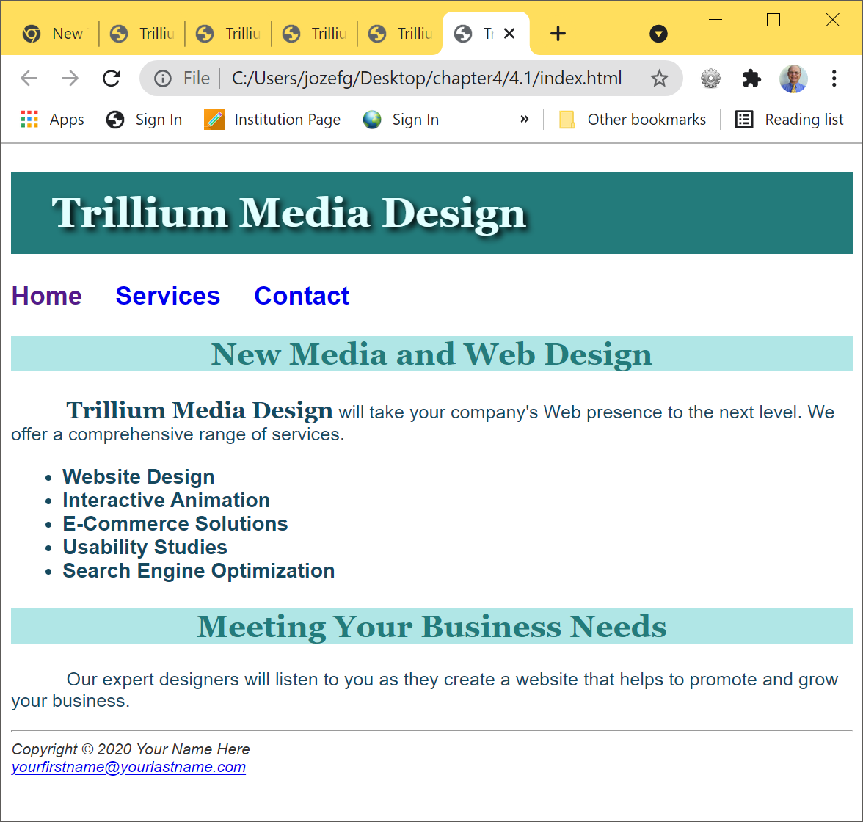
HOP 4.1 – a horizontal line
starter1.html => result: hr.html

Slide 8
The CSS border Property p.139-142, p.653
Configures a border surrounding an element
- on the top, right, bottom, and left sides of an element
border: 3px,solid,#000000
Consists of
border-width: 3px or thin, medium, thick
border-style: none or double, groove, inset, ridge, solid, dashed, dotted, hidden
border-color:#444444, RGB or color name
Ex:
.dashedborder { border-width:3px;
border-style:dashed;
border-color:#000066;}
A shorthand notation:
.dashedborder { border:3px dashed #000066;}

Slide 9
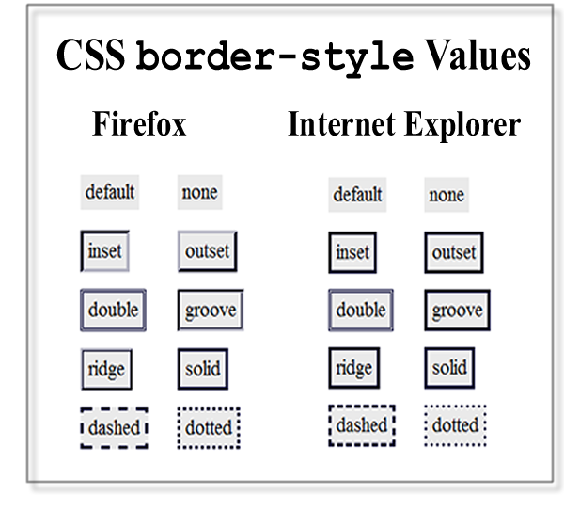


Browser Display Can Vary p.139
border-style:
By default, the border has a width = 0 and doesn’t display a border but it displays a rectangle box.
.dashedborder{border-width: 3px;
border-style: dashed;
border-color: #000033;}

Slide 10

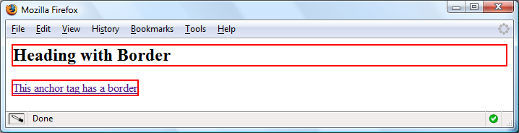
CSS Borders: Block / Inline Elements
Block element
default width of element content extends to browser margin (or specified width)
h2 { border: 2px solid #ff0000; }
Inline element
Border closely outlines the element content
a { border: 2px solid #ff0000; }

Slide 11

Configuring Specific Sides of a Border p.141
Use CSS to configure a line on one or more sides of an element
border-top
border-right
border-bottom
border-left
configure individual settings:
h2 {border-bottom:2px solid #ff0000 }
h2 { border: 2px solid #ff0000 }

Slide 12

The CSS padding Property p.141-142, 653
Configures empty (blank) space between the content of the HTML element and its border
Set to 0px by default
h2 { border: 2px solid #ff0000;
padding: 5px; } //all sides of the element
No padding configured:

Slide 13
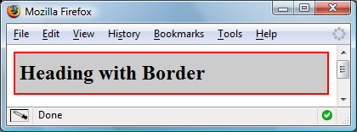
Configuring Padding on Specific Sides of an Element
The values configure the padding
padding-top
padding-right
padding-bottom
padding-left
h2 { border: 2px solid #ff0000;
background-color: #cccccc;
padding-left: 5px;
padding-bottom: 10px;
padding-top: 10px;}

Slide 14
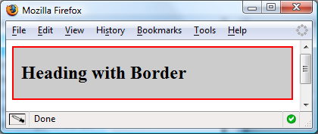

CSS padding Property Shorthand: 2 values
Two numeric values or percentages configure as follows:
first value configures top and bottom padding
the second value configures left and right padding
h2 { border: 2px solid #ff0000;
background-color: #cccccc;
padding: 20px 10px;
}

Slide 15
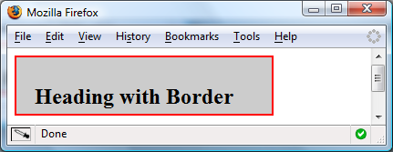
CSS padding Property Shorthand: 4 values
Four numeric values or percentages
configure as follows: (1) top, (2) right, (3) bottom, and (4) left padding
(1)
(4) (2)
(3)
h2 { border: 2px solid #ff0000;
width: 250px;
background-color: #cccccc;
padding: 30px 10px 5px 20px;
}

Slide 16
Hands-On Practice
HOP 4.2
Follow the directions in your book for the HOP.
START-UP File | chapter4/starter1.html
SAVE SOLUTION AS | border.html

Slide 17
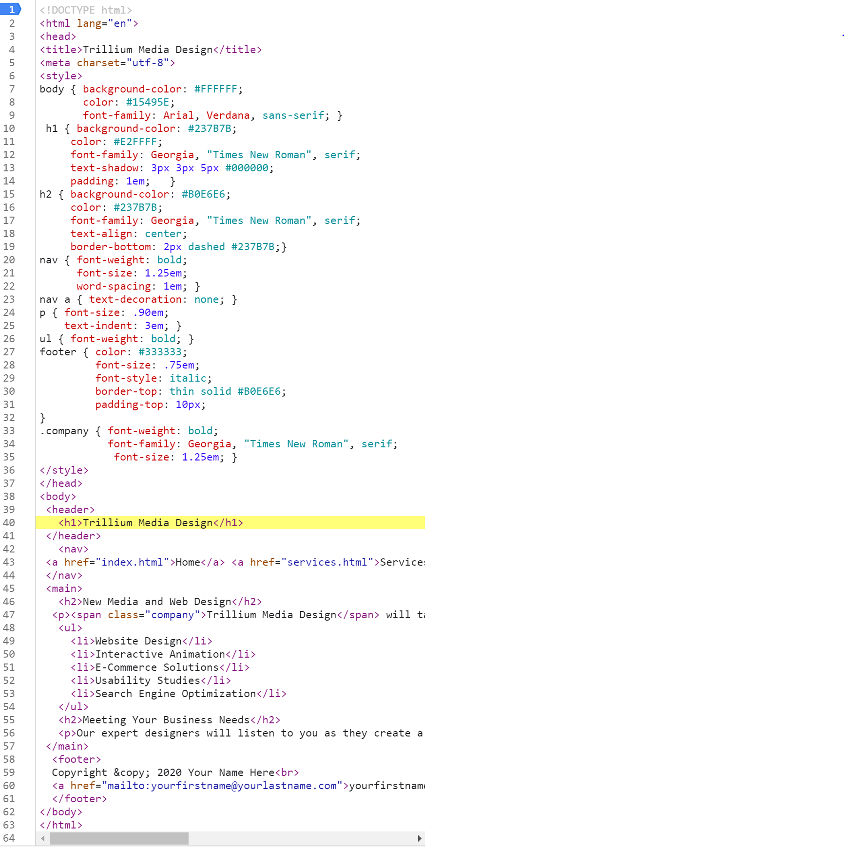
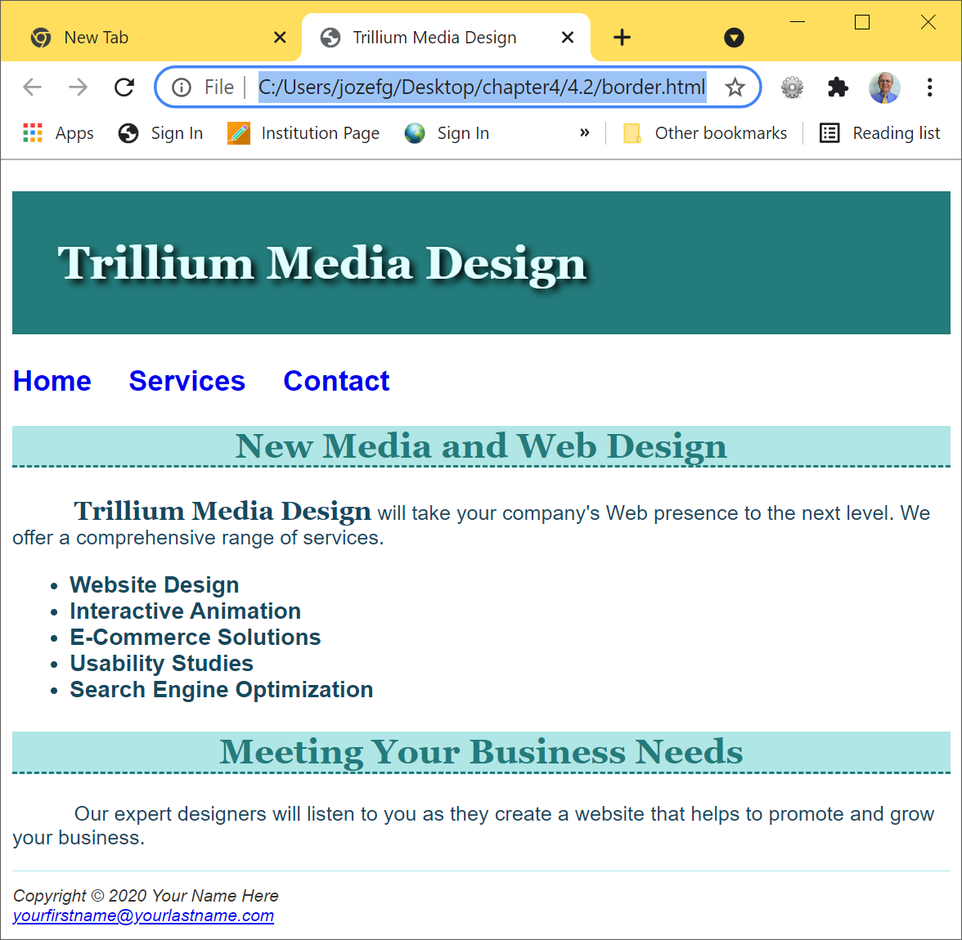


HOP 4.2 – border and padding
=>Use “inspect element” to see padding
HOP 4.2
starter1.html => border.html

Slide 18
Checkpoint 4.1
1. Is it reasonable to try to code a web page that looks exactly the same on every browser and every platform? Explain your answer.
It is reasonable to look similar on various browser and OS =>see previous slide
And look best on browser and OS most used by their visitors
2. When a Web page containing the style rules below is rendered in a browser, the border does not display. Describe what is incorrect with the following code:
h2 { background-color: #ff0000
border-top: thin solid #000000}
Missing ;
3. True or False? CSS can be used to configure visual elements such as rectangular shapes and lines on Web pages.
True. CSS can be used to configure color, text, rectangular shapes, lines etc.

Slide 19
Types of Graphics p.144
Browsers render Web page docs and standard images in order from top to bottom
the top of a standard image begins to display after 50% of the image has been read by a browser
Graphic types commonly used on web pages:
GIF
JPEG
PNG

Slide 20
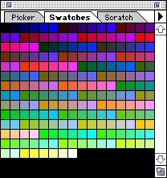
GIF
Graphics Interchange Format: Pronounced “jif,” not “gif”
Best used for line art, line drawings, simple images and logos
Uses indexed color for each pixel
Maximum of 256 colors
256 colors (8 bit), but you can only use 216
1. Graphic File Optimization –
balancing image quality (# of colors used) and
file size
It can be used Adobe Photoshop or GIMP (gimp.org) to optimize the Image for the Web

Slide 21
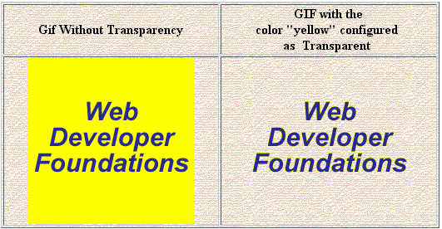
GIF
2. One color can be configured as transparent
3. Can be animated
animation: contain a GIF file that consists of several images of frames each of which is slightly different
Adobe Fireworks, Adobe ImageReady
4. When a GIF file is saved, lossless compression is used
Nothing in the original image is lost when rendered by a browser
- Display 2 images on a textured background
Background color – no transparency

Slide 22

GIF
5. Can be an interlaced GIF
To illuminate a screen by displaying all odd lines in the frame first and then all even lines. Interlacing uses half frames per second (fields per second) rather than full frames per second.
The interlace method was developed for TV broadcasting because the allotted bandwidth for TV channels.
Image progressively displays and seems to fade (appears fuzzy) in as it downloads
first 13% then 25% of the image is displayed and so on.
Works best for flat color, sharp-edged art (stuff that looks like clip art)
flat-color: (1) Any color created
by printing only one ink,
as compared to a color created
by printing four-color process.
Also called block color and spot color.
(2) color that seems weak or lifeless.

Slide 23
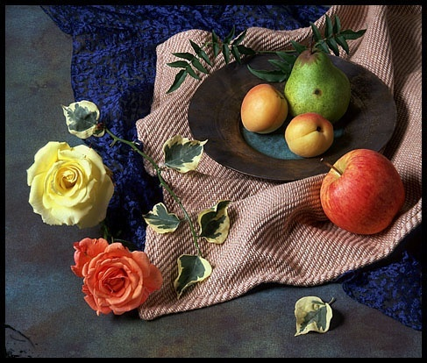
JPEG
Joint Photographic Experts Group
Best used for photographs
Up to 16.7 million colors
Cannot be made transparent
Cannot be animated
Uses lossy compression
The more times you save a JPEG file, the worse it looks b/c some pixel are removed, even at the lowest compression
more compression will have lower quality
7. Graphic File Optimization – tradeoffs between the image
quality (# of colors used) and the amount of compression
Give up quality for size savings
p.133

Slide 24
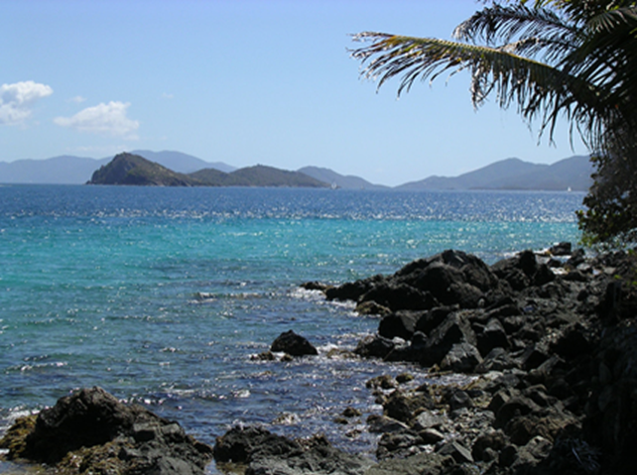
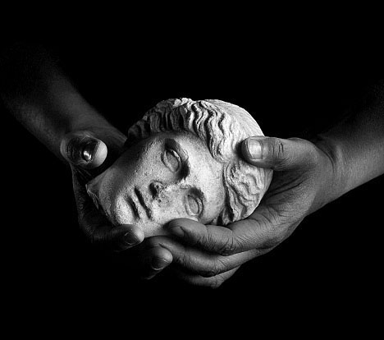
JPEG
Full-color (or gray-scale) images of real-world scenes
Figure 4.7 A JPEG saved at 80% quality (55KB file size) displays well on a web page
Doesn’t do very well on flat-color art (like clip art)
Available progressive JPEG (when a file is created) – similar to an interlaced GIF and seems to fade in as it downloads

Slide 25
GIFs vs JPEGs
GIFs
216 Colors
Lossless
Best for flat-color art
JPEGs
16,777,216 colors
Lossy
Best for full-color images of real-world scenes

Slide 26
PNG
Portable Network Graphic - PNG
Support millions of colors
Support multiple levels of transparency
but browsers do not -- so limit to one transparent color for Web display
the native file format of some applications, such as Adobe Fireworks
Support interlacing
Use lossless compression
Combines the best of GIF & JPEG
Browser support is growing

Slide 27
WebP
Google’s new WebP (weppy) – currently used by Chrome, Android and Opera
Offers improved file compression over other types of images used on the Web https://developers.google.com/speed/webp/
Supports millions of colors
Supports transparency and animation but not interlacing
Uses both lossy and lossless compression
Intended to provide improved compression for GIF and JPG images
Browser support is growing
See table 4.2 p.146

Slide 28
Attributes of HTML <img> tag p.147, 648
The image tag <img>(stand alone tag), XHTML: <img />
Used to place graphics on a web page
src attribute (vs longdesc long description attribute)
used to indicate the file name of the graphic
specifies file where image comes from
alt attribute
used to configure a text description (label)
align=“left”|”right”|”center”|”bottom”|” top”|“middle”
controls the relationship of text and images.
vspace
adds vertical space to image (above and below).
hspace
adds horizontal space to image (left and right)
height attribute
used to configure the height of the image in pixels
width attribute
used to configure the width of the image in pixels
border attribute
allows a surrounding border.
clear attribute
separates image from text
id text name, alphanumeric, the value must be unique
<img src=“cake.gif” alt=“birthday cake” height=“100” width=“100”>
Important commonly used: 1, 2, 6, 7

Slide 29
1. src - Identifying Location of an Image
Path – specific directory location of the image file
Specify local directory – if image in the same directory as Web page
<img src="picture.gif" >
Specify remote directory – if an image in a different folder on same machine as Web page
<img src="images/picture.gif" >
Specify Web URL – if an image on a different computer on the Internet
<img src=http://www.web-nswers.com/images/picture.gif>
29
Notes:
29
Here, you can discuss the importance of arranging your Web site so that images go into a common folder. This will be discussed in more detail in a future project, but point out to students here that the notion of a "remote directory" on the same machine is very common practice for storing the collection of images used throughout a Web site.

Slide 30
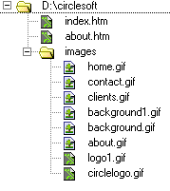


Organizing Your Web
Best Practice: Place images in their own folder in order to separate from your Web pages
Code the path to the file in the src attribute
<img src=“images/home.gif” alt=“Home” height=“100” width=“200”/>

Slide 31
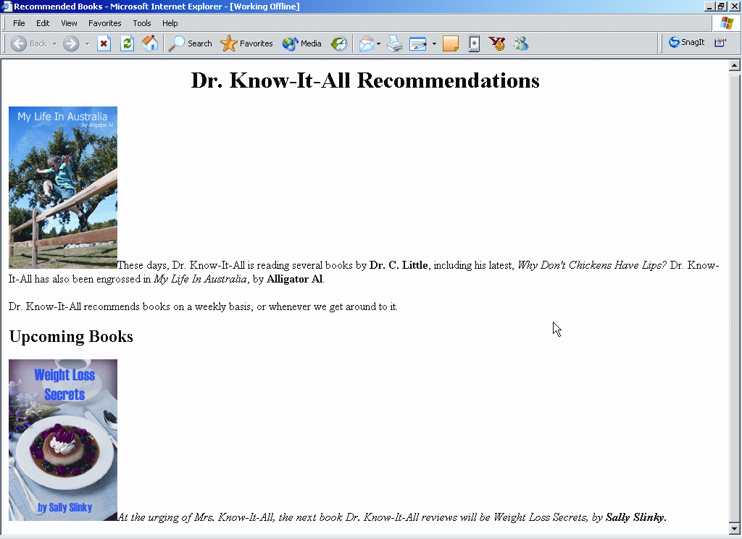
Effects of <img> and src
Image generated by
<img src="book1.jpg“ >
Image generated by
<img src="book2.jpg" >
No path needed if .jpg file is in same location as Web page
Copyright (c) 2006 Prentice-Hall. All rights reserved.
31

Slide 32
2. Why Use Alternate Text?
Bandwidth – is related the speed of a user’s connection to the Internet.
Images take a long time to load
Some users turn off images in their browser (cell phones)
alt attribute written as alt=“text” displays:
alternate text if images are turned off
text as tool tip associated with an image when mouse hovers over an image
32

Slide 33
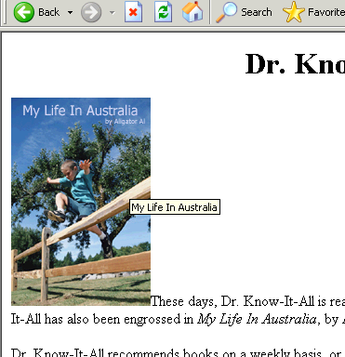

2. Effects of Setting Alternate Text
Tool tip text appears
<img src="book1.jpg" alt="My Life In Australia" />
This takes place when user hovers mouse over the image
Copyright (c) 2006 Prentice-Hall. All rights reserved.
33

Slide 34
2. Accessibility & Images
Required:
Configure the alt attribute
Alternate text content to convey the meaning/intent of the image
Used: NOT the file name of the image
Use alt=“” for purely decorative images
Optional:
Configure the longdesc attribute
Used when meaning cannot be conveyed in the alt text
Usually a URL to a Web page with text that contains a detailed text description of the image

Slide 35
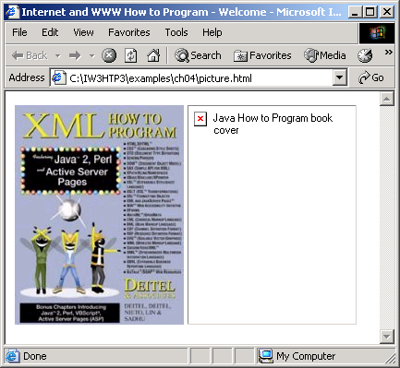

Slide 36
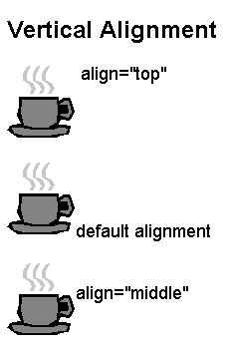

HTML<img> 3. alignment
- controls the relationship of text and images
Vertical Alignment
<img> tag align Attribute
5 possible values:
Top
Bottom
(Default)
Middle
Left
Right

Slide 37
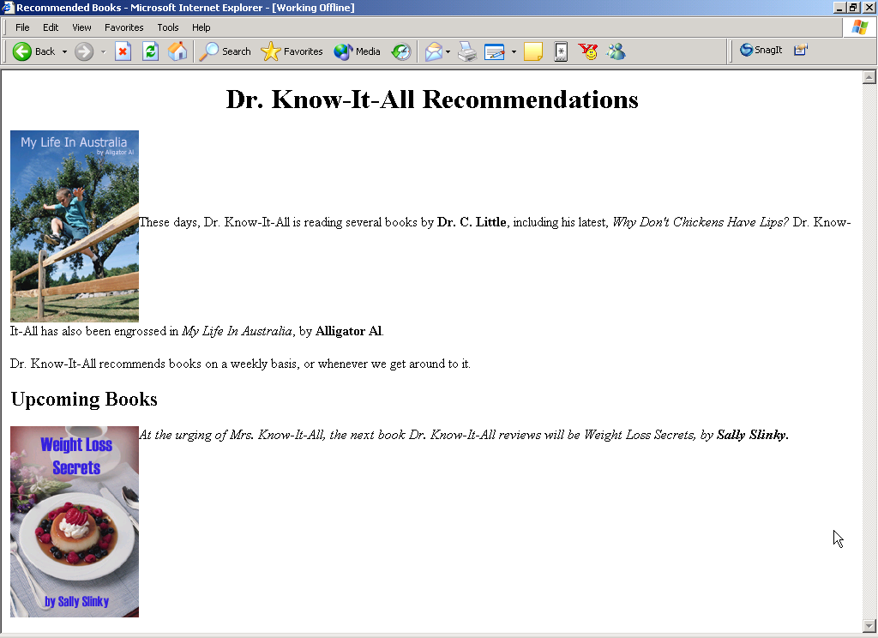
3. Effect of Image Alignment
Middle alignment:
<img src="book1.jpg" align="middle" alt="My Life In Australia" />
Top alignment:
<img src="book2.jpg" align="top" alt="Weight Loss Secrets" />
Copyright (c) 2006 Prentice-Hall. All rights reserved.
37

Slide 38
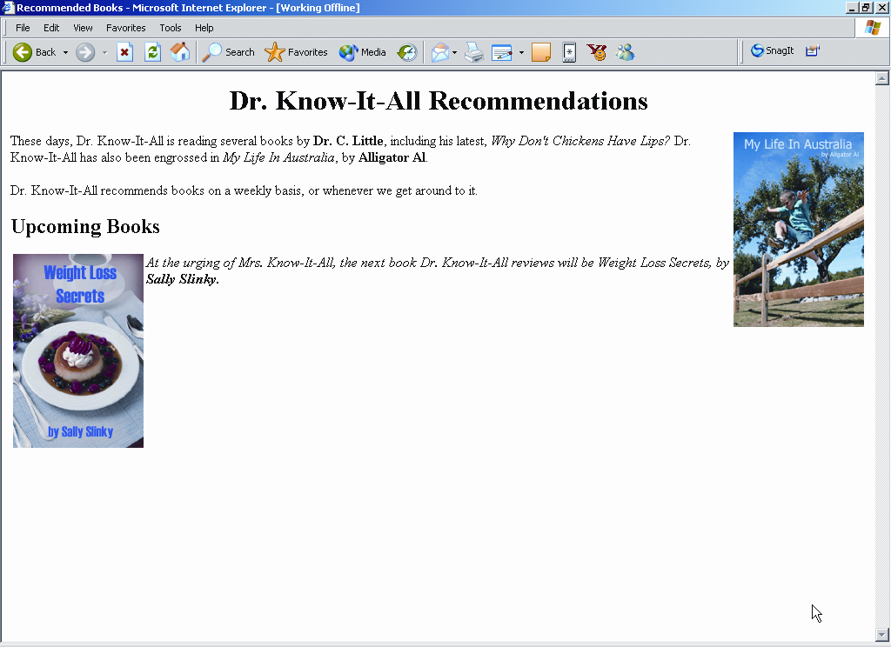
3. Effect of Image Alignment (continued)
Right alignment:
<img src="book1.jpg" align="right" alt="My Life In Australia" />
Left alignment:
<img src="book2.jpg" align="left" alt="Weight Loss Secrets" />
Left and right alignment causes remaining content to wrap around the image
Note that Upcoming Books is at same level as right-aligned image
Copyright (c) 2006 Prentice-Hall. All rights reserved.
38

Slide 39
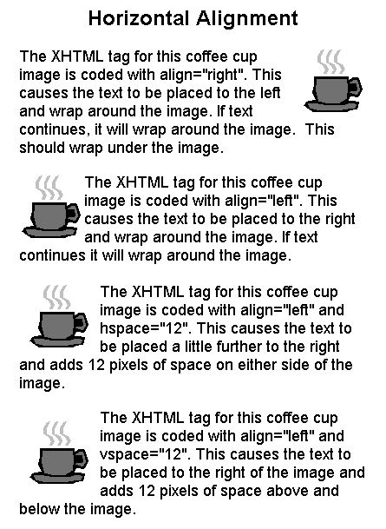
attributes: 4. vspace and 5.hspace
Text aligns to the portion of the image specified by align attribute
e.g. – Top makes text align to the top of the image
<= right, left – text wraps around image
<= Adding Horizontal Space
hspace Attribute
adds horizontal space to image (left and right)
Adding Vertical Space – position the image on the page relative to text
vspace Attribute
adds vertical space to image (above and below)

Slide 40
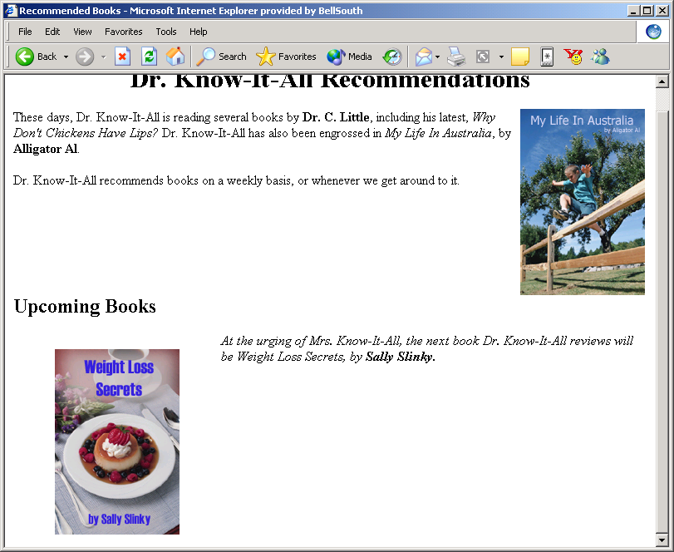



Effect of Vertical and Horizontal Spacing
<img src="book2.jpg" align="left" alt="Weight Loss Secrets" width="150" height="223" vspace="20" hspace="50" />
20 pixels of vertical space above the image
50 pixels of horizontal space to the left and right of the image
40
Note: A more modern approach is to use the CSS padding property
Copyright (c) 2006 Prentice-Hall. All rights reserved.

Slide 41
6. Scaling Images
Resolution – clarity and definition of image
Scaling – reducing or enlarging
Scaling affects image quality
Scaling up results in pixelated image
Can see individual pixels when image is scaled up
Scaling down forces pixels into too small space
Copyright (c) 2006 Prentice-Hall. All rights reserved.
41

Slide 42
6. and 7. Using Image Sizing Attributes
Two <img> attributes
width
height
Specify both pixel sizing
+’s: of using width and height
Saves calculation time for browsers to adjust and shift other elements
Copyright (c) 2006 Prentice-Hall. All rights reserved.
42

Slide 43
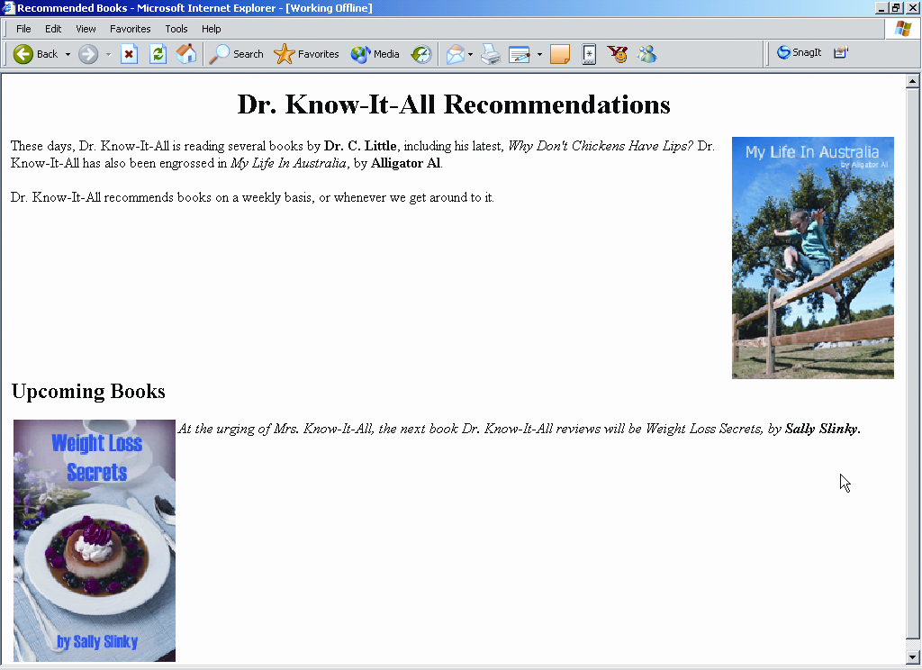
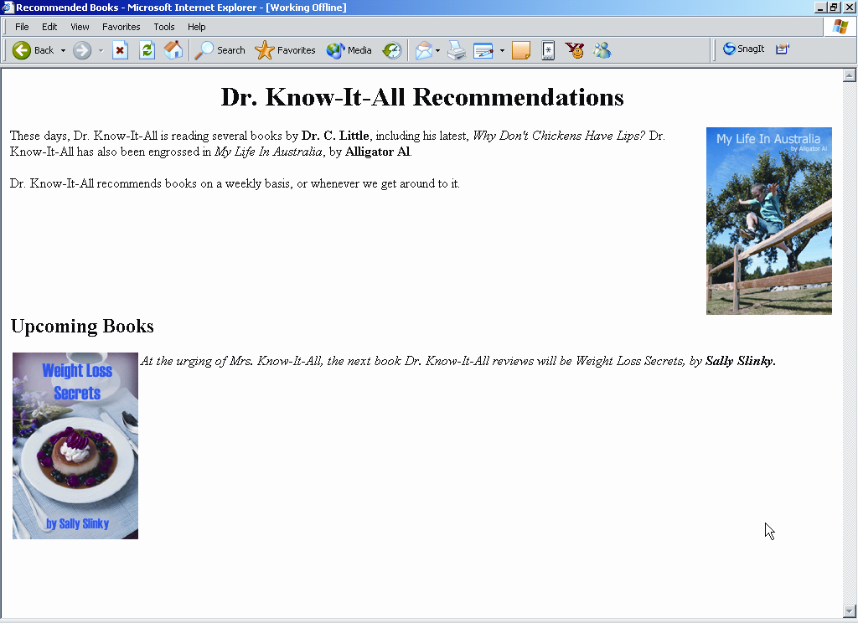


6. and 7. Effects of Image Sizing
<img src="book1.jpg" align="right" alt="My Life In Australia" width="150" height="224" />
<img src="book2.jpg" align="left" alt="Weight Loss Secrets" width="150" height="223" />
Copyright (c) 2006 Prentice-Hall. All rights reserved.
43
Notes:
43
You can demonstrate this more dramatically by scaling to very small and very large sizes.

Slide 44
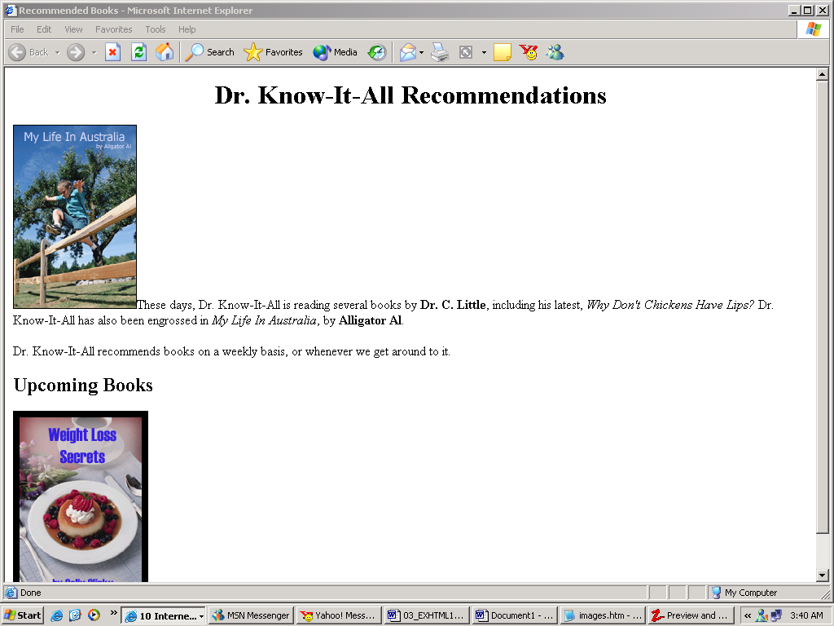
8. Effects of border
One-pixel border
<img src="book1.jpg" border="1" />
Eight-pixel border
<img src="book2.jpg" border="8" />
Copyright (c) 2006 Prentice-Hall. All rights reserved.
44

Slide 45
9. Using the <br> tag's clear Attribute
By default, text displays next to an image
The clear attribute can separate image from text
Syntax options
<br clear="right" > – forces text to move down the page until there are no more images on the right
<br clear=“left" > – forces text to move down the page until there are no more images on the left
<br clear="all" > – forces text to move to section with nothing on either side
45
Copyright (c) 2006 Prentice-Hall. All rights reserved.

Slide 46
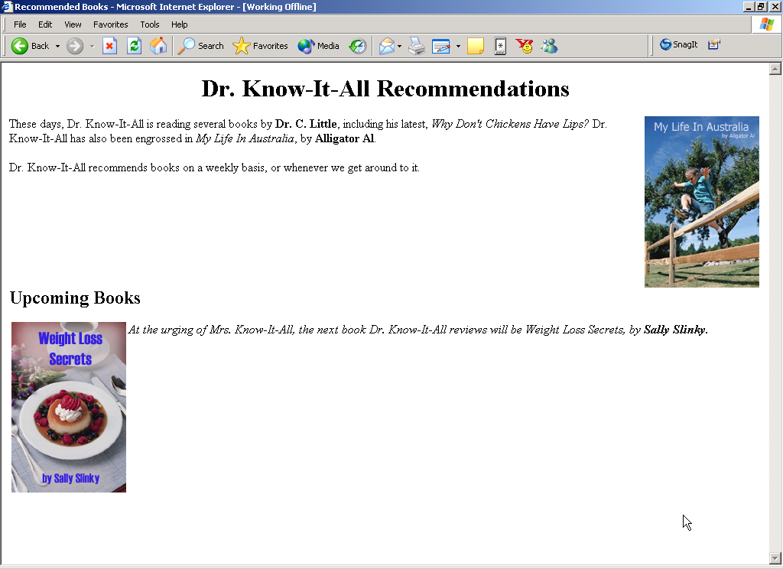

Effect of Clear Attribute
Force Upcoming Books header to appear below right-aligned image:
<br clear="right“ >
<br clear="right“> – forces text to move down the page until there are no more images on the right
Copyright (c) 2006 Prentice-Hall. All rights reserved.
46

Slide 47

Image Links
To create an image link use an anchor tag to contain an image tag
<p><a href="URL path to external link" title="Mouseover Description"><img style="width: XXpx; height: YYpx; border: 0;" src=“path to the img location/img name" alt="Text Description"></a></p>
Browsers automatically add a blue border
to image links.
or configure CSS to eliminate the border img {border:none}
Home
<a href="index.html"> <img src="home.gif" height="19" width="85" alt="Home"></a>
<img src=“dog.jpg” alt=“Dog at computer” height=“100” width=“100”>
<a href="index.html"> <img src="home.gif" height="19" width="85" alt="Home“ border=”0”></a>

Slide 48
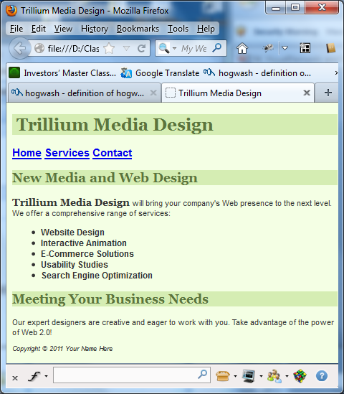

Image links
</header>
starter2.html => index.html

Slide 49
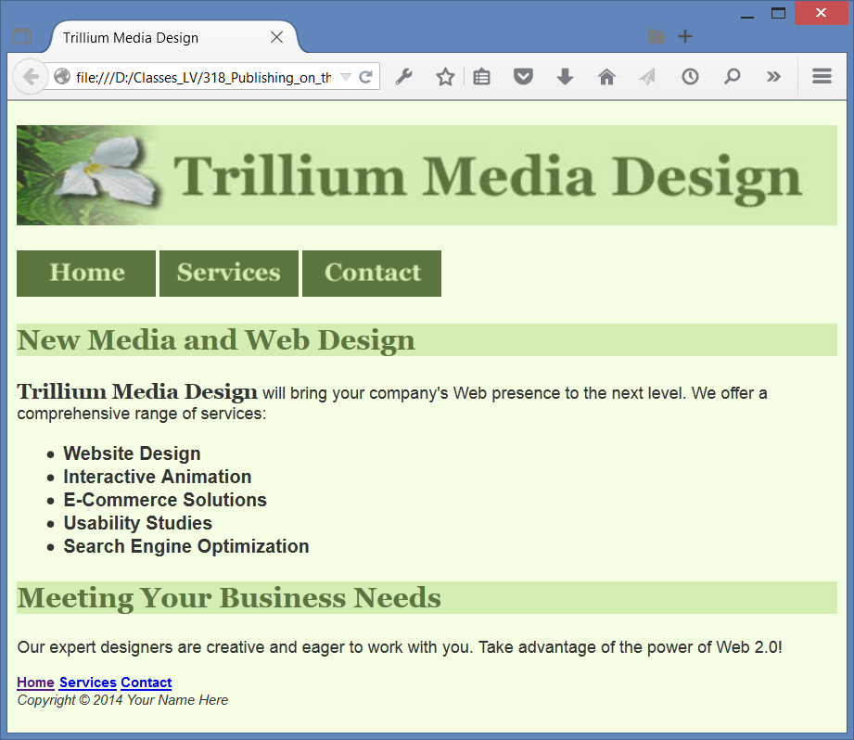
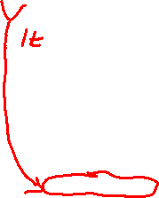

Add image links
index.html
Needed:
index.html
trillinmbanner.jpg
home.gif
services.gif
contact.gif
=> index.html
<nav> <a href="index.html"> <img src="home.gif" alt="Home" width="120" height="40" > </a>
1. Move down the text base navigation
2. Have h1 { height: 86px; }
3. Modify nav for size to .75em
4. Add a new style rule to CSS: img {border-style:none}
5. Implement a minimum width for the page = 700px
body{ min-width: 700px;}
6.
footer { font-size: .75em; font-style: italic;}
Recommended:
If your site navigation uses image links for the main navigation, provide simple text links at the bottom of the page.

Slide 50
Hands-On Practice
HOP 4.3
Follow the directions in your book for the HOP.
START-UP File | chapter4/starter2.html
SAVE SOLUTION AS | index.html

Slide 51
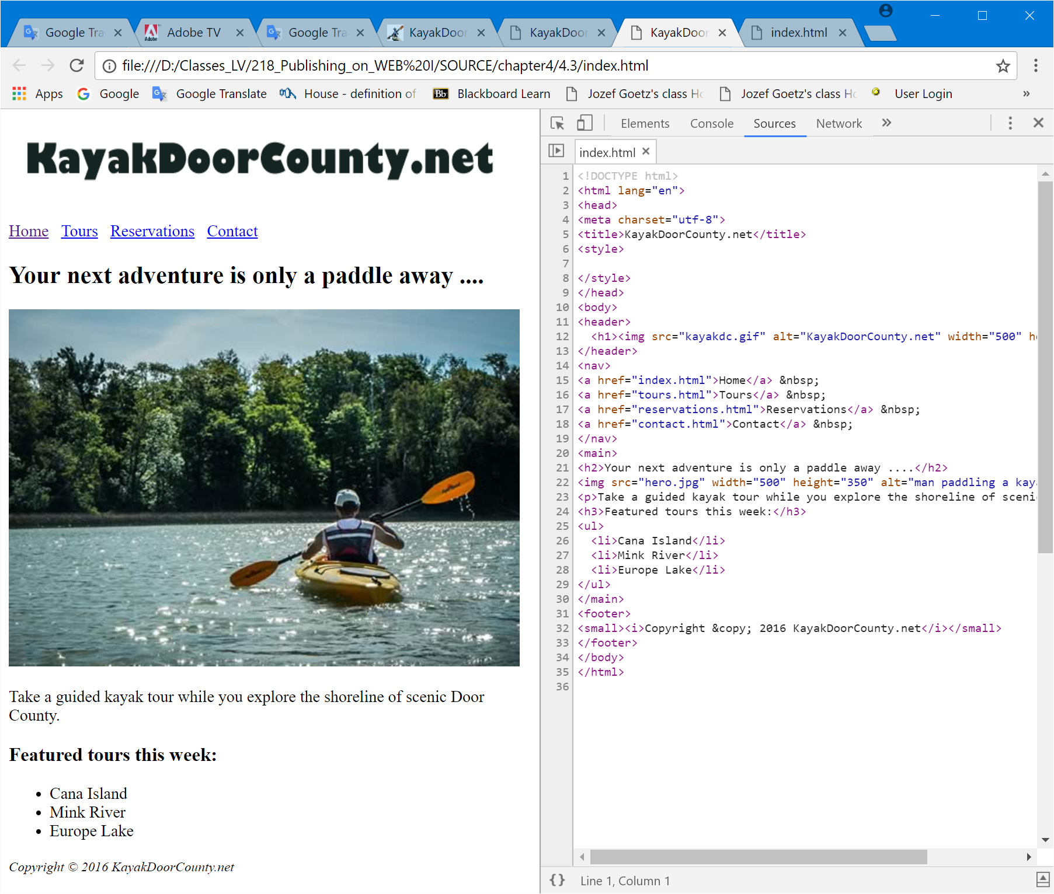

HOP 4.3 – image and text based navigation

Slide 52
Hands-On Practice
HOP 4.4
Follow the directions in your book for the HOP.
START-UP File | kayakch4 folder chapter4/starters
SAVE SOLUTION AS | index.html

Slide 53
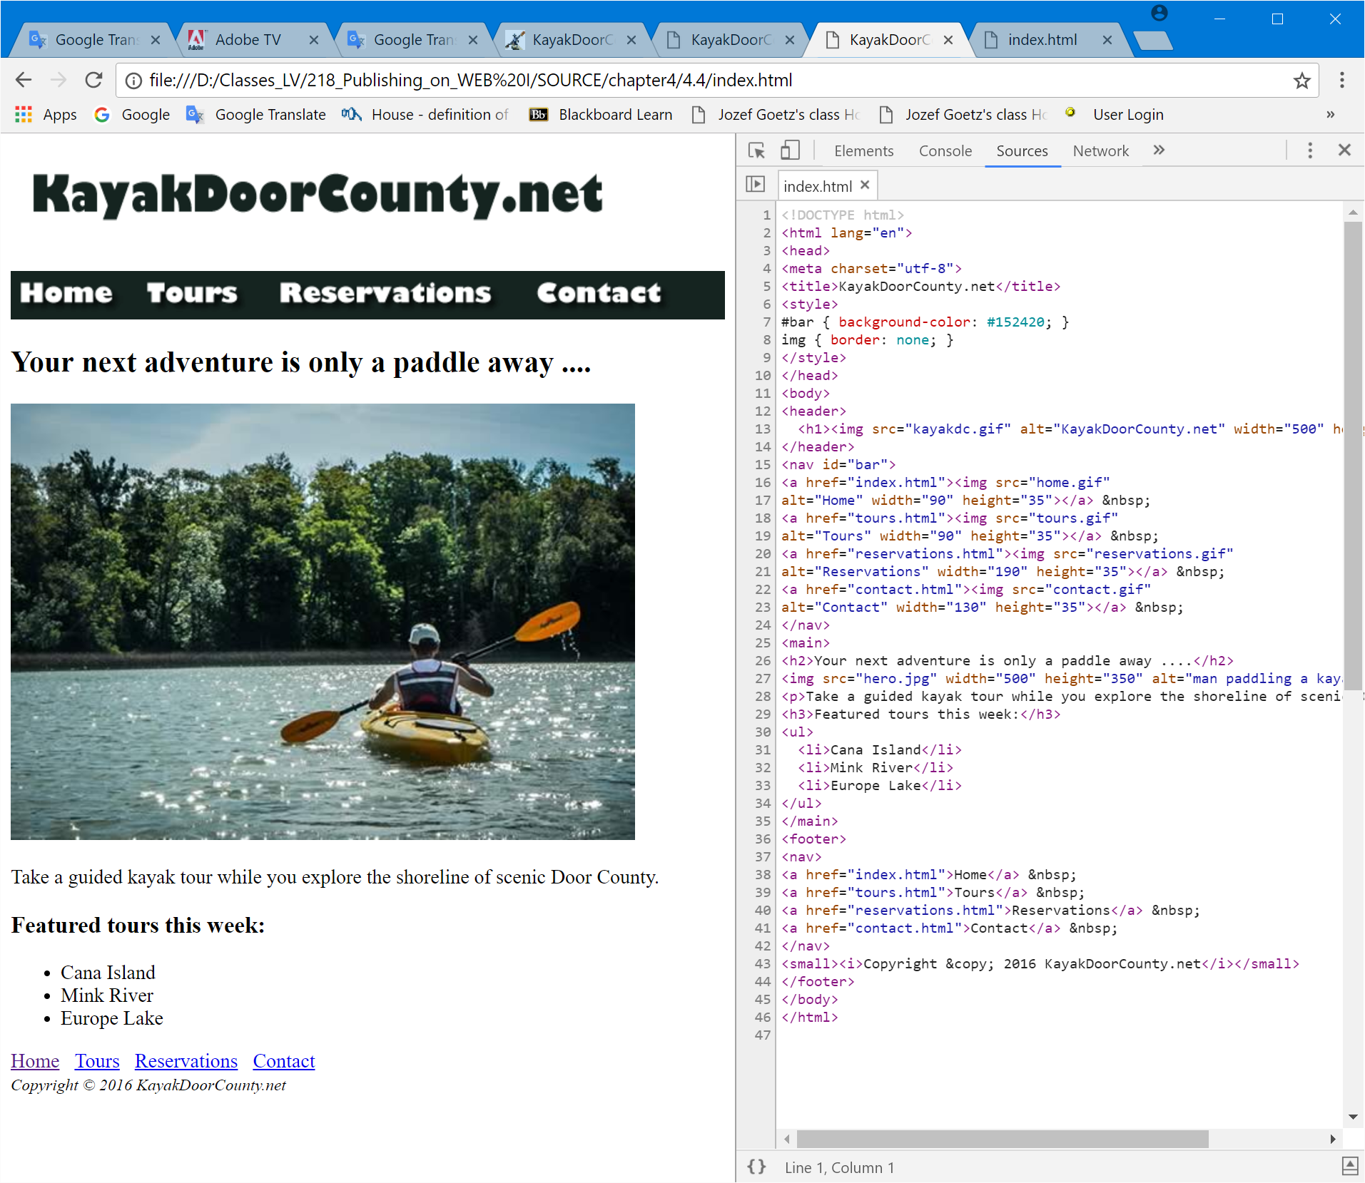


HOP 4.4 – image based navigation
<= text based navigation
moved from HOP 4.3

Slide 54
Design Tips + FAQ p.151
Design for the browser you think most of your visitors will use
Design the page so that is “degrades gracefully” (looks OK) in other browsers
The W3C recommends to use the hex numeric values rather than the color name
GIMP http://gimp.org is popular open-source image editor that supports OS multiple platforms

Slide 55
Choosing Names for Image Files p.151
1. Use all lowercase letters
2. Do not use punctuation symbols and spaces
3. Do not change the file extensions (should be .gif, .jpg, .jpeg, or .png)
4. Keep your file names short but descriptive
i1.gif is probably too short
myimagewithmydogonmybirthday.gif is too long
dogbday.gif may be just about right

Slide 56
Optimize An Image for the Web
Image Optimization
Reduce the file size of the image
Reduce the dimensions of the image to the actual width and height of the image on the web page.
Image Editing Tools:
GIMP https://www.gimp.org/ (FREE!)
Adobe Photoshop
Pixlr
https://pixlr.com/x/ (FREE!)

Slide 57
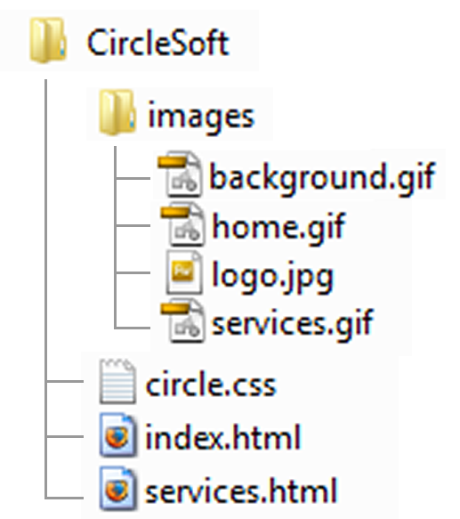
Organizing Your Site
Place images in their own folder
Code the path to the file in the src attribute
In index.html and services.html:
<img src=“images/home.gif” alt=“Home” height=“100” width=“200”>

Slide 58
Hands-On Practice
HOP 4.5
Follow the directions in your book for the HOP.
START-UP File | myisland.jpg
SAVE SOLUTION AS | index.html

Slide 59
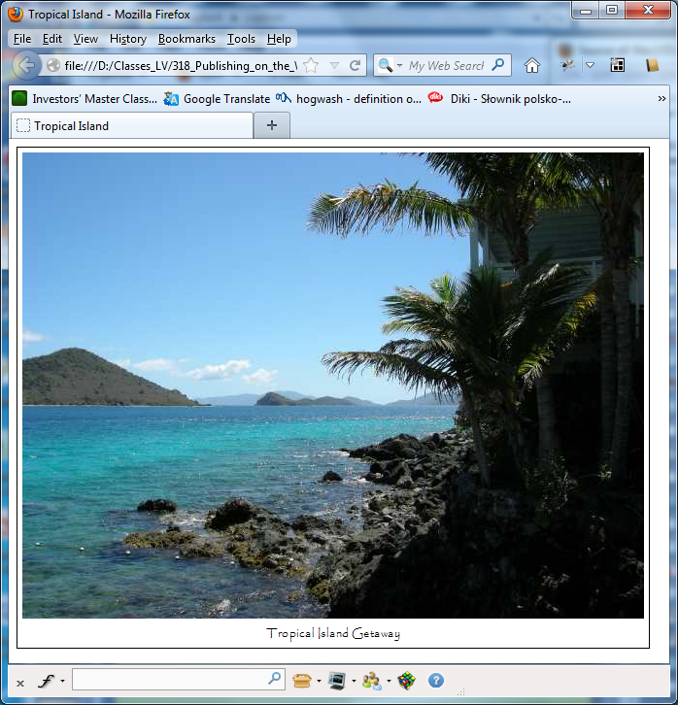
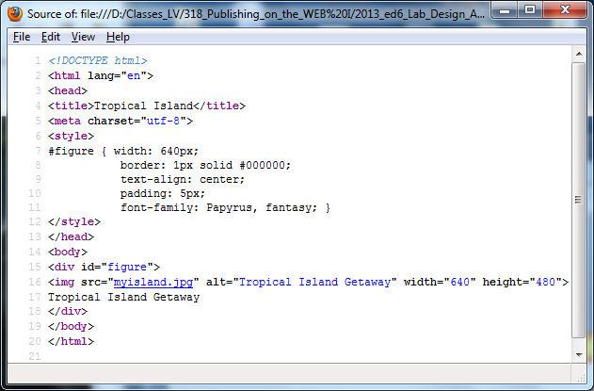

HTML Visual Elements using <div> as a container - HOP 4.5

Slide 60
Hands-On Practice
HOP 4.6
Follow the directions in your book for the HOP.
START-UP File | chapter2/template.html
SAVE SOLUTION AS | index.html

Slide 61
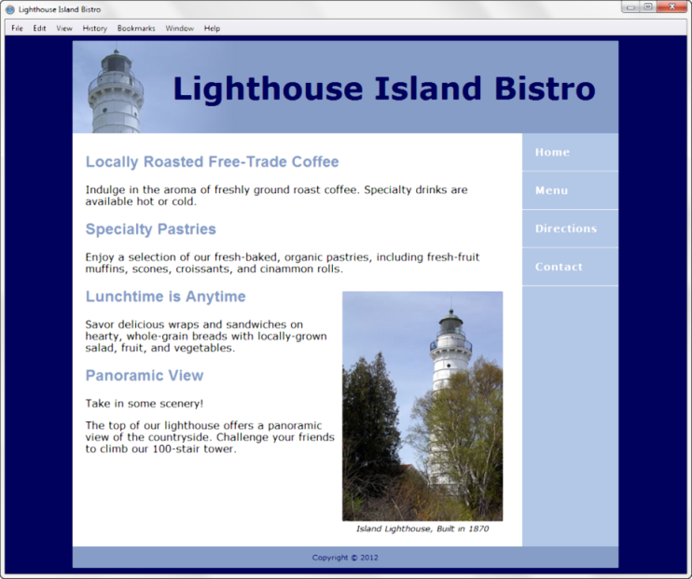
HTML5 Figure and Figcaption Elements
Figure element: contains a unit of content that is self-contained, such as an image, along with one optional figcaption element.
<figure>
<img src="lighthouseisland.jpg" width="250" height="355" alt="Lighthouse Island">
<figcaption> Island Lighthouse, Built in 1870 </figcaption>
</figure>

Slide 62
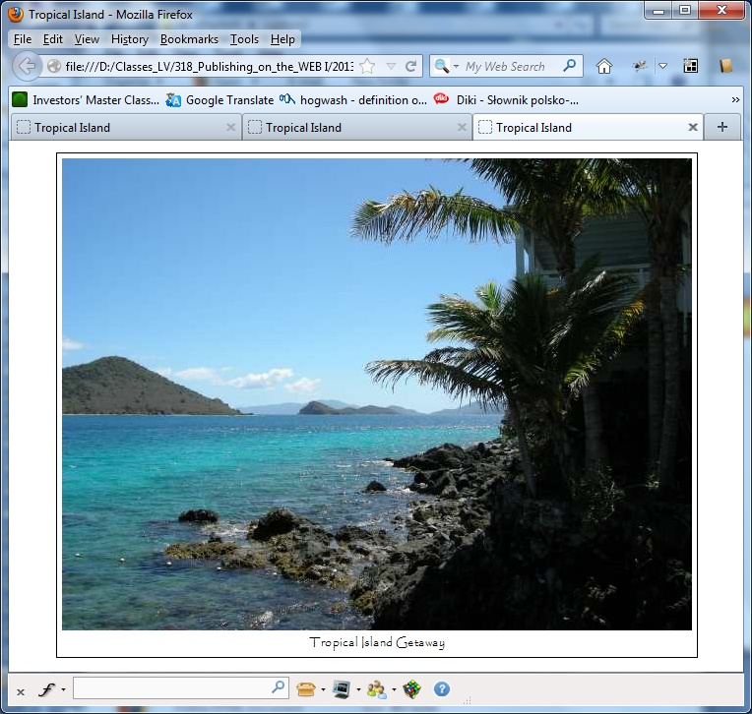
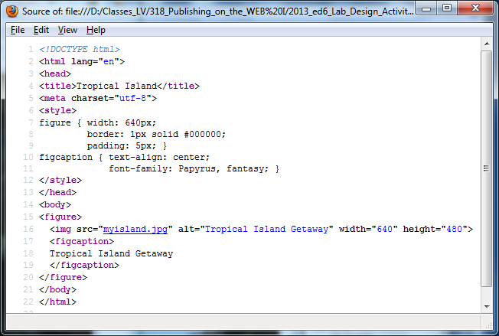
HTML Visual Elements using <figure> as a container with <figcaption> - HOP 4.6

Slide 63
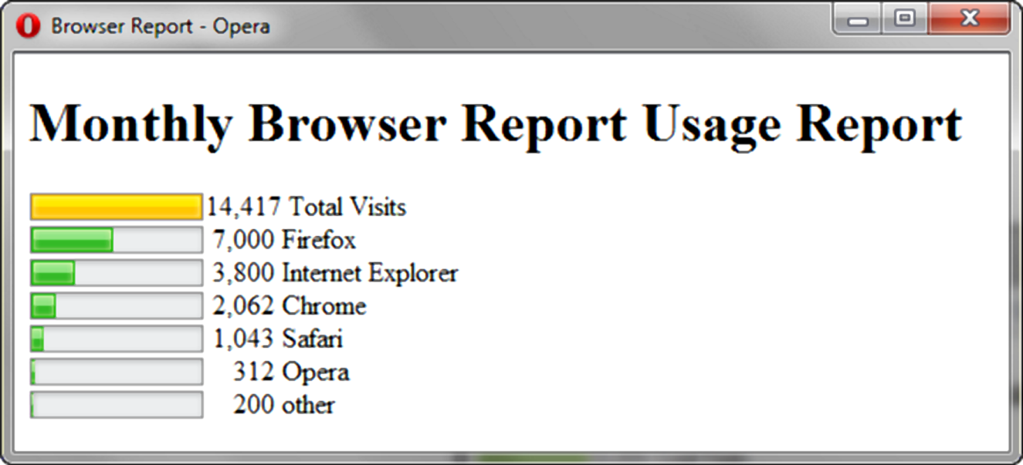
HTML5 Meter Element
Displays a visual gauge of a numeric value within a known range
<meter value="14417" min="0" max="4417"> 14417</meter> 14,417 Total Visits<br>
<meter value="7000" min="0" max="14417">7000</meter> 7,000 Firefox<br>
<meter value="3800" min="0" max="14417">3800</meter> 3,800 Internet Explorer<br>
<meter value="2062" min="0" max="14417">2062</meter> 2,062 Chrome<br>
<meter value="1043" min="0" max="14417">1043</meter> 1,043 Safari<br>
<meter value="312" min="0" max="14417">312</meter> &nbsp;&nbsp; 312 Opera<br>
<meter value="200" min="0" max="14417">200</meter> &nbsp;&nbsp; 200 other<br>

Slide 64
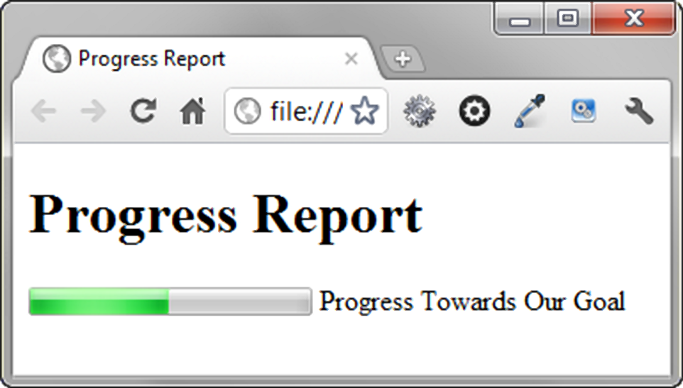
HTML5 Progress Element
Displays a bar that depicts a numeric value within a specified range
<progress value="5000" max="10000">5000</progress> Progress Towards Our Goal

Slide 65
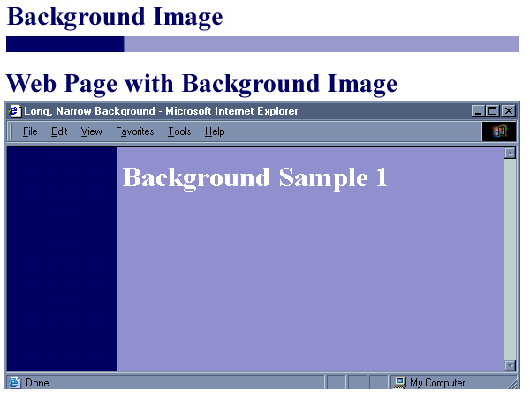
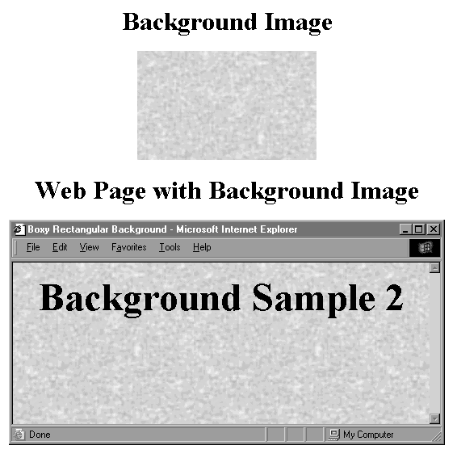
<body> attributes – Image as a background
background attribute
Used to configure a background image for a web page
<body background=“clouds.jpg”>
A background image is often smaller than the typical viewport
Browser repeats, or tile, these images to cover the page’s background unless otherwise specified in a style rule

Slide 66
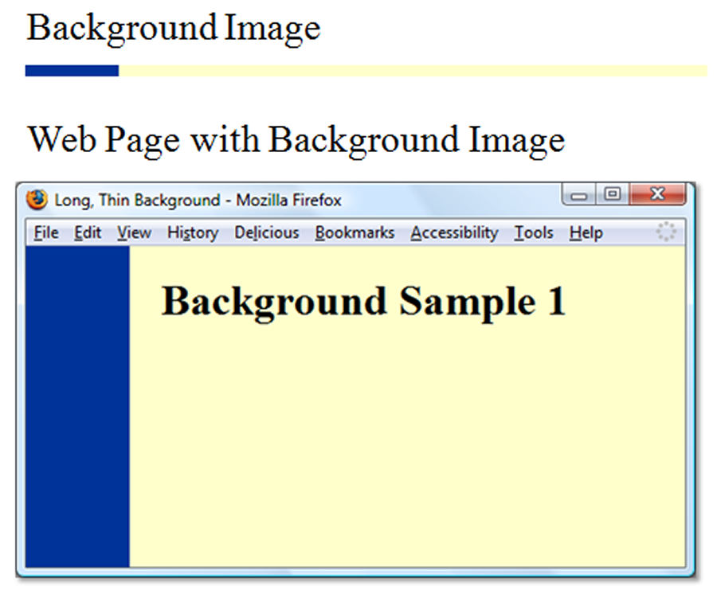
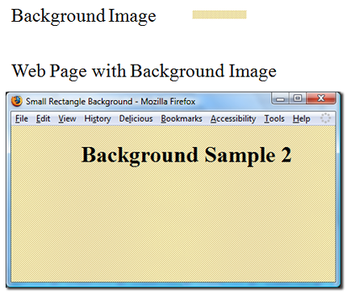

CSS background-image Property
Configures the background of a web page:
body { background-color: #ffff99;}
Configures a background-image
By default, background images tile (repeats)
body { background-image: url(background1.gif); }
body { background-color: #ffff99; background-image: url(background1.gif); } -
background color property is displayed first and next the image specified as the background will be displayed as it is loaded by the browser.
background color covers areas not covered by the background image.

Slide 67
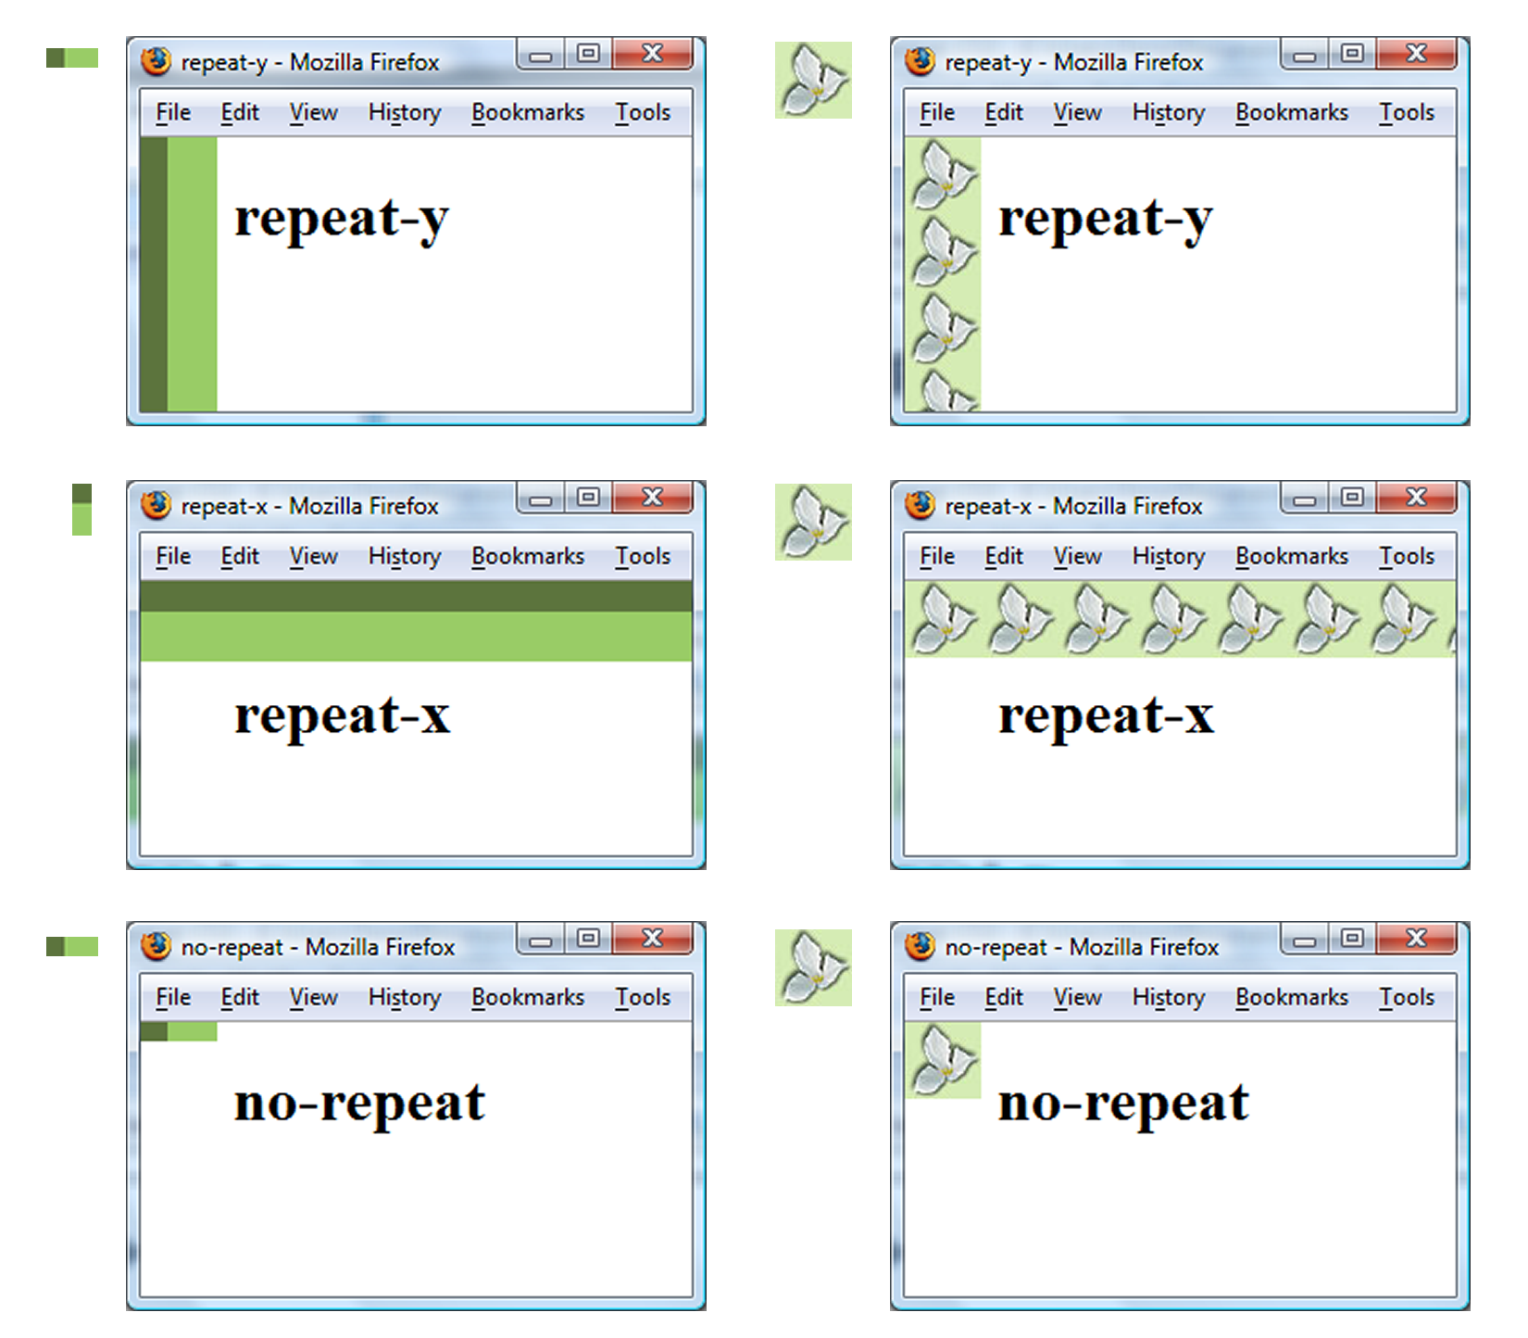
CSS background-repeat Property

Slide 68


Using CSS background-repeat and background-image
trilliumbullet.gif:
h2 { background-color: #d5edb3;
color: #5c743d;
font-family: Georgia, "Times New Roman", serif;
padding-left: 30px;
background-image: url(trilliumbullet.gif);
background-repeat: no-repeat;
}

Slide 69
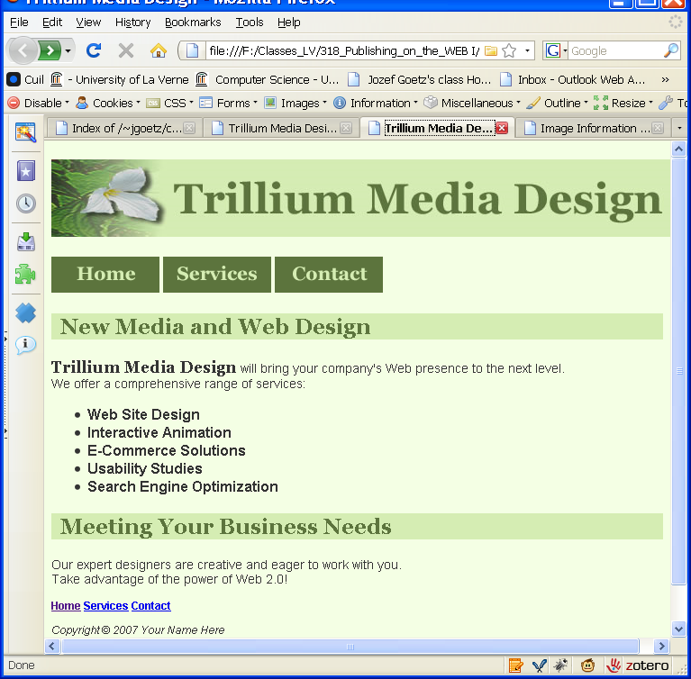
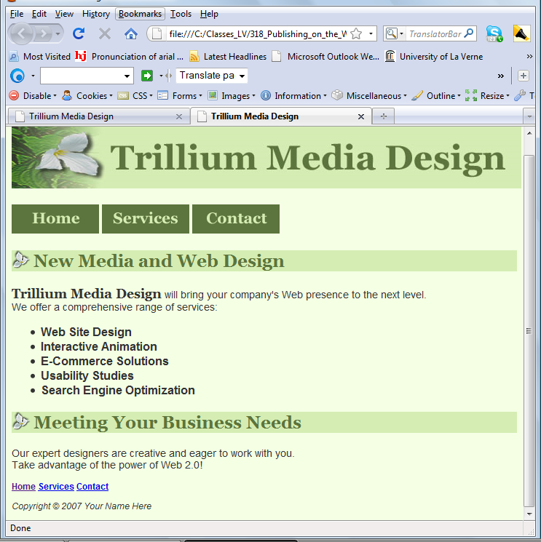

background-repeat; no-repeat
HOP 4.3 index.html => index.html
h2 { background-color:#d5edb3; color:#5c743d; font-family:Georgia, "Times New Roman", serif;
background-image: url(trilliumbullet.gif); background-repeat: no-repeat; padding-left: 30px; }

Slide 70
Checkpoint 4.2
Describe the CSS to configure a graphic named circle.jpg to display once in the background of all <h1> elements. Code sample CSS to demonstrate this. p.675
h1 {background-image: url(circle.jpg);
background-repeat: no-repeat;}
Describe the CSS that configures a file named bg.gif to repeat vertically down the background of a Web page. Code sample CSS to demonstrate this.
body {background-image: url(bg.jpg);
background-repeat: repeat-y;}
3. True or False? When coding image links, you must configure the image tag with border="0" to avoid the default blue border.

Slide 71
Hands-On Practice
HOP 4.7
Follow the directions in your book for the HOP.
START-UP File | chapter4/4.4folder
SAVE SOLUTION AS | index.html

Slide 72


HOP 4.7 – background images

