Slide 1
HOP 4.8
More About Images
HOP 4.9
CSS3 Visual Effects
HOP 4.10
More About Images
HOP 4.11
CSS3 Rounded Corners
HOP 4.12
CSS3 box-shadow Property
HOP 4.13
CSS3 box-shadow Property (Continued)
HOP 4.14 – 4.16
CSS3 opacity Property
CSS3 RGBA Color
CSS3 HSLA Color
HOP 4.17
CSS3 Gradients

Slide 2
Chapter 4
Visual Elements
And
Graphics
Part II
Credits: © 2011 - 2022 Pearson Education
Credits: (c) 2011 Prentice-Hall. All rights reserved.

Slide 3

CSS background-position and background-attachment Property
The default placement of a background image is top left.
The background-position property can change this placement.
h2 { background-image: url(flower.gif);
background-position: right;
background-repeat: no-repeat; }
The background-attachment property configure whether the background fixed or scroll along with the page in the browser viewport:
scroll (default) – the background image scrolls with the page in the browser viewport
fixed – the background image doesn’t scroll
local - – the background image scrolls with the element’s content the browser viewport

Slide 4
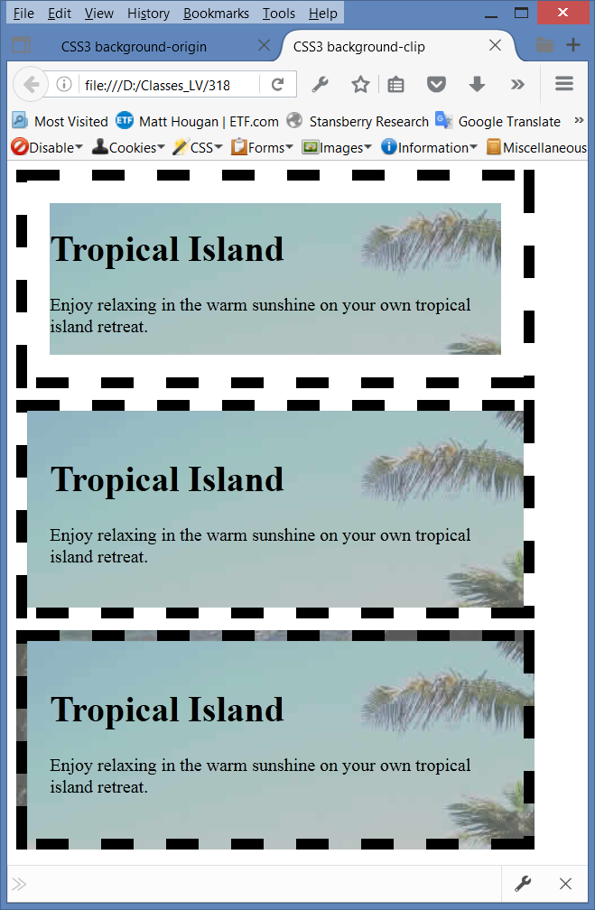
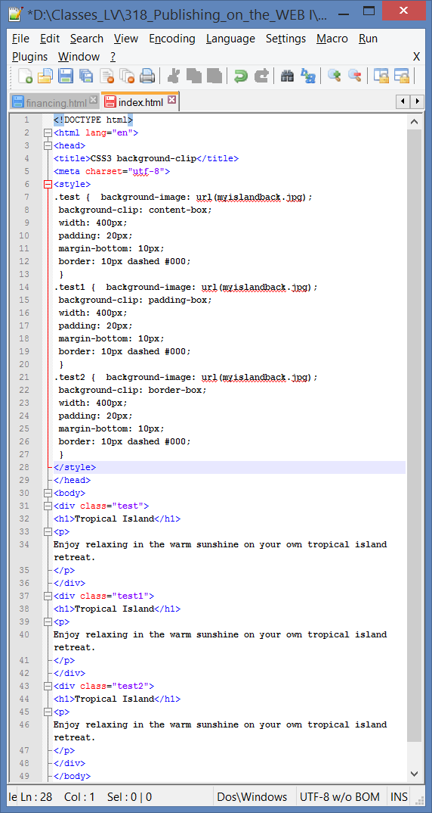
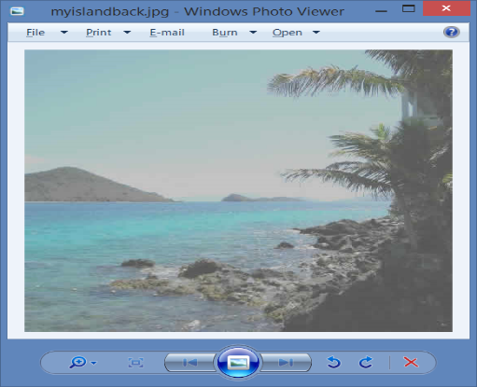

CSS3 background-clip Property p.160
clips display to the area behind the content
clips display to the area behind the content and padding
clips display to the area behind the content, padding and border

Slide 5
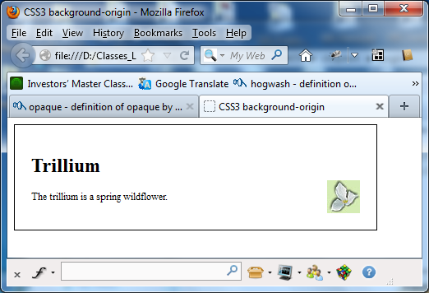
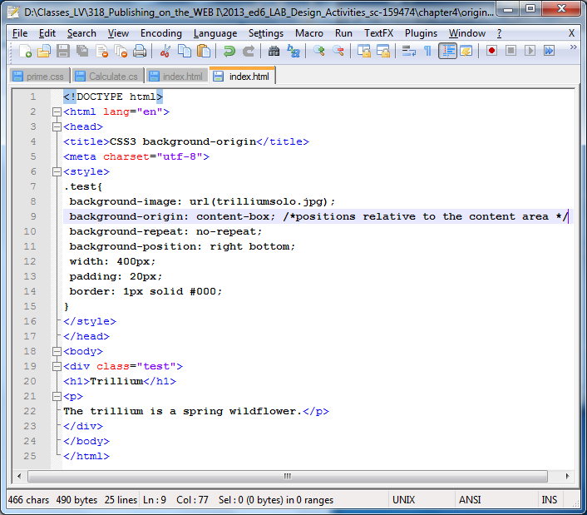

CSS3 background-origin Property
background-origin positions the background-image, using values:
p.166
  content-box => positions relative to the content area
  padding-box => positions relative to the padding area
  border-box => positions relative to the border area

Slide 6
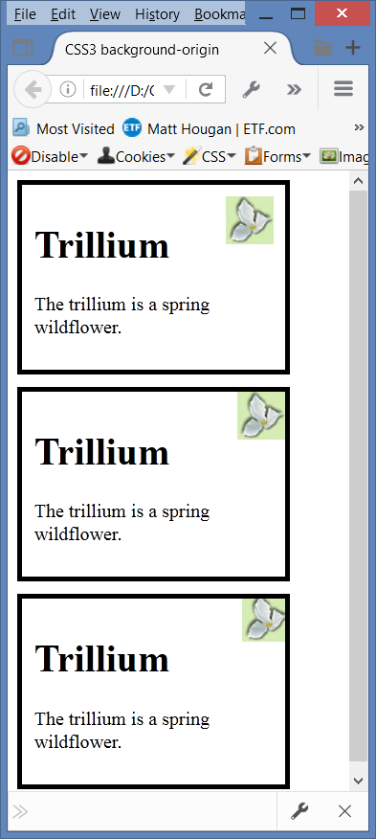
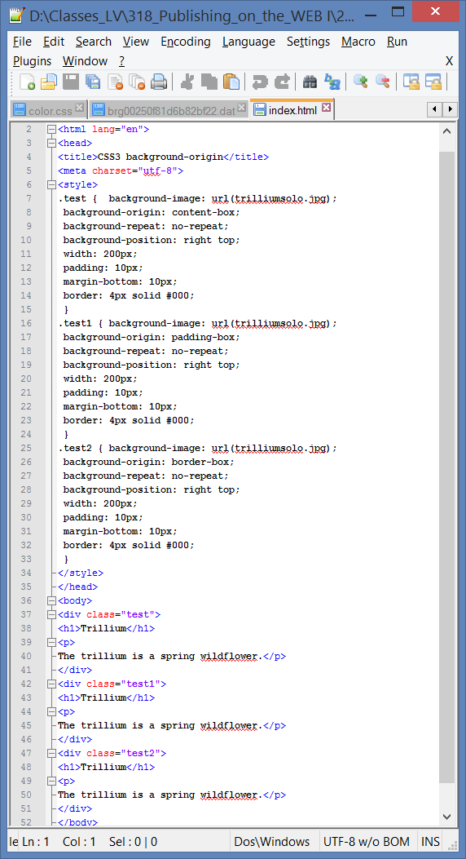
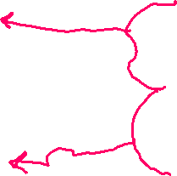
CSS3 background-origin Property
background-origin positions the background image, using values:
p.166
  content-box => positions relative to
  the content area
  padding-box => positions relative to
  the padding area
  border-box => positions relative to
  the border area

Slide 7
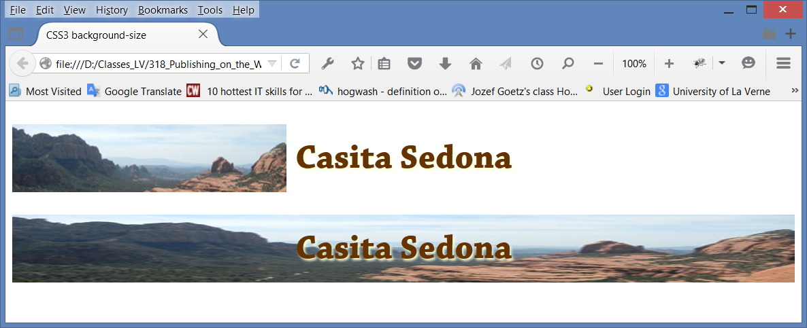
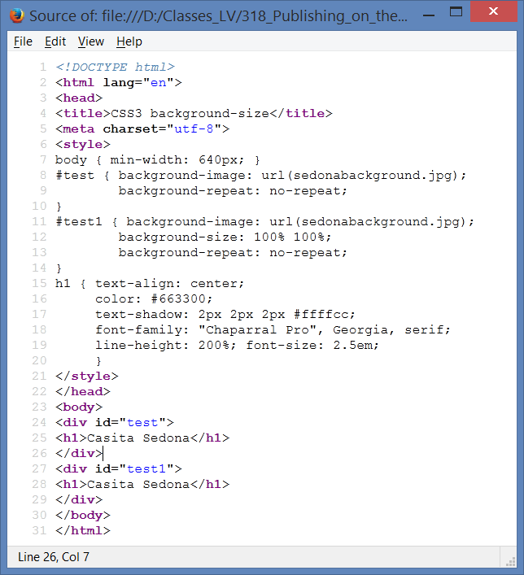
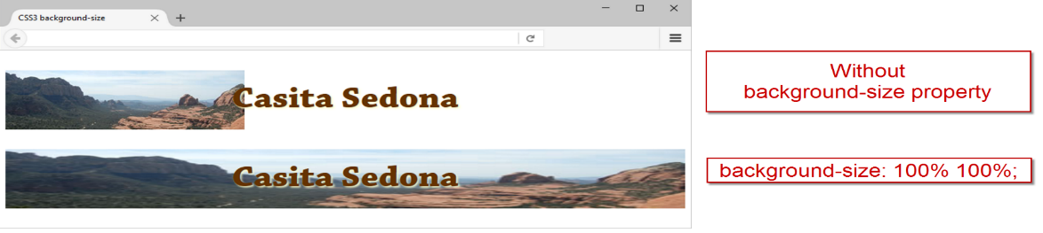

CSS3 background-size Property
background-size positions the background image, using values:
p.164
  width height => 100% 100% or 1200px 900px
    – resizes the background image p.161-2
    background-size: 100% 100%;
    meaning the size values:
    width hight => 100% auto or 1200px auto
    width height => auto 100% or auto 900px
    width height => 100% auto or 1200px auto

Slide 8
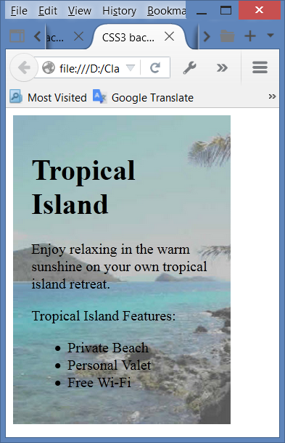
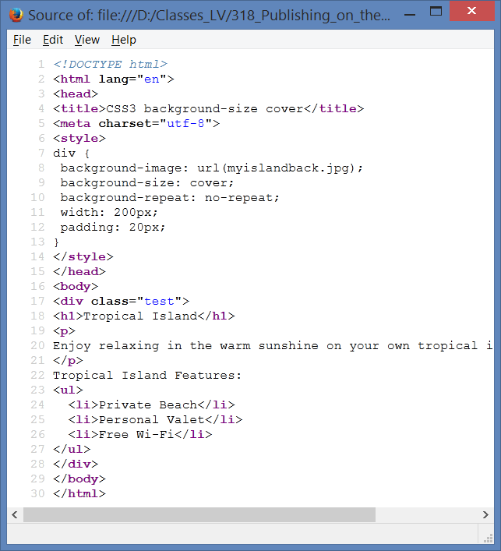
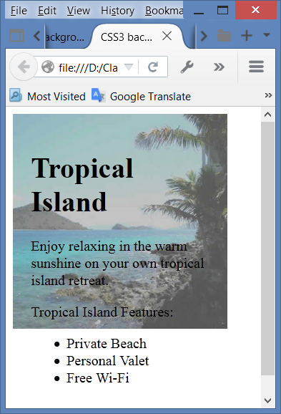

CSS3 background-size Property
background-size positions the background image, using values:
p.161
  cover => preserves the aspect ratio of the image in the way that completely covers the area
  contain => preserves the aspect ratio of the image
  as it scales the bkgrd image to the largest size for which both the height
  and width of the image will fit within the area

Slide 9


Hands-On Practice
HOP 4.8
Follow the directions in your book for the HOP.
START-UP File | coffeestarters folder
SAVE SOLUTION AS | index.html

Slide 10
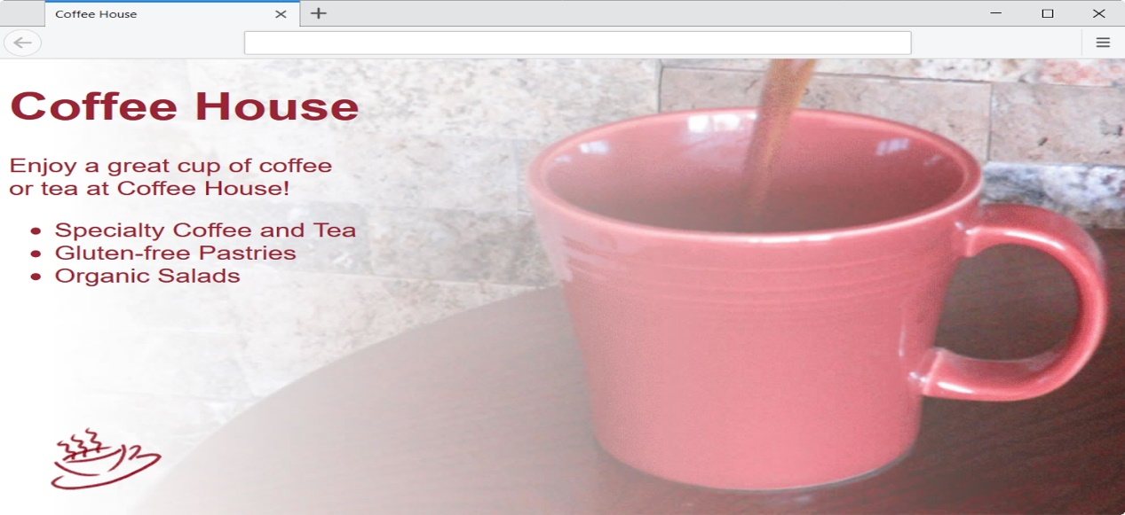



CSS Multiple Background Images - background Property
Use the background property to configure
multiple background images.
Example:
body { background:url(coffee.gif) no-repeat left bottom,
url(coffeepour.jpg) no-repeat fixed;
background-size: auto, cover; }

Slide 11
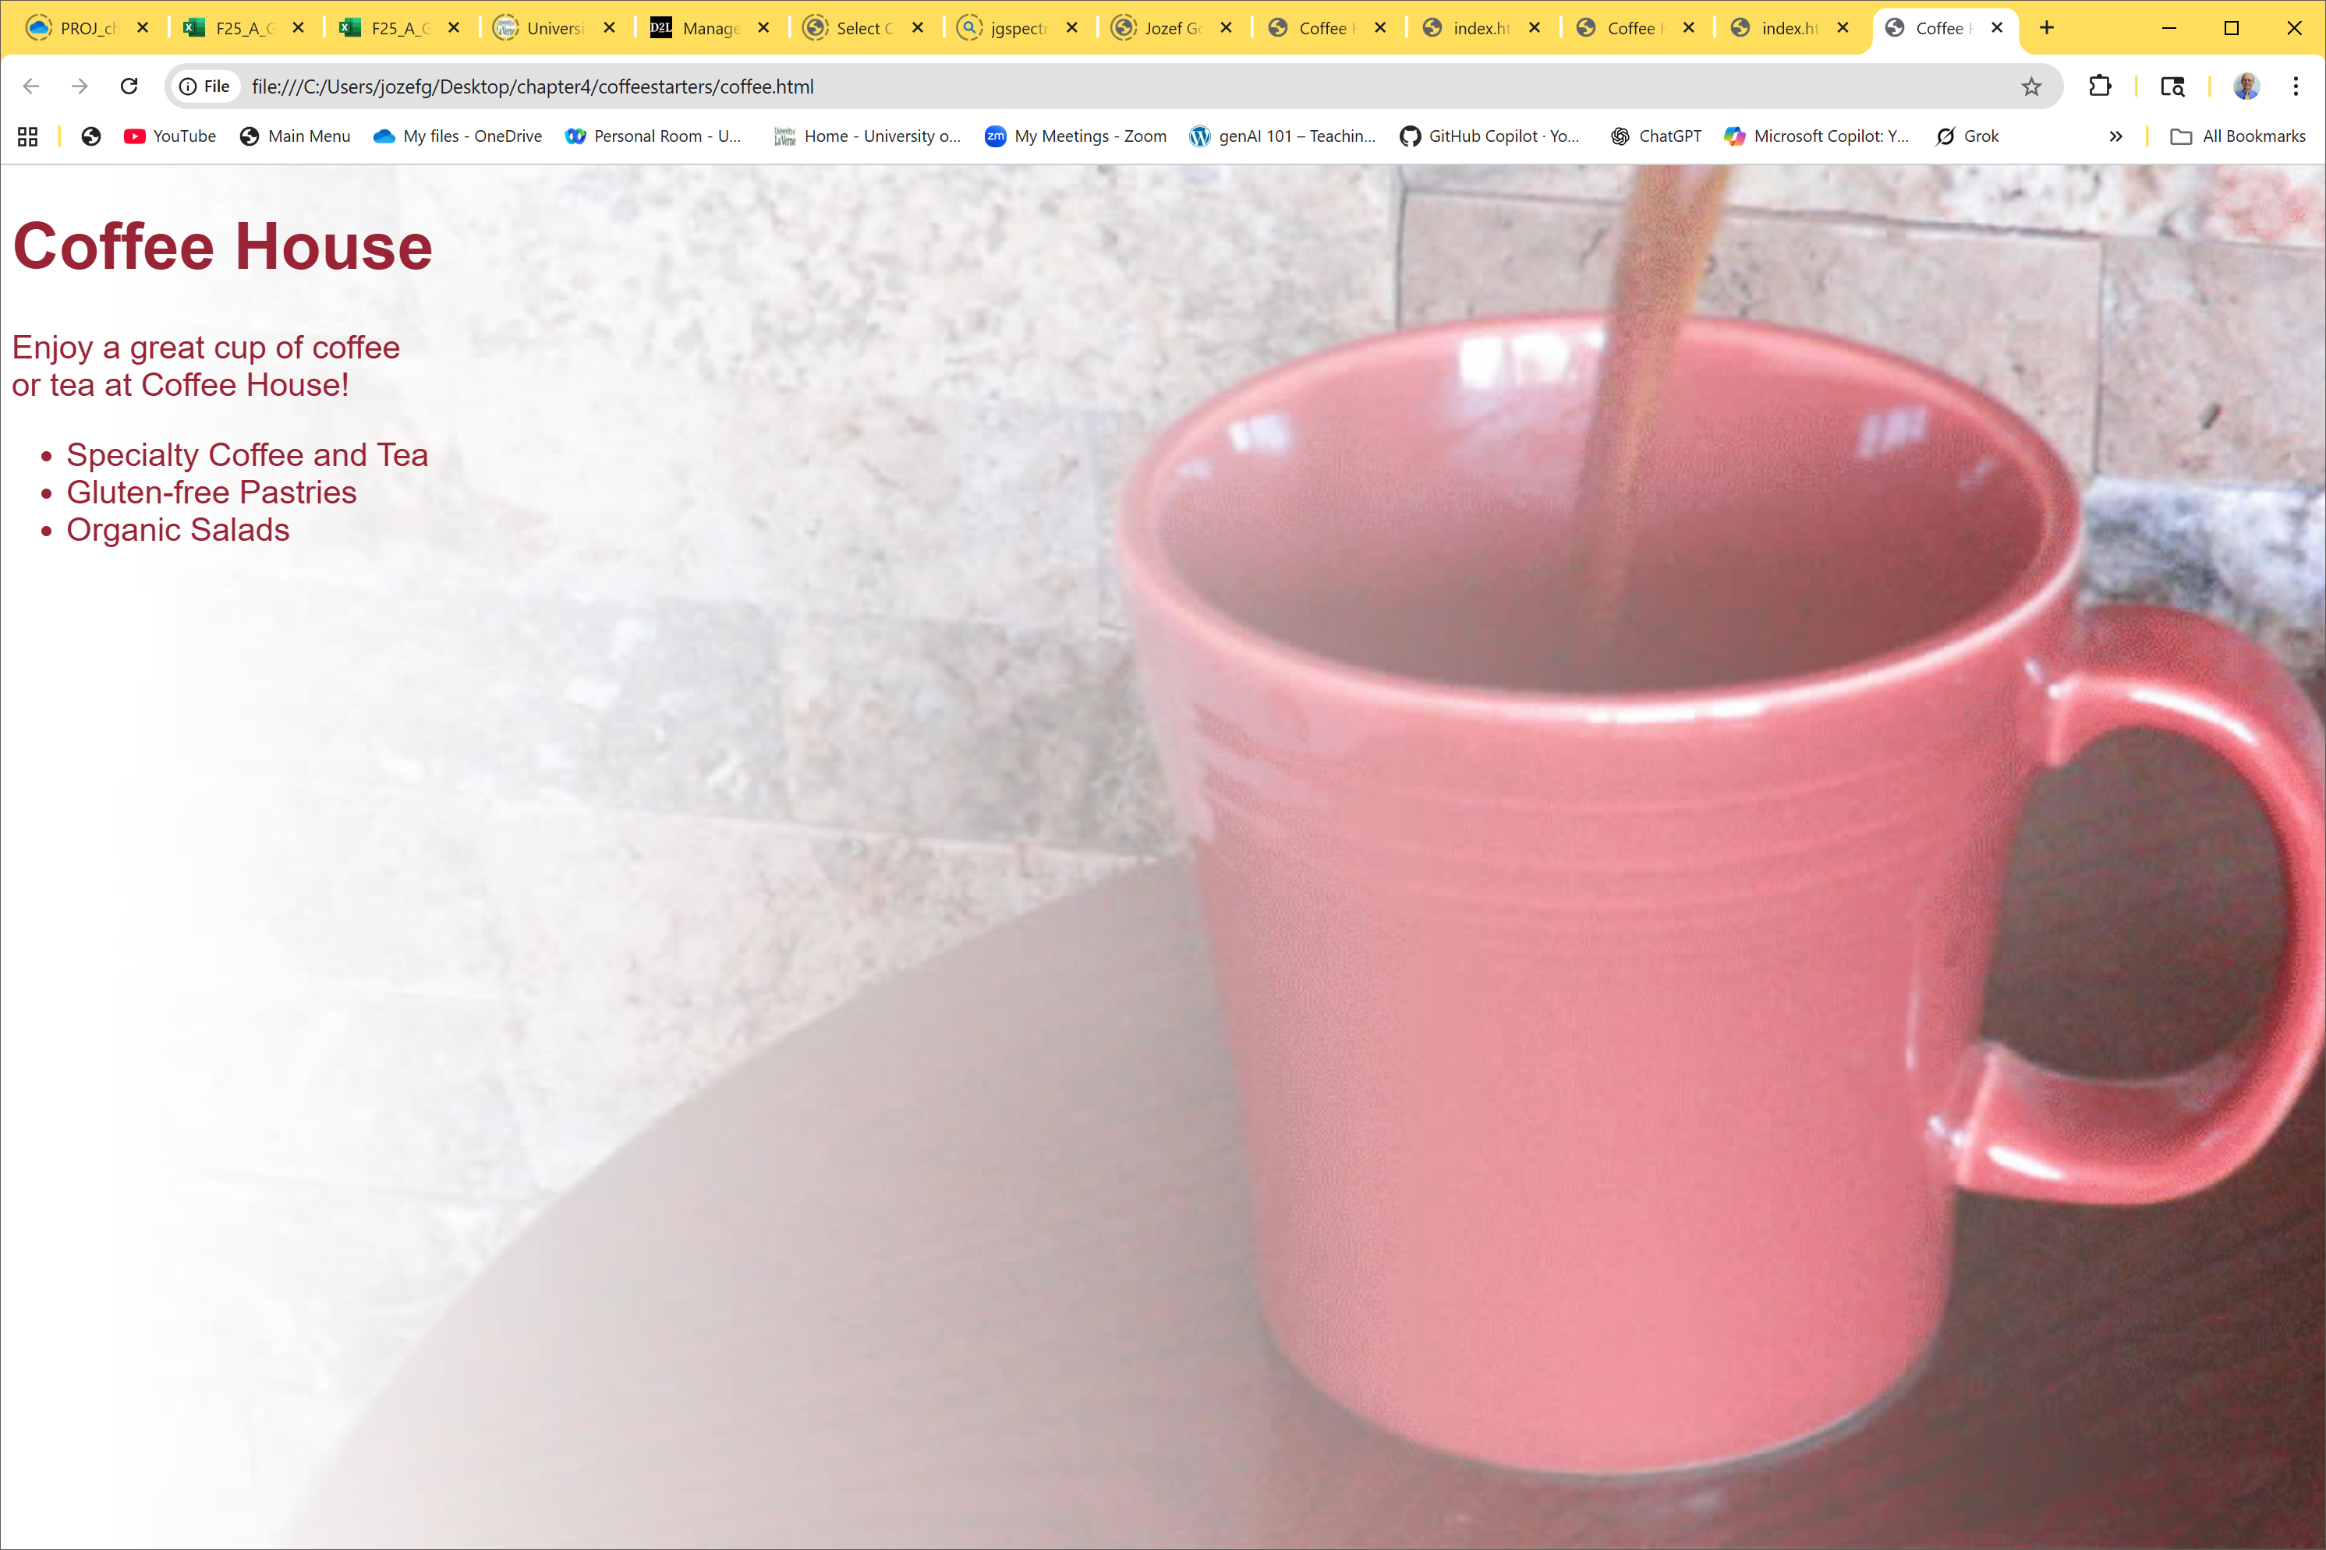
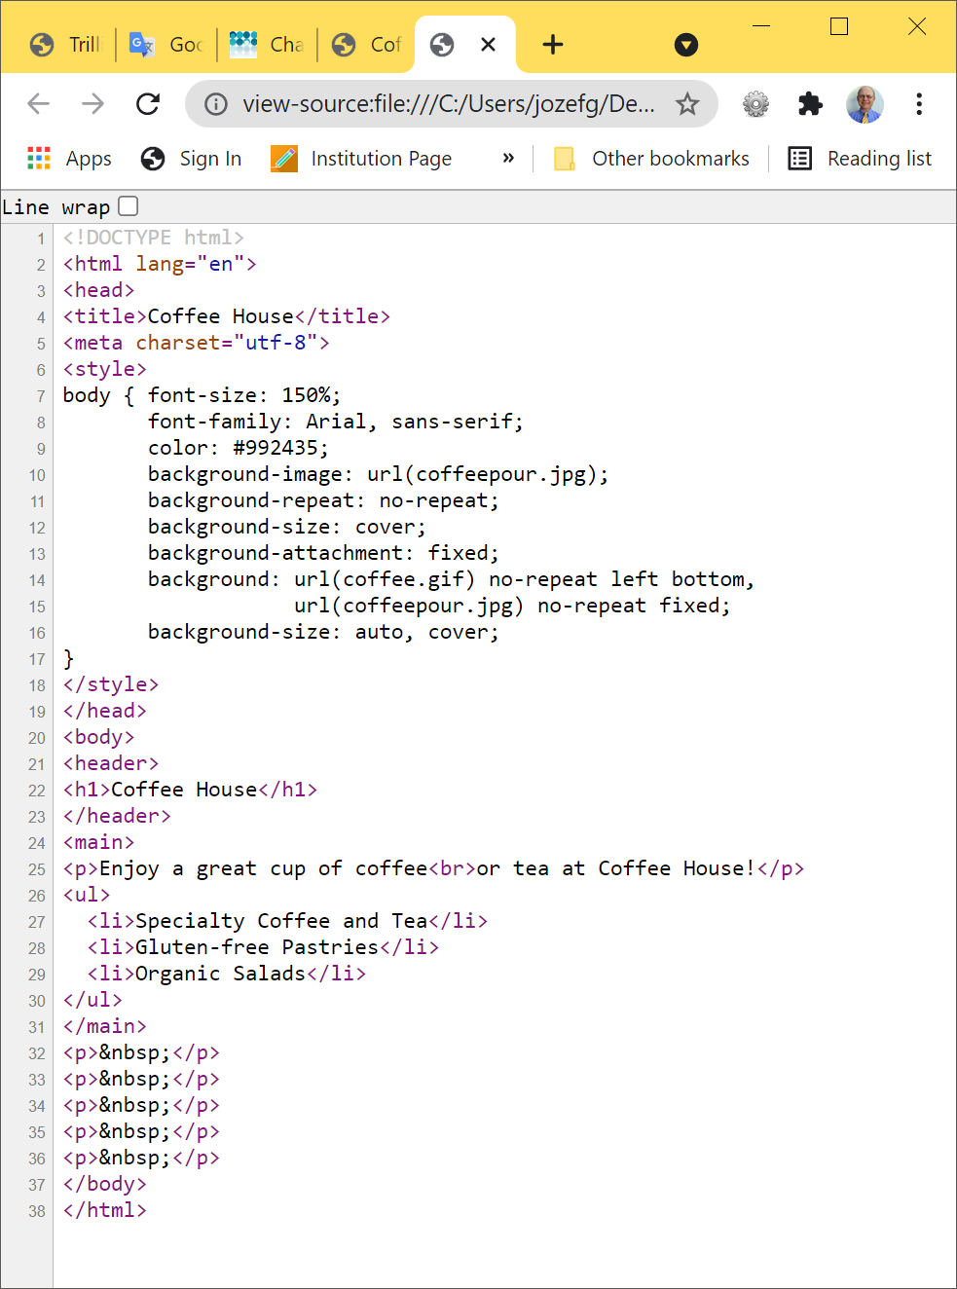


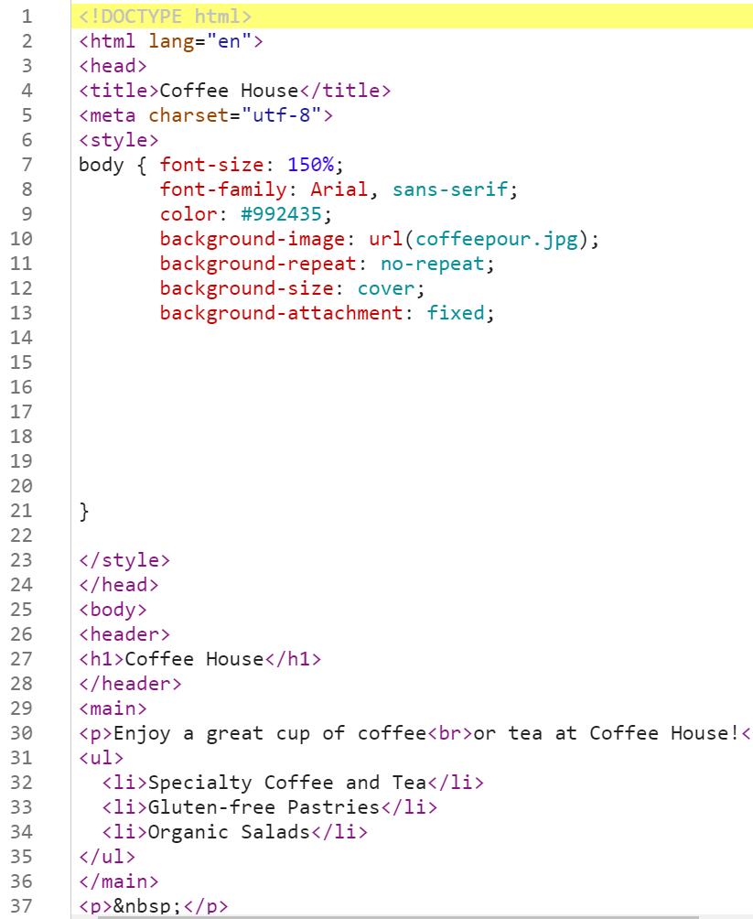









Multiple Background Images - background Property HOP 4.8
coffeestarters => coffee.html:
HOP 4.8

Slide 12
Hands-On Practice
HOP 4.9
Follow the directions in your book for the HOP.
START-UP File | 4.8 folder
SAVE SOLUTION AS | coffeepour.html

Slide 13
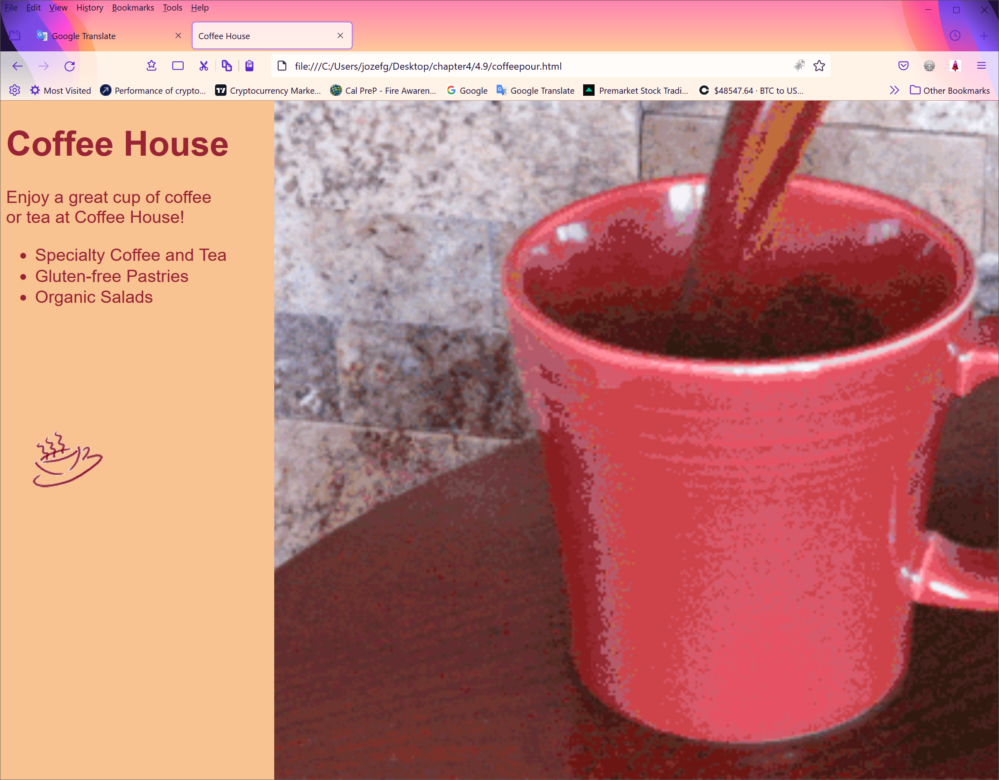
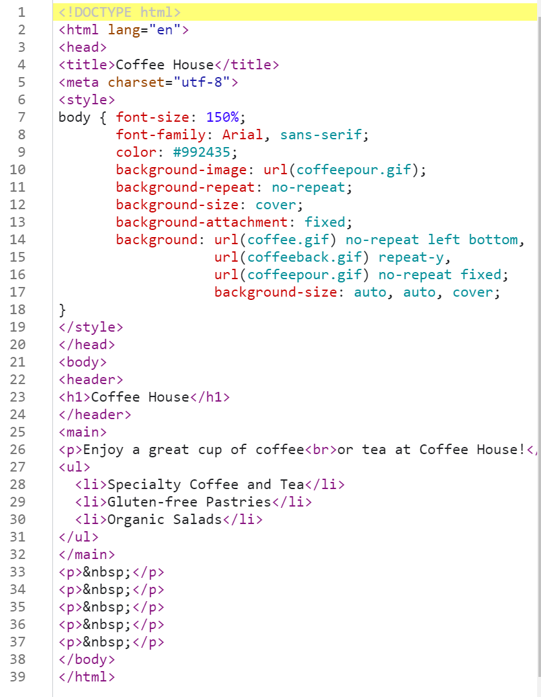





HOP 4.9 p.164
HOP 4.9

Slide 14
Coding Navigation Techniques associated with using images on Web pages
Images in a navigation bar in a horizontal row
  a. using <nobr> tag
  b. using a table
A small image used to link to a larger version of that image
An image map is an image can be used as one or more hyperlinks.

Slide 15
1 a. Images in navigation <nobr>
No Break tag: <nobr>… </nobr>
Used when you might be using images in a navigation bar and you would like to keep the images in a horizontal row
  no matter
    what the screen resolution settings are
    or browser window size is on your visitor's computer.
<nobr>…place image tags here</nobr>

Slide 16
1b. Using a Table to Format Navigation chapt. 8
The HTML code for a table:
<table cellspacing=“0” cellpadding=“0”>
<tr>
<td>…first image tag goes here…</td>
<td>…second image tag goes here…</td>
<td>…third image tag goes here…</td>
<td>…fourth image tag goes here…</td>
</tr>
</table>
It gives you greater control over the placement of text and images

Slide 17
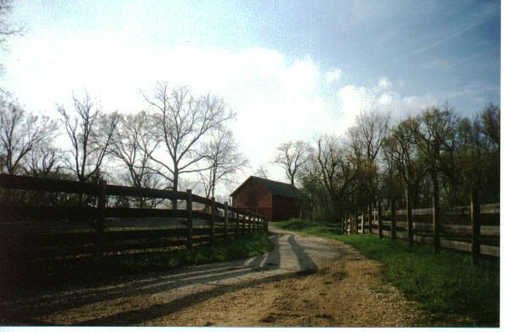

2. Thumbnail Image
A small image configured to link to a larger version of that image.
<a href=“big.jpg”><img src=“small.jpg” alt=“country road” width=“200” height=“100”></a>

Slide 18
3. Creating and Using Image Maps
Designate certain areas of an image (called clickable areas or hotspots) as links
  Element map
    Attribute id
      Identifies the image map
    Element area
      Defines hotspots:
      Attribute shape and coords
        Specify the hotspot’s shape and coordinates
        Rectangular ( shape = “rect” )
        Polygon ( shape = “poly” )
        Circle ( shape = “circle” )
http://www.worldatlas.com/webimage/countrys/namerica/usstates/usmaps.htm => Search by Map

Slide 19
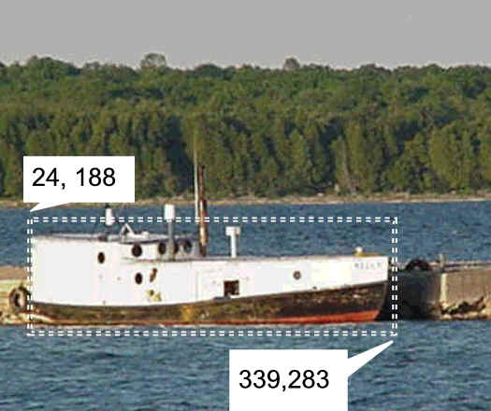
Sample
Image Map
<map> tag
  Defines the map
<area> tag
  Defines a specific area on a map
  href Attibute
  shape Attribute
    Rectangular ( shape = “rect” )
    Polygon ( shape = “poly” )
    Circle ( shape = “circle” )
  coords Attribute
<map name="boat" id="boat">
<area href="http://boat.com" shape="rect"
coords="24, 188, 339, 283" alt=“fishing boat" >
</map>
<img src="boat.jpg" usemap="#boat" alt=“Lake Michigan" width="416" height="350" >

Slide 20
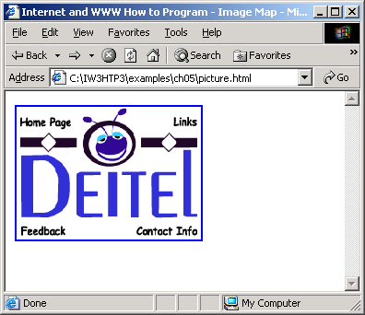
picture.html
(1 of 3)

Slide 21
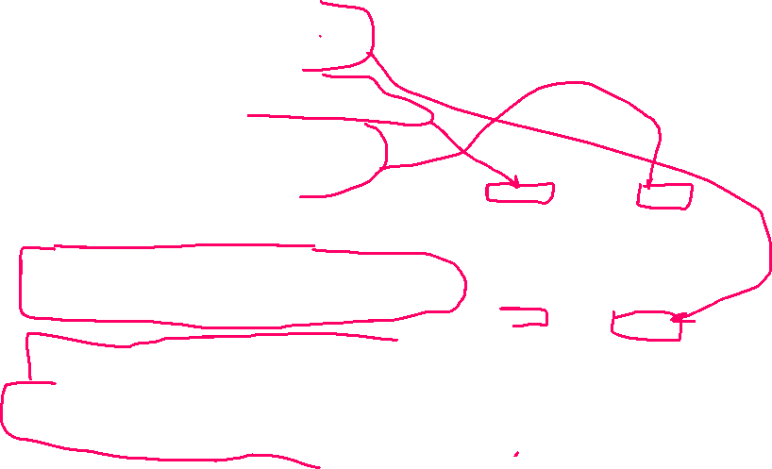


picture.html
(2 of 3)

Slide 22
Hands-On Practice
HOP 4.10
Follow the directions in your book for the HOP.
START-UP File | favicon.ico kayakch4 folder (HOP 4.7)
SAVE SOLUTION AS | index.html favicon.ico

Slide 23
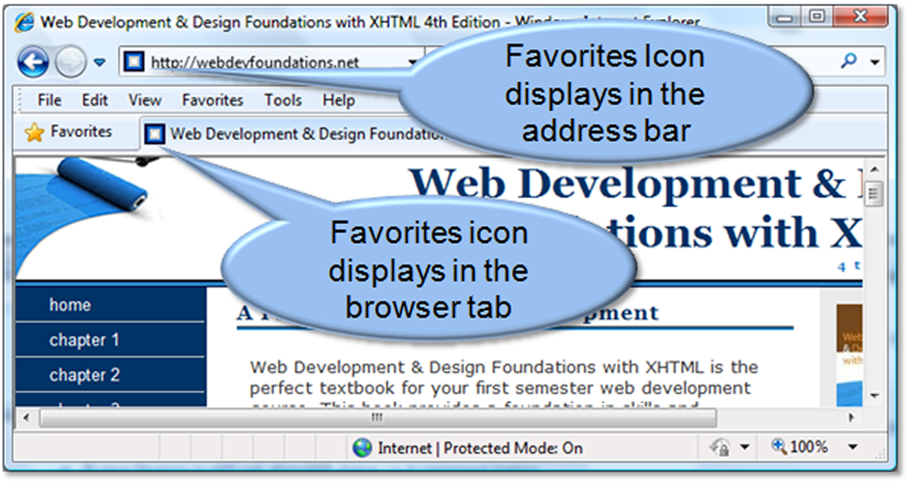




Favorites Icon – favicon p.167 HOP 4.10
A square image
associated
with a Web
page (either 6 x 16
or 32 x 32)
Usually named:
favicon.ico
May display in the browser address bar, tab, or
favorites/bookmarks list
Configure with a link tag in a head:
<link rel="icon" href="favicon.ico" type="image/x-icon" >
For Microsoft Internet Explorer
<link rel=“shortcut icon" href="favicon.ico" type="image/x-icon" >

Slide 24
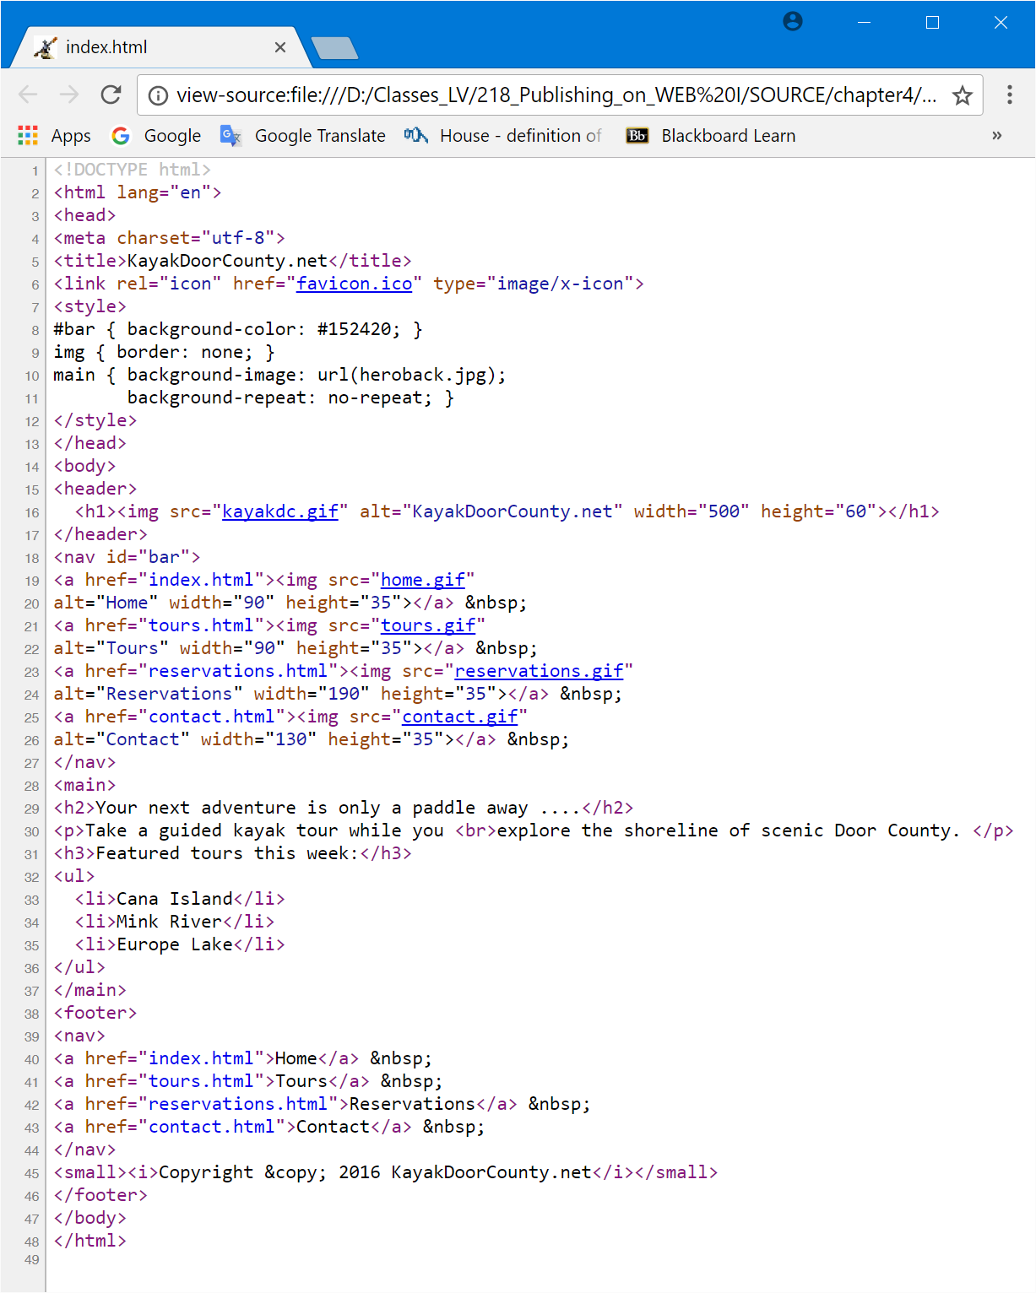
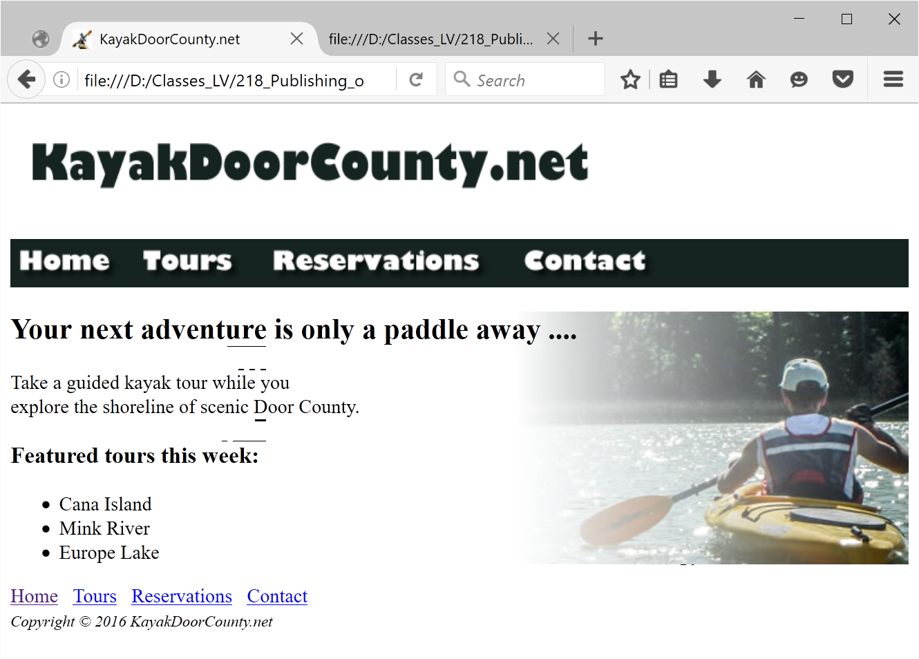
Use HOP 4.7 main, #bar; HOP 4.10
HOP 4.10

Slide 25
CSS Sprites
Sprite –
  an image file that contains multiple small graphics that are configured as background images for various web page elements
Modern technique to optimize use of multiple icon or small images
Saves overhead by reducing the number of http requests made by the browser.
You’ll use CSS Sprites in Chapter 7!

Slide 26
4.7 Sources for Graphics
create them yourself using a graphics application
download them from a free site
purchase and download them from a graphics site
purchase a graphics collection on a DVD/CD
take digital photographs
scan your photographs
scan your drawings
hire a graphic designer to create graphics
https://webdevfoundations.net/10e/

Slide 27
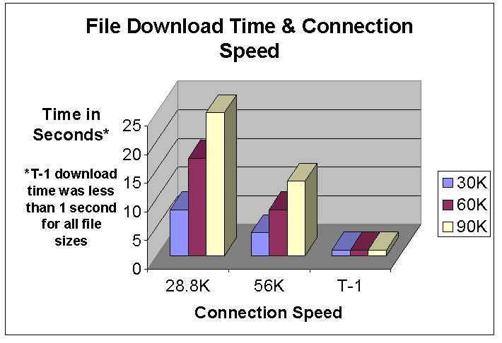
Guidelines for
Using Images
T-1 = 1.544 Mbit/s.
1. Consider image load time
  Used to be a suggested max file size = 60 KB for Web pages and all media files
2. Reuse images
  It is recommended that you reuse common graphics such as logos and navigation buttons on multiple pages instead of creating multiple different version of these common graphics

Slide 28
Guidelines for
Using Images
3. Specify dimensions
  height and width on image tag
4. Use appropriate resolution – Web browser display images at relatively low resolution-72 ppi (72 pixels per inch) or 96 ppi
  Higher resolution means larger file size
5. Be aware of brightness and contrast
  Gamma refers to the brightness and contrast of the monitor display
  Macintosh and Windows use a different default gamma settings (Macintosh 1.8, Windows 2.2)
  Developer cannot control gamma

Slide 29
Optimize an Image for the Web
5. Consider image size with image quality
  Image Optimization
    a. Reduce the file size of the image that gives you appropriate quality
    b. Reduce the dimensions of the image to the actual width and height of the image on the web page.
6. Image Editing Tools:
  GIMP (free!) - http://gimp.org is popular open-source image editor that supports multiple OS platforms.
    Whether you are a graphic designer, photographer, illustrator, or scientist, GIMP provides you with sophisticated tools to get your job done
  paint
  Adobe Fireworks
  Adobe Photoshop
  JASC Paintshop Pro
  http://pixlr.com/editor (free!) - see mouse coordinates

Slide 30
Guidelines for Accessibility
1. Don't rely on color alone.
  Some visitors may have color perception deficiencies.
  Use high contrast between background and text color.
  http://webaim.org/resources/contrastchecker/
2. Avoid using the colors red and brown next to each other.
  These colors are difficult for individuals with the most common color perception deficiency to differentiate.
3. Provide a text equivalent for non-text elements.
  Use the alt attribute on your image tags.
4. If your site navigation uses image links, provide simple text links at the bottom of the page!!!

Slide 31
Checkpoint 4.3 p.675
1. Search for a site that uses image links to provide navigation. List the URL of the page.
    What colors are used on the image links?
    If the image links contain text, is there good contrast between the background color and letters on the image links?
    Would the page be accessible to a visitor who is sight-challenged?
    How have accessibility issues been addressed?
    Is the alt attribute used to describe the image link?
    Is there a row of text links in the footer section of the page?
  Answer the questions above and discuss your findings.
  See www.alithsa.org

Slide 32
Checkpoint 4.3
2. When configuring an image map, describe the relationship between the image, map, and area tags.
3. True or False? Save your images using the smallest file size possible.
  The goal is to save it using the smallest file size that provides acceptable display quality.

Slide 33
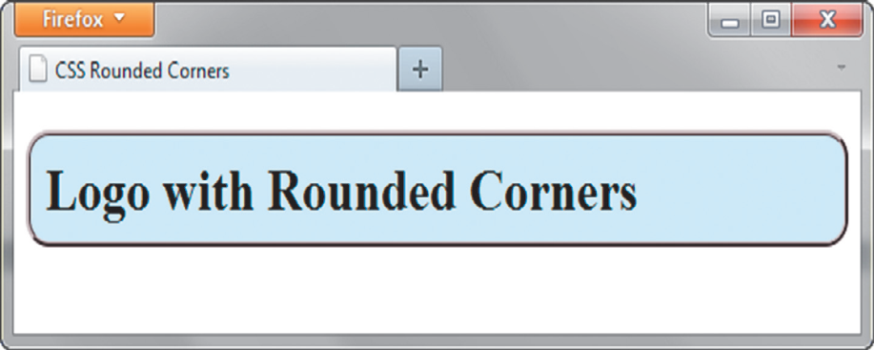
CSS3 Rounded Corners
border-radius property – creates rounded corners
  Configures the horizontal radius and vertical radius of the corner
  Numeric value(s) with unit (pixel or em) or percentage
Browser vendor proprietary properties:
  -webkit-border-radius (for Safari & Chrome)
  -moz-border-radius (for Firefox)
  border-radius (W3C syntax)
Example
h1 { border: 3x ridge #330000;
-webkit-border-radius:15px;
-moz-border-radius:15px;
border-radius:15px;}

Slide 34


Examples of Rounded Corners
One value for border-radius configures all four corners
Example:
border-radius: 15px;
Four values for border-radius configure each corner separately
  Ordered by top left, top right, bottom right, bottom left
  border-radius: 15px 30px 100px 5px;
You may configure corners individually using:
border-top-left-radius, border-bottom-right-radius, etc.

Slide 35
Hands-On Practice
HOP 4.11
Follow the directions in your book for the HOP.
START-UP File | lighthouselogo.jpg background.jpg Chapter4/starters folder
SAVE SOLUTION AS | index.html

Slide 36
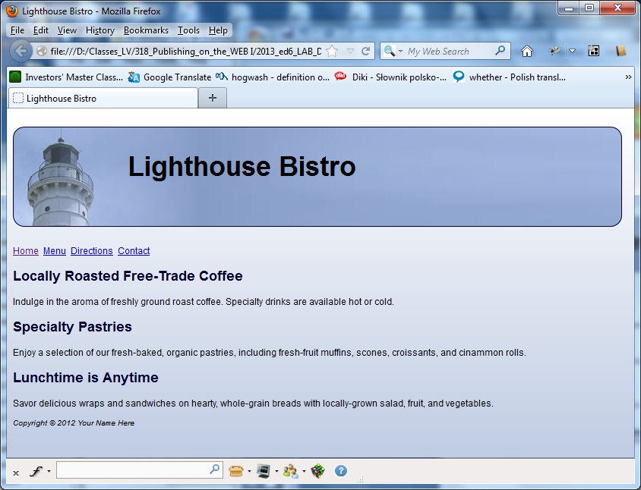
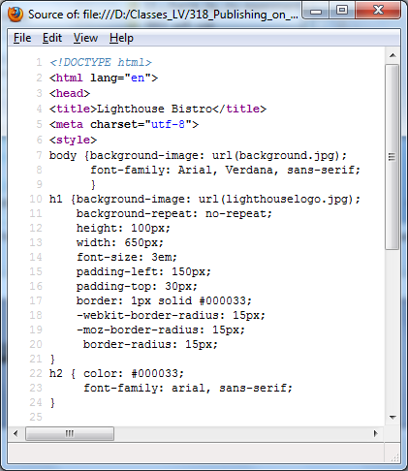

CSS3 box-radius Property
HOP 4.11

Slide 37
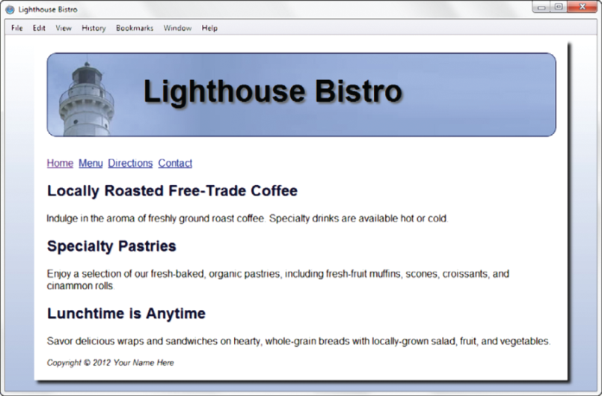

CSS3 box-shadow Property
Used to create a shadow effect on block-display elements <div> and <p>
Configure correspondingly the
  horizontal offset, < 0 > 0
  vertical offset, < 0 > 0
  blur radius, >=0, higher more blur
  valid color value
#wrapper { -webkit-box-shadow: 5px 5px 5px #828282;
-moz-box-shadow: 5px 5px 5px #828282;
box-shadow: 5px 5px 5px #828282;}
Optional keyword: inset to configure an inner shadow
#wrapper { -webkit-box-shadow: inset 5px 5px 5px #828282;
-moz-box-shadow: inset 5px 5px 5px #828282;
box-shadow: inset 5px 5px 5px #828282;}

Slide 38
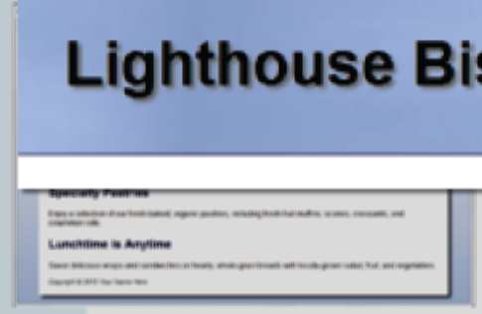


CSS3 text-shadow Property
A shadow effect on text
Configure the
  horizontal offset, < 0, > 0 – configures it on the right
  vertical offset, < 0, > 0 - configures it below
  blur radius, >=0, higher more blur
  valid color value
#wrapper { text-shadow: 3px 3px 3px #666; }

Slide 39
Hands-On Practice
HOP 4.12
Follow the directions in your book for the HOP.
START-UP File | lighthouselogo.jpg shadowch4 chapter4/starters
SAVE SOLUTION AS | index.html

Slide 40
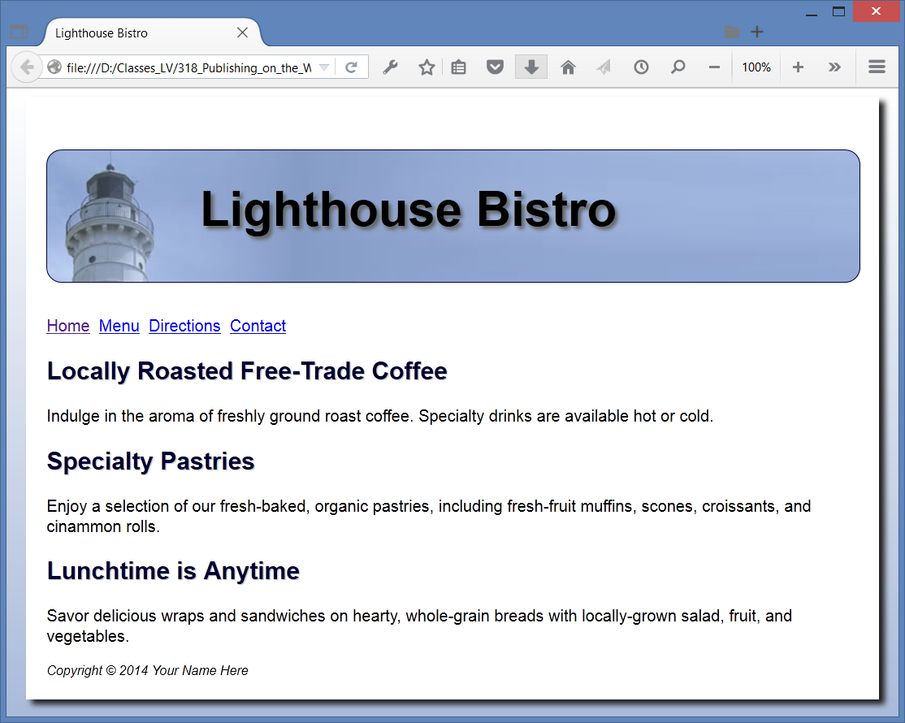
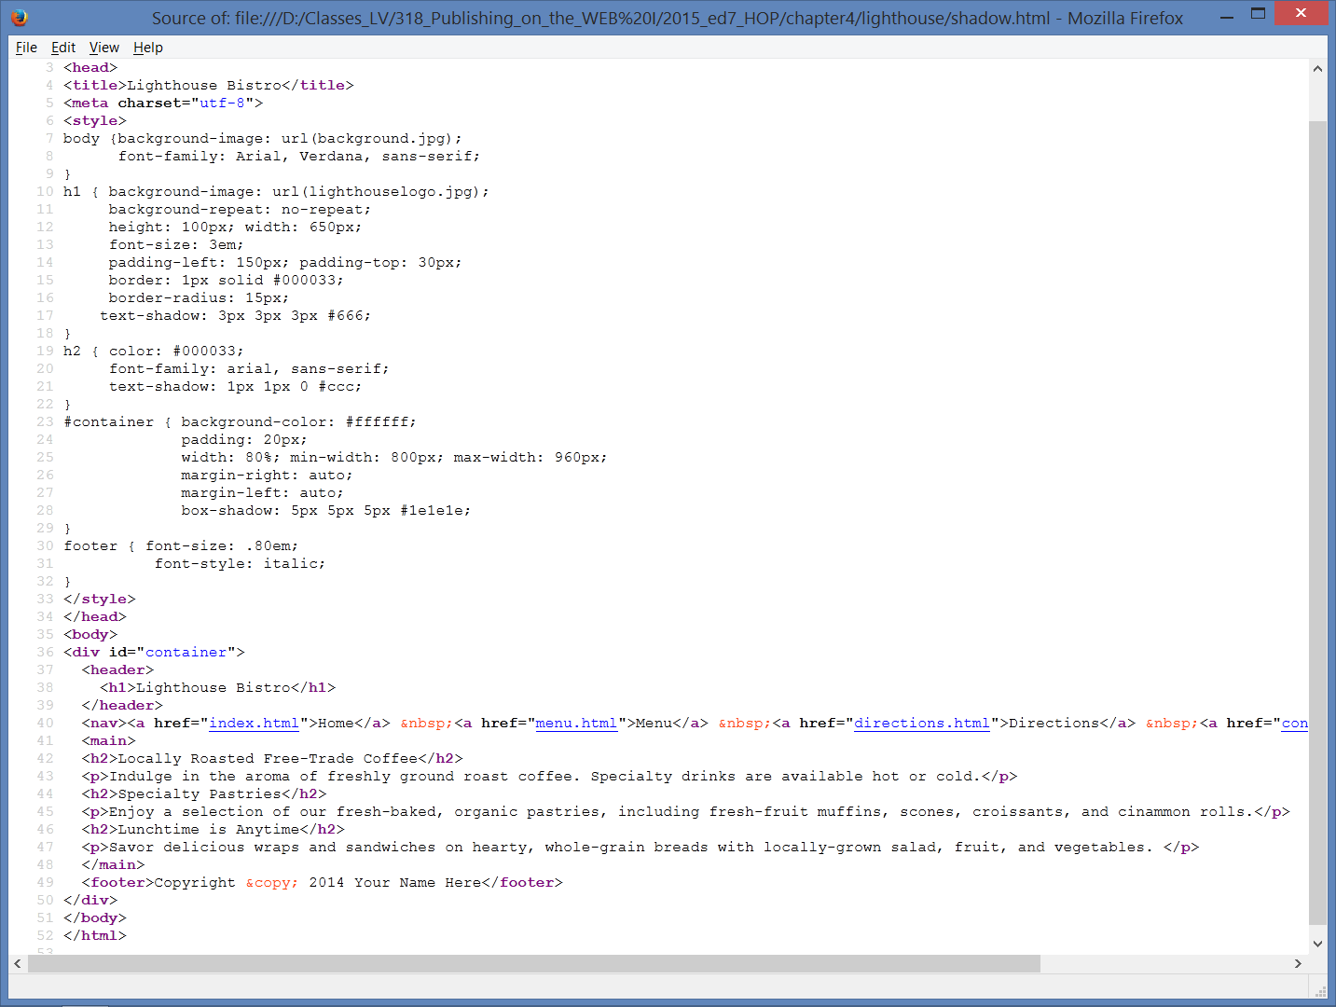

CSS3 text and box-shadow Property
HOP 4.12

Slide 41
Hands-On Practice
HOP 4.13
Follow the directions in your book for the HOP.
START-UP File | background.jpg heroback2.jpg headerbackblue.jpg kayakch4 chapter4/starters chapter4/starter2.html
SAVE SOLUTION AS | index.html

Slide 42
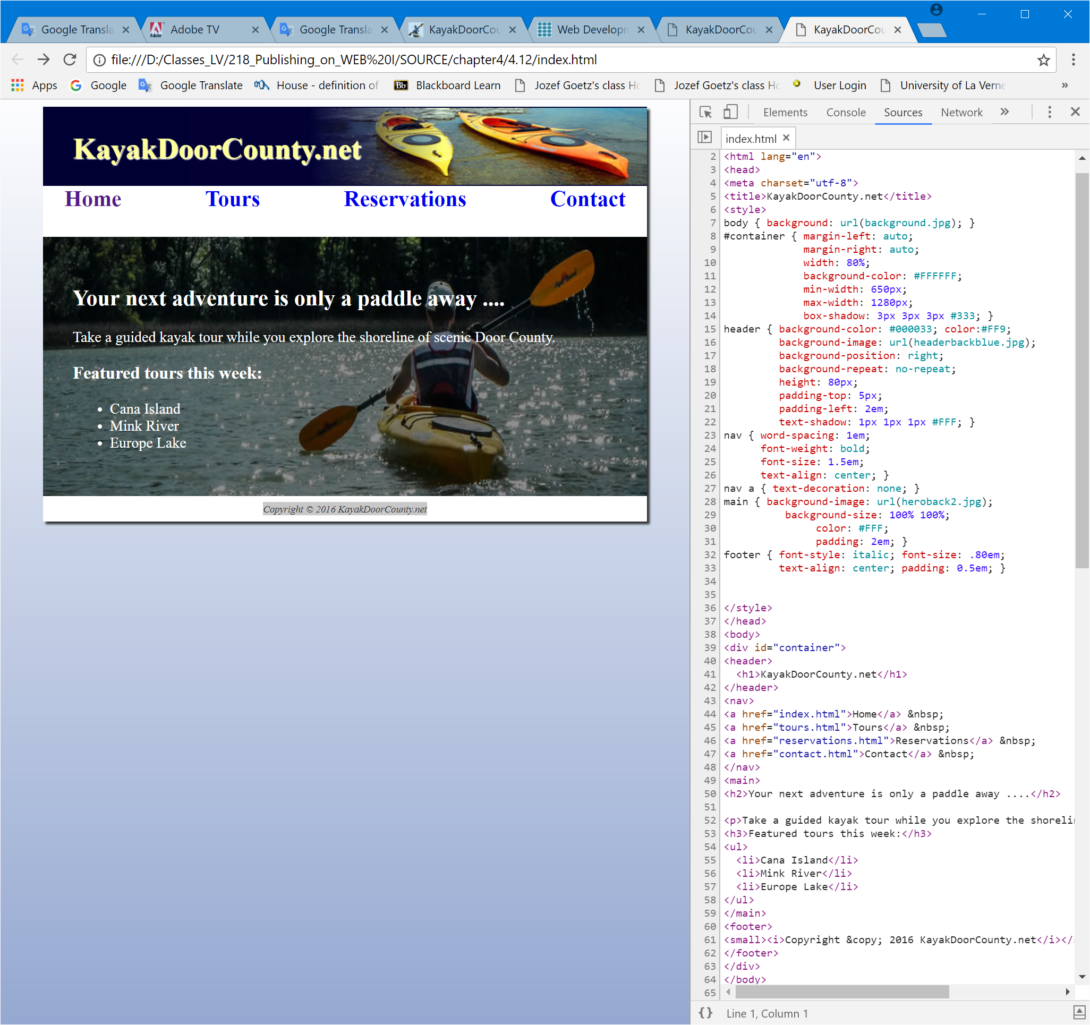
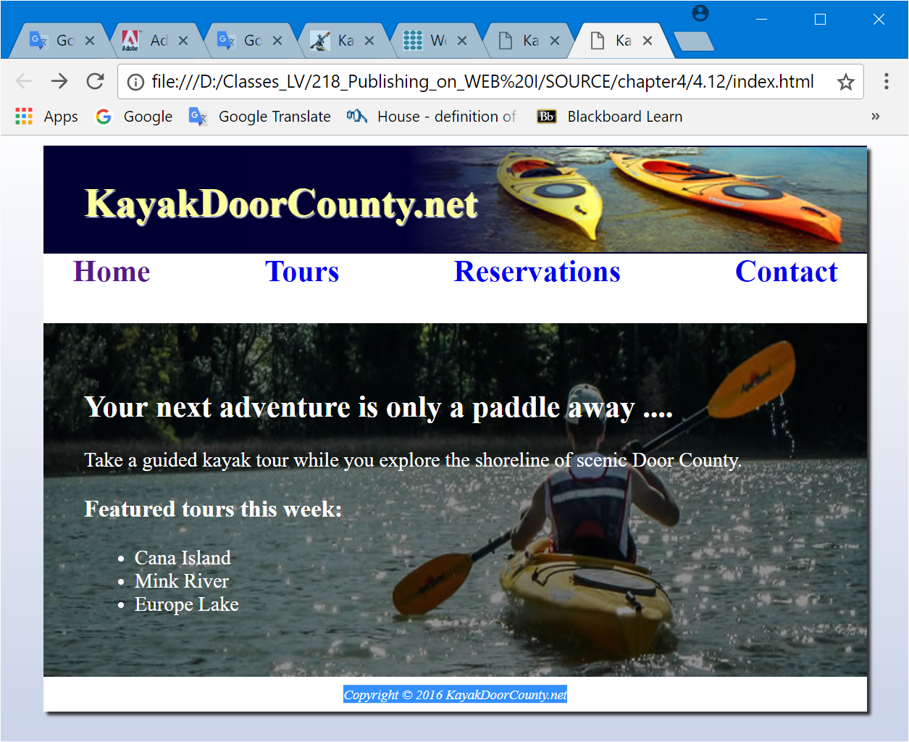


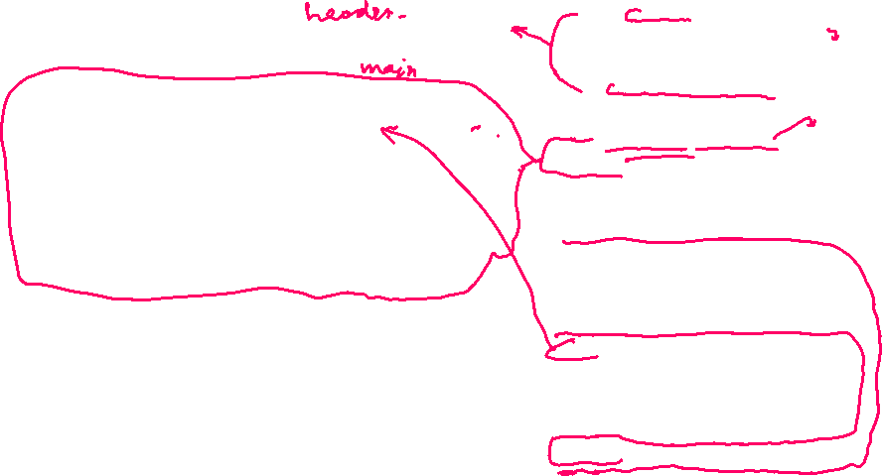

HOP 4.13 – centered content

Slide 43
Hands-On Practice
HOP 4.14, 4.15 and 4.16
Follow the directions in your book for the HOP.
START-UP File | fall.jpg chapter4/starters
SAVE SOLUTION AS | index.html

Slide 44
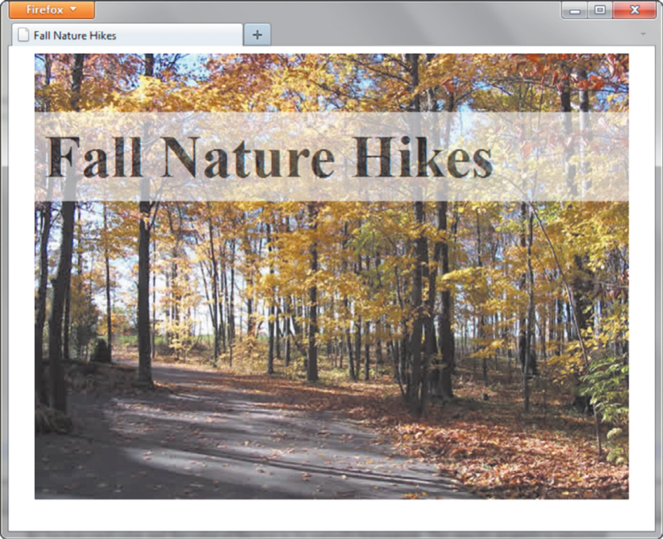
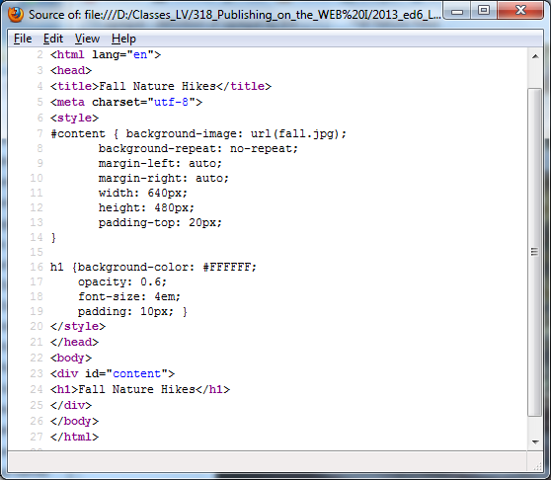
CSS3 opacity Property HOP 4.14
Configures the opacity (transparency)
of the background color
Opacity range:
  0 Completely Transparent
  1 Completely Opaque
h1{ background-color: #FFFFFF;
opacity: 0.6; font-size:4em;
padding:10px;}

Slide 45
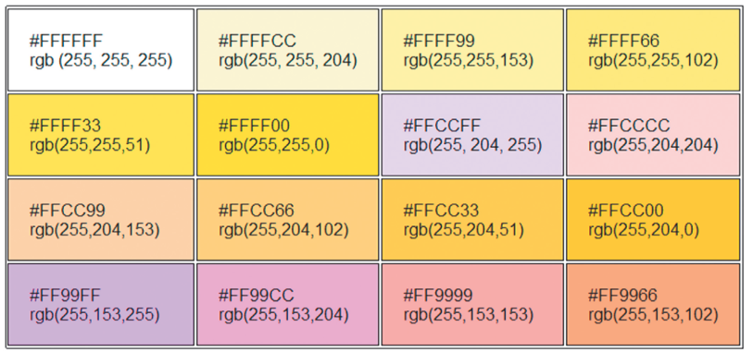
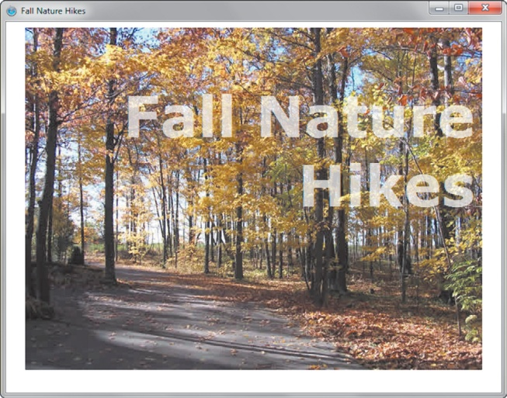
RGBA Color HOP 4.15
Configures transparent color
Four values are required:
Red color, Green color, Blue color, and Alpha (transparency)
  The values for red, green, and blue
  must be decimal values from 0 to 255.
  The alpha value must be a number between 0 (transparent) and 1 (opaque).
h1 { color: #ffffff;
color: rgba (255, 255, 255, 0.7);
font-size: 5em; padding-right: 10px;
text-align: right;
font-family: Verdana, Helvetica, sans-serif;
}

Slide 46
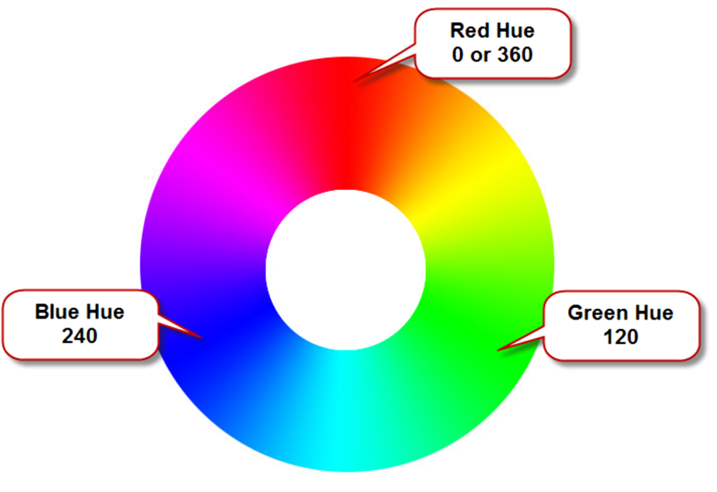
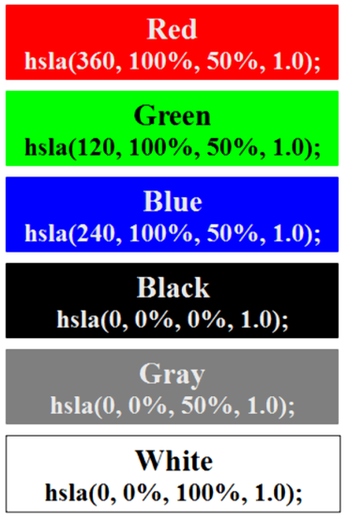
HSLA Color system - is based on color wheel
Hue, Saturation,
Light, Alpha
Hue is the actual color - a value between 0 and 360
Saturation is the intensity of the color: %
Lightness determines the brightness: %
Optional Alpha: from 0 to 1

Slide 47
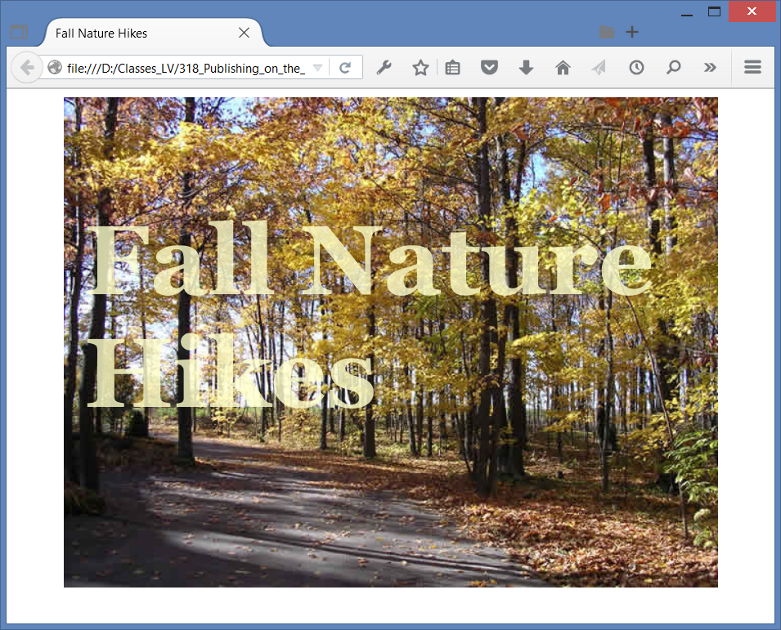
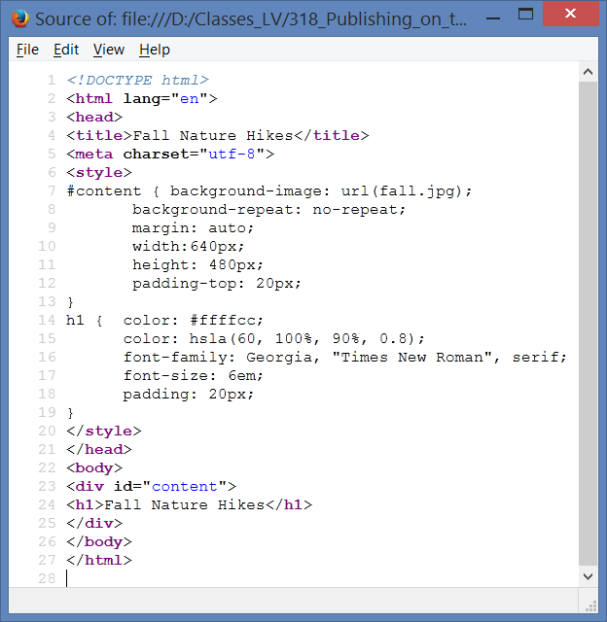
HOP 4.16 – configure light yellow transparent text

Slide 48
Hands-On Practice
HOP 4.17
Follow the directions in your book for the HOP.
START-UP File | chapter4/starter4.html
SAVE SOLUTION AS | index.html

Slide 49
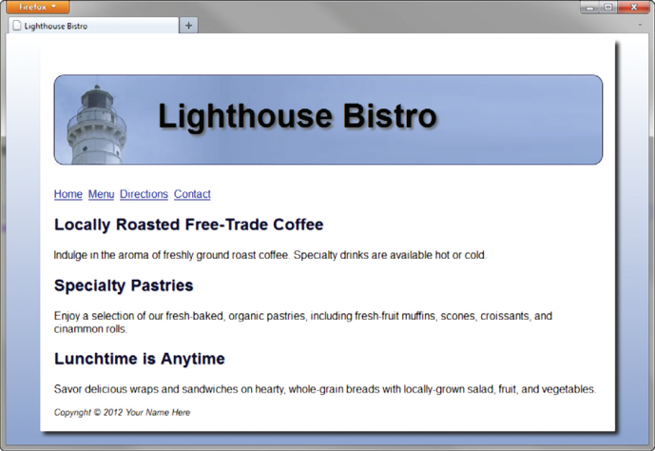

CSS3 Gradients
Gradient: a smooth blending of shades from one color to another with indication the direction of the gradient
Use the background-image property
  linear-gradient()
  radial-gradient()
Example:
body {
background-color: #8FA5CE;
background-image: linear-gradient(to bottom, #FFFFFF, #00FF00); /*W3C syntax */
} /* no use a jpg background to get the same effect as HOP 4.11
// to bottom indicates the direction of the gradient, next values indicate the color starts and the color stops
background-image: radial-gradient(#FFFFFF, #0000FF);

Slide 50
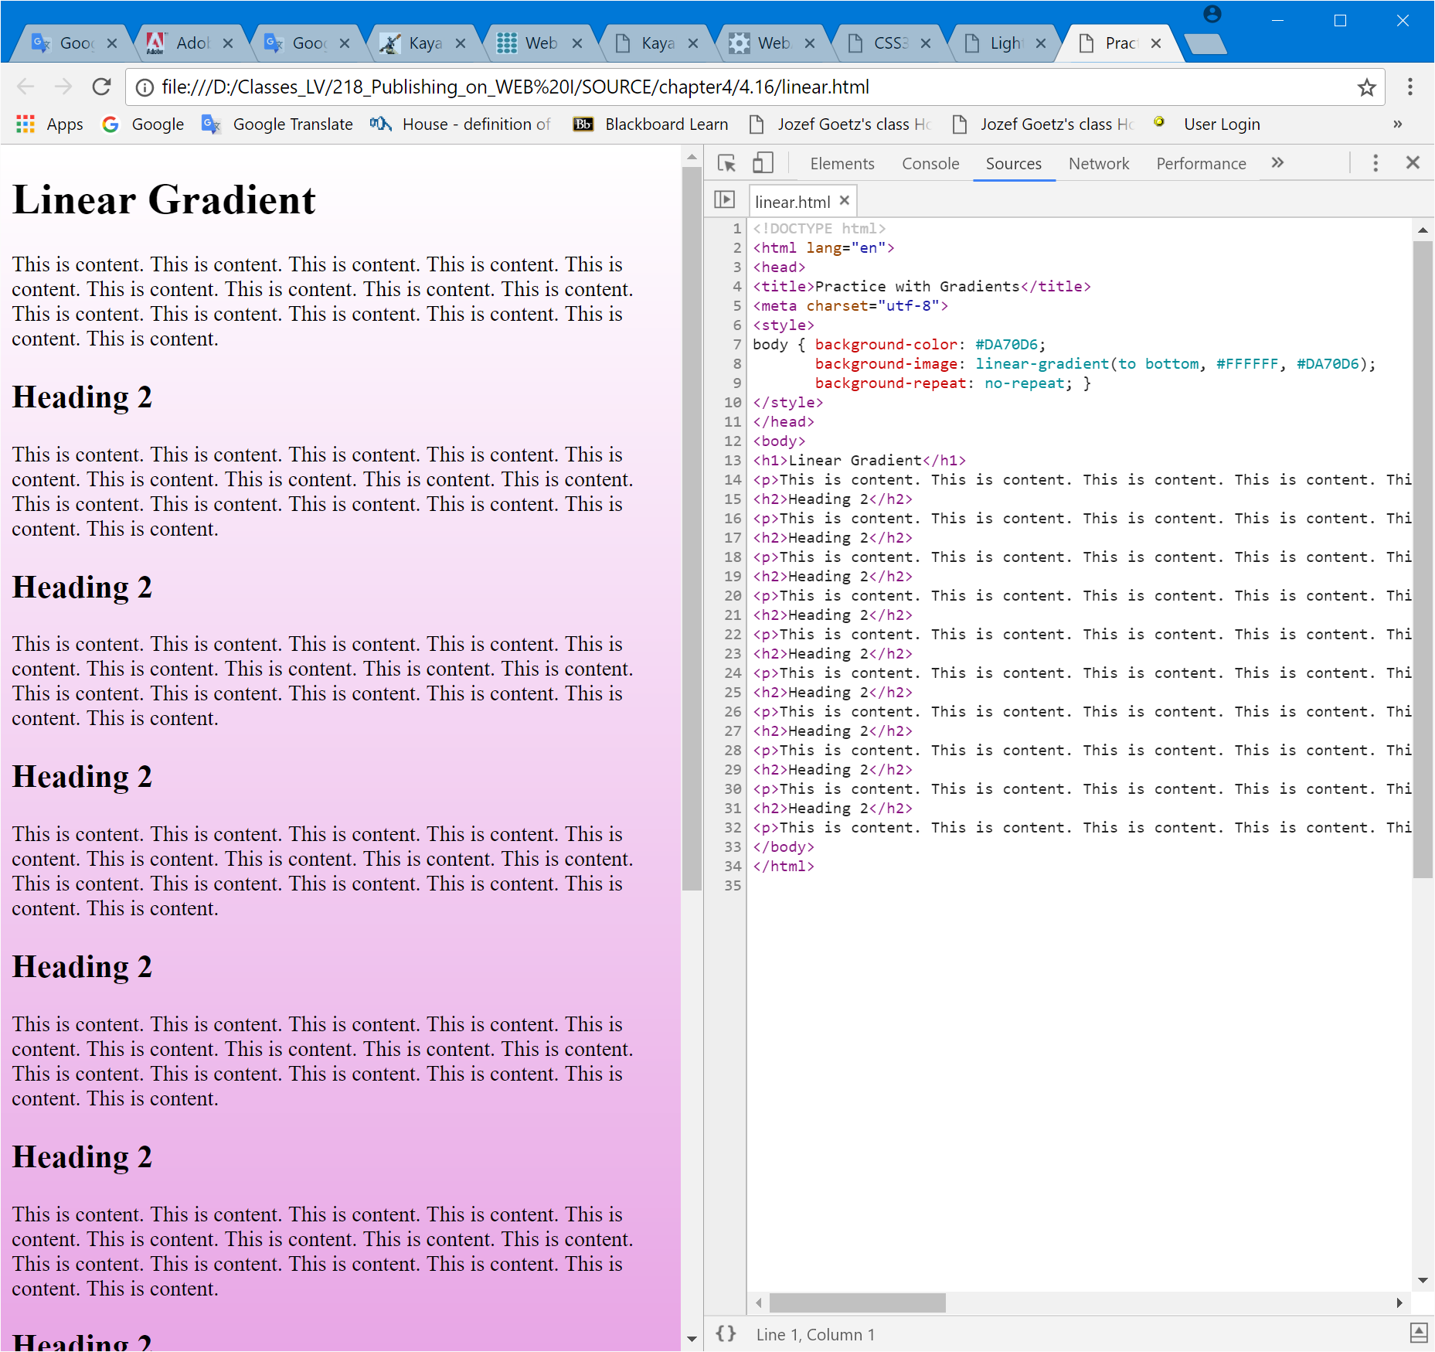
CSS3 Linear Gradients: HOP 4.17

Slide 51
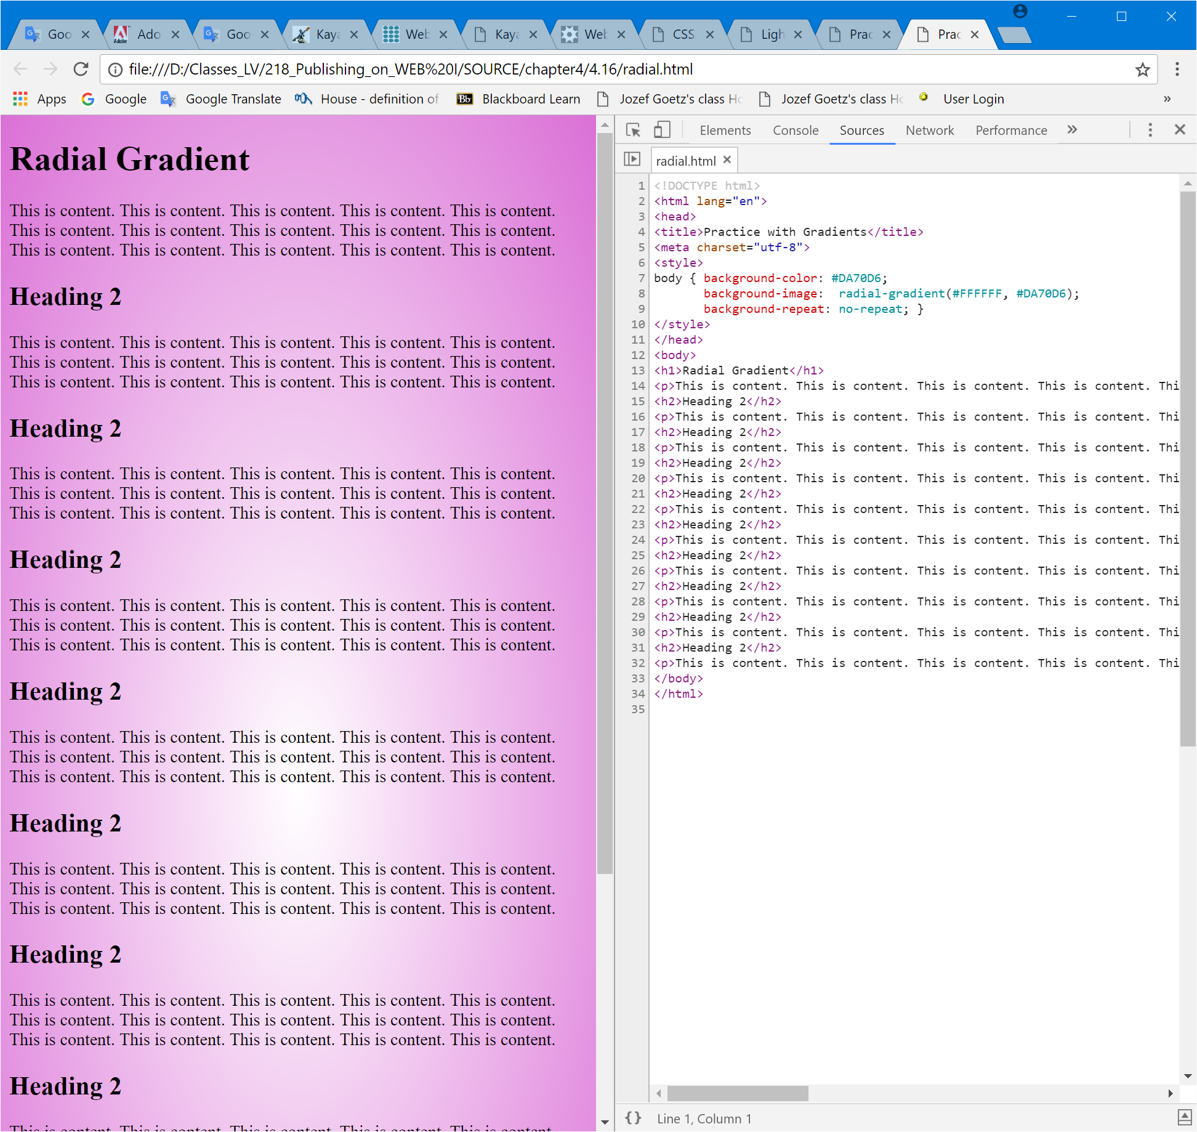
CSS3 Radial Gradients: HOP 4.17

Slide 52
Summary
This chapter introduced the use of color and graphical elements and image hyperlinks:
the key solution for one of the navigation image links:
  #bar { background-color: #152420; }
  img { border: none; }
  main { background-image: url(heroback.jpg);
  background-repeat: no-repeat; }
  inside the body:
  <nav id="bar">
  <a href="index.html"><img src="home.gif" alt="Home" width="90" height="35"></a> &nbsp;
As you continue to create web pages, look back at the guidelines and accessibility issues related to graphics.
The number one reason for visitors to leave web pages is too long of a download time.
  When using images, be careful to minimize this issue.
Provide alternatives to images (such as text links) and use the alt attribute on your pages.

Slide 53
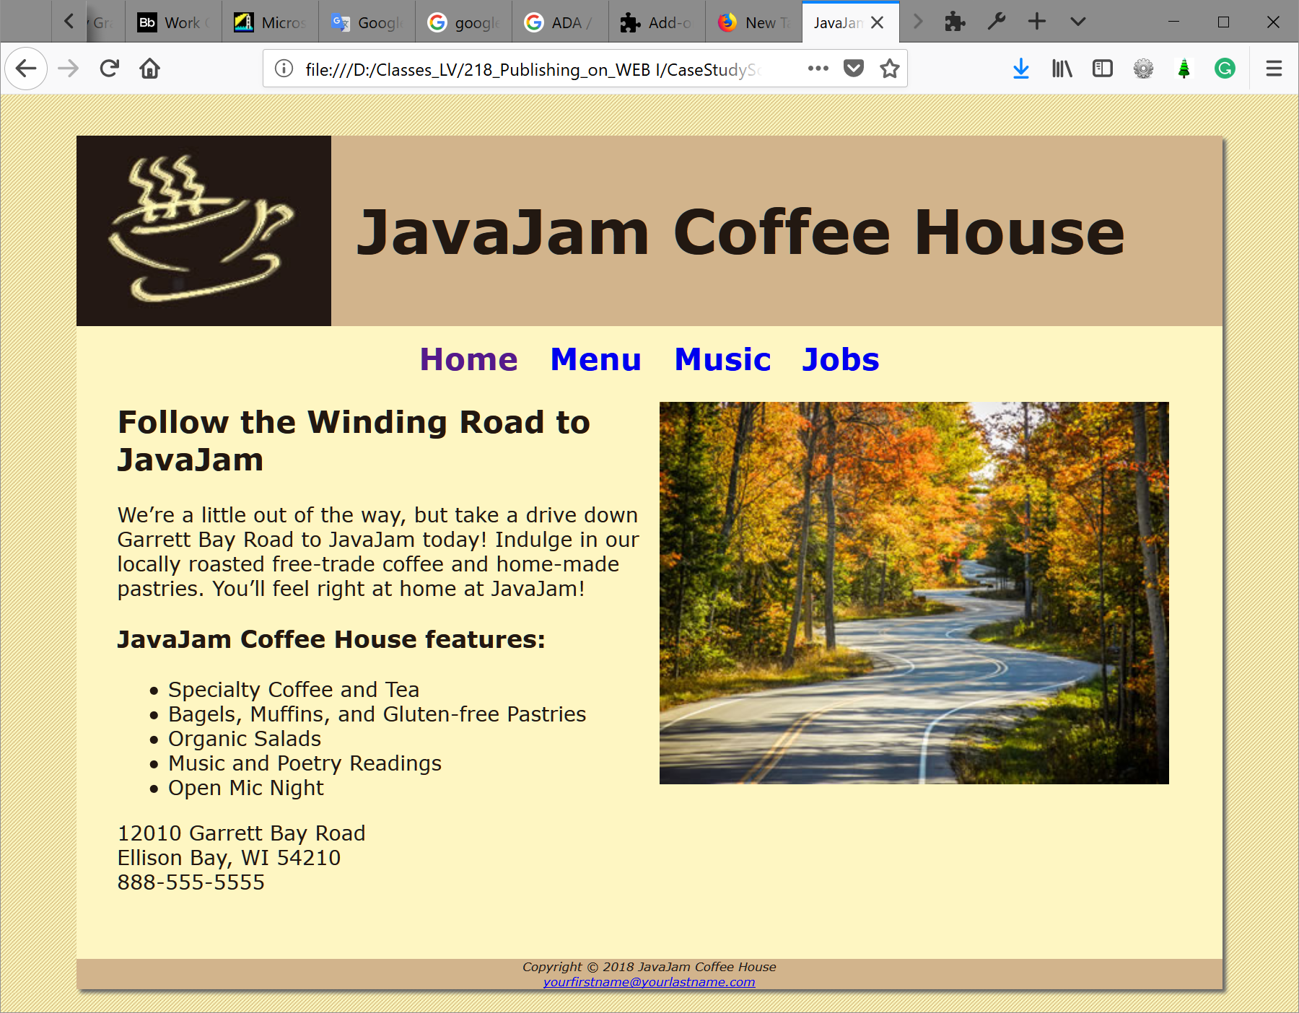


Project Ch4 JavaJam Coffee House – add images and a new web page - music.html
music.html

Slide 54





Project Ch4

Slide 55



Project Ch4 Path of Light Yoga Studio – add images and a new web page - schedule.html

Slide 56


Project Ch4 Fish Creek Animal Hospital

