Slide 1
Chapter 5
Web Design
Part I
Expanded by J. Goetz, 2025
Credits: © 2011- 2022 Pearson Education
Copyright (c) 2006 Prentice-Hall. All rights reserved.

Slide 2
Learning Outcomes
In this chapter, you will learn how to: http://webdevfoundations.net/
  5. 1 Overall Design
  5.2 Types of web site organization – site map
  5.3 Describe web page design principles - CARP
  5.4 Utilize guidelines for creating accessible web pages
  5.5 Text design: Best Practices - Writing for the Web
  5.6 Making color choices
  5.7 Graphic design: Best Practices
  5.8 Web page design: Best Practices
  5.9 Navigation design: Best Practices
  5.10 Page layout design: Best Practices
  5.10.1 Wireframes
  5.10.2 Page layout design techniques: Fixed, Jello, Fluid
  5.11 What separates the good from the bad?
  Apply Best Practices of web design
  5.12 Responsive Web design

Slide 3
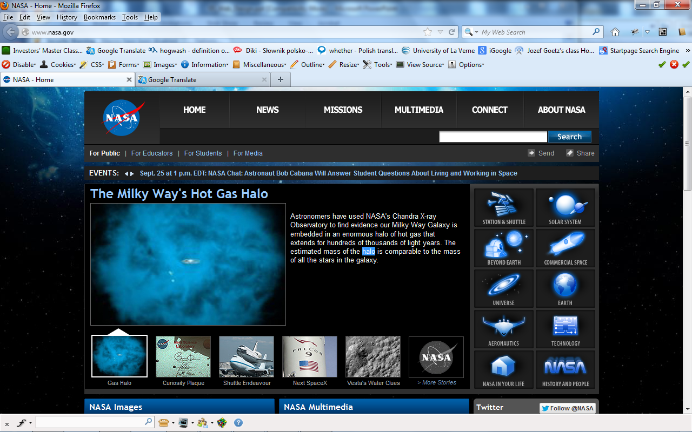
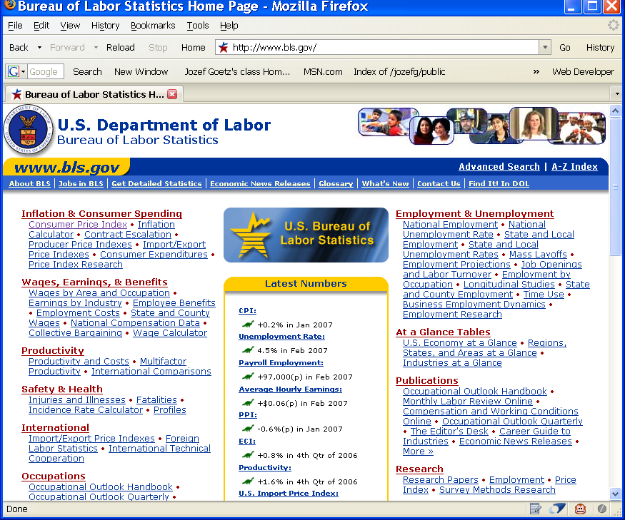
5. 1 Overall Design Is Related to the Site Purpose
1st one: compelling graphics and has a different look and feel from the 2nd the text-based link-intensive Bureau of Labor Statistics site.
1st one engages you and draws you in.
2nd one provides you with a wide range of choices so that you can quickly get down work.
Consider the target audience of these sites.

Slide 4
5.2 Web Site Organization
Diagram - flowchart –that shows the navigational flow of a Web site
Diagram of the organization of a Web (or architecture) is called a site map or storyboard
  Useful for planning and designing a complex Web site
Create the flowchart before actually creating and linking the site’s pages
Copyright (c) 2006 Prentice-Hall. All rights reserved.
4

Slide 5
5.2 Web Site Organization
How will visitors move around or navigate your site?
How will visitors find what they need?
Web Site Organization types:
  A. Hierarchical
  B. Linear
  C. Random (sometimes called Web Organization)

Slide 6
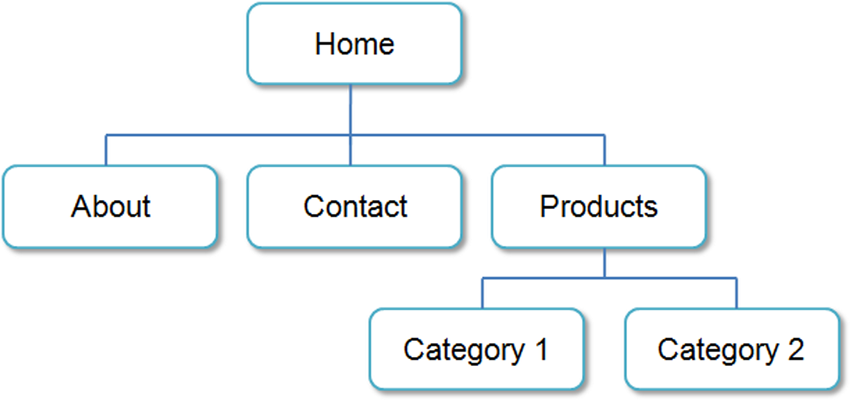
A. Hierarchical Organization
Characterized by a clearly defined home page with links (no arrows) to major site sections
Often used for commercial and corporate web sites
  http://www.ebay.com/ - great to understand the menu layout

Slide 7
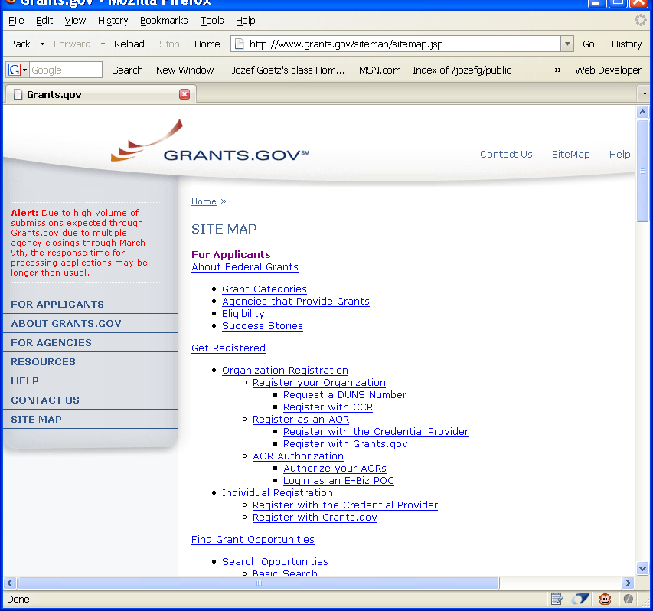
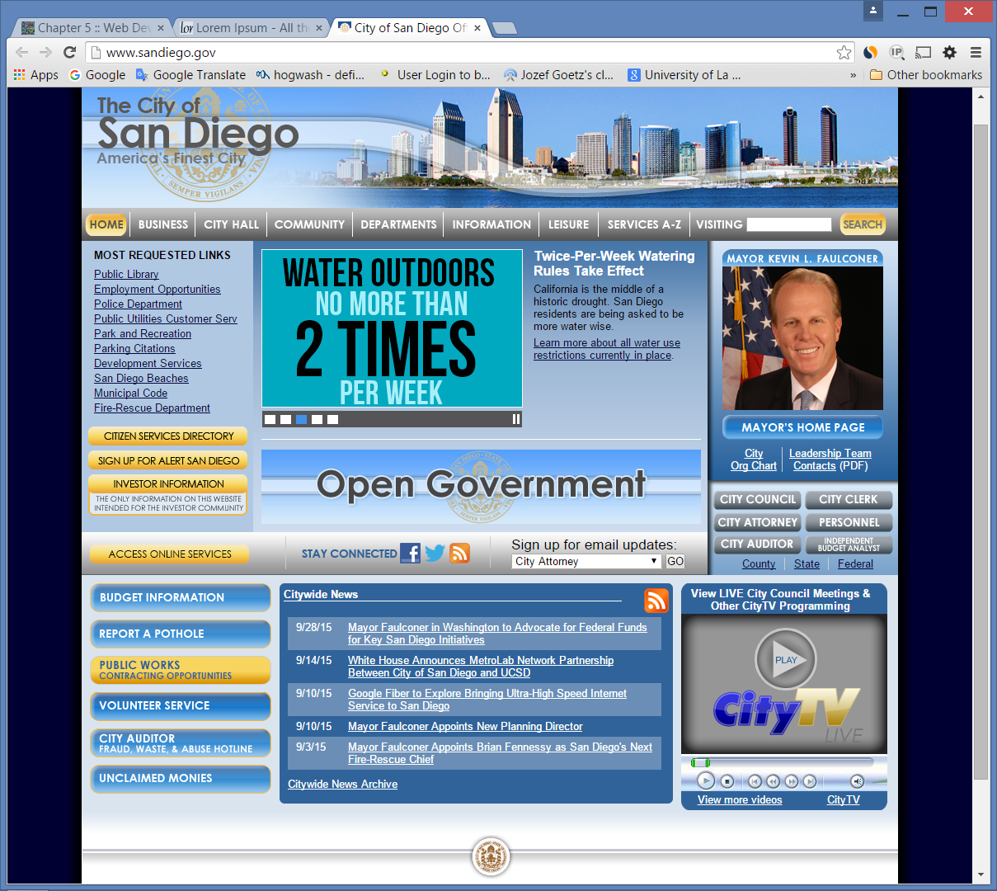

A. Hierarchical Organization
A site map
A site search
http://www.sandiego.gov/

Slide 8
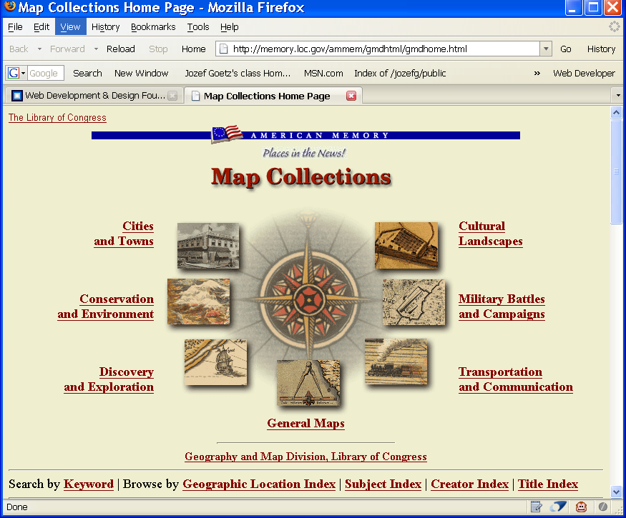
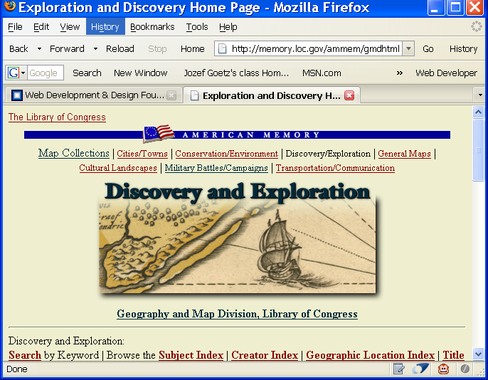
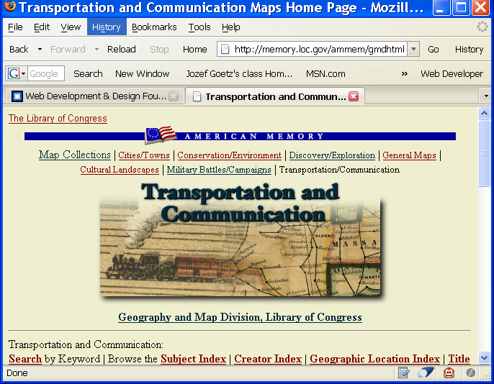
A. Hierarchical Organization
Main sections (dashboard) content pages have a similar look and feel
Each main section may have one or more subpages

Slide 9
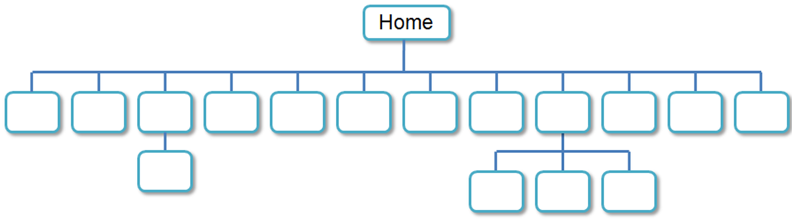
A. Hierarchical Too Shallow
Be careful that the organization is not too shallow.
  This provides many choices and could result in a confusing and less usable web site
Information Chunking
  George A. Miller (psychologist from Princeton Univ.) found that humans can store only 5 to 9 chunks of information at a time in short-term memory.
  He called the 7 + 2 principle.
  Many web designers try not to place more than 9 major navigation links on a page or in a well-defined page area.

Slide 10
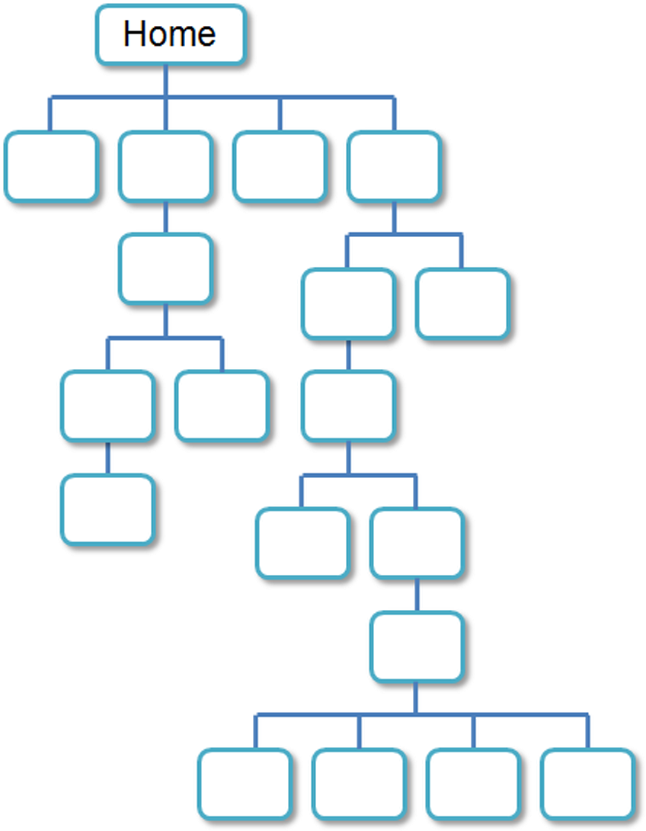
A. Hierarchical Too Deep
Be careful that the organization is not too deep.
  This results in many “clicks” needed to drill down to the needed page.
  User Interface “Three Click Rule”
    A web page visitor should be able to get from any page on your site to any other page on your site with a maximum of 3 hyperlinks
      Otherwise the user begin to feel frustrated and may leave your site

Slide 11
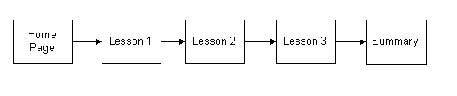
B. Linear Organization
Used when the purpose of a site or series of pages on a site is to provide a tutorial tour, or presentation that needs to be viewed in a sequential fashion.

Slide 12
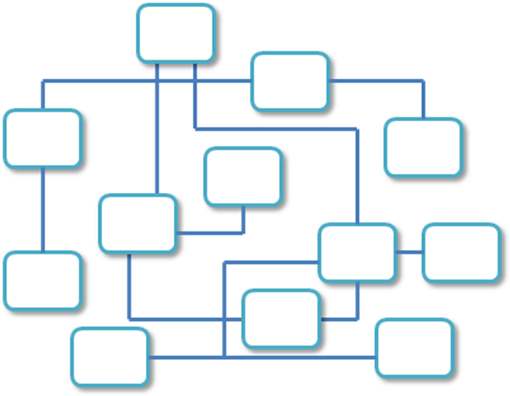
C. Random Organization
Sometimes called “Web” or Random Organization
Utilized there is no clear path through the site
May be used with artistic or sites that strive to be especially different and original
Generally not used for commercial web sites.

Slide 13
5.3 Visual Design Principles
Use 4 visual design principles (CARP):
    CONTRAST
    ALIGNMENT
    REPETITION
    PROXIMITY
whether you design:
      a Web page,
      a button,
      a logo,
      a CD cover or
      a software interface etc.
It will create the “look and feel” of your project and will determine whether your msg is effectively communicated.
Make the design interesting

Slide 14
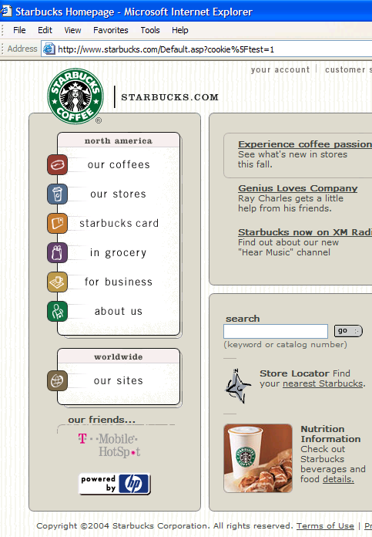
5.3 Visual Design Principles
Repetition
ties the work together
  Repeat
    visual elements
    color
    shape
    image
  Repetition throughout the product helps to unify a design
    repeating the color of a background
    repeating the shape
      e.g. the square icons with rounded corners and a # of rounded rectangles
  Align elements to create visual unity

Slide 15

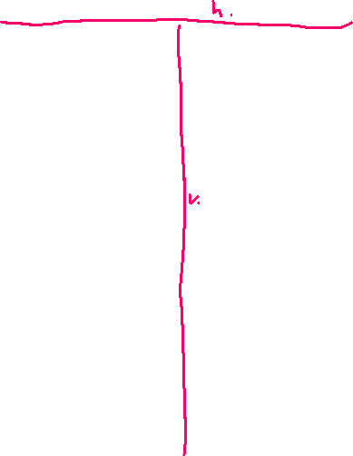
Visual Design Principles p.209
2. Contrast
  between the bkground color & the text
  make elements very different to draw attention
  add visual excitement
  i.e. site uses dark text on a medium or light bkgrd to provide good visual contrast and easy reading - http://webaim.org/resources/contrastchecker/
3. Proximity
  group related items physically close together
    the vertical navigation links are all placed in close proximity to each other
    it gives visual clues to the logical organization of info and functionality
4. Alignment
  each element placed has some vert. & hor. alignments with another element on the page
  it helps to create a cohesive Web page
  align elements to create visual unity (cohesive Web page)
  e.g.
    site rectangles in navigation are aligned v.
    2 columns of the page aligned h.
    links in the top right site of the page aligned v.
CARP is used on this site

Slide 16
5.4 Designing for Accessibility: Quick Checklist Courtesy of W3C
Vinton Cerf, the co-inventor of TCP/IP and the former chairman of the Internet Society, proclaimed, "The Internet is for everyone”. I proclaim the same for AI: AI is for everyone.
Tim Berners-Lee, the inventor of the World Wide Web, states,
"The power of the Web is in its universality. Access by everyone regardless of disability is
an essential aspect" (see http://www.w3.org/WAI/).
Who benefits from increased accessibility?
Consider the following scenarios:
Maria, a young woman in her twenties with physical challenges who cannot manipulate a mouse and who uses a keyboard with much effort…
Leotis, a college student who is deaf and wants to be a Web developer…
Jim, a middle-aged man who has a dial-up Internet connection and is using the Web for personal enjoyment.
Nadine, a mature woman with age-related macular degeneration who has difficulty reading small print.
Karen, a college student using a different type of user-agent, such as a cell phone, to access the Web.
Prakesh, a man in his thirties who is legally blind and needs access to the Web to do his job…
All the individuals above benefit from Web pages designed with accessibility in mind.
A Web page that is
  designed to be accessible
  typically more usable for all

Slide 17
5.4 Designing for Accessibility: Quick Checklist Courtesy of W3C
Legal Requirement: Section 508 - Accessibility is protected by laws in the United States.
  Section 508 of the Rehabilitation Act requires electronic and information technology, including Web pages, used by federal agencies to be accessible to people with disabilities.
  The accessibility recommendations discussed in this textbook are intended to satisfy the Section 508 standards and follow the WCAG 1.0 Web Content Accessibility Guidelines recommendations discussed below. See http://www.access-board.gov/sec508/guide/1194.22.htm for an informative, descriptive list of the Section 508 Standards for Web pages.
The federal government is promoting accessibility by law and the private sector is following its lead.
The W3C is also active in this cause and has created the Web Accessibility Initiative (WAI) (see http://www.w3.org/WAI/ ) to create guidelines and standards applicable to
  Web content developers,
  authoring tool developers, and
  browser developers.

Slide 18
5.4 Designing for Accessibility
Standards: WCAG 2.1
  The purpose of this new version Web Content Accessibility Guidelines WCAG 2.1 of Web content accessibility guidelines is to address
    a variety of different Web technologies,
    be easier to understand, and
    be more precisely tested.
  Check the WAI's WCAG Overview page (http://www.w3.org/WAI/intro/wcag.php and the textbook's Web site (http://webdevfoundations.net) for updates on WCAG 2.1.
Developing accessible Web sites is an important aspect of Web site design.
Web authoring tools such as Adobe Macromedia Dreamweaver provide extensions that will help you create accessible sites.
  The Cynthia Says Portal (http://www.cynthiasays.com/) provides a free accessibility validation service to test your site.

Slide 19
5.4 Designing for Accessibility Quick Checklist Courtesy of W3C
Web Content Accessibility Guidelines 2.1 (WCAG 2.1)
  http://www.w3.org/TR/WCAG21/Overview
  https://www.w3.org/WAI/WCAG21/quickref/?versions=2.1
Based on 4 Principles (the acronym POUR)
  Perceivable
  - Content must be Perceivable i.e. easy to see and hear.
  -Any graphic should be available in a text format (description, captions etc)
  2. Operable
  - Interface components in the content must be Operable i.e. content has navigation form and operated with either a mouse or keyboard.
  - Avoid flashing , which may cause a seizure.
  3. Understandable
  - Content and controls must be Understandable i.e. easy to read and organized in a consistent manner.
  4. Robust.
  - Content should be Robust enough to work with current and future user agents, including assistive technologies such as screen reader apps.
  - Robust content is written to follow W3C recommendation

Slide 20
Web Content Accessibility Guidelines
From http://www.w3.org/TR/WCAG20/Overview - Web Content Accessibility Guidelines (WCAG) 2.1 p.659 Appendix D
WCAG 2.0 Guidelines1 Perceivable
  1.1 Provide text alternatives for any non-text content so that it can be changed into other forms people need, such as large print, braille, speech, symbols or simpler language.
  1.2 Provide alternatives for time-based media.
  1.3 Create content that can be presented in different ways (for example simpler layout) without losing information or structure.
  1.4 Make it easier for users to see and hear content including separating foreground from background.
2 Operable
  2.1 Make all functionality available from a keyboard.
  2.2 Provide users enough time to read and use content.
  2.3 Do not design content in a way that is known to cause seizures.
  2.4 Provide ways to help users navigate, find content, and determine where they are.

Slide 21
Web Content Accessibility Guidelines
From http://www.w3.org/TR/WCAG20/Overview - Web Content Accessibility Guidelines (WCAG) 2.0
3 Understandable
  3.1 Make text content readable and understandable.
  3.2 Make Web pages appear and operate in predictable ways.
  3.3 Help users avoid and correct mistakes.
4 Robust
  4.1 Maximize compatibility with current and future user agents, including assistive technologies.

Slide 22
5.4 Designing for Accessibility: Quick Checklist Courtesy of W3C
Web Accessibility Initiative WAI Quick Tips (http://www.w3.org/WAI/References/QuickTips/ )
Images & animations.
  Use the alt attribute to describe the function of each visual.
Image maps.
  Use the client-side map and text for hotspots.
Multimedia.
  Provide captioning and transcripts of audio, and descriptions of video.
Hypertext links.
  Use text that makes sense when read out of context. For example, avoid "click here.“
Page organization.
  Use headings, paragraphs, lists, and consistent structure.
  Use Cascading Style Sheets for layout and style where possible.

Slide 23
5.4 Designing for Accessibility
Graphs & charts.
  Summarize or use the longdesc attribute.
7. Scripts, applets, & plug-ins.
  Provide alternative content in case active features such as JavaScript, Java Applets, Flash are inaccessible or unsupported.
8. Frames.
  Use the <noframes> element and meaningful titles.
9. Tables.
  Make line-by-line reading sensible. Summarize.
10. Check your work.
  Validate. HTML at http://validator.w3.org
  Validate CSS at http://jigsaw.w3.org/css-validator/
  Validate Accessibility at http://www.cynthiasays.com/
    Use tools, checklist, and guidelines at http://www.w3.org/TR/WCAG

Slide 24
5.4 Designing for Accessibility
Finally, the Section 508 Standards require that if a Web page cannot comply with accessibility requirements
  a separate text-only version of the Web page must be provided and regularly updated.
    Although the text pages could be coded manually, other options exist to provide this functionality.
      The LIFT Text Transcoder server, available from UsableNet dynamically generates text-only, accessible pages that comply with accessibility standards

Slide 25
5.5 Text Design: Best Practices - Writing for the Web
The text content should be quickly scanned:
  Avoid long blocks of text
  Use short sentences and phrases
  Use bulleted list
  Be concise
  Use headings and subheadings
  Use unordered list
  Bold and emphasized important text
  Use left-aligned text
  Use multiple column if possible
  Use fonts such as Arial, Verdana, Georgia or Times New Roman
    Some fonts may be not available on the visitor’s computer
    The san serif Verdana font, designed by Microsoft specifically for computer screens, may be more readable than Arial due to increased width and openness of the letters.
  11. Font size
    12 point = “Medium” size is the same as 1 em, size=“3” , 100%
    Fonts display smaller on Mac than on a PC
  12. Check spelling and grammar (Chek yur spellin)

Slide 26
5.5 Text Design: “Easy to Read” Text
  13. Color
    You may take from an image or logo
    Make sure your bckgrnd color properly contrast (with your text, link, visited link, and active link colors
    14. Use strong contrast between text & background => http://webaim.org/resources/contrastchecker/
  15. Use white space and multiple columns instead of large areas of horizontal text
  16. A paragraph of centered text is more difficult to read than left-aligned text
  17. Important text bold (<strong> tag) or emphasize (<em> tag)
  18. Hyperlink keywords or phrases – don’t hyperlink entire sentences.
    Avoid hyperlink “click here” – everyone knows by now
  19. Use vocabulary that they will be comfortable with your target audience – test at https://juicystudio.com/services/readability.php

Slide 27

5.6 Making Color Choices
Color Theory:
  the study of color and its use in design
Color Wheel is a circle of color depicting p.215
  Primary Colors: red, yellow, blue
  Secondary Colors: orange, violet, green
  Tertiary Colors: red-orange, yellow-orange, red-violet, blue-violet, blue-green, and yellow-green

Slide 28



Color Schemes Based on The Color Wheel (1)
Monochromatic – consists of =>
  shades – a color is darker than the original – mixed with black
  tints – a color is lighter than the original – mixed with white
  tones - a color has less saturation than the original - mixed with grey
    Tool to determine the above values
    http://meyerweb.com/eric/tools/color-blend++
Analogous – a main color and two colors adjacent to it on the color wheel
Complementary – two colors that are opposite each other on the color wheel

Slide 29






Color Schemes Based on The Color Wheel (2)
4. Split Complementary – a main color, the color opposite it on the color wheel (the complement) and two colors adjacent to the complement
5. Triadic - three colors that are equidistant (4) on the color wheel
Tetradic – two complementary color pairs
http://www.colorsontheweb.com/colorwizard.asp+++

Slide 30
Implementing a Color Scheme
Implementing a Color Scheme
1. Choose one color to be dominant
  Choose from a logo or a photograph or other image
    http://www.colr.org
  Begin with a favorite color
    Use one of the sites below to choose other colors
      http://www.colorsontheweb.com/colorwizard.asp +++
      http://www.colorschemedesigner.com +
      http://www.colorjack.com
      helper to choose a color: http://paletton.com/#uid=1000u0kllllaFw0g0qFqFg0w0aF
2. Use colors as accents for
  headings,
  subheadings
  borders,
  list markers,
  backgrounds etc.

Slide 31
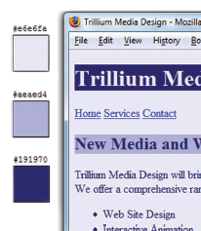
5.6 Making Color Choices
3. Use neutrals such as white, off-white, gray, black, or brown
4. Feel free to use tints, shades, or tones of colors of the primary, secondary, and tertiary colors
  Monochromatic
    http://meyerweb.com/eric/tools/color-blend +

Slide 32
Verify Sufficient Contrast
5. When you choose colors for text and background, sufficient contrast is needed so that the text is easy to read.
6. Use one of the following online tools to verify contrast:
  http://webaim.org/resources/contrastchecker/ ++
  http://snook.ca/technical/colour_contrast/colour.html ++
  http://juicystudio.com/services/luminositycontrastratio.php +

Slide 33
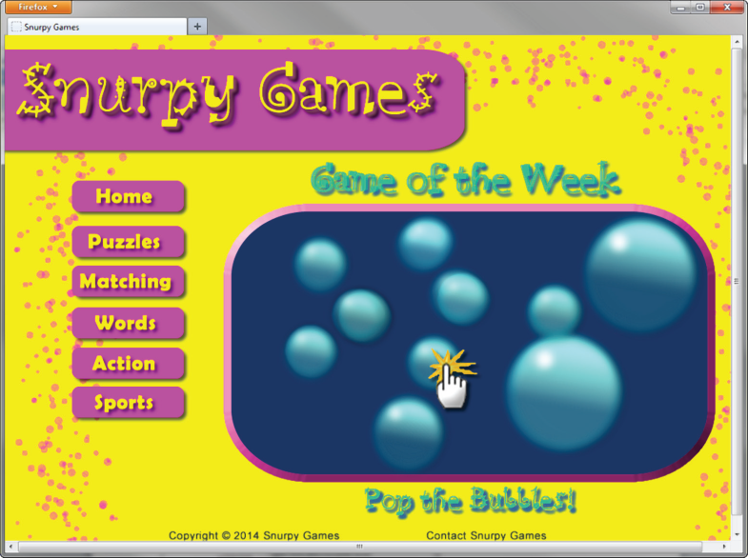
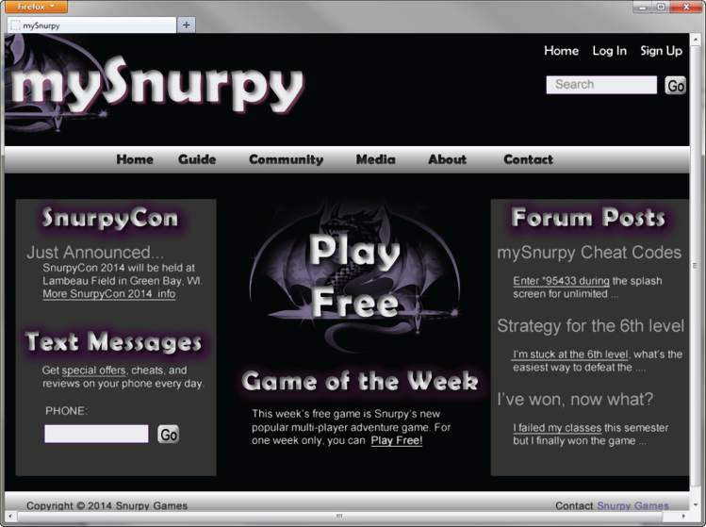
Appealing to Kids & Preteens
Appealing to Everyone
Color & Target Audience
http://nps.gov
Appealing to Young Adults
Appealing to Older Adults

Slide 34
5.7 Graphic Design: Best Practices(1)
Be careful with large graphics;
Rules:
  Limit the total size of the home page to 60 KB for non-broadband users
  recommendation on Never create images larger than 760 pixels wide
    The standard resolution for Web graphics is 72 pixels per inch
  Always Set Width and Height
  Use the alt attribute to supply descriptive alternate text
  Use the text transcript of an audio, video recording
  Use animation only if it makes the page more effective and provide a text description.
  Be sure your message gets across even if images are not displayed.
    If using images for navigation provide plain text links at the bottom of the page for accessibility by screen readers

Slide 35


5.7 Graphic Design: Recommended Practices(2)
Choose from 216 save colors on the web palette if consistency across older Windows/Mac platforms is needed
  Feel free to use tints, shades, or tones of colors
Use anti-aliased (smooth jagged edges) text in images
  Adobe Photoshop and Adobe Fireworks can be used to create it
10. Use only necessary images
Reuse images
Keep images as small as possible with acceptable display quality
  Create a thumbnail image that links to a larger version of the image

Slide 36
5.7 Graphic Design: Recommended Practices(2)
13. Make sure the site is usable if images are not displayed
  If there are a large number of images, or the page is dependent on images consider creating a special an alternate text-only version of the page
    Double maintenance for all future page modifications
  If your main navigation uses images, place a plain text navigation bar at the bottom of each page
  Don’t rely on images alone- some individuals may not be able to see them

Slide 37
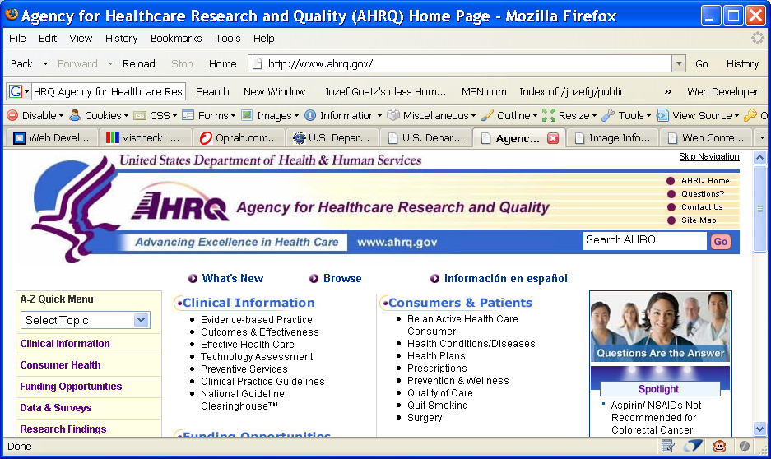
5.7 Graphic Design: Recommended Practices(2)
14. Limit the use of animated items.
  Only use animation if it makes the page more effective.
  Consider limiting how long an animation plays.
15. Provide a method to skip repetitive image based navigation
  “Skip Navigation” text link (to the text section) in the upper-right-hand side of the Web page.

Slide 38
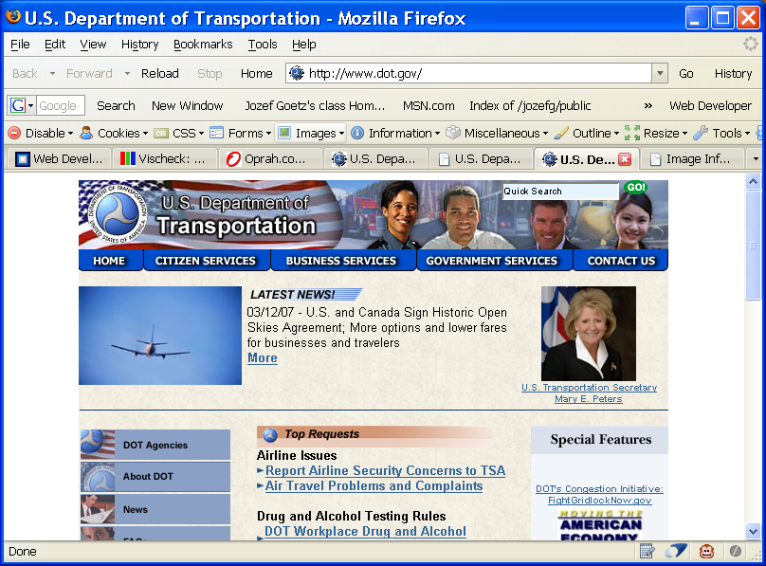
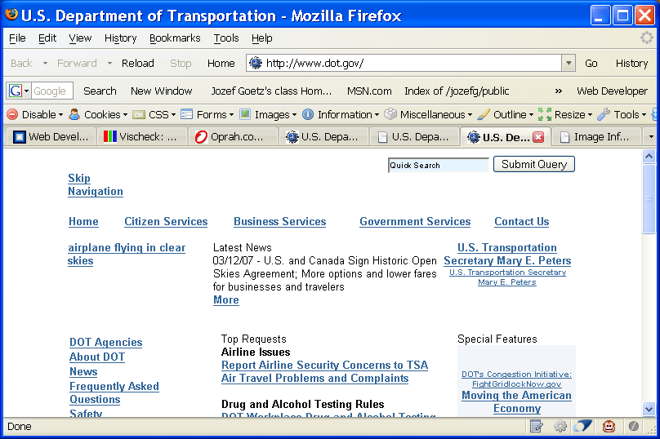


5.7 Graphic Design: Recommended Practices(2)
15. Continuation: Provide a method to Skip repetitive image based navigation
  Images cannot be visible for color blindness individuals
  Give the option to display “Replace all images with Alt attributes”
16. Use Web Developer tools for Mozilla (or Chrome): https://addons.mozilla.org/
Search for Web Developer by Chris Pederick
  Web Developer adds a menu and a toolbar with various Web developer tools to the browser. The tools allow the user to disable, view, and edit cookies, CSS, HTML, forms, and images; validate pages; and much more..
  If you use the Firefox’s Web Developer extension above and select “Disable Images => All images” from the “Images” menu you get the picture on the right side.

Slide 39
5.7 Web Page Design Browsers & Screen Resolution
17. Test with multiple browsers
  Google Chrome, Mozilla Firefox, Microsoft Edge, Opera, Apple Safari etc.
18. Test at various screen resolutions
19. Design to look good at various screen resolutions
  Centered page content
  Set to either percentage width or a fixed.

Slide 40
5.8 Web Page Design: Best Practices
1. The major components of Web Page Site (WPS):
  Accessibility considerations ➔ 5.4
  Text Design ➔ 5.5
  Graphic Design ➔ 5.7
  Web Page Design ➔ 5.8
  Navigation Design ➔ 5.9
  Page Layout Design ➔ 5.10
2. Another related factors
  usability
  appeal site to the target audience – use of
    color
    text
    graphics
    animation
3. Others
  load time
  browser support
  screen resolution

Slide 41
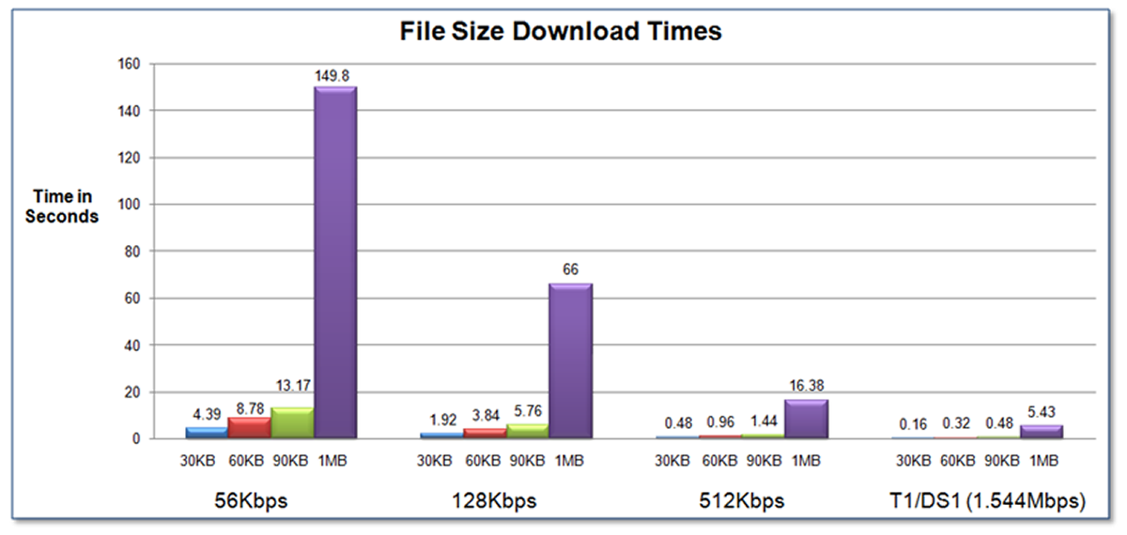
5.8 Web Page Design: 1. Load Time
Watch the load time of your pages
  not more than several secs
shorten the perceived loading time by
  breaking long pages
  dividing large images
  limiting web page document and associated media to under 500K for 2018, now 2.5 Mb for broadband users and under 60 KB for non-broadband users for on the home page

Slide 42
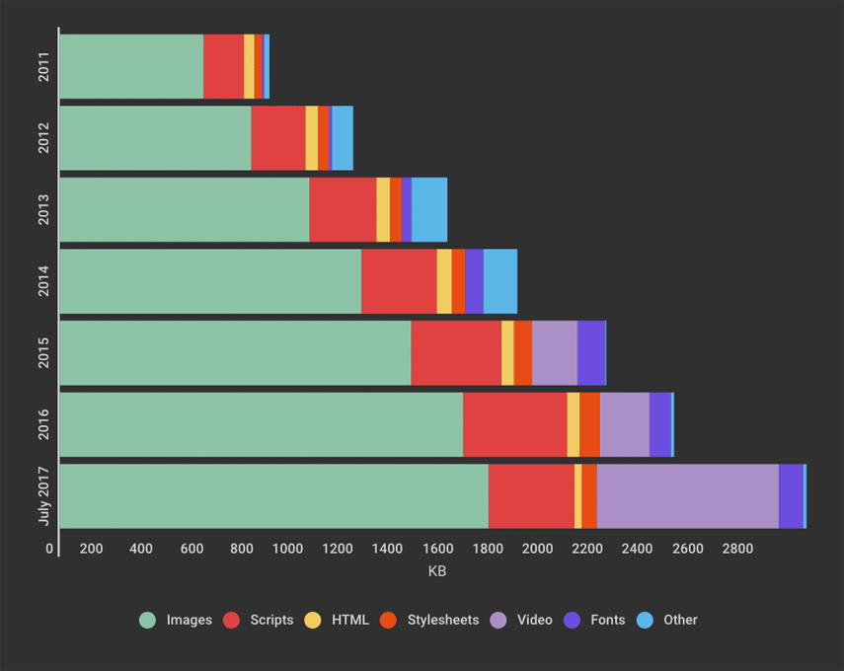
5.8 Web Page Design: 1. Load Time
  Typical page size for real estate is more than 3MB in 2017.
Here you can see page growth from 2011 to now, broken out by content type:

Slide 43
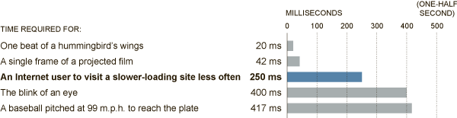
1. Load Time
On a mobile phone, a Web page takes a leisurely nine seconds to load, according to Google, which tracks a huge range of sites from the homes of large companies to the legions of one-person bloggers.
Download times on personal computers average about six seconds worldwide, and about 3.5 seconds on average in the United States.
These days, even 400 milliseconds — literally the blink of an eye — is too long, as Google engineers have discovered. That barely perceptible delay causes people to search less.
Google released some research in which they concluded:
  The average time it takes to fully load the average mobile landing page is 22 seconds. However, research also indicates 53% of people will leave a mobile page if it takes longer than 3 seconds to load.
For Impatient Web Users, an Eye Blink Is Just Too Long to Wait
According to Harry Shum, a Microsoft computer scientist, computer users will visit a Web site less if its loading time is slower than its competitors by 250 milliseconds, or one-quarter of a second. That is less time than a single eye blink.

Slide 44
5.8 Web Page Design: What is the average load time
https://www.machmetrics.com/speed-blog/average-page-load-times-websites-2018/: - no available for 2021-2023.
The following stats are consolidated from that Google report, which focuses on mobile landing page experiences.
While the average of the values in the table is 8.66 sec, the recommendation for 2018 is to be under 3 seconds.
Close to 30% of households do not have broadband access, so
  shorten the user’s perception of waiting
  try to limit your media files to 60 KB on the home page for non-bradband users
  divide large images into several smaller graphics since each graphics displays as it loads
Industry | United States | United Kingdom | Germany | Japan
Automotive | 9.5 sec | 12.3 sec | 11.0 sec | 10.3 sec
Business & Industrial Markets | 8.7 sec | 8.3 sec | 8.2 sec | 8.1 sec
Classifieds & Local | 7.9 sec | 8.3 sec | 7.0 sec | 8.3 sec
Finance | 8.3 sec | 8.0 sec | 8.6 sec | 7.6 sec
Media & Entertainment | 9 sec | 8.8 sec | 7.6 sec | 8.4 sec
Retail | 9.8 sec | 10.3 sec | 10.3 sec | 8.3 sec
Technology | 11.3 sec | 10.6 sec | 8.8 sec | 10sec
Travel | 10.1 sec | 10.9 sec | 7.1 sec | 8.2 sec
Testing tools: https://websiteincome.com/12-best-website-checker-tool/
https://app.speedcurve.com/benchmarks/
  https://testmysite.thinkwithgoogle.com/?gclid=EAIaIQobChMIsayb987D1gIVlFx-Ch3xlwA3EAAYASAAEgIB2PD_BwE - to test your URL speed; 2.3 sec for ULV (9/21/21)

Slide 45
5.8 Web Page Design
2. Appeal site to the target audience by
  color
    consistent color and logo
  text
  graphics
  animation
3. Above the Fold
  arrange interesting content above the fold (visible part of the web after download)
4. Web Page “Real Estate”
  determined by location: the upper-left side and top center of the page the most valuable
  b/c of eyes go there and all browser display that vs the far right site may not be displayed by browser at some screen resolution

Slide 46
5.8 Web Page Design
4. Adequate white space
  place blank or white space around block of text or graphics and between
5. Avoid wide pages and avoid scroll horizontally
    test in 800x600 pixels
      use 100% to avoid scroll horizontally or 760 width pixels by placing the entire page in a table with width = 760
      If your pages to be printed set the width <= 560
        On a screen, the smallest part of an image is called a “pixel” or “picture Element”
        Pixels are just those squillions of dots that make up an on-screen image

Slide 47
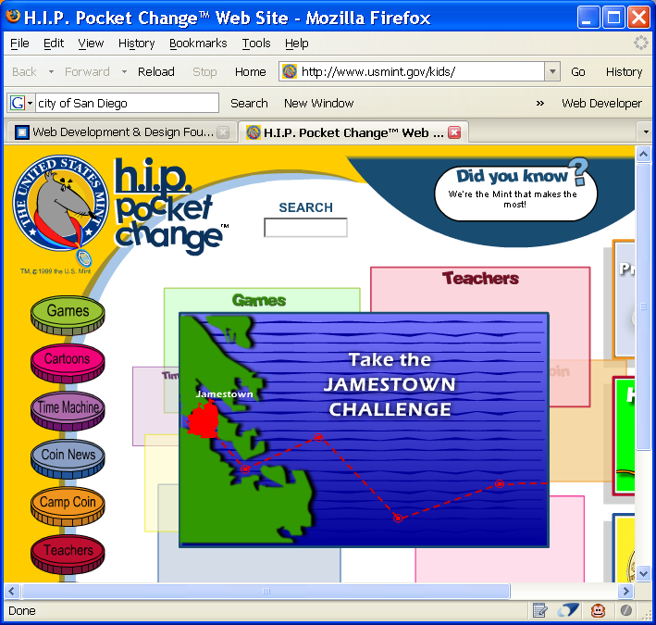
5.8 Web Page Design: Target Audience
  Site for kids it features:
    bright graphics,
    bright color
    lots of color,
    interactive
    lots of animation
    dynamic navigation
    (menu with submenus)
6. Design for your target audience
  Appropriate reading level of text
  Appropriate use of color
  Appropriate use of well done animation to appeal target group

Slide 48
5.8 Web Page Design: Target Audience
7. Use colors and animation that appeal to your target audience
  Kids
    Bright, colorful, tons of animation
  Older target audience
    light bkgrd, well defined images, and large text appropriate
    more subtle animation
    http://www.drs.wa.gov
  To appeal to everyone:
    Follow http://www.amazon.com/ or http://www.ebay.com/
    Good contrast between background and text
    Easy to read
    Avoid animation if it makes the page load too slowly

Slide 49
5.8 Web Page Design: Target Audience
7. Animation
    Appeals more to younger audiences than to older
    Adobe Flash
  Everyone:
    According to study of 50 top Web pages:
      84 % of the sites used white as the bckgrnd
      72% used black as the text color
8. Reading Level
    Match the reading level and style to your target audience

Slide 50
5.8 Web Page Design: Target Audience
9. Accessibility Tip: Many individuals are unable to distinguish between certain colors (color deficiency).
    See https://www.color-blindness.com/coblis-color-blindness-simulator/ and online simulator there to see colors by a person with color blindness
    Use high contrast between bckg and text:
    white, black, and shades of blue and yellow are easier for these individuals to differentiate
      Avoid red, brown, gray, or purple next to each other

Slide 51
5.8 Web Page Design: 10. Browser Compatibility
10. Web pages do NOT look the same in all the major browsers
  Test with current and recent versions (specify the version) of:
    Google Chrome
    Mozilla Firefox
    Edge/Internet Explorer
    Safari
    Opera
    Mac versions
  Design to look best in one most popular browser and degrade gracefully (look OK) in others
  Test your pages on Mac and PC platforms

Slide 52
5.8 Web Page Design: 11. Screen Resolution
11. Test at various screen resolutions
  Most widely used: 1366x768 (30% use it), 1920x1080 (15% use it), 1440x900 (7 % use it), 1024 x 768 (6%)
  for 800x600 pixels
    use 760 width pixels by placing the entire page in a table with width = 760 or 100% and see if it is required to use horizontal scrolling:
  Design to look good at various screen resolutions
  12. Centered page content
You can center by using <div align="center"> or better <div style=“text-align: center”>
    <div style=“text-align: center”>
    <table>
    ....Page content goes here. The table may be given either a percentage width or an exact width using pixels.
    </table>
    </div>

Slide 53
Flat Web Design
13. A minimalistic design style with a focus on simplicity,
blocks of color,
empty space between design elements,
hero images,
long shadows,
buttons with transparent backgrounds, and
use of typography.
Figure 5.27

Slide 54
Single Page Website
14. “One Page Website”
Is a website that contains one very long page (a single HTML file) with a clearly defined navigation area, usually at the top of the page. This navigation takes you to specific areas on the page. See my http://classes.jgspectrum.com/.
A single page website can be quick to create any website and can be a good choice for a portfolio website for a small business.
(More in Chapter 6)

