Slide 1
Chapter 5
Web Design
Part II
Expanded by J. Goetz, 2025
Credits: © 2011- 2023 Pearson Education
Copyright (c) 2006 Prentice-Hall. All rights reserved.

Slide 2
Learning Outcomes
In this chapter, you will learn how to: http://webdevfoundations.net/
5. 1 Overall Design
5.2 Types of web site organization – site map
5.3 Describe web page design principles - CARP
5.4 Utilize guidelines for creating accessible web pages
5.5 Text design: Best Practices - Writing for the Web
5.6 Making color choices
5.7 Graphic design: Best Practices
5.8 Web page design: Best Practices
5.9 Navigation design: Best Practices
5.10 Page layout design: Best Practices
5.10.1 Wireframes
5.10.2 Page layout design techniques: Fixed, Jello, Fluid
5.11 What separates the good from the bad?
Apply Best Practices of web design
5.12 Responsive Web design

Slide 3
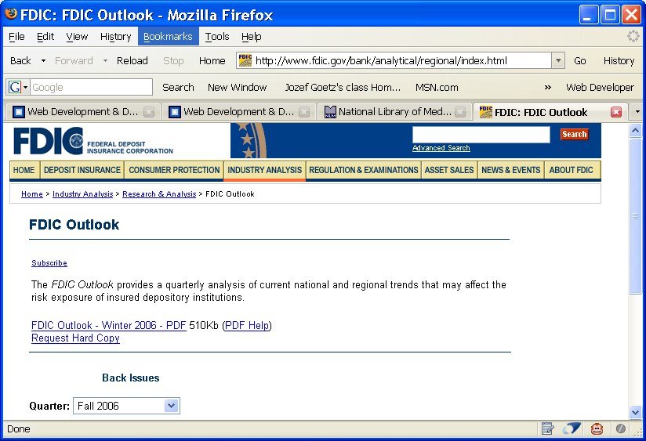
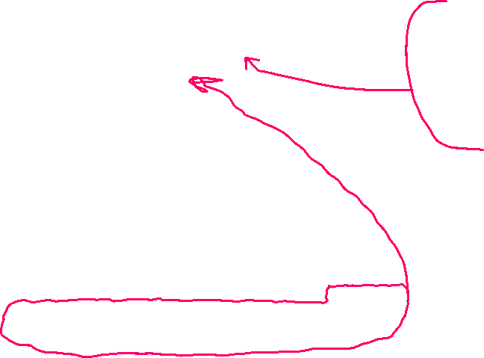
5.9 Navigation Design: Best Practices(1)
1. Make your site easy to navigate
A. Provide clearly labeled navigation in the same location on each page
Most common – across top or down left side
B. Provide “breadcrumb” navigation
It's also a good idea to let people know exactly where they are at the given moment.
breadcrumb - statements inserted into a web that emits the navigation path which indicates the web site’s state
visitors can easily retrace their steps or jump back to a previously viewed page
<!-- BEGIN BREAD CRUMB TRAIL -->
<img src="/images/spacer.gif" width="1" height="2" alt="" border="0" /><br />
<font face="arial, helvetica, sans-serif" size="-2"><a href="/index.html">Home</a> &gt;
<a href="/bank/index.html">Industry Analysis</a> &gt;
<a href="/bank/analytical/index.html">Research & Analysis</a>
&gt; FDIC Outlook </font><br /> p.224
See https://laverne.edu/directory/person/page/0/?department=computer-science

Slide 4
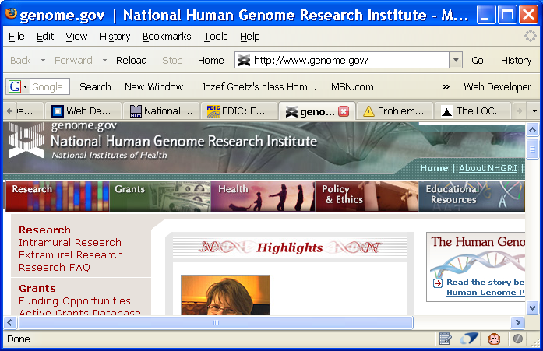
5.9 Navigation Design : Best Practices(2)
2. Navigation Bars
Types of Navigation –
Graphics-based: Types of Navigation
The tabs provide
horizontal graphics based navigation => Adobe flash is no longer supported
http://www.genome.gov/++
- Now, it is changed to the CSS button

Slide 5

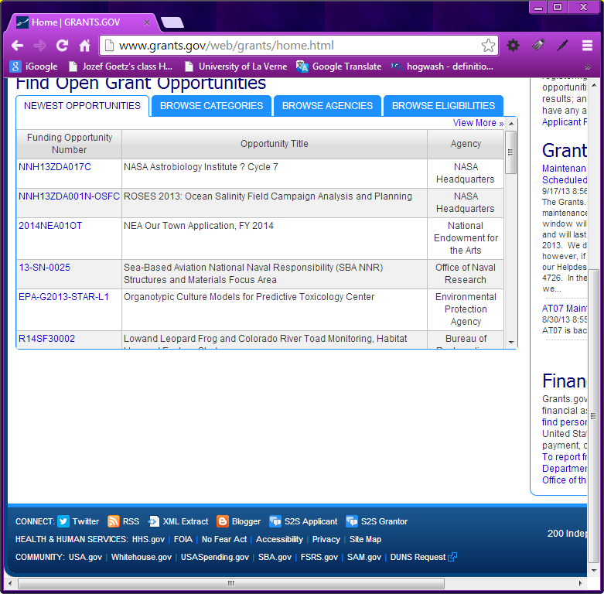
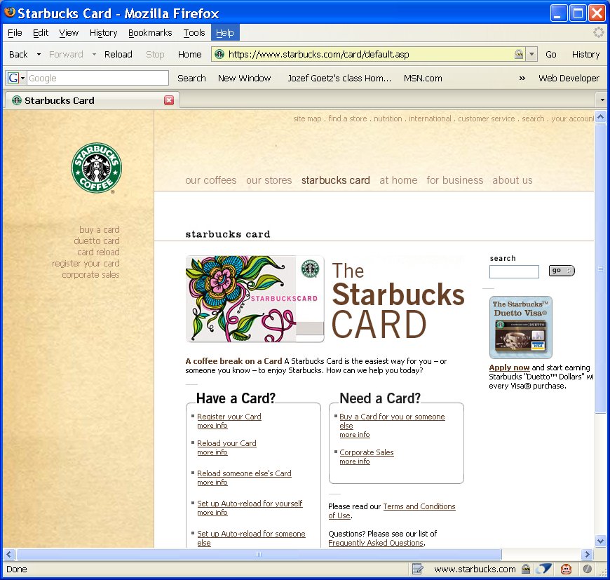
5.9 Navigation Design : Best Practices(2)
2. Navigation Bars
Text-based:
includes a vertical text navigation bar down the left site of the page

Slide 6
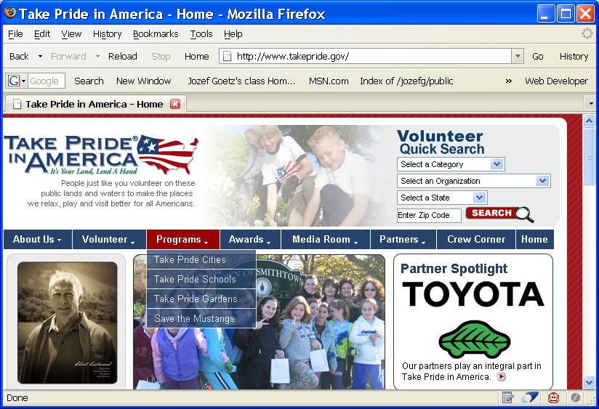
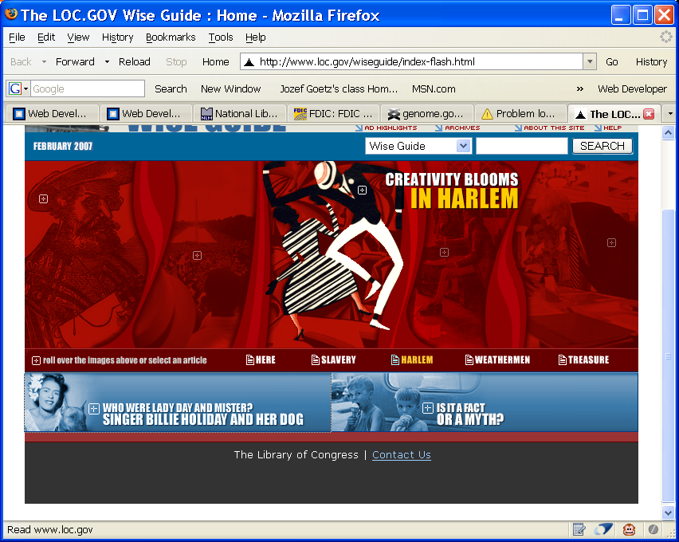



5.9 Navigation Design : Best Practices(2)
2. Navigation Bars
Interactive Navigation Technologies
Dynamic HTML (DHTML)
Java Applet
Flash
Dynamic Navigation: p.225. It's also a good idea to let people know exactly here they are at the given moment. You can accomplish this by having the button for the page they are on slightly altered in appearance, for example dimmed or highlighted or another color.
Image- based navigation
with horizontal menu and the vertical menu for a major category
The “text” is stored in image files
Flash
Navigation =>

Slide 7
5.9 Navigation Design : Best Practices(2)
2. Navigation Bars
Accessibility Tip
When graphics is used for the main navigation (an outdated design) of a web site,
Need to provide clear text-based links on the bottom of each page.
Use the text based navigation with CSS background which is more accessible and more easily indexed by search engines

Slide 8
5.9 Navigation Design : Best Practices(3)
3. Short Pages
A Web page is long if it >= 3 screen length
larger pages are usually slow to load
consider breaking long pages in to multiple shorter pages using Linear Organization
Large sites may benefit from a site map or menu at the top or site search feature
4. Use a Table of Contents
with links to other specific parts of the page for long pages

Slide 9
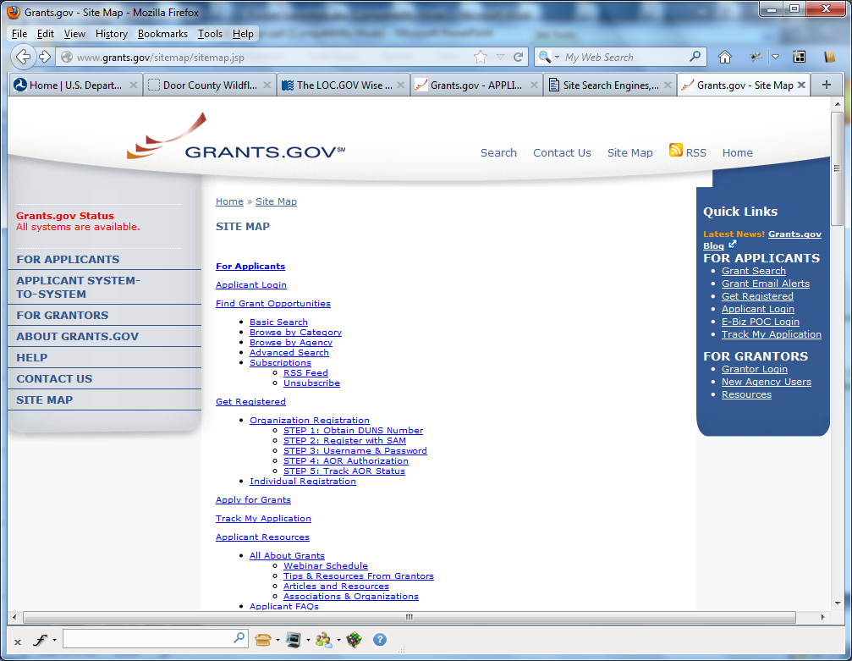


5.9 Navigation Design : Best Practices (3)
5. Site Map (http://www.grants.gov/+ = > Site Map) and Site Search Features
Good to have a site search and site map (to scan the contents visually) on the same page
< = site search
Google or
MS Search Desktop
indexes the sites
`site map =>
Add to your web Search Engine, Free and Pro Versions - http://www.freefind.com/

Slide 10
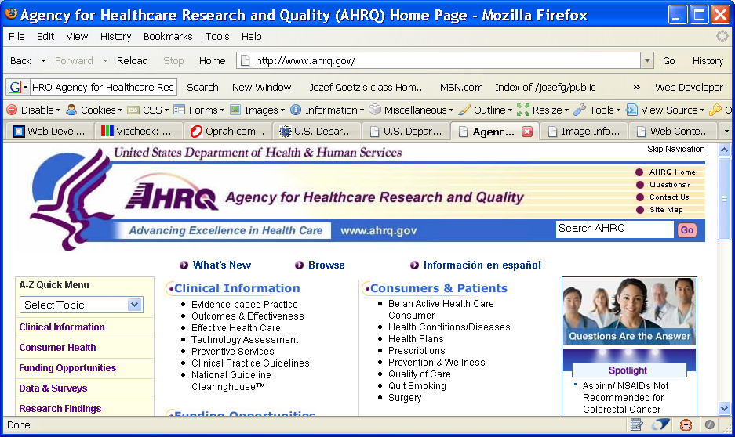

5.9 Navigation Design : Best Practices (3)
6. Provide a method to skip repetitive image based navigation
“Skip Navigation” text link (to the text section) in the upper-right-hand side of the Web page.

Slide 11
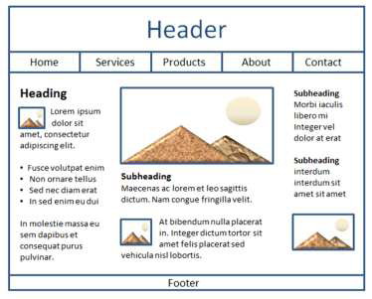
5.10 Page Layout Design: Wireframe
A sketch of blueprint (wireframe) of a Web page
Shows the structure of the basic page elements, including:
Logo
Navigation
Content
Footer
May include
new items
Interactive features such as a
Login
Search function

Slide 12
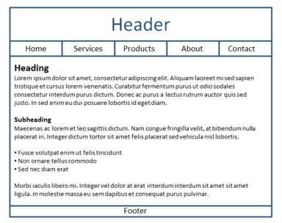
5.10.1 Web Page Design: Page Layout(1)
Place the most important information "above the fold"
Use adequate "white" or blank space
Use an interesting page layout
This is usable, but a little boring. See the next slide for improvements in page layout.

Slide 13
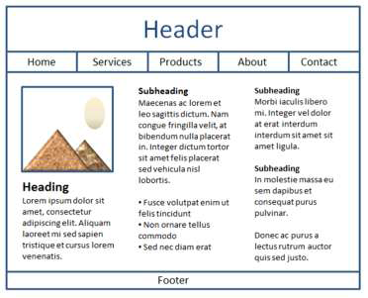
5.10.1 Web Page Design: Page Layout(2)
Better
Columns make the page more interesting and it’s easier to read this way.
Best
Header and horiz. navigation area;
3 columns of different widths interspersed with graphics and headings create the most interesting, easy to read page.

Slide 14
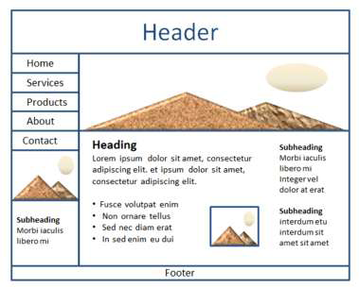
5.10.1 Web Page Design: Page Layout(3)
A consistent logo and color scheme will produce a more cohesive Web site and will keep visitors interested in your Web site
Best
The wireframe with a header, vert. navigation area, content area (with headings, subheadings, images, paragraphs, and unordered lists), and a footer area

Slide 15
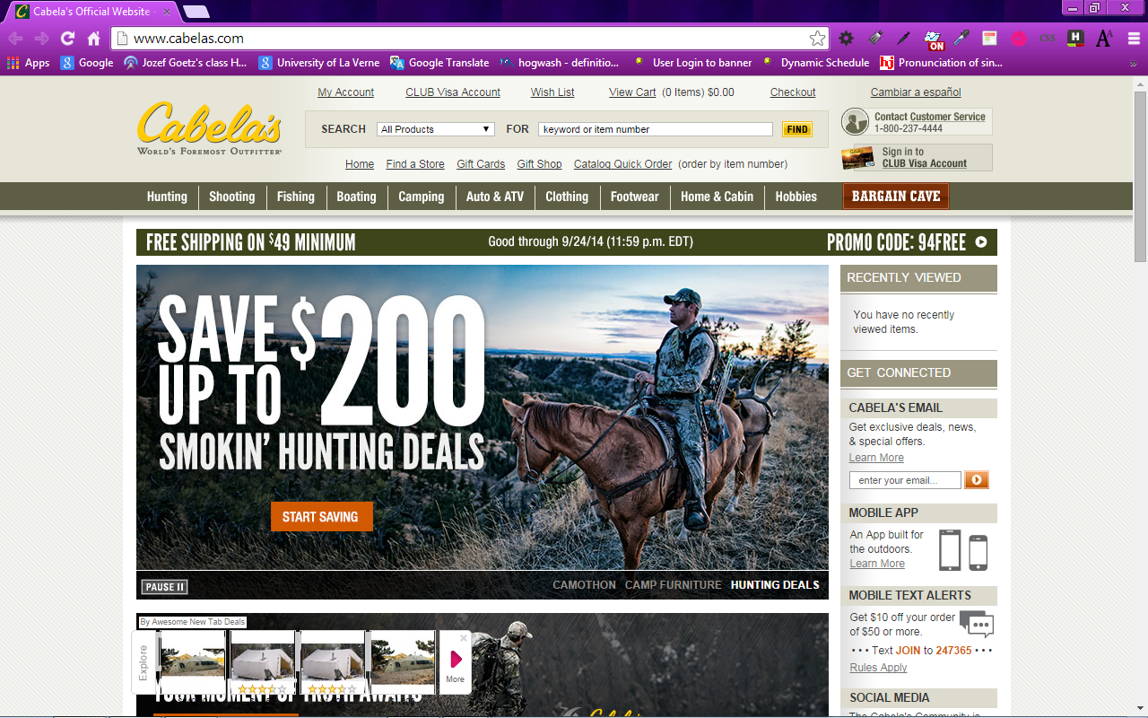
5.10.2 Page Layout Design Techniques
1. Fixed Design or Ice
rigid or fixed design
either CSS is used to configure a fixed-width block –element design: #wrapper {width: 960px;}
or table is used to format the page
Fixed-width table usually at left margin
-’s: large empty areas when viewed at higher screen resolution
<= http://www.cabelas.com/+

Slide 16
5.10.2 Page Layout Design Techniques
Fixed Layout
Fixed-width often at left margin
More appealing if fixed with content is centered

Slide 17
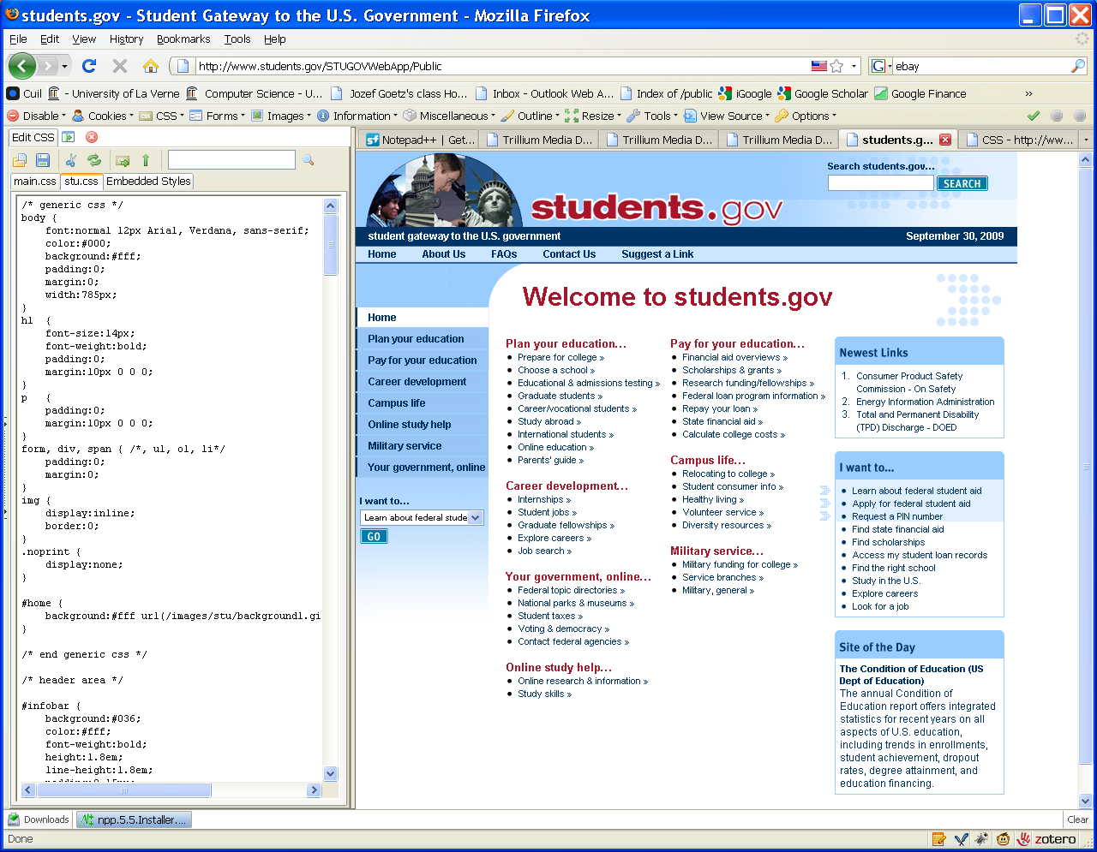
5.10.2 Page Layout Design Techniques
Fixed Design

Slide 18
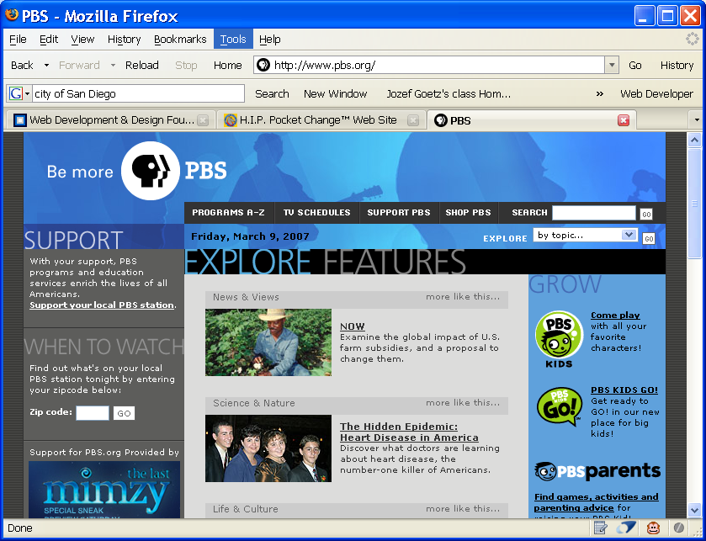

5.10.2 Page Layout Design Techniques
2. Jello Design
Page content typically centered with even margins on both sides
often use, more pleasing to view at high resolution than Ice Design
and often configured with a table of percentage width – 80%
or a CSS style rule:
#wrapper {width: 80%;
margin-left: auto;
margin-right: auto;
}
ulv.edu - old
http://www.officedepot.com++
http://www.energy.gov/++

Slide 19
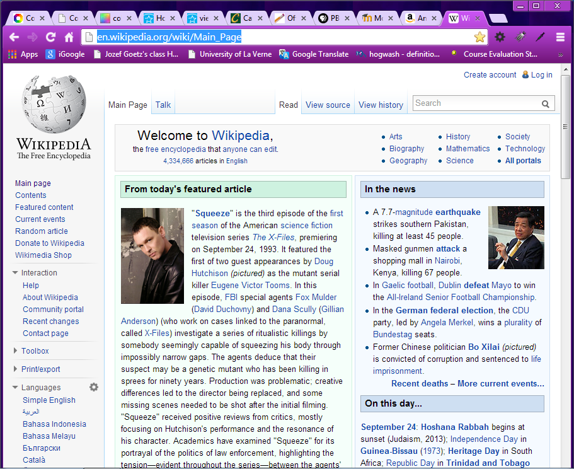
5.10.2 Page Layout Design Techniques
3. Fluid Design or Liquid
Page expands to fill the browser at all resolutions. Often configured with CSS or with a table width of 100%
The textbook includes Jello Design in Fluid Design
+’s:
no margin on the left or right,
quicker loading pages
-’s:
At higher resolution the page may stretch to fill wider area than originally intended by the developers
http://www.amazon.com/
http://en.wikipedia.org/wiki/Main_Page:

Slide 20
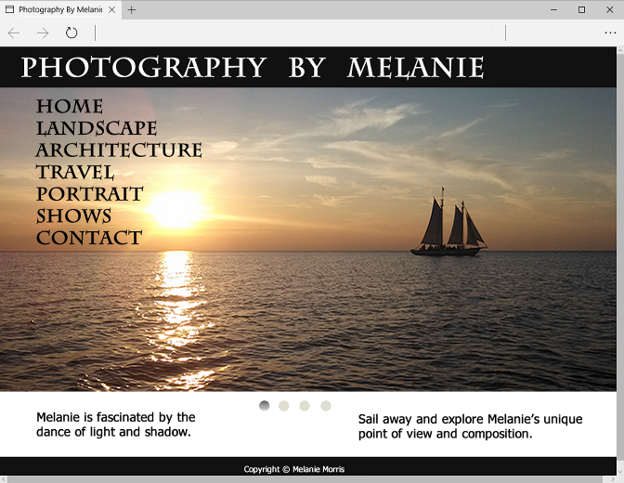
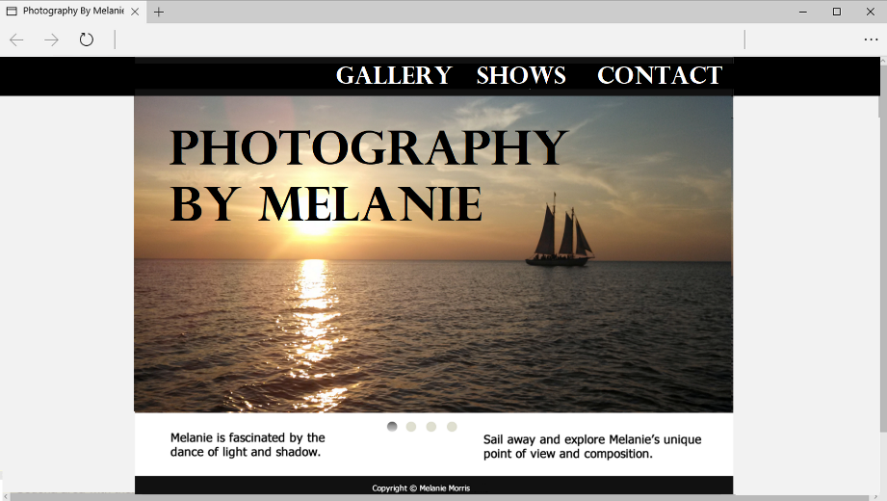
5.10.2 Page Layout Design Techniques
Fluid Layout
Expands to fill the browser at all resolutions.
Adaptation:
A 100% width for the header and navigation and
a page content typically centered and often configured with a percentage width such as 80% - Jello design

Slide 21
5.10.2 Page Layout Design Techniques
New Trend: Use CSS to configure fluid/liquid design page layout (see Chapter 6) – NSA
Using CSS instead of a table to configure Web page layout has +’s:
Smaller Web page doc sizes
Quicker loading pages
More accessible pages that are easier for screen reader to access

Slide 22
Checkpoint 5.1 p.676
List the 4 basic principles of design. View the home page of your school and describe how each principle is applied.
- CARP
2. View http://www.walmart.com+, http://www.mugglenet.com/, and http://www.sesameworkshop.org/sesamestreet/.
Describe the target audience for each site.
How do their designs differ?
Do the sites meet the needs of their target audiences?
Tip: check
Background
Contrast
Product hierarchy
Site Search
Color
Interactivity
Animation

Slide 23
Checkpoint 5.1
3. View your favorite web site (or a URL provided by your instructor - http://www.laverne.edu/ or http://www.laverne.edu/academics/arts-sciences/computer-science/ ).
Maximize and resize the browser window.
a. Decide whether the site uses fixed, jello, or fluid design.
Adjust the screen resolution on your monitor (Start > Control Panel > Display > Settings) to a different resolution than you normally use.
b. Does the site look similar or very different?
c. List two recommendations for improving the design of the site.

Slide 24
5.11 Mobile Web Design Best Practices
Design for One Web (more efficient than creating multiple versions of a web pages) – (chapter 7) it refers to a single resource code (the same web page) that is configured for optimal display on multiple types of devices.
Responsive Web Design – coding techniques (chapter 7)
fluid layouts,
flexible images and
media queries
for configuring a web page to display well at various screen resolutions and various display sizes – see a gallery of sites at
https://designmodo.com/responsive-design-examples/
Mobile Best Practice Requirements:
http://www.w3.org/2007/02/mwbp_flip_cards.html++
https://www.sitepoint.com/7-best-practices-designing-mobile-user-experience/

Slide 25

5.11 Mobile Web Limitations
Small Screen Size
Low bandwidth, slow connection
Large images are not displayed
Limited fonts
Limited color
Awkward controls
Single column
Mostly text displayed
Hyperlinks displayed under the header
Lack of Flash support
Limited processor and memory
Cost per kilobyte

Slide 26
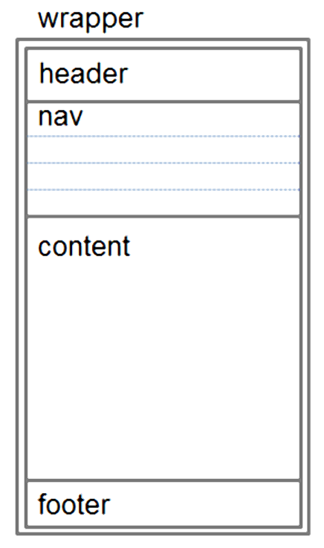
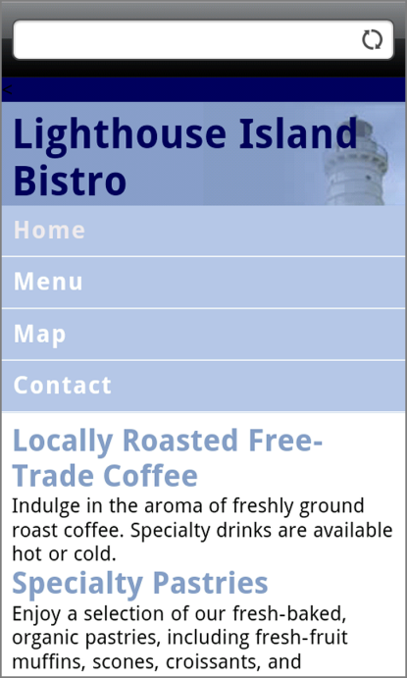
Design Best Practice for Mobile Web p.231 -232
One column design
Avoid floats, tables, frames
Descriptive page title
Descriptive heading tags
Hyperlinks under the header
Optimize images
Descriptive alt text for images
Eliminate unneeded images
Navigation in lists
Provide “Skip to Content” hyperlink
Provide “Back to Top” hyperlink
Design “One Web”, one code version
for optimal display on multiple types of devices
13. Optimize Layout, Navigation, Graphics,
and Text for Mobile Use
14. Recommended by the W3C
http://www.w3.org/2007/02/mwbp_flip_cards.html+
Resolution:
from 320x240 BlackBerry Pearl
480x800 Android HTC Desire, Windows HTC Pro,
640x690 iPhone4
640x1136 iPhone5
1920x1080 iPhone6
720x1280 Samsung Galaxy SIII
2560x1440 Samsung Galaxy S6 edge
2560x1440 Samsung Note
2560x1440 Galaxy Note 7 – 5.7-inch curved panel
2560x1440 Galaxy S7 – 5.1-inch flat panel
1334 x 750 iPhone8 at 326 ppi - screen 4.7 in, 148g, 2GB, iOS11
1920 x 1080 iPhone8+ at 326 ppi - screen 5.5 in, 202g, 3GB, iOS11
2960 x 1440 Galaxy S8 at 570 ppi – screen 5.8 in, 155g, 4GB, Andr 7.0
2960 x 1440 Galaxy S8+ at 529 ppi - screen 6.2 in, 173g, 4GB, Andr 7.0
2960 x 1440 Galaxy Note 8 at 522 ppi - screen 6.3 in, 195g, 6GB, Andr 7.1.1
https://www.digitaltrends.com/mobile/galaxy-note-9-vs-galaxy-s9-plus-vs-galaxy-s9/:
2960 x 1440 Galaxy S9 at 558 ppi - screen 5.8 in, 163g, 4GB, Andr 8.0, MicroSD, up256GB, 3.0Ah
2960 x 1440 Galaxy S9+ at 531 ppi - screen 6.2 in, 189g, 6GB, Andr 8.0, MicroSD, up256GB, 3.5Ah
2960 x 1440 Galaxy Note 9 at 516 ppi - screen 6.4 in, AI in camera, 201g, 8GB, Andr 8.0, MicroSD,
128-512GB, 4Ah, USB Type-C to HDMI cable to see on TV; S Pen to control a phone from up to 30 feet;
https://www.apple.com/iphone-xs/specs/:
2436 x1125 iPhone X at 458 ppi - - screen 5.8 in, 174g, 3GB, iOS11, 12.0 hours mixed usage
2436 x1125 iPhone XS at 458 ppi - - screen 5.8 in, 177g, 4GB, iOS12, up512GB, 2.685Ah,
speaker array
2688 x1245 iPhone XSMax at 458 ppi - - screen 6.5 in, 208g, 4GB, iOS12, up512GB,
13.5 hours mixed usage – 3.174Ah, octa-core chip – 5T oper/sec

Slide 27
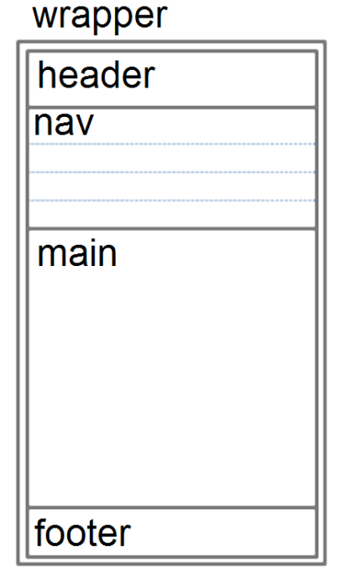
Optimize Layout for Mobile Use p.232
Single column design
Limit scrolling to one direction
Use heading elements
Use lists
Avoid using tables
Provide labels for form controls
Avoid using pixel units in style sheets
Avoid absolute positioning in style sheets
Hide content that is not essential for mobile use.

Slide 28
Optimize Navigation for Mobile Use p.231
Provide minimal navigation near the top of the page
Provide consistent navigation
Avoid hyperlinks that open files in new windows or pop-up windows
Try to balance both the number of hyperlinks on a page and the number of levels needed to access information

Slide 29
Optimize Graphics for Mobile Use p.232
Avoid displaying images that are wider than the screen width
Configure alternate, small optimized background images
Provide alternate text for graphics and other non-text elements.
Some mobile browsers will downsize all images, so avoid using images that contain text
Avoid the use of large graphic images
Specify the size of images

Slide 30
Optimize Text for Mobile Use p.233
Configure good contrast between text and background colors
Use common font typefaces
Configure font size with em units or percentages
Use a short, descriptive page title

Slide 31
5.12 Responsive Web Design
Ethan Marcotte, noted web developer https://www.alistapart.com/articles/responsive-web-design++
Progressively enhancing a web page – see chapter 7 for different viewing contexts (such as smartphones and tablets) through the use of coding techniques, including
flexible layouts and
media queries.

Slide 32


Progressive Enhancement
Design your website so it displays well in mobile devices
Design your website so that it is usable in older browsers
Add enhancements with CSS and/or HTML5 to take advantage of the capabilities of modern browsers.

Slide 33
5.13 Web Design Best Practices Checklist
Table 5.1 in your Textbook p.234 http://terrymorris.net/bestpractices
Page Layout
Browser Compatibility
Navigation
Color and Graphics
Multimedia
Content Presentation
Functionality
Accessibility

Slide 34
Checkpoint 5.2 p.236
1. View the home page of your school. Use the Best Practices Checklist (Table 5.1) to evaluate the page. Describe the results.
2. View your favorite web site (or a URL provided by your instructor).
Maximize and resize the browser window.
Decide whether the site uses ice, jello, or liquid design.
Adjust the screen resolution on your monitor (Right click on the Desktop area => Display settings => Resolution) to a different resolution than you normally use.
Does the site look similar or very different?
List two recommendations for improving the design of the site .
3. List three best practices of using graphics on web pages. View the home page of your school. Describe the use of graphic design best practices on this page.

Slide 35
Summary
Resources: https://www.webdevfoundations.net/10e/.
This chapter introduced you to best practices of web site design
The choices you make in the use of color, graphics, and text should be based on your particular target audience.
Developing an accessible web site should be the goal of every web developer.
Prominent names for providing the physical servers, hosting space include GoDaddy.com, Equinix (EQIX), Rackspace (RAX), and Terremark Worldwide (TMRK)

Slide 36
Summary
1. In Web application development, the first step is usually the creation of a site map to define the logical page navigation and cross reference linking.
2. Next are the functional/interface specifications that define the look and feel of the site, what the request and response actions are, and screenshots of page mock-ups.
3. The project plan also needs to address the technical specifications, including documentation of the hardware, software, and network requirements and specific hardware needed.

Slide 37
UX – User Experience Design - extra
User Experience Design (UXD or UED) is the process of enhancing customer satisfaction and loyalty by
improving the usability,
ease of use, and
pleasure provided in the interaction between the customer and the product.
User experience design encompasses traditional human-computer interaction (HCI) design, and extends it by addressing all aspects of a product or service as perceived by users.
User experience is any aspect of a person's interaction with a given IT system, including the interface, graphics, industrial design, physical interaction, and the manual.

Slide 38
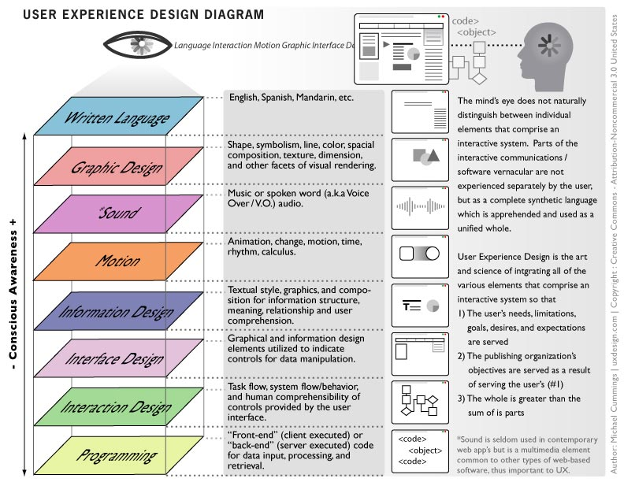
UX – User Experience Design
http://uxdesign.com/ux-defined - user-centered design

Slide 39
Summary
Characteristic:
Simplicity, hierarchical organized – CARP, navigability, consistency and accessibility.
Table 5.1 in your Textbook http://terrymorris.net/bestpractices
Page Layout
Browser Compatibility
Navigation
Color and Graphics
Multimedia
Content Presentation
Functionality
Accessibility

Slide 40
Summary
FR: https://www.enchantingmarketing.com/writing-for-the-web-vs-print/
1. Treat your web visitors like wild animals
Your website visitors behave like wild animals (source: Jakob Nielsen’s Alertbox).
They’re hunting for information or a product to buy—just like a hungry panther hunts for his next meal.
When a panther sniffs a scent trail he quickly decides: Will the scent trail lead to a good meal? And will it be an easy catch?
Your web visitors consider the same two things: Does your website offer what they’re looking for? And can they find it easily?
A hungry panther doesn’t like wasting time to catch a meal. And your web visitors don’t want to browse around your website for several long minutes to find the product they’re after. They want to find it quickly.
Just like the panther makes a fast decision whether to follow a scent trail or not, your web visitor decides quickly whether your site is useful or not. So if your site looks complicated with a lot of options to choose from, they click away to check out another website.
Web visitors quickly glance at your web page before guessing whether they’re in the right place or not. They don’t need to know for sure. They just want to make a quick decision.
If your web visitors only glance at your website, how do you get your message across?

Slide 41
Summary
FR: https://www.enchantingmarketing.com/writing-for-the-web-vs-print/
2. Put your most important information first
Writing for the web is completely different from writing an essay or a paper.
An essay might go like this: First, explain what you’re going to discuss. Then, present an overview of the literature. Next, discuss; and finally draw your conclusion. The most important point you make is in the conclusion – at the end of your essay!
On web pages you have to do the opposite: your most important points always come first.
An example: you’re looking for a new red three-seater sofa. When you arrive at a website you want to see it sells sofas. And secondly, you want a search box so you know you can quickly find out what the red three-seater sofas are like.
Or say you’re looking for a copywriter for your website. Maybe you’re looking for someone local, so you need to see a copywriter is based in Manchester which is nearby. Or maybe your copywriter needs to understand medical terminology, so you like to see a headline like copywriting for the medical industry.
Information that’s most important to your web visitors is often a simple statement of what you do. Once they understand what you do, they might want to know some important details. And then – maybe they’d like to know some background information.
Journalists call this way of writing the inverted pyramid. In newspaper articles the most newsworthy information comes first before details and background information. Even if you only read the first paragraph of a newspaper story you still understand the big picture.
It’s the same on your website. Your customers want to know the big picture first. Basically: What do you do? Or what can you do for them?

Slide 42
Summary
FR: https://www.enchantingmarketing.com/writing-for-the-web-vs-print/
3. Don’t try to be clever or creative
On the web it’s rare that a reader hangs on to every word you write. He doesn’t have time. He’s in a hurry because he could check out several other scent trails – websites – instead of wasting time trying to figure out what you do.
Simple statements often work best.
Clever phrasing requires people to think. And asking people to think, doesn’t work on the web because web visitors are hunting – they don’t have time to think. So keep your web copy as simple as possible.
Write as if you’re writing for a 12-year old because that makes your copy easy-to-follow. And be careful with jokes unless you’re absolutely sure your target audience will get them.
4. How can you write for scanners? A check list:
Does your headline communicate what you’re about?
Does your image caption communicate a sales message?
Do your sub headlines summarize your key points?
Do easy-to-scan bullet points reduce wordiness?
Your web visitor is hunting for information or products. Ensure he can understand your most important information by just glancing at your web page.
5. Use familiar words
scan pages for carewords. Carewords are the words people are looking for.

Slide 43
Summary
FR: https://www.enchantingmarketing.com/writing-for-the-web-vs-print/
6. Write for lazy people
Just like the lazy panther looks for an easy catch for his dinner, your web visitor doesn’t want to make an effort to read your text.
Make your copy easy to read:
Use short paragraphs—four sentences max
Use short sentences—twelve on average
Skip unnecessary words
Avoid jargon and gobbledygook
Avoid the passive tense
Avoid needless repetition
Address your web visitors directly—use the word you
Shorten your text
7. Expect people to arrive anywhere on your website
People usually read a book from chapter one, via chapter two to three and four etc.
That’s what the web is like. Most web visitors will not start reading at your home page. They may arrive on any of your web pages.
If you don’t know where people arrive on your website, go to Google Analytics >> Site Content >> Landing Pages. You can see exactly how many web visitors arrived on each web page.
If each web page can be an entry page what does that mean?
Each page should be easy to scan
Each page should clarify to people where they are; and what your site is about
Each page should have a call to action telling people where to go next.

Slide 44
Summary
FR: https://www.enchantingmarketing.com/writing-for-the-web-vs-print/
8. Make it easy for hunters to find you
how writing for SEO (Search Engine Optimization) basically works:
Answer the questions potential customers are asking
Discuss one key topic for each page
Include links to relevant pages on your own website or to other websites
Use phrases and words your potential customers are looking for
9. Make a visual impression
How to increase the visual appeal of your web copy:
Replace text by photographs or videos
Consider different font sizes – think about people scanning large text first
Emphasize quotes of customers (or experts) to add credibility
Play around with highlights, bold text, CAPS, or italics
Break a long headline into a headline with a sub headline
Change paragraphs into bullet points
Most importantly: de-clutter. Reduce noise and add white space. Not only will it make your website easier to read, it will also increase your perceived trust (source: Social Triggers).

Slide 45
Summary
FR: https://www.enchantingmarketing.com/writing-for-the-web-vs-print/
The truth about writing persuasive web copy
I’d love to tell you that writing persuasive web copy is easy.
But the truth is that writing simple, useful copy is hard.
Don’t treat your web visitors like academics who love reading challenging and complicated texts. Don’t treat your web visitors like lawyers poring over small print. Don’t be wordy. And don’t show off your extensive vocabulary.
Instead make your text as simple as possible.
Don’t try to be everything to everybody. Know who you are and what you do.
If your positioning is clear, it’s much easier to stand out on the web and be found. If your message is clear, it’s much easier to create persuasive web copy.
Be clear.
Be specific.
Be bold.

Slide 46
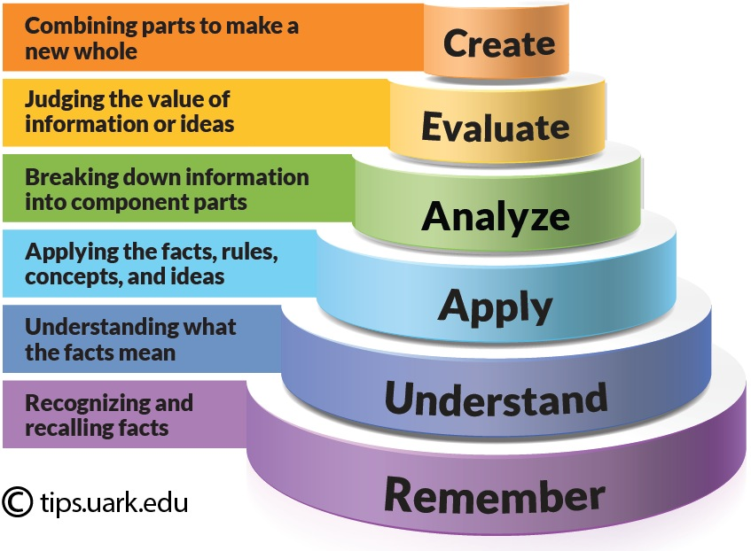
Bloom’s Taxonomy
Using Bloom’s Taxonomy to Write Effective Learning Outcomes | Teaching Innovation and Pedagogical Support (uark.edu); Posted by Jessica Shabatura | Jul 26, 2022 | Assignments & Measuring Student Learning

Slide 47
Bloom’s Taxonomy
What is Bloom’s Taxonomy
Bloom’s Taxonomy is a classification of the different outcomes and skills that educators set for their students (learning outcomes). The taxonomy was proposed in 1956 by Benjamin Bloom, an educational psychologist at the University of Chicago. The terminology has been recently updated to include the following six levels of learning. These 6 levels can be used to structure the learning outcomes, lessons, and assessments of your course. :
Remembering: Retrieving, recognizing, and recalling relevant knowledge from long‐term memory.
Understanding: Constructing meaning from oral, written, and graphic messages through interpreting, exemplifying, classifying, summarizing, inferring, comparing, and explaining.
Applying: Carrying out or using a procedure for executing, or implementing.
Analyzing: Breaking material into constituent parts, determining how the parts relate to one another and to an overall structure or purpose through differentiating, organizing, and attributing.
Evaluating: Making judgments based on criteria and standards through checking and critiquing.
Creating: Putting elements together to form a coherent or functional whole; reorganizing elements into a new pattern or structure through generating, planning, or producing.
Learning outcome examples adapted from, Nelson Baker at Georgia Tech: nelson.baker@pe.gatech.edu
Bloom’s Level | Key Verbs (keywords) | Example Learning Outcome
Create | design, formulate, build, invent, create, compose, generate, derive, modify, develop. | By the end of this lesson, the student will be able to design an original homework problem dealing with the principle of conservation of energy.
Evaluate | choose, support, relate, determine, defend, judge, grade, compare, contrast, argue, justify, support, convince, select, evaluate. | By the end of this lesson, the student will be able to determine whether using conservation of energy or conservation of momentum would be more appropriate for solving a dynamics problem.
Analyze | classify, break down, categorize, analyze, diagram, illustrate, criticize, simplify, associate. | By the end of this lesson, the student will be able to differentiate between potential and kinetic energy.
Apply | calculate, predict, apply, solve, illustrate, use, demonstrate, determine, model, perform, present. | By the end of this lesson, the student will be able to calculate the kinetic energy of a projectile.
Understand | describe, explain, paraphrase, restate, give original examples of, summarize, contrast, interpret, discuss. | By the end of this lesson, the student will be able to describe Newton’s three laws of motion to in her/his own words
Remember | list, recite, outline, define, name, match, quote, recall, identify, label, recognize. | By the end of this lesson, the student will be able to recite Newton’s three laws of motion.

