Slide 1
Learning Outcomes
HOP 6.1
CSS Width and Height Properties
HOP 6.2
Normal Flow
HOP 6.3
CSS Float
HOP 6.4
CSS Two-Column Layout
HOP 6.5
CSS Interactivity with Pseudo-Classes
HOP 6.6
Practice with CSS Two-Column Layout
CSS Buttons in nav
HOP 6.7
CSS Sprites
HOP 6.8
CSS for Printing
HOP 6.9
Practice with an Image Gallery
HOP 6.10
Fixed Position Navigation Bar
HOP 6.11
Single Page Website Navigation
HOP 6.12
Single Page Website Navigation with background-attachment: fixed

Slide 2
Chapter 6
Page Layout
with CSS
credits: © 2011 – 22 Pearson Education
Copyright (c) 2015 Prentice-Hall. All rights reserved.
expanded by J. Goetz, 2025

Slide 3
Learning Outcomes
In this chapter, you will learn about:
Configure width and height with CSS
Describe and apply the C S S Box Model
Configure margin with C S S
Configure float with C S S
Configure fixed, relative, and absolute positioning with C S S
CSS Box Sizing property
Create two-column page layouts using C S S
Configure navigation in unordered lists and style with C S S
Add interactivity to hyperlinks with C S S pseudo-classes
Add interactivity to hyperlinks with CSS pseudo-classes
Configure a hyperlink to a named fragment internal to a web page
Configure images with CSS sprites
Configure CSS for printing
Configure a single page website with parallax scrolling

Slide 4
CSS Advantages
1. Greater typography and page layout control without using tables
This includes:
font size,
line spacing,
letter spacing,
indents, margins, paddings, borders
and element positioning without using tables
2. Style is separate presentation from the page structure
Styles can be stored in a separate document and linked to from the web page
3. Potentially smaller html documents
4. No need for <font> tags
5. Easier site maintenance
6. This text concentrates on using CSS for formatting – a feature that is well-supported by browsers.
7. Increased page layout control
A variety of positioning options
8. Increased accessibility for screen readers or other assistive technology
9. Ability to define styles for multiple media types
e.g. separate style for printing
10. Support of the Semantic Web – the future technology

Slide 5
Width and Height with CSS
Table 6.1 Unit Types and Purpose
Unit | Purpose
px | Configures a fixed number of pixels as the value
em | Configures a value relative to the font size
% | Configures a percentage value of the parent element – e.g. 60%
vh | Configures a value relative to 1% of the viewport height
vw | Configures a value relative to 1% of the viewport width

Slide 6
CSS Width and Height Properties
width property
Configures the width of an element’s content
height property
Configures the height of an element
e.g. To avoid the background image truncated – p.247 Fig. 6.4 – 6.5, 50vw = 50% of the viewport height.
min-width property
Configures minimum width of an element in the browser viewport e.g. p.246 Fig 6.3. Scrollbars appear if the browser vieport is resized below minimum witdth.
max-width property
Configures the maximum width of an element in the browser viewport
To avoid the possibility of text stretching across a high-resolution monitor
h1{ width: 80%; }
Fig. 6.1 p.246
h1{ height: 100px; }

Slide 7


Hands-On Practice
HOP 6.1
Follow the directions in your book for the HOP.
START-UP File | chapter6/starters
SAVE SOLUTION AS | index.html.html

Slide 8
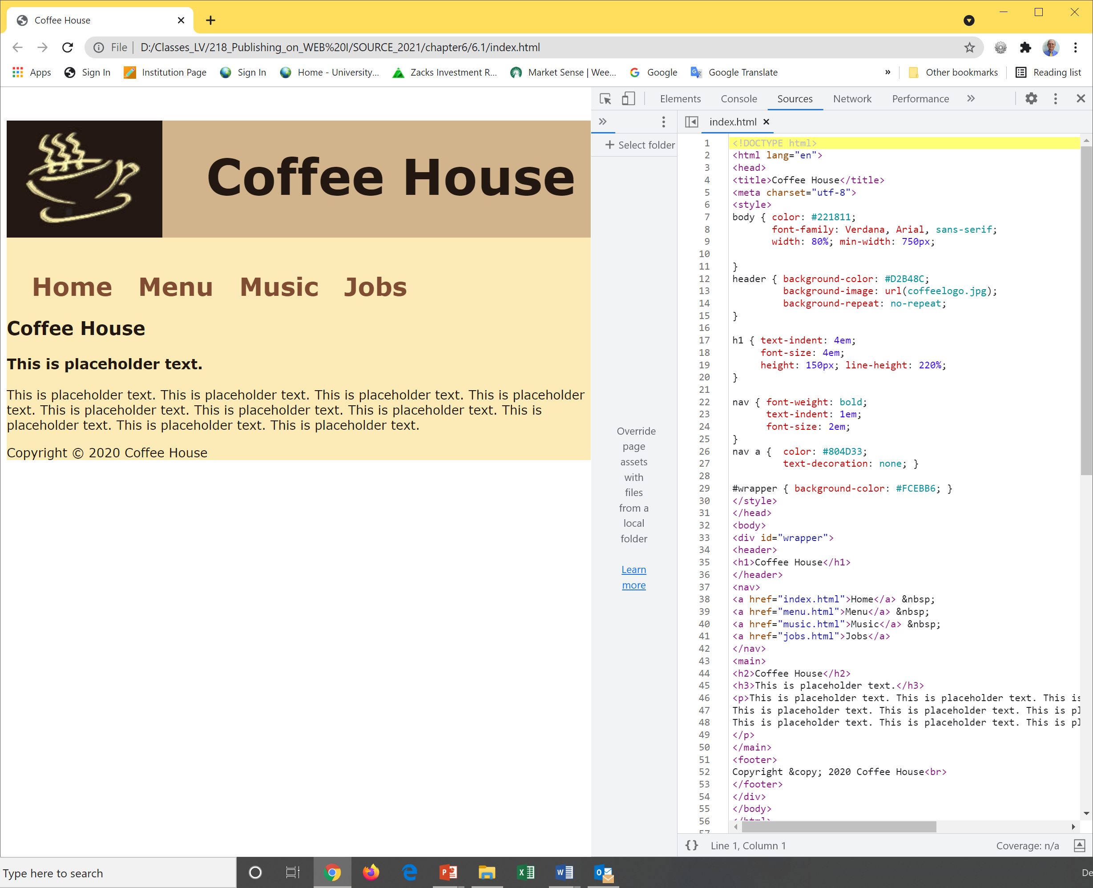




HOP 6.1 - CSS Width and Height Properties

Slide 9
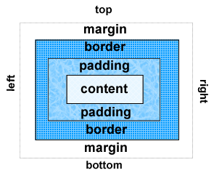
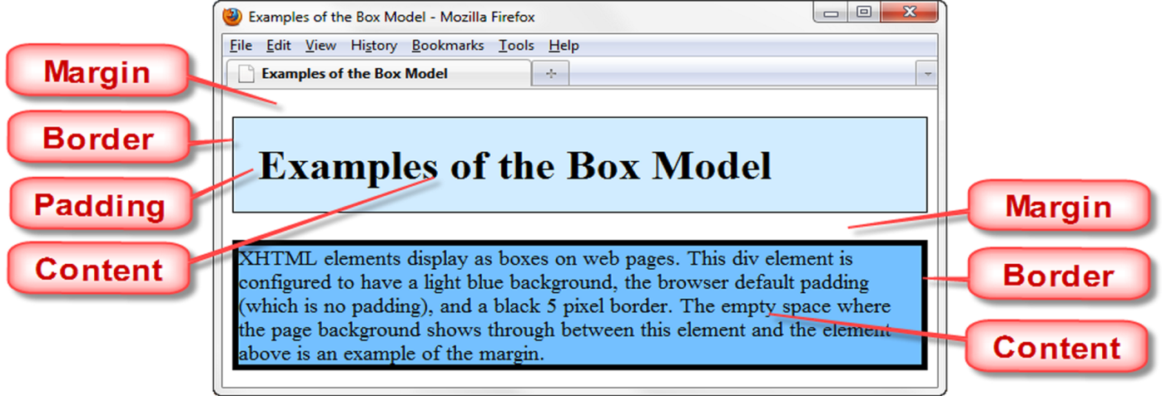
6.1 The Box Model
Content
The area consists of Text & web page elements in the container
Padding
The area between the content and the border
Border
The area between the padding and the margin.
Margin
Determines the empty space between the element and adjacent elements,
Always transparent
Each element in a doc is considered
to be rectangular box
The content and padding area picked up the background

Slide 10
Box Model and Text Flow
Block-level HTML/XHTML elements (e.g. h1 to h6, div, p) have a virtual box drawn around them based on the box model
When the browser renders using the box model, each element is surrounded by:
Padding - default = 0
The padding property determines the distance between the content inside an element and the edge of the element
Padding be set (configured) for each side of the box by using
padding-top, padding-right, padding-bottom and padding-left.
h1 { padding: 0; }
h1 { padding : 20px 10px; }
h1 { padding : 10px 30px 20px; }
h1 { padding : 20px 30px 0 30px; }
Margin - default is set by browsers
Determines the distance between the element’s edge and any adjacent element
Margins for individual sides of an element can be specified by using
margin-top, margin-right, margin-bottom and margin-left .
h1 { margin: 0; }
h1 { margin: 20px 10px; }
h1 { margin: 10px 30px 20px; }
h1 { margin: 20px 30px 0 30px; }
Border - default = 0
shorthand
border: <width> <style> <color>

Slide 11

The Box Model
Each element in a doc is considered to be rectangular box
Use a <div> tag
Other block elements are paragraphs and heading elements
Block level elements in HTML - https://www.w3schools.com/html/html_blocks.asp :
<address> <article> <aside> <blockquote> <canvas> <dd> <div> <dl> <dt>
<fieldset> <figcaption> <figure> <footer> <form>
<h1>-<h6>
<header>
<hr>
<li>
<main>
<nav>
<noscript>
<ol>
<output>
<p>
<pre>
<section>
<table>
<tfoot>
<ul>
<video>
The browser renders these elements beginning and ending on
their own lines – forming a “block”
The 2nd box is nested inside the 1st one p.248
<div class=“div1”>
This is the outer box.
<div class=“div2”>
This is the inner box.
</div>
</div>
This is the outer box.
This is the inner box.

Slide 12
Hands-On Practice
HOP 6.2
Follow the directions in your book for the HOP.
START-UP File | chapter6/starter1.html
SAVE SOLUTION AS | box1.html

Slide 13
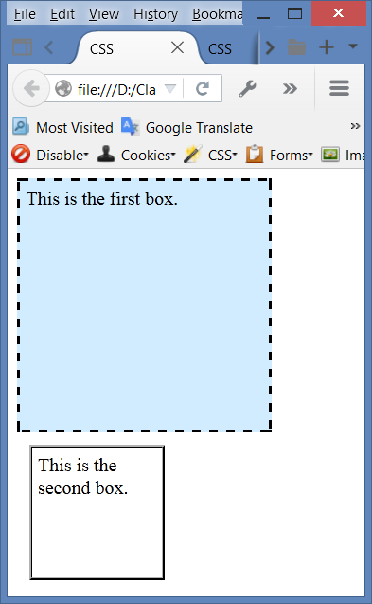
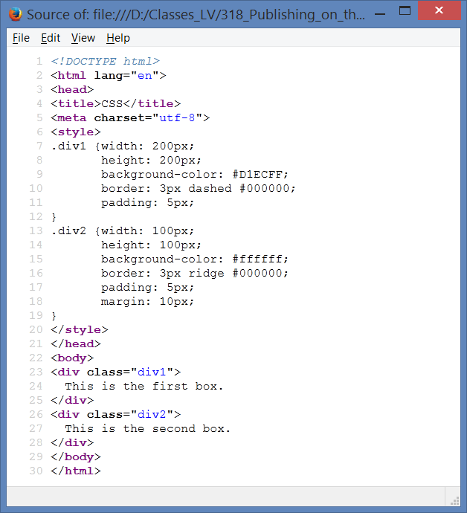
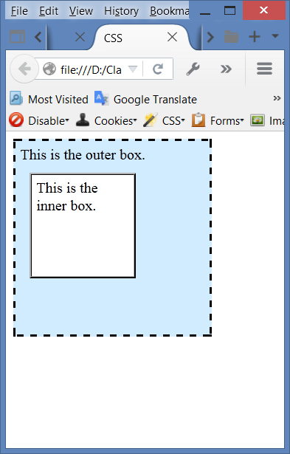
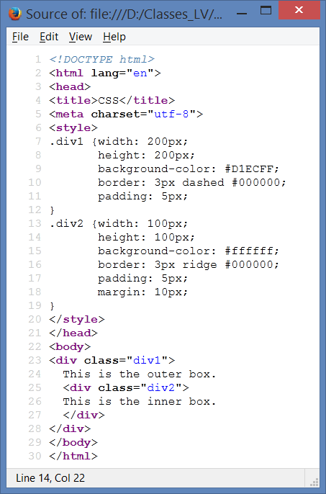

Normal Flow: HOP 6.2 start: starter1.html
2 separate <div> boxes
one nested inside the other
box1.html
box2.html

Slide 14
see section 6.12: CSS Positioning (1)
Normal flow (HOP 6.1) causes the browser to render the elements in the order they appear in the HTML/XHTML source code.
Using CSS for page layout the location of elements can be changed.
Cross browser-support positioning is more reliable when the <div> element is used for positioning.

Slide 15
CSS-P (positioning)
W3C Recommendations for CSS level 2 or CSS2 published in 1998
Adds new properties for positioning
Relies on CSS properties rather than tables to design a Web page.
A growing trend is to configure pages using CSS
The technology is for this is called “table-less layout” or CSS-P for CSS Positioning
Even Web sites with so-called “table-less” layouts may include tables to present info in a tabular manner to facilitate design of a small portion of the page.

Slide 16
(1) Position Property p.275
Table 6.8 The position Property
Value | Purpose
static | Default value; the element is rendered in normal flow
fixed | Configures the location of an element within the browser viewport; the element does not move when the page is scrolled
relative | Configures the location of an element relative to where it would otherwise render in normal flow
absolute | Precisely configures the location of an element outside of normal flow
sticky | Combines features of relative and fixed positioning:
nav { position: sticky;
top: 0;
Combines features of relative and fixed positioning.
Element rendered in normal flow and then, when reached during scrolling, sticks to the specified position and remains there – see HOP 6.10

Slide 17
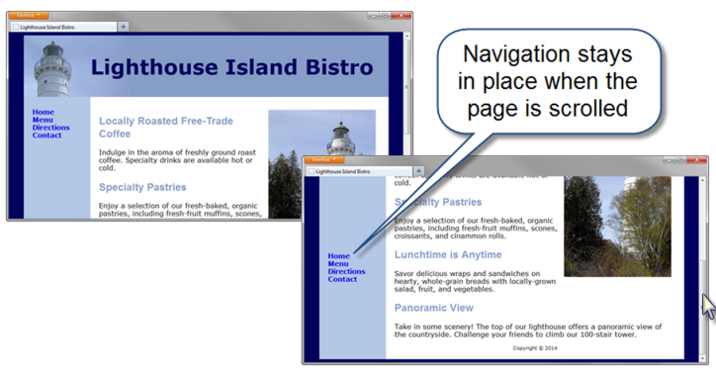
A. Fixed Positioning
nav { position: fixed; }

Slide 18
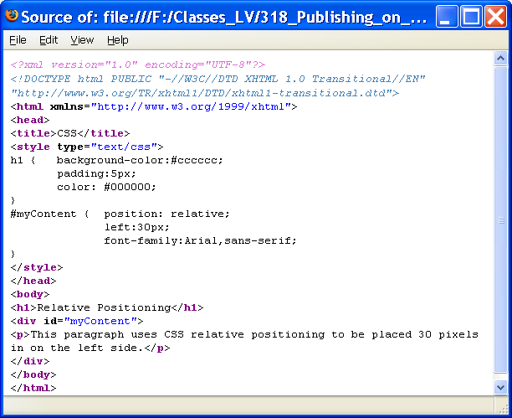
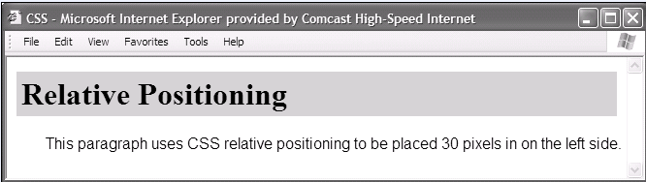
B. Relative CSS Position properties
Relative positioning keeps elements in the general flow on the page and offsets them by the specified top, left, right or bottom value of the container element.
Relative
Use to slightly change the location (one coordinate) of an element in relation to where it would otherwise appear in normal flow (for example the left side of the browser window). So, it needs only one coordinate for the location.
h1 { background-color:#cccccc;
padding:5px;
color: #000000;
}
#myContent { position: relative;
left:30px;
font-family:Arial,sans-serif;
}

Slide 19
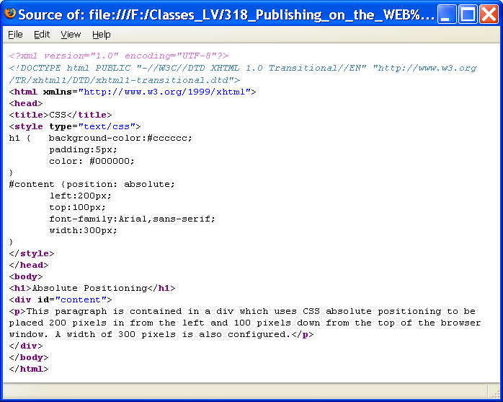
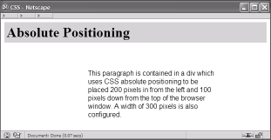
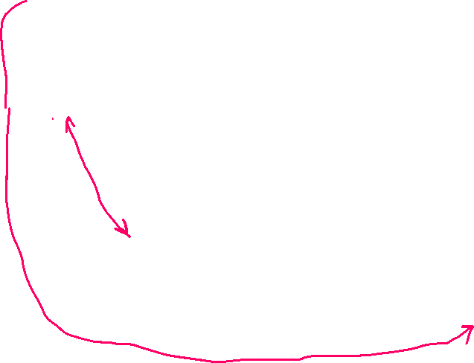
C. Absolute CSS Position Properties
h1 { background-color:#cccccc;
padding:5px;
color: #000000;
}
#content {position: absolute;
left:200; //from the left margin
top:100; //down from the top of the browser window
font-family:Arial,sans-serif;
width:300;
}
Absolute
Use to precisely specify the location (2 coordinates) of an element in relation to the body of the web page (the browser window)
Elements rendered outside of normal flow!

Slide 20
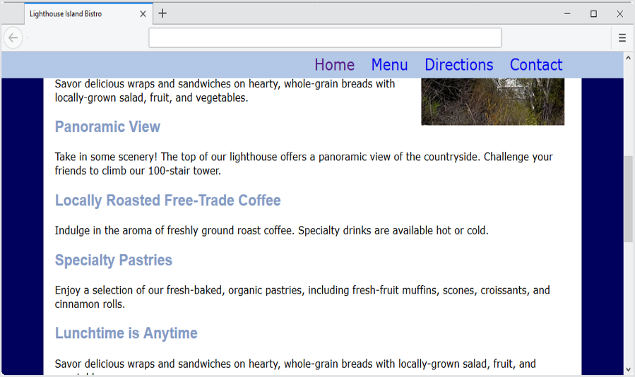
D. Sticky CSS Position Properties
“Sticky” Navigation Bar
Figure 6.49 The navigation bar stays in place while the content is scrolled.
nav { position: sticky;
top: 0; /*target 0 */
Combines features of relative and fixed positioning.
Element rendered in normal flow and then, when reached during scrolling, sticks to the specified position and remains there – see HOP 6.10

Slide 21
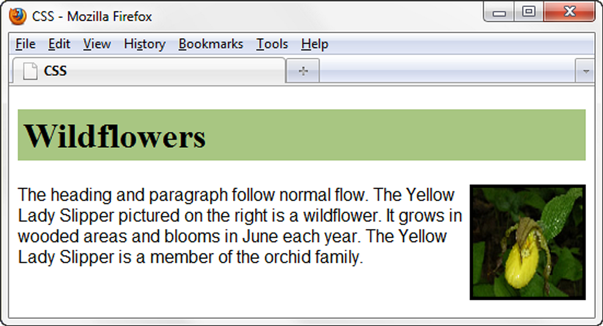
6.4 CSS Float Properties (2)
h1 { background-color:#cccccc;
padding:5px;
color: #000000;
}
p { font-family:Arial,sans-serif;
}
#yls {float:right;
margin: 0 0 5px 5px;
border: 1px solid #000000;
}
Float [flout] p.253 p.655
Elements that seem to “float" on the right or left side of their container (usually either browser window or a <div> element) are often configured using the float property.
Other content (here text and paragraph) will flow around the floated element.
The browser renders these elements using normal flow, and then shifts them to either the right or left as far as possible within their container (usually either browser window or a <div> element).
Code float BEFORE its companion element

Slide 22
Hands-On Practice
HOP 6.3
Follow the directions in your book for the HOP.
START-UP File | starteryls.html yls.jpg
SAVE SOLUTION AS | index.html

Slide 23
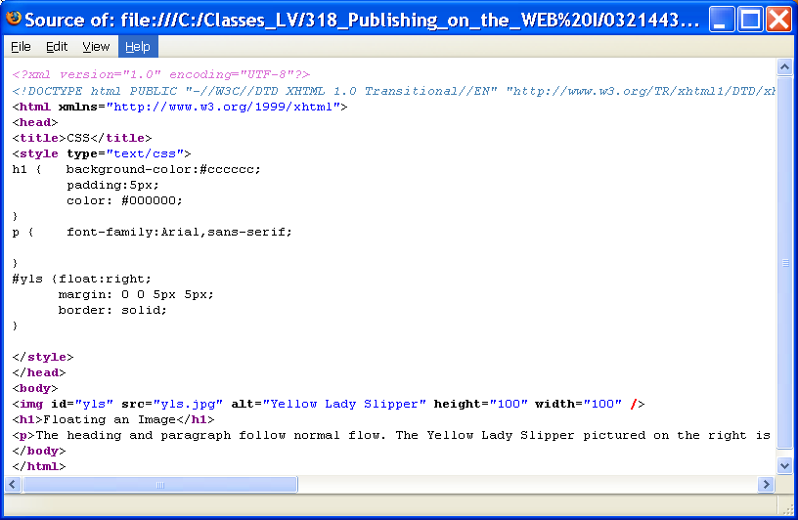

h1 { background-color:#cccccc;
padding:5px;
color: #000000;
}
p { font-family:Arial,sans-serif;
}
#yls {float:right;
margin: 0 0 5px 5px;
border: solid;
}
6.4 CSS Float Properties (2)
The browser will shift the floated element over to the side of the browser viewport and display other content (here text and paragraph) that follow alongside the floated element.
To stop this flow use the clear property p.254
.rightfloat {float:right;
margin: 5px;
clear:right;
border: solid;}

Slide 24
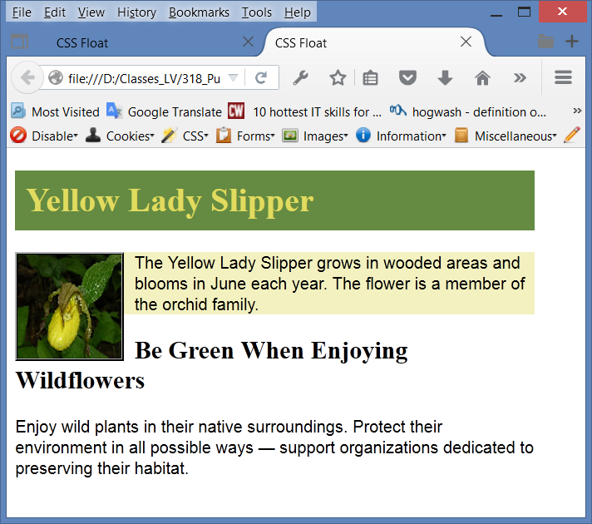
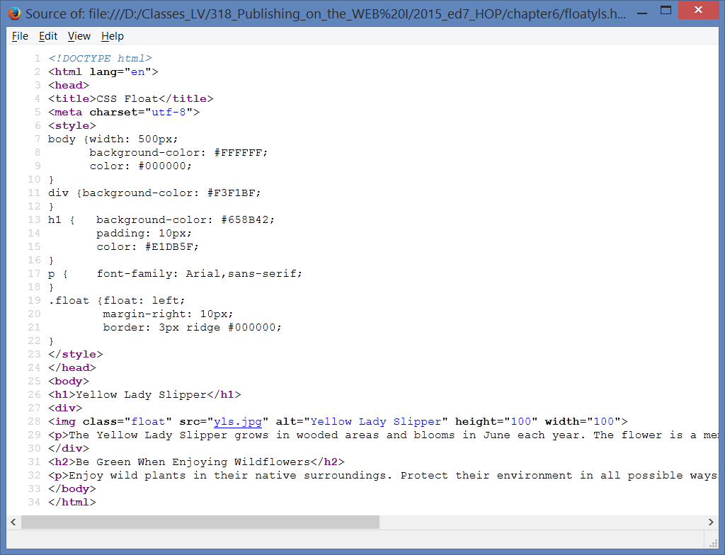


Float the image: p.253 HOP 6.3
configure a CSS style for a class=“float”, the browser uses normal flow => p.253 explanation
floatyls.html

Slide 25
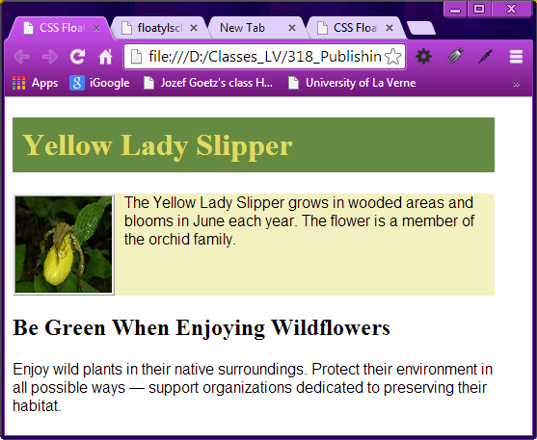
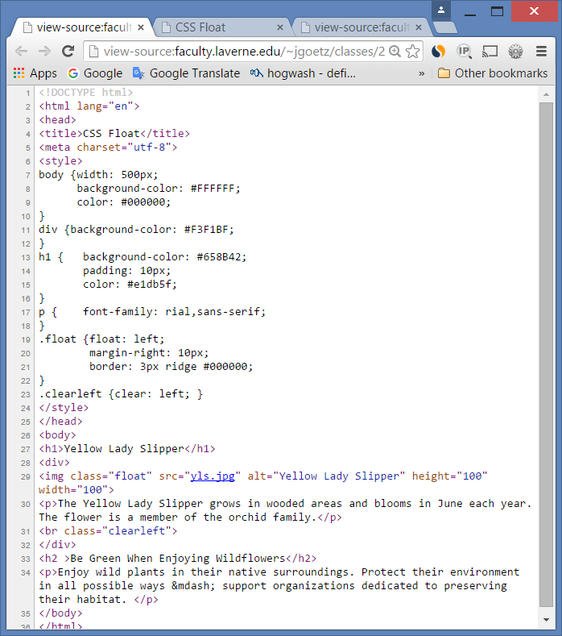
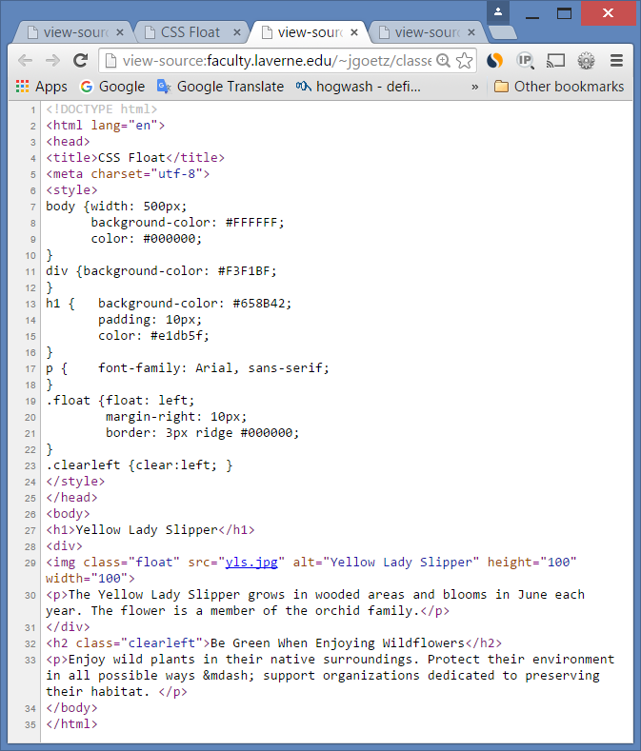
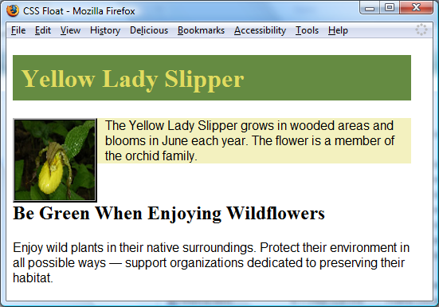

6.5 clear Property (3) to clear float
<br> is displayed. The h2 text is displayed in normal flow.
Useful to “clear” or terminate a float
Clear values: left, right, and both
.clearleft {clear:left;} applied to a line break <br class=clearleft” >
within the <div> of the image and yellow background – see the 1st one

Slide 26
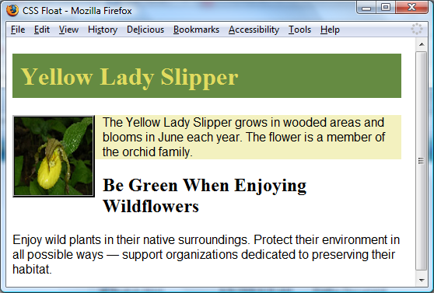
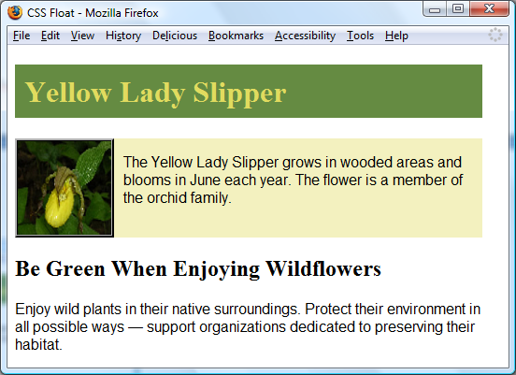
6.5 overflow Property (4) to clear float
Is often used to clear a float
Intended to configure the display of elements on a Web page to fit the room allocated
However, it is useful to “clear” or terminate a float before the end of a container element
Overflow (how content should be displayed) values are auto, hidden, and scroll
visible (default) – if the content too large it will “overflow” outside the area allocated to it
<=auto – the content fills the area and, if needed, scroll bars are displayed
scroll - scroll bars are displayed
hidden - the content is clipped to fit the room allocated
The background does not extend as far as you’d expect. See floatyls.html before.

Slide 27
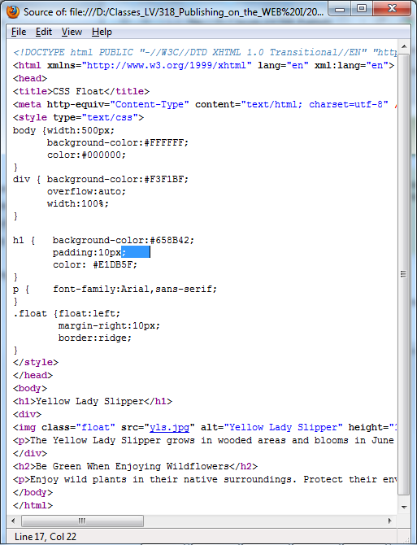

overflow Property (4)
Good Solution
overflow:auto;
was applied to the div that contains the image within the paragraph.
Now the background extends and the h2 text displays AFTER the floated image.
The clear property to a br
<br class="clearleft"> gives the same result within the <div>– see previous slides. In this example the overflow is more efficient.

Slide 28
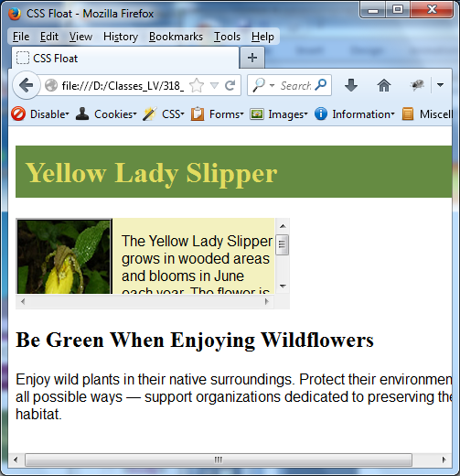
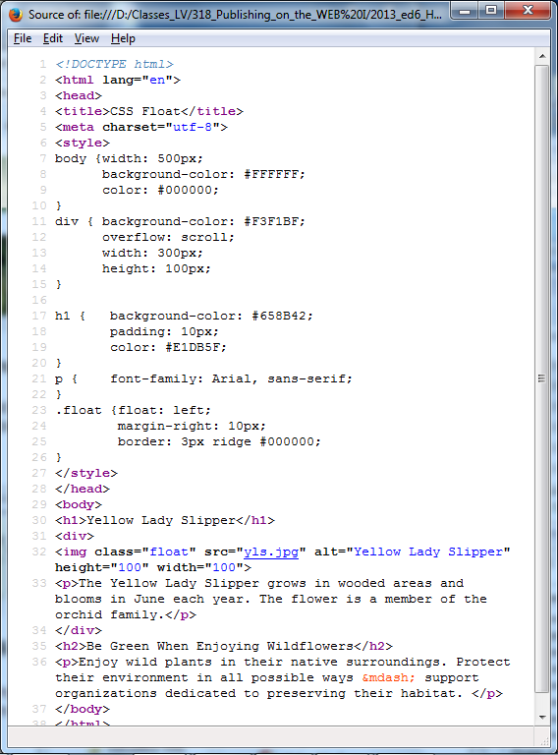
overflow Property (4)

Slide 29
CSS Display properties (5) p.264
Display
The display property configures how and if an element is displayed.
An element configured with:
display:none ;
will not be displayed. This is sometimes used when configuring styles to print a web page
display:block ;
will be rendered as a block element – a line break above and below (even if it is actually an inline element, such as an anchor tag).
display:inline;
The element will be rendered as an inline element – no line break above and below (even if it is actually a block element – such as a <li>)
display:inline-block;
The element will be rendered as an inline element adjacent to other inline display elements but also can be configured with properties of block display elements including width and height
display:flex;
The element will be rendered as a block-level flex container, chapter 7
display:grid;
The element will be rendered as a block-level grid container, chapter 7

Slide 30
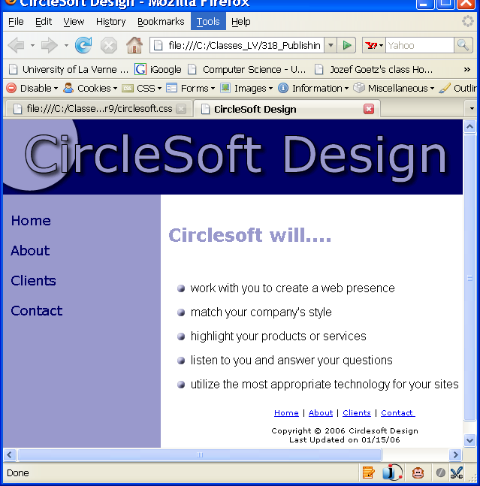
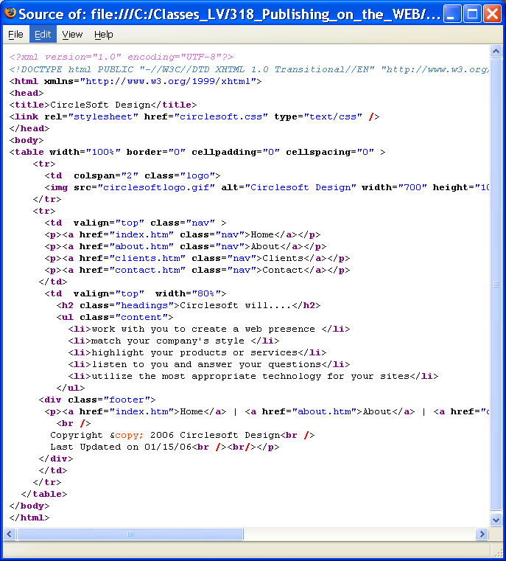

CSS Display (5)
Display
We can replace all paragraphs <p> => elements around anchor tags by
display:block
See the next slide

Slide 31
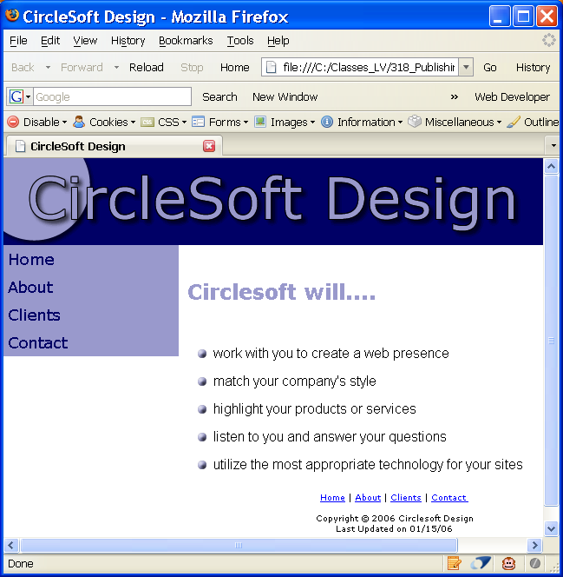
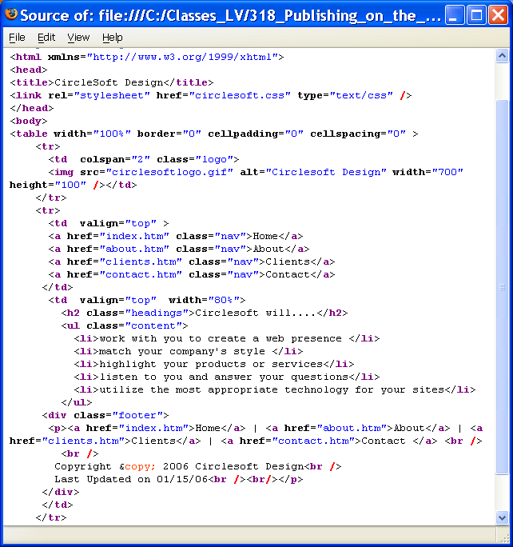
Display property (5)
all paragraphs <p> elements around anchor tags are replaced by
display:block
body { margin: 0px;
background-color: #ffffff;
color: #000000;
font-family:Verdana, sans-serif;
}
.logo {background-color:#000066;
color:#9999cc;
}
.nav {padding: 5px;
background-color:#9999cc;
color:#000066;
text-decoration:none;
font-size:large;
display:block;
}
a.nav:link {color:#000066;
}
a.nav:visited {color:#000000;
}
a.nav:hover {color:#ffffff;
}
.content {font-family:Arial,sans-serif;
line-height:200%;
}
.headings {color:#9999cc;
background-color:#ffffff;
line-height:200%;
padding:10px;
}
.footer {font-size:xx-small;
text-align:center;
}
ul {list-style-image: url(circlesoftbullet.gif);
}
An element configured with display:block
will be rendered as a block element (even if it is actually an inline element,
such as an anchor tag).
Display property is used
to display a menu vertically

Slide 32
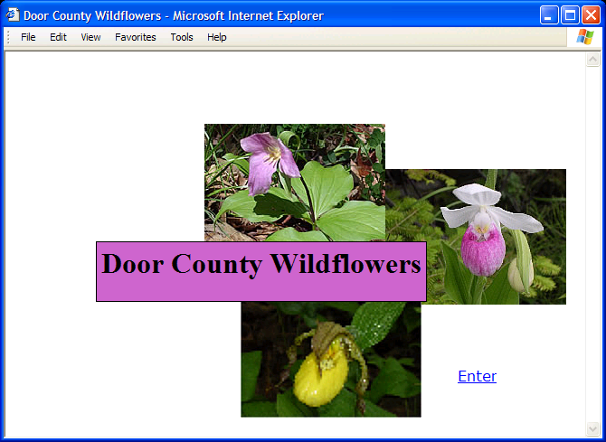
CSS Z-index Properties (6)
Z-index p.279, 658
Used to modify the stacking order of elements on a web page.
The z-index property allows a developer to layer overlapping elements
The default z-index = “0".
Elements with higher z-index values will appear stacked on top of elements with lower z-index values rendered on the same position of the page.

Slide 33
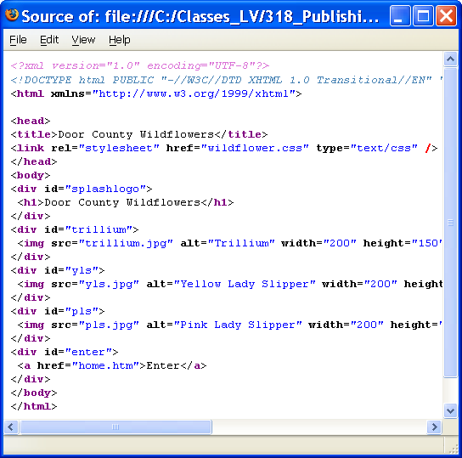
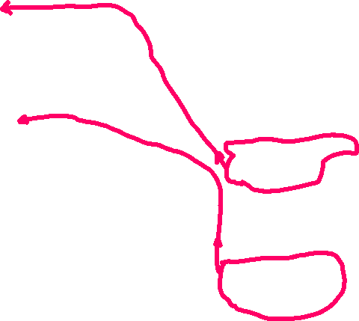




CSS Z-index Properties (6)
#splashlogo {background-color:#e8b9e8;
padding:5px 20px;
color: #000000;
font-family:”Times New Roman”, serif;
position:absolute;
text-align: center;
z-index:4;
top:210px;
left:80px;
border: 2px solid #000000;
}
#trillium {position:absolute;
z-index:3;
left:220px;
top:80px;
}
#pls {position:absolute;
z-index:2;
left:420px;
top:130px;
}
#yls {position:absolute;
z-index:3;
left:300px;
top:270px;
}
#enter {position:absolute;
left:520px;
top:350px;
font-family:Verdana,sans-serif;
}
splash.htm with part of wildflower.css

Slide 34
Checkpoint 6.1
1. List components of the box model from innermost to outermost.
The content, padding, border and margin
2. State three reasons to use CSS for page layout on a commercial site being developed today.
Greater typography and page layout control without using tables
Style is separate presentation from the page structure
Potentially smaller html documents
No need for <font> tags
Easier site maintenance
Support of multiple media types
3. Describe the difference between relative and absolute positioning.
Relative - slightly change the location of an element in relation to where it would otherwise appear in normal flow
Absolute - precisely specify by pixels the location of an element in the browser window. Elements rendered outside of normal flow!
4. Describe the purpose of the CSS float property.
5. Which two C S S properties can be used to clear a float? p.677 the clear & overflow

Slide 35
HTML5 Structural Elements
<header> Element </header>
configures the header area of a web page
block display
header {display : block;} //for old browsers
<nav> Element </nav>
contains a section of navigation hyperlinks
block display
<main> Element </main>
configures the main contain area of a web page
block display
<footer> Element </footer>
contains the footer content of a web page or specific area (such as a section or article) on a web page
block display

Slide 36
6.6 The C S S Box-Sizing Property (7)
In the box model default value for width or height property is the value for ONLY the content (it doesn't include border and padding).
The box-sizing property is used to selector to direct the browser to calculate the width and height of an element to include the value for content, padding, and border.
Use the universal selector (*) to apply this to all the element on the page
Example:
* { box-sizing: border-box; }
It is common practice for web developers to apply border-box when they plan to use floated elements or multicolumn layouts.

Slide 37
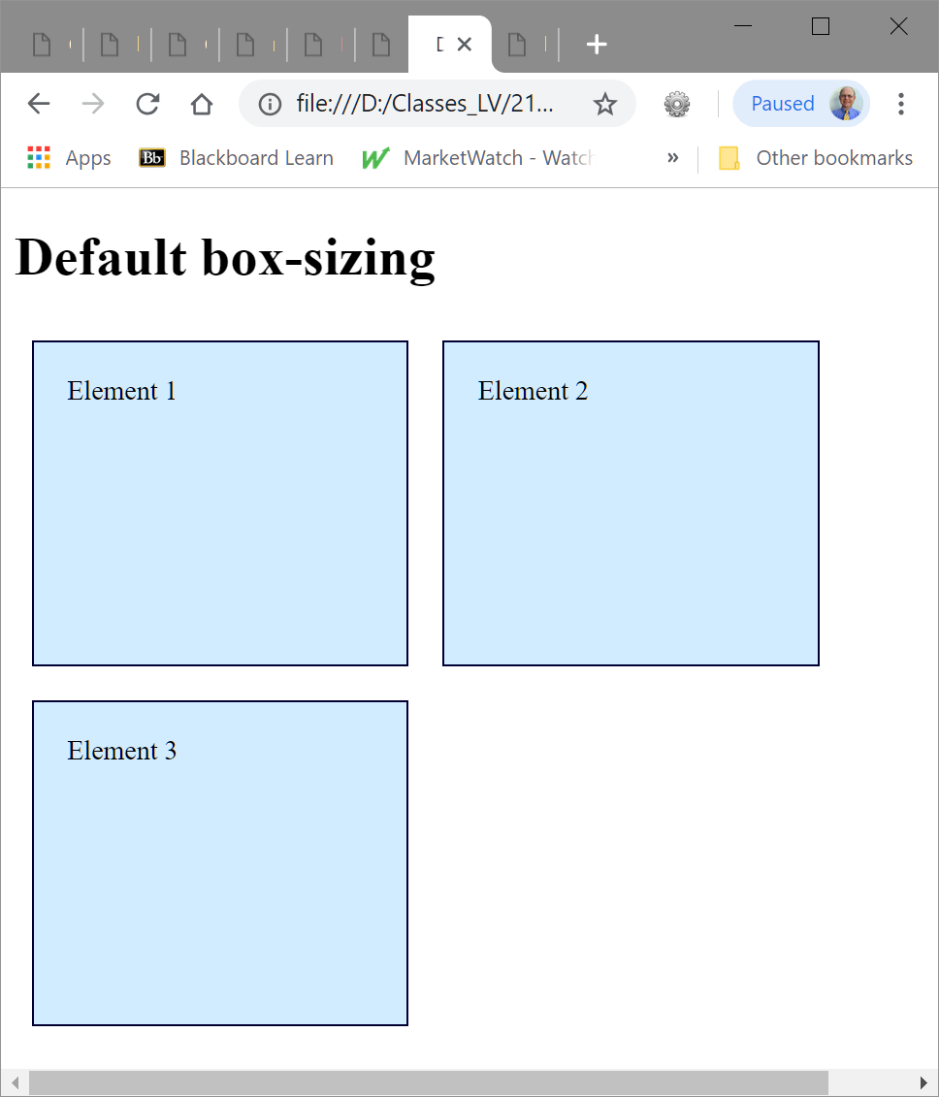
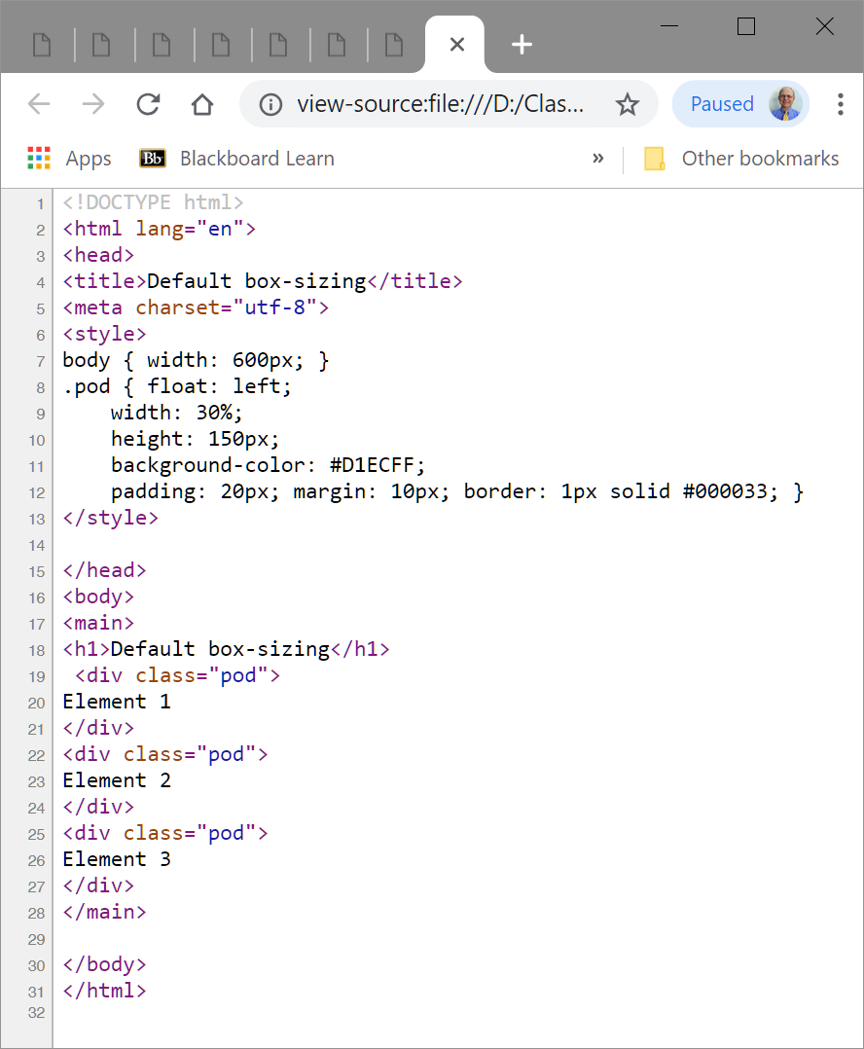
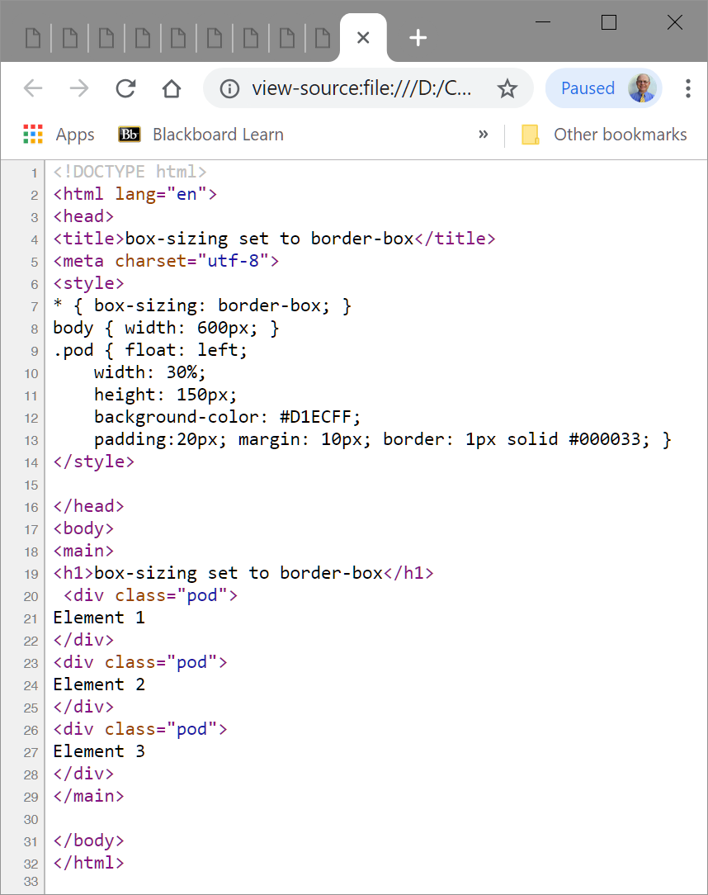
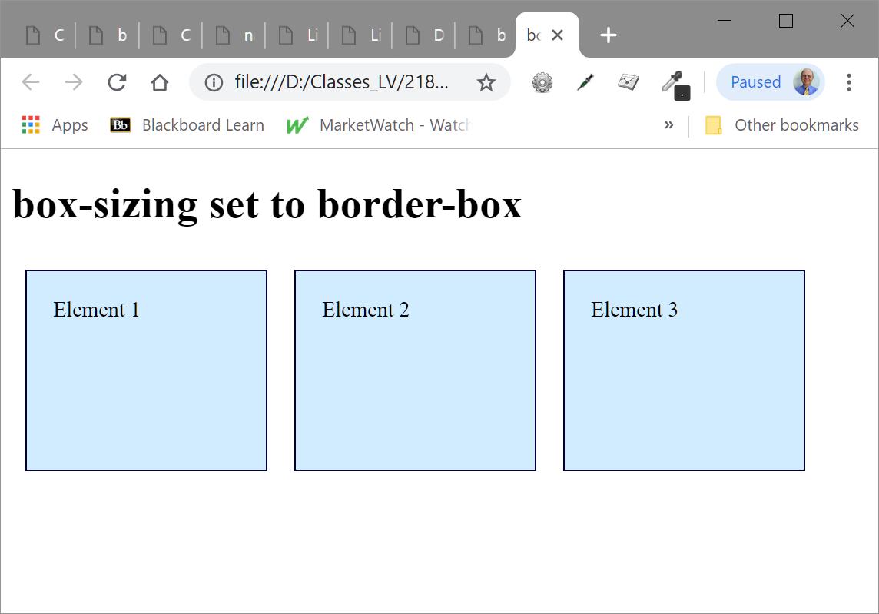


6.6 The C S S Box-Sizing Property (7)
First add width: 30% to default (which has
included the content’s width only) and then
padding 20 px for each side and the border
First add width: 30% with combined
the content, padding 20 px for each side,
and the border 1 px so it is smaller display.

Slide 38
6.7 CSS Two Column Page Layout
A common design for a web page is a two-column layout with left-column navigation and right-column logo and content.
The key to this layout is that the left column is coded to float to the left using float:left
CSS Page Layout Two Columns (left nav)

Slide 39
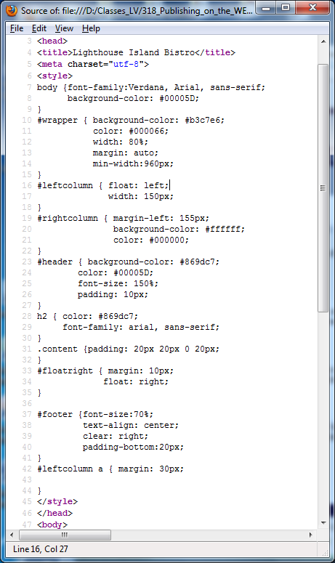
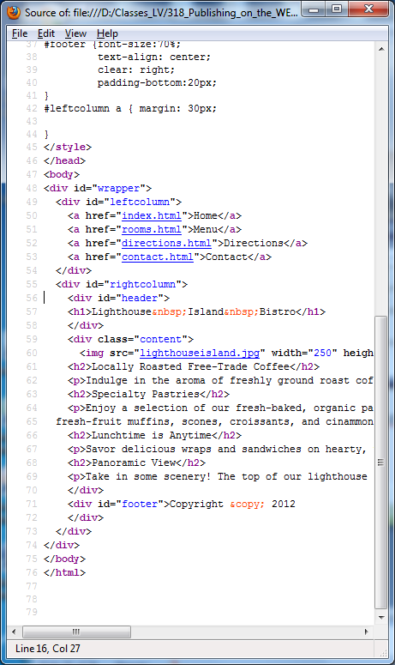





CSS Two Column Page Layout – edition(ed)6

Slide 40
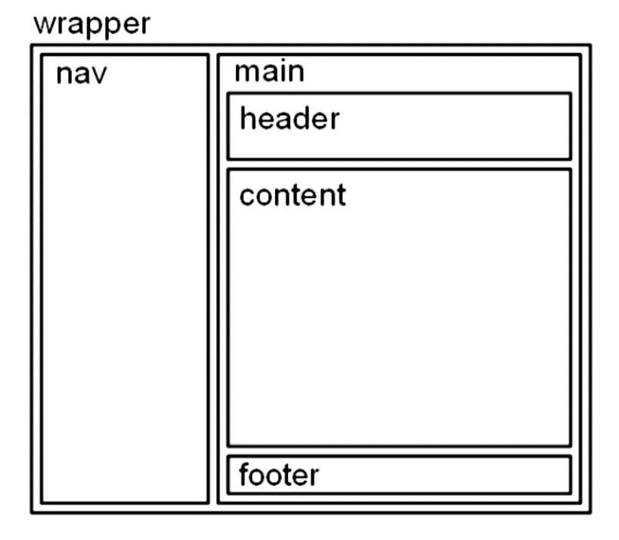

6.7 CSS Page Layout Two Columns (left nav) - edition(ed)10
ed10
nav { float: left;
width: 150px;
padding: 20px; }
main { margin-left: 165px;}
header { background-color: #CCCCFF;}
footer { margin-left: 165px;}
p.261
ed6
similar HOP 6.4 p.258-260

Slide 41
Hands-On Practice
HOP 6.4
Follow the directions in your book for the HOP.
START-UP File | singlecol.html
SAVE SOLUTION AS | index.html

Slide 42
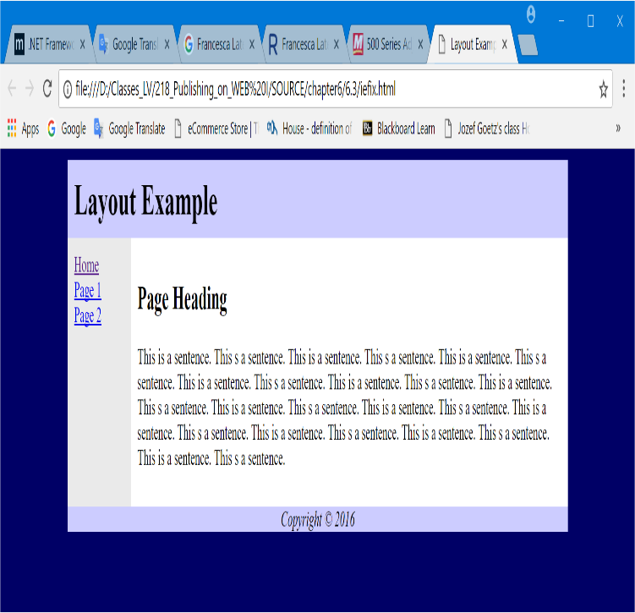
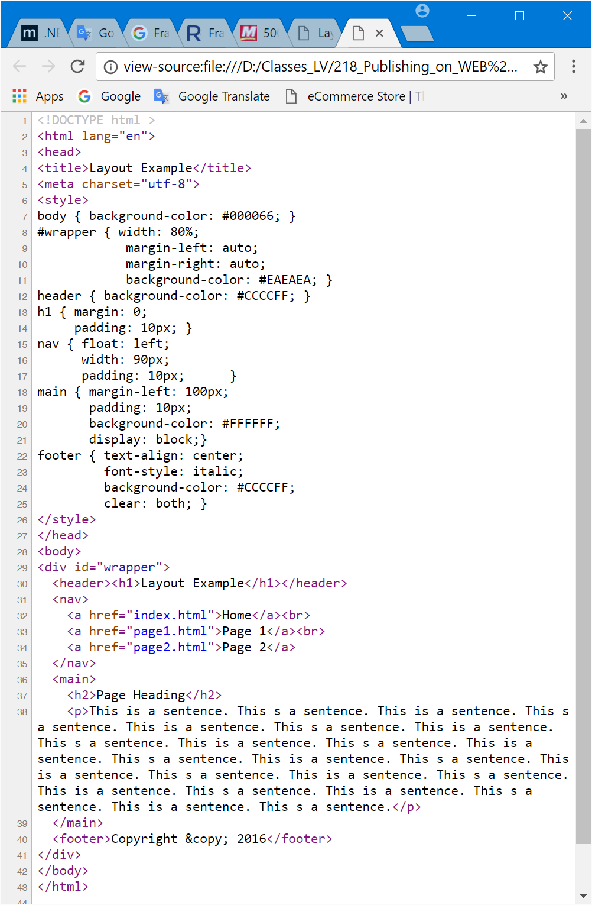




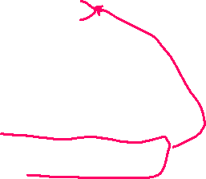
HOP 6.4 - top logo

Slide 43
6.8 Configure Hyperlinks in an Unordered List - ed6
Vertical Navigation
<div id="leftcolumn">
<ul>
<li><a href="index.html">Home</a></li>
<li><a href="menu.html">Menu</a></li>
<li><a href="directions.html">Directions</a></li>
<li><a href="contact.html">Contact</a></li>
</ul>
</div>
CSS removes the list marker and underline:
#leftcolumn ul { list-style-type: none; } /*no markers */
#leftcolumn a { text-decoration: none; } /*no underline */

Slide 44

6.8 Configure Hyperlinks in an Unordered List – ed10
Vertical Navigation
<nav>
<ul>
<li><a href="index.html">Home</a></li>
<li><a href="menu.html">Menu</a></li>
<li><a href="directions.html">Directions</a></li>
<li><a href="contact.html">Contact</a></li>
</ul>
</nav>
Read entire pages 263-264!
CSS removes the list marker and underline:
nav ul { list-style-type: none; } /*no markers p.263 */
nav a { text-decoration: none; } /*no underline p.263 */

Slide 45
Configure Hyperlinks in an Unordered List
Horizontal Navigation
HTML:
<nav>
<ul>
<li><a href="index.html">Home</a></li>
<li><a href="menu.html">Menu</a></li>
<li><a href="directions.html">Directions</a></li>
<li><a href="contact.html">Contact</a></li>
</ul>
</nav>
CSS removes the list marker, removes the underline, adds padding, and configures the list items for inline display.
nav ul { list-style-type: none;} /*no markers */
nav a { text-decoration: none; padding-right: 10px; } /*no underline */
nav li { display: inline; } /*inline p. 264*/
or nav li { float: left; } // see the link below
https://www.w3schools.com/html/tryit.asp?filename=tryhtml_lists_menu

Slide 46
6.9 CSS Pseudo-classes
<style type=”text/css>
a:link {color:#FF0000 }
a:hover {text-decoration:none;
color:#000066 }
</style>
An addition to conventional style classes, the CSS2 standard defines pseudo-classes, which allow you to define the display style for certain tag states.
Pseudo-classes are like regular classes, with 2 notable differences:
they are attached to the tag name with a colon instead of a period, and
they have predefined names, not arbitrary ones you may give them.

Slide 47
CSS Pseudo-classes
<style type=”text/css>
a:link {color:#FF0000 }
a:hover {text-decoration:none;
color:#000066 }
</style>
a:link {color:#000066;}
a:visited {color:#003366;}
a:focus {color:#FF0000;}
a:hover {color:#0099CC;}
a:active {color:#FF0000;}
Pseudo-classes (predifined names) uses a colon (:) to apply the pseudo class for the anchor tag
need to be in the following order (the mnemonic is lovehate):
Link – default state for a link (anchor tag)
Visited – a hyperlink that has been visited
focus – triggered when the hyperlink has focus
Hover – triggered when the mouse is currently over the hyperlink
Active – triggered when the hyperlink is being clicked

Slide 48
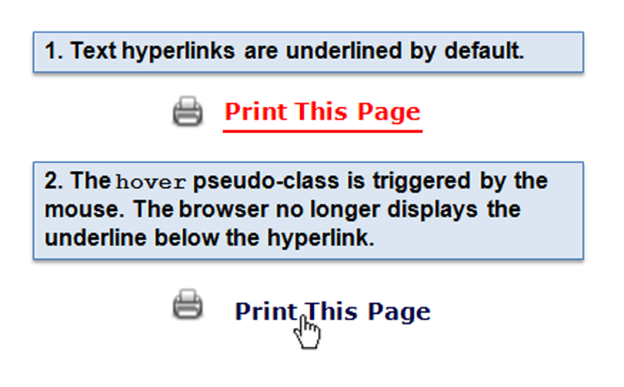
6.9 CSS Pseudo-classes
a:link { color: #ff0000; }
a:hover { text-decoration: none; color: #000066; }

Slide 49
Hands-On Practice
HOP 6.5
Follow the directions in your book for the HOP.
START-UP File | lighthouseisland.jpg lighthouselogo.jpg Chapter6/starters
SAVE SOLUTION AS | index.html

Slide 50
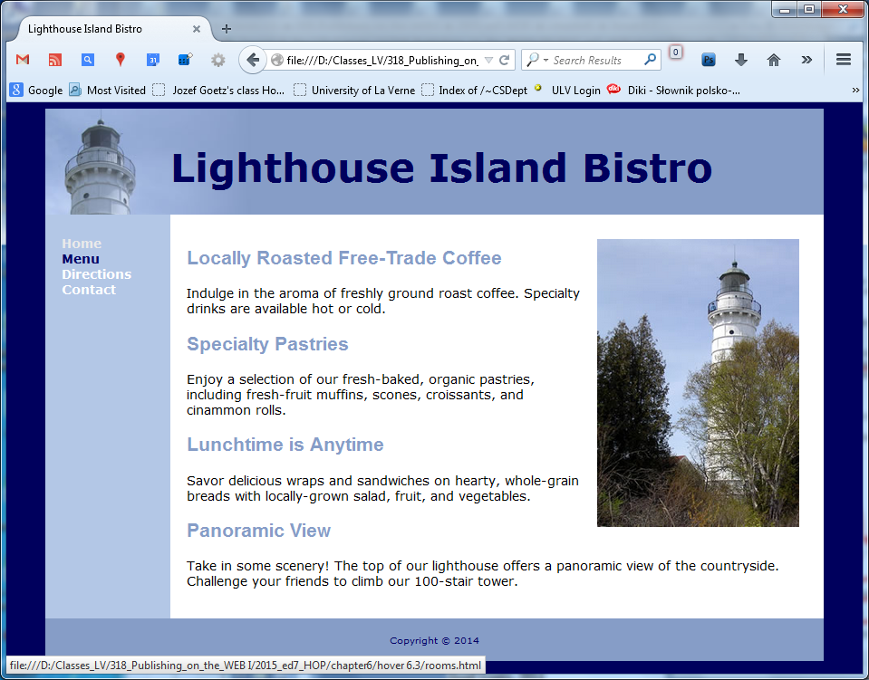
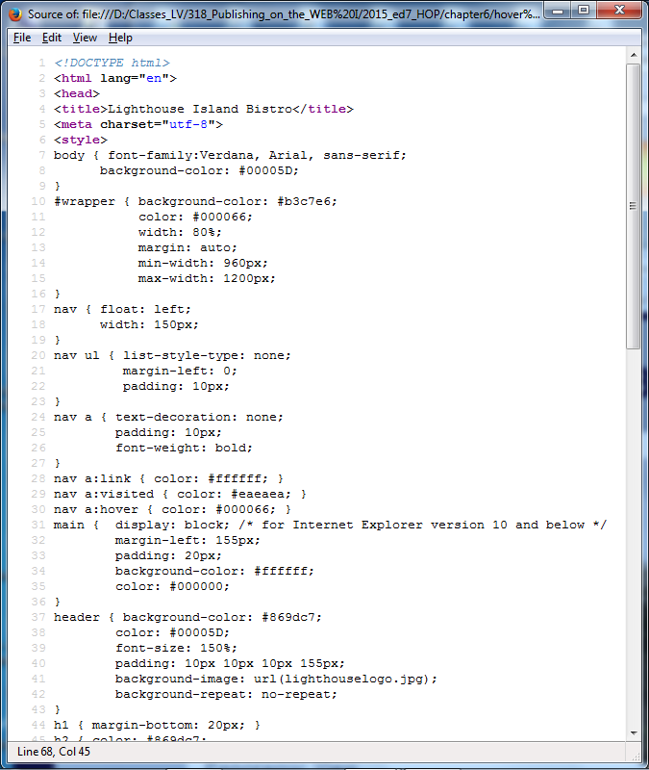
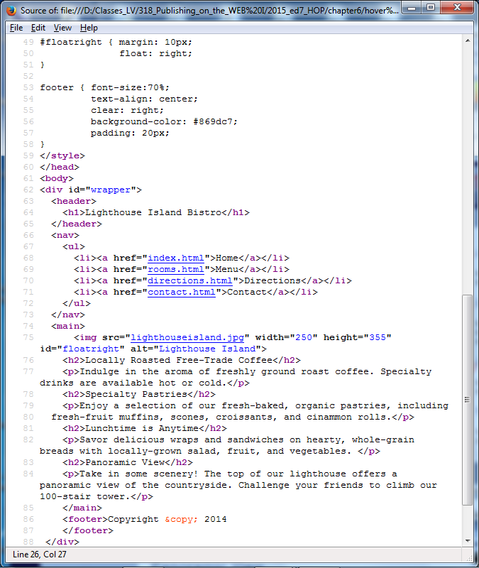



2 column layout: HOP 6.5 mouse over with HTML 5

Slide 51
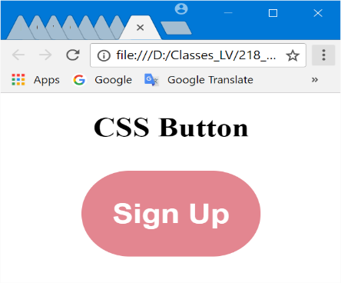
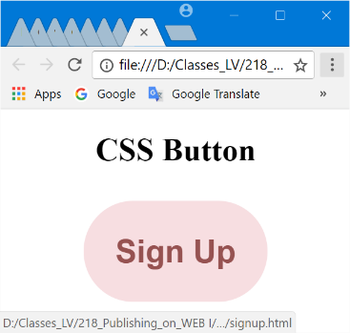

.button class - button.html

Slide 52


CSS “buttons” to configure nav. Menu
http://classes.jgspectrum.com/classes/218_F22/examples/ch6/navbuttons.html

Slide 53
Hands-On Practice
HOP 6.6
Follow the directions in your book for the HOP.
START-UP File | chapter6/starters starters3.html
SAVE SOLUTION AS | index.html

Slide 54






6.9 2 column layout: HOP 6.6 with display:block

Slide 55

Header Text Image Replacement
Useful when a non web-safe font must be used in the header logo banner area
Display the banner image but also configure text in the h1 (usually the same text displayed in the banner) for use by search engines and assistive technologies.
To apply Header Text Image Replacement:
1. Code the company or website name with the h1 element.
2. Configure styles for the header element set the header banner image as
the background of the header or h1 element.
3. Configure the placement of the h1 text to be beyond the browser viewport:
h1 { text-indent: 100%; /* h1 text outside of the browser viewport */
white-space: nowrap;
overflow: hidden; } /*fit to the room allocated */
SOURCE: http://www.zeldman.com/2012/03/01/replacing-the-9999px-hack-new-image-replacement/
<h1> Lighthouse Island Bistro </h1>

Slide 56




<h1> is not visible – available for the screen readers and search engines:
To apply Header Text Image Replacement:
1. Code the company or website name with the h1 element.
2. Configure styles for the header element set the header banner image as
the background of the header or h1 element.
3. Configure the placement of the h1 text to be beyond the browser viewport:
h1 { text-indent: 100%; /* h1 text outside of the browser viewport */
white-space: nowrap;
overflow: hidden; } /*fit to the room allocated */

Slide 57

HTML5 Structural Elements
<header> Element </header>
contains the headings of either
a web page document or an area
in the document such as a section
or article.
<hgroup>Element </hgroup>
contains two or more heading
elements (h1, h2, and so on)
Example: <header>
<hgroup>
<h1>Lighthouse&nbsp;Island&nbsp;Bistro</h1> /*1st is displayed in the page outline*/
<div id=“tagline”>the best coffee on the coast</div>
</hgroup>
</header>

Slide 58






HTML 5 – new: hgroup, figure, figcaption
nav { float: right; width: 150px; letter-spacing:0.1em; font-weight: bold; }

Slide 59
Hands-On Practice
HOP 6.7
Follow the directions in your book for the HOP.
START-UP File | chapter6/starters
SAVE SOLUTION AS | index.html

Slide 60


6.10 CSS Sprites HOP 6.7
Sprite
an image file that contains multiple small graphics
+’s: saves download time b/c
Reduced bandwidth
Reduced the # of http request by the browser
Quick display of individual images in the sprite

Slide 61







CSS Sprites HOP 6.7
Exc. – index_MOD_6.7.html:
nav a {background-position: left 0px;}
nav a:hover background-position: left -110px;
role - semantic description
of HTML elements for a screen readers
move

Slide 62
Hands-On Practice
HOP 6.8
Follow the directions in your book for the HOP.
START-UP File | Ch6spiretes folder
SAVE SOLUTION AS | index.html

Slide 63
6.11 CSS Styling for Print
Create an external style sheet with the configurations for browser display.
Create a second external style sheet with the configurations for printing.
Connect both of the external style sheets to the web page using two <link> tags.
<link rel="stylesheet" href="wildflower.css" type="text/css" media="screen" />
<link rel="stylesheet" href="wildflowerprint.css" type="text/css" media="print" />

Slide 64
Print Styling Best Practices HOP 6.8
Hide non-essential content like navigation Example:
1. nav { display: none; }
Configure font size and color for printing
2. Use pt font sizes (12pt for the main), smaller font sizes for the footer
3. use dark text color e.g. #000000,
4. background #FFFFFF
Control page breaks p.274 - configure a break at a specific point
page-break-before or page-break-after a designed/specific element:
Example: 5. .newpage { page-break-before: always; }

Slide 65





HOP 6.8
header { background-color: #869DC7;
color: #000000;
font-size: 20pt;
padding: 10px 10px 10px 155px;
background-repeat: no-repeat;
background-image: url(lightlogo.jpg); }
header a { text-decoration: none; }
nav { display: none; }
main { background-color: #ffffff;
color: #000000;
padding: 10px 20px;
display: block;
overflow: auto;
font-family: "Times New Roman", serif; font-size: 12pt; }
footer { font-size: 70%;
text-align: center;
padding: 10px;
background-color: #869DC7;
clear: both;}

Slide 66
Hands-On Practice
HOP 6.9
Follow the directions in your book for the HOP.
START-UP File | chapter6/starters photo1.jpg – photo4.jpg photo1thumb.jpg – photo4thumb.jpg
SAVE SOLUTION AS | index.html

Slide 67



6.12 Practice with Positioning - Image Gallery HOP 6.9
Exc: Resize the browser window to see all images in a single row.

Slide 68






Interactive Image Gallery HOP 6.9
When you place the mouse over a thumbnail image, the larger version of the image is displayed along with a caption.

Slide 69
Hands-On Practice
HOP 6.10
Follow the directions in your book for the HOP.
START-UP File | From chapter6/6.4 layout lighthouse.jpg, lightlogo.jpg, Horizontal.html
SAVE SOLUTION AS | index.html

Slide 70







HOP 6.10
<body>
<div id="wrapper">
<header>
<h1>Lighthouse Island Bistro</h1>
</header>
<nav>
<ul>
<li><a href="index.html">Home</a></li>
<li><a href="rooms.html">Menu</a></li>
<li><a href="directions.html">Directions</a></li>
<li><a href="contact.html">Contact</a></li>
</ul>
</nav>
<main>
<img src="lighthouse.jpg" width="250" height="355" id="floatright" alt="Lighthouse Island">

Slide 71




HOP 6.10
“Sticky” Navigation Bar
Setup only in purple:
nav { position: sticky;
top: 0; left: 0; /*target */
height: 40px;
width: 100%; min-width: 40em;
background-color: #B3C7E6;
z-index: 9999; }
nav ul { list-style-type: none;
font-size: 1.5em;
text-align: right;
margin: 5px;
padding-right: 10%;
}
nav li { display: inline; }
nav a { text-decoration: none;
padding-right: 10px;
<div id="wrapper">
<header>
<h1>Lighthouse Island Bistro</h1>
</header>
<nav>
<ul>
<li><a href="index.html">Home</a></li>
<li><a href="rooms.html">Menu</a></li>
<li><a href="directions.html">Directions</a></li>
<li><a href="contact.html">Contact</a></li>
</ul>
</nav>
sticky1.html – p.281 down
nav { position: sticky; top: 0; } :
Combines features of relative and fixed positioning
Element rendered in normal flow and then, when reached the top during scrolling down, sticks to the that position and remains there.
If you scroll up the nav will revert to the initial position below the header.

Slide 72
Hands-On Practice
HOP 6.11
Follow the directions in your book for the HOP.
START-UP File | starter4.html starters
SAVE SOLUTION AS | ch6blog folder index.html

Slide 73
6.14 Single Page Website
One very long page (a single HTML file)
Clearly defined navigation area
Navigation links to specific sections that function as a “page”
Technique: hyperlinks to fragment identifiers
Website Linking to Specific Places Within Documents
Anchors are special places that you can link to inside documents.
Softfruits.html
Soft Fruits
Please choose a subtopic:
Strawberries
Cane Fruits
Blackberries
Raspberries
Loganberries
Bush Fruits:
Blueberries
Huckleberries
Softfruits.html
Blackberries
Blackberries grow on canes
Blueberries
Blueberries grow on bushes in colder climates
Strawberries
Strawberries are an herbaceous plant

Slide 74

HTML Linking to Fragment Id (Identifier)
<a name=“top” id=“top”></a>
This line has
<a href="#top">Back To Top</a>
Clicking here takes you to the top of the page
(no need for an anchor named "top"
Copyright (c) 2006 Prentice-Hall. All rights reserved.
74

Slide 75

HTML/XHTML Internal Links using the <a> tag
A link to a part of a web page
Also called bookmarks, named anchors, named fragments
2 components:
1. Establish the target – named fragment:
identifies a bookmark or
named fragment of a web page.
This requires two attributes: the id attribute (for HTML/XHTML) and the name (for Netscape 4) attribute.
<a name=“top” id=“top”></a>
or instead of “a” can be
h1 or <div name =“content” id=“content”>
2. Reference the target - anchor tag (pointer) :
links to the bookmark or named fragment of a web page.
This uses the href attribute
<a href=“#top”>Back to Top</a>
or: <a href=“#content”>Skip to content</a>

Slide 76

Creating and Linking to Within-Page Targets
1. The <a> tag's name attribute
Creates a target at the location of the anchor tag
Commonly used on longer Web pages
Syntax:
<a name="specific choice">link text</a>
Example anchors
<a name=“education”>Education</a>
<a name=“dinner”>Dinner</a>
2. The pound (#) symbol in an href attribute
References one of the named anchor tags
Value after the pound sign must be identical to name of an anchor
Syntax: <a href=“#specific choice">link text</a>
76

Slide 77

Effects of Within-Page Linking
This line has
<a href="#duck">Can a duck fly if it's wet?</a>
Clicking here takes you to the "duck" line
This line has
<a name="duck">Can a duck fly if it’s wet?</a>
Copyright (c) 2006 Prentice-Hall. All rights reserved.
77

Slide 78
Linking to Specific Places on another Documents/Website
1. Linking to the target in the same page
use the hash mark (#) and the anchor name only
<a href=“#dinner”>What’s for dinner?</a>
2. Linking to the target on another page
use the same form as you would to link to the page
add a hash mark (#) and the name of the anchor at the end
<a href=“filename.html#education”>Education</a>
3. Linking to the target on another website by appending a hash mark (#) and name value
<a href=“URL/filename.html#name”>What’s for dinner?</a>

Slide 79










6.14 Single Page Website
Figure 6.52 Wireframe
for single page website
Figure 6.51 Single page website – with Linking to Fragment Identifiers

Slide 80






Single Page Website – HOP 6.11
footer { background:rgba(25,25, 25, 0.90);
width: 100%;
font-size: 90%;
text-align: center;
color: #EAEAEA;
position: fixed;
bottom: 0;
}
footer a { text-decoration: none;
color: #EAEAEA; }
.tourshero {
background-image: url(kayaks.jpg);
min-height: 100vh;
background-repeat: no-repeat;
background-size: cover;
}

Slide 81
Hands-On Practice
HOP 6.12
Follow the directions in your book for the HOP.
START-UP File | HOP 6.11
SAVE SOLUTION AS | index.html

Slide 82
Parallax Scrolling
Page layout technique in which the background images scrolled at a different speed than the text content
Often accomplished with JavaScript and advanced CSS
Most basic implementation:
CSS background-attachment property background-attachment: fixed;
Will prevent the background image from scrolling with the page

Slide 83
Figure 6.53 Using the background-attachment property
Using the background-attachment property
will prevent the background image from scrolling within the page.
Other elements will scroll vertically.

Slide 84


HOP 6.12
FROM HOP 6.11:
.tourshero {
background-image: url(kayaks.jpg);
min-height: 100vh;
background-repeat: no-repeat;
background-size: cover;
}

Slide 85
6.14 CSS Debugging Tips
Manually check syntax errors
the error could be in the line above the style that is not correctly applied
CSS doesn’t apply due to a syntax error
Programmatically check syntax errors - use W3C CSS Validator: http://jigsaw.w3.org/css-validator/
Testing is crucial
Configure temporary background colors: such as red or yellow
Configure temporary borders with an element a
3 pixel; solid border; red
Use comments for some part of CSS to find the unexpected errors
/* temporarily commented out during testing
.nav {text-decoration:none} */
Don’t expect your pages to look exactly the same in all browsers, design they look the best on Chrome, Firefox, Edge, Opera or the browser’s clients!
Be patient!

Slide 86
Deciding to Configure a class or id
Configure a class:
If the style may apply to more than one element on a page
Use the . (dot) notation in the style sheet.
Use (refer) the class attribute in the HTML/XHTML
(ex. class=“navBar”).
Configure an id:
If the style is specific to only one element on a page
Use the # notation in the style sheet.
Use (refer) the id attribute in the HTML/XHTML
(ex. id=“imagelogo”).
A class name should be descriptive of the purpose (such as nav, news, footer, and so on) rather than being descriptive of the presentation (such as redText).
According to Google’s Web Authoring Statistics Study, the 10 most commonly used class names or HTML5 selectors are footer, menu, title, small, text, content, header, nav, copyright, and button.

Slide 87


https://css-tricks.com/average-web-page-data-analyzing-8-million-websites:

Slide 88


More HTML5 Elements
<aside> Element </aside>
contains a sidebar, a note, or other
tangential content
this block display element could contain
header,
footer,
section,
aside,
div, and
other elements needed to configure the content.

Slide 89

More HTML5 Structural Elements
<section> Element </section>
contains a “section” of a document, such as a chapter or topic
this block display element could contain header, footer, section, article, aside, div, and other elements needed to configure the content.
<article> Element </article>
contains an independent entry, such as a blog posting, comment, or e-zine article that could stand on its own
this block display element could contain header, footer, section, aside, div, and other elements needed to configure the content.
<time> Element </time>
represents a date or a time
could be useful to date articles or blog posts
inline display
There is a confusing (lack of) difference in the HTML5 standard, between <article> <section> and <div>.
In the HTML5 standard, the <section> element is defined as a block of related elements.
The <article> element is defined as a complete, self-contained block of related elements.
The <div> element is defined as a block of children elements.
How to interpret that?
In the example above, we have used <section> as a container for related <article>.
But, we could have used <article> as a container for articles as well.

Slide 90





Aside Element HTML 5
<=div is replaced by span in ed8
header, nav, footer, figure, figcaption, section, article, aside{ display: block; }

Slide 91
CSS Page Layout Resources
The textbook is just an intro to using CSS technology
For additional study:
http://glish.com/css/
Large collection of CSS page layouts and links to tutorials
http://www.websitetips.com/css/index.shtml
Comprehensive list of tutorials and CSS-related sites
http://www.meyerweb.com/eric/css/
The web site of Eric Meyer, a leading-edge web developer
http://www.w3.org/Style/CSS/learning
W3C’s list of CSS resources
http://www.bluerobot.com/web/layouts/
A “reservoir” of CSS page layouts
http://www.blooberry.com/indexdot/css/
CSS syntax reference list

Slide 92
Overview of Cascading Style Sheets
Cascading Style Sheets (CSS) is a stylesheet language used to describe the presentation of a document written in a markup language.
Its most common application is to style web pages written in HTML and XHTML, but the language can be applied to any kind of XML document, including SVG and XUL.
CSS is used to help readers of web pages to define colors, fonts, layout, and other aspects of document presentation.
It is designed primarily to enable the separation of document content

Slide 93
Checkpoint 6.2 p.287, 677
1. State an advantage of using CSS to style for print.
Navigation can be hidden,
page breaks can be configured,
properties margin, padding, width, float can be adjusted
2. State an advantage of using CSS sprites in a website
Reduced bandwidth
Reduced the # of http request by the browser
Quick display of individual images in the sprite
3. Describe a technique to keep an HTML element, such as a nav element, displayed at the top of the browser viewport even while the browser is scrolled.
Set the value
nav { z-index:9999;
position: fixed or sticky;
top: 0;
left: 0;

Slide 94
Summary
This chapter introduced you to the box model, Cascading Style Sheets to configure two-column layout page, CSS pseudo-classes and HTML5 structural elements.
This technique is more difficult than develop pure XHTML/HTML but save you a lot of time and will give you much flexibility over just using XHTML/HTML
Be patient with yourself and plan on reviewing the CSS resources material.
It takes a while to grasp this technology.

Slide 95



Project Ch6 JavaJam Coffee House – modify .css to have 2 columns

Slide 96



Pr. Ch6 Pacific Trails Resort – modify .css to have 2 columns

Slide 97



Project Ch6 Path of Light Yoga Studio – modify .css to have 2 columns

