Slide 1
Introduction
HOP 7.1
CSS Flexible Box Layout
HOP 7.2
Configure CSS Flexible Box Layout with 3-column
HOP 7.3
CSS Grid Layout – image gallery grid
HOP 7.4
CSS Grid Layout – lighthouse
HOP 7.5
CSS Grid Layout – configure template
HOP 7.6
Progressive Enhancement with Grid
HOP 7.7
Centering with Flexbox and Grid
HOP 7.8
Responsive Layout with Media Queries
HOP 7.9
Responsive Layout with Media Queries
HOP 7.10
Responsive Images
HOP 7.11
Picture Element
HOP 7.12
Responsive Img Element Attributes

Slide 2
Chapter 7
Responsive
Page Layout
Credits: © 2011- 22 Pearson Education
Copyright (c) 2009 Prentice-Hall. All rights reserved.
expanded by J. Goetz, 2025

Slide 3

Learning Objectives
In this chapter, you will learn about:
7.1 Describe CSS Flexible Box Layout (called flexbox)
7.2 Create a web page that applies CSS Flexible Box Layout
7.3 Configure Flexbox Container and Flexbox Items
7.4 Describe CSS Grid Layout
7.3 Configure a Grid Container
7.4 Create responsive page layouts with CSS Grid Layout
7.10 Configure web pages for mobile display using the viewport meta tag
7.12 Apply responsive web design techniques with
CSS media queries,
CSS feature queries, and
flexible images
7.14 Apply responsive image techniques including the HTML5 picture element

Slide 4
7.1 CSS Flexible Box Layout Module
Referred to as “flexbox”, a new emerging technique
GREAT way to easily configure multi-column page layout
elements contained within a flex container can be configured either horizontally or vertically in a flexible manner with flexible sizing
Flexbox is not yet well-supported by browsers.
Check http://caniuse.com/flexbox for the current level of browser support.
Common Properties used with flexbox see p.313-318:
display flex
flex-direction order
flex-wrap
justify-content

Slide 5
CSS Flexible Box Layout aka flexbox
Purpose: Provide for a flexible, responsive layout https://www.w3.org/TR/css-flexbox-1/
Best used for one dimension – a row or a column
1. The display property configures a flexbox container
display: flex; // flex1.html => #gallery { display: flex;}
Flex Item – a child element of the flex container
2. The flex-wrap property
Determines whether flex items are displayed on multiple lines
Values are: nowrap (default), wrap, wrap-reverse
3. The flex-direction property
Configures the flow direction
Values are:
row (default),
column,
row-reverse, and column-reverse
– flex2.html => #gallery { display: flex; flex-wrap: wrap;}

Slide 6
Using Flexible Box Layout - Flexbox
1. Configure a flexible container “flex container”
2. Configure the direction of the flex
Example:
#demo {display: flex;
flex-direction: row; } // configures a horizontal direction
3. Adjust the proportion of the “flex item” elements in the container
Example:
nav {flex: 1; } // take 1 portion of the whole space
main {flex:7; } // take 7 portions of the whole space
aside {flex: 2 } // take 2 portions of the whole space
Flexible Box Layout is designed for one-dimensional layout of a row or column
Useful for configuring a portion of a page layout such as the nav, main, and aside areas horizontally across a web page

Slide 7
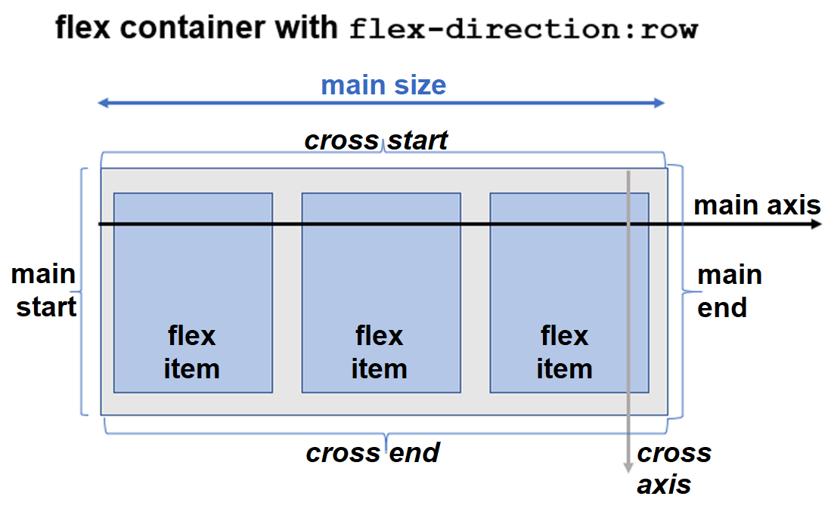



7.2 More About Flex Containers Diagram of a Flex Container (1 of 2)
Figure 7.3 Horizontal flow direction = main axis
The cross axis is the direction of the wrap (if any exists)

Slide 8



Diagram of a Flex Container (2 of 2)
Figure 7.4 Vertical flow direction = main axis
The cross axis is the direction of the wrap (if any exists)

Slide 9
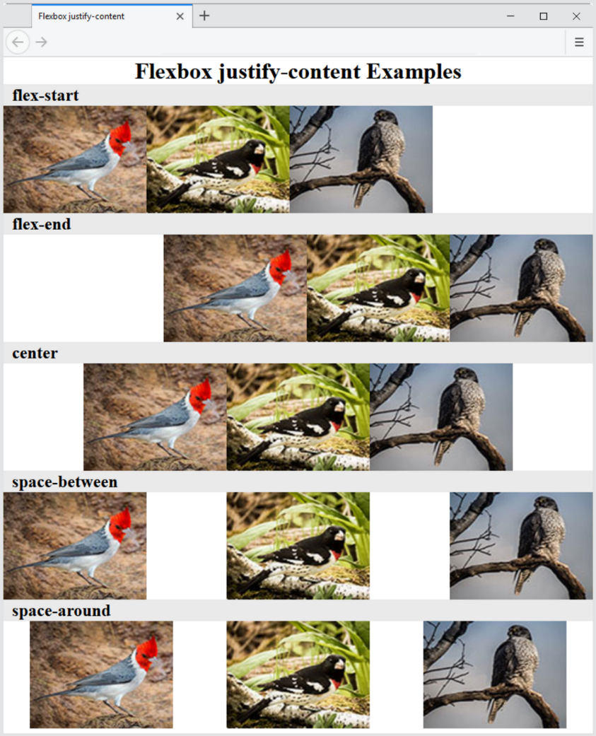
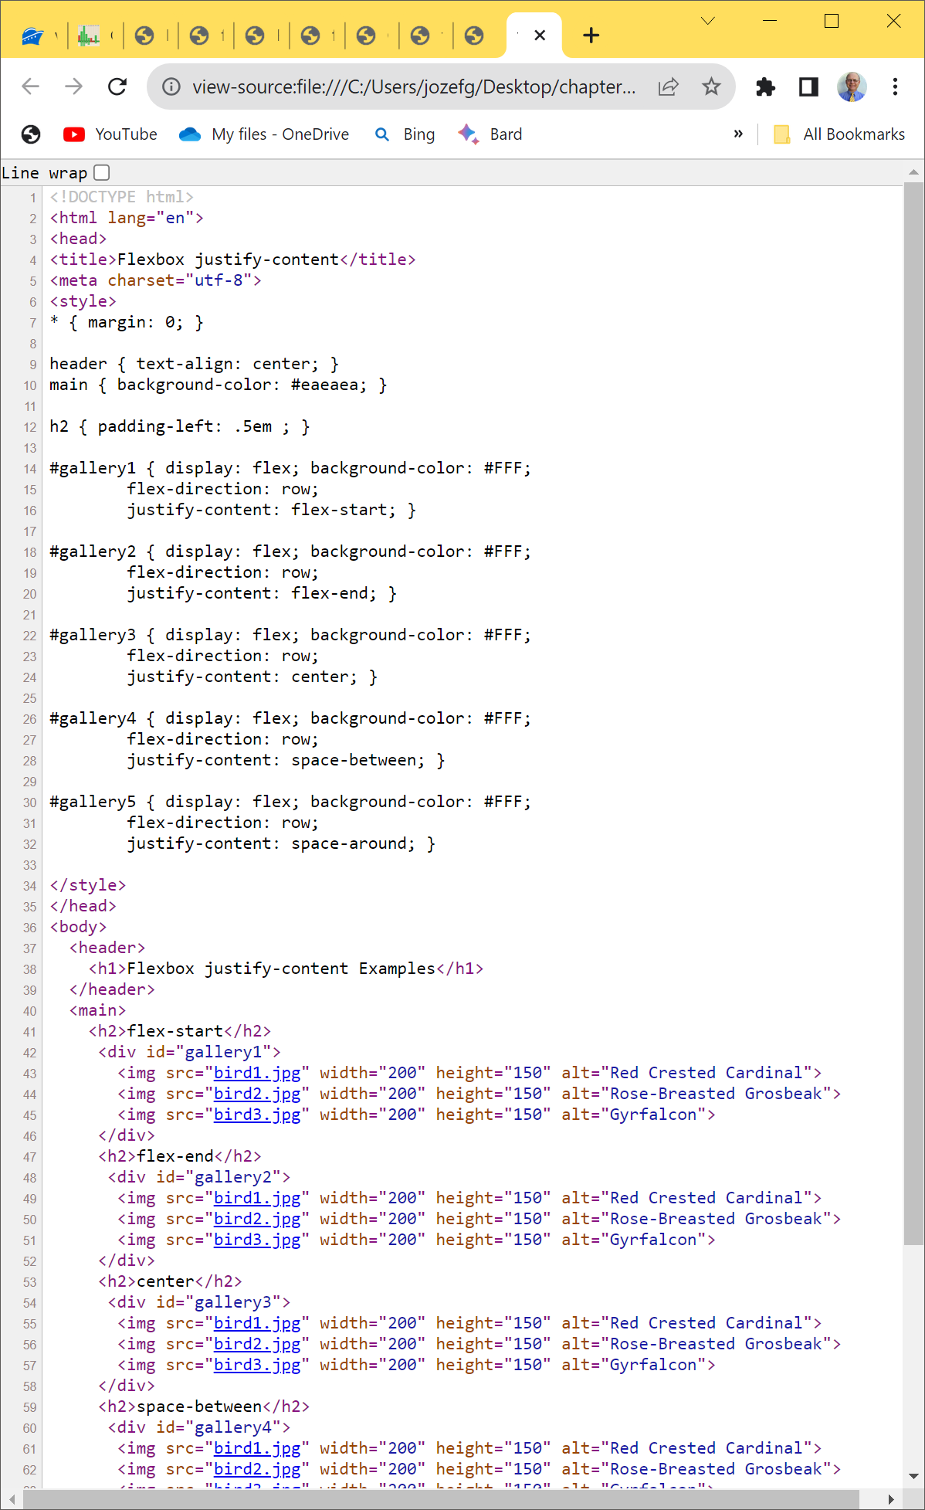



The justify-content Property
The justify-content properties configures how the extra space along the main axis should be displayed p.314.
Figure 7.5 displays a series of flex containers with horizontal flow, see flexj.html
flex-start -> default. Flex items begin at main start =>
flex-end -> begin at main end =>
Figure 7.5 The justify-content property

Slide 10
More flexbox Properties
The align-items Property
Configures how the browser displays extra space along the cross-axis
Values: flex-start, flex-end, center, base-line, stretch
flex3.html
The flex-flow Property
Shorthand to configure flex-direction and flex-wrap properties; a flexible container with a horizontal flow that wraps
#demo{ display: flex; flex-flow: row wrap}
The order Property
Causes the browser to display flex items in a different order than they are coded.
Accept numeric values, 0. 1, 2, 3 etc. Default = 0.
Warning – this could be an accessibility issue for screen readers.

Slide 11

Hands-On Practice
HOP 7.1
Follow the directions in your book for the HOP.
START-UP File | starter1.html chapter7/starters: bird1.jpg bird2.jpg bird3.jpg bird4.jpg bird5.jpg bird6.jpg
SAVE SOLUTION AS | index.html

Slide 12
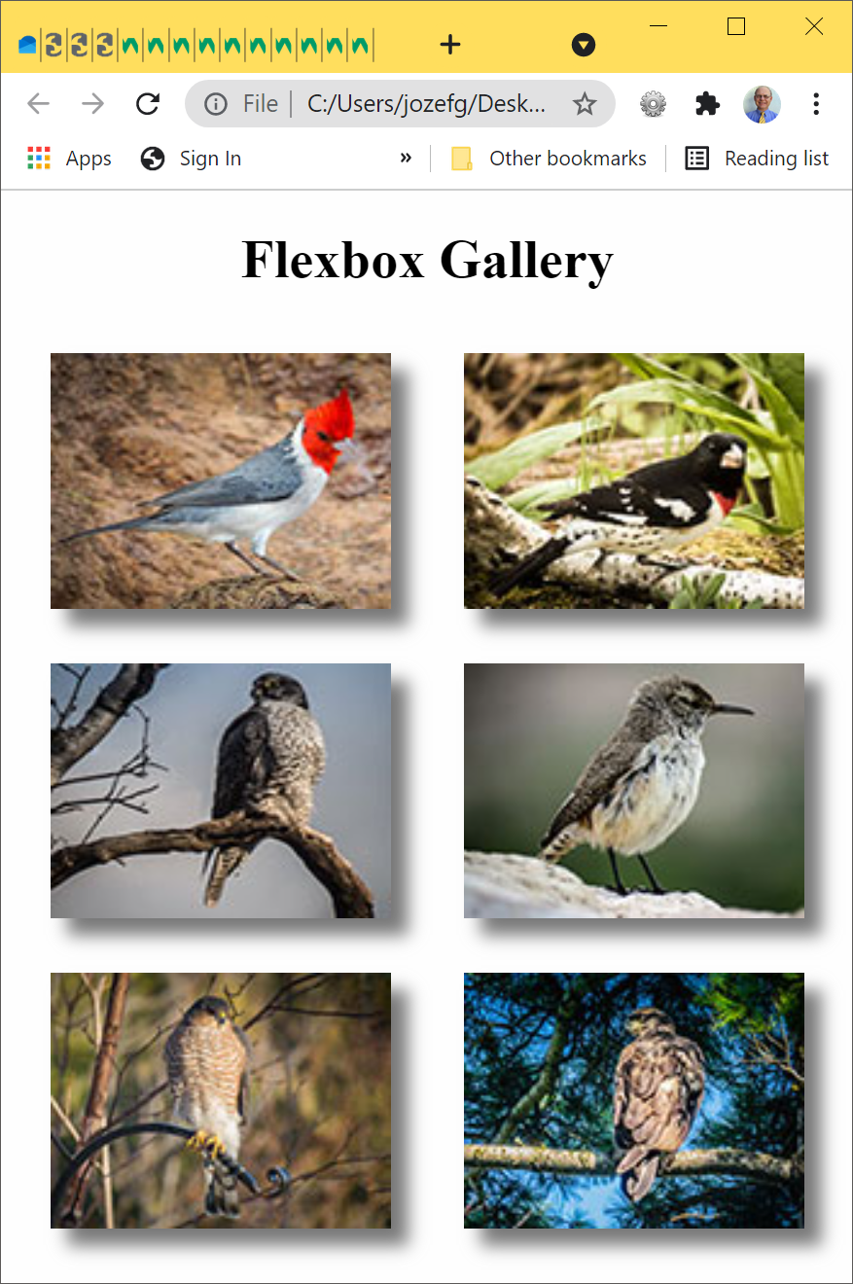
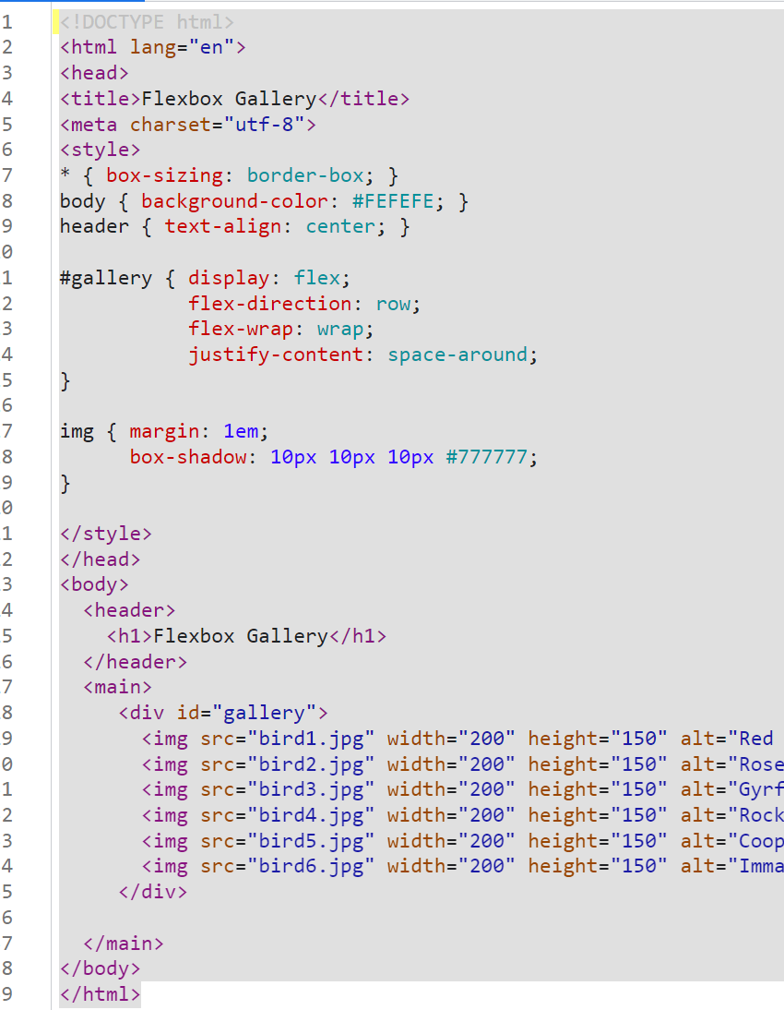







HOP 7.1 - flexbox
Exc: Notice that display is flexible
and responsive to the browse size p.317
smartphone

Slide 13
7. 3 Configure Flex Items
By default flex items are flexible in size and allocated the same amount of space in the flex container p.318
The flex property: Customizes the size of each flex item;
values are (Table 7.2 p.318):
none or
initial or
3 values that configure
1. flex-grow - indicated the flex grow factor relative to the other items in the flex container. Default = 0.
2. flex-shrink - indicates the flex shrink factor relative to the other items in the flex container. Default = 1.
3. flex-basis: values:
content = width
auto = width or width of the content if not specified
positive # - indicated the width a proportional flexible item in units or %, Default = 0.
Ex: Proportional Flexible Item takes up the specified proportion of the free space in the container flex: positive number; such as flex: 3; the same is flex: 3 1 0; see the last row at Table 7.3 p.318;
Other shorthand's: flex: auto; flex:none; flex:initial;

Slide 14
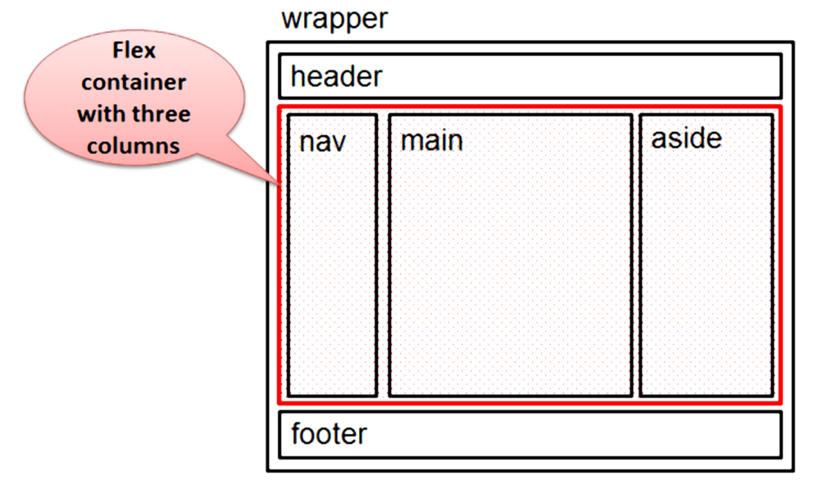
Proportional Flexible Item Figure 7.10 Three-column page layout with the flex container indicated
nav { flex: 1; } // take 1 portion of the whole space (row container)
main { flex: 7; } // take 7 portions of the whole space
aside { flex: 2; } // take 2 portion of the whole space

Slide 15
Hands-On Practice
HOP 7.2
Follow the directions in your book for the HOP.
START-UP File | chapter7/starter2.html chapter7/starters.html/ lighthouse.jpg chapter7/starters.html/ light.gif
SAVE SOLUTION AS | index.html

Slide 16
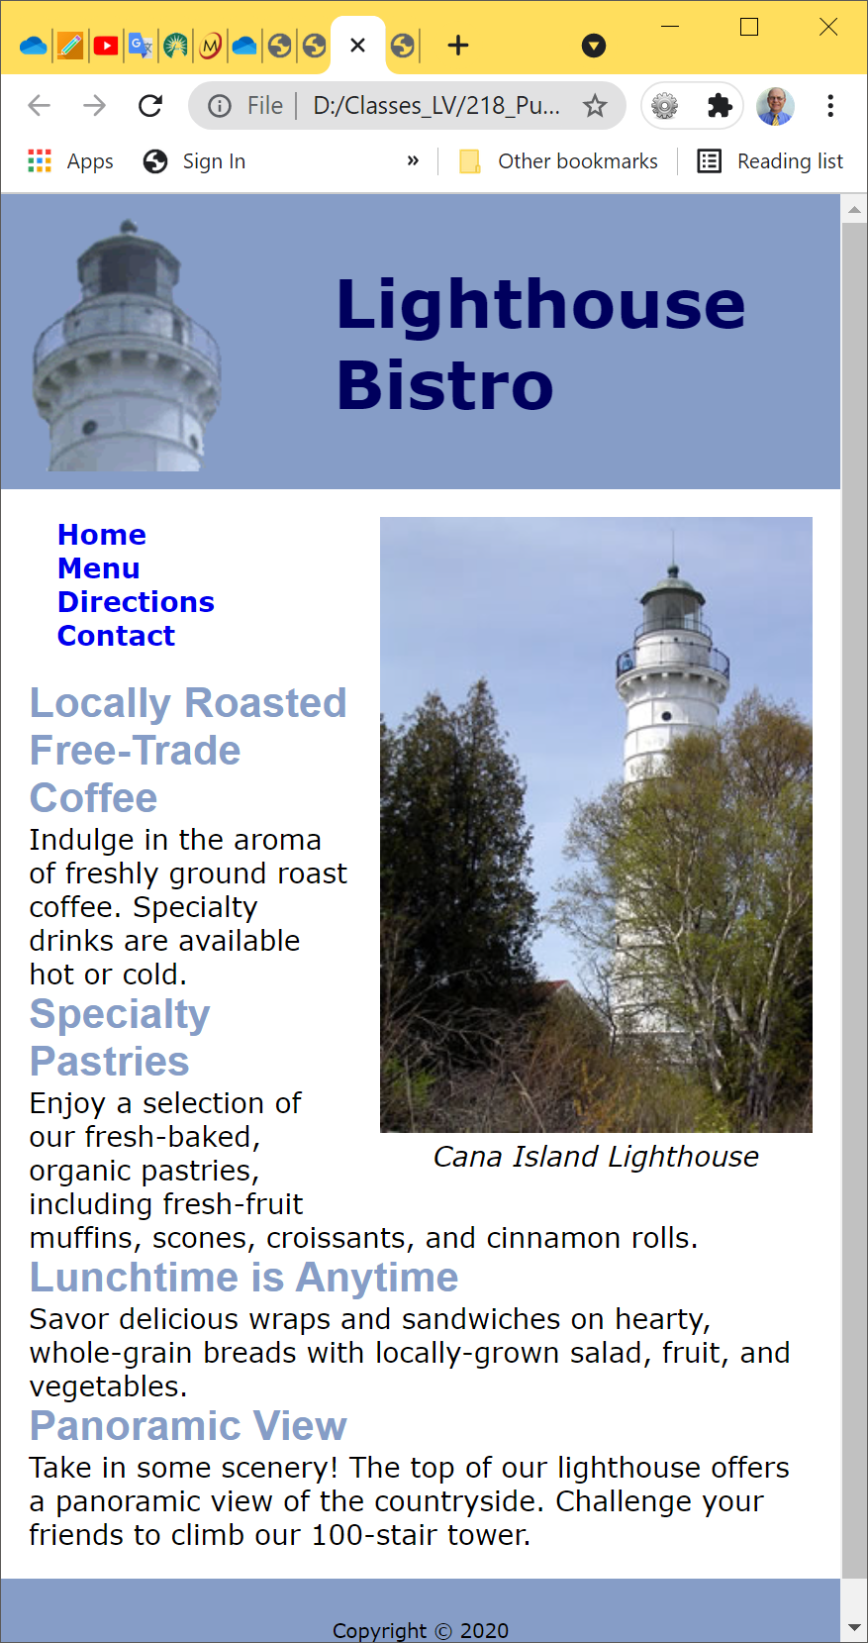
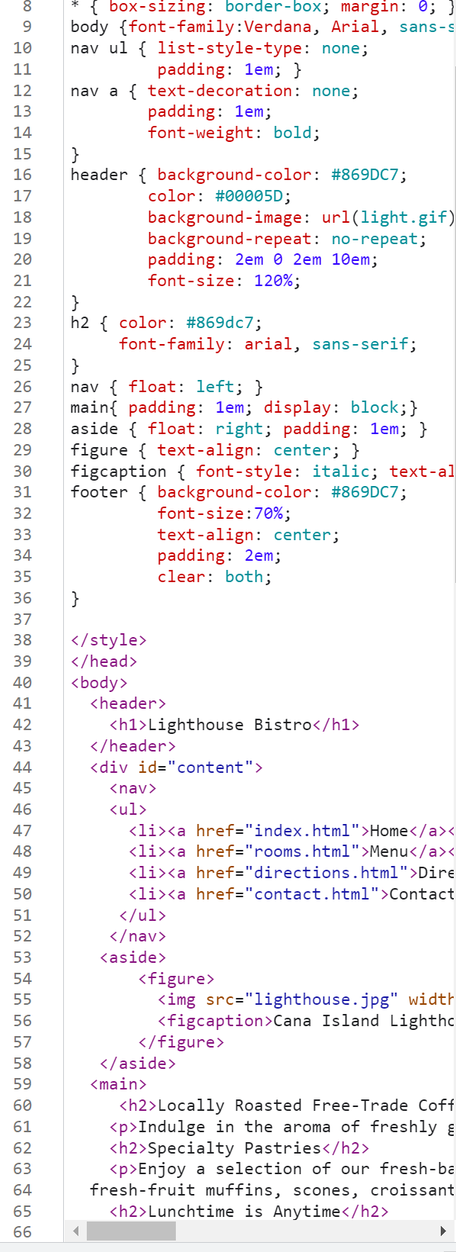
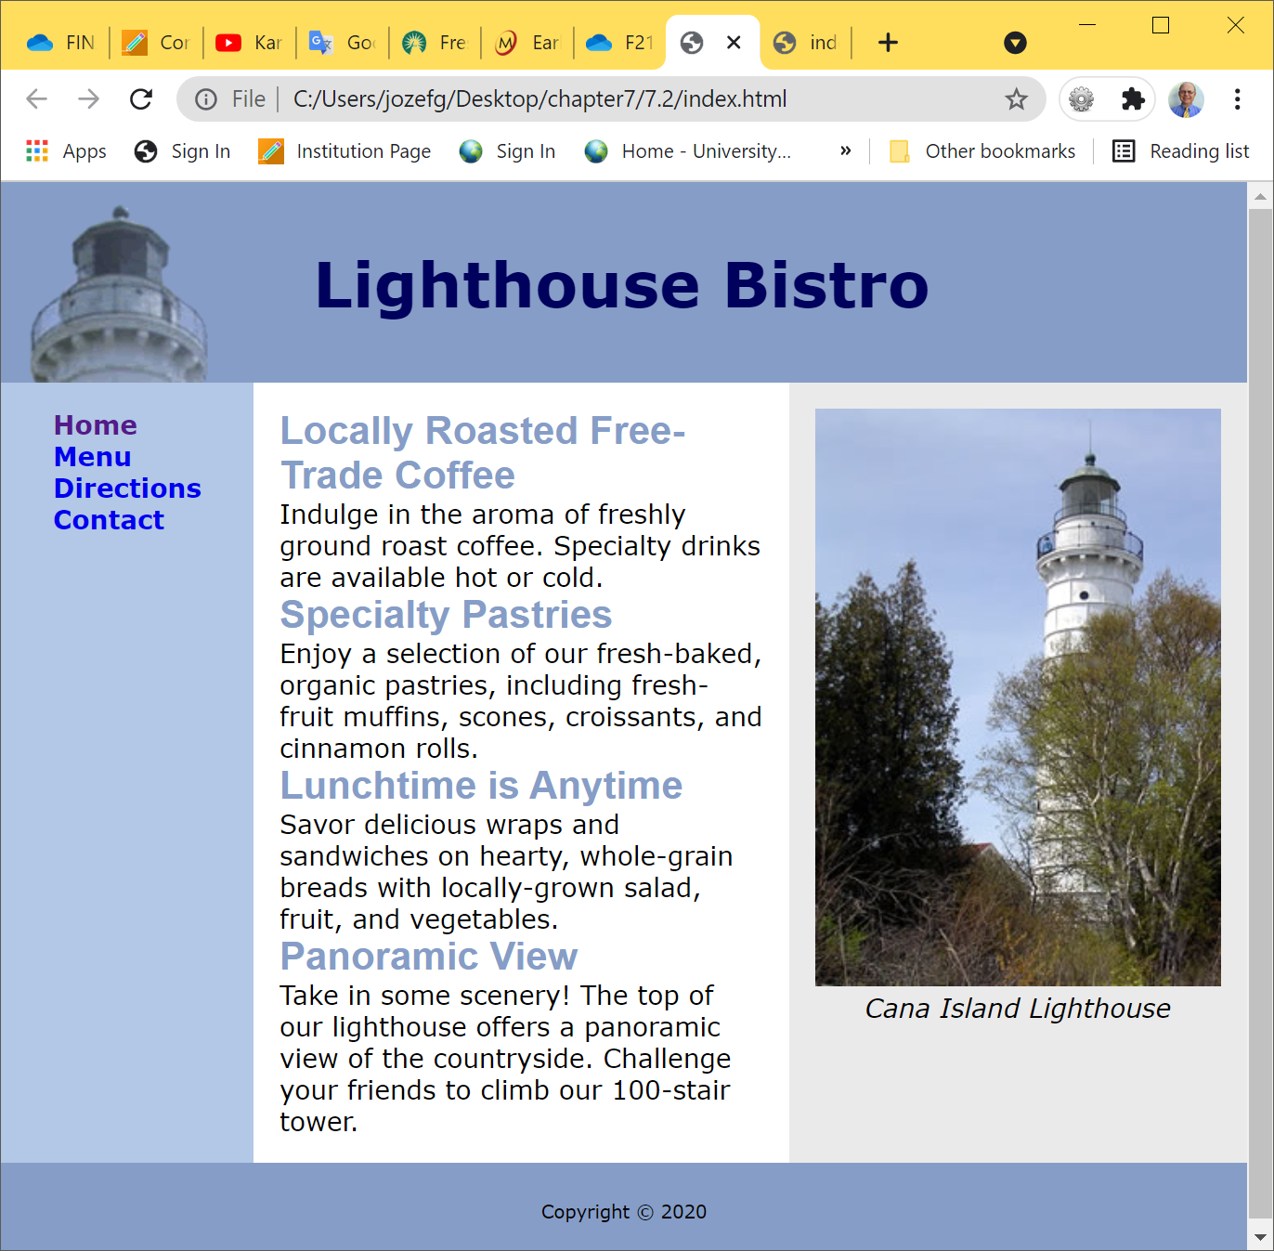
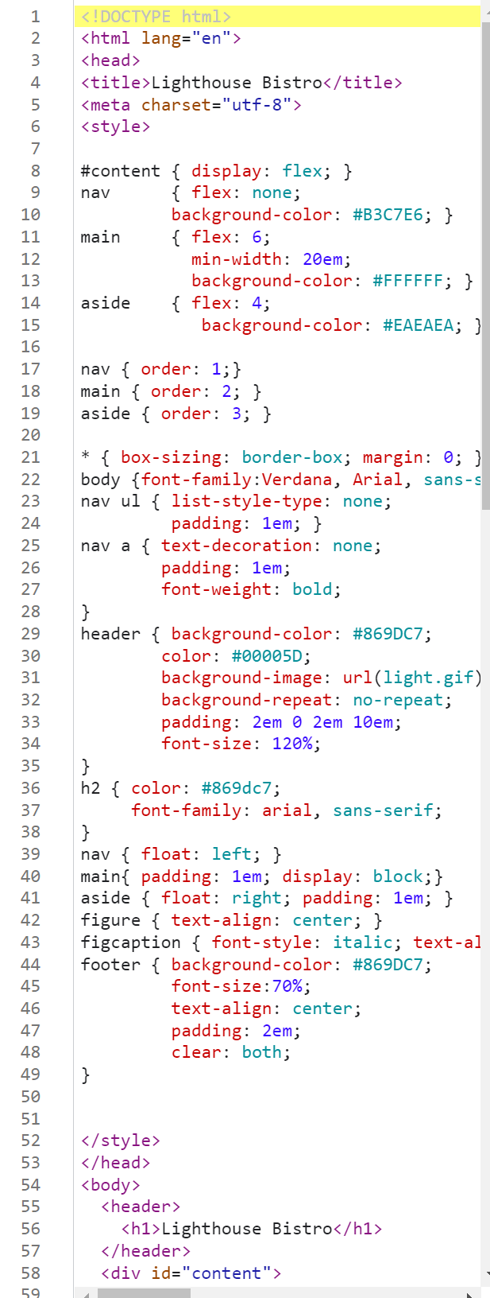
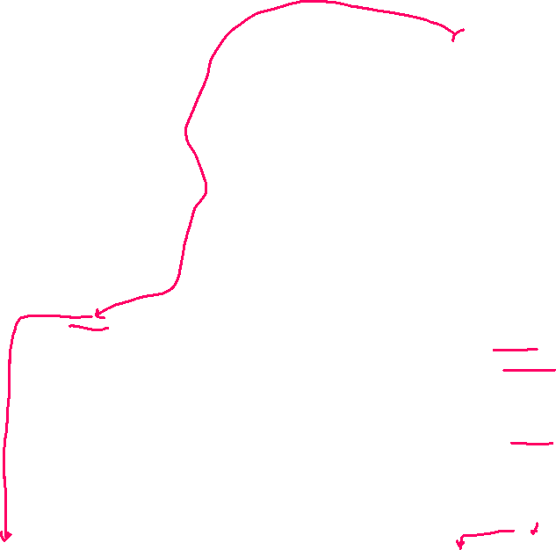

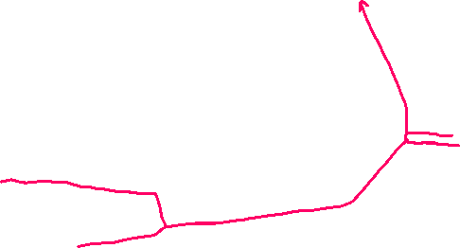





HOP 7.2 - flexbox
starter2.html
index.html
tablet

Slide 17
7.4 CSS Grid Layout
Purpose: Configure a two-dimensional grid-based layout
The grid can be
fixed in dimension or
flexible and responsive. https://www.w3.org/TR/css-grid-1/
The display property
Configures a grid container
display: grid; // or
display: inline-grid;

Slide 18
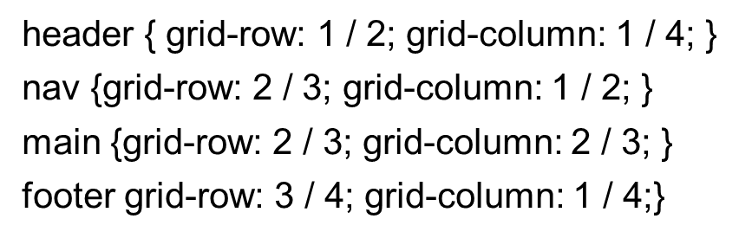
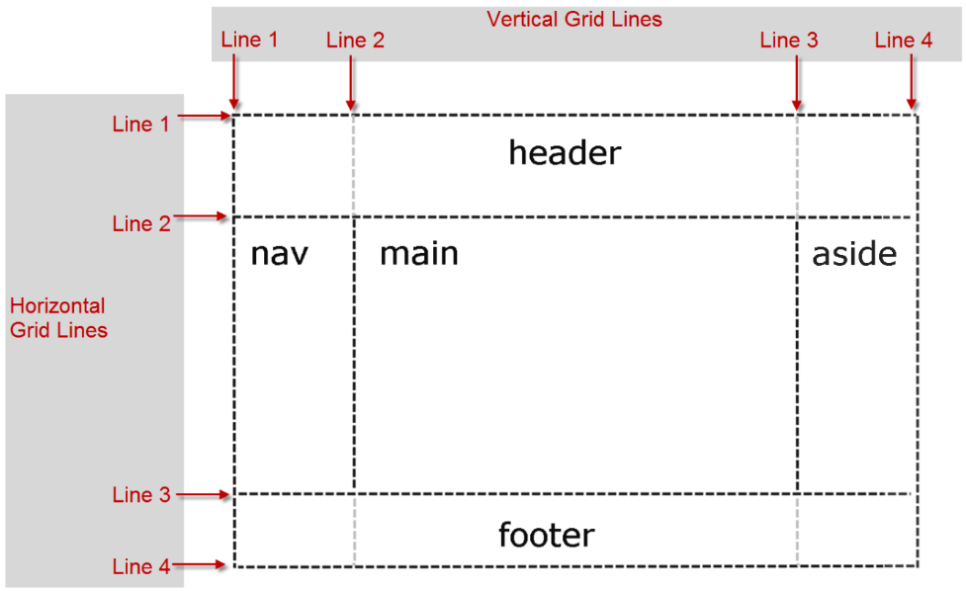

7.4 CSS Grid Layout
A grid consists of horizontal and vertical grid lines that delineate grid rows and grid columns (referred grid tracks). A grid cell is the intersection of a grid row and a grid column.
Configure a grid container and dimensions:
#wrapper { display: grid;
grid-template-columns: 160px 1fr 160px;
grid-template-rows: 200px auto 100px;}
// 3 columns, 1 fr(action) - allocate portions of the remaining space
// 3 rows
Configure grid location for each item in the grid:
+’s: Grid Layout is designed for two-dimensional layout
has many robust features to aid in page layout

Slide 19
CSS Grid Layout
Grid Item – a child element of the grid container
Each img within the gallery div is considered to be a grid item (grid cell)
Grid Terms:
Grid line
Grid row
Grid column
Grid track
Grid gap
 | <div id="gallery"> <img src="bird1.jpg" width="200" height="150" alt="Red Crested Cardinal">
 | <img src="bird2.jpg" width="200" height="150" alt="Rose-Breasted Grosbeak">
 | <img src="bird3.jpg" width="200" height="150" alt="Gyrfalcon">
 | <img src="bird4.jpg" width="200" height="150" alt="Rock Wren">
 | <img src="bird5.jpg" width="200" height="150" alt="Coopers Hawk">
 | <img src="bird6.jpg" width="200" height="150" alt="Immature Bald Eagle">
 | </div>

Slide 20
Table 7.4 Commonly Used Values to Configure Columns and Rows p.324
Value | Description
numeric length unit | Configures a fixed size with a length unit such as px or em Example: 220px
numeric percentage | Configures a percentage size; Example: 20%
numeric fr unit | Configures a flex factor unit (denoted by fr) that directs the browser to allocate a fractional part of the remaining space
auto | Configures a size to hold the maximum content
minmax (min, max) | Configures a size range [min, max]. The max can be set to a flex factor.
repeat (repetition amount, format value) | Repeats the column or row the number of times specified by the repetition amount numeric value or keyword and uses the format value to configure the column or row. The auto-fill keyword indicates to repeat but stop before an overflow. Example: repeat (autofill, 250px)

Slide 21
Hands-On Practice
HOP 7.3
Follow the directions in your book for the HOP.
START-UP File | starter3.html chapter7/starters: bird1.jpg bird2.jpg bird3.jpg bird4.jpg bird5.jpg bird6.jpg
SAVE SOLUTION AS | index.html

Slide 22
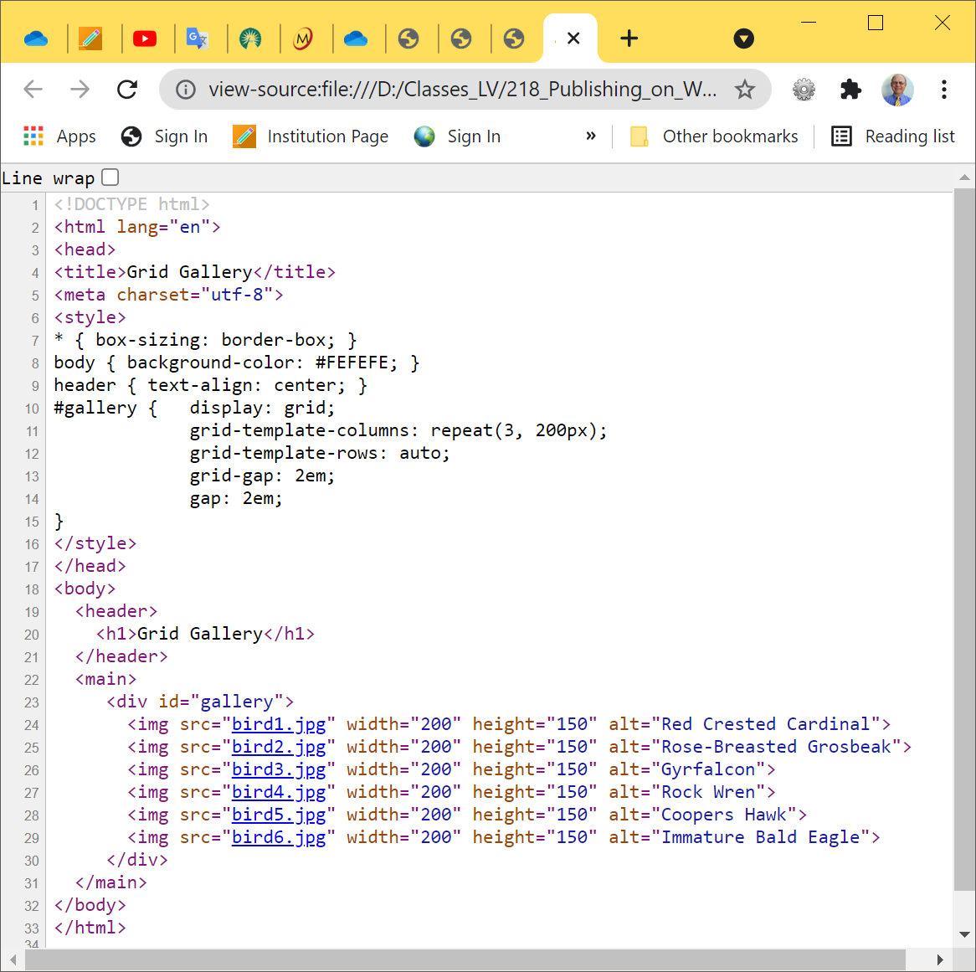
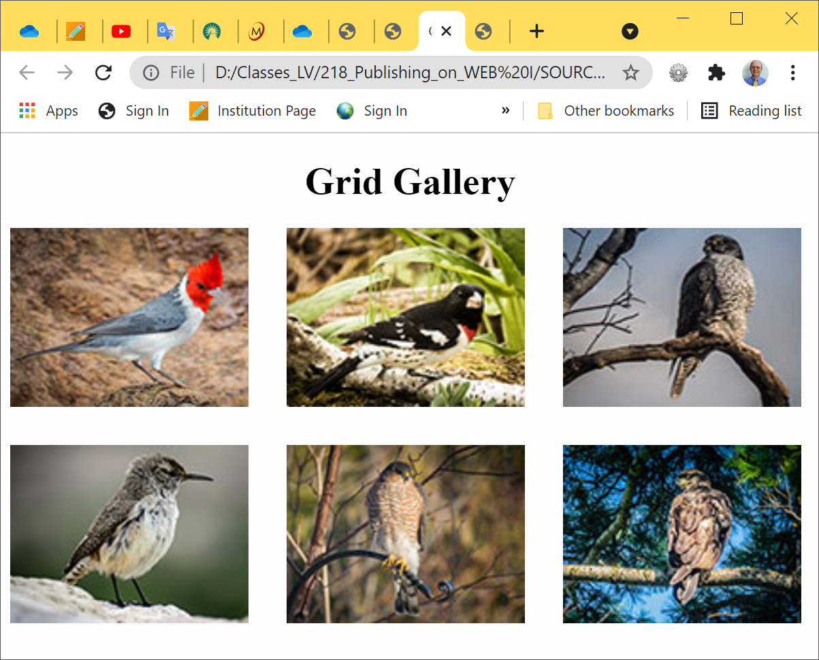






CSS Grid Layout – HOP 7.3 part I

Slide 23
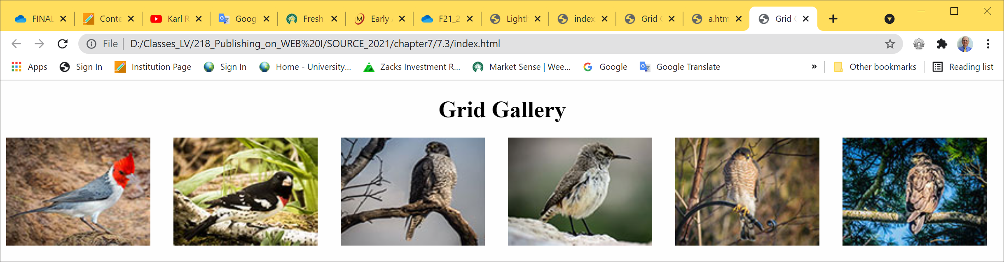
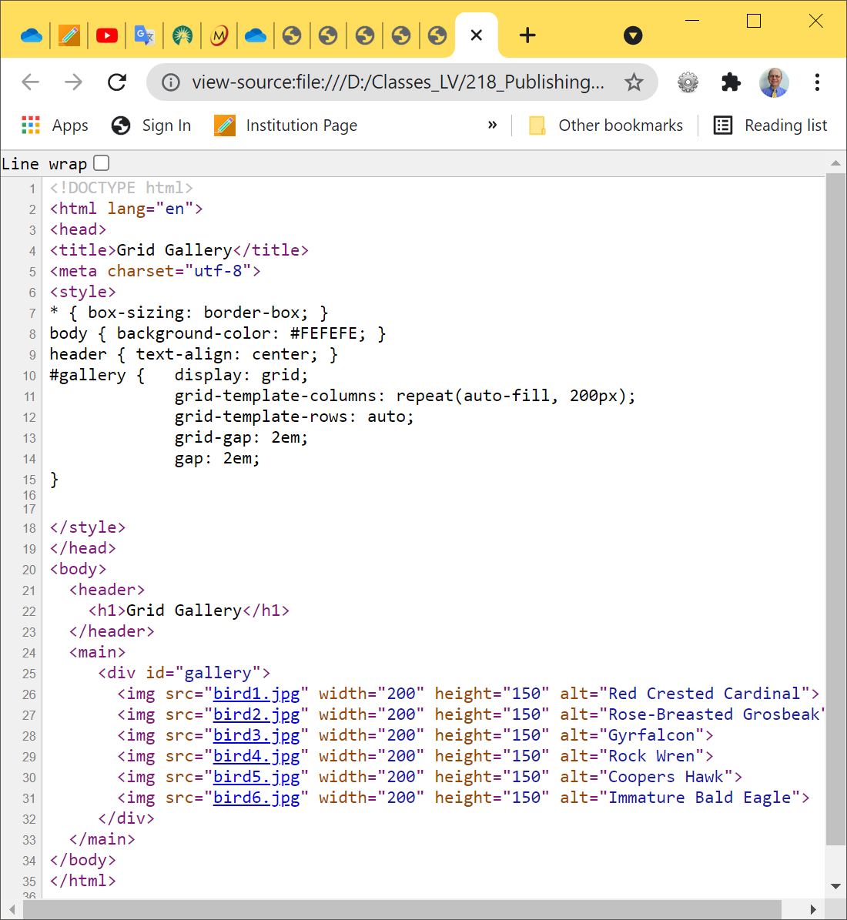
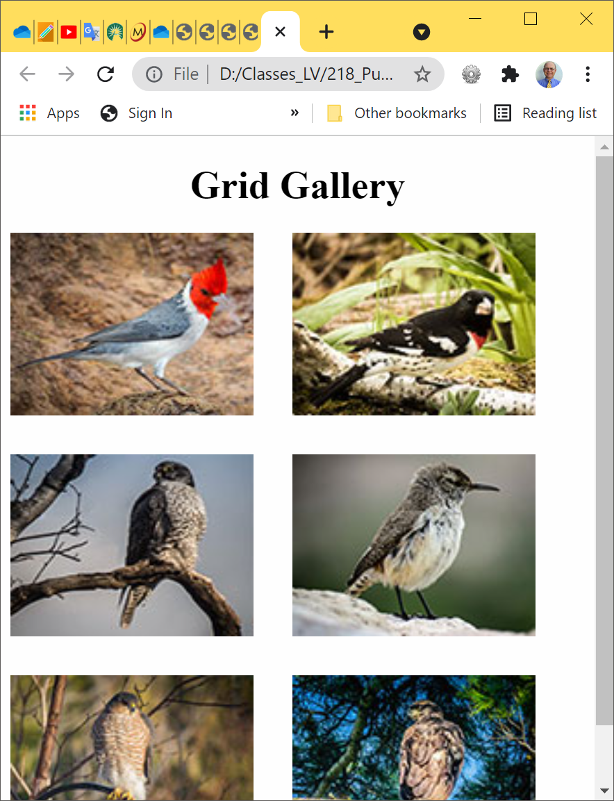




CSS Grid Layout – HOP 7.3 part II
//stop before 200 px
// auto-fill : fill the viewport with as many columns as it can without overflowing

Slide 24
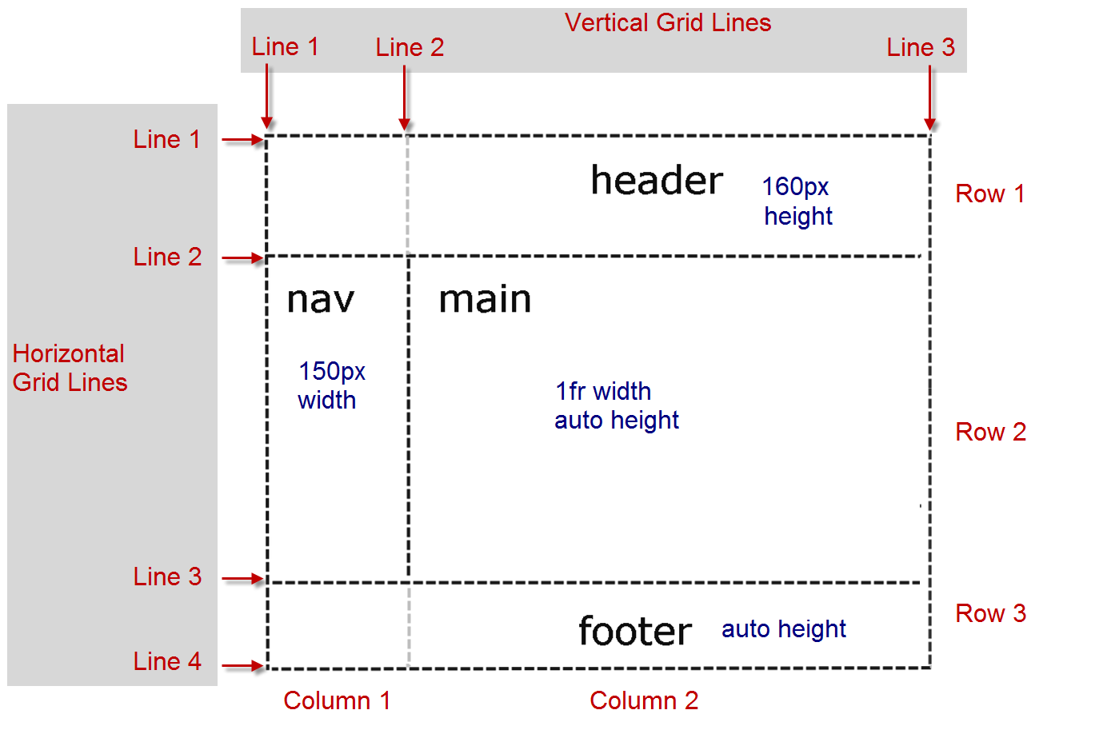
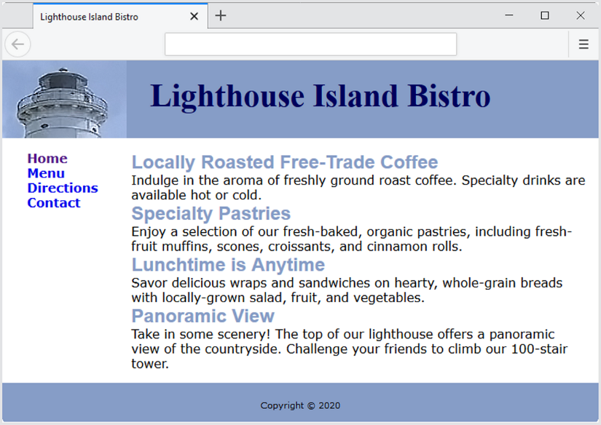


7.6 Two-column CSS Grid Layout - Figure 7.18, 7.19
Once you have declared the grid and coded a template for the col and rows you need to indicate what elements should be placed in each cell
The grid-row property
configures the area in rows that is reserved for the item in the grid
The grid-column property
configures the area in columns that is reserved for the item in the grid
header { grid-row: 1 / 2; grid-column: 1 / 3; }
nav { grid-row: 2 / 3; grid-column: 1 / 2; }
main { grid-row: 2 / 3; grid-column: 2 / 3; }
footer { grid-row: 3 / 4; grid-column: 1 / 3; }
https://www.w3.org/TR/css-grid-1/#typedef-grid-row-start-grid-line

Slide 25
Hands-On Practice
HOP 7.4
Follow the directions in your book for the HOP.
START-UP File | starter4.html Light2.jpg
SAVE SOLUTION AS | index.html

Slide 26
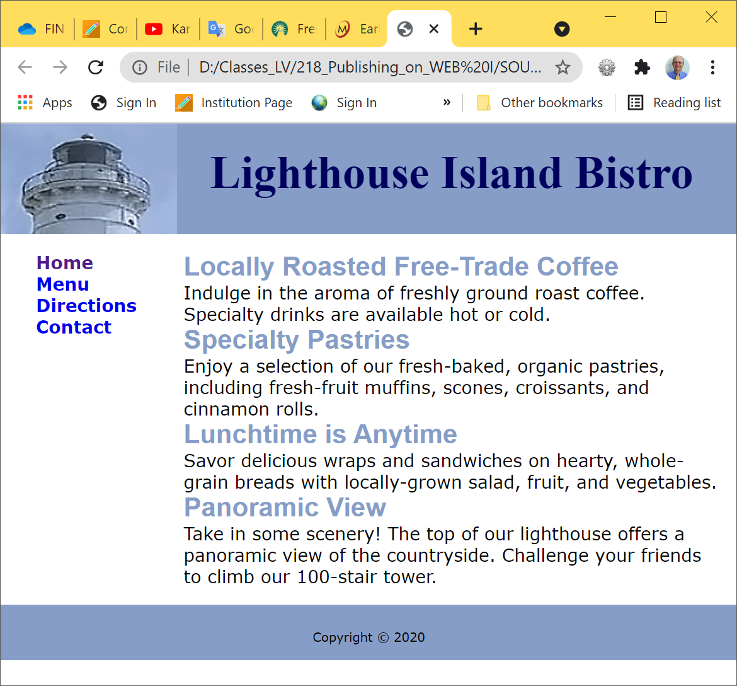
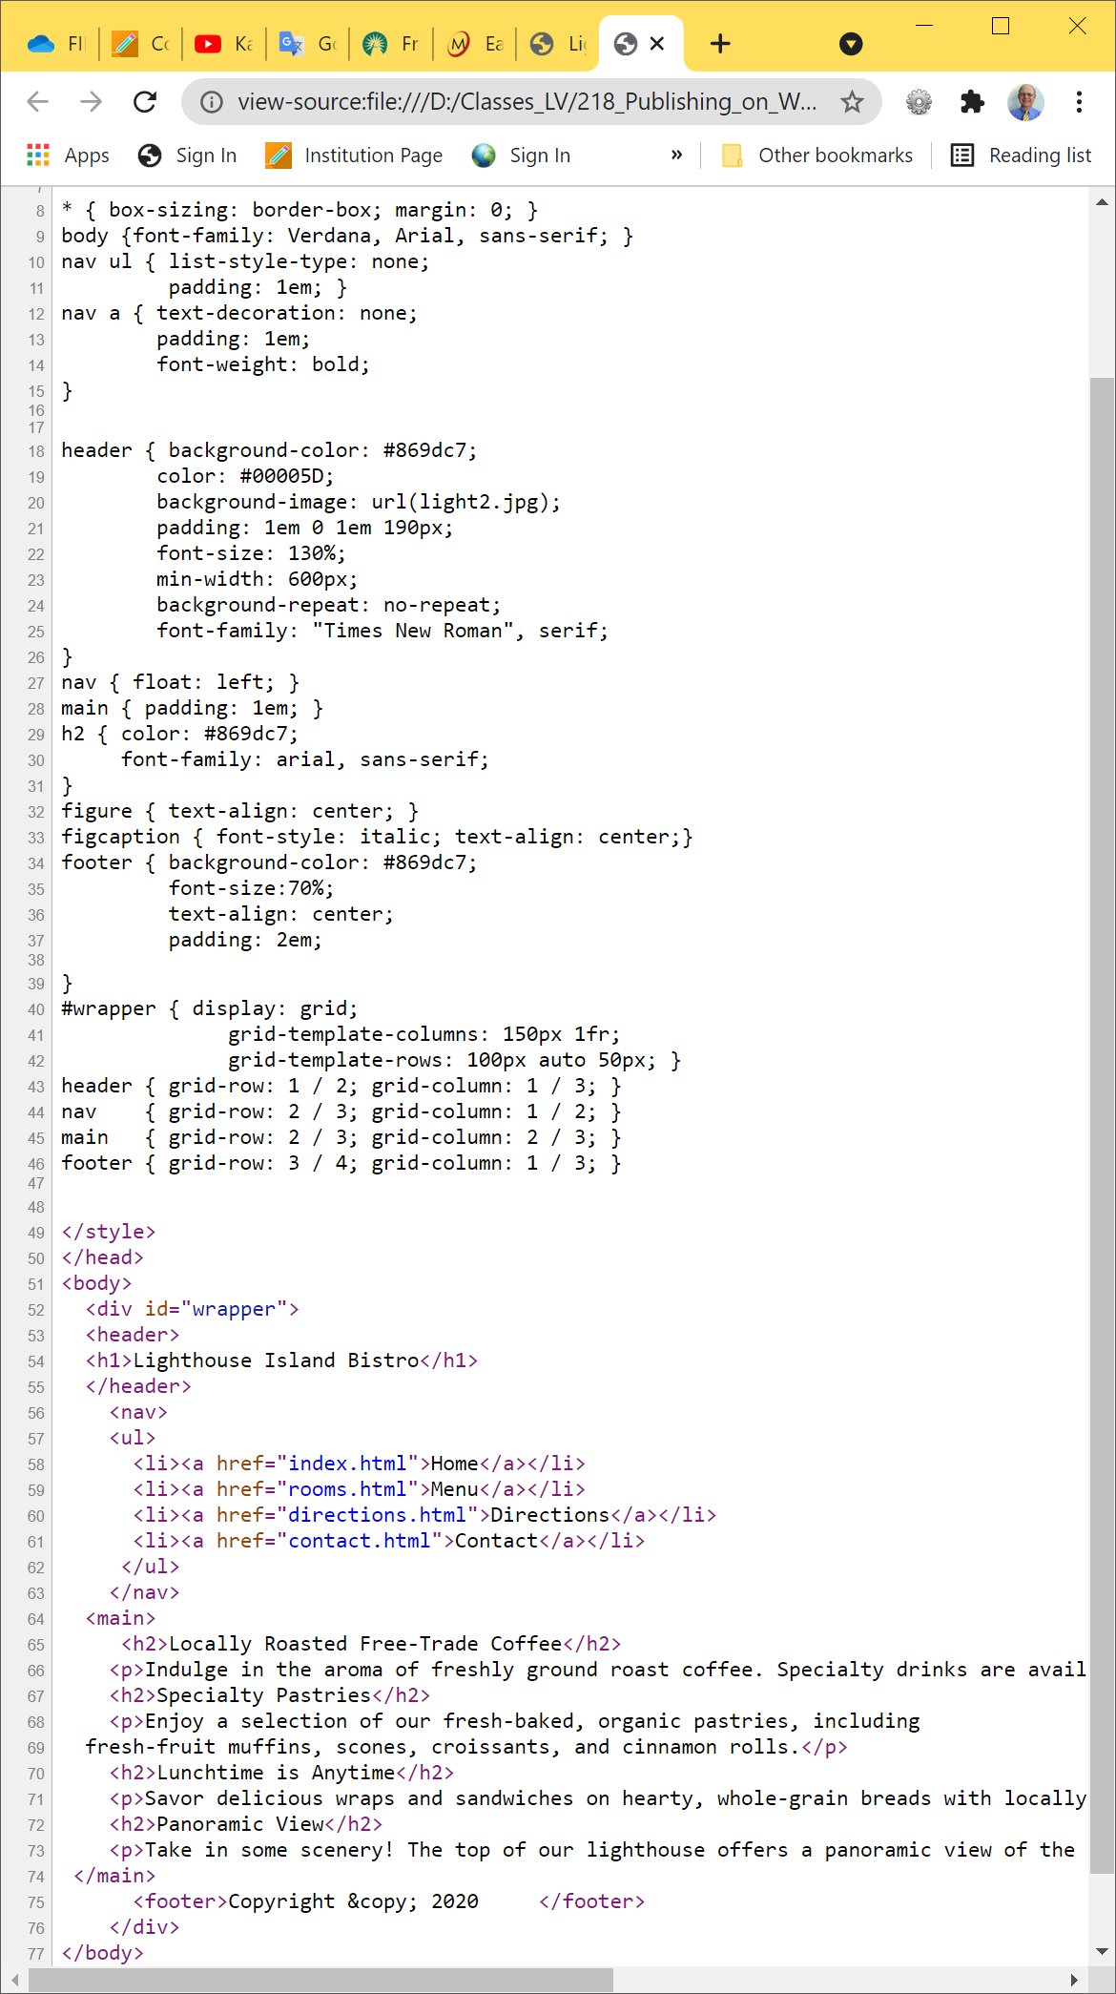
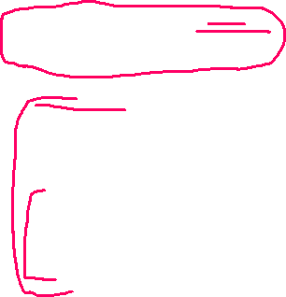
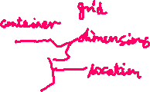
HOP 7.4 Grid Layout

Slide 27


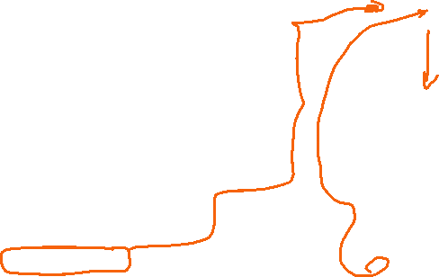

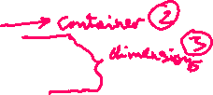


7.7 Layout with Grid Areas
grid-area is a rectangle that can contain 1 or more grid items. There 4 grid areas in Fig.
grid-area property = definition:
header { grid-area: header; }
nav { grid-area: nav; }
main { grid-area: main; }
footer { grid-area: footer; }
Figure 7.21 A grid wireframe
grid-template-areas property:
#wrapper { display: grid;
grid-template-columns: 150px 1fr;
grid-template-rows: 100px auto 50px;
grid-template-areas:
"header header“ // header goes across 2 cols
"nav main"
"footer footer"; }
ttps://www.w3.org/TR/css-grid-1/#grid-template-areas-property
grid-template-areas property:
#wrapper { display: grid;
grid-template-columns: 150px 1fr;
grid-template-rows: 100px auto 50px;
grid-template-areas:
"header header“ // header goes across 2 cols
"nav main"
“. footer"; } // nothing in 1st column

Slide 28
Hands-On Practice
HOP 7.5
Follow the directions in your book for the HOP.
START-UP File | chapter 7/starters.html header.jpg scenery.jpg
SAVE SOLUTION AS | index.html

Slide 29
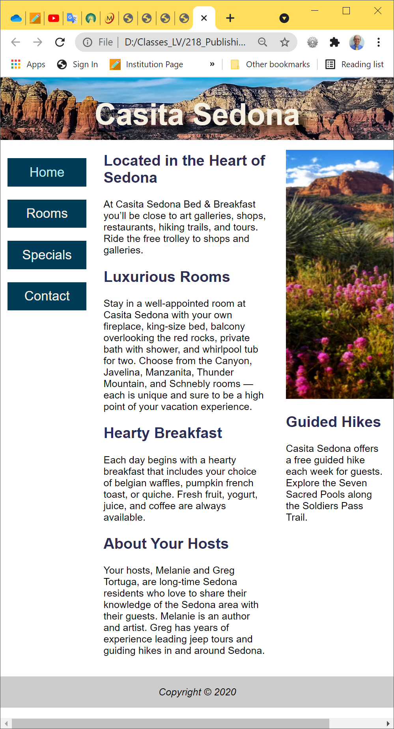
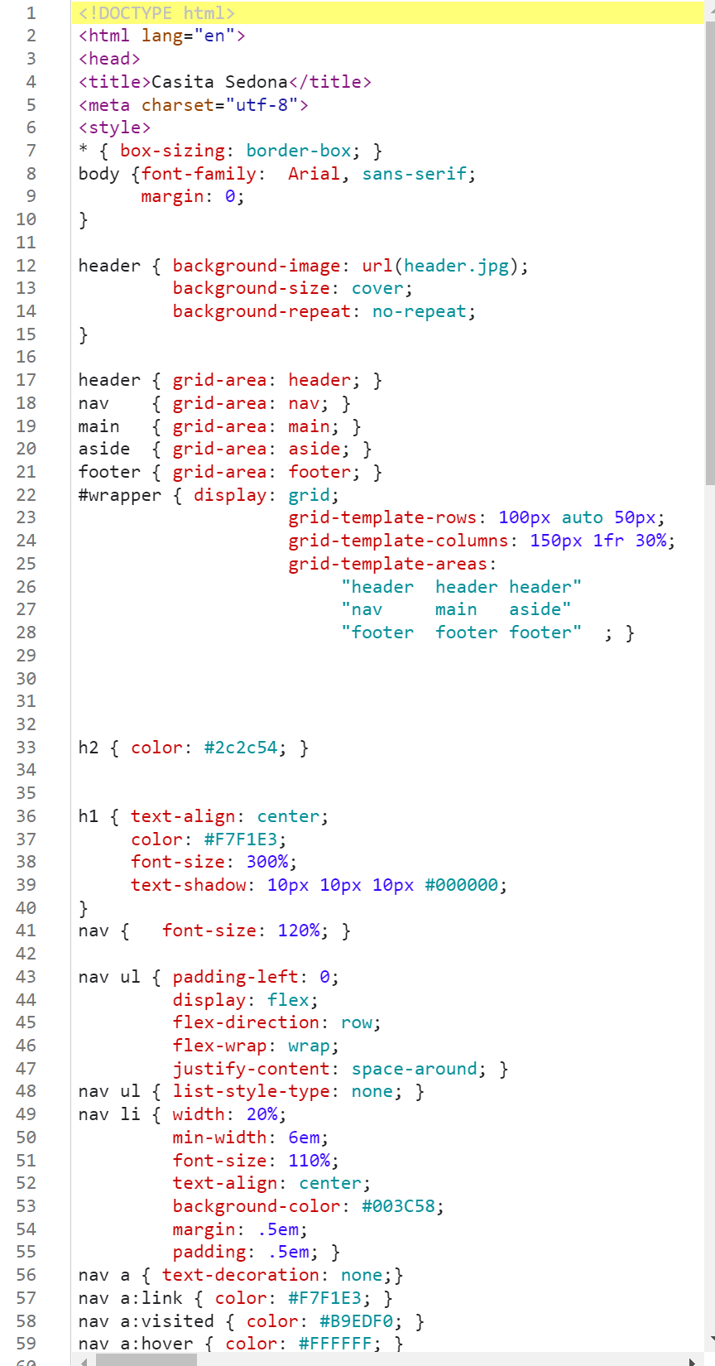


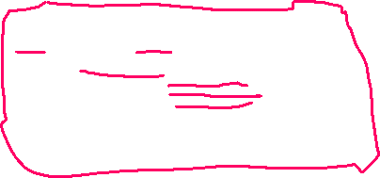


HOP 7.5 Configure Grid Template Areas

Slide 30
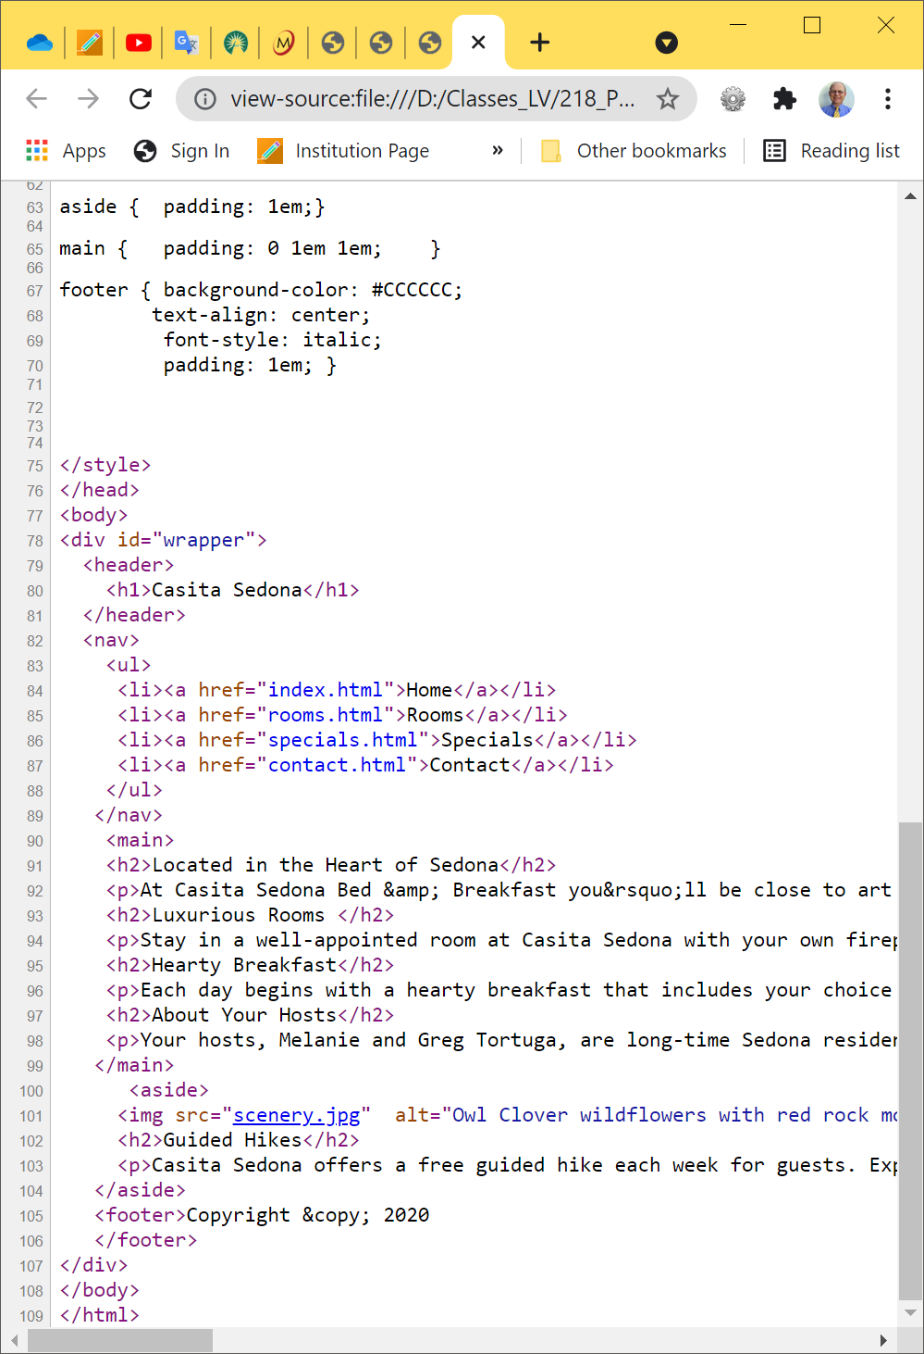
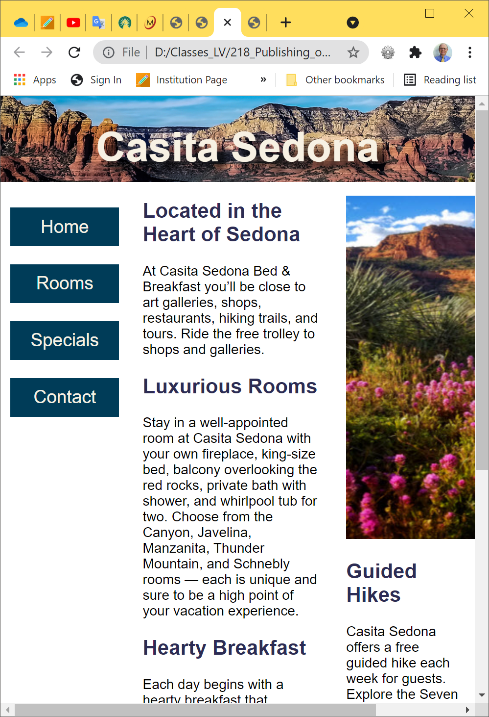



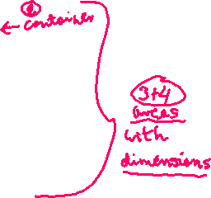
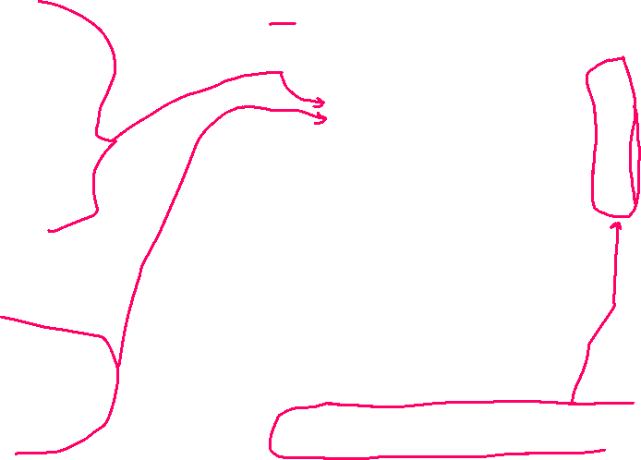

HOP 7.5 Configure Grid Areas using grid-template
shorthand technique: grid-template property combines
grid-template-areas, grid-template-rows and grid-template-columns.
#wrapper { display: grid;
grid-template:
"header header header" 100px
"nav main aside " auto
"footer footer footer" 50px // 3rd row
/ 150px 1fr 30%; // column width}
https://www.w3.org/TR/css-grid-1/#propdef-grid-template
grid-area property
header { grid-area: header; }
nav { grid-area: nav; }
main { grid-area: main; }
aside { grid-area: aside; }
footer { grid-area: footer; }

Slide 31
Checkpoint 7.1 p.678
Which CSS property is used to identify a CSS selector as a grid or flexbox container?
display: grid; display: flexbox;
2. The CSS justify-content property used in flexbox layout is quite versatile.
3. Which CSS property can be used to indicate the location and dimensions of named grid areas?

Slide 32
Hands-On Practice
HOP 7.6
Follow the directions in your book for the HOP.
START-UP File | chapter 7/starters.html/light2.jpg
SAVE SOLUTION AS | index.html

Slide 33
7.8 Progressive Enhancement with Grid
CSS Feature Query
A feature query is a conditional that can be used to test for support of a CSS property, and if support is found, apply the specified style rules.
@supports ( display: grid) {
…. grid styles go here …
}
Progressive Enhancement Strategy
Configure web page layout with normal flow or float for browsers and devices that do not support grid
Configure a feature query with grid layout for modern browsers

Slide 34
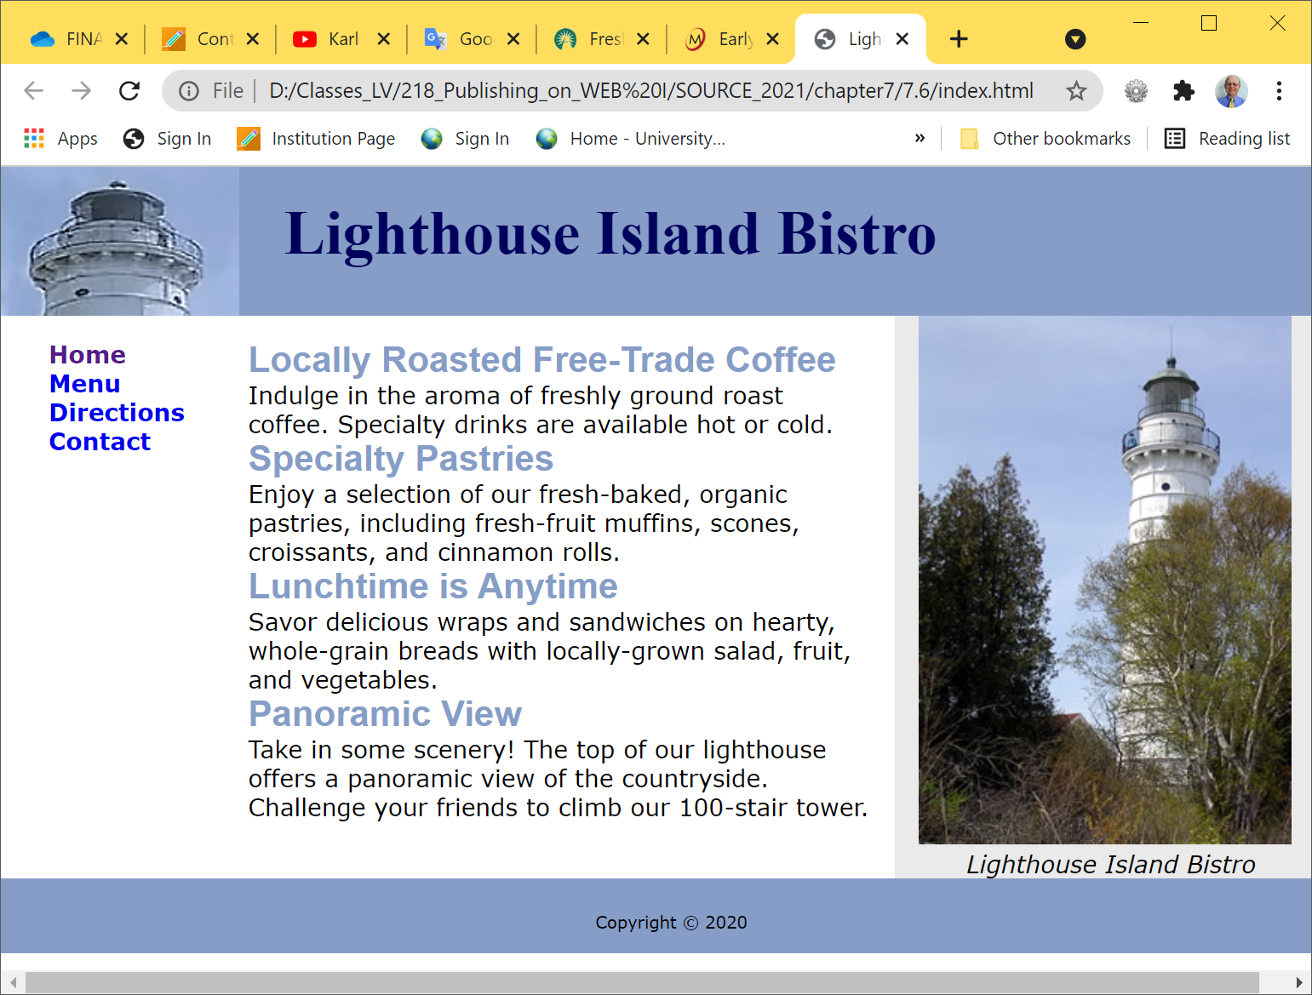
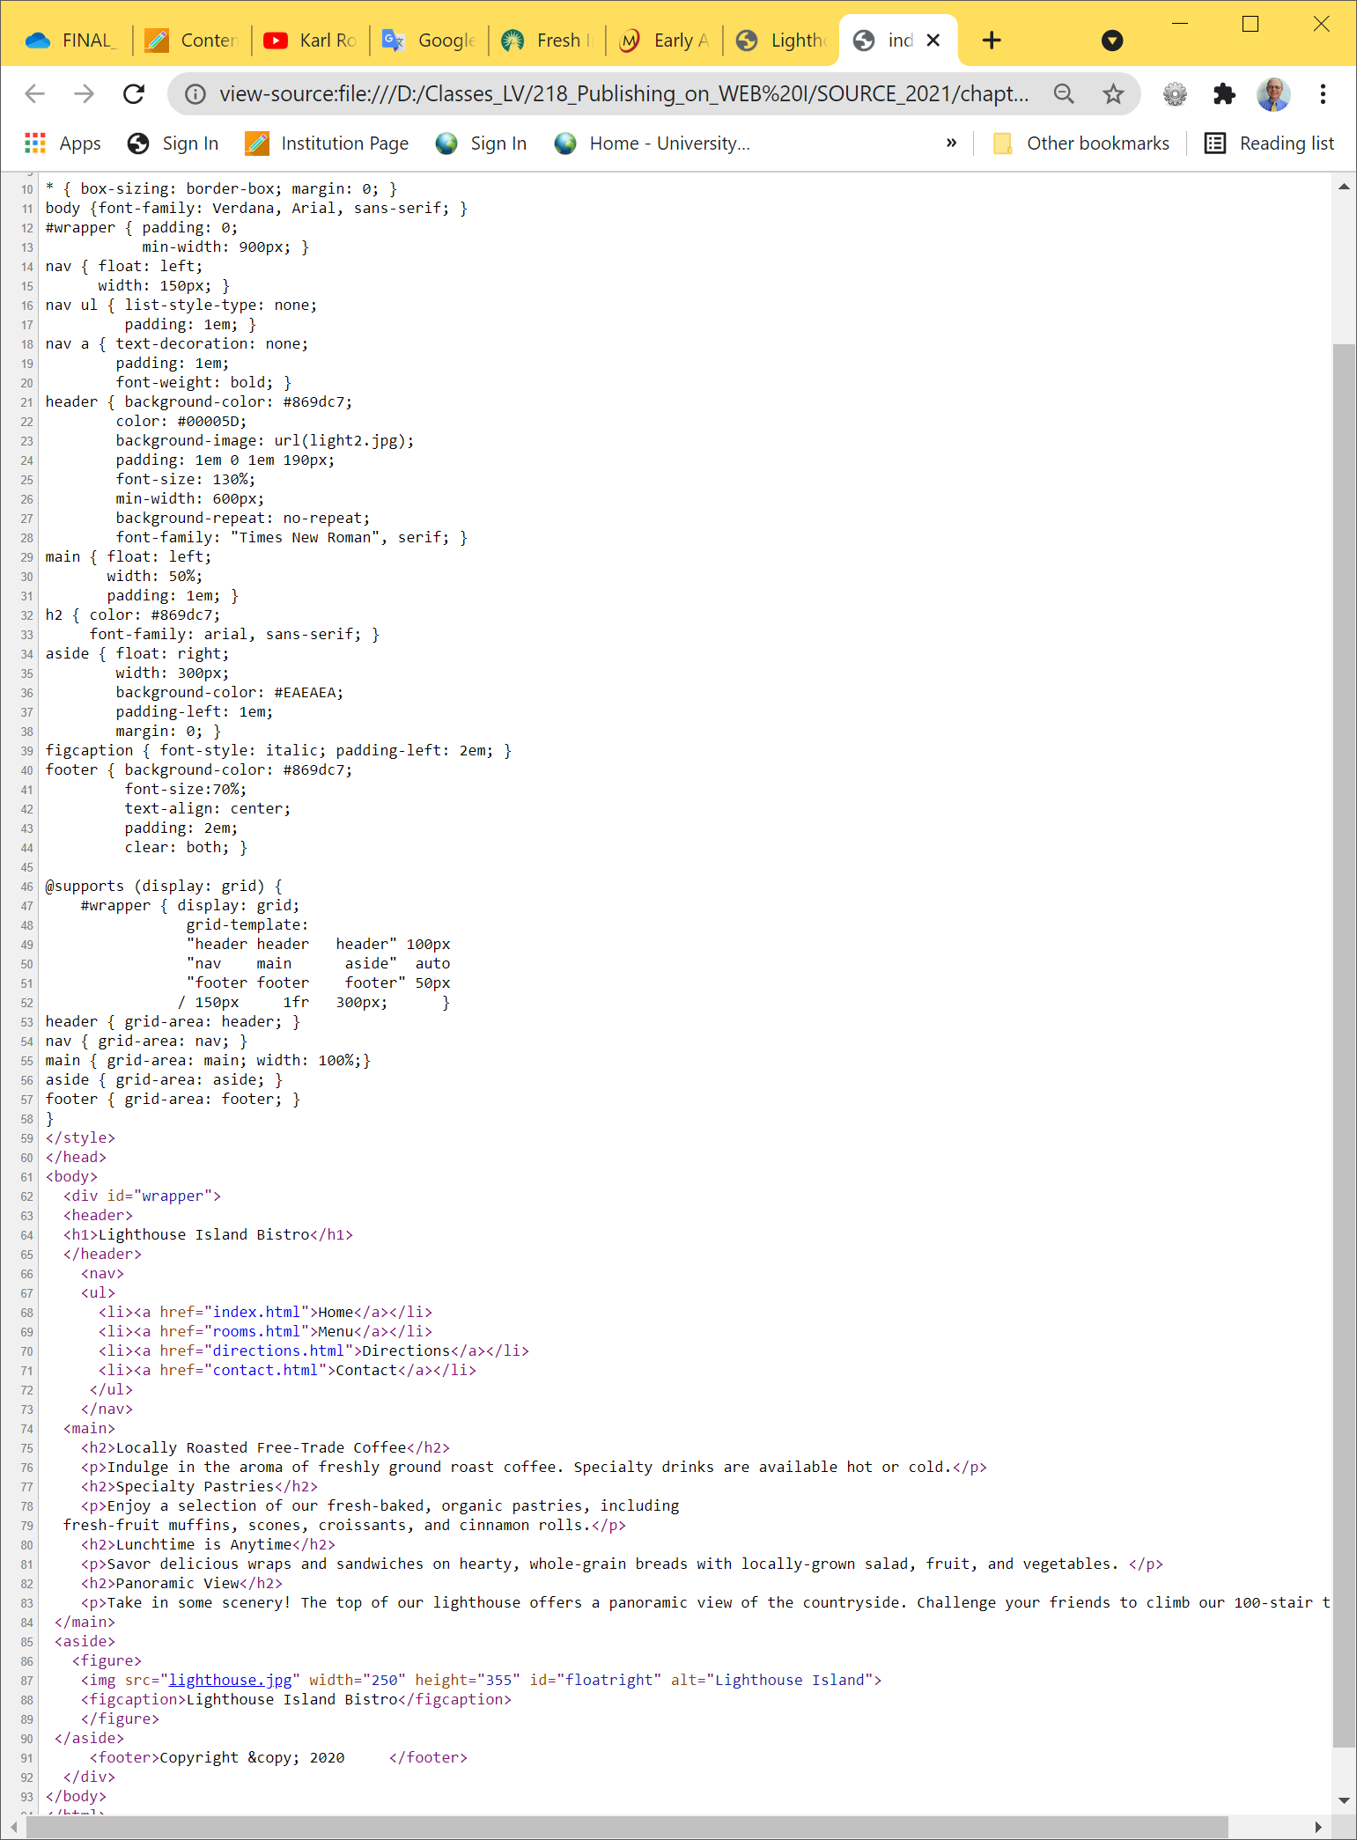
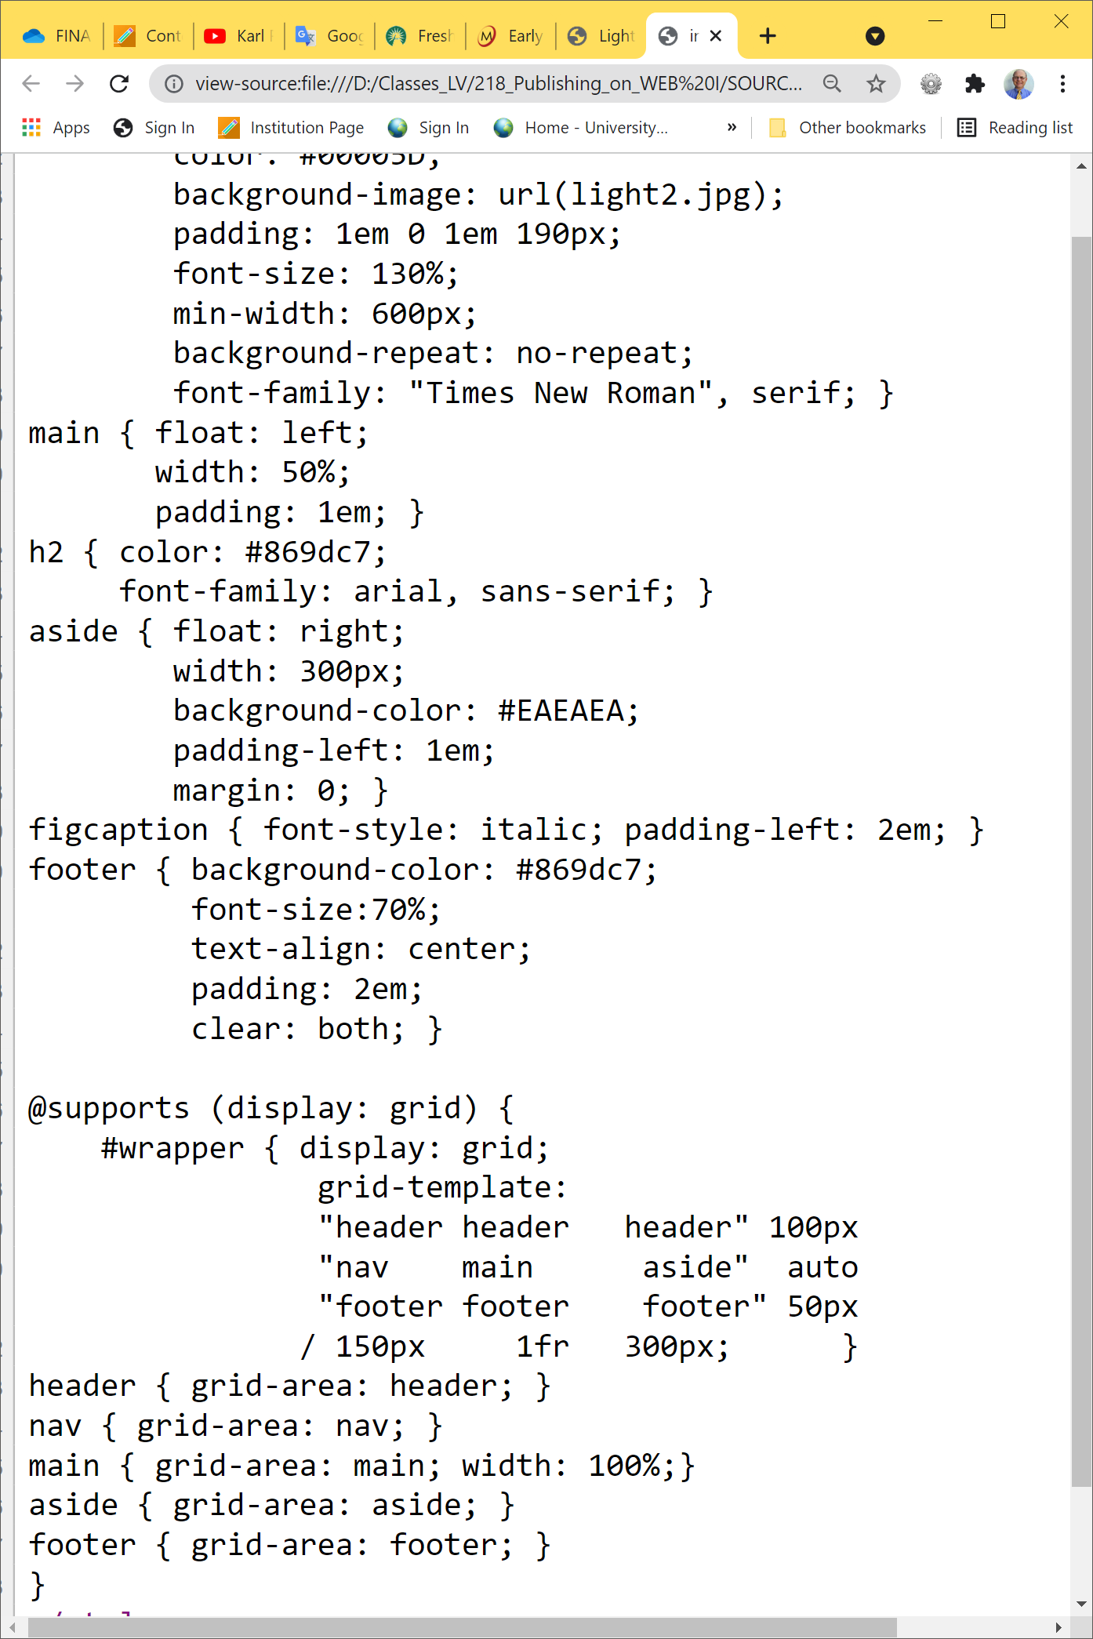
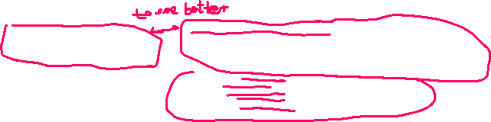




HOP 7.6
Larger fonts

Slide 35
Hands-On Practice
HOP 7.7
Follow the directions in your book for the HOP.
START-UP File | chapter7/starters.html/lake.jpg chapter7/template.html
SAVE SOLUTION AS | index.html

Slide 36
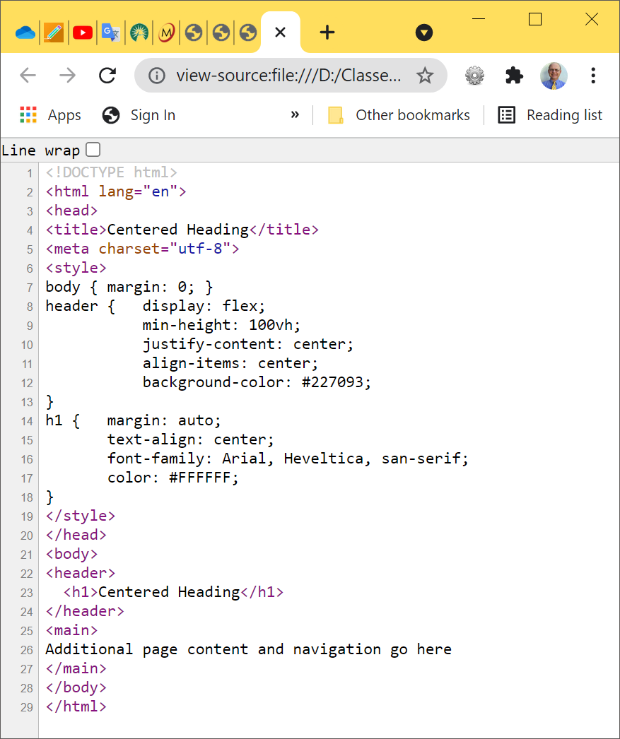
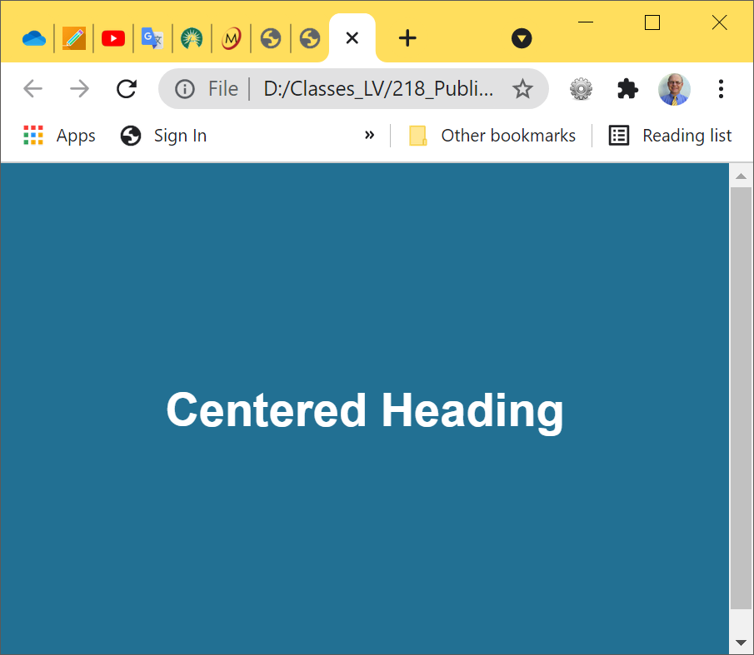
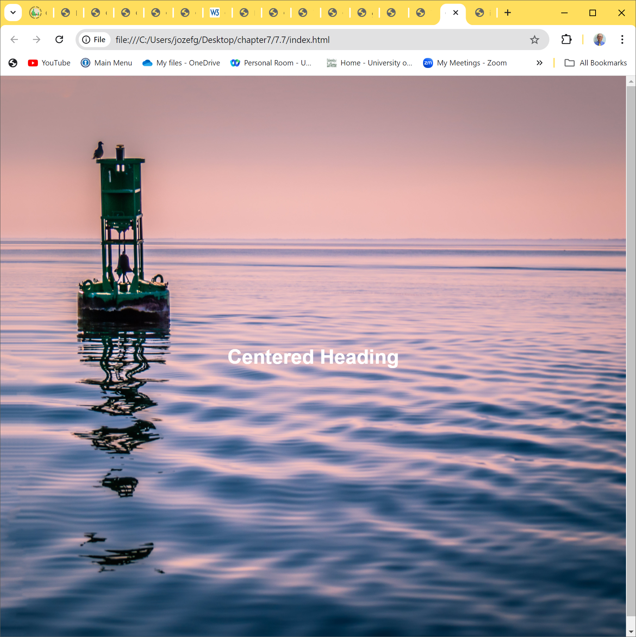



7.9 Center with Flexbox and Grid- vertically and horizontally, HOP 7.7 part I
In ch3 we horizontally center a block display with CSS using
margin: auto
header { display: flex;
min-height: 100vh;
justify-content: center;
align-items: center;
background-color: #227093;
background-image: url(lake.jpg);
background-size: 100% 100%;
background-repeat: no-repeat; }
When you resize it, the h1 text remains cantered

Slide 37
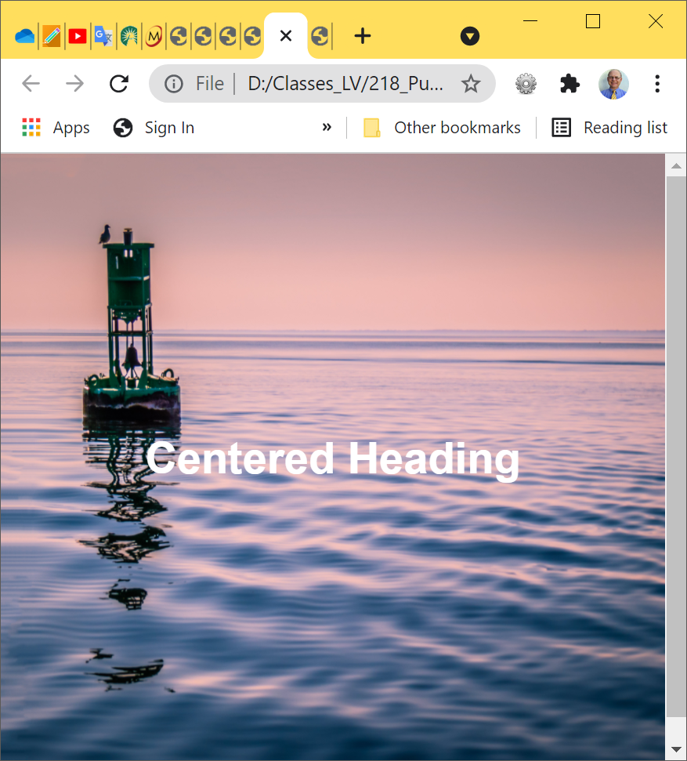
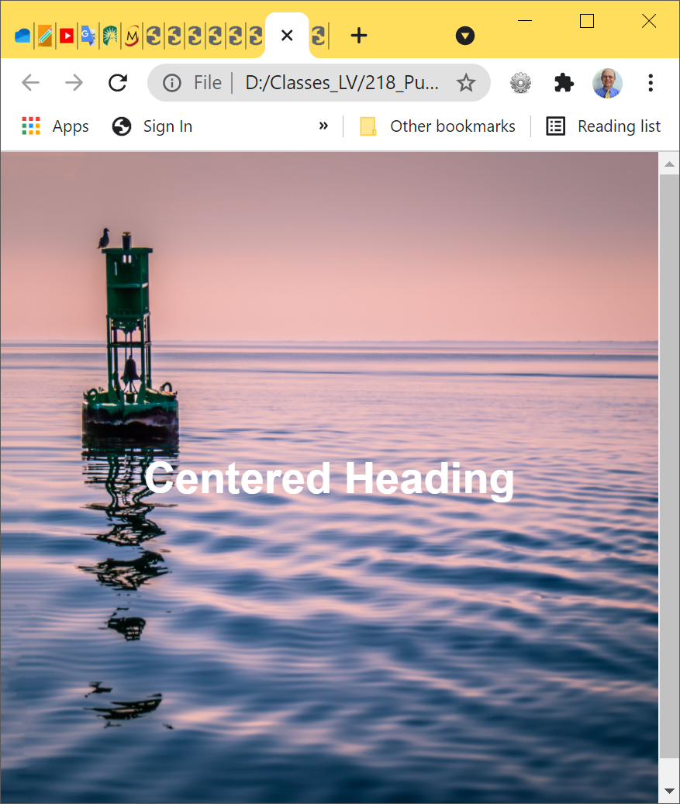
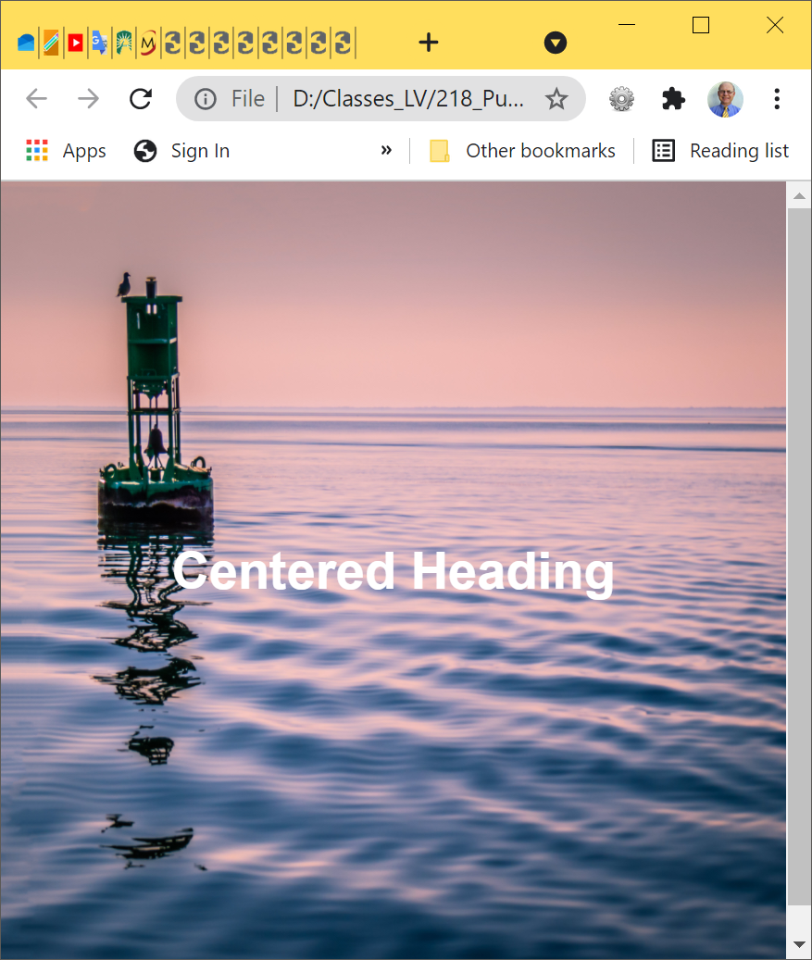
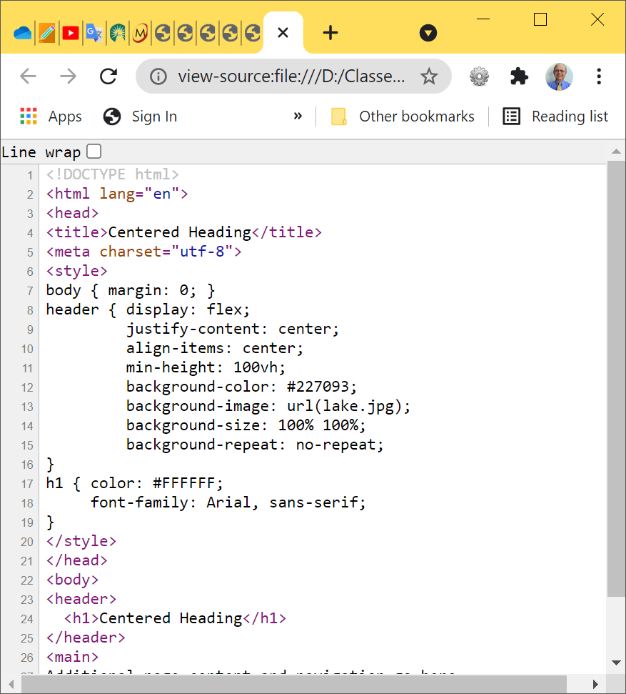
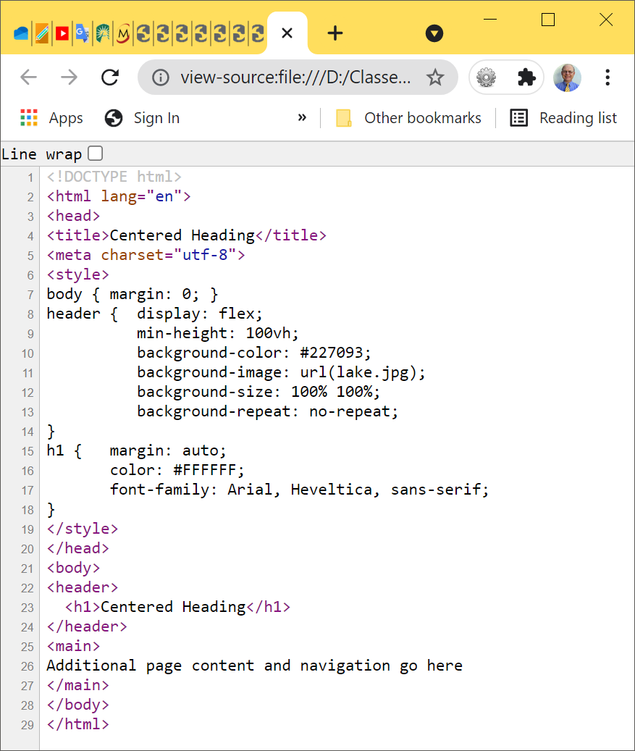
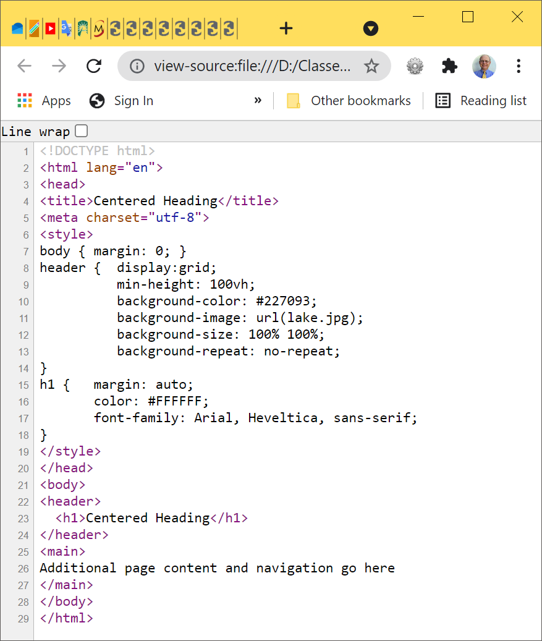








HOP 7.7 part II- IV – the same results

Slide 38
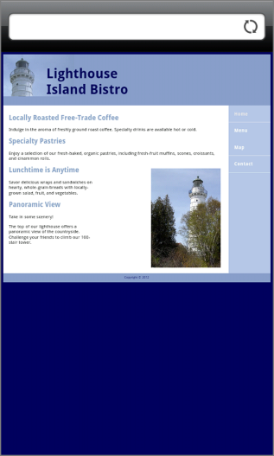
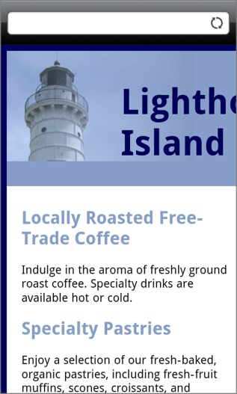
7.10 Viewport Meta Tag p.338
Default action for most mobile devices is to zoom out and scale the web page
Viewport – is a framed area on a display screen for viewing information.
Configures width and initial scale of browser viewport, see p.339
<meta name="viewport" content="width=device-width, initial-scale=1.0"> see a screenshot =>
where: width=device-width = actual width of the device screen
initial-scale=1.0 – the initial zoom level, set for 100%
Viewport Meta Tag directives such as name and content
that controls zooming and scale are in Table 7.6 p.339
Android –
no viewport
A <meta> viewport element gives the browser instructions on how to control the page's dimensions and scaling.
The width=device-width part sets the width of the page to follow the screen-width of the device (which will vary depending on the device).
The initial-scale=1.0 part sets the initial zoom level when the page is first loaded by the browser.

Slide 39
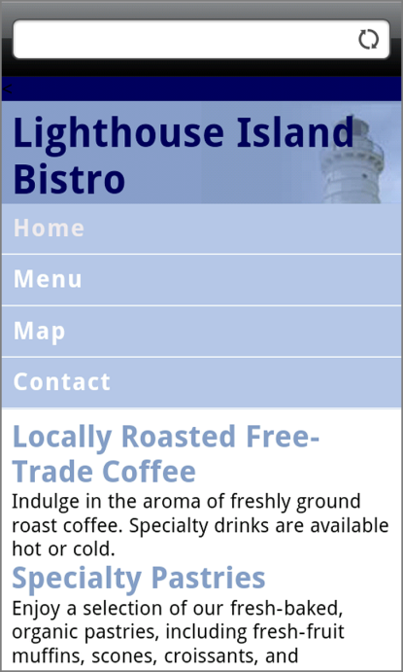
7.11. CSS3 Media Queries using a Link
1. Media Query using a link
Is made up of a media type (such as screen)
and logical expression that determines the capability of the mobile device, such as screen resolution and orientation (portrait or landscape)
Directs the browser to styles configured specifically for those capabilities
Example p.340:
<link href="lighthousemobile.css" rel="stylesheet" media="only screen and (max-width: 480px)">
Where media type: all, screen, speech, print, only
<link href="lighthousetablet.css" rel="stylesheet" media="only screen and (min-width: 768px)“ and (max-width: 1024px)">

Slide 40
2. CSS3 Media Queries using an @media Rule
2. Media Query using an @media Rule p.341
Determines the capability of the mobile device, such as screen resolution using an @media rule and orientation (portrait or landscape)
Directs the browser to CSS styles configured specifically for those capabilities
syntax: @media [media type] [logical expression]
where: media type: all, screen, speech, print, only
@media only screen and (max-width: 480px) {
header {background-image: url( mobile.gif)}} //smartphone
@media only all and (max-width: 768px) { … } //tablet
@media only all and (min-width: 769px) and (max-width: 1024px) {… } //desktop

Slide 41
Mobile First Approach for Design
Responsive design layout strategy
Term coined by Luke Wroblewski
The Mobile First Process:
Configure a single-column page layout for narrow screens – smartphones! Test with a small browser window if needed.
Resize the browser viewport to be larger until the design “breaks” and needs to be reworked for a pleasing display— this is the point where you may need to code a media query.
Continue resizing the browser viewport to be larger until the design breaks and code additional media queries.

Slide 42
Hands-On Practice
HOP 7.8
Follow the directions in your book for the HOP.
START-UP File | starter7.html lighthouse.jpg light.gif
SAVE SOLUTION AS | index.html

Slide 43








7.12 Responsive Layout with Media Queries
HOP 7.8
Figure 7.34 Three wireframe layouts

Slide 44

















HOP 7.8 - Media Queries p.343 - 6
No min widths assigned: smartphone
tablet
desktop,

Slide 45








May omit: ed.9 - Media Queries – first configure desktop
<=exclusively
tablet
<=exclusively
smartphone
desktop
as tablet
test desktop,
tablet and smartphone

Slide 46




7.13 Responsive Grid Layout with Media Queries
- more modern approach
HOP 7.9
Figure 7.40 Three wireframe layouts

Slide 47
Hands-On Practice
HOP 7.9
Follow the directions in your book for the HOP.
START-UP File | starter7.html lighthouse.jpg light.gif
SAVE SOLUTION AS | index.html

Slide 48
















HOP 7.9 – Grid with Media Queries p.347-351
Smartphone - no min width assigned:
tablet
desktop,

Slide 49
Hands-On Practice
HOP 7.10
Follow the directions in your book for the HOP.
START-UP File | starter8.html chapter7/starters header.jpg pools.jpg
SAVE SOLUTION AS | index.html

Slide 50

7.14 Responsive Images
Figure 7.47 The web page demonstrates responsive web design techniques
1. Edit HTML: remove height and width attributes
2. CSS:
img { max-width: 100%;
height: auto; } //display the image actual size or if greater than the width, resize it to fit in the container;
hight: auto - to keep the aspect ratio of the image
Responsive Web design is with
1. fluid layout, (ex. {width:80%; margin:auto;}
2. media queries and
3. responsive/flexible images

Slide 51










Responsive Web Design using grid and flex for Desktop menu
HOP 7.10
can be your startup
website for your final project.
<=exclusively
Tablet –
2-columns
media query =>
media query =>
<=exclusively
Desktop –
3-columns
Responsive Web design is with
1. a shortcut grid layout (replaces fluid layout),
2. media queries and
3. flexible images.
flexible images =>

Slide 52
Bloom’s Taxonomy ex: from ch7 layout
Bloom’s Level | Key Verbs (keywords) | Example Learning Outcome
Create | design, formulate, build, invent, create, compose, generate, derive, modify, develop. | By the end of this lesson, the student will be able to build and develop a chapter project using Modern, Responsive GRID Layout (ch7 p366-371)
Evaluate | choose, support, relate, determine, defend, judge, grade, compare, contrast, argue, justify, support, convince, select, evaluate. | By the end of this lesson, the student will be able to determine whether using Media Queries using Float properties HOP 7.8: slide 44 ch7) vs using a Grid Layout (HOP 7.10:slide 51 ch7) would be more appropriate for 3-column layout.
Analyze | classify, break down, categorize, analyze, diagram, illustrate, criticize, simplify, associate. | By the end of this lesson, the student will be able to differentiate between the Tablet Display and the Desktop Display code (HOP 7.9 slide 48 ch7)
Apply | calculate, predict, apply, solve, illustrate, use, demonstrate, determine, model, perform, present. | By the end of this lesson, the student will be able to implement and perform HOP 7.9.
Understand | describe, explain, paraphrase, restate, give original examples of, summarize, contrast, interpret, discuss. | By the end of this lesson, the student will be able to explain the code for the Tablet Display and the Desktop Display code (HOP 7.9: slide 48, ch7 => p347-351)
Remember | list, recite, outline, define, name, match, quote, recall, identify, label, recognize. | By the end of this lesson, the student will be able to recite three wireframe layouts (slide 46 ch7)
See the end of ch5 as well.

Slide 53


























You may omit ed. 9 HOP 7.10 with Media Query:
media query =>
<=exclusively
tablet
<=fluid layout
<= to fill the container
media query =>
<=exclusively
smartphone
desktop
flexible images
as tablet
Responsive Web design with fluid layout, media queries and flexible images.

Slide 54
Hands-On Practice
HOP 7.11
Follow the directions in your book for the HOP.
START-UP File | chapter7/starters large.jpg medium.jpg small.jpg fallback.jpg large.webp medium.webp small.webp chapter7/template.html
SAVE SOLUTION AS | index.html

Slide 55







HTML 5.1 with <Picture> tag – HOP 7.11
Run in Firefox, Chrome and Opera
Intention: Eliminate multiple image downloads i.e. the browser downloads the one is chosen.
A different image is displayed depending on the width of the browser viewport.
<picture> element is the a container for the <source> element to provide image selection files.
<= for old browsers
<source> attributes: media = [media query conditions for browser display, min viewport dimension], srcset = [ the image URL] p.355

Slide 56








<Picture> with WebP images – HOP 7.11
Run in Firefox, Chrome and Opera
Intention: Eliminate multiple image downloads i.e. the browser downloads the one is chosen
<picture> element is the a container for the <source> element to provide image selection files.
<source> attributes: media = [media query conditions for browser display, min viewport dimension], srcset = [ the image URL], the MIME type p.355
<= for old browsers

Slide 57
Hands-On Practice
HOP 7.12
Follow the directions in your book for the HOP.
START-UP File | chapter7/starters chapter7/template.html
SAVE SOLUTION AS | index.html

Slide 58





HTML 5.1Responsive Img Element Attributes : sizes and srcset - HOP 7.12
Run in Firefox, Chrome and Opera
Intention: Eliminate multiple image downloads i.e. the browser downloads the one is chosen
How much the viewport can be used
100% of the viewport width=>
based on specific size
criteria (in blue)
<= for old browsers
image choices =>
<= viewport’s min width

Slide 59
Checkpoint 7.2 p.679
1. What is meant by the phrase "Mobile First"?
2. Are there certain values that must be used in CSS media queries? Why or why not?
No values that must be used in media queries – used mobile first strategy
3. Describe coding techniques that will configure an image with a flexible display (responsive flexible images). 1. Edit HTML: remove height and width attributes
2. CSS:
img { max-width: 100%;
height: auto; } //display the image actual size or if greater than the width resize it to fit in the container;
hight: auto - to keep the aspect ratio of the image
3. <picture> element container
4. Responsive Image Element Attributes: the image element with the new HTML 5.1 sizes and srcset attributes
4. Test your mobile website using Android emulator recommended in 2025: https://www.androidauthority.com/best-android-emulators-for-pc-655308/ or check other emulators/simulators – see next page

Slide 60

7.15 Testing Mobile Display Options p.358
Test with a mobile device
Test with emulators (they support media queries):
1. Android Mobile Emulator – windows only download
Android emulator recommended in 2025: https://www.androidauthority.com/best-android-emulators-for-pc-655308/.
2. iPhone Emulator
http://testiphone.com, runs in a browser
3 . Google Chrome Dev Tools https://developers.google.com/web/tools/chrome-devtools/device-mode/
4. iPadPeek, runs in a browser
Test with a Desktop Browser by reducing the width and height of the viewport
Install an iOS or Android SDK which includes emulators
Recommended by the W3C list of the test features!!!
http://www.w3.org/2007/02/mwbp_flip_cards.html
Figure 7.51 Testing a web page with the Opera Mobile Emulator. © Opera Software 1995–2019

Slide 61
CSS Debugging Tips
Manually check syntax errors
Use W3C CSS Validator to check syntax errors
http://jigsaw.w3.org/css-validator/
Configure temporary background colors
Configure temporary borders
Use CSS comments to find the unexpected
/* the browser ignores this code */
Don’t expect your pages to look exactly the same in all browsers!
Be patient!

Slide 62
Summary
This chapter introduced you to modern layout techniques which configure responsive web pages that display well on desktop browsers and mobile devices.
three and multiple column layout and
designing for the mobile web
Flexible Box Layout is designed for one-dimensional layout of a row or column
Useful for configuring a portion of a page layout such as the nav, main, and aside areas horizontally across a web page
Grid Layout is designed for two-dimensional layout
has many robust features to aid in page layout
Midterm

Slide 63






Pr. Ch7 JavaJam– Configure the website to display in desktop, tablet and smart phone browsers

Slide 64



Pr. Ch7 JavaJam– Configure the website to display on mobile devices as well

Slide 65



Pr. Ch7 Pacific Trails Resort– Configure the website to display on desktop, tablet and mobile devices

Slide 66






Proj. Ch7 Yoga Studio – Configure the website to display in desktop, tablet and smart phone browsers

