Slide 1
Introduction
HOP 8.1
Table Rows, Cells, and Headers
HOP 8.2
Span Rows and Columns
HOP 8.3
Style a Table with CSS
HOP 8.4
CSS3 Structural Pseudo-Classes

Slide 2
Chapter 8
Tables
Credits: Parts of the slides are based on slides created by textbook,
Essentials for Design HTML/XHTML
Credits: © 2011-23 Pearson Education
Copyright (c) 2006 Prentice-Hall. All rights reserved.

Slide 3

Learning Outcomes
In this chapter, you will learn how to:
Create a table on a web page
Apply attributes to format tables, table rows, and table cells
Format the layout of a Web page with a table
Use nested tables
Use CSS to configure an HTML/XHTML table

Slide 4
Table
Tables are commonly used on Web pages in two ways:
To organize information
To format the layout of an entire Web page

Slide 5
Using Tables
An HTML/XHTML table is composed of rows and columns -- similar to a spreadsheet.
Each individual table cell is at the intersection of a specific row and column.
<table> tag
Contains the table Common attributes:
border,
width,
align
<tr> tag Contains a table row
<td> tag Contains a table data

Slide 6
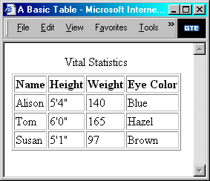
Table Parts
Caption indicates what the table is about
Table headings label the rows, columns, or both
Table cells are the individual rectangles in the table
Table data (td) are the values in the table cells

Slide 7
Table Parts
<table> </table>
Beginning and end of the table
<tr> </tr> (table row)
Beginning and end of a row in the table
Several can be nested inside the <table> </table>
<td> </td> (table data)
Beginning and end of a cell (column) in the table row
Several can be nested inside the <tr> </tr>
<th> </th> (table header - optional)
Special type of cell that contains headers
Text inside cell is bold and centered

Slide 8
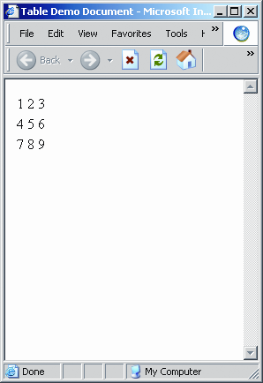
Effects of <table>, <tr>, and <td> Tags
<html>
<head><title>Tables</title></head>
<body>
<table>
<tr> <td>1</td> <td>2</td> <td>3</td> </tr>
<tr> <td>4</td> <td>5</td> <td>6</td> </tr>
<tr> <td>7</td> <td>8</td> <td>9</td> </tr>
</table>
</body>
</html>
By default, no border and narrow columns
Copyright (c) 2006 Prentice-Hall. All rights reserved.
8
Notes:
8
Creating a table with border=0 is a useful technique for structuring content. In a sense, the use of tables with no borders serves a similar purpose as the use of <p>, <br>, and &nbsp;.
In other words, it provides the ability to control white space between text and image content.

Slide 9
I Common <Table> Attributes p.387
align - specifies the horizontal alignment of the table
W3C has deprecated the use of this attribute with the <table> tag.
Use <div align=“center”> <table> ….. </table></div>
border - specifies the size of the border around the cells,
=> bordercolor - the color of the table border – widely used even not part of W3C recommendation
width (the width of the table)
percentage or pixels
=> height
cellspacing
the distance between the cells (the borders of each cell) in pixels
default is 2 pixels
cellpadding
the distance between the cell content and the edge of the cell in pixels
default is 1 pixels
bgcolor - deprecated
summary
specifies a summary of the table contents that can be accessed by a screen reader
=>title - some browsers p.387
May be displayed as a tooltip when the mouse passes over the table
1, 2, 4, 6, 7, 8, 9 are obsolete in HTML 5,
3, 5, 10 are not obsolete, we will use “=>” to indicate that
<table bordercolor="#0000FF“ >
<table style="color:blue; margin:2px;“ bordercolor=“red” >

Slide 10
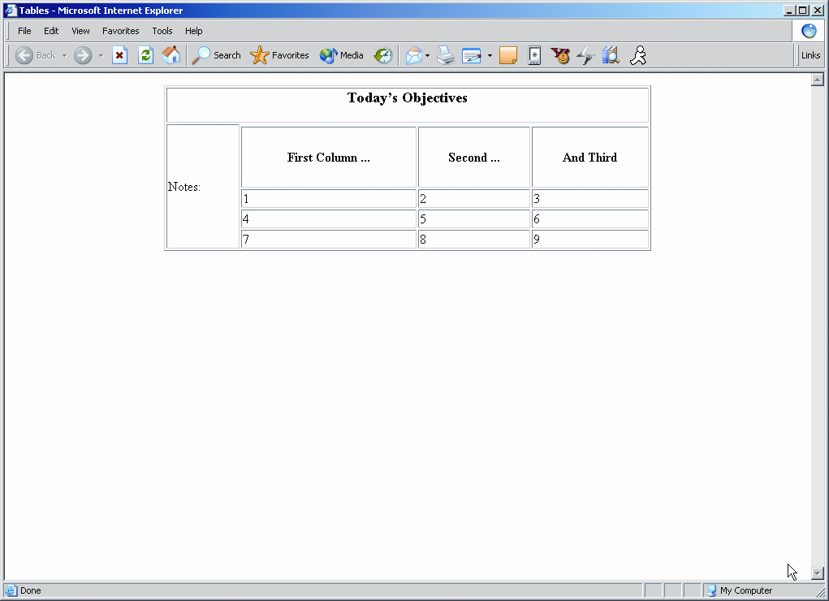
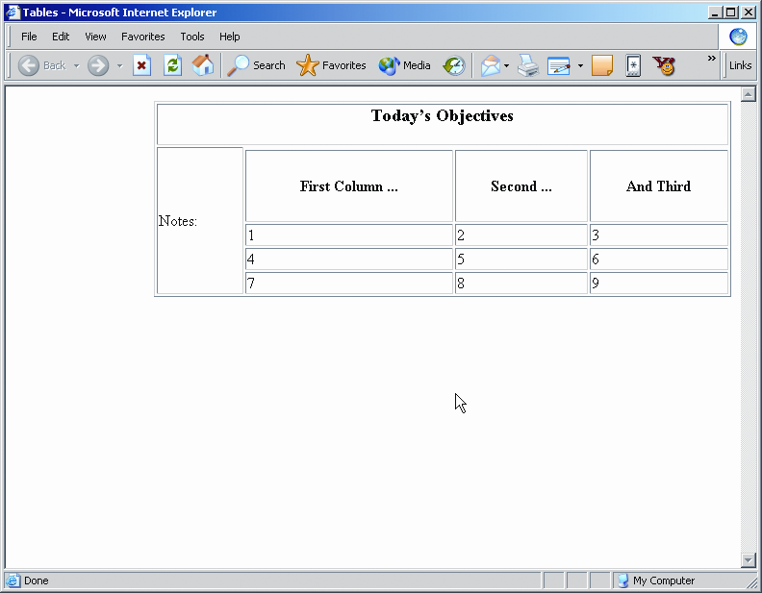
1. Effect of Table Alignment
<table border="1" width="600" align="center"> changed to
<table border="1" width="600" align="right">
Copyright (c) 2006 Prentice-Hall. All rights reserved.
10

Slide 11
=>2, 4 Two Common <table> Attributes
border (from 0 to 100)
Pixel width of the lines surrounding cells
Default is 0 (no border)
1 is a relatively thin
width
Indicate how much of page width is taken by table
By default, each column is wide enough to handle the largest text in one of its cells
Can be set in pixels or percentages
11

Slide 12
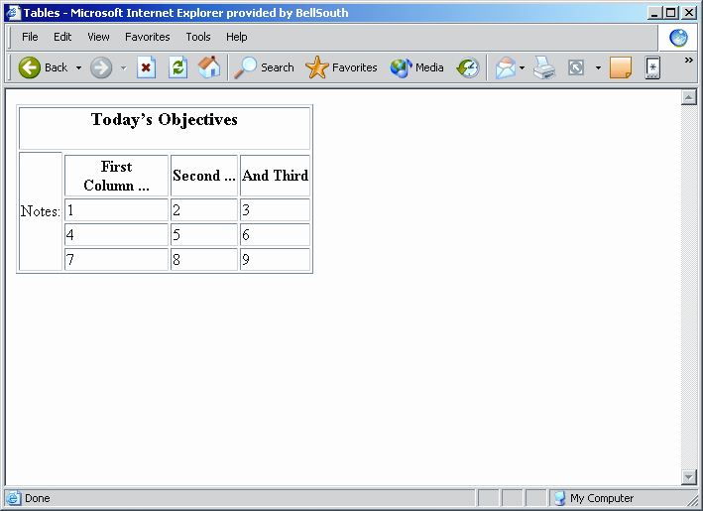
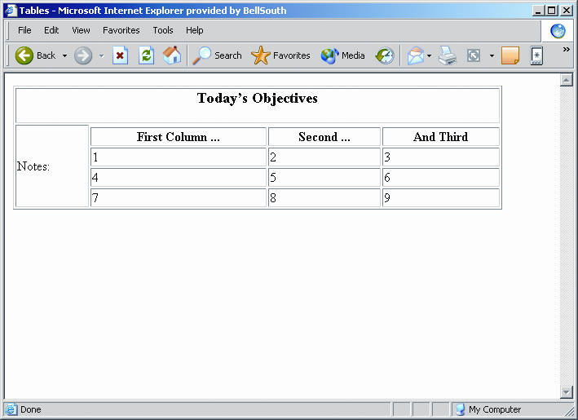
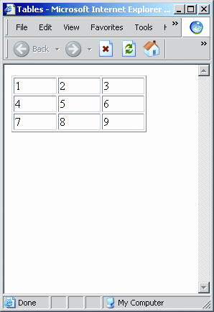
4. Effect of Changing Table Size
<table border="1"> changed to <table border="1" width="600">
<table border="1" width="75%">
Lines surround cells
Table width takes up ¾ of page width

Slide 13
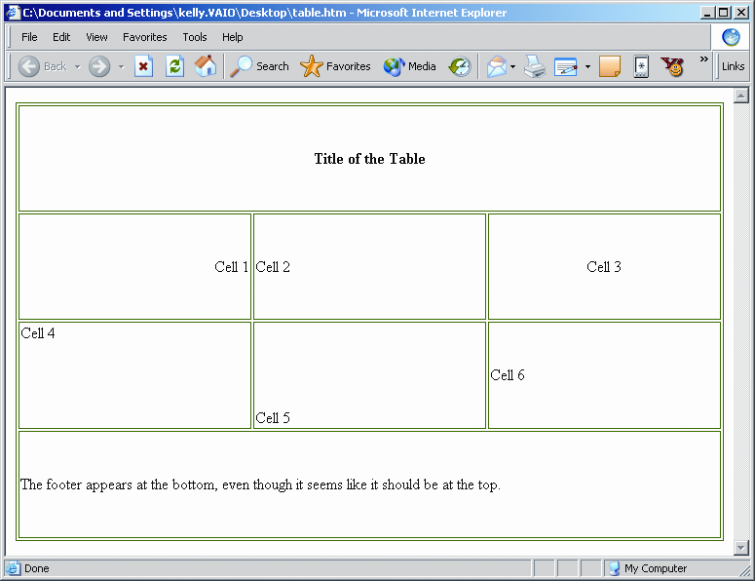
=> 3. Effects of Border Color Control
<table bordercolor="green">
Copyright (c) 2006 Prentice-Hall. All rights reserved.
13

Slide 14
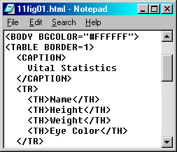
Table Parts
Captions
captions tell what the table is about
captions are optional
<caption> tag
goes inside the <table> tag just before the table rows
it has a closing tag, </caption>
Caption indicates
what the table
is about

Slide 15
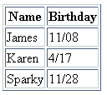
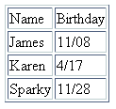
Table Example
<table border="1">
<tr>
<td>Name</td>
<td>Birthday</td>
</tr>
<tr>
<td>James</td>
<td>11/08</td>
</tr>
<tr>
<td>Karen</td>
<td>4/17</td>
</tr>
<tr>
<td>Sparky</td>
<td>11/28</td>
</tr>
</table>
<table border="1">
<tr>
<th>Name</th>
<th>Birthday</th>
</tr>
<tr>
<td>James</td>
<td>11/08</td>
</tr>
<tr>
<td>Karen</td>
<td>4/17</td>
</tr>
<tr>
<td>Sparky</td>
<td>11/28</td>
</tr>
</table>
Using the table
Header
<th> tag

Slide 16
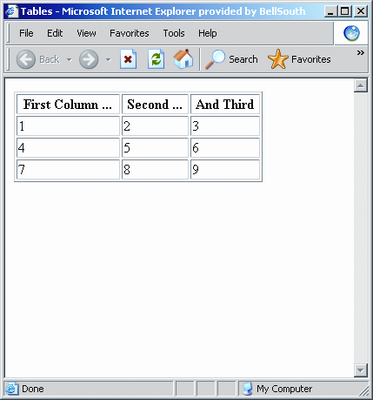
Effects of th = table heading Attributes
<tr>
<th>First Column ...</th>
<th>Second ... </th>
<th>And Third</th>
</tr>
Header cells have bold and centered text
Copyright (c) 2006 Prentice-Hall. All rights reserved.
16

Slide 17
4 , =>5 Applications of Width and Height Attributes
Table width and height
Absolute pixel sizes: <table width="300" height="200">
Relative percentages: <table width="25%" height="50%">
Row height
Absolute pixel sizes: <tr height="150">
Relative percentages: <tr height="50%">
Column width and height
Absolute pixel sizes: <td width="100" height="150">
Relative percentage of row: <td width="50%">
The browser stretches to take up 25% of the browser window in width
no matter what the screen resolution or window size
17

Slide 18
4, =>5 How Width and Height Decisions Are Made
Widest cell width setting determines column width
Largest cell (or row) height setting determines entire row height
If content is larger than size settings, element is made just large enough to satisfy content's needs
Percentages % in table settings are based on page size
Percentages % in cell and row settings are based on table size
18
Notes:
18
By default, cells will be made just large enough to handle the content embedded within them.
This could mean that different columns (and different rows) of a table will have different sizes. Sometimes this isn't what you want, so setting width and height attributes help give you more control.

Slide 19
II Common Table Row <tr> Attributes p.388
align - specifies the horizontal alignment of the table
bgcolor – the color of the background, deprecated
1, 2 obsolete in HTML 5

Slide 20
III Common Table Data <td> Attributes p.388
Element colgroup
Groups and formats columns – slide 34
Element col and td
align
determines the alignment of text in the column
valign
aligns data vertically
attributes: top, middle, bottom
bgcolor – the color of the background
=>background – file name of an image
=> colspan
the number of columns occupied by a cell
=> rowspan
the number of rows occupied by a cell
height
width
=> headers
associates the table data cells with the table header
1, 2, 3, 7, 8 are obsolete in HTML 5
4, 5, 6, 9 => are not obsolete

Slide 21
1 align, 2 valign. Table and Table Data Alignment
<table> tag's align Attribute
Controls horizontal alignment of table in the page
Options: left (default), right, center
<td> tag's align attribute
Controls horizontal alignment of content in the cell
Options: left (default), right, center
<td> tag's valign attribute
Controls vertical alignment of content in the cell
Options: top, bottom, center (default)
Copyright (c) 2006 Prentice-Hall. All rights reserved.
21

Slide 22
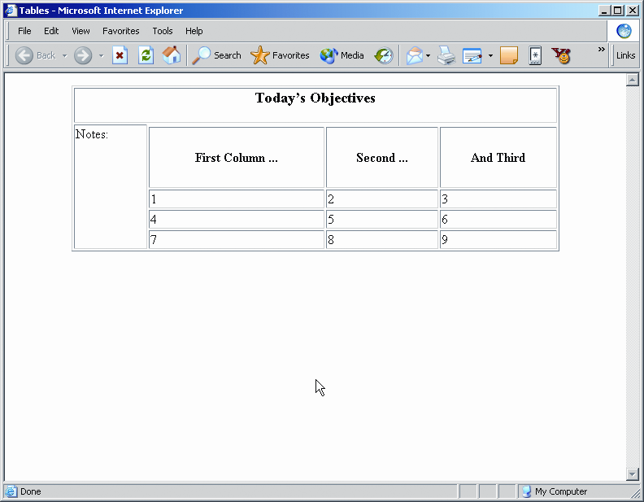

2. Effect of Cell Data Alignment
colspan
the number of columns occupied (spanned) by a cell - see later slides as well
rowspan
the number of rows occupied by a cell
<td rowspan=“4">Notes:</td>
changed to
<td rowspan=“4" valign="top">Notes:</td>
Copyright (c) 2006 Prentice-Hall. All rights reserved.
22

Slide 23
3 - 4 Attributes for Color Control
Border color control
bordercolor – sets the overall border color
Background color control
bgcolor – sets the color of the fill area
23

Slide 24
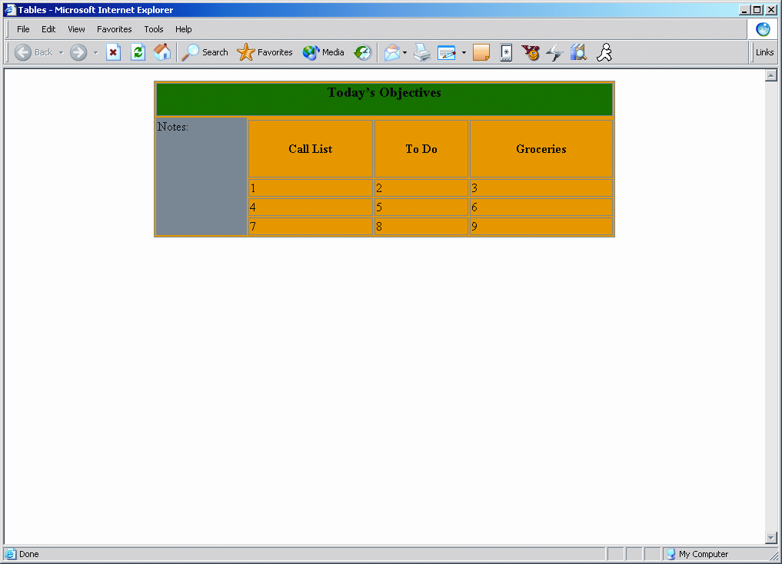
3. Effects of Background Color Control
These can be applied to table, row, or cell
Local settings override global settings
Color control attributes are deprecated
Use CSS instead
Global settings:
<table border="1" width="600" align="center" bgcolor=“orange">
Local settings:
<td colspan="4" bgcolor="green">
<td rowspan=“4" valign="top" bgcolor="gray">
24

Slide 25
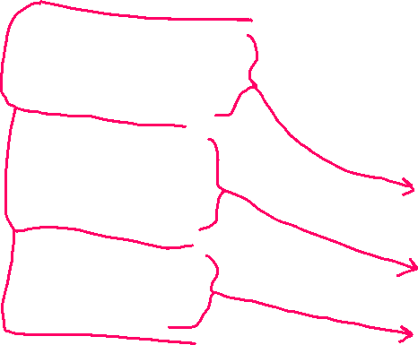

=>5. colspan Attribute
colspan
Specify number of columns to span
The cell will then take up that many columns in the table
Syntax:
<td colspan = “# of columns"> text </td>
<table border="1">
<tr>
<td colspan=“2”> Birthday List</td>
</tr>
<tr>
<td>James</td>
<td>11/08</td>
</tr>
<tr>
<td>Karen</td>
<td>4/17</td>
</tr>
</table>

Slide 26
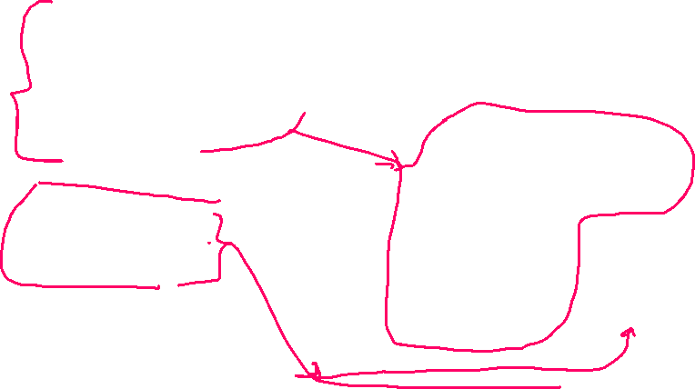
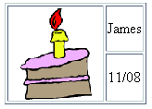
=>6. rowspan Attribute
Specify number of rows to span
The cell will then take up that many rows in the table
Syntax:
<td rowspan = “# of rows "> text </td>
<table border="1">
<tr>
<td rowspan=“2>
<img src=“cake.gif” alt=“cake” height=“100” width=“100” /></td>
<td>James</td>
</tr>
<tr>
<td>11/08</td>
</tr>
</table>

Slide 27
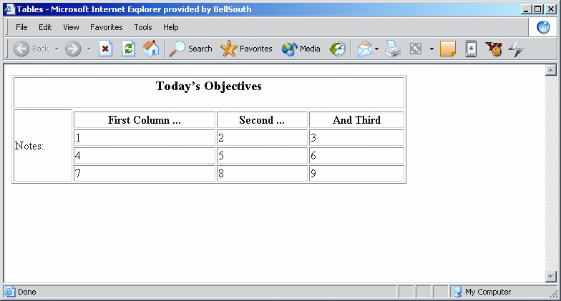
Effects of Column and Row Spanning
Column spanning:
<td colspan="4"><h3 align="center">Today’s Objectives</h3></td>
Note the space below "Today's Objectives", caused by making it a header (h3)
Row spanning:
<td rowspan=“4">Notes:</td>
Copyright (c) 2006 Prentice-Hall. All rights reserved.
27
HOP 8.2
Notes:
27
It is truly amazing how much flexibility is available to Web designers through the use of column and row spanning.
By combining spanning with table nesting, you can exert tremendous control over the look and feel of a Web page.
Experiment with different column/row spanning in order to demonstrate this.

Slide 28
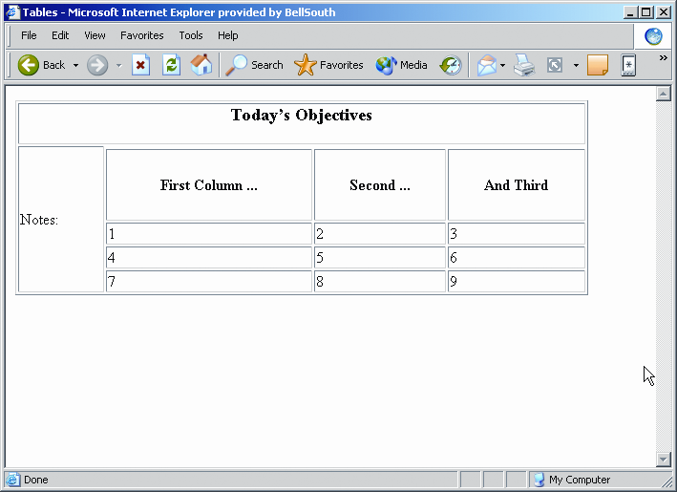
7. Effect of Changing header size
<th>First Column ...</th>
changed to
<th height="75">First Column ...</th>
Copyright (c) 2006 Prentice-Hall. All rights reserved.
28

Slide 29
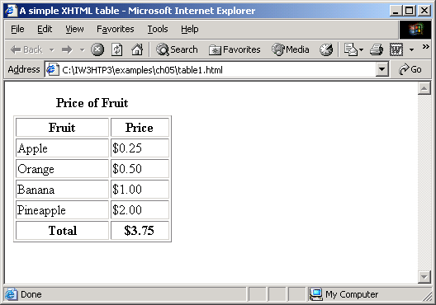

Configure an Accessible Table
W3C Web Accessibility Initiative (WAI) Web Content Accessibility Guidelines 2.0 (WCAG 2.0) recommends:
use <th> tags to indicate column or row headings
use <caption> tags to provide a text or caption for the table

Slide 30
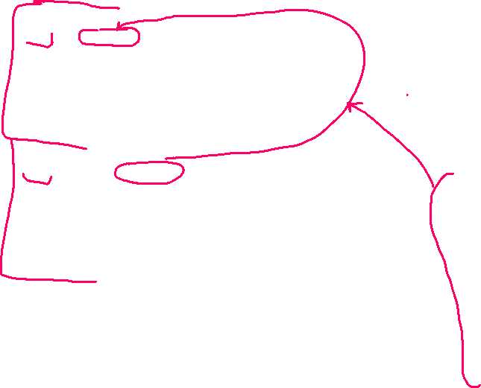
<table border="1" width="75%" title="Educational Background"
summary="This table lists my educational background including school attended, years, subject, and degree awarded (column headings). ">
<tr>
<th id="school">School Attended</th>
<th id="years">Years</th>
<th id="subject">Subject</th>
<th id="degree" >Degree Awarded</th>
</tr>
<tr>
<td headers="school">Schaumburg High School</td>
<td headers="years">2000 - 2005</td>
<td headers="subject">College Prep</td>
<td headers="degree">H.S. Diploma</td>
</tr>
</table>
=>9. headers
attribute
Table element title attribute
provide a brief description of the table.
Use <th> elements to indicate column or row headings.
Table element summary attribute
provide an overview of the table contents
Associate <td> tags with corresponding <th> tags to increase accessibility for more complex tables !!!
<th> tag id attribute
<td> tag headers attribute
table cell values with their corresponding headers. This technique uses the id attribute
(usually in a <th> element) to identify a specific header cell and the headers attribute
The W3C recommends specifically the table data <td> cell values with the corresponding headers. This technique uses the id attribute.
Using assistive technology like a screen reader you’d hear contents of the table just the way it is coded

Slide 31
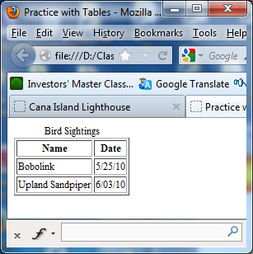
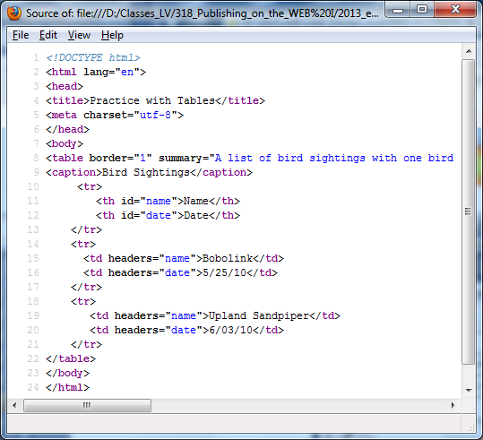
W3C recommendations

Slide 32

Hands-On Practice
HOP 8.1
Follow the directions in your book for the HOP.
START-UP File | chapter2/template.html
SAVE SOLUTION AS | mytable.html

Slide 33
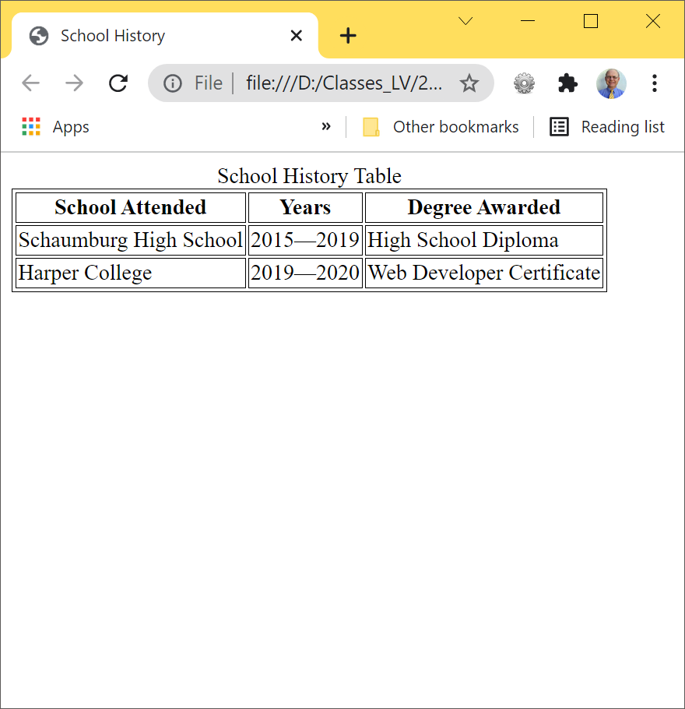
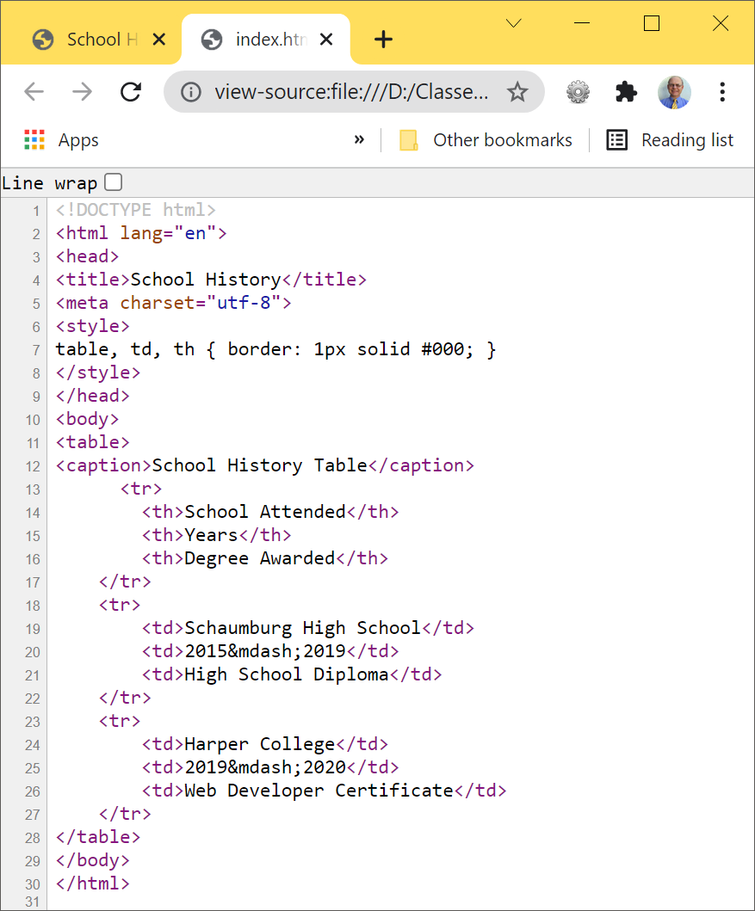

Example – HOP 8.1 - <th>

Slide 34
Checkpoint 8.1
1. Describe two reasons to use tables on a web page.
Organize info (layout) + format an entire Web page
2. Describe the difference between the cellpadding and cellspacing table attributes.
Define the amount of empty space between …
Which one defines the distance between the cells
3. Describe the method preferred by the W3C to align a table on a web page.
<div> tag

Slide 35
Hands-On Practice
HOP 8.2
Follow the directions in your book for the HOP.
START-UP File | chapter2/template.html
SAVE SOLUTION AS | myrowspan.html

Slide 36
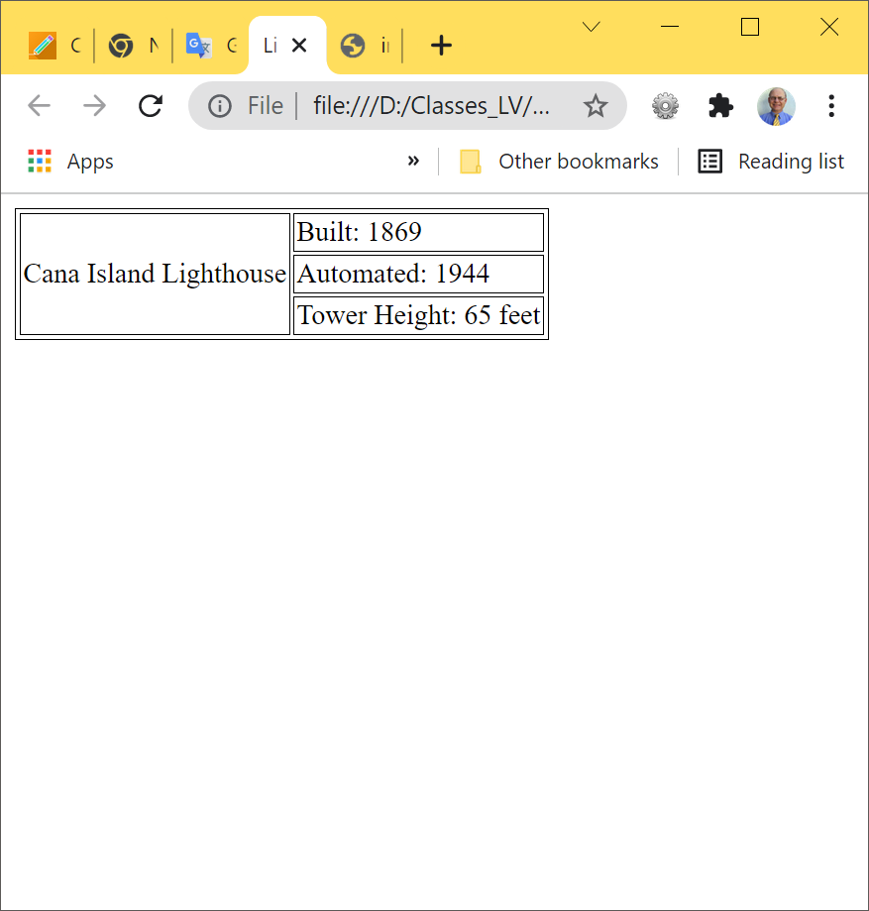
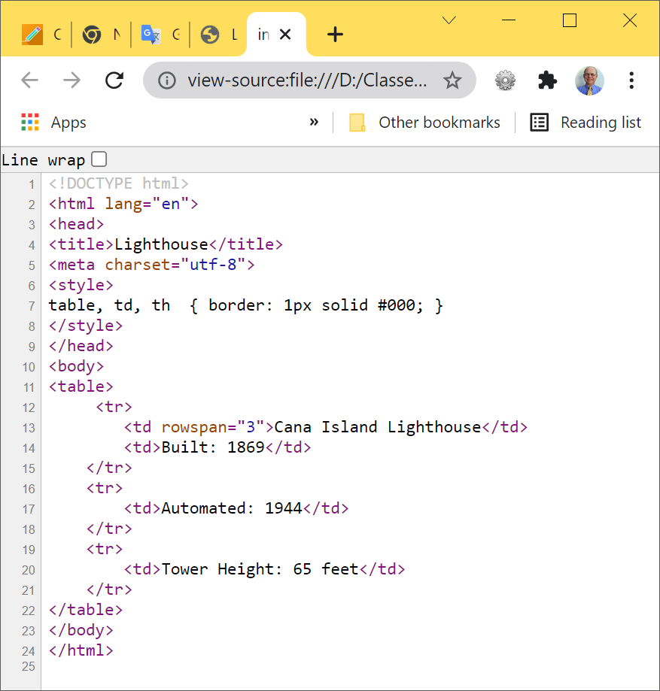

HOP 8.2 - <rowspan>
Exc:
rowspan=“3” and expand it to 4 rows by adding an additional pair of <tr>

Slide 37
8.7 Table Section (Row Groups) Tags p.398-399
The order of coding:
Header
Appears at top of each printed page of a multi-page table
<thead> </thead>
Footer
Appears at bottom of each printed page of a multi-page table
<tfoot> </tfoot>
Body
Contains main content of the table
<tbody> </tbody>
Headers and footers are not supported in all browsers
37

Slide 38
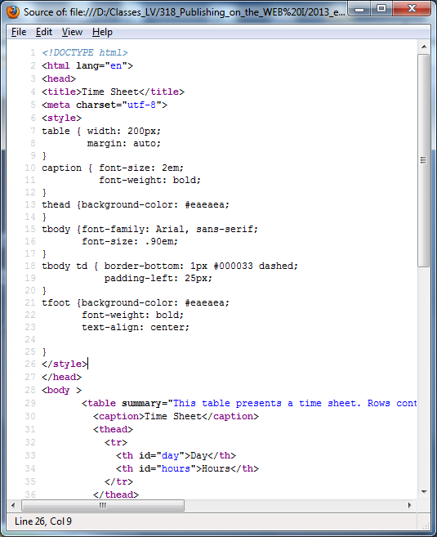
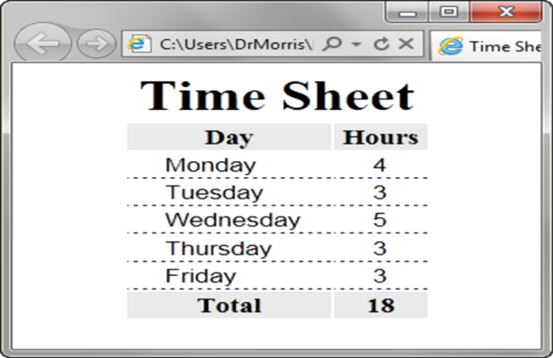
8.7 Table Row Groups p.398-400
<table> <caption>Time Sheet</caption>
<thead>
<tr>
<th id="day">Day</th>
<th id="hours">Hours</th>
</tr>
</thead>
<tbody>
<tr>
<td headers="day">Monday</td>
<td headers="hours">4</td>
</tr>
…
<tr>
<td headers="day">Friday</td>
<td headers="hours">3</td>
</tr>
</tbody>
<tfoot>
<tr>
<td headers="day">Total</td>
<td headers="hours">18</td>
</tr>
</tfoot> </table>
<thead> table head rows
<tbody > table body rows
<tfoot> table footer rows

Slide 39
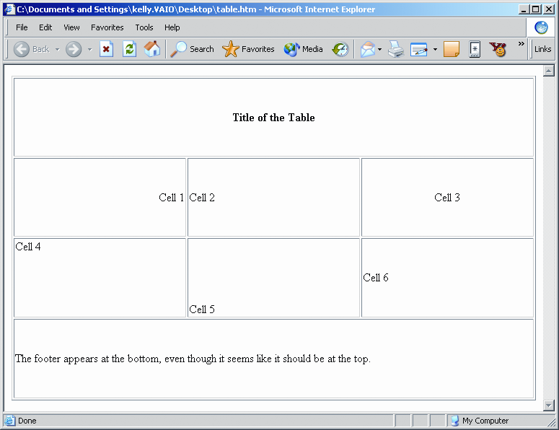
Effects of Headers and Footers
<tfoot>
<tr>
<td colspan="3">
The footer appears at the bottom
</td>
</tr>
</tfoot>
<thead>
<tr>
<th colspan="3">Title of the Table</th>
</tr>
</thead>
Copyright (c) 2006 Prentice-Hall. All rights reserved.
39
Notes:
39
Headers and footers are most useful for very large tables.

Slide 40
table.html (1 of 3)

Slide 41
table.html (2 of 3)

Slide 42
table.html (3 of 3)

Slide 43
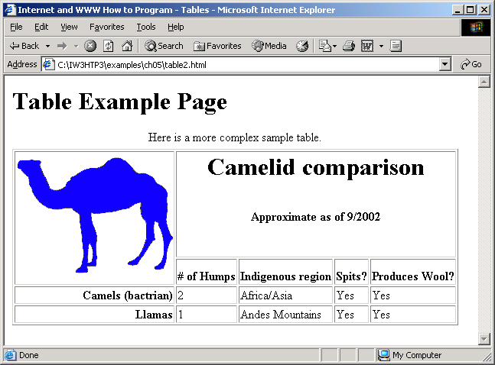

table2.html (1 of 3)
The <colgroup> tag is used to group columns in a table for formatting.
The <colgroup> tag is useful for applying styles to entire columns, instead of repeating the styles for each cell, for each row.
The <colgroup> tag can only be used inside a table element.

Slide 44


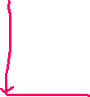
table2.html (2 of 3)
<span> tag provides a way to add a hook to a part of a text or a part of a document.

Slide 45
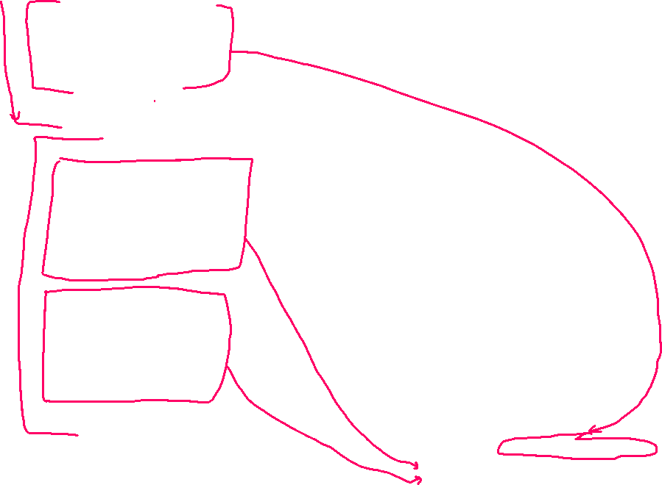
table2.html (3 of 3)
73 </tr>
74
75 </tbody>
76
77 </table>
78
79 </body>
80 </html>

Slide 46
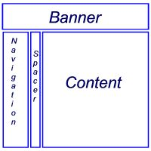

Using a Table to Format a Web Page
1. Vertical Navigation
<table border="0" width="80%">
<tr>
<td colspan="3"><h2>This is the banner area</h2></td>
</tr>
<tr>
<td width="20%" valign="top">Place Navigation here</td>
<td width="10">&nbsp;</td>
<td>Page content goes here</td>
</tr>
</table>
Access Table: The screen readers “read” the table row by row
So the order is:
banner, navigation, spacer, and content
e.g. http://orangecounty.craigslist.org/

Slide 47
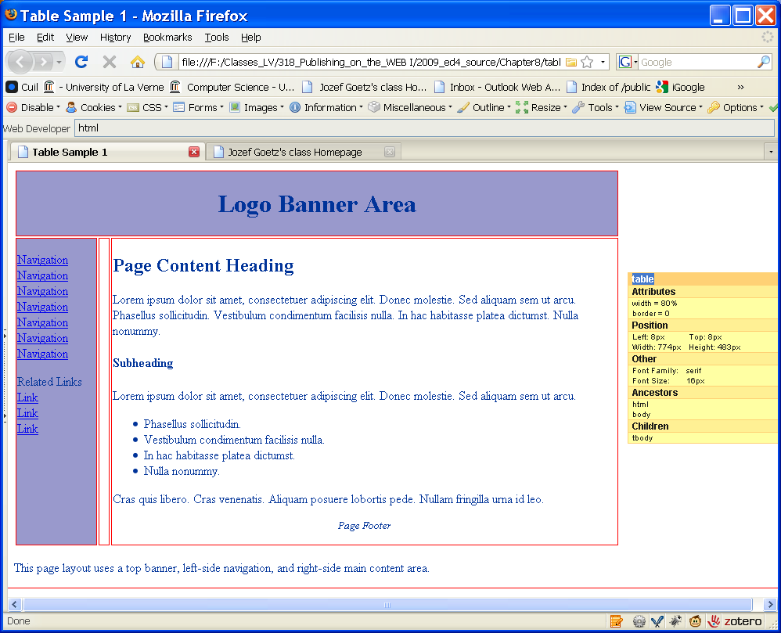
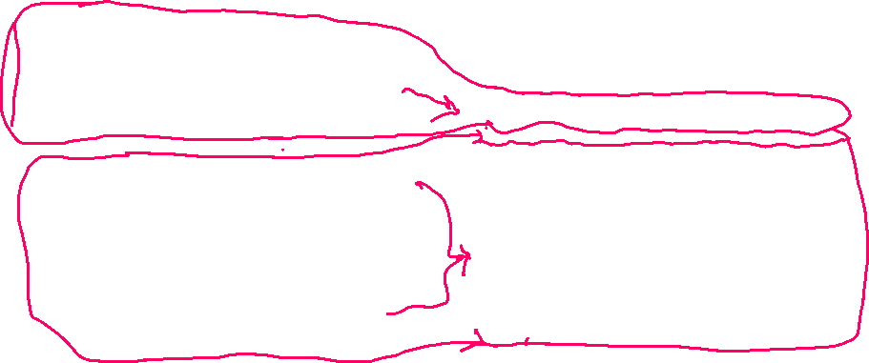
Using a Table to Format a Web Page
1. Vertical Navigation
<table border="0" width="80%">
<tr>
<td colspan="3"><h2>Logo Banner Area</h2></td>
</tr>
<tr>
<td width="20%" valign="top">Navigation Place here</td>
<td width="10">&nbsp;</td>
<td>Page content goes here</td>
</tr>
</table>
<p><a href="#">Navigation</a><br />
<a href="#">Navigation</a><br />
<a href="#">Navigation</a><br />
<a href="#">Navigation</a></p>
<p>Related Links<br />
<a href="#">Link</a><br />
<a href="#">Link</a><br />
<a href="#">Link</a><br />
</p>
tablel1a.html shows rows and cells
Navigation example =>
A screen reader reads each links over and over as a page is rendered,
to avoid it ch7 use CSS display:none
Navigation example =>

Slide 48
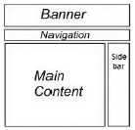
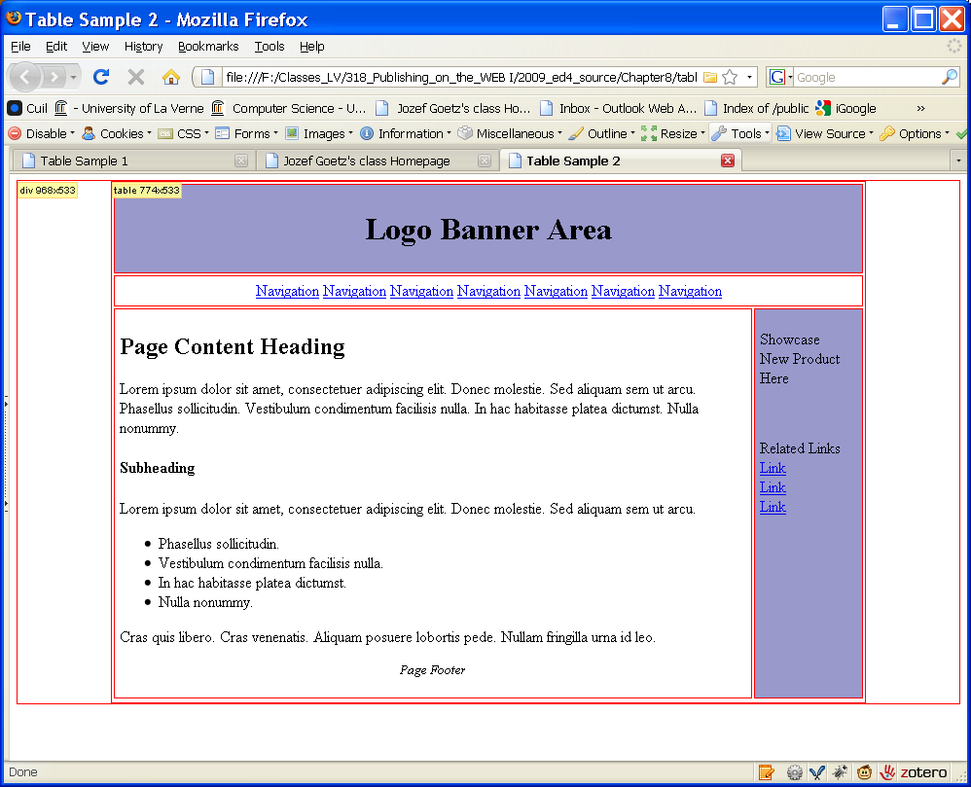
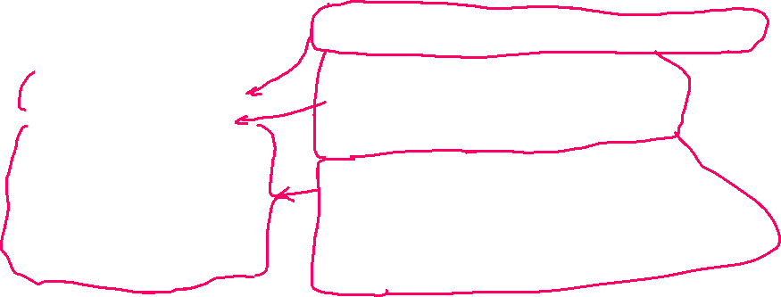
2. Horizontal Navigation, 2 content columns
A sidebar is commonly used for ads
Horizontal Navigation
The browser stretches to take up 80% of the browser window
no matter what the screen resolution or window size
Table shows rows and cells
<table width="80%" border="0" cellpadding="5">
<tr bgcolor="#9999cc">
<td colspan="2"><h1 align="center">Logo Banner Area</h1></td>
</tr>
<tr>
<td colspan="2“><h3 align="center">Navigation</h3>
<a href="#">Navigation</a>
<a href="#">Navigation</a>
<a href="#">Navigation</a></td>
</tr>
<tr>
<td valign="top"><h2>Page Content Heading</h2></td>
<td width="100" valign="top" bgcolor="#9999cc"
<p>Related Links <br />
<a href="#">Link</a><br />
<a href="#">Link</a><br />
<a href="#">Link</a> </p></td>
</tr>
</table>

Slide 49
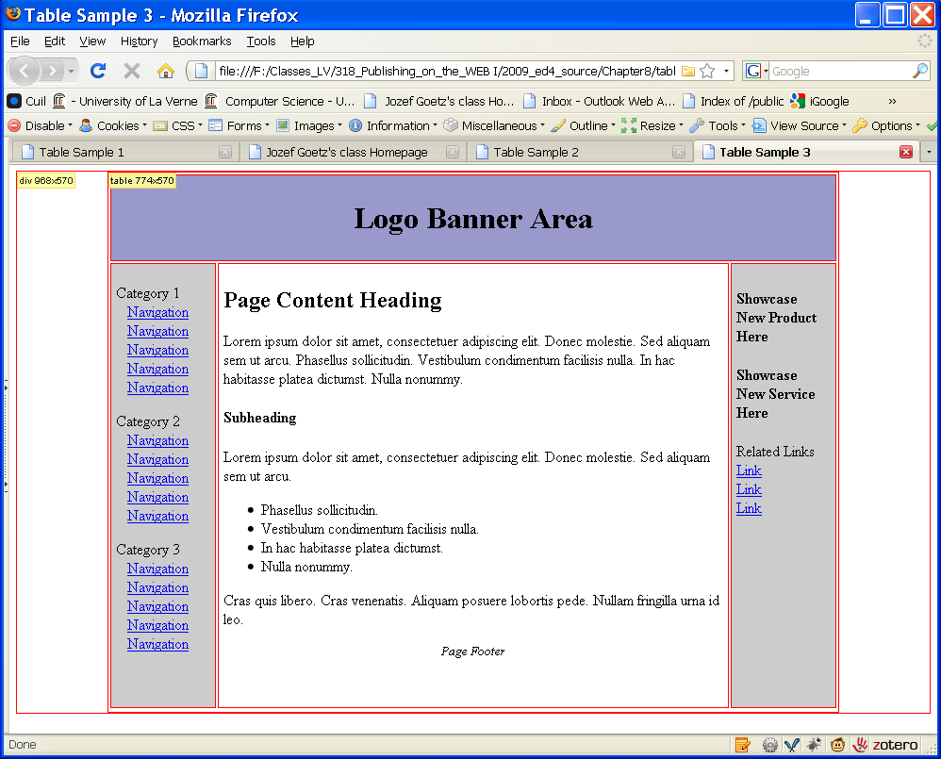
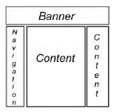
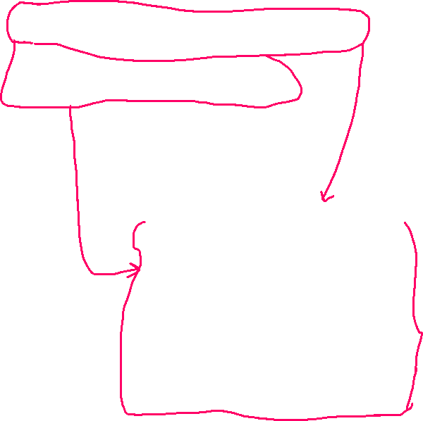
3. Left-side vertical navigation, center main content area and right sidebar area
<table width="80%" border="0" cellpadding="5">
<tr bgcolor="#9999cc">
<td colspan=“3"><h1 align="center">Logo Banner Area</h1></td>
</tr>
<tr>
<td width="100" valign="top“> Navigation </td>
<td> Main Content </td>
<td width="100" valign="top“> Sidebar </td>
</tr>
</table>
Useful for a large site than the previous one
Left side navigation
shows rows and cells

Slide 50
Flexible & Fixed Table Widths
Fixed Table:
Table width attribute in pixels: e.g. 760
Flexible Table:
Table width attribute in percent

Slide 51
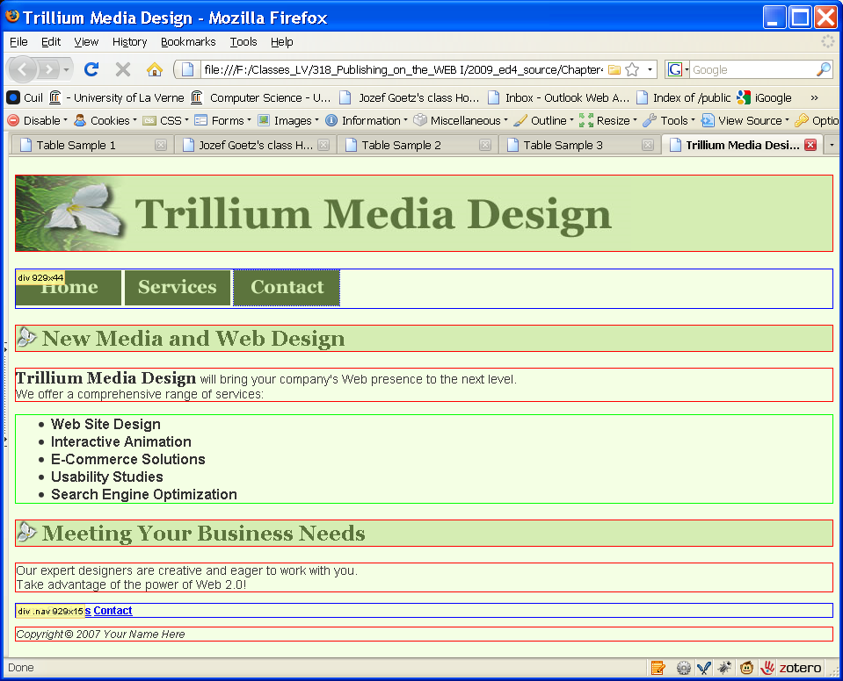
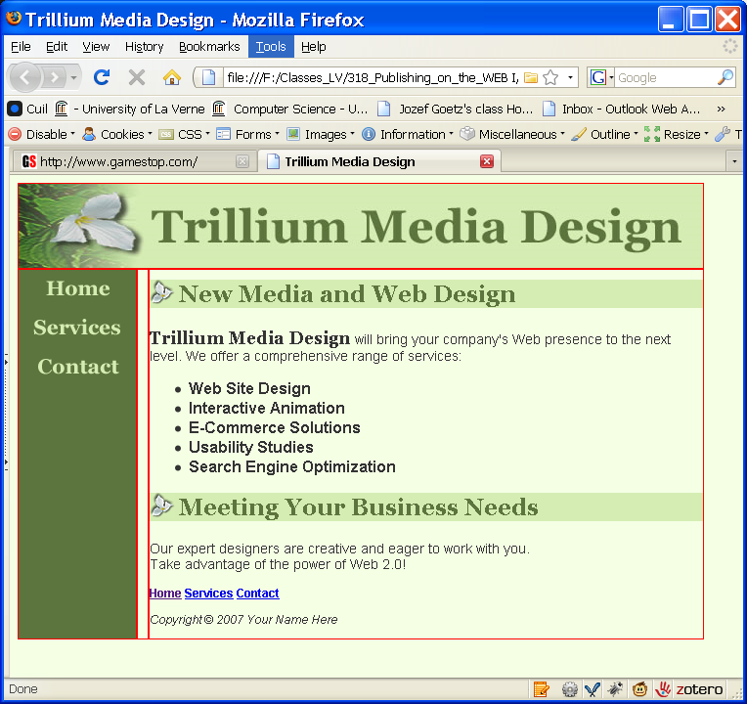
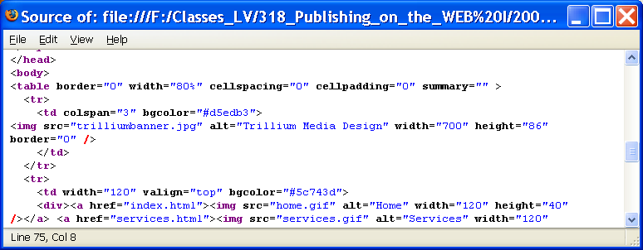

HOP 8.3 edition 5 (p.329-330)
From ch4.5 index.html shows all blocks elements = =>
Output: newindex.html shows rows and cells
part of the code

Slide 52
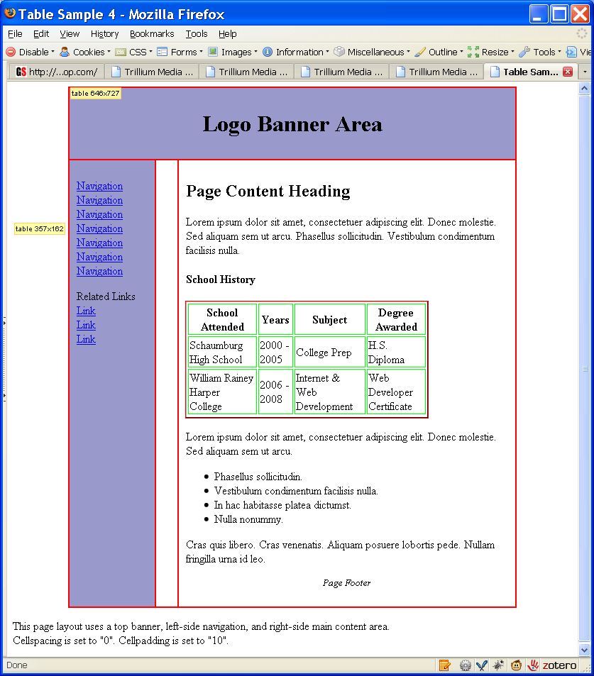
Nested Tables
Outer table used to configure page layout
Inner table (e.g. school history) used to organize some information on the page
-s’:
nested table can slow the browser display
a larger .html file size
difficult to read source code
better to use CSS to eliminate attributes inside the code
easier to read
smaller .html file sizes
efficient display by browsers
Old edition 5 =>:

Slide 53
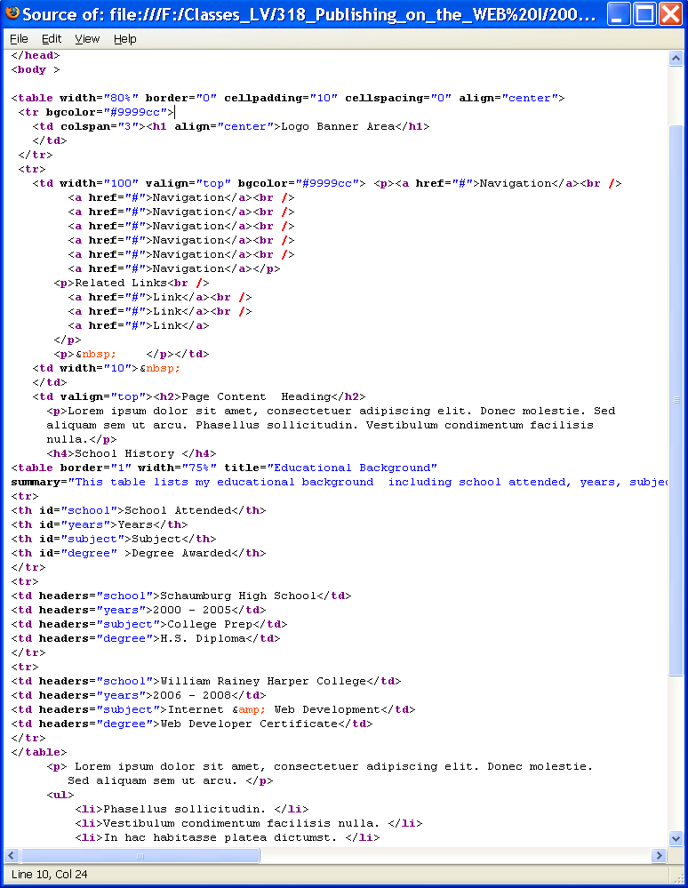
Nested Tables

Slide 54
Checkpoint
1. List 3 elements that are used to group table rows:
The thead, tbody, and tfoot.
2. Describe one coding technique that increases the accessibility of an HTML table.
the summary attribute, the title attribute, and configuring headers for the columns and rows

Slide 55
Checkpoint
1. Describe a reason to use a percentage width for a table that configures a web page layout. Provide an example of a page that uses this technique.
flexibility
2. Describe a reason to use a fixed pixel width for a table that configures a web page layout. Provide an example of a page that uses this technique.
Consistent on monitor with different resolutions
3. True or False. Tables can be nested within other tables.

Slide 56
8.5 Using CSS replacement to Style a Table p.394
HTML Attribute | CSS Property
align | Align a table: table { width: 75%; margin: auto; } Align within a table cell: text-align
bgcolor | background-color
cellpadding | padding
cellspacing | To configure a shared common border (default) and eliminate space between table cells: table { border-collapse: separate or collapse; }
height | height
valign | vertical-align
width | width
border, bordercolor - | border, border-style or border-spacing p.654 background-image p.654, border-color p.654

Slide 57
Hands-On Practice
HOP 8.3
Follow the directions in your book for the HOP.
START-UP File | starter.html
SAVE SOLUTION AS | menu.html

Slide 58
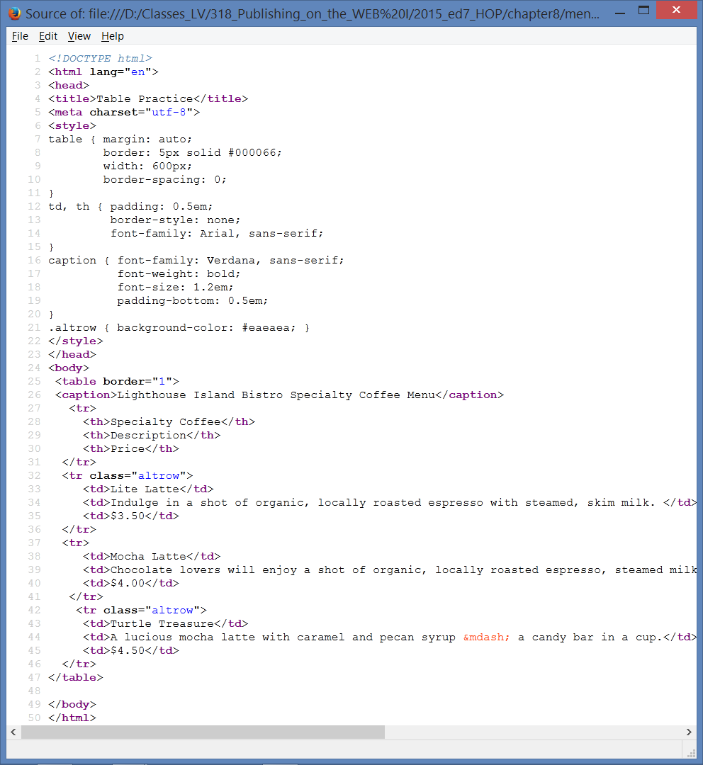
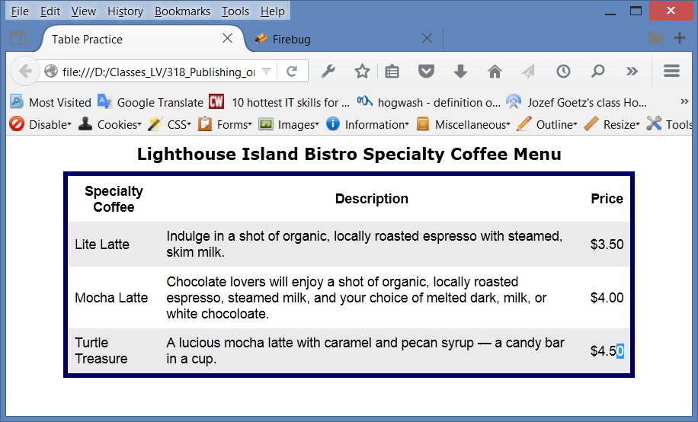
Lab Excercises – HOP 8.3
starter.html => menu.html
Exc: go to inspect (right click) and
remove border-style:none for td, th
and put
border: 4px solid #000066

Slide 59
CSS3 Structural Pseudo-classes p.396-7
Pseudo-class | Purpose
:first-of-type | Applies to the first element of the specified type
:first-child | Applies to the first child of an element (CSS2 selector)
:last-of-type | Applies to the last element of the specified type
:last-child | Applies to the last child of an element
:nth-of-type(n) | Applies to the “nth” element of the specified type n values: a number, odd, or even
Zebra Stripe a Table li:first-of-type { color: #FF0000} /* the 1st item in an ordered list to display with red text */
tr:nth-of-type(even) { background-color: #eaeaea; } /* blue dark */

Slide 60
Hands-On Practice
HOP 8.4
Follow the directions in your book for the HOP.
START-UP File | chapter8/8.3/index.html
SAVE SOLUTION AS | menu2.html

Slide 61
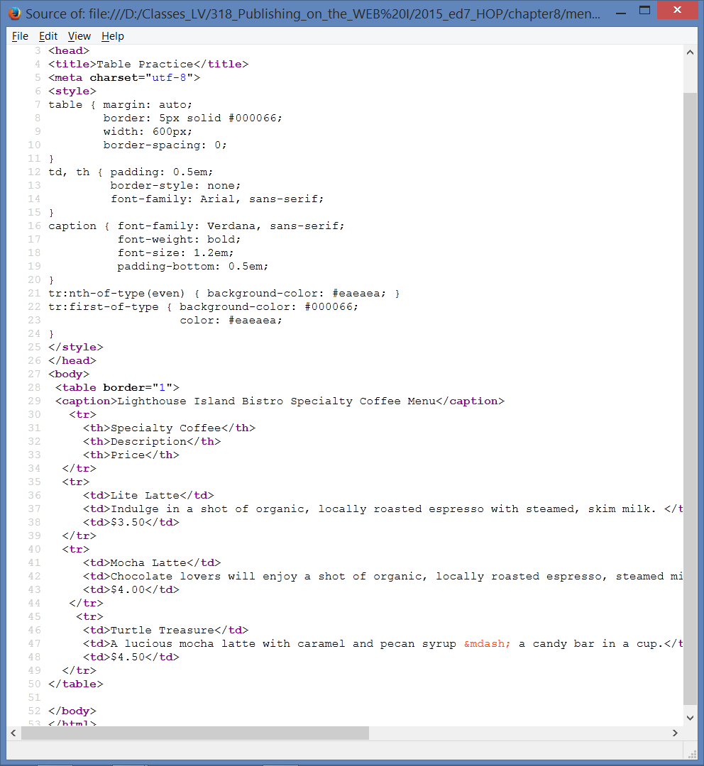



Lab Excercises – HOP 8.4
1. Using the web developer (CSS -> Edit CSS) in Mozilla browser, change the background color for the table header and every odd row.
2. Change the width and the border for the table using the inspect tool by right clicking on the Web page

Slide 62
Summary
This chapter introduced the HTML techniques used to create and configure tables.
CSS page layout configuration is more modern and preferred method even though many current Web sites are still designed with table based page layout
You will use these skills over and over again as you create Web pages.

Slide 63


Project JavaJam – Case Study, use CSS to a table

Slide 64


Project: Pacific Trails Resort – use CSS to the table

Slide 65



Proj. Yoga Studio – Case Study, use CSS to a table to modify schedule.html
Desktop
Mobile

Slide 66



Project Prime Properties – use a table

