Slide 1
Introduction
HOP 9.1
Input Element Form Controls
HOP 9.2
Scrolling Text Box
HOP 9.3
Accessibility and Forms
HOP 9.4
Fieldset and Legend Elements
HOP 9.5
Style a Form with CSS
HOP 9.6
HTML5 Form with Grid Layout
HOP 9.7
Server-Side Processing
HOP 9.8
HTML5 Form Controls

Slide 2
Chapter 9
HTML Forms
Credits: © 2011 - 25 Pearson Education
Copyright (c) 2006 Prentice-Hall. All rights reserved.

Slide 3

Learning Outcomes
In this chapter, you will learn (a very powerful tool for Web developers) how to:
  Describe common uses of forms on web pages
  Create forms on web pages using the
    <form>,
    <input>,
    <textarea>, and
    <select> tags
  Describe the elements used in forms
  Create forms that provide additional accessibility features using the
  accesskey and tabindex attributes
  5. Associate form elements and element groups using the
    <label>,
    <fieldset>, and
    <legend> tags
  Create custom image buttons and use the <button> tag to include more variety and richer content than the standard form button
  Describe the features of CGI
  Invoke server-side processing to handle form data
  Find free CGI resources on the Web

Slide 4
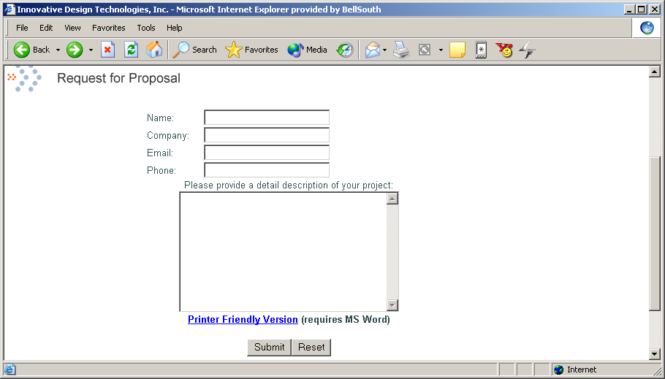
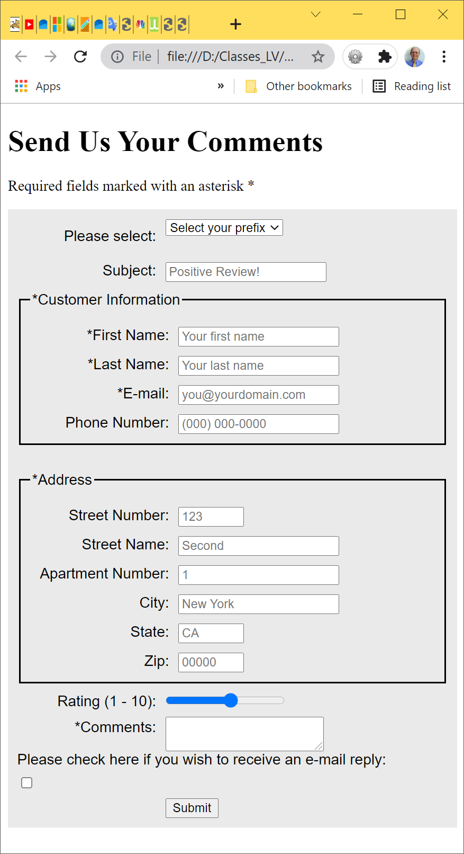
Visual Summary of Form
Single-line text fields
Multi-line text area
Submit input
A typical form
A form is an HTML/XHTML element that is used to contain and organize other objects such as:
  text boxes,
  check boxes, and
  buttons
that can accept information from web site visitors.
4

Slide 5

9.1 Overview of Forms; Why Use Forms?
Forms are used all over the Web to
  Accept information
  Provide interactivity
Types of forms SANOS:
  Search form,
  Add to Cart form,
  Newsletter sign-up form,
  Order form,
  Survey form etc.
Purpose of a form – acquire information from the user
  Accepting order info and send it to the server
  Visitor feedback
  Send a news story to a friend
  Collecting e-mail addresses for a newsletter
+’s:
  Monitor users’ behavior on your sites
  Interactions with users
  Enable Internet searches
  E-commerce checkout
5
Notes:
5
Although forms are covered in this project, the real benefit of using forms cannot be fully realized solely via HTML. What HTML forms and input tags will allow is for the browser to SEND information. However, something has to RECEIVE this information, and HTML provides no mechanism for doing this. The recipient of the information will most likely be some Web application running on the Web server. Scripts for these are listed in slides 7 and 74, but a detailed description of these scripting options is beyond the scope of this textbook but it is addressed in CMPS 320 Internet Apps Development.

Slide 6
Two Components of Using Forms
The HTML/XHTML form itself, which is the web page user interface and
2. The server-side processing, called CGI for Common Gateway Interface, which
  works with the form data and
  sends an email,
  writes to a text file,
  updates a database, or
  performs some other type of processing on the server.

Slide 7
HTML/XHTML Using Forms
<form> tag
  Used to contain the form elements on a web page
  Container tag
  <input> tag;
      used inside <form>
    Used to configure a number of form elements (controls) including
      text boxes,
      radio buttons,
      check boxes, and
      buttons
    Stand alone tag

Slide 8

Hands-On Practice
HOP 9.1 – Code a form.
Follow the directions in your book for the HOP.
START-UP File | chapter2/template.html
SAVE SOLUTION AS | form1.html

Slide 9
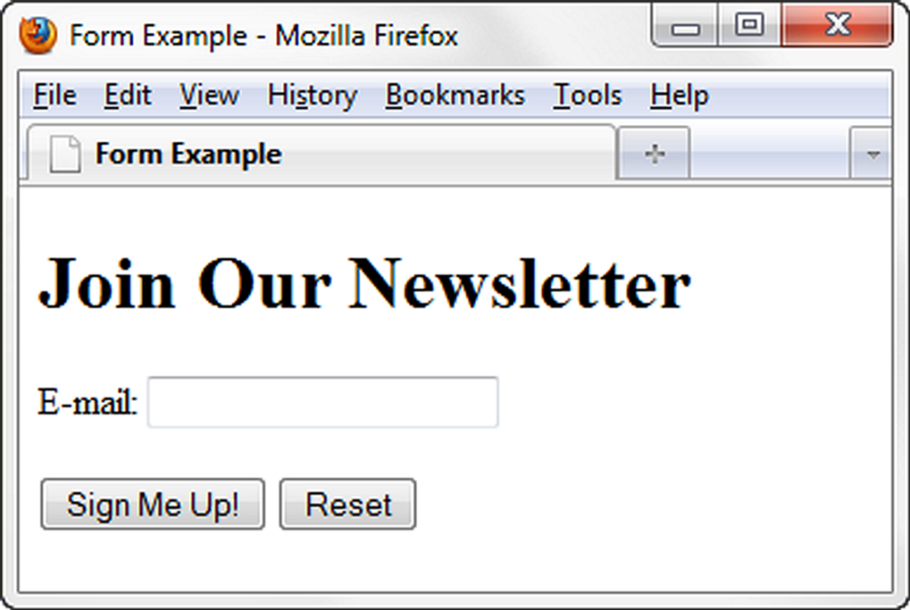
Input tag for text box HOP 9.1
  <input> tag => used inside <form>
HOP 9.1 p.418-9
<form>
E-mail: <input type="text" name ="email" id="email"><br>
<input type="submit">
<input type=“reset">
</form>

Slide 10
Using the <form> Tag
<form> </form>
Tells browser where a form begins and ends
Cannot be nested inside each other but you can have many forms on a web page
Attributes can indicate
  Name of form (name) used by C#, JavaScript, PHP,CGI
  The id attribute used by CSS
  How data is sent (method post or get)
  What server-side program or file will process the form (action)
<form name=“order” id=“order” method=“post”
action=“cgi-bin/order.php”>
<form elements go here ….
</form>
10

Slide 11
<form> tag
The form tag p.415
Attributes:
  1. action
    Specifies the server-side program or script will process your form data
    specifies the relative or absolute URL of the receiving page
    action attribute will usually pertain to a server-side script file (CGI, ASP.NET, PHP, C#)
  2. autocomplete – off, on - default value, HTML5; browser will use it to fill form fields
  3. id
    Identifies the form, a unique id for the form element,
    usually the same as name; use id to be compatible with CSS and HTML/XHTML
  4. name
    a unique name identifies the form, could be used by client or server-side
  5. method
    get
      default value,
      form data passed (appended to) in URL
    post
      more secure,
      form data passed in HTTP Entity Body
<form name=“order” id=“order” method=“post”
action=“cgi-bin/order.php”>
<form elements go here ….
</form>

Slide 12
Type of Form Elements (Controls)
<form>
  Contains the form elements on a web page
  Container tag
  1. <input>
    Configures a variety of form elements including text boxes, radio buttons, check boxes, and buttons
    Stand alone tag
  2. <textarea>
    Configures a scrolling text box
    Container tag
  3. <select>
    Configures a select box (drop down list)
    Container tag
    <option>
      Configures an option in the select box
      Container tag

Slide 13
9.2 Using the <input> Tag
<input > - a self-contained tag
Specifies an input field of the form
Enables you to create many different types of controls for the form
Attributes can indicate
  type -- specifies the type of control (default is text):
    text,
    password,
    checkbox,
    radio,
    submit,
    image,
    reset,
    hidden,
    button,
    file
  name -- assigns a name to the control
  other items such as size, color, formats
13
Notes:
13
Note: all <input> tags must be placed between the <form> and </form> tags. You cannot have user inputs without surrounding forms.

Slide 14

Submitting Form Data
Form data – the information a user types into a form
Submitting
  pressing the Enter key,
  or clicking a Submit button
Form Data is submitted as part of the URL address location if method get is used
Data is submitted in name-value pairs
  Name – the name of the input field's tag
  Value – the value the user typed into the input field
Copyright (c) 2006 Prentice-Hall. All rights reserved.
14

Slide 15
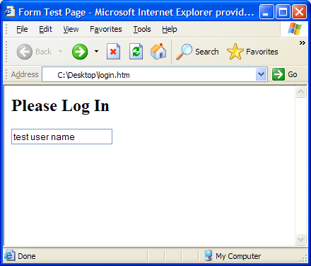
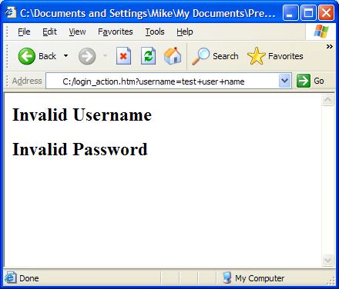
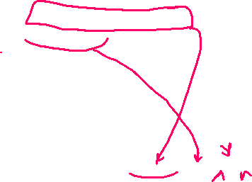


Effect of Using the action Attribute
<form action="login_action.htm">
<input name=“username" > </form>
Name = username
Value = test user name
(spaces represented with +)
Note that data entered by user was sent to the Web server using method get,
  by appending to the URL address
Action attribute caused a different page to be called
Data was sent to this page as a name-value pair
The text-type input field.
User has typed text into the field
Copyright (c) 2006 Prentice-Hall. All rights reserved.
15
Notes:
15
The common term for data that is appended to a URL is "URL parameter". As will be shown later, URL parameters are in the form "name=value", where "name" is the name of the input tag and "value" is its content.
Note again here the URL parameter, with the Name=Value structure. You can tell the end of the address portion of the URL by the question mark.
If there were multiple URL parameters (i.e. multiple input tags with user content), then these parameters would be separated with ampersand symbols (&).
There is something else important to point out in this slide. The file login_action.htm, which is the recipient of the data sent by the login.htm file, contains JavaScript code to deal with the input. As stated earlier, it is beyond the scope of this book to discuss in detail how data that is sent from a form can be received by another application. However, it may be useful to look at the code contained in the login_action.htm file to get a feel for how it is structured and what it is doing. The main point here is that something must RECEIVE and deal with the data that is SENT via a form.

Slide 16

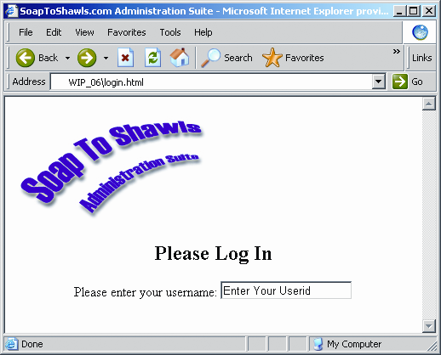


HTML/XHTML<input> tag: Text box p.416
Used to accept text information
Attributes:
  type=“text”
  name
  id
  size
  maxlength
  value
  required=“required” HTML5; browser verifies entry of info before submitting the form
  autocomplete - use autocomplete to fill the form control
  autofocus – browser places the cursor in the control
  placeholder – brief info intended to assist the user
<input type="text" size="20" name="username" maxlength="20" value="Enter Your Userid" >
Type = "text"
Single line text field
Size = "20"
20 visible characters
Maxlength = "20"
max 20 characters can be entered
Value = "Enter Your Userid"
initial value seen in text field
Notes:
11. accesskey – configure a hot key for the form control => see 9.6 slide 50
12. tabindex – configure a tab order of the form control => see 9.6 slide 50

Slide 17
Working with Text Input Fields: full list p.416
Text input field – a single-line option that allows users to enter alphanumeric text
E-mail: <input type="text" name ="email" id="email">
Attributes controlling text input fields:
  type ="text", this makes it a single-line text field
  name, id - identifies the text, could be accessed by client or server-side
  size – specifies number of visible characters
  maxlength – specifies the maximum number of characters that can be input into the field
  value – sets initial value displayed in the text field - unique value can be accessed by client-side and by server-side processing
  disabled =“disabled” - form control is disabled
  readonly - makes the text read-only
17
Copyright (c) 2006 Prentice-Hall. All rights reserved.

Slide 18

HTML/XHTML<input> tag: Password box
Used to accept text information that needs to be hidden as it is entered
Attributes:
  type=“password”
  name // could be accessed by client or server-side
  id
  size
  maxlength
  value

Slide 19
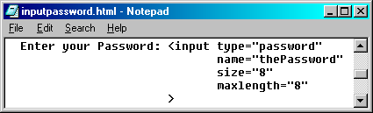
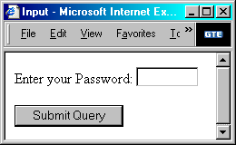
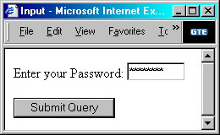
Essential Elements of a Form
  Creating Password Controls
    Single line text input field but input is masked with asterisks
    password is the value for the type attribute of input
    note that any information sent using this control is not encrypted

Slide 20
HTML/XHTML<input> tag: Hidden form element p.421
This form element is not displayed on the web page.
Hidden form fields can be accessed by both client-side and server-side scripting and are sometimes used to contain information needed as the visitor moves from page to page (such as id, name, value etc.).
Attributes:
  type=“hidden”
  name
  id
  value
Notes:
accesskey – configure a hot key for the form control => see 9.6 slide 50
tabindex – configure a tab order of the form control => see 9.6 slide 50

Slide 21

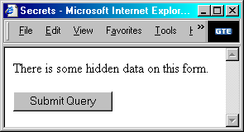
HTML/XHTML<input> tag: Essential Elements of a Form
  Hiding Controls with hidden
    Used to pass along data that the user can’t see or modify
    hidden is the value for the type attribute of input
    name attribute is how the control is referenced and
    what the value attribute data is attached to
      value attribute is the data that is sent with the other form data

Slide 22
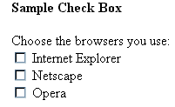
HTML<input> tag: Check box p.419
Used to allow the user to select one or more of a group of predetermined items
Attributes:
  type=“checkbox”
  name
  id
  checked=“checked” //initial value
  value // unique value can be accessed
  // by client-side and by server-side processing
  6. required=“required” HTML5; browser verifies entry of info before submitting the form
  7. autofocus – HTML5, places cursor in the form control and sets the
  focus
  Difference from Radio Buttons – user can select more than one choice
    A control that can be toggled between checked and unchecked
    checked attribute will initially display the check box as checked
Notes:
accesskey – configure a hot key for the form control => see 9.6 slide 50
tabindex – configure a tab order of the form control => see 9.6 slide 50

Slide 23
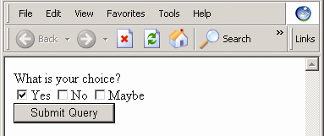
Effect of grouped CheckBoxes
<input type="checkbox" name="choice" value="Y" checked="checked" />Yes
<input type="checkbox" name="choice" value="M" />Maybe
<input type="checkbox" name="choice" value="N" />No
Copyright (c) 2006 Prentice-Hall. All rights reserved.
23
Notes:
23
Now you can contrast the effect of the checkbox against the effect of the radio button. This example from the text is a good vehicle for such demonstration. Execute the code for this example, and note the effect when clicking the different buttons, which is that turning one checkbox on has no effect on the other checkbox values. Also, note what happens to the URL parameter when the form is submitted. If multiple checkboxes were on when the form was submitted, there will be multiple choice parameters displaying in the URL.

Slide 24
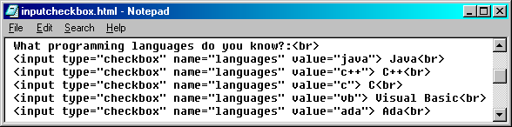
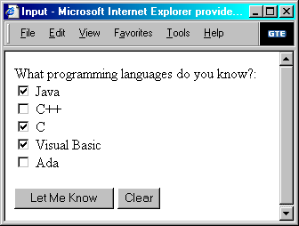
Essential Elements of a Form
    check boxes can be grouped by assigning them all the same value for the name attribute
      use the value attribute to assign values to the check boxes that are part of the group

Slide 25
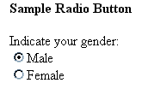
HTML/XHTML<input> tag: Radio Button p.420
Used to allow the user to select exactly one from a group of predetermined items
Each radio button in a group is given the same name and a unique value
Attributes:
  type=“radio”
  name
  checked=“checked” //initial value
  value // unique value can be accessed
  // by client-side and by server-side processing
  required=“required” HTML5; browser verifies entry of info before submitting the form
  autofocus – HTML5, places cursor in the form control and sets the focus
Notes:
accesskey – configure a hot key for the form control => see 9.6 slide 50
tabindex – configure a tab order of the form control => see 9.6 slide 50

Slide 26
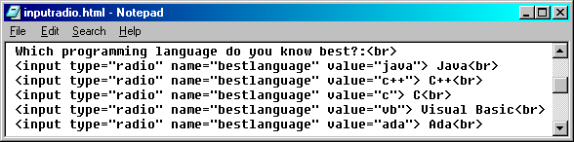
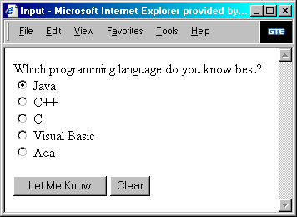


Radio Buttons Syntax
<input type="radio"
  name="name"
  value="val"
    checked="checked">
    Text to Display
Indicates radio type
Name of the group
Value that will be submitted for the group if checked
Label displayed to the user for the radio button
Selected item. Only one in a group
26
      Radio Buttons can be grouped by assigning them all the same value for the name attribute
Notes:
26
All radio inputs of the same name belong to the same radio group, and only one radio button within the group can be "on" at a time. Thus, when the user clicks a radio button in the group, any other radio button that had been "on" will now be turned off.

Slide 27
Essential Elements of a Form
  Creating Radio Buttons
    A control that is used when a choice between two or more items is needed and only one should be selected
    Grouped radio buttons are mutually exclusive (only one can be selected at any one time)
    Should be used in groups of two or more
      can be grouped by assigning them all the same value for the name attribute
      use the value attribute to assign values to the radio button that are part of the group

Slide 28
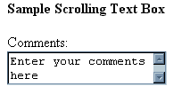
9.3 HTML/XHTML<textarea> tag: Scrolling Text Box p.423
Used to configure a scrolling text box
Attributes:
  name
  id //unique id
  cols
  rows
  value
  wrap=“hard” or “soft” HTML5; configures line breaks within the info entered
  required=“required” HTML5; browser verifies entry of info before submitting the form
  autofocus – HTML5, places cursor in the form control and sets the focus
  placeholder – HTML5, brief info intended to assist the user

Slide 29
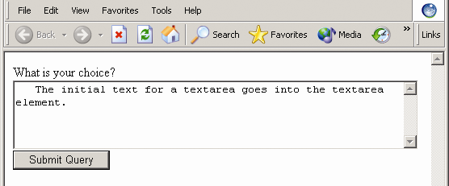
Essential Elements of a Form
Create Large Text-Entry Fields with textarea
  <textarea> element creates a large text-entry field so users can enter more information
    Attributes
      cols – indicates number of visible characters in a line
      rows – indicates the number of lines of the text area that will be visible
    Container tag
      text within these tags is displayed in the textarea

Slide 30
Hands-On Practice
HOP 9.2 – Code a contact form.
Follow the directions in your book for the HOP.
START-UP File | HOP 9.1/form.html
SAVE SOLUTION AS | form2.html

Slide 31
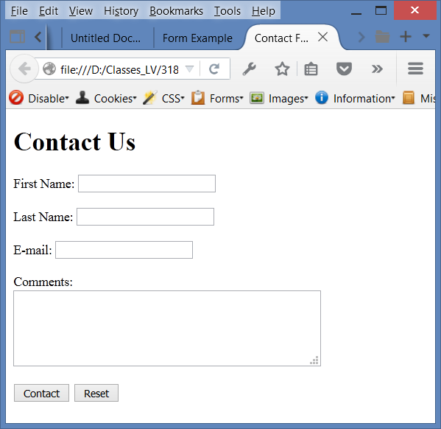
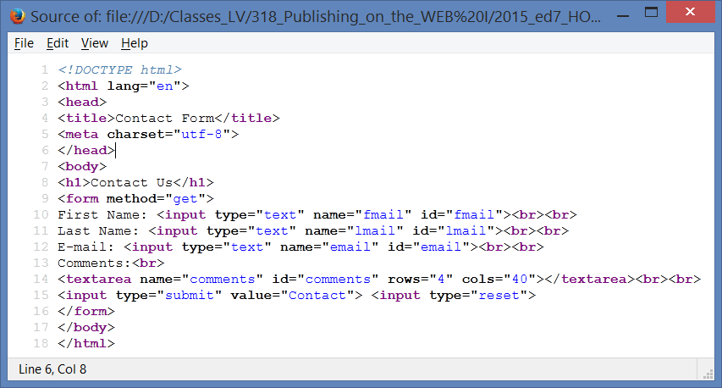
Effect of <textarea> HOP 9.2 p.424-425
<textarea cols="60" rows="5">
The initial text for a textarea goes into the textarea element.
</textarea>
Notes:
31
Exc: place the placeholder attribute

Slide 32

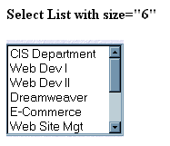
9.4 Essential Elements of a Form: select list p.426
Used to allow the user to select one or more items from a list of predetermined choices.
Creating Menus with select and option
<select name="choice">
<option value="Y" selected="selected">Yes</option>
<option value="N">No</option>
<option value="M">Maybe</option>
</select>
<select> attributes
  creates a menu of choices, allows for multiple selections to be made
    name – name of the element from which a value is chosen
    id
    size – how many options are visible at a time,
    multiple – whether more than one option can be chosen at a time; multiple=“multiple” for many
size=“1” display only one item,
Synonyms: a
  drop-down box,
  drop down list,
  drop down list box,
  select list or
  select box
  option box
Notes:
tabindex – configure a tab order of the form control => see 9.6 slide 50
disabled - if present, form control is disable

Slide 33
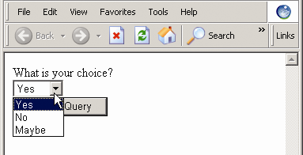
Single-Selection Dropdown List
<select name="choice">
<option value="Y" selected="selected">Yes</option>
<option value="N">No</option>
<option value="M">Maybe</option>
</select>
Copyright (c) 2006 Prentice-Hall. All rights reserved.
33
Notes:
33
Similarly to contrasting the radio button vs. checkbox, it is useful to compare the behavior of single-selection vs. multiple-selection lists. The single-selection list behaves rather like radio buttons, in that only one item can be selected and that the URL parameter will contain a single value for the name. Demonstrate this to the class.

Slide 34
HTML/XHTML<option> tag: Select List
Used to configure the options in a select list
<option> tag attributes
    specifies the choices for the select element
      value – value of the option;
        used when data other than what is being displayed needs to be sent with the form
        can be accessed by client-side and by server-side processing
      selected – whether the option is chosen,
        pre-selects the option item; =“selected” - initially selected when displayed by a browse
      disabled without any value - form control is disabled
<select name="choice">
<option value="Y" selected="selected">Yes</option>
<option value="N">No</option>
<option value="M">Maybe</option>
</select>

Slide 35
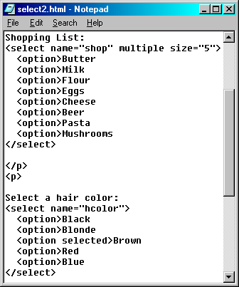
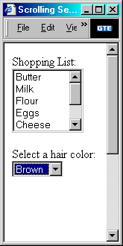
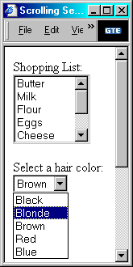
Essential Elements of a Form

Slide 36
Summary
<form> tag
  Used to contain the form elements on a web page
  Container tag
  <input> tag; used inside <form>
    Used to configure a number of form elements including
      text boxes,
      radio buttons,
      check boxes, and
      buttons
    Stand alone tag
  <textarea> tag
    Used to configure a scrolling text box
    Container tag
  <select> tag to create a menu of items
    Used to configure a select box (drop down list)
    Container tag
    <option> tag, used inside <select> </select>
      Used to configure an option in the select box
      Container tag

Slide 37

9.5 HTML/XHTML<input> tag: Submit Button attribute p.428
Used to submit the form
When clicked, it triggers the action method on the <form> tag and causes the browser to send the form data (the name and value pairs for each form element) to the web server.
Attributes:
  type=“submit”
  id
  name
  value - default text is “Submit Query” =>
        that appears in the label of the button

Slide 38

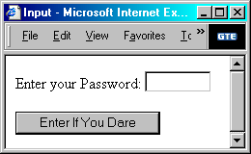
Essential Elements of a Form p.428
  Creating Submit Buttons
    Used to transmit form data
    submit is the value for the type attribute of input
    value attribute will change the default text of the button (default text is “Submit Query”)
    A form can have more than one submit button

Slide 39
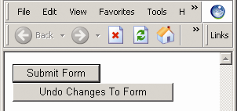

HTML/XHTML<input> tag: Reset Button attribute p.428
Submit buttons
  type=“submit”
  Send form data to the Web server
  Syntax: <input type="submit" >
Reset buttons
  Clear the data in input fields of a form to their initial values
  Syntax: <input type="reset" >
  Attributes
    type=“reset”
    name – identifier of the button
    value – text that appears in the label of the button (default text is “Reset”)
<input type="submit" name="submitButton" value="Submit Form" />
<input type="reset" value="Undo Changes To Form" />

Slide 40

HTML/XHTML<input> tag: Button attribute
Used to offer a flexible user interface
There is no default action when the button is clicked
Usually a JavaScript function (client-side) is invoked when a button is clicked
  The client side processing include calculations, edits, displaying different page etc.
Attributes:
  type=“button”
  name
  alt
  value

Slide 41

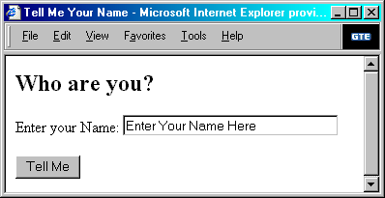



HTML/XHTML<input> tag: Essential Elements of a Form
  Creating push Buttons
    Used to initiate a client-side script to execute
    button is the value for the type attribute of input
    value attribute is needed to specify the name displayed on the button

Slide 42
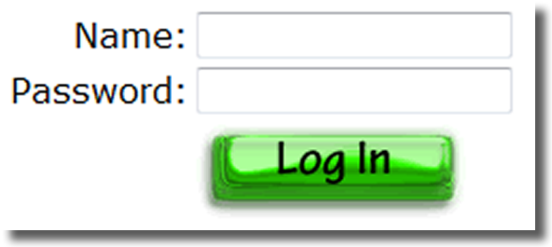
HTML/XHTML Form Enhancements <input> tag: Image Button attribute
Used to submit the form p.428
  more compelling and visually interesting that are configured with type = submit
When clicked, it triggers the action method on the <form> tag and
  causes the browser to send the form data (the name and value pairs for each form element) to the web server.
Attributes:
  type=“image”
  name
  src
  alt
  <input type=“image” src=“login.gif” alt=“Login Button”>

Slide 43

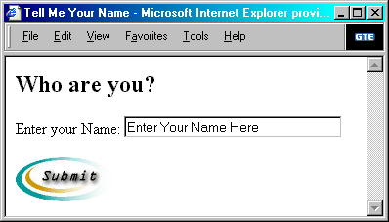

HTML/XHTML<input> tag: Essential Elements of a Form
  Creating Graphical Buttons
    Submit button that has an image on it instead of text
    image is the value for the type attribute of input
    src attribute is needed to specify the name and location of the image file
    alt (alternative text) provides accessibility to visitors unable to view the image
    The x and y coordinate of where the user clicked is also submitted with the form data

Slide 44

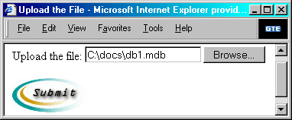
HTML/XHTML<input> tag: Essential Elements of a Form
  Upload Files with the file Select Control
    Allows uploading a file along with the form (after submitting the form)
    file is the value for the type attribute of input
    name attribute is how the control is referenced and what the value attribute data is attached to
    The control includes a “Browse” button which allows user to browse their hard drive for a file to upload

Slide 45
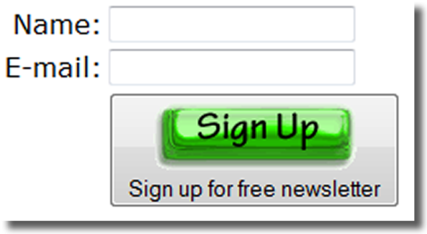
HTML/XHTML Form Enhancements: <button> tag
The <button> tag is not used as often as the submit or the image button
  A container tag
  When clicked, its function depends on the value of the type attribute.
  Button can contain a combination of text, images, and media
Common Button attributes used with <input>:
  type=“submit” => function as a submit button - send the form data
  type=“reset” => function as a reset button
  type=“button” => function as a button
  name
  value
  alt
  id
  <button type="submit"> <img src=“see.jpg" width="100" height="30" alt="Submit form" />
  </button>

Slide 46
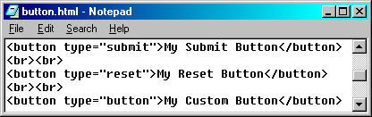
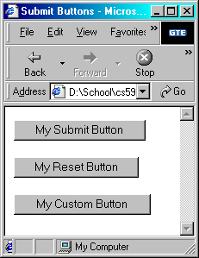
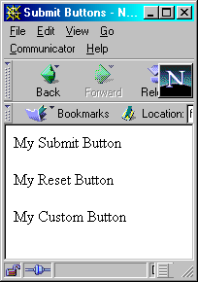






<button> tag
    Three different types of buttons can be created:
    submit, reset, and button (a custom button)

Slide 47
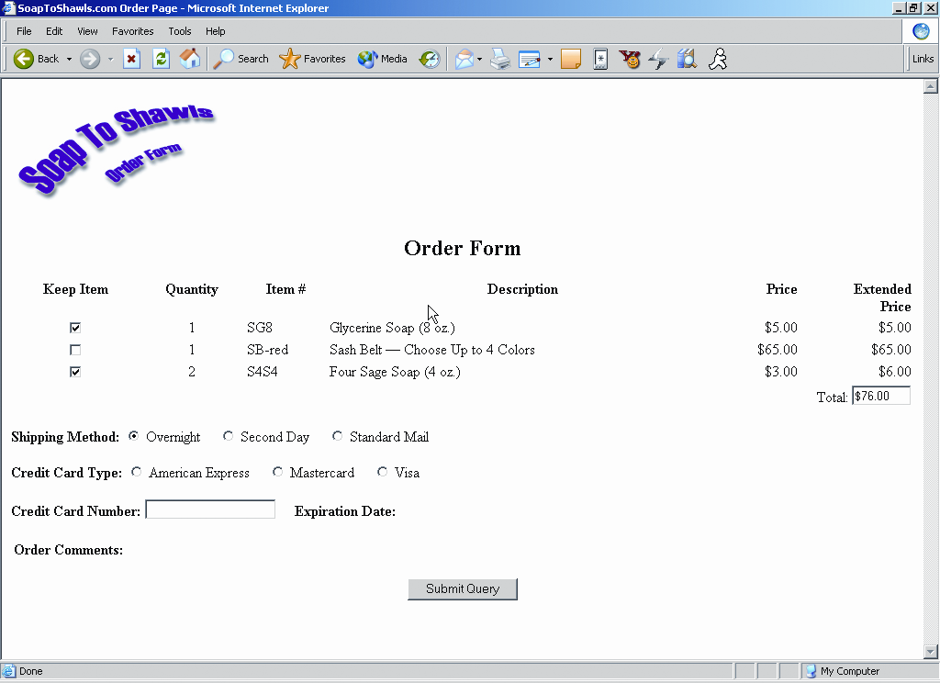
Creating an Order Form
Check boxes, more than one can be checked at a time
Radio buttons, only one in the group can be checked at a time
Radio buttons, only one in the group can be checked at a time
Copyright (c) 2006 Prentice-Hall. All rights reserved.
47

Slide 48
Checkpoint 9.1
1. You are designing a web site for a client who sells items in a retail store.
  They want to create a customer list for e-mail marketing purposes.
  Your client sells to consumers and needs a form that accepts their customer’s name and e-mail address.
  Would you recommend using
    2 input boxes (one for the name and one for the e-mail) or
    3 input boxes (for the first name, last name, and email address)?
  Explain your answer.
  personalized 3 input boxes for the server-side processing

Slide 49
Checkpoint 9.1
2. You are designing a survey form for a client.
  One of the questions has 10 possible responses.
  Only one response can be selected per question.
  What type of form element would you use to configure this question on the web page?
  consider a group radio button (for short responses), select list (for long responses) and check boxes (not good b/c they allow many responses)
3. True or False.
In a radio button group, the value attribute is used by the browser to process separate elements as a group.
  -No, the name attribute is used.

Slide 50
9.6 Accessibility & Forms
Label Element
Fieldset Element
  Legend Element
Tabindex Attribute
Accesskey Attribute

Slide 51
Hands-On Practice
HOP 9.3 – Add the label & text area.
Follow the directions in your book for the HOP.
START-UP File | HOP 9.2/form2.html
SAVE SOLUTION AS | form3.html

Slide 52
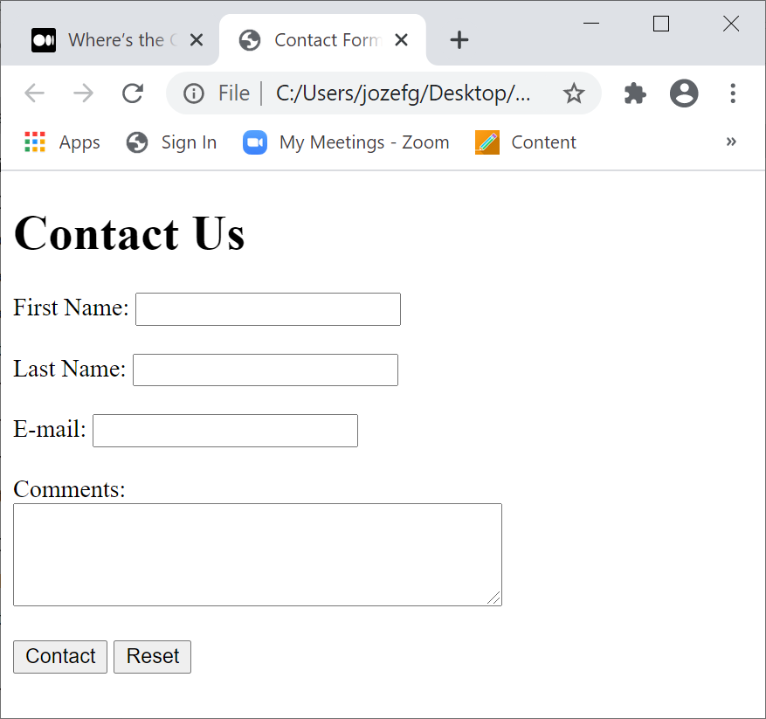
1. Form Enhancements: <label> tag p.430
<label>First Name: <input type="text"
name="fname" id="fname"></label><br><br>
HOP 9.3 practices both approaches:
displays information for a form control
  uses in HOP 9.3:
  <label>Email: <input type="text" name="CustomerEmail" ><label>
<label for="email " >Email: </label>
  <input type="text" name="CustomerEmail" id= "email " >
  The <label> is a container tag used to associate a text (e.g. Email) with a form element (type="text“)
    clicking anywhere on a form or its associated text will move cursor to the field (- exercise)
  the label tag with the “for” and “id” attribute can serve as a fragment id or bookmark used by anchor tags and allow the form element to be directly linked to other parts of the Web page(s)
HOP 9.3

Slide 53
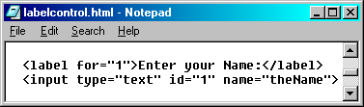
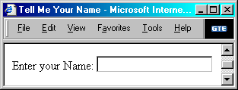
<label> tag
    for attribute value matches the id of the control
Displaying Control labels
  Text between the opening and closing tags is what is displayed
  for attribute
    used to map the label to a control
    for attribute value matches the id of the control

Slide 54
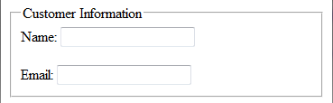

2. HTML/XHTML Form Enhancements: <fieldset> & <legend> tags p.431
The fieldset tag
  Container tag
    Used to create a visual group of form elements on a web page
    Creates a visual border around the elements contained within the fieldset
    Creates an organized and appealing Web page containing form
The legend tag
  Container tag
  Used to create a text label within the fieldset
  <fieldset><legend>CustomerInformation</legend>
    Name: <input type="text" name=CustomerName" size="30" /><br />
    Email: <input type="text" name="CustomerEmail" />
  </fieldset>
The fieldset and legend tags increase the usability of the Web form for all visitors

Slide 55
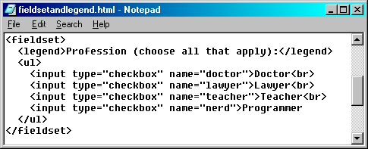
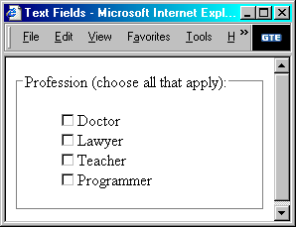
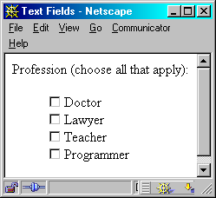
<fieldset> & <legend> tags
Grouping Controls with fieldset and legend
  fieldset element
    element organizes controls into groupings
    has an opening and closing tag
  legend element
    displays a caption for a fieldset

Slide 56
Hands-On Practice
HOP 9.4 – Use the fieldset and legend.
Follow the directions in your book for the HOP.
START-UP File | HOP 9.3/form3.html
SAVE SOLUTION AS | form4.html

Slide 57
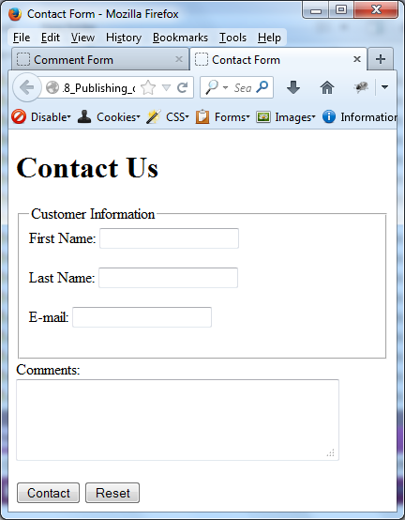
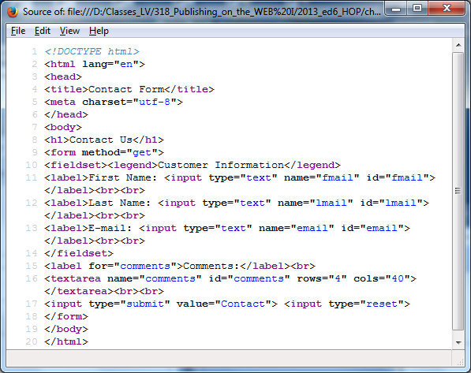
HOP 9.4 part I – no CSS p.401
HOP 9.4 part I – no CSS p.419
form4.html includes the fieldset, legend, and the label

Slide 58
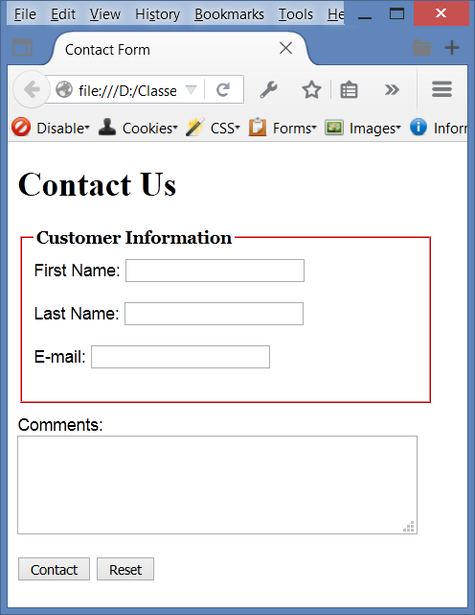
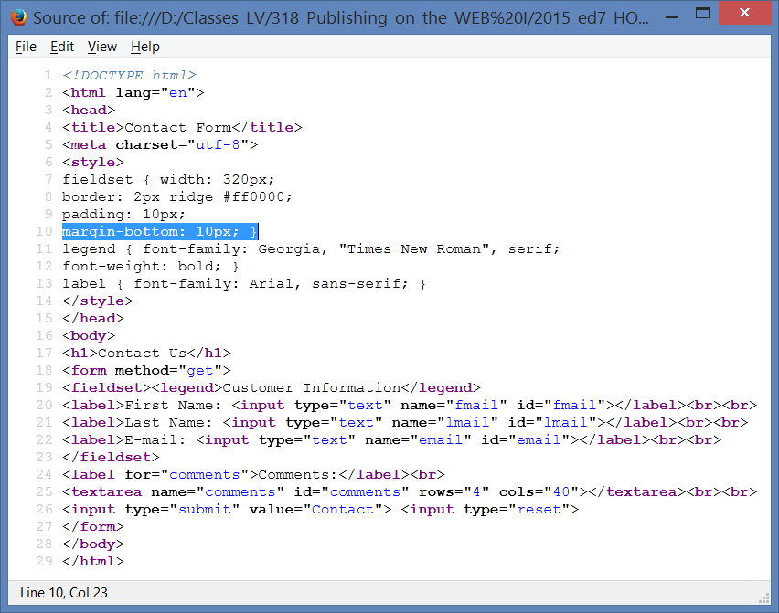
HOP 9.4 part II – with CSS
Expand HOP 9.4 by including spaces to align vertically the e-mail field with other fields (controls).
Moreover, configure the fieldset width to 400px and border to 5px.

Slide 59
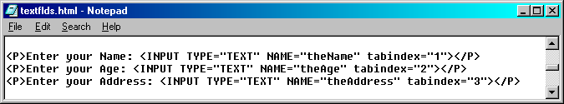
3. HTML/XHTML Form Enhancements: tabindex attribute
The tab key is used to move/navigate a cursor from
  one form element to another or
  from hyperlink to hyperlink.
Used to modify the default tab order which is the order of a cursor movement when the tab key is pressed
  The order of the form elements are coded starting with 1, 2, 3, and so on.
  0 - will visit after all other controls that are assigned tabindex
Attribute tabindex can be used on form elements:
  Assign a numeric value
  <input type="text" name="CustomerEmail" tabindex=”1” />

Slide 60
4. HTML/XHTML Form Enhancements: accesskey attribute
Used to create a “hot-key” combination to place immediately the focus on the component
  accesskey assigns a character to an element that moves the focus to that element when it is pressed
Attribute that can be used on form elements and anchor tags
Assign a value of a keyboard letter
  <input type="text" name="CustomerEmail" accesskey="E" />
On Mozilla Firefox use the
<Shift> +<Alt> +“hot-key”
to move the cursor to the corresponding input

Slide 61

accesskey attribute
Using Access Keys
  accesskey attribute
    assigns a character to an element that moves the focus to that element when it is pressed
  Mozilla: [Alt] + [Shift] + character key
  Internet Explorer: [Alt] + character key
  Mac: [Ctrl] + character key

Slide 62
Checkpoint 9.2
Describe the purpose of the fieldset and legend tags.
  fieldset – a visual border around the elements contained within the fieldset
  legend – a text description of the area bounded by the <fieldset>
Describe the purpose of the accesskey attribute and how it supports accessibility.
accesskey – allows to select element immediately by using the keyboard (hot keys) instead of a mouse
3. When designing a form, should you use
  the standard submit button,
  an image button or
  a button tag?
Are these different in the way that they provide for accessibility?
Explain your answer.
Use the simplest technology that provides the needed functionality - the standard submit button (in the form tag) with an access key attribute (or an image button with the alt access key attribute).
Avoid the <button> tag - - so complex; if you need it for an insistent client, configure with the alt access and access key attributes.

Slide 63


1. HTML/XHTML Using a Table to Format a Form
– old fashioned method

Slide 64


2. Styling Forms with Tables and CSS
Moderate (transitional) Approach
  Use a table to format the form but configure styles instead of HTML table attributes.
table { background-color: #eaeaea;
border-style: none;
width: 20em;
font-family: Arial, sans-serif; }
th { font-weight: normal;
text-align: right;
vertical-align: top; }
td, th {padding: 5px; }

Slide 65


2. Styling Forms with Tables and CSS
Moderate (transitional) Approach
  Use a table to format the form but configure styles instead of HTML/XHTML table attributes.
table { border: 3px solid #000000;
width: 100%;}
td { padding: 5px;
margin: 0px;}
.mylabel { text-align: right;}

Slide 66


3. Styling Forms with only CSS – edition 5
“Pure" CSS Approach
  Do not use a table to format the form.
  Use CSS divs and spans with positioning properties to configure the page.

Slide 67
Hands-On Practice
HOP 9.5 – Configure a form with CSS.
Follow the directions in your book for the HOP.
START-UP File | starter.html
SAVE SOLUTION AS | contactus.html

Slide 68



3. Styling Forms with only CSS p.434 ed10
“Pure" CSS Approach
  Do not use a table to format the form.
  Use CSS float and display: block
form { background-color:#eaeaea;
font-family: Arial, sans-serif; padding: 10px; }
label { float: left; width: 100px;
clear: left; text-align: right; padding-right: 10px;
margin-top: 10px; display: block; }
input, textarea { margin-top: 10px; display: block; }
#mySubmit { margin-left: 110px; }

Slide 69




9.7 Styling Forms with only CSS p.434 ed10
HOP 9.5

Slide 70
Hands-On Practice
HOP 9.6 – Configure a form with grid layout.
Follow the directions in your book for the HOP.
START-UP File | HOP 9.5
SAVE SOLUTION AS | contact2.html

Slide 71





HOP 9.6 – Configure a form with grid layout.

Slide 72

9.8 CGI Common Gateway Interface
CGI is a protocol or standard method for a web server to pass a web page user's request
  which is typically initiated through the use of a form to an application program and accept information to send to the user.
The web server typically passes the form information to a small application program that processes the data and usually sends back a confirmation web page or message.

Slide 73
Using CGI
A web page invokes CGI by either
  an action method on a form or
  a hyperlink – program or the URL of the CGI script is used.
  <form method=“post” action=“order.php”> or
  <form method=“post” action=“https://webdevfoundations.net/scripts/demo.php” >
  - for HOP 9.7
Any form data that exists is passed to the server-side CGI script.
The server-side script completes its processing and may
  create a confirmation or
  response Web page with the requested information.
    the web server returns this page to the web browser.
Every time you perform a search engine using Google or other engines, you are using CGI.

Slide 74

Steps in Utilizing CGI
Web page invokes CGI by an action attribute on a form configured as
  a hyperlink - the URL of the CGI script or
  a program is used
    any form information is sent in the form of name=value pairs to the web sever.
Script/program on web server is executed
Script /program accesses requested database, file, or process
4. Web server returns web page with requested information or confirmation of action
Notes:
In PHP: The $_GET variable is an array of variable names and values sent by the HTTP GET method. The $_GET variable is used to collect values from a form with method="get".
The $_POST variable is an array of variable names and values sent by the HTTP POST method. The $_POST variable is used to collect values from a form with method="post"

Slide 75
Languages that support CGI
Programs or scripts that work with CGI protocol can be written in many languages:
Microsoft ASP.NET (Active Server Pages .NET) in C# or VB (.aspx) - CMPS 480 Distributed Internet Computing
  Previous version: Active Server Pages (.asp)
PHP (.php) refer to CMPS 320 Internet Apps Development
Oracle Java Server Pages (.jsp)
Adobe ColdFusion (.cfm)
Ruby on Rails
And so on….

Slide 76
Common Uses of
Server-Side Scripting & CGI
Search a database
Place an order at an online store
Subscribe to a newsletter
Send a web page to a friend
Any type of server-side file or e-mail processing is a candidate for CGI

Slide 77
Hands-On Practice
HOP 9.7 – Configure a form to invoke a server-side script.
Follow the directions in your book for the HOP.
START-UP File | HOP 9.6
SAVE SOLUTION AS | contact.html

Slide 78


Sending information to a Server-side Script
HOP 9.7
<form method="post" action="https://webdevbasics.net/scripts/demo.php">
change: action=“mailto:yourname@gmail.com”

Slide 79
Sources of Free Remote-Hosted Form Processing
Many web host providers offer free form/email processing scripts for their clients. Contact their support area or FAQ to learn more about their services.
Some web sites that offer remotely hosted scripts (in return for displaying an ad).
  http://formbuddy.com
  http://master.com
  http://response-o-matic.com
  http://www.formmail.com – FormMail
    FormMail has been processing and emailing the results of web forms for more than fifteen years. Since 1997, it has been downloaded over three million times.
    As always, this product remains free to download. Many users, however, do not have the capability to run CGI scripts (need to have access to a web server) or the desire to hassle with the installation and configuration.
    Now, $1.00 per month, you can utilize the power of this script without the need to install or configure it!
  http://wufoo.com
  http://icebrrg.com
  http://formassembly.com
There are different form processing on the server side:
    sending form data in emails,
    saving form data in files (e.g. Google apps), and
    saving form data in databases.

Slide 80
Other Technologies Used for Server-Side Processing
can be used for server-side scripting, form processing, and information sharing:
Microsoft's .NET Framework
  Microsoft .NET http://www.microsoft.com/net
PHP (http://www.php.net)
JavaServer Pages (http://www.oracle.com/technetwork/java/javaee/jsp /)
Web Services (http://www.webservicesarchitect.com , http://webservices.org, and http://www.uddi.org/)
ColdFusion (http://www.adobe.com/products/coldfusion/ /)
Ruby on Rails (http://www.rubyonrails.org , http://tryruby.hobix.com)
Any of these technologies would be a good choice for future study.
  Web developers often learn the client-side first (HTML, CSS and JavaScript), and then progress to learning a server-side scripting or programming language

Slide 81
Checkpoint 9.3 p.681
Describe CGI.
Common Gateway Interface is a standard method or protocol for Web pages to request special processing on the Web server, such as
    querying databases,
    sending e-mails, or
    handling form data
2. Code the form tag for a web page form
  First Name value=“fname”
  Last Name value=“lname”
  E-mail Address value=“email”
that will use the post method to invoke a server-side script located at https://webdevbasics.net/scripts/demo.php
3. Describe client and server-side processing.
Describe why communication is needed between the developer of a
server-side script and the web page designer.
  They need to communicate regarding to get, post methods and the location of the server side script.

Slide 82


9.9 HTML5: 1. Email Text Box
<input> form control
Accepts text information in e-mail address format
Common Attributes:
  type=“email” to configure/accept an email
  name
  id
  size
  maxlength
  value
  placeholder
  required
  http://www.w3schools.com/html/tryit.asp?filename=tryhtml_form_mail

Slide 83

HTML5: 2. URL Text Box
<input>
Accepts text information in URL format
Common Attributes:
  type=“url”
  name
  id
  size
  maxlength
  value
  placeholder
  required

Slide 84

HTML5: 3. Telephone Number Text Box
<input>
Accepts text information in telephone number format
Common Attributes:
  type=“tel”
  name
  id
  size
  maxlength
  value
  placeholder
  required
  Browsers don’t support it will render a text box.

Slide 85

HTML5: 4. Search Text Box
<input>
Accepts search terms
Common Attributes:
  type=“search”
  name
  id
  size
  maxlength
  value
  placeholder
  required

Slide 86


HTML5: 5. Datalist Control
<input> form control with <datalist>
offers selections of options
<label for="color">Favorite Color:</label>
<input type="text" name="color" id="color" list="colors" >
<datalist id="colors">
<option value="red">
<option value="green">
<option value="blue">
<option value="yellow">
<option value="pink">
<option value="black">
</datalist>

Slide 87


HTML5: 6. Slider Control p.445
<input> form control: range
accepts numerical information
<label for="myChoice">
Choose a number between 1 and 100:</label><br>
Low <input type="range" name="myChoice" id="myChoice“
min=“1” max=“100”> High
min
max
step

Slide 88

HTML5: 7. Spinner Control p.446
<input> form control: number
accepts numerical information
<label for="myChoice">Choose a number between 1 and 10:</label>
<input type="number" name="myChoice" id="myChoice"
min="1" max="10">
min
max
step

Slide 89

HTML5: 8. Calendar Control p.447
<input> form control - see date and time form controls – p.447
accepts date and time-related information
<label for="myDate">Choose a Date</label>
<input type="date" name="myDate" id="myDate">
Chrome and Opera display

Slide 90


HTML5: 9.Color-well Control p.448
The form displays an interface that offers a color-picker interface to the user.
<label for="myColor">Choose a color</label>
<input type=“color" name="myColor" id="myColor">

Slide 91
Hands-On Practice
HOP 9.8 – Code HTML 5 form controls, required, placeholder, (tabindex and accesskey) attributes.
Follow the directions in your book for the HOP.
START-UP File | HOP 9.7
SAVE SOLUTION AS | comment.html

Slide 92





Send Us Your Comments HOP 9.8
Expand HOP 9.8 see Assignment doc by including at least
the fieldset, legend,
HTML 5 e-mail type
HTLM 5 telephone # field
the first field salutation with
the drop down list box
accesskey and tabindex
for each field.

Slide 93


Practice with an HTML5 Form – HOP 9.8
The form display and functioning varies with browser support.

Slide 94
Summary
This chapter introduced the use of forms on web pages.
You learned about how to configure form elements and provide for accessibility.
You also learned how to configure a form to access server-side processing
In addition, you learned about new HTML5 form controls.

Slide 95
Summary
https://www.w3schools.com/html/html5_new_elements.asp
https://www.w3schools.com/html/html_form_attributes.asp:
HTML5 added the following attributes for <input>:
autocomplete
autofocus
form
formaction
formenctype
formmethod
formnovalidate
formtarget
height and width
list
min and max
multiple
pattern (regexp)
placeholder
required
step
and the following attributes for <form>:
autocomplete
novalidate
New Input Types | New Input Attributes
color date datetime datetime-local email month number range search tel time url week | autocomplete autofocus form formaction formenctype formmethod formnovalidate formtarget height and width list min and max multiple pattern (regexp) placeholder required step

Slide 96






JavaJam Project - adds enhanced fields to a form on the right side
Desktop
Tablet
Smartphone

Slide 97



Home Project – Pacific Trails Resort
Desktop
Tablet
Smartphone

Slide 98








Yoga Studio Project - adds additional fields to a form on the right side
Desktop
Tablet
Smartphone

