Slide 1
Chapter 10
Web Development
credits: ©2011-22 Pearson Education
Copyright (c) 2006 Prentice-Hall. All rights reserved.

Slide 2
Learning Outcomes
In this chapter, you will learn how to:
10.1 Describe the skills, functions, and job roles needed for a successful web project development
10.2 Utilize the stages in the standard System Development Life Cycle
10.3 Identify other common system development methodologies
10.4 Apply the System Development Life Cycle to web development projects
10.5 Describe the activities in the Conceptualization, Analysis, Design, Production, Testing, Launch, Maintenance, and Evaluation stages of a website project. Compare the goals of the website to the results as part of the Evaluation phase.
10.6 Find the right web host provider for your website
10.7 Choose a domain name for your website

Slide 3
10.1 Skills and Functions Needed for a Successful Large-Scale Project
A group of people working together, read p.470-471:
Project Manager
Information Architect
User Experience Designer – UX Designer
Marketing Representative
Copy Writer & Editor
Content Manager
Graphic Designer
Database Administrator
Network Administrator
Web Developer/Web designer (HTML, CSS, JavaScript, some graphic designer job duties, may specialize in writing server-side scripting with database access)
Finding the right people to work on it is crucial.

Slide 4
Skills and Functions Needed for a Successful Small Project
The skills and functions are essentially the same as on a large project
Each person may wear many “hats” and juggle their job roles
Example: The web developer may also be the graphic designer.
Some job roles may be outsourced
Most Common: An external web site provider is used, so there is less if any need for a Network Administrator.

Slide 5
Project Staffing Criteria
Finding the right people to work on a project is crucial
When selecting staff for a project consider:
The individual’s work experience, portfolio, formal education, and certifications.
Alternative option: Outsource all or portions of the project to a web design/development firm
such as graphics creation, multimedia animation or server-side scripting
The success of a Web site project depends on planning and communications and coordination between them.

Slide 6
10.2 The Development Process
Formal project development methodology is used to coordinate and facilitate the planning and communications.
It is a step by step plan that encompasses the life cycle of a project from start to finish.
Most modern methodologies have their roots in
the System Development Life Cycle (SDLC) p.472 Fig. 10.1
SDLC a guide to successful project management.
The basic phases of SDLC are:
Systems Investigation – includes Feasibility Study => 2
Systems Analysis – includes Functional Requirements => 3
Systems Design - includes Systems Specification => 4
Systems Implementation – includes Operational System => 5
Maintenance – includes Improved System => 1
There are many variations of the SDLC that is modified to apply to Web projects.

Slide 7
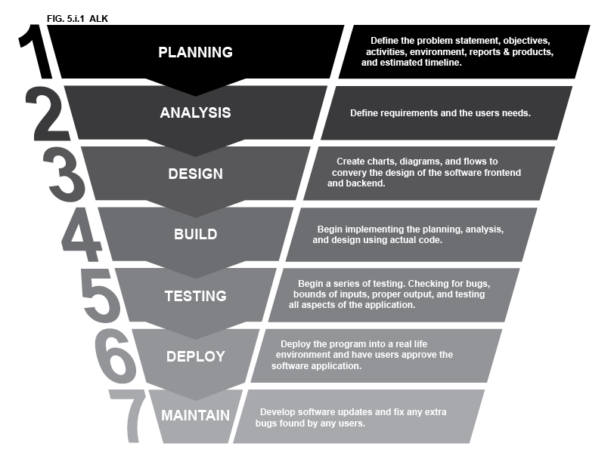
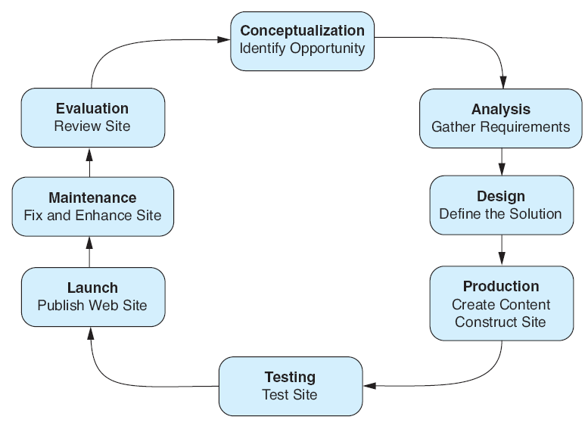
The Web Development Process
Formal project development methodology is used to coordinate and facilitate the planning and communications
Is a guide to successful web project management.
There are a number of system and web site development methodologies => p.472
Often firms will create their own special methodology
Agile Software Development
A suggested Web Development Methodology is shown at the left:

Slide 8


Creative Solving Process in general vs in software development

Slide 9
Web Development: 1. Conceptualization
Determine the intended audience
Determine the goals or mission of the web site
Short-term goals (e.g. publish a home page)
Long-term goals ( e.g. 30 percent of product sales on the website)
Develop measurable objectives such as:
Number of visitors (e.g. each month)
Percent of product sales on the website
Main Job Roles Involved:
Client, Project Manager, Information Architect, Marketing Representative, Senior Web Developer

Slide 10
Web Development: 2. Analysis
Determine the following:
information topics - info organized into categories and hierarchy
functionality requirements (high-level) – e.g. a site will accept credit card order or use ASP.NET or PHP with MySQL in order to look up each price and sale tax etc.
Determine “what” a site will do – not “how” it will do it
environmental requirements (hardware, OS, memory, screen resolution, and bandwidth)
content requirements (e.g. is there a specific look and feel or corporate branding component that must be present on the site?)
who is responsible for the content for the site
If a redesign, compare the old approach with the new approach
Review competitor’s sites
Estimate costs and time involved to create the site (Microsoft Project may be used to estimate cost and plan project schedule)
Cost/benefit analysis – compare cost and benefits

Slide 11
Web Development: 2. Analysis
Main Job Roles Involved:
Client, Project Manager,
Information Architect or other Analyst,
Marketing Representative,
Senior Web Developer,
Depends on the scope of the project
5. Network Administrator,
6. Database Administrator,
7. Content Manager

Slide 12
Web Development: 3. Design
Determine how can be accomplished
Determine the site organization
hierarchical, linear, or random => a flowchart (create a site map)
Determine a page layout design with wireframes and sample page mock-ups (look and feel should be designed)
The site color scheme, size of logo graphics,
button graphics, text should be determined,
sample of layouts for the Home and Content pages
Document each page - p.475 Fig 10.3 =>
Prototype the design
to show to clients - try to use figma.com/education (easy to use) or a draw.io (diagrams.net) or justinmind.com tools as well
Main Job Roles Involved:
Client, Project Manager, Information Architect or other Analyst, Marketing Representative, Senior Web Developer, Graphic Designer, Content Manager
Page Title:
.file Name:
Purpose of Page
Suggested Graphic Elements
Other Special Features
Information Needs
Information Sources
=================== Content Providers
List name, e-mail, and phone number of each content provider
File Format of Content
Date Required: Date Provided:
Content Approval _____________________

Slide 13
Web Development: 4. Production
Choose a web authoring tool (e.g. Dreamweaver)
Determine page templates, task management, Web page check-in and check-out to overlapping page updates – a source control such as GitHub
Organize your site files
Determine naming conventions for Web pages, images and media
Determine standards related to indentation and comments.
Code the content
Develop and individually test components
Unit test: each Web page, images, links, menu, server-side scripting
See my Test Table for each project
Main Job Roles Involved:
Project Manager (may review the component for quality and standards compliance), Senior Web Developer, Web Developer/Web Designer, Graphic Designer, Database Administrator, Content Manager

Slide 14
Web Development: 5. Testing
Test on different web browsers and browser versions
Test with different screen resolutions
Mobile phone resolution - e.g. 320x480; tablet - e.g. 1920x1080, 1920x1200, 1024x768, 1280x800, and 1336x768; desktop 1440x900
Test using different bandwidths: T3 line and slow over a 56K modem
Test from another location
Test using desktop, tablets, mobile devices (smartphones)
Test, Test, Test
Create a test plan (table) - see p.477 or next page
Main Job Roles Involved:
Project Manager, Web Developer, Tester (sometimes web developer, sometimes Quality Assurance person), Client, Content Manager

Slide 15
Web Development: 5. Testing p.477 & Tab 5.1
Web Page Document Test Plan
File Name: |  |  |  |  |  |  |  |  |  |  |  | Date:
Page Title: |  |  |  |  |  |  |  |  |  |  |  | Tester:
Browser Compatibility
 |  |  | 1024x768 | 1280x800 | 800x600 | Other | PC | Mac | Linux | Images Disabled | CSS Disabled | Other | Notes
Internet Explorer (Version #)
Internet Explorer (Version #)
Firefox (Version #)
Safari (Version #)
Opera (Version #)
Chrome (Version #)
JAWS Screen Reader
Mobile (Device Name)
Other
Document Validation |  |  |  |  |  |  |  | Search Engine Optimization
 |  |  | Pass | Fail | Notes |  |  |  |  |  | Notes
HTML Validation |  |  |  |  |  |  |  | Meta tag (description)
CSS Validation |  |  |  |  |  |  |  | Keywords in page title
Check Spelling |  |  |  |  |  |  |  | Keywords in headings
Check for Required Content |  |  |  |  |  |  |  | Keywords in content
Check for Required Graphics |  |  |  |  |  |  |  | Other
Check Alt Attributes |  |  |  |  |  |  |  | Download Time Check
Test Hyperlinks |  |  |  |  |  |  |  |  |  |  | Time | Notes
Accessibility Testing |  |  |  |  |  |  |  | 56.6Kbps
Form Processing |  |  |  |  |  |  |  | 128Kbps
Scripting/Dynamic Effects |  |  |  |  |  |  |  | 512Kbps
Usability Testing |  |  |  |  |  |  |  | T1/DS1 (1.544 Mpbs)
Other |  |  |  |  |  |  |  | Other
Notes

Slide 16
Web Development: 5. Types of Testing
Automated Testing Tools and Validation
Software packages exist that will test a web site in an automated manner
CoScripter is a system for recording, automating, and sharing processes performed in a web browser. Instructions for processes are recorded and stored in easy-to-read text here on the CoScripter web site, so anyone can make use of them.
AI-driven test automation for modern software delivery - https://www.geeksforgeeks.org/websites-apps/top-ai-testing-tools-for-test-automation/
Camtasia (free) is a professional-grade screen recording and video editing software developed
test broken links with Web Developer - add-ons for Firefox
analyze download speed
https://gtmetrix.com/recommendations.html (https://gtmetrix.com/avoid-multiple-page-redirects.html++ => use https://classes.jgspectrum.com/)
https://pagespeed.web.dev/++ -> use https://laverne.edu/
http://www.websiteoptimization.com/services/analyze/ - check with
https://classes.jgspectrum.com/ - use Firefox
Analyze a server response, estimated download speed, syntax and style analysis, spell-check, link verification, images, search engine compatibility, site link popularity
W3C offers (X)HTML and CSS validation applications – google it
Validate your website for Accessibility at http://www.cynthiasays.com/

Slide 17
Web Development: 5. Types of Testing
Web Content Accessibility Guidelines 2.0 (WCAG 2.0)
http://www.w3.org/TR/WCAG20/Overview
http://www.w3.org/WAI/WCAG20/quickref
Based on 4 Principles (the acronym POUR)
Perceivable - Content must be Perceivable i.e. easy to see and hear.
-Any graphic should be available in a text format (description, captions etc)
2. Operable - Interface components in the content must be Operable i.e. content has navigation form and operated with either a mouse or keyboard.
- Avoid flashing , which may cause a seizure.
3. Understandable - Content and controls must be Understandable i.e. easy to read and organized in a consistent manner.
4. Robust. - Content should be Robust enough to work with current and future user agents, including assistive technologies such as screen reader apps.
- Robust content is written to follow W3C recommendation

Slide 18
Web Development: 5. Types of Testing
Accessibility Testing:
Section 508 of the Rehabilitation Act requires electronic and information technology, including Web pages, used by federal agencies to be accessible to people with disabilities / challenges.
checkers are available => p.478
Web accessibility tools: https://wave.webaim.org/ , https://achecker.ca/ .
Usability Testing (use case scenario testing) – is the measure of the quality of user’s experience when interacting with a website
http://usability.gov and
http://www.usability.gov/get-involved/blog/2014/09/building-a-lab-series-determining-goals-and-resources.html
Testing how actual web page visitors use a web site
Use a usability test (synonym: a use case scenario test)
Can be done at almost any stage of development
Early –- use paper and sketches of pages
Design – use prototype
Production & Testing – use actual pages
All can lead to a confirmation that the site is easy to use and well designed.

Slide 19
Web Development: 6. Approval & Launch
User or your client Testing
Client will test site before giving official approval for site launch
Approval & Launch
Obtain sign-off form or email from client
Upload files to web server
Create backup copies of files
MAKE SURE YOU TEST THE WEB SITE AGAIN!

Slide 20

Web Development: 7. Maintenance
Maintenance – the never-ending task…
Enhancements to site
Fixes to site
New areas added to site
A new opportunity or issue is identified and another loop through the development process begins.

Slide 21
Web Development: 8. Evaluation
Re-visit, review the goals, objectives, and mission of the web site (set in the conceptualization phase)
Determine how closely they are being met
Develop a plan to better meet the goals, objectives and mission

Slide 22
Checkpoint 10.1 p.480, 682
Describe the role of the project manager.
create the project plan and schedule
Explain why so many different roles are needed on a large-scale web project.
A complex information system so
1 or 2 people cannot fulfill all different roles and create a quality Web site
List three different techniques used to test a web site. Describe each technique in one or two sentences.
Unit test done by developers
Automated testing by checker programs
Code testing and validation performed by code validation programs
Usability (a use case scenario) testing by watching typical Web visitors

Slide 23
10.3 File Organization: HTML/XHTML <a> tag
The anchor tag
Used to specify a hypertext reference (href) to a web page you want to display.
The text between the <a> and </a> is displayed on the web page
href Attribute
used to indicate the document to link to
Syntax:
<a href=“URL”>text</a>
Absolute link
<a href=“http:// yahoo.com”>Yahoo</a>
indicates the protocol http:// being used
Relative link
<a href=“index.htm”>Home</a>

Slide 24
More on Relative Linking
Absolute URLs include a full path - both
the domain name + the file name
Domain name – the computer's unique name on the Internet or
The root directory on the same Web server
Relative URLs – include only a file name within the current directory.
Refer to files within the current directory (position) on the same Web server
URL refers to the same domain name

Slide 25
Anatomy of a URL
URL - Uniform Resource Locator
URLs are global addresses of documents and other resources on the Web
Parts of URLs
there are three parts:
protocol - the way the page is accessed
host name ( = Web server name + domain name) – the system on which the page is stored e.g. http://classes.jgspectrum.com/
directory & filename - location of the page on the host system
http://www.w3.org/TR/html4/intro/intro.html
protocol
host name
directory and filename

Slide 26
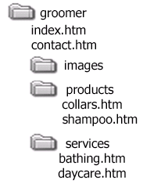

10.3 File Organization More on Relative Linking
Relative pathnames point to files based on their locations relative to the current file (position.)
To specify relative pathnames
link to Web pages within your site
use UNIX-style pathnames regardless of the system
directory names are separated with a forward slash (/)
use two dots (..) to refer to the (parent) directory above the current directory
From the groomer directory:
<a href="contact.htm">Contact</a>
<a href="products/collars.htm">Collars</a>
//now from the collars.htm level
<a href="../index.htm">Home</a>
<a href="../services/bathing.htm">Dog Bathing</a>
<= Relative links from the home
page: index.htm
See HOP 10.1 below

Slide 27
Linking Local Pages Using Relative and Absolute Pathnames
Examples of Relative pathnames:
href=“index.html”
href=“resumes/jaden.html”
href=“jobs/software/javaprogrammer.html”
href=“../news/company.html”
href=“../../products/widget.html”
href=“../../../officers.html”

Slide 28
Linking Local Pages Using Relative and Absolute Pathnames
Absolute pathnames point to files based on their absolute location on the file system (root) or to other websites
begin with a forward slash (/)
Absolute pathnames:
href=“/index.html”
href=“/resumes/jaden.html”
href=“/d/jobs/software/javaprogrammer.html”

Slide 29
Linking Local Pages Using Relative and Absolute Pathnames
Which should you use?
Relative pathnames:
use to link between your documents
can move the site from one server to another and the links will still work -- portable
easier to maintain
Absolute pathnames
easier on complicated sites but they are not portable

Slide 30
Links to Other Documents on the Web
Linking to remote documents
these are documents that are not on the system which you are currently working
use the URL of the remote site
http://the.url.com/of/the/remote/page.html

Slide 31
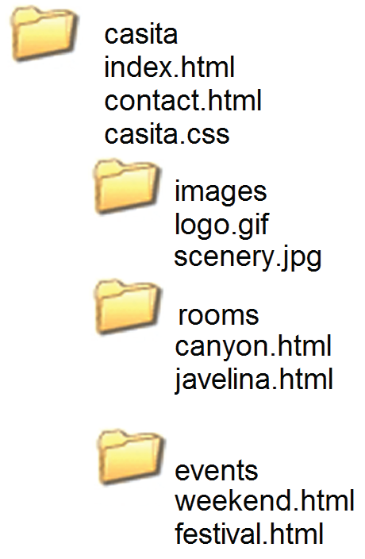

10.3 File Organization More on Relative Linking
Relative links from the Home page: index.html
<a href="contact.html">Contact</a>
<a href="rooms/canyon.html">Canyon</a>
<a href="../index.html">Home</a>
<a href="../events/weekend.html">Weekend</a>
Relative links from the Canyon page: rooms/canyon.html

Slide 32
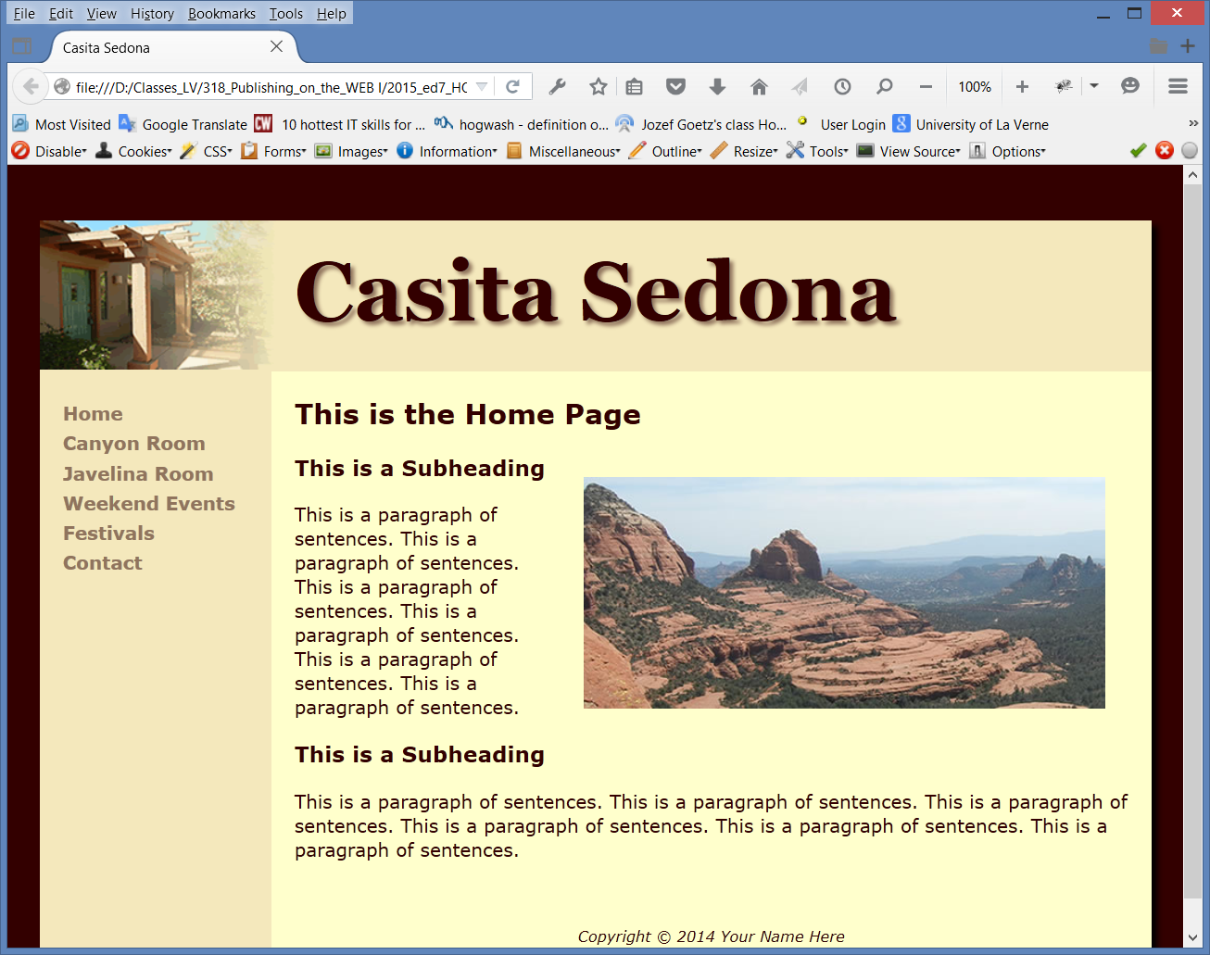
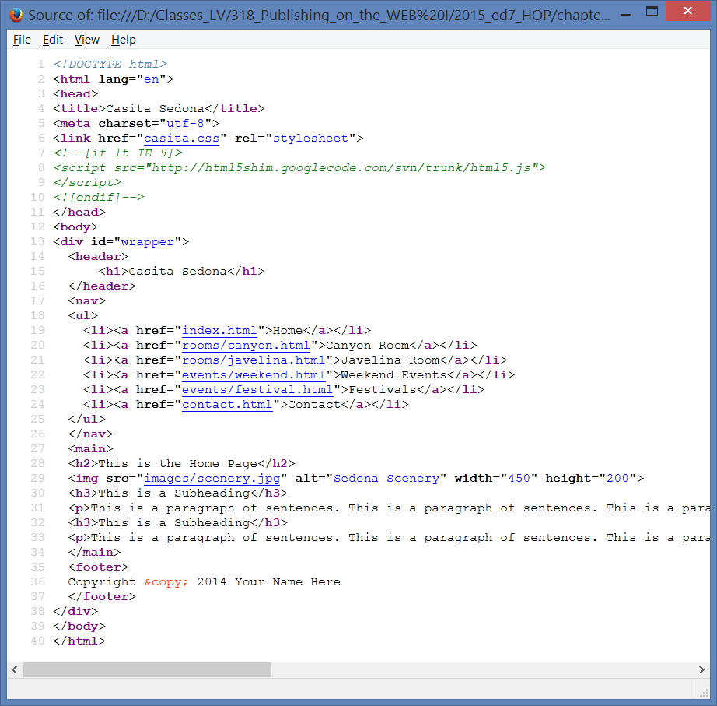
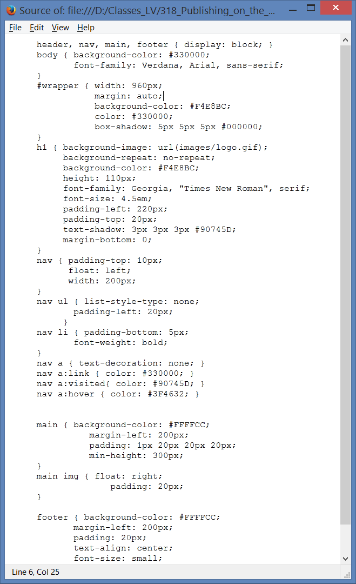
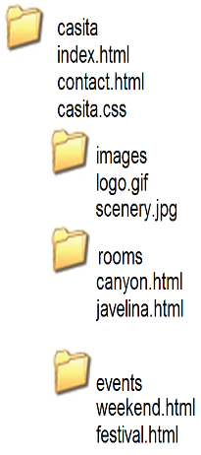






HOP 10.1 – starter Casita/Example

Slide 33
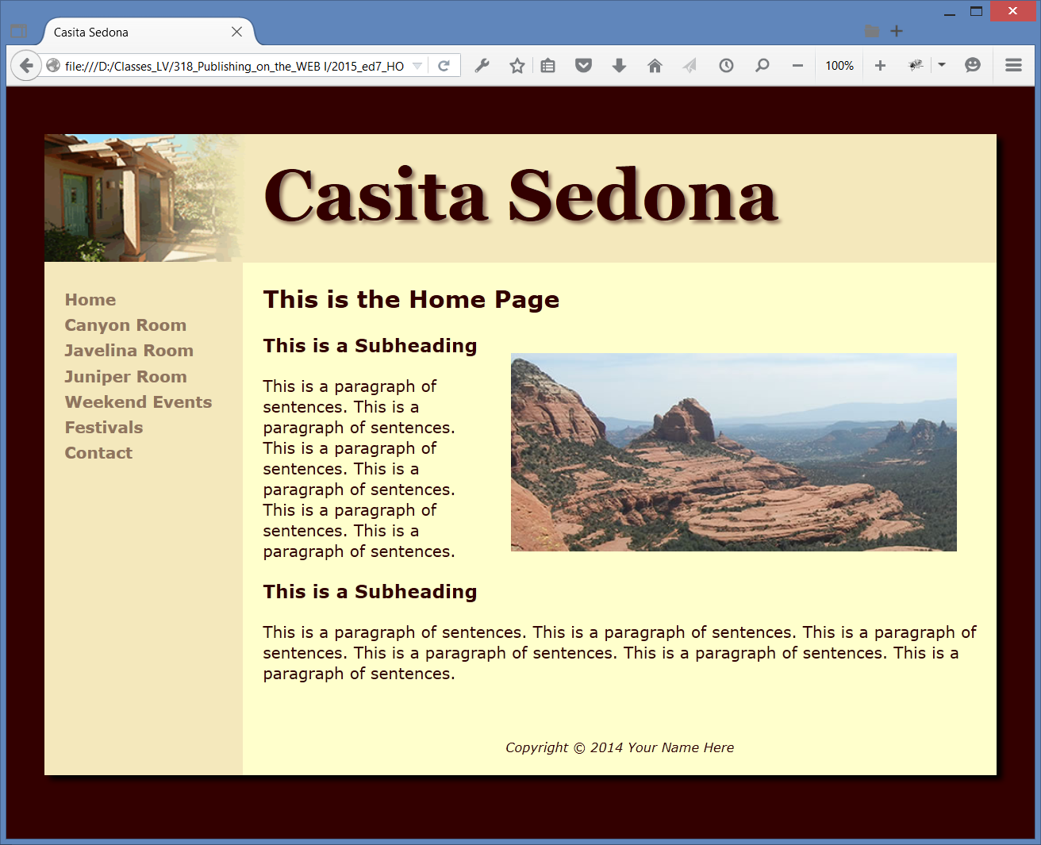
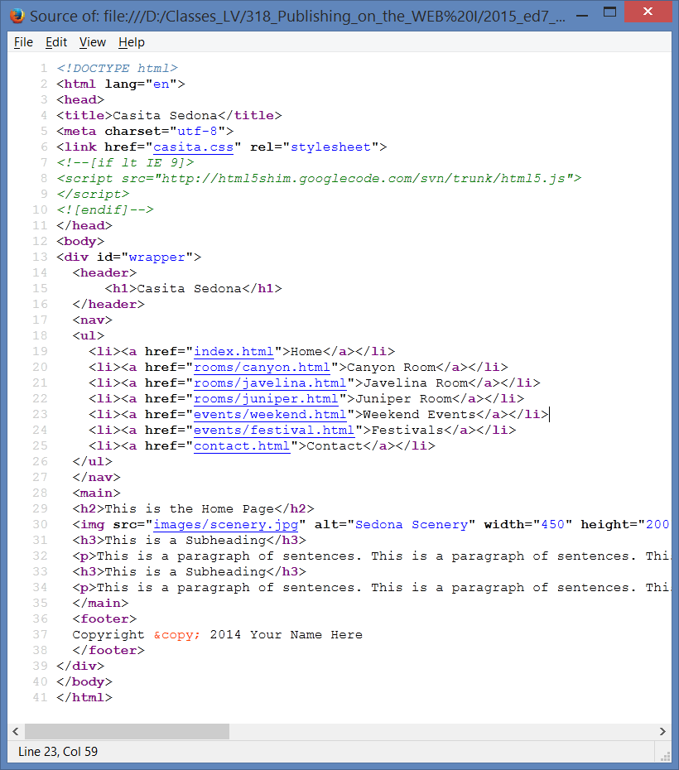
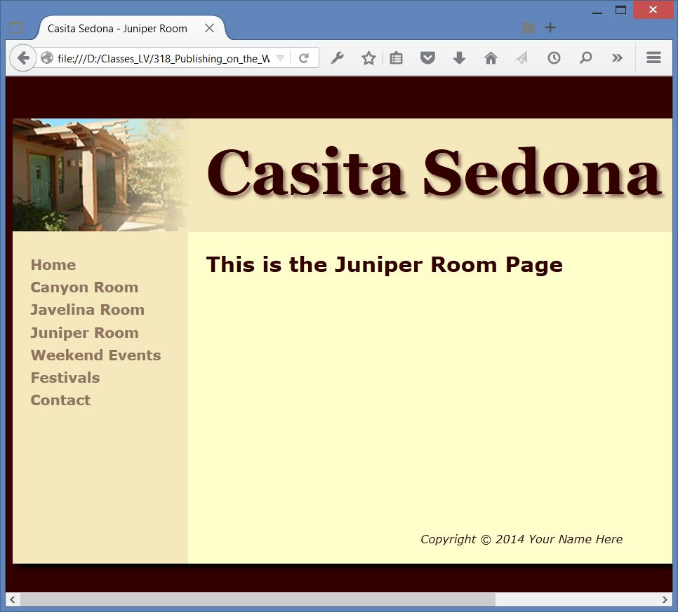
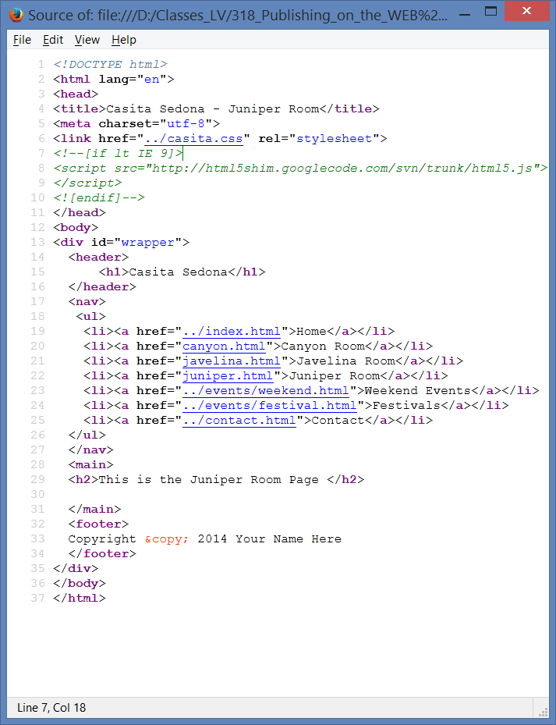









HOP 10.1 - solution

Slide 34
10.4 Domain Name Overview
Choose a domain name that relates to your existing business presence.
Describe your business
Be brief, if possible
Avoid hyphens
TLD (top level domain name)
.com ($35 /year)
consider: .net, .biz, .us, .mobi, .xyz and others
.org for non-profits
Brainstorm potential keywords
Avoid trademarked words or phrases
Know the territory (use Google!)
If the potential name/keywords exists on Google
Verify Availability – select a domain name
www.godaddy.com
www.register.com
www.networksolutions.com
Private registration – additional fee but personal information is kept private and out of the WHOIS database

Slide 35
10.5 Web Hosting
Some organizations administer a Web server in house and host their own website.
Important decision is to choose Web host provider
Many companies use a web host provider.
A good web hosting service will provide a robust, reliable home for your website.
A poor web hosting service will be the source of problems and complaints
Determine responsiveness by calling and e-mail a Web host provider
Do not choose free web hosting for a commercial website.

Slide 36
Types of Web Hosting
Hosting Needs: Small to Medium Web Site”
1. Virtual Hosting
You have the authority to update files, while the web hosting provider maintains the web server computer and Internet connectivity.
The web host provider's server is divided into a number of virtual domains, and multiple web sites are set up on the same computer.
Consider:
Future growth, your processing needs and scalability of web host
CGI or database support, e-commerce packages you need
Operating System - Linux/Unix an Apache Web server is quite common and very efficient,
Linux is a case sensitive but not Windows SO, so <a href=“MyPage.html”> My Page</a>)
will give an error 404 a file is named mypage.html – use always lowercases
Types of server-side processing supported (php, asp.net etc.)
Bandwidth (the range of frequencies within a given band) of Internet connection
Both local and national web host providers
Guaranteed uptime – service level agreement
Technical support

Slide 37
Types of Web Hosting
2. Dedicated Web Server
The exclusive use of a rented computer and connection to the Internet that is housed in the Web hosting company's premises.
Usually needed for tens of millions of hits per day.
The server
can usually be configured and operated remotely from the client company
or
you can pay the web host provider to administer it for you.

Slide 38
Types of Web Hosting
3. Co-Located Web Server
A computer that your organization has purchased and configured and
Your organization effectively rents space at the web host provider's location.
Your server is kept and connected to the Internet at their location.
Your organization administers this computer.

Slide 39
Types of Web Hosting
Hosting Needs: Large to Enterprise Web Site
You don’t share the processor or hard drive with other organization
Dedicated Web Server
Co-located Web Server
Consider:
24-hour staffing
Large national web host providers
Guaranteed uptime – service level agreement
Bandwidth of Internet connection – dedicated access via T1 or T3 (OC-1 or higher)
Hardware and media redundancy - cluster Web servers, support e-commerce packages
Don’t share the processor or hard disk with others
Network utilization statistics
Log access
Streaming media delivery
Enhanced security
Technical Support 24/7

Slide 40
10.6 Choosing a Virtual Host
See the Web Host Checklist (Table 10.1 p.486)
Operating System
Web Server Software
Bandwidth – low traffic 100-500MB/month, medium 20GB/month
Technical Support – 24/7
by e-mail, chat, forum, phone
Service Agreement
Uptime, automatic monitoring
Disk Space – offer 100MB+
E-mail – many, to handle separately customer service and technical
Uploading Files – ftp access
Canned Scripts – pre-written script
Scripting Support – ASP.NET. PHP
Database Support – MySQL, MS Access, MS SQL server
E-Commerce Packages – shopping card package
Scalability for bandwidth, disk space
Backups – daily, periodically
Site Statistics – statistics about what pages were visited, how visitors found them, row log, log reports
Domain Name – with your host or better have your own domain
Price – usually is the last one – “you get what you pay for”

Slide 41
Checkpoint 10.2 p.683
Describe the type of web host that would meet the needs of a small company for their initial web presence.
A virtual Web host
Describe the difference between a dedicated web server and a co-located web server.
Explain why price is not the most important consideration when choosing a web host.

Slide 42
Summary
This chapter introduced you to the system development life cycle and its application to web development projects.
The job roles related to web site development and issues related to web hosting were also discussed.
Hands-On-Exercises p.490 task 2

