Slide 1
Introduction
HOP 11.1
Configure Audio with a hyperlink to an MP3
HOP 11.2
Audio Podcast
HOP 11.3
HTML5 Video Elements
HOP 11.4
Interactivity - submenu
HOP 11.5
CSS3 Transform Property
HOP 11.6
CSS Transition Property
HOP 11.7
Interactive Image Gallery
HOP 11.8
CSS Animations
HOP 11.9
HTML5 Details and Summary Elements

Slide 2
Chapter 11
Web Multimedia &
Interactivity
Credits: © 2011-24 Pearson Education
Copyright (c) 2006 Prentice-Hall. All rights reserved.

Slide 3

Learning Outcomes
In this chapter, you will learn about:
Helper Applications and Plug-ins
Audio file types and how to obtain them
Adding sound to a web page
Video file types and how to obtain them
Adding video to a web page
Configure audio and video on a web page with HTML5 elements
The features and common uses of JavaScript, Java Applets, Adobe Flash, Ajax, and JQuery
Adding a Java Applet to a web page
Configure a Flash Animation to a web page
Create an interactive image gallery with CSS
Configure a widget with the HTML5 details and summary elements
Configure the CSS3 transform and transition properties
Describe the purpose of geolocation, web storage, offline web applications, and canvas HTML5 APIs.
Describe the purpose of the HTML5 canvas element.

Slide 4
11.1 Helper Applications & Plug-ins, Containers, and Codec
Browsers can display web pages and GIF, JPG, and PNG images.
When the media is not one of these types, the browsers searches for a plug-in or helper application.
Helper Application
A program that can be designated to handle a particular file type (such as .wav or .mpg)
to allow the user to view or otherwise utilize the special file.
The helper application runs in a separate window from the browser.
Plug-In (e.g. flash player, adobe reader, web developer)
A newer and more common method
Plug-ins run right in the browser window so that media objects can be integrated directly into the web page.
Issues:
Some visitors will not have the plug-ins or file types associated with correct plug-ins then the web browser offers the visitors the option of saving the file to their computer.

Slide 5
Commonly Used Plug-ins
Real Player
Windows Media Player
Apple Quicktime
Adobe Reader
Adobe Macromedia
Adobe Flash Player
Adobe Shockwave

Slide 6
Containers & Codecs
Plug-ins and helper apps have been used for on the Web for years.
Now new H T M L5 audio & video tags
Native to the browser
Require container and codec
1. Container
Designated by the file extension – contains the media and metadata
2. Codec
The algorithm used to compress the media
Issue: Browsers do not all support the same codecs

Slide 7
A. Common Audio File Types p.494
Extension Container with description
1. .wav Wave File (by Microsoft)
2. .aiff Audio Interchange File Format (by Mac)
3 .mid Musical Instrument Digital Interface (MIDI)
to recreate a musical sound
small file size
limited # of types of sounds that can be reproduced
4. .au Sun UNIX sound file
old one – 8-bit samples
5 .mp3 MPEG-1 Audio Layer-3
advanced compression – 1/12 the size of the original
podcasts typically use the MP3 audio file format
6 .ogg Ogg-Vorbis
new audio compression that is comparable to mp3
open source , not patented and free to use
7. .mp4 .m4a MPEG-4 Audio
format is supported by Quicktime, iTunes, and iPods

Slide 8
Obtaining Audio Files
Audio files can be obtained from various sources:
1. Record your own sounds or music
A sound recorded at 8 bit resolution will have a smaller file size than a sound recorded using 16 bit resolution (music CD quality)
2. Download sounds or music from a free site: e.g. Microsoft’s Clip
Art or www.flashkit.com
3. Record music in any audio format from a CD/DVD
A commercial CD/DVD can only be copied for personal use and not for publishing to the Web.
Contact the owner of the copyright to request permission to use the music.
4. Purchase a CD/DVD of sounds or music.
5. There are some ethical issues related to using sounds and music created by others.
Be certain to only publish sounds or music that you have either created yourself or have obtained the rights (sometimes called a license) to publish.

Slide 9
Using Sound on a Web Page
Methods:
1. Link to the sound
<a href="ringing.wav" title=”Hear a telephone ring.”>telephone ringing</a>
When you click on the link, the plug-in for .wav files that is installed on the computer will display embedded in a new browser window or tab.
2. Embed the sound
You can e[i]mbed the sound in a page and optionally display a control panel for the sound
The <embed> tag
Not part of the W3C standard for HTML 4 but it is for HTML 5; commonly used
3. The <object> tag
is W3C standard but not well supported by browsers
4. The <audio> tag for HTML 5 (now native to the browser) - see later slides

Slide 10

Hands-On Practice
HOP 11.1
Follow the directions in your book for the HOP.
START-UP File | podcast.mp3 podcast.txt chapter2/template.html
SAVE SOLUTION AS | podcast2.html

Slide 11
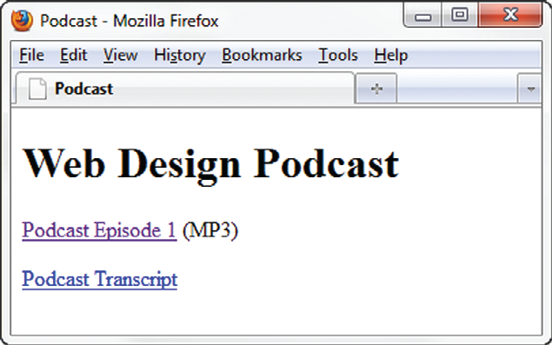
1. Configure Audio – HOP 11.1
Most basic method to provide audio or video files:
Hyperlink
<div><a href="podcast.mp3" title="Web Design Podcast &amp; Episode 1">Podcast Episode 1</a> (MP3)</div>
<div> <a href="podcast.txt">Podcast Transcript</a> </div>
HOP 11.1
<= Podcasting - study p.496
When you click the MP3 hyperlink, an audio player (whichever player or plug-in is configured for the browser) will launch to play the file.
<= podcast.html is received from copying from the starter folder podcast.mp3 and podcast.txt

Slide 12
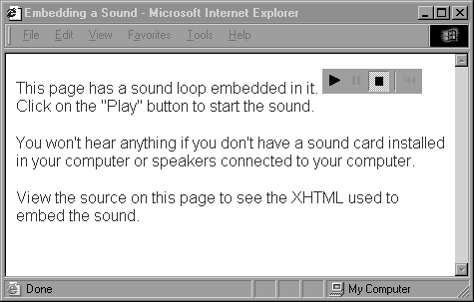
2. Self-contained <embed> tag
<embed src="catch.wav" autostart="false" controls="smallconsole" height="25" width="100" />
The embed tag
A stand alone tag
Attributes:
src (specific)
controls (specific)
align (specific)
width
height
autostart
loop
hidden
specific – it means not in object attributes – see next slides
The <embed> tag
Not part of the W3C standard for HTML 4 but it is for HTML 5; commonly used
audio1.htm

Slide 13
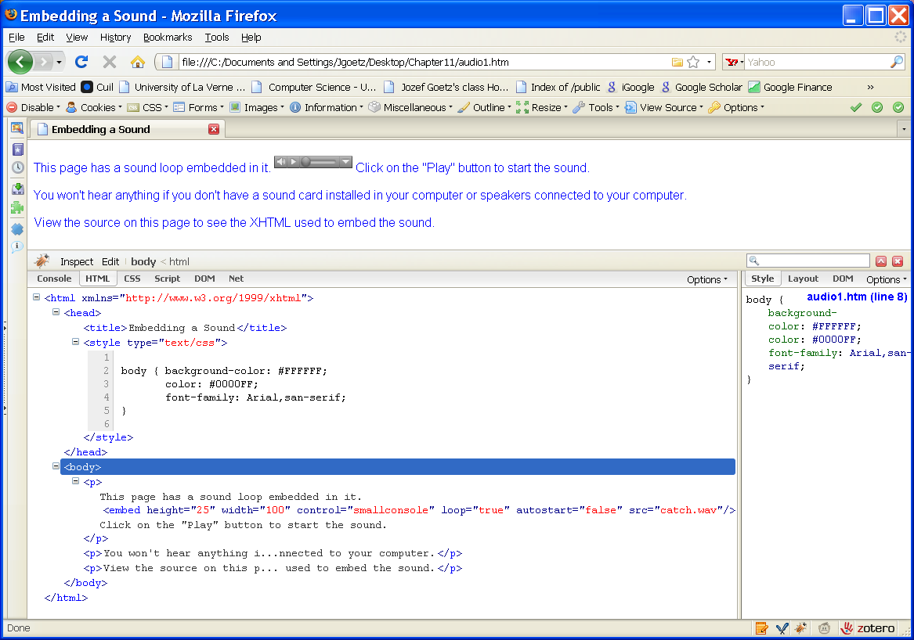
<embed> tag
audio1.htm
audio1.htm

Slide 14
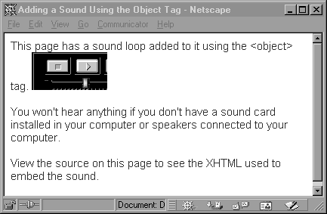
3. XHTML, HTML5 <object> tag
3. Use <object> to place Java applets, sound and other media on a Web:
<object data="catch.wav " autostart="false" height="50" width="100" type="audio/wav" >
<param name=“src” value=“catch.wav” /></object>
Depending on the media type and plug-in or player to be used, additional configuration values, called parameters <param /> , to pass values to an object or Java applet
The object tag
A container tag
Attributes:
data (specific)
type (specific)
width
height
autostart
loop
hidden
specific – it means not in embed attributes
The <object> tag
W3C standard but not well supported by browsers
audio2.htm

Slide 15
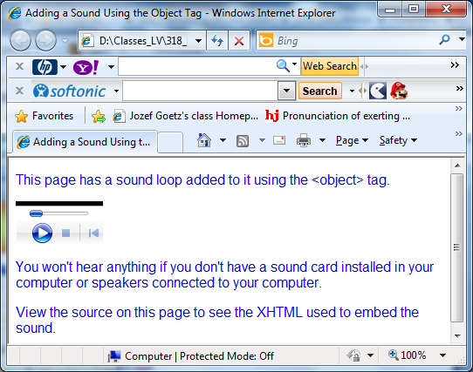
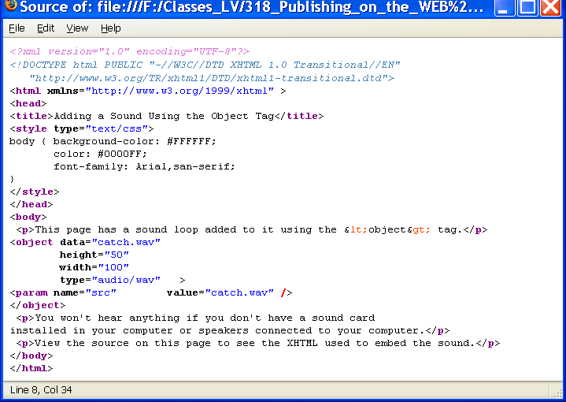
<object> tag
audio2.htm - use IE

Slide 16
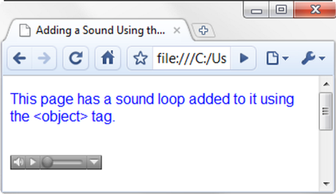
Using <object> & <param /> tags to embed audio
<object data="soundloop.mp3" height="50" width="100" type="audio/mpeg" title="Music Sound Loop">
<param name="src" value="soundloop.mp3" />
<param name="controller" value="true" />
<param name="autoplay" value="false" />
</object>
musicbase.html

Slide 17
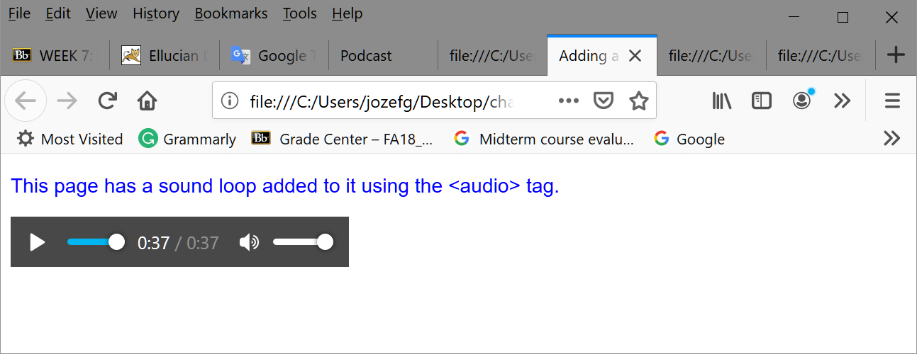
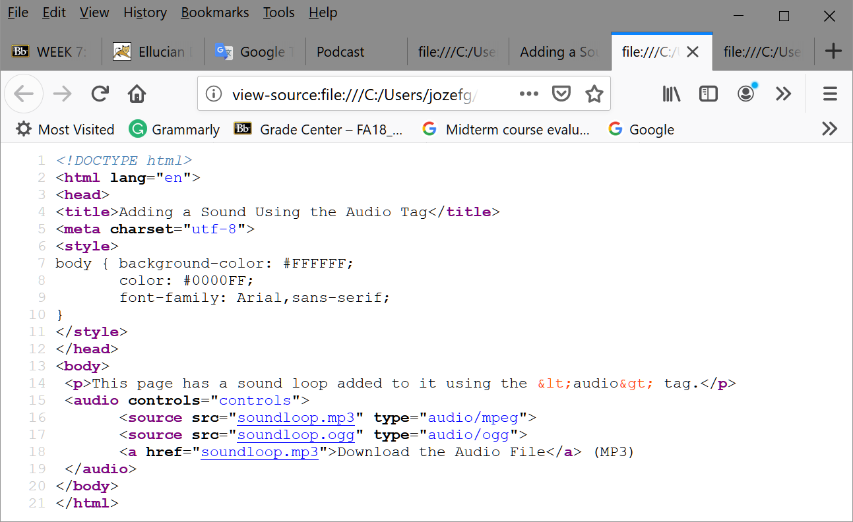
4. HTML 5 using <audio>
audio.html
<!– if not supported by HTML 5 →

Slide 18
Hands-On Practice
HOP 11.2
Follow the directions in your book for the HOP.
START-UP File | podcast.mp3, podcast.ogg, podcast.html
SAVE SOLUTION AS | index.html

Slide 19
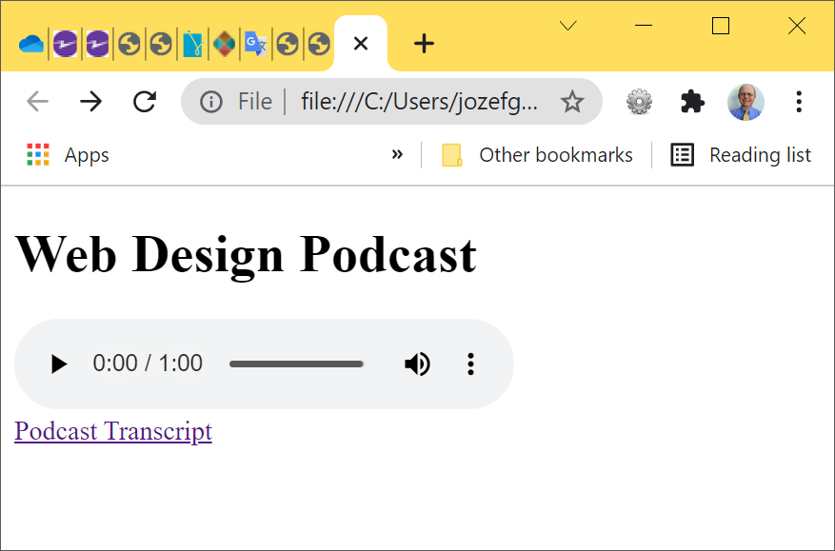
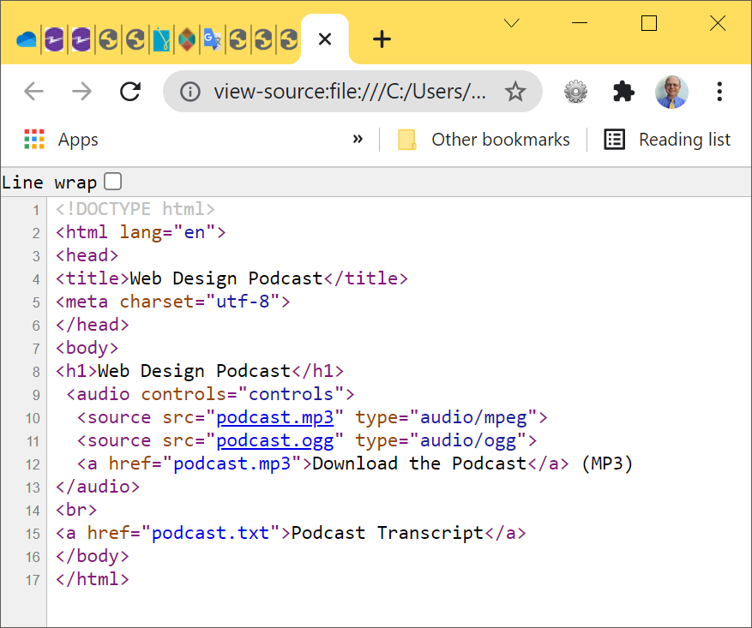
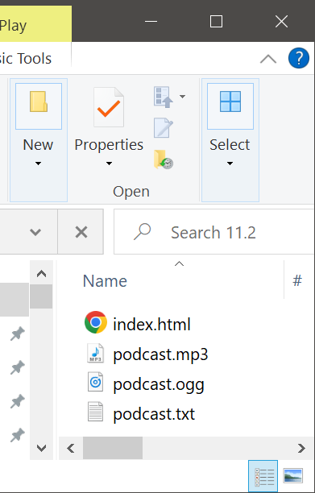
HOP 11.2

Slide 20
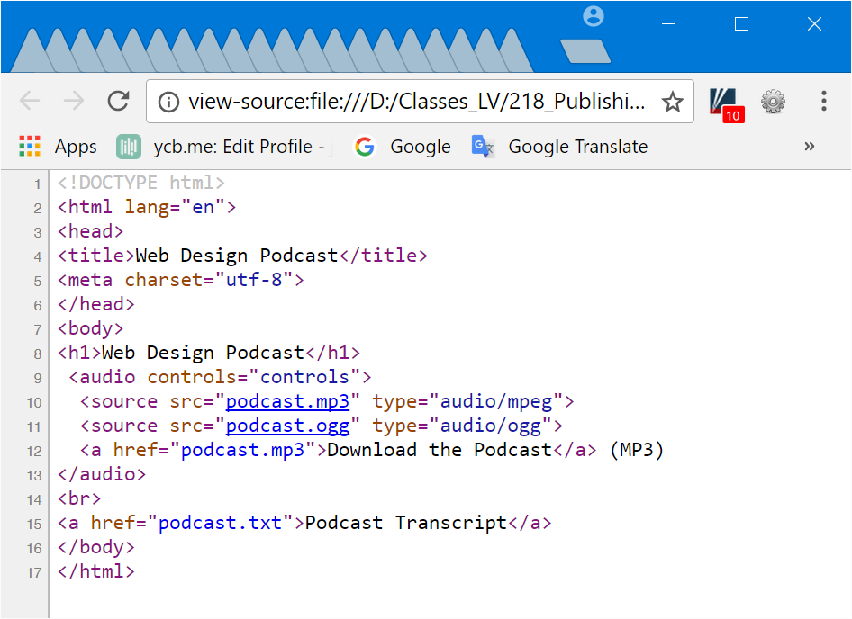
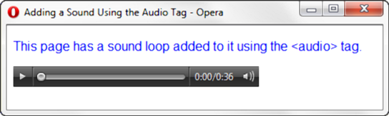
HTML5 Audio Elements HOP 11.2
The audio tag – see the audio section, tab 11.3 p.497
Optional attributes:
src
type
autoplay
controls
loop
preload
title
podcast5.html
Supply multiple versions of the audio b/c the browser support of
different codecs (the algorithms used to compress the media) – e.g. mp3 uses MP3 codec
<audio controls="controls">
<source src=“podcast.mp3" type="audio/mpeg">
<source src="podcast.ogg" type="audio/ogg">
<a href="podcast.mp">Download the Audio File</a> (MP3)
</audio>
<!– if not supported by HTML 5 →

Slide 21
Obtaining Video Files
Video files can be obtained from various sources:
1. Record your own
Digital Camcorder
Webcam
Copy video tapes using a video capture card
2. Edit using Microsoft Movie Maker, Apple Quicktime,
etc.
3. Download from a site for a fee
4. Purchase a DVD of stock videos
5. Here are some ethical issues related to using videos created by others.
Be certain to only publish videos that you have either created yourself or have obtained the rights (sometimes called a license) to publish.

Slide 22
Obtaining Video Files
Video files can be obtained from various sources:
1. Record your own
Digital Camcorder
Webcam
Copy video tapes using a video capture card
2. Edit using Microsoft Movie Maker, Apple Quicktime,
etc.
3. Download from a site for a fee
4. Purchase a DVD of stock videos
5. Here are some ethical issues related to using videos created by others.
Be certain to only publish videos that you have either created yourself or have obtained the rights (sometimes called a license) to publish.

Slide 23
Video File Types
1. .mov Quicktime –
format widely used on the Macintosh and Windows platforms
A file begins to play before the entire file is downloaded, giving the effect of streaming video
others format files must be downloaded first
2. .avi Microsoft Audio Video Interleaved
The original standard for PCs
3. .wmv Windows Media File
The Windows Media Player supports this file format
4. .mpg MPEG (Motion Picture Experts Group)
used on the Macintosh and Windows platforms
5. .flv Flash Video File commonly used in YouTube
6. .m4v and .mp4 (MPEG-4) – format supported by Quicktime, iTunes and iPods
7. .3gp (3GPP Multimedia File) – based on MPEG-4, it is a standard for delivery of multimedia over 3rd generation, high-speed wireless networks

Slide 24
Video File Types
8. .ogv or .ogg -Ogg Theora - open-source video file format,
that uses the Theora codec
9. .webm - open media format sponsored by Google;
uses the VP8 video codec (open video format, free)
and Vorbis audio codec

Slide 25
Using Video on a Web Page
Link to the video
<a href="sparky.mpg" title=”Video of dog barking”>Sparky! (Caution: long video download)</a>
Compare link to the sound
<a href="ringing.wav" title=”Hear a telephone ring.”>telephone ringing</a>

Slide 26
Using Video on a Web Page
1. Link to the video
<a href="sparky.mpg" title=”Video of dog barking”>Sparky! (Caution: long video download – 1.8 MB)</a>
A good practice to include the file type and file size
2. Embed the video
You can embed the video in a page and optionally display a control panel for the sound
The <embed> tag
Not part of the W3C standard for HTML 4 but it is for HTML 5; commonly used
3. The <object> tag
W3C standard but not well supported by browsers
4. The <video> tag for HTML 5 (now native to the browser) - see later slides
The <embed> tag will not pass W3C validation

Slide 27
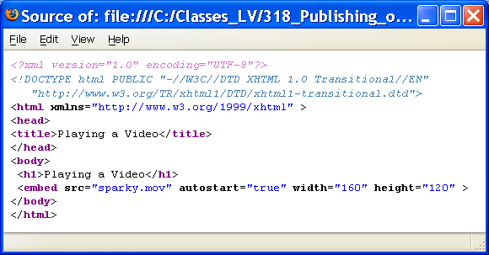
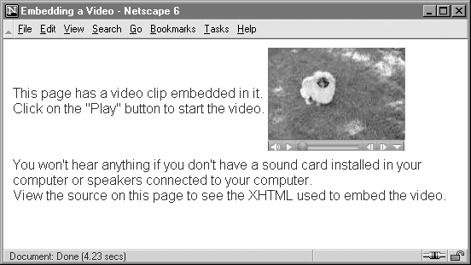
2. <embed> tag
<embed src="sparky.mpg" autostart="false" width="160" height="120" />
The embed tag – ed4
A stand alone tag
Attributes:
src -specific
controls -specific
align -specific
width
height
autostart
loop
hidden
specific – it means not in the object tag attributes

Slide 28
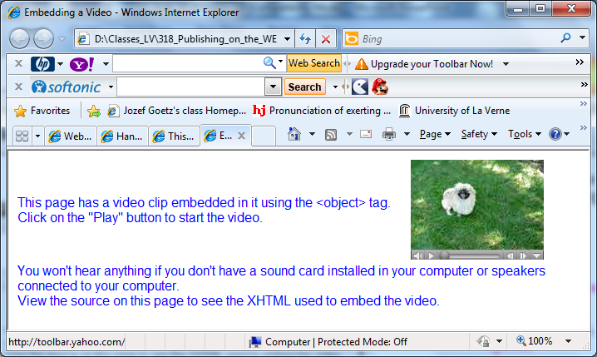
3. XHTML, HTML <object> tag
<object data="sparky.mpg" type="video/mpeg" autostart="false" width="160" height="120" >A video displaying a cute Pekingese dog barking.</object>
The object tag
A container tag
Attributes:
data -file to be played, - specific
type -specific
codebase - location of Quick
classid - player software: ActiveX must be installed - specific
Time player if the user’s computer doesn’t have it, -specific
width
height
autostart
loop
hidden
-specific – it means not in the embed tag attributes

Slide 29
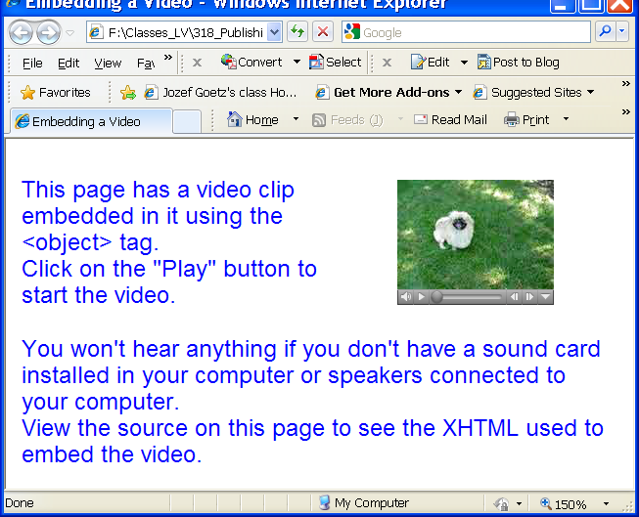
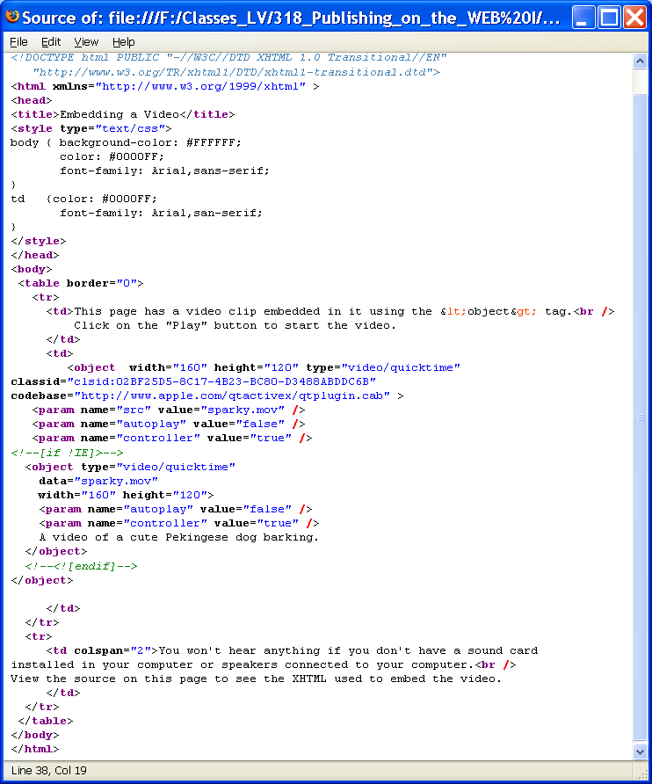
<object> tags
The <object> tag will pass W3C XHTML 1.0 validation
codebase specifies the current plug-in if the user’s computer doesn’t have it
parm uses for the additional configuration values

Slide 30
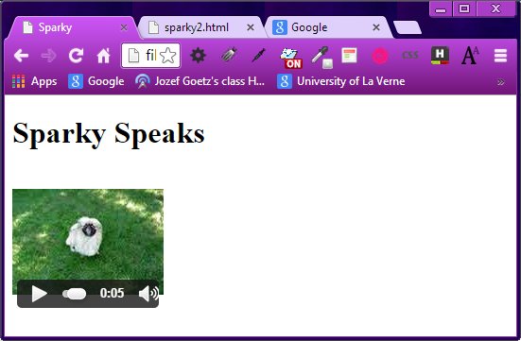
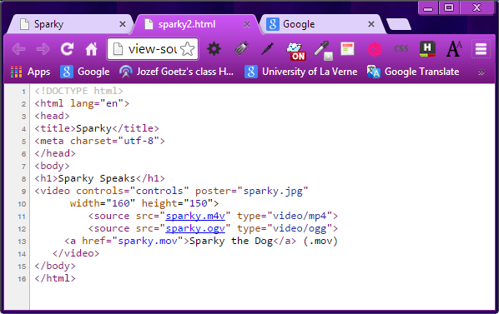
4. HTML 5 Video SOLUTION FOR Sparky
<!– if not supported by HTML 5 →
Go to sparky2.html

Slide 31
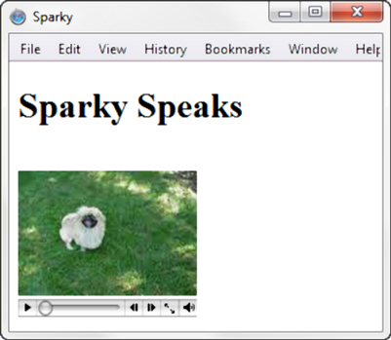
HTML5 Audio & Video Elements
The video tag – see the audio section, tab 11.4 p.499
Optional attributes:
src
type
autoplay
controls
height
width
loop
poster (an image to display if the browser cannot play)
preload
title
sparky2.html
Configure a source element for each version of the video file
<video controls="controls" poster="sparky.jpg"
width="160" height="150">
<source src="sparky.m4v" type="video/mp4">
<source src="sparky.ogv" type="video/ogg">
<a href="sparky.mov">Sparky the Dog</a> (.mov)
</video>
<!– if not supported by HTML 5 →

Slide 32
Hands-On Practice
HOP 11.3
Follow the directions in your book for the HOP.
START-UP File | lighthouse.m4v, lighthouse.ogv, lighthouse.move lighthouse.jpg chapter2/template.html
SAVE SOLUTION AS | index.html

Slide 33
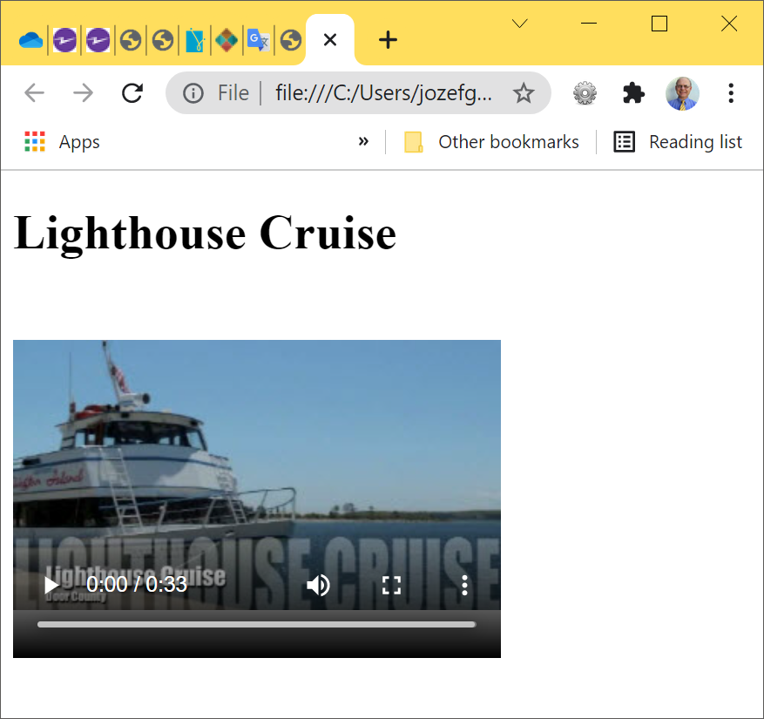
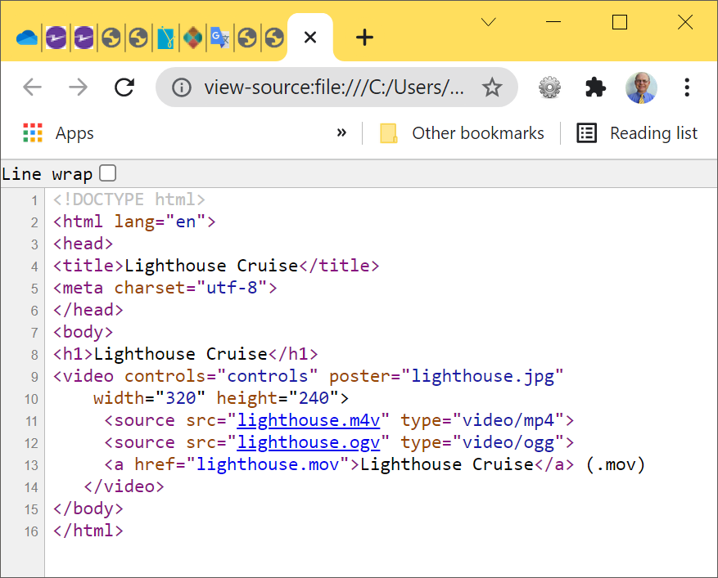
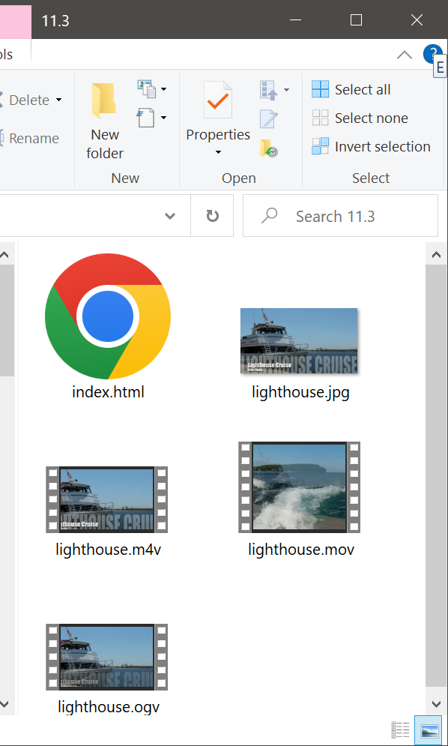
HOP 11.3

Slide 34
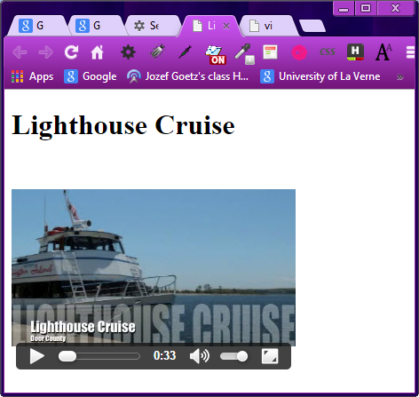
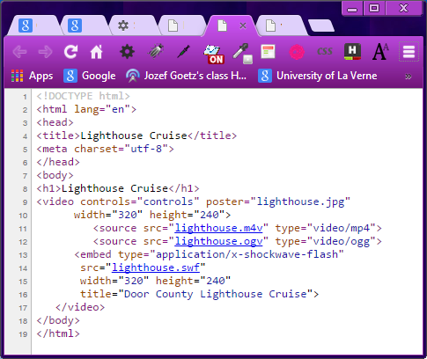
HOP 11.3
<!– if not supported by HTML 5 →
video.html
Fallback (an alternate plan)

Slide 35
Accessibility
Provide alt(ernate) content
Text Transcript (for audio)
Captions (for video)
Printable PDF format
<object data="sparky.mpg" type="video/mpeg" autostart="false" width="160" height="120" >A video displaying a cute Pekingese dog barking.</object>
<a href="sparky.mpg" title=”Video of dog barking”>Sparky! (Caution: long video download – 1.8 MB)</a>

Slide 36
What is Adobe Flash?
Flash is a popular multimedia application developed by Adobe/Macromedia.
It is often used to create animation and multimedia effects on web pages
can use audio and video files.
Flash effects are saved in “.swf” (ShockWave Flash) files
.swf files play as they download and give the perception of speedy display of complex graphic animations.
Flash requires a free browser plug-in, which is available for download from Adobe

Slide 37
. How to create Adobe Flash?
“.swf” files can be created in a number of applications including
1. Adobe Macromedia Flash,
2. Adobe Macromedia Fireworks,
3. Adobe Macromedia Dreamweaver,
4. Swish
1 – 3 available in our labs
Read tutorials and lessons available on Adobe web sites

Slide 38
. Common Uses of Adobe Flash
Navigation
Splash Screen – displays an introductory (splash) screen while the program loads
Entire Web Site
including navigation, content, and forms
http://www.nsf.gov/ or
http://www.nps.gov/ - slide show

Slide 39
. Adobe / Macromedia Flash
The Flash Player is installed on most browsers but will drop support after 2020.
Current Flash technology may discourage usability for 3 reasons:
1. The code supplied by Adobe usually doesn’t pass W3C validation
Some vendors are intended to hide the Flash media code from the W3C validator.
2. It breaks with the Web’s fundamental
interaction style
3. It consumes resources that would be better
spent enhancing a site’s core value

Slide 40

Flash General Syntax: <object> & <param /> tags
If object tags are not supported the embed tag can be applied
<object … object attributes go here….>
<param name="movie" …value attribute goes here… >
<param name="quality" …value attribute goes here… >
<param name="bgcolor" …value attribute goes here… >
<embed … object attributes go here…. >
<noembed> … a brief description of the Flash media can go here along with a link to alternate text content if appropriate… to improve accessibility e.g. screen readers </noembed>
</object>
Both the <object> tag and the <embed> tag are used to place Flash media on a page.
Use the <noembed> tag to contain a text description of the Flash media in order to provide for accessibility.

Slide 41
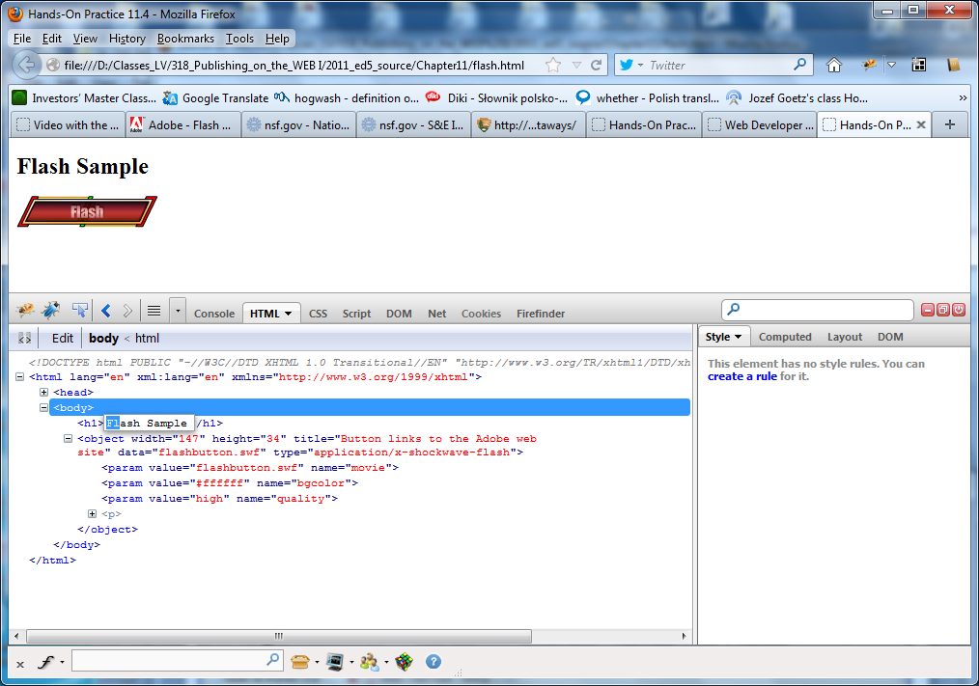
. Flash sample
flash.html

Slide 42
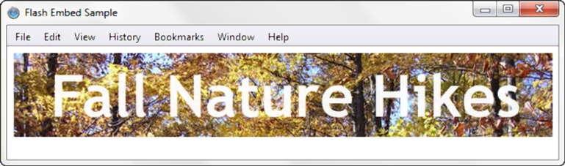
. HTML5 Embed Element
Now the <embed> tag
official element of the W3C standard for HTML5
flashembed.html
The embed element can be use to display a Flash .swf file:
<embed type="application/x-shockwave-flash" src="fall5.swf"
width="640"
height="100"
quality="high”
title="Fall Nature Hikes">
The embed tag – see the audio section
Attributes:
src
height
width
type
Optional attributes:
bgcolor
quality
title
wmode (to configure transparent bgground)

Slide 43
11.4 Multimedia Files & Copyright Law p.502
It is very easy to copy and download an image, audio, or video file from a web site.
It may be very tempting to reuse a file in one of your own projects, but that may not be ethical or lawful.
Only publish web pages, images, and other media that you have personally created or have obtained the rights or license to use.
If another individual has created an image, sound, video, or document that you believe would be useful on your own web site, ask permission to use the material instead of simply “grabbing” it.

Slide 44
11.4 Multimedia Files & Copyright Law p.502
All work (web pages, images, sounds, videos, etc.) is copyrighted – even if there is no copyright symbol and date on the material.
Be aware that there are times when students and educators can use portions of other’s work and not be in violation of copyright law – this is called “fair use”.
"Fair use" is use of a copyrighted work for purposes such as
criticism,
reporting,
teaching,
scholarship, or
research.

Slide 45
11.4 Multimedia Files & Copyright Law p.502
Criteria used to determine “fair use”:
1. The use must be educational and not
commercial
2. The nature of the work
The amount copied must be as small of a portion of the work as possible.
3. The copy does not impede (obstruct)
the marketability of the original work.

Slide 46
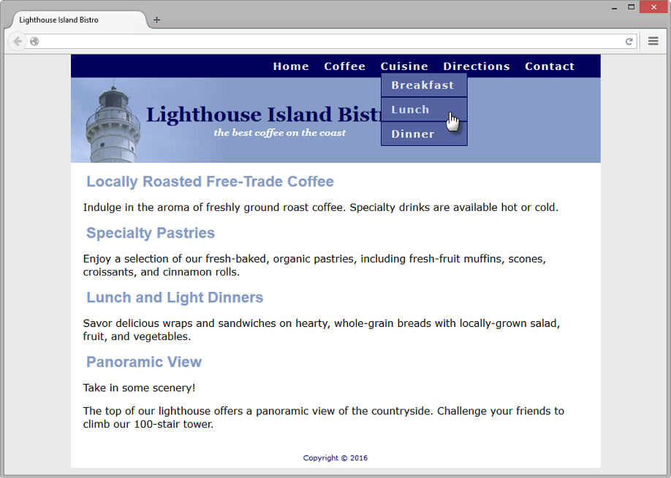
11.5 CSS3 and Interactivity CSS Drop Down Menu HOP 11.4
Configure an interactive navigation menu with CSS and HTML
Configure nav container with position relative
Code submenu (drop down menu) ul element with the parent li element
Configure submenu ul element to initially not displayed
Configure submenu ul element with absolute positioning

Slide 47
Hands-On Practice
HOP 11.4
Follow the directions in your book for the HOP.
START-UP File | chapter11/bistro folder
SAVE SOLUTION AS | mybistro folder

Slide 48
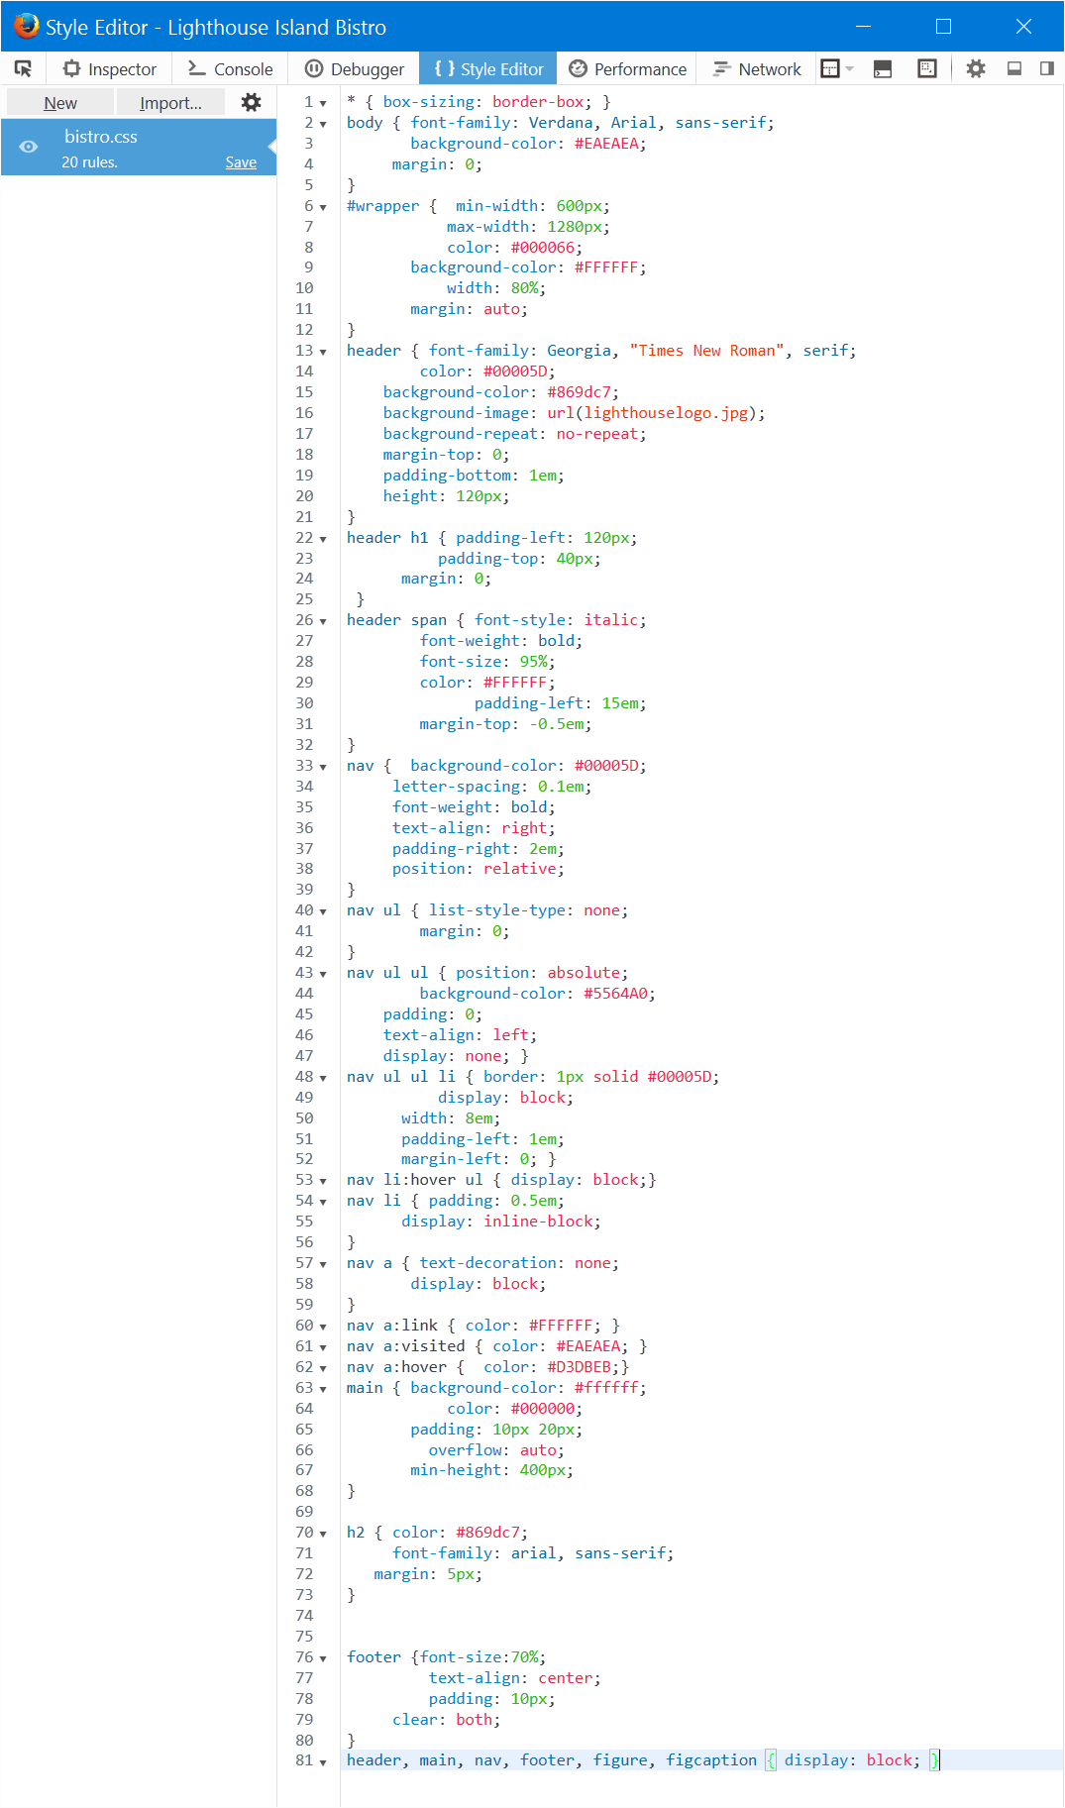
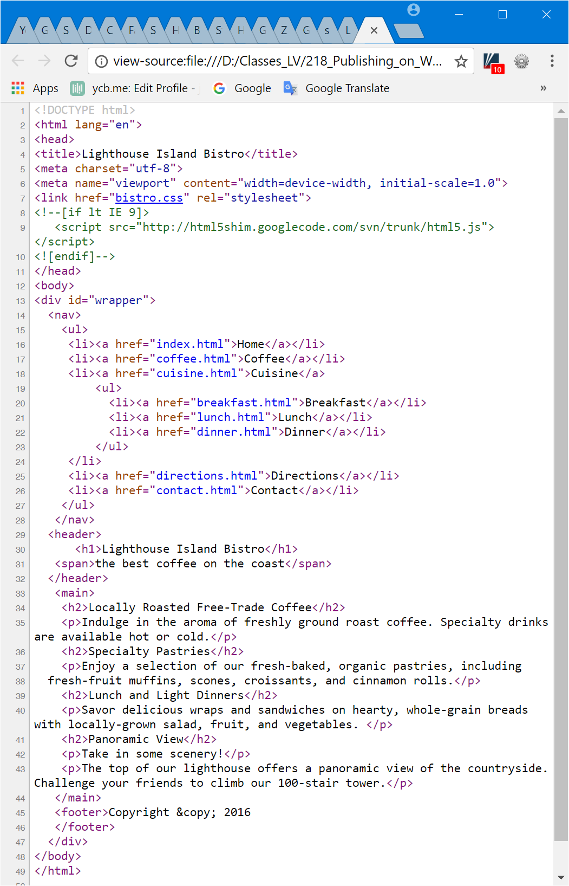
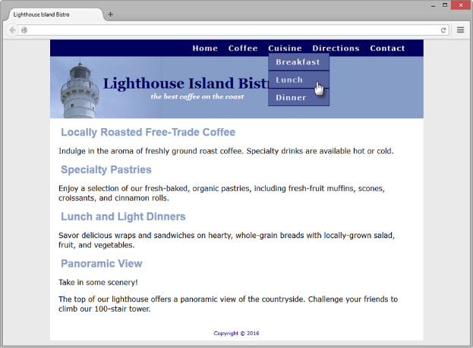
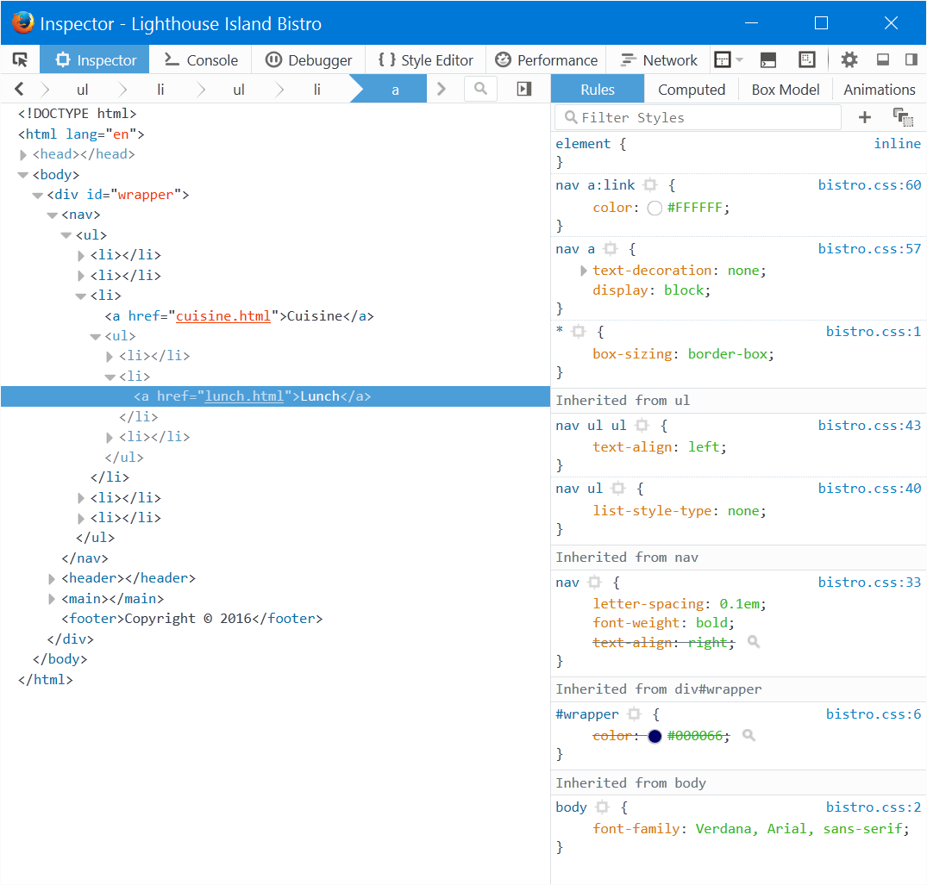
HOP 11.4
1. Configure nav container with position relative
2. Code submenu (drop down menu) ul element with the parent li element
3. Configure submenu ul element to initially not displayed
4. Configure submenu ul element with absolute positioning

Slide 49
Hands-On Practice
HOP 11.5
Follow the directions in your book for the HOP.
START-UP File | lighthouse.jpg light.gif
SAVE SOLUTION AS | index.html

Slide 50
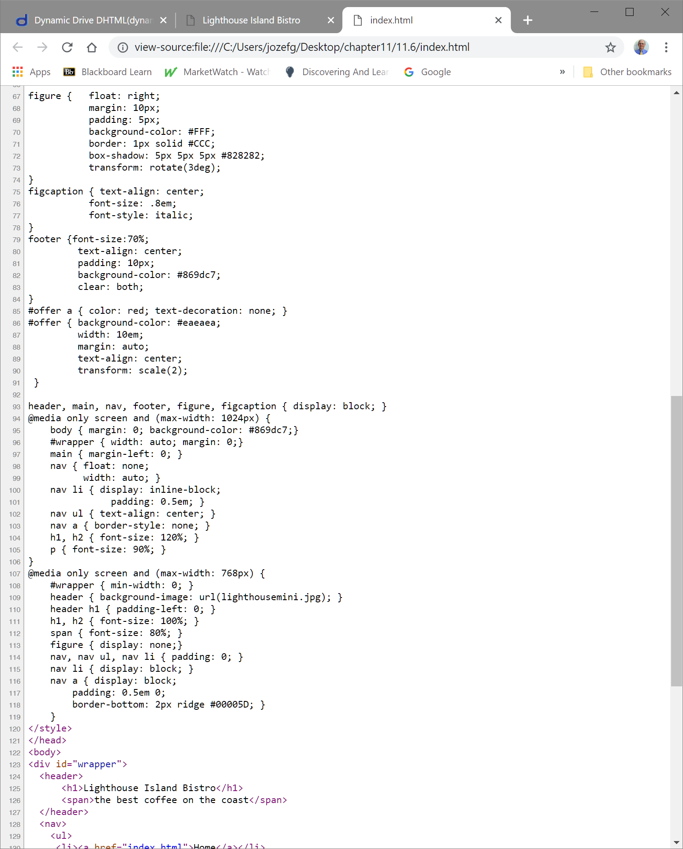
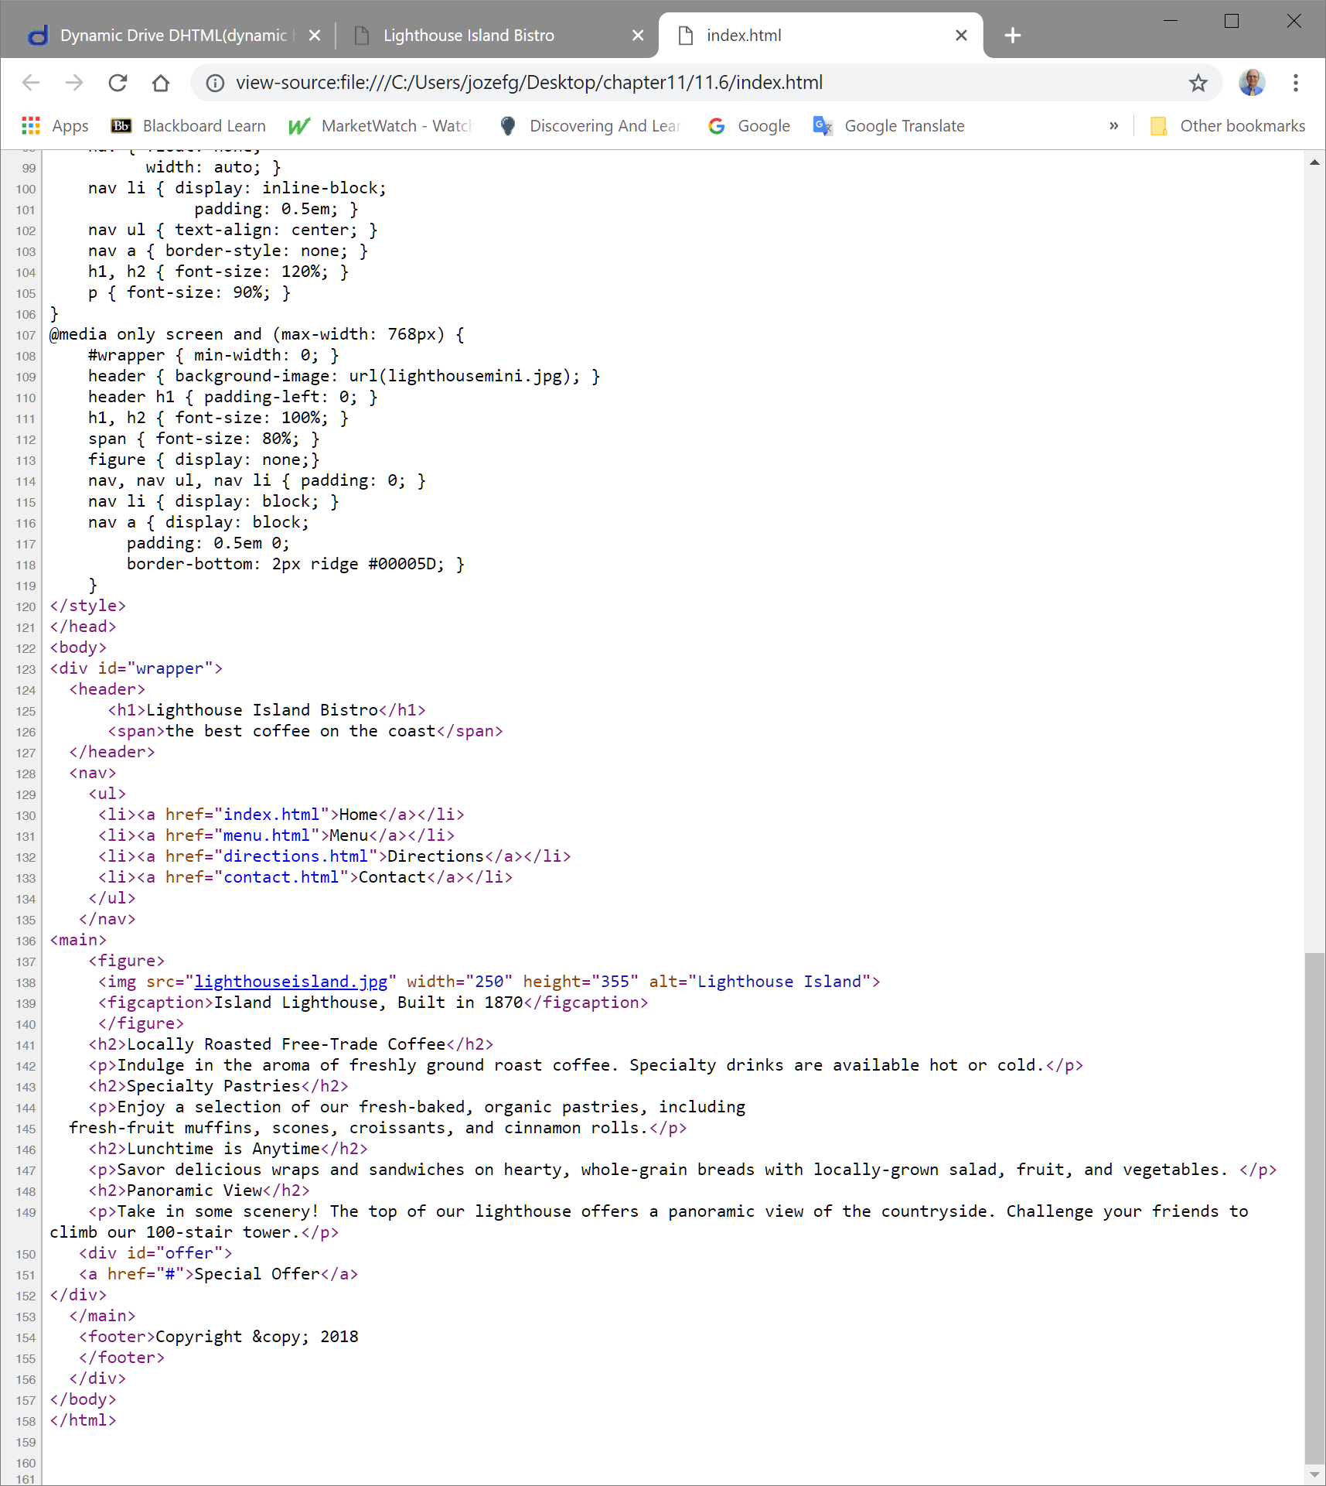
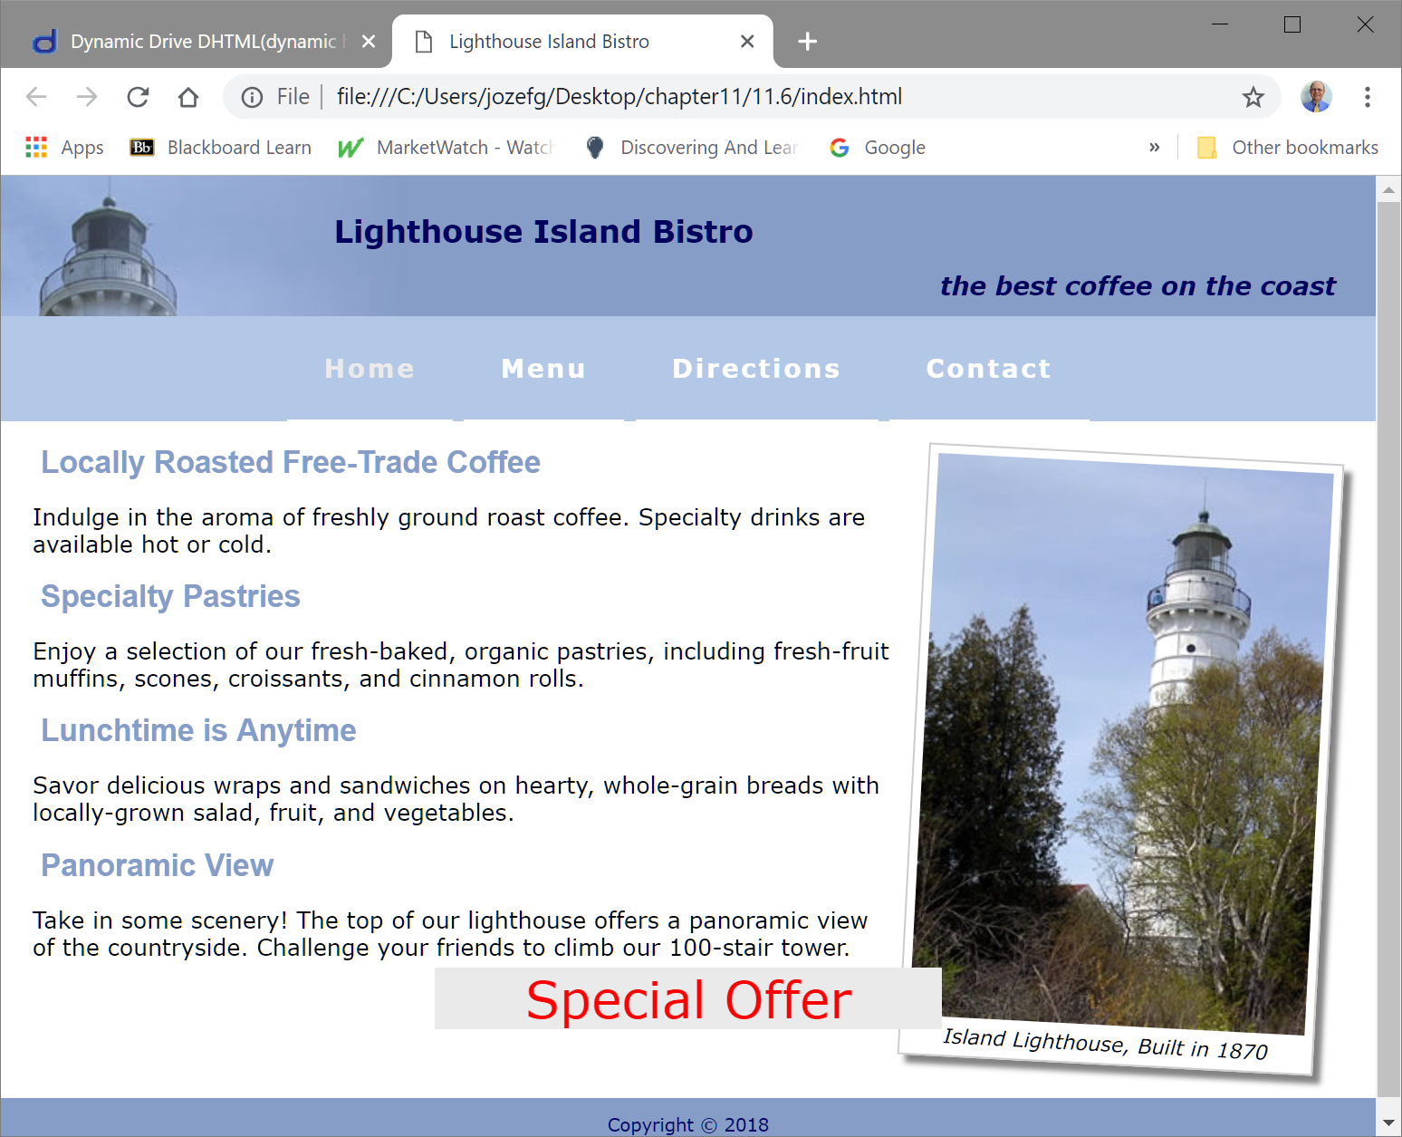

CSS3 Transform Property p.505 HOP 11.5
Allows you to rotate, scale, skew, or move an element
transform: rotate(30deg); /*W3C syntax – all browsers in future*/
Exercise:
a. transform: rotate(35deg);
b. box-shadow: 15px 15 px 15px #0000FF;
c. transform: scale(3)

Slide 51
Hands-On Practice
HOP 11.6
Follow the directions in your book for the HOP.
START-UP File | lighthouse.jpg light.gif
SAVE SOLUTION AS | index.html

Slide 52
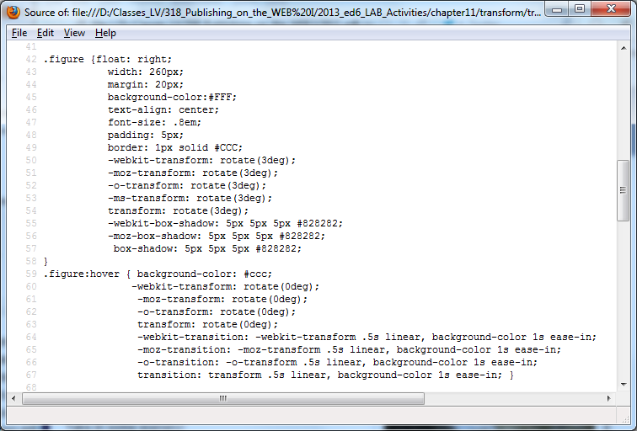
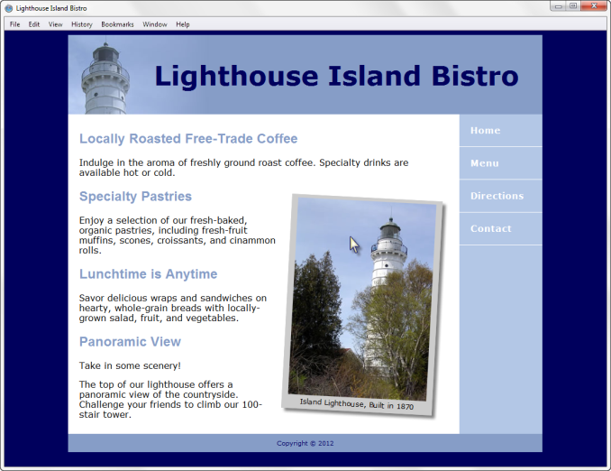







CSS3 Transition Property p.508
Provides for changes in property values to display in a smoother manner over a specified time.
Run example from ed.8
background-color: #cccccc; -webkit-transition: background-color 1s ease-in; -moz-transition: background-color 1s ease-in; -o-transition: background-color 1s ease-in; transition: background-color 1s ease-in;
No IE supports it
List different transition properties p.507:
transition-property, transition-duration, transition-timing-function, transition-delay, transition

Slide 53
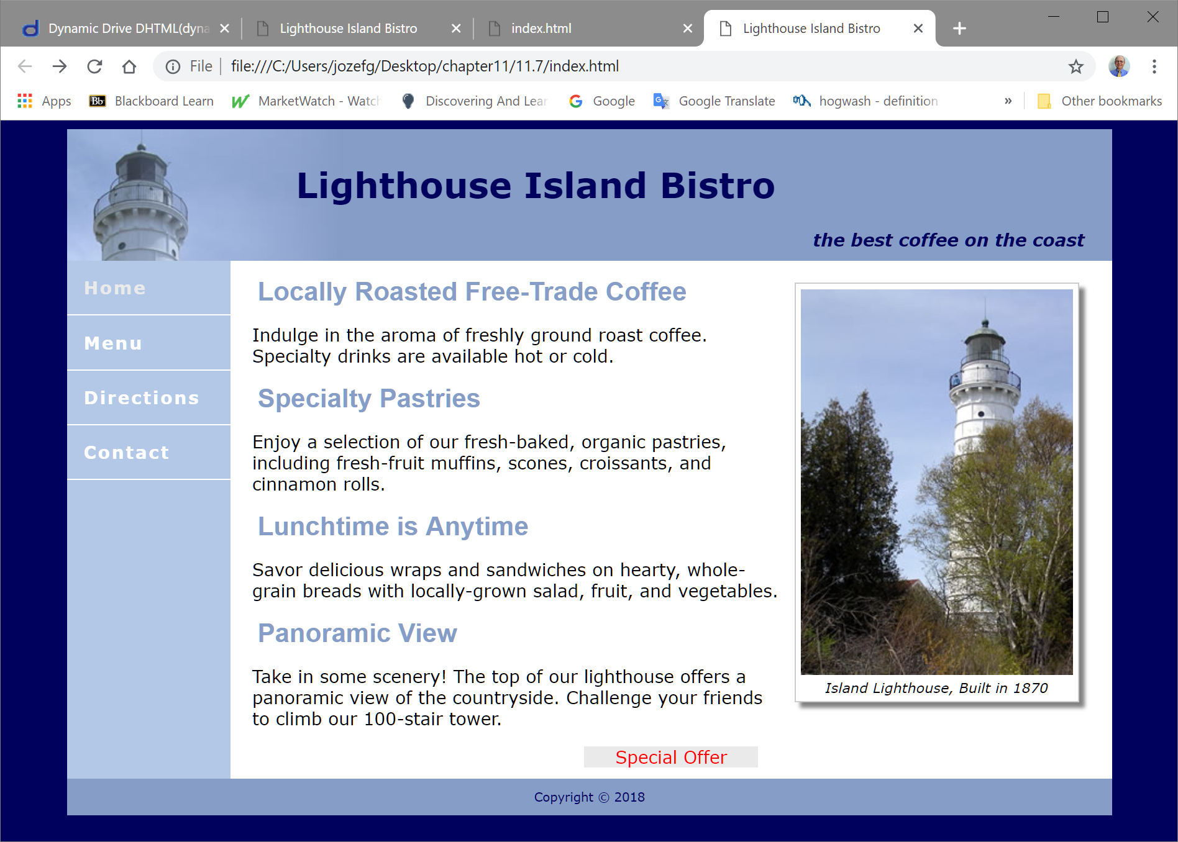
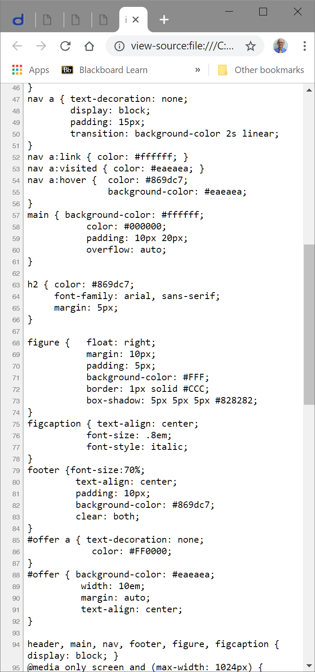
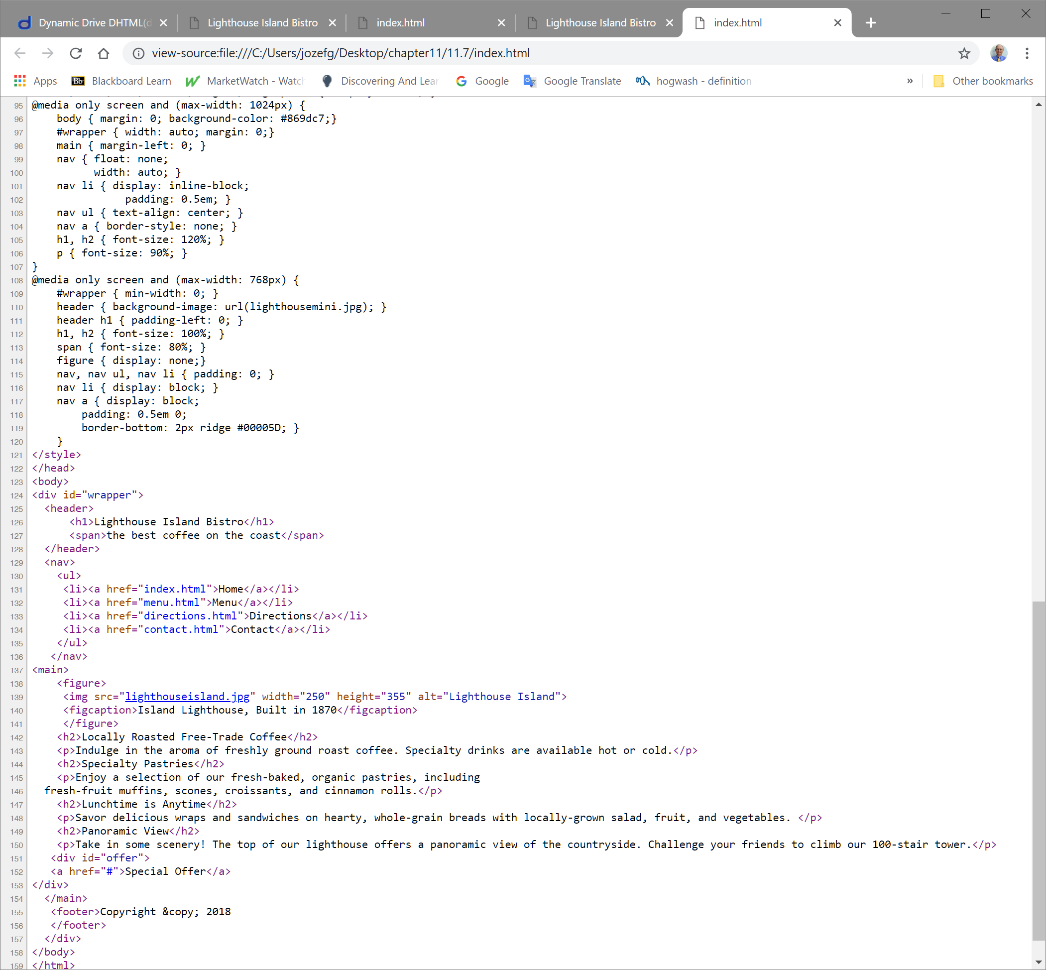
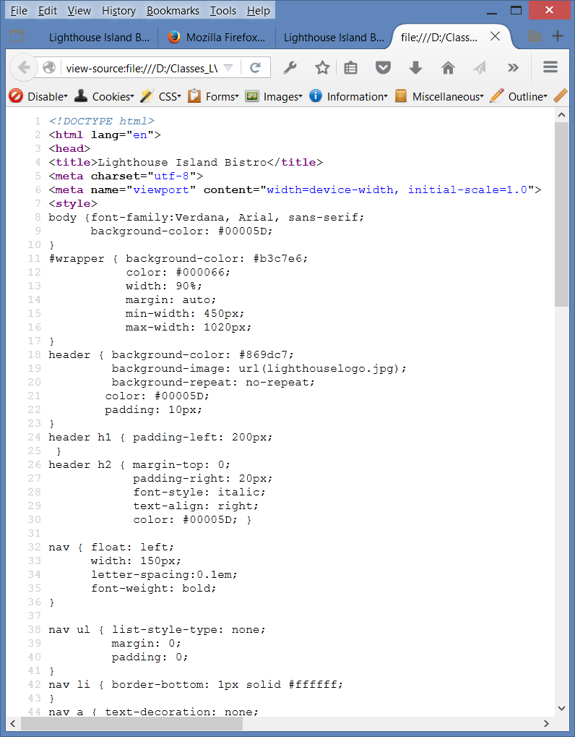

CSS3 Transition Property p.508 HOP 11.6
Exc: change
1. & 2. nav a {transition: transition-duration to 5s,
transition-timing-function to easy-out}
3. f igure box-shadow to -10px -10px 10px
See slide 50 and insert here
a. figure transform: rotate to 45 deg
b. figure:hover transform: rotate to 0 deg.

Slide 54
Hands-On Practice
HOP 11.7
Follow the directions in your book for the HOP.
START-UP File | chapter11/starters/ gallery folder chapter2/template.html
SAVE SOLUTION AS | index.html gallery2 folder

Slide 55
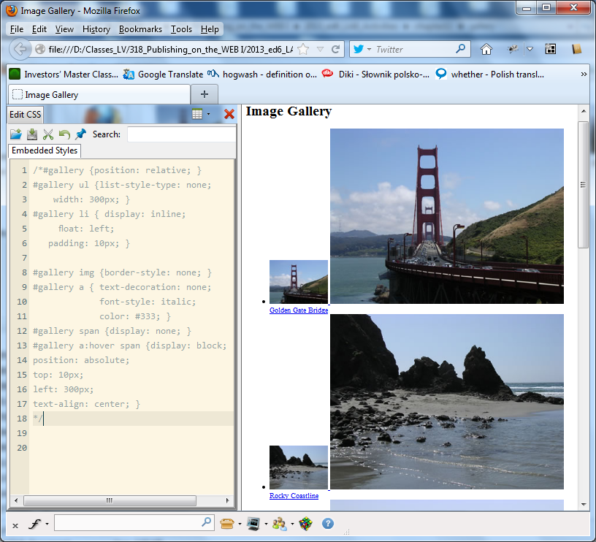
11.5 CSS3 and Interactivity: Image Gallery
Configure each thumbnail image:
<li><a href="photo1.jpg"><img src="photo1thumb.jpg" width="100"
height="75" alt="Golden Gate Bridge">
<span> <img src="photo1.jpg" width="400" height="300“ alt="Golden Gate Bridge"><br>Golden Gate Bridge </span> </a>
</li>

Slide 56
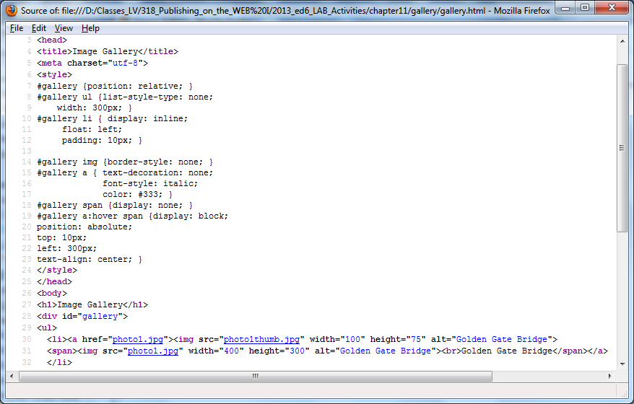
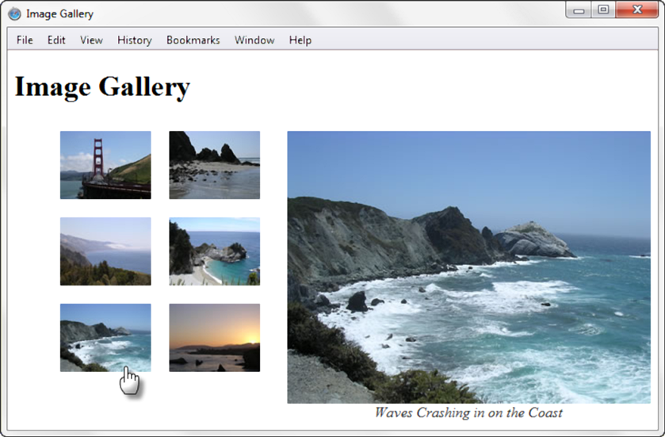

Image Gallery – add CSS3 HOP 11.7 ed 6
Place the mouse over a thumbnail image =>
The larger version of the image is displayed,
along with a caption.
#gallery a:hover span {display: block;
position: absolute;
top: 10px;
left: 300px;
text-align: center; }
gallery.html
Exc: change to top: 40 px and left: 400px in the setting above

Slide 57
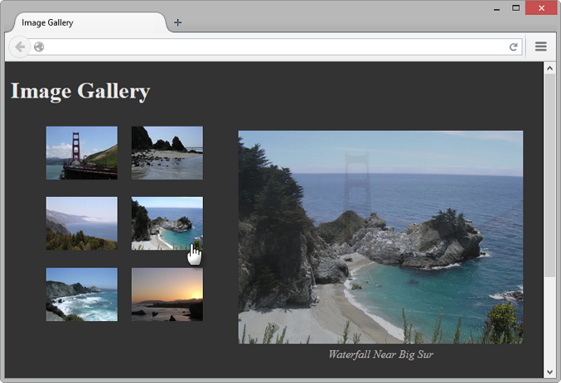




CSS Image Gallery HOP 11.7
Configure each thumbnail image:
<li><a href="photo1.jpg"><img src="photo1thumb.jpg" width="100"
height="75" alt="Golden Gate Bridge">
<span> <img src="photo1.jpg" width="400" height="300“ alt="Golden Gate Bridge"><br>Golden Gate Bridge </span> </a>
</li>
The key CSS added in ed 10 in yellow:
#gallery span { position: absolute; opacity: 0;
transition: opacity 3s ease-in-out;
left: -1000px; }
#gallery a:hover span { position: absolute;
top: 16px; left: 320px;
text-align: center; opacity: 1;}

Slide 58
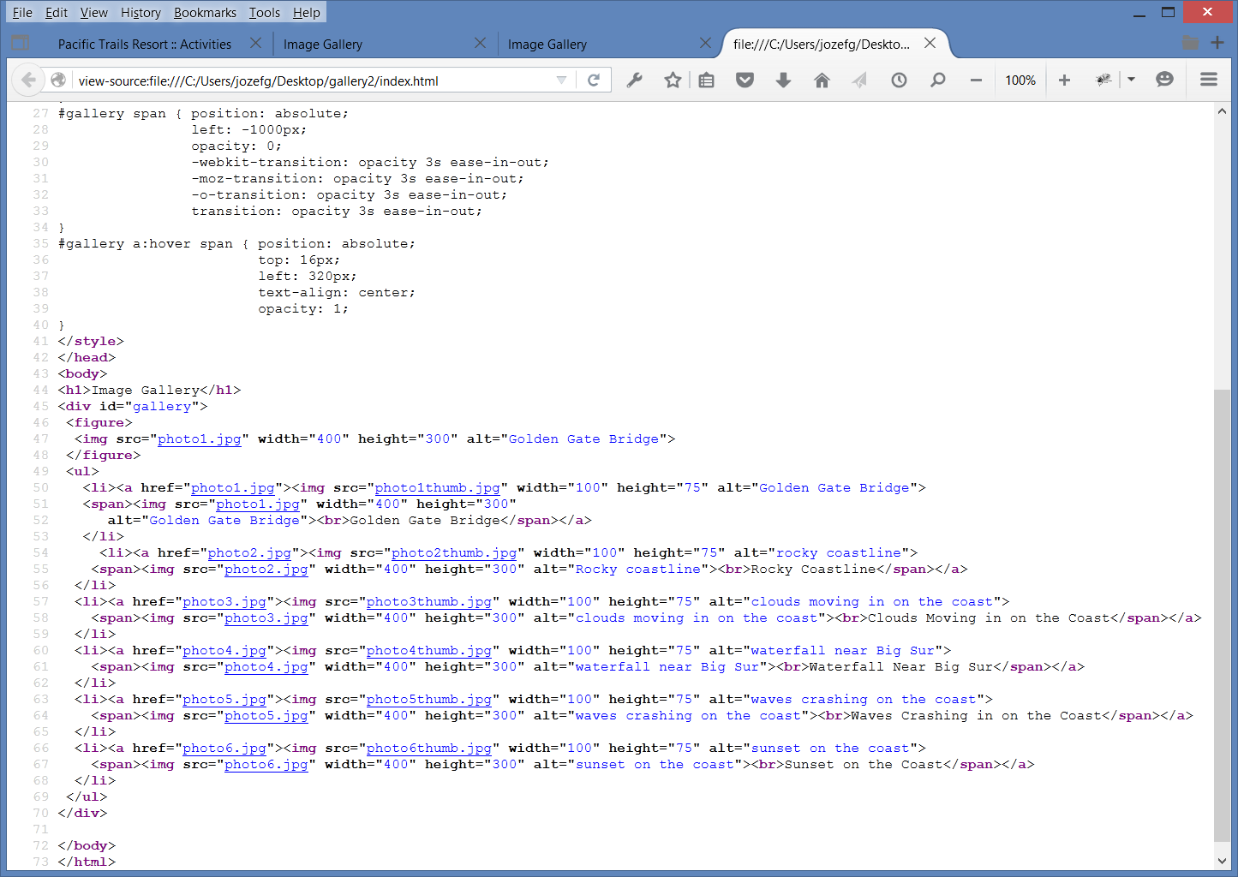
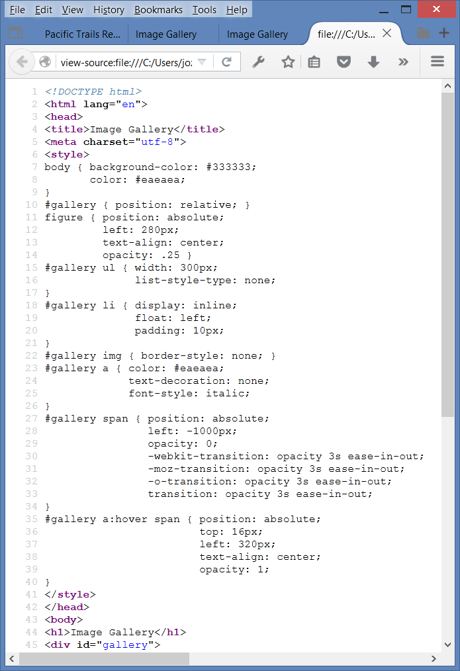
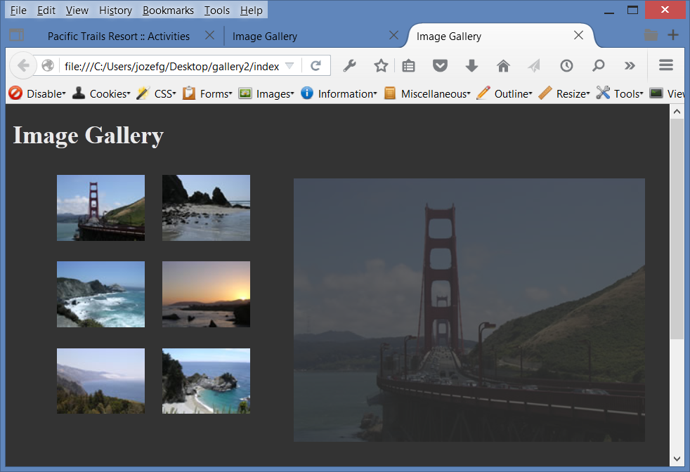




HOP 11.7
<= absolute position on the span elem
<= fig initially is semi-opaque
img placeholder
<= not display span initially in viewport
When you place the mouse over a thumbnail
Exc: change
1. figure {opacity: 0.15}
2. #gallery span{opacity 0.10; transition-duration: 8s;
transition-delay: easy-out}
3. #gallery a:hover span {opacity 0.9; left: 450 }

Slide 59
Hands-On Practice
HOP 11.8
Follow the directions in your book for the HOP.
START-UP File | starter.html
SAVE SOLUTION AS | index.html

Slide 60










CSS Animations
Provide a way to animate the values of CSS properties over time
Two Steps:
1. Define the animation with the @keyframes rule
@keyframes test {
from {transform: scale (0.5); background-color: blue;}
to {transform: scale (2); background-color: red;}
2. Apply the animation using the CSS animation property
.myAnimate {animation: test 5s; width: 100px; height:100px;
background-color: blue; border: 3px solid #000;
margin: auto;}
See animate1.html – the square returns to the original
See animate2.html – sets property animation-fill-mode: forward; //last keyframe
it means to freeze the animation at the end – p.513

Slide 61







HOP 11.8
Configures a CSS animation that slides the h1 text “Lighthouse Bistro” in from the right while it increases in size

Slide 62
Hands-On Practice
HOP 11.9
Follow the directions in your book for the HOP.
START-UP File | template.html
SAVE SOLUTION AS | index.html

Slide 63

11.6 HTML 5 Details & Summary Elements
Used together to configure an interactive widget.
Details element contains one summary element and detailed information.
Summary element contains the text initially displayed.

Slide 64


HTML 5 Details & Summary – HOP 11.9
Details element contains one summary element and detailed information.
Summary element contains the text initially displayed.

Slide 65
What is Java?
Java is an Object Oriented Programming (OOP) language developed by Sun Microsystems.
Java is not the same language as JavaScript.
Java is more powerful and much more flexible than JavaScript.
Java can be used to develop both
stand-alone executable applications and
applets that are invoked by web pages.

Slide 66

Java Applets
Java applets - .java files are compiled (translated from the English-like Java statements to an encoded form) and saved as “.class” files which contain byte code.
The byte code is interpreted by the Java Virtual Machine (JVM) in the web browser.
The JVM interprets the byte code into the proper machine language for the operating system.
The applet is then executed and appears on the web page.

Slide 67
Common Uses of Java Applets
Some applets are free, some require permission
Navigation Bars, menu and Buttons http://apycom.com
Manipulating Images
Creating Text Effects
Games
Web and Business Applications

Slide 68
Adding a Java Applet to a Web Page
The object (or applet) tag - a container tag
Attributes:
code,
codebase
folder that contains the applet
if not in the same folder
as the Web page
height,
width,
alt,
id
Works together with <parameter> tags
Stand alone tags
Attributes:
name,
value
The <parameter> tags used by an applet are determined by the developer who writes and distributes the applet
<applet code=“myapplet.class" height=“50" width=“500“
alt=“Java applet: displays a moving logo with company name”>
<param name="bgColor" value="#FFFFFF" />
<param name=“txtColor" value="#0000CC” />
This Java applet displays a moving logo with the company name
</applet>

Slide 69

Adding a Java Applet to a Web Page
OBSOLETE: the applet element
HTML5: the object element
<object type="application/x-java-applet" width="610" height="30"
title="This Java Applet displays a message that describes what Java Applets can be used for.">
<param name="code" value="fader26.class">
<param name="AppletHome" value="http://www.crosswinds.net/~fader/">
<param name="Data" value="message.txt">
<param name="bgColor" value="#FFFFFF">
Java Applets can be used to display text, manipulate graphics, play games, and more.
Visit <a href="http://download.oracle.com/javase/tutorial/">Oracle</a> for more information.
</object>
create file message.txt =>
Save as java.html, create file message.txt

Slide 70


Sample Java Applet
See p. 481-482 ed6
create file message.txt =>
Save as java.html, create file message.txt

Slide 71
11.7 What is JavaScript?
Object-oriented powerful scripting language.
Used to work with the objects associated with a web page document –
the window,
the document,
the elements such as
forms,
images,
links, etc.
Originally developed by Netscape and called LiveScript
Netscape collaborated with Sun Microsystems on modifications to the language and it was renamed JavaScript
JavaScript is NOT Java

Slide 72
11.7 Common Uses of JavaScript
Response to events such as moving mouse, clicking a button, and loading a Web page
Dynamic navigation based on mouse movement
Hiding and showing elements such as navigation area based on mouse movement
Edit and validate form information
Calculations
Display a message box
Hiding and showing text
Navigation
Select list navigation
Create a new window with a specified size and screen position
Image Rollovers
Status Messages
Display Current Date

Slide 73

11.7 Document Object Model (DOM)
The DOM defines every object and element on a web page.
Its hierarchical structure can be used to access page elements and apply styles to page elements.
A portion of the DOM is shown at the left.
Current version of browsers such as IE, Firefox, and Opera support the W3 DOM

Slide 74
What is DHTML (Dynamic HTML)?
DHTML is an umbrella term for a collection of technologies used together to create interactive and animated web sites.
Technologies used in DHTML:
1. Document Object Model - DOM
not all browser use the same DOM
There are 3 DOMs
W3C DOM – current browser support it
Microsoft DOM
Netscape DOM
2. Cascading Style Sheets - CSS
3. Client-side Scripting – Java Script, VBScript, Jscript
These technologies allow the web page to respond to user actions.
Dynamic navigation based on mouse movement
Hiding and showing elements such as navigation area based on mouse movement
Animation in which the CSS positioning properties of elements are changed
Has a long learning curve because of the extent of the knowledge needed to successfully combine the three technologies.

Slide 75
Common Uses of DHTML
Hiding and showing text
Navigation
http://www.opencube.com/index.asp
Image Effects with slide show
http://www.dynamicdrive.com/ - Dynamic Web site and tools
the #1 place on the net to obtain free, original DHTML & Javascripts to enhance your web site to obtain free, original DHTML & Javascripts to enhance your web site

Slide 76
11.8 Asynchronous JavaScrit and XML - Ajax
Ajax uses HTML, CSS, DOM, JavaScript and XML. Jesse James Garrett introduce it.
By contrast to DHTML, Ajax “behind the scenes” requests to the server to refresh a portion of the browser display instead of the entire Web page (so far). Very basic example: http://webdevfoundations.net/css
Ajax is for creating interactive Web apps.
Google: maps, e-mail, suggest, www.Flickr.com – photo sharing, http://del.icio.us – shared collection of favorite sites.
Ajax is part of the Web 2.0 movement –
the transition of the Web from isolated static Web sites to a platform that uses technology to provide rich interfaces and social networking opportunities for people.
You have a strong foundation in HTML and CSS you can move to JavaScript and AJAX.
See you in the next class CMPS 319 Publishing on the Web II

Slide 77
THE 10 MOST In-Demand PROGRAMMING LANGUAGES TO LEARN IN 2023
https://bootcamp.berkeley.edu/blog/most-in-demand-programming-languages/
All languages below you can learn in my Internet Programming classes and in my electives classes Mobile App Development (CMPS 481), Python (CMPS 372), and Intro to Data Mining (CMPS 386).
JavaScript - used for: Web development, Game development, Mobile apps, Building web servers
Python used for: Back end development, Data science, App development
HTML used for: Web documents, Website development, Website design, Website maintenance
CSS used for: Web documents, Website development, Website design, Website maintenance
Java is used for: App development, E-commerce, Finance
SQL used for: Database management, Sales reports, Business management
NoSQL used for: Database management, Sales reports, Business management
C# used for: Game development, Desktop/web/mobile apps, VR.

Slide 78
11.9 What is jQuery?
jQuery is a free open-source JavaScript Library
Compatible with all current browsers
Provides interaction and dynamic effects on web pages
Understanding of JavaScript is needed to be efficient when using jQuery
Resources:
http://webdevfoundations.net/jquery
http://jquery.com
http://jquery.org

Slide 79

11.9 What is jQuery?
The jQuery A P I can be used to configure many interactive features, including:
image slideshows
animation (moving, hiding, fading)
event handling (mouse movements and mouse clicking)
document manipulation
Ajax
A P I – Application Programming Interface:
A protocol that allows software components to communicate – interacting and sharing data.
jQuery Slideshow Example

Slide 80
11.10 HTML5 APIs
A variety of APIs that are intended to work with HTML5, CSS, and JavaScript are currently under development and in the W3C approval process, including:
geolocation
web storage
offline web applications
canvas
A P I – Application Programming Interface:
A protocol that allows software components to communicate – interacting and sharing data.

Slide 81
1. HTML5 Geolocation
Allows your web page visitors to share their geographic location
Their location may be determined by the
IP address,
wireless network connection,
local cell tower, or
GPS hardware depending on the type of device and browser.
JavaScript is used to work with the latitude and longitude coordinates provided by the browser.
Examples:
http://webdevfoundations.net/geo and
http://html5demos.com/geo+++

Slide 82
2. HTML5 Web Storage
Traditionally, the JavaScript cookie object has been used to store information in key-value pairs on the client (the website visitor’s computer).
NEW FOR HTML5: Web Storage API
provides two new ways to store information on the client side:
local storage and
session storage.
Advantage: increase in the amount of data that can be stored (5MB per domain).
The localStorage object stores data without an expiration date.
The sessionStorage object stores data only for the duration of the current browser
JavaScript is used to work with the values stored in the localStorage and sessionStorage objects.
Examples:
http://webdevfoundations.net/storage and
http://html5demos.com/storage

Slide 83
3. HTML5 Offline Web Applications
An offline web application enables website visitors to view documents and access web applications even when they are not connected to the Internet.
A web application (app) can be written with HTML, CSS and JavaScript (or C#, Java, C-objective etc.) and can run in any browser – as long as you are online.
An offline web application takes this one step further and stores the HTML, CSS, and JavaScript files on the visitor’s device for use offline, even when the device is not connected to the Internet.
Examples:
http://html5demos.com/offlineapp
http://www.w3schools.com/html/html5_app_cache.asp

Slide 84
Progressive Web Application (PWA)
Progressive Web Application (PWA)
Rich user experience similar to a native iPhone or Android app
Provides some level of functionality even when the user is offline.
A big development: A web application (app) can be written with HTML, CSS and JavaScript and can run in any browser – as long as you are online.

Slide 85
Progressive Web Application (PWA)
Key Progressive Web Application APIs:
Manifest API Provides information about the PWA; including the data needed for the PWA’s icon to be added to the home screen of a device.
Service Workers API JavaScript that runs in the background; Provides for push notifications and background data syncing; Requires HTTPS

Slide 86

4. HTML5 <canvas> tag
Configures dynamic graphics (replaces Adobe Flash) with JavaScript
Draw lines, shapes, text, image
Interact with actions taken by the user
Canvas API (Application Programming Interface)
JavaScript – client-side scripting language needed to implement it
<head>
<style>
canvas {border:2x solid red;}
</style>
<script type="text/javascript">
function drawMe() {
var canvas =
document.getElementById("myCanvas");
if (canvas.getContext) {
var ctx = canvas.getContext("2d");
ctx.fillStyle = "rgb(255, 0, 0)";
ctx.font = "bold 3em Georgia";
ctx.fillText("My Canvas", 70, 100); ctx.fillStyle = "rgba(0, 0, 200, 0.50)"; // 50% opacity
ctx.fillRect (57, 54, 100, 65); // draw rectangle
}
}
</script>
</head>
<body onload=“drawMe()”>
<h1> The Canvas Element <h1>
<canvas id=“myCanvas” width=“400” height=“175”></canvas>
</body>
</html>
Draw programmatically by writing JavaScript statements

Slide 87
Checkpoint 11.3 p.523 and 684
1. Describe two uses of JavaScript.
- validation, popup windows, image rollovers,
status msg changes, calculations etc.
2. Describe two technologies used in Ajax.
- HTML, CSS, DOM, JavaScript, and XML
3. Describe the purpose of the HTML5 canvas element.
- configure dynamic graphics with JavaScript

Slide 88
Multimedia & Accessibility
To create a compelling, engaging experience for your website visitors
Provide links to plug-ins
Provide text descriptions and captions
Verify keyboard access and text description for Flash animation and Java applets
Check for screen flickering – no item that flashes > 3 times per sec to avoid seizures
Verify that the basic functionality works if JavaScript or unable to manipulate the mouse is disabled
If media is used for main navigation, provide plain text links.

Slide 89
Summary
This chapter introduced the HTML techniques used to place sound, video on the web pages.
It also discussed accessibility, usability, and copyright as they relate to media use on the Web.
This chapter also introduced you to a number of technologies used to add interactivity to web pages.
As you continue your studies, you may choose to specialize in one or more of these technologies.

Slide 90





Pacific Trails Project
video

Slide 91


Yoga Studio Project

Slide 92


JavaJam Coffee Project based on HOP 11.3

Slide 93
Chapter Links & Resources
Browser Plug-ins
Flash Player
Shockwave Player
Adobe Reader
Java Runtime Environment
Real Player
Windows Media Player
Apple Quicktime
Firefox Plug-in List
Recording, Hosting, Media & Podcasting
Sound Recorder Tutorial
Wav File Recording
Archive
OurMedia
RSS Feed Tutorial
Create an RSS Feed
Ponyfish
Feedburner
Icerocket
iTunes
Feedreader
Commercial & Open-Source Software
Sonic Foundry
Audacity
LAME MP3 Encoder
Media Box
Goldwave
Audio MP3 Maker
Adobe Premiere
Apple Quicktime
Microsoft MovieMaker
Adobe Flash
Swish
TechSmith Camtasia
Microsoft Silverlight
Web Sources of Media Files
Microsoft Clip Art
FreeAudioClips
Flashkit
YouTube
Copyright & Ethical Issues
Copyright.gov
Copyright Web Site
Creative Commons License
Media, Accessibility & Standards
Video Captioning
MAGpie
Bye Bye Embed
Adobe Resources
Jakob Nielsen circa 2001
Flash & Accessibility
Flash & Standards
Flash Examples & Resources
NSF
NPS
Rich Media Ads
2advanced
NeonSky
Flashkit
ActionScript.org
ScriptOcean
Kirupa.com
http://www.dhtmlgoodies.com/index.html?whichScript=slidedown-menu2 slide down menu !
Java Resources & Applets
Sun Microsystems
Navigation & Menus
Apycom
CodeBrain
Lake Applet
Text Effects
Games
Applet Collection
Java on the Brain
Jars.com
Visual Mining
Stock Quote
JavaScript Resources
EchoEcho Tutorials
PageResource Tutorials
Image Swapping
The JavaScript Source
DTHML Resources
Dynamic Drive
Brain Jar
DHTML Goodies:
http://www.dhtmlgoodies.com/index.html?whichScript=slidedown-menu2 slide down menu !
Ajax Examples & Resources
Adaptive Path
Web 2.0
Fickr
Del.ico.us
Gmail
A9 Search
Microsoft Live
Ajax Developer Journal
Ajax Patterns
Web Pasties
DHTML Nirvana Ajax

