Slide 1
Chapter 12
E-Commerce Overview
Credits: © 2011-22 Pearson Education
Copyright (c) 2007Prentice-Hall. All rights reserved.

Slide 2
Learning Outcomes
In this chapter, you will learn how to:
Define E-Commerce
Identify benefits and risks of E-Commerce
Describe E-Commerce business models
Describe E-Commerce Security and Encryption
Describe EDI (Electronic Data Interchange)
Describe trends and projections for E-Commerce
Describe issues related to E-Commerce
Describe order and payment processing
Describe E-Commerce solution options

Slide 3
12.1 What is E-Commerce?
The integration of
communications,
data management, and
security technologies
to allow individuals and organizations to exchange information related to the sale of goods and services.
Major functions of E-Commerce include:
the buying of goods,
the selling of goods, and
the performance of financial transactions on the Internet.

Slide 4
E-Commerce Advantages for Businesses
1. Reduced Costs
Business stays 24 hours a day
2. Increased Customer Satisfaction
Available representative by e-mail,
Others
FAQ,
discussion forum,
online chat
product rating
3. Potentially Higher Sales
The store available 24 hours a day to everyone on the planet
4. More Effective Data Management
Automation of credit card verification and authorization, update inventory level

Slide 5
E-Commerce Advantages for Consumers
5. Convenience
No travel time, available discussion forum about products
6. Easier Comparison Shopping
No driving
Easily surf the Web and compare prices and value
7. Wider Selection of Goods
Surf not only one store

Slide 6
E-Commerce RISKS for Businesses
1. Need for a robust, reliable website – reliability, user friendly, robust, ease of use are critical factors in the success of your business
If your website isn’t available
2. Fraudulent credit card
Fraudulent transactions
Order placed by vandals
3. Customer reluctance to purchase online
Offer some incentives such as free shipping and “no question asked” returns policy
4. Increased competition
b/c the overhead is lower than for a traditional brick and mortal store
Your website looks professional

Slide 7
E-Commerce RISKS for Consumers
4. Possible Security Issues
Whether the Web site has SSL (Secure Socket Layer) for encryption and security info
Is the database secure and have a backup?
5. Possible Privacy Issues
Privacy policy available – the potential lack of privacy
What the site will do with the info received
6. Purchasing based on photos & descriptions
Holding an item before purchasing in a traditional brick and mortal store
So can the Web site have a return policy to feel more confident about purchase
7. Possible difficulty with returns
vs a traditional brick and mortal store

Slide 8
12.2 E-Commerce Business Models
1. B2C – Business-to-Consumer
Takes place at online stores
Amazon.com
2. B2B – Business-to-Business
Supply chain among vendors, partners and business customers
EDI (Electronic Data Interchange) is also included
3. C2C – Consumer-to-Consumer
Individuals are selling to each other on the Internet
Auction ebay.com founded in 1995
http://losangeles.craigslist.org/
4. B2G – Business-to-Government
Section508.gov of the Rehabilitation Act requires the Web site used by federal agencies is available to people with disabilities.

Slide 9
12.3 Electronic Data Interchange (EDI) p.540
The transfer of data between different companies using networks.
Facilitates the exchange of standard business documents including purchase orders and invoices
The Accredited Standards Committee ASCX12 is chartered by ANSI to develop and maintain EDI standards
EDI is not new
In existence since the 1960s
Trading Partners
Organizations that exchange EDI transmissions
Newer technologies
XML, JSON and Web Services are replacing traditional EDI
Provide opportunities to customize secure information exchange over the Internet
Blockchain has enormous potential to disrupt the retail industry, particularly when it comes to the supply chain.
Blockchain can bring some much-needed transparency to the movement and exchange of goods, providing a secure, complete record of where products and materials have come from.

Slide 10
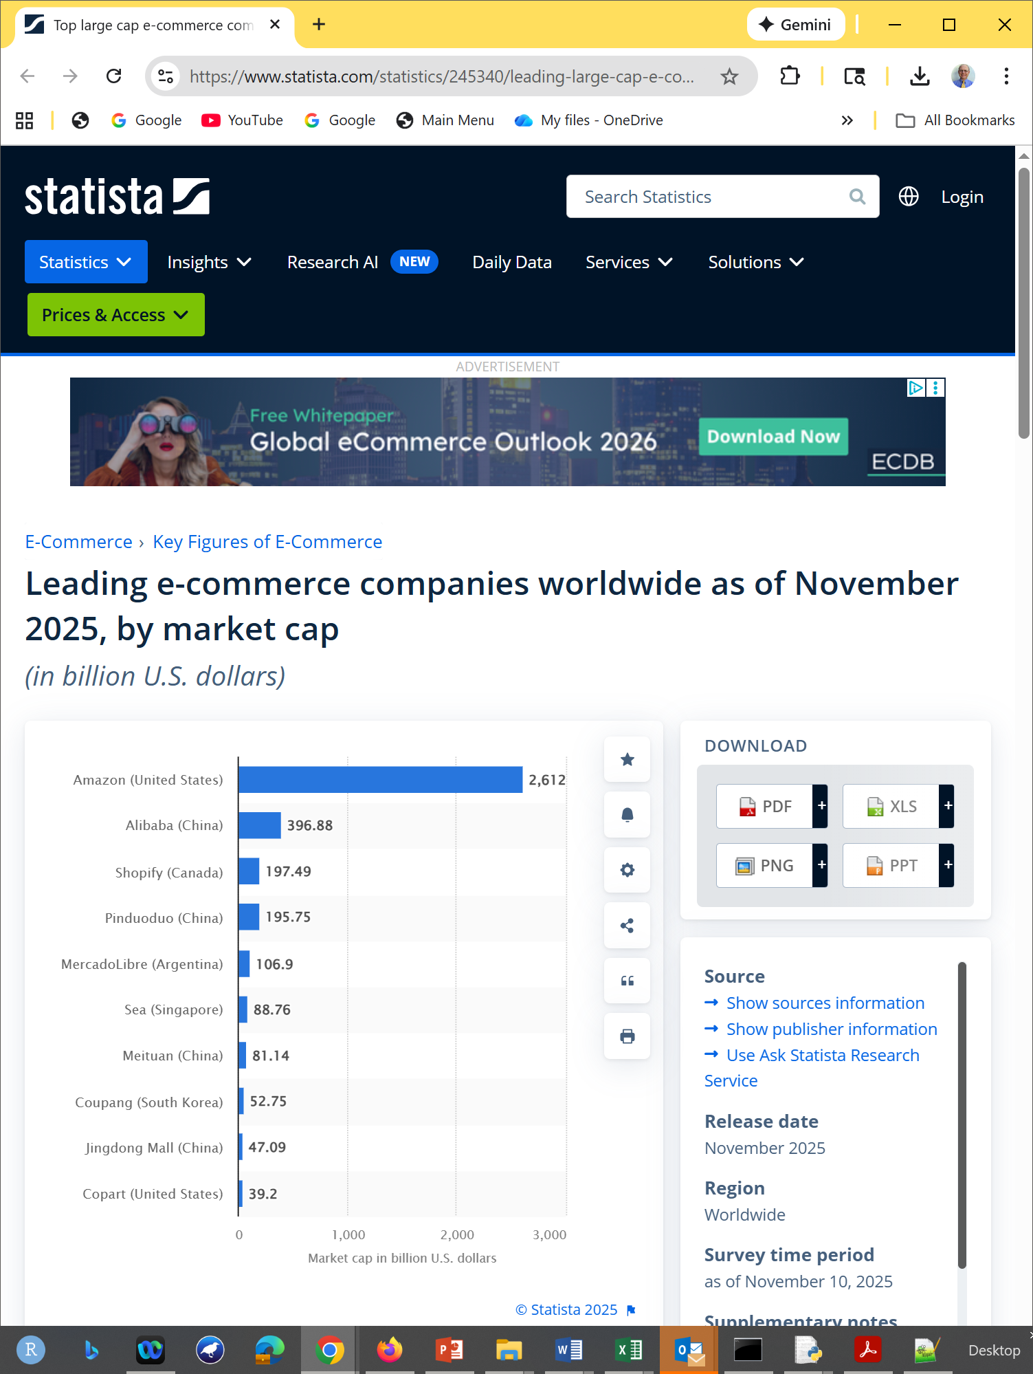
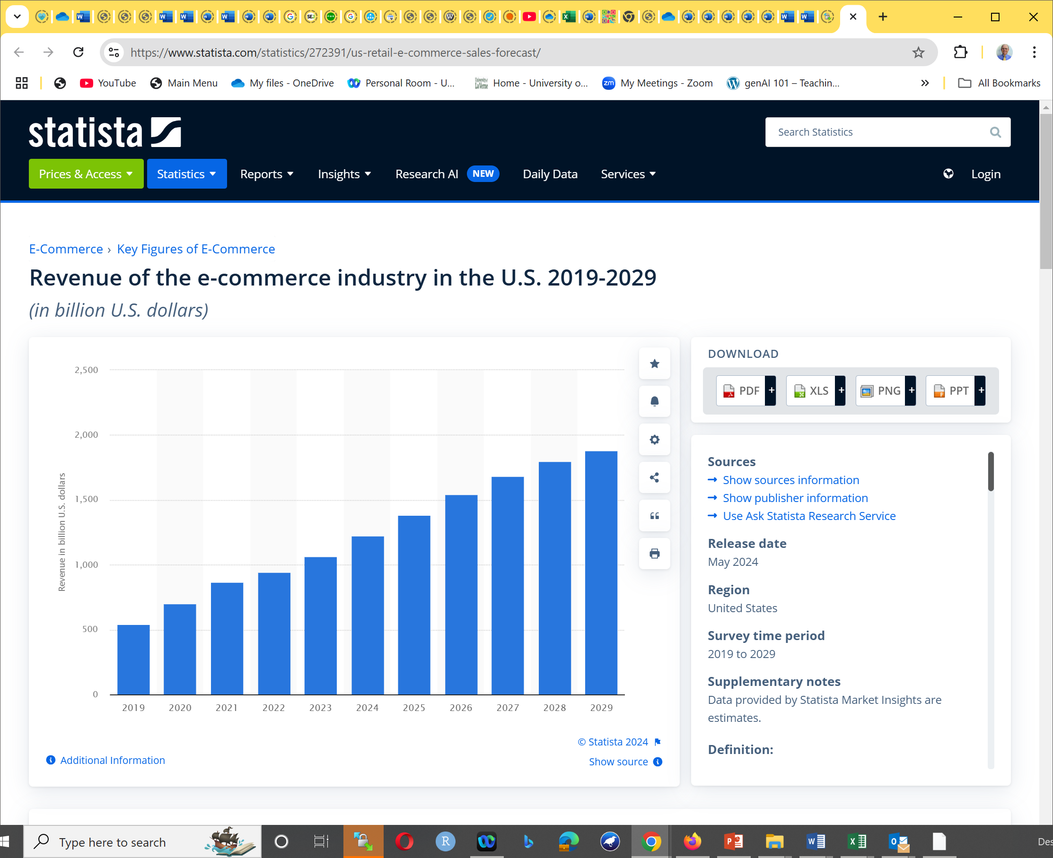
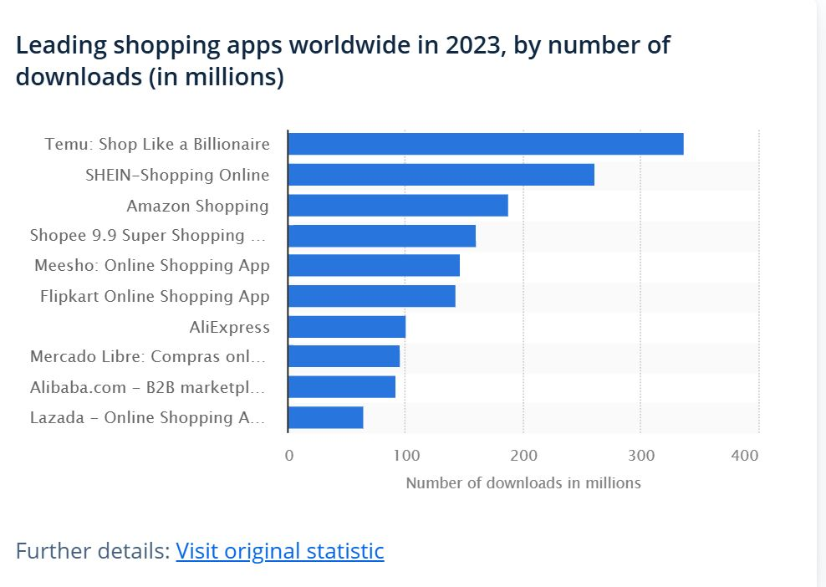
E-Commerce sales
https://www.statista.com/statistics/245340/leading-large-cap-e-commerce-companies-market-cap/
https://www.statista.com/statistics/272391/us-retail-e-commerce-sales-forecast/
To get the current data you need to register for statista and pay!

Slide 11
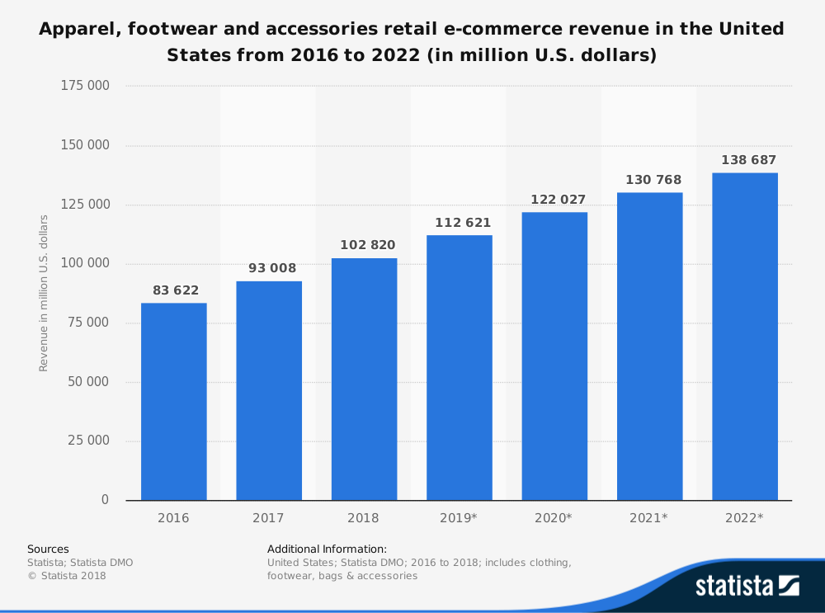
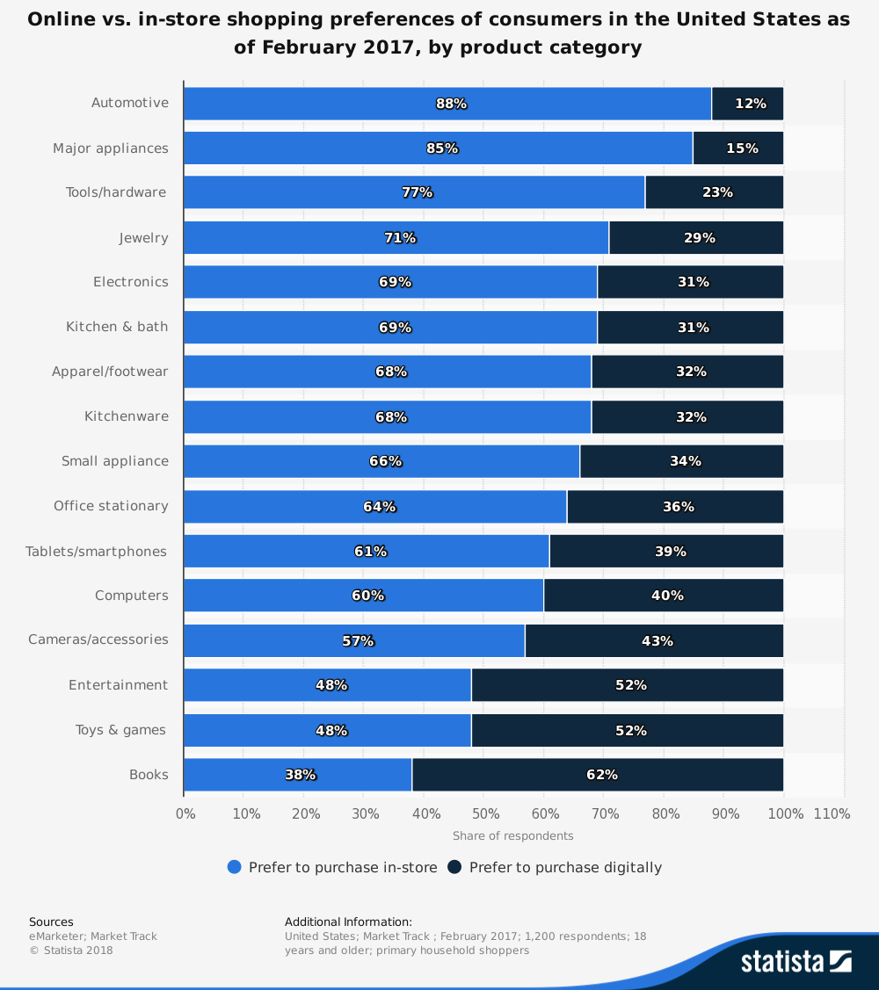
E-Commerce U.S. Retail Sales
https://www.statista.com/statistics/278890/us-apparel-and-accessories-retail-e-commerce-revenue/
To get the current data you need to register for statista
https://www.statista.com/statistics/311459/us-online-in-person-shopping-preferences-product-category/
http://www.census.gov/retail/ => sales

Slide 12
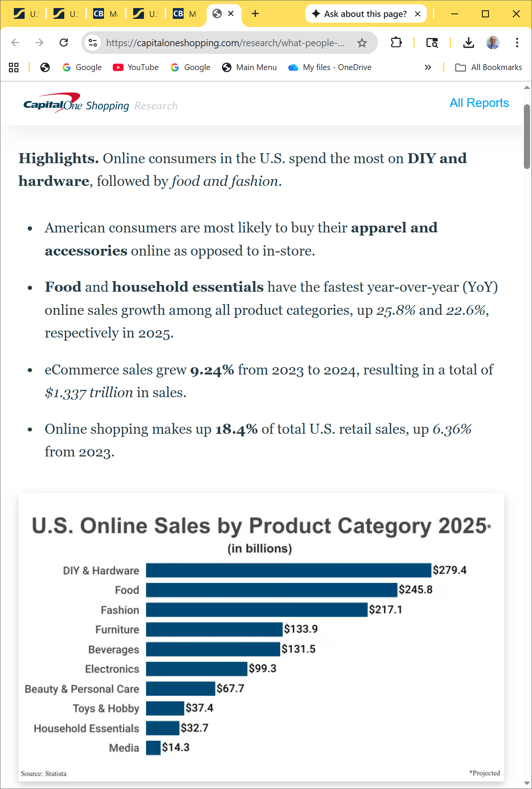
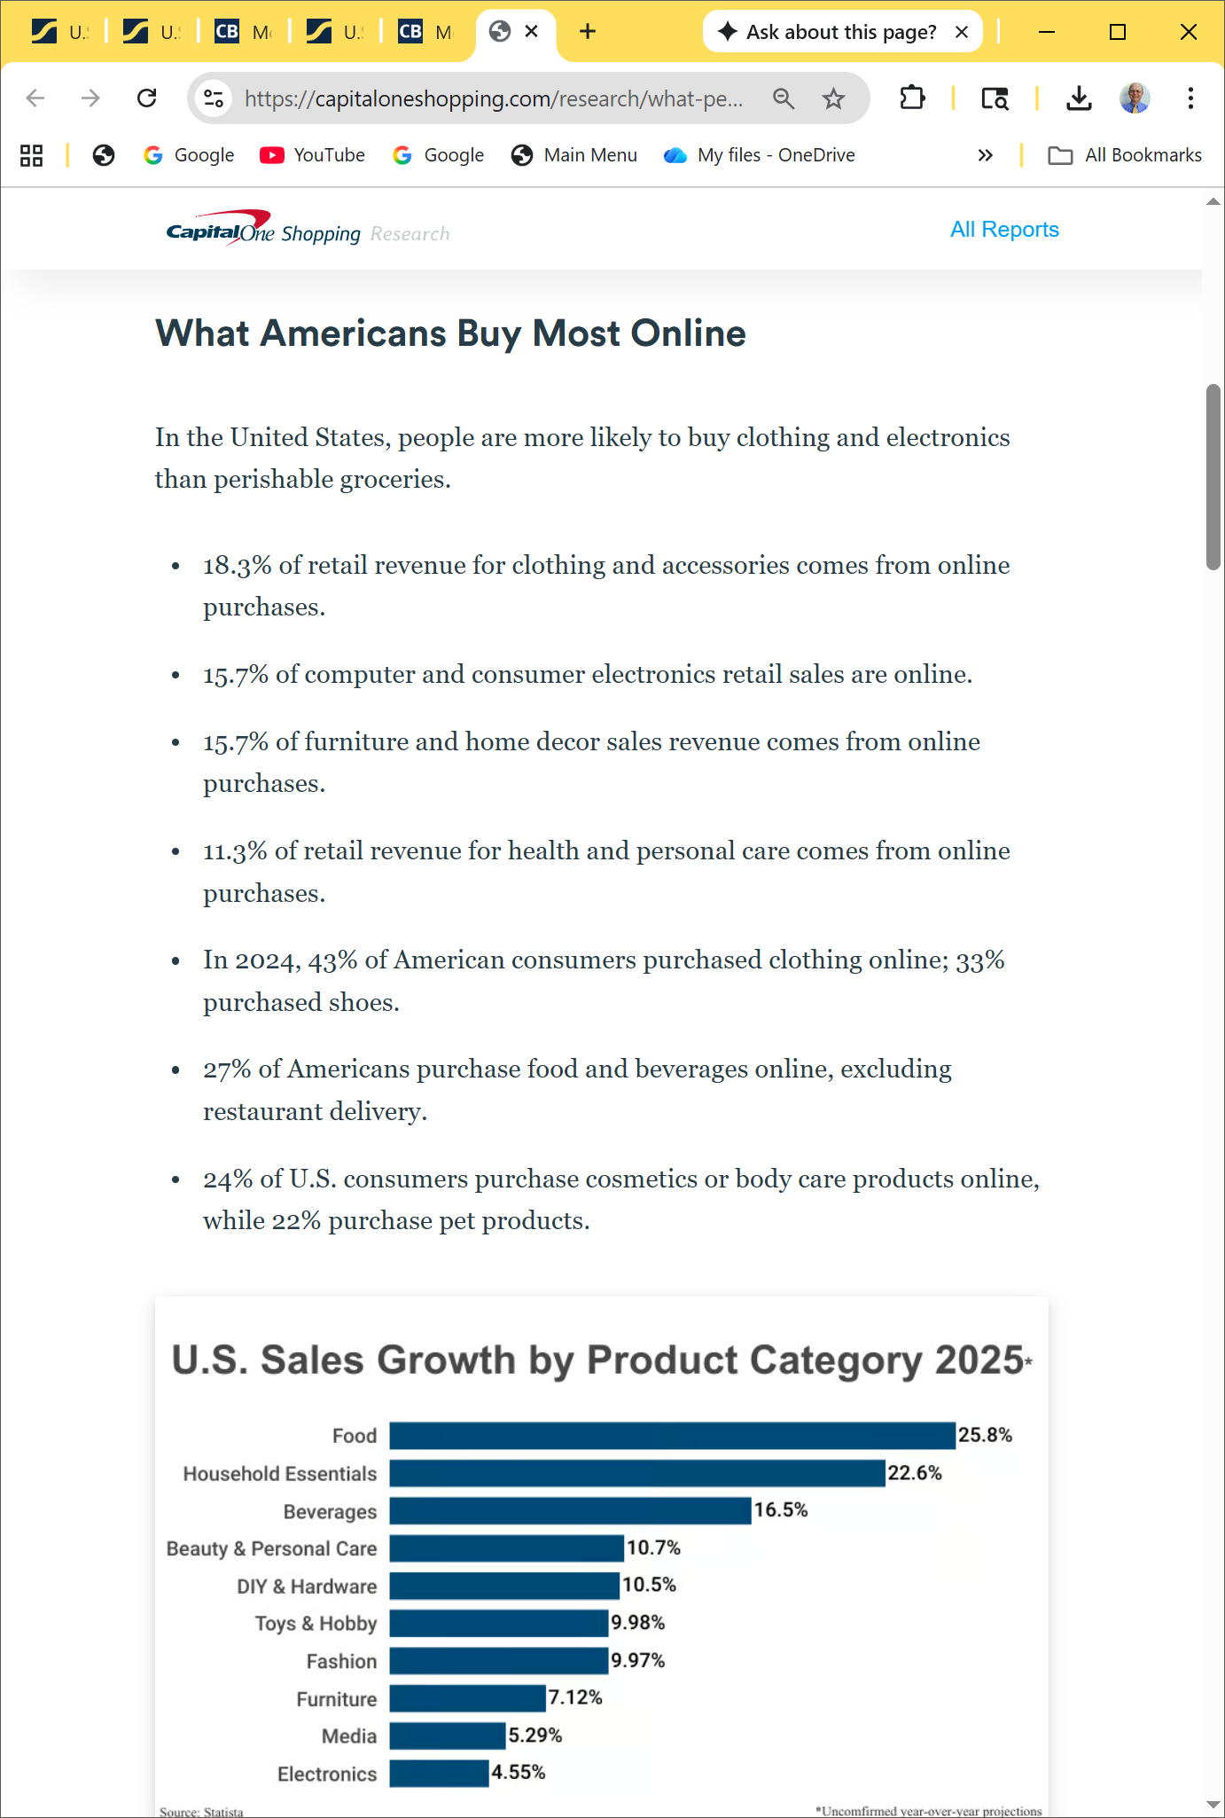

E-Commerce U.S. Retail Sales
What do people buy online? What Do People Buy Online (2023): Sales Data & Yearly Trends (capitaloneshopping.com):

Slide 13
Who’s On the Internet?
Table 12.1 Online population
Category | Percentage That Use the Internet
Men | 89%
Women | 86%
Age: 18-29 | 99%
Age: 30-49 | 96%
Age: 50-64 | 87%
Age: Over 65 | 57%
Household Income: Less than $30,000 | 79%
Household Income: $30,000 to $49,999 | 90%
Household Income: $50,000 to $74,999 | 95%
Household Income: $75,000 or higher | 98%
Education: High school graduate | 81%
Education: Some college | 94.1%
Education: College graduate | 98%
93% of American adults use the Internet.
Other Demographics:
http://www.pewinternet.org/
http://www.clickz.com
http://www.census.gov/eos/www/ebusiness614.htm

Slide 14
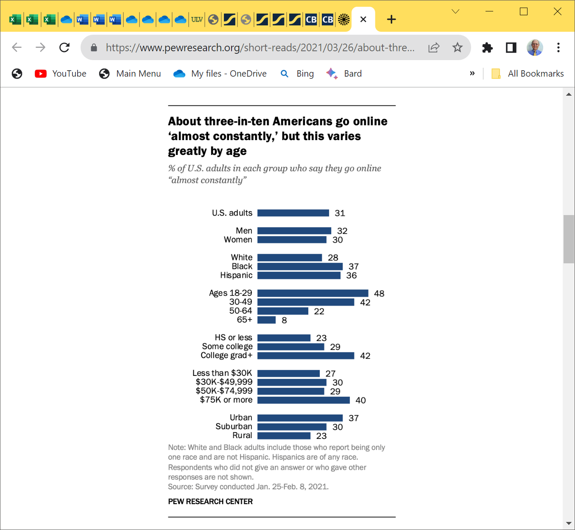


How Many Americans Admit to Being Online “Almost Constantly”?
Table 12.1 Americans online “almost constantly” Data from Pew Research Center Internet Project Survey.
Category | Percentage Online “Almost Constantly”
Adults | 26%
Men | 25%
Women | 27%
Age: 18-29 | 39%
Age: 30-49 | 36%
Age: 50-64 | 17%
Age: Over 65 | 8%
Household Income: Less than $30,000 | 24%
Household Income: $30,000 to $49,999 | 27%
Household Income: $50,000 to $74,999 | 23%
Household Income: $75,000 or higher | 35%
Education: High school graduate | 20%
Education: Some college | 28%
Education: College graduate | 34%
Source: https://www.pewresearch.org/fact-tank/2018/03/14/about-a-quarter-of-americans-report-going-online-almost-constantly/
https://www.pewresearch.org/short-reads/2021/03/26/about-three-in-ten-u-s-adults-say-they-are-almost-constantly-online/ available in 2023

Slide 15
12.5 E-Commerce Issues p.541
Intellectual Property – by registering a trademark
Security
denial of service DoS attacks have shutdown popular e-commerce sites
Fraud
fraudulent websites ask for credit card #s without any intent of delivering products
Taxation
State gov and local municipalities need sales tax to fund education, public safety, health, and many other services
International Commerce
Automatic website translation problem (systranlinks.com, worldlingo.com)
GUI – more letters in German than in English
Not offensive website but appealing – the culture of your target international audience
Credit card acceptance
Currency conversion
Cost of shipping
The availability of delivery

Slide 16
12.6 E-Commerce Security
Encryption
The conversion of data into an unreadable form, called a ciphertext.
Ensures privacy within an organization and on the Internet.
Decryption
The process of converting the ciphertext back into its original form, called plaintext or cleartext, so it can be understood.
The encryption/decryption process requires an algorithm and a key (a numeric code).

Slide 17
12.6 E-Commerce Security Encryption Types
Secure E-Commerce transactions use the encryption technologies below:
Symmetric-key Encryption
Asymmetric-key Encryption
Hash Encryption
SSL (Secure Sockets Layer)
Utilizes these 3 encryption technologies
Provides for secure transmission of data on the Internet.

Slide 18
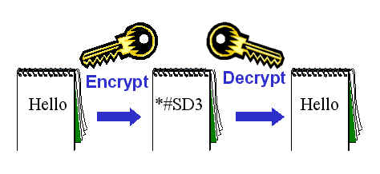
E-Commerce Security Types of Encryption(1)
1. Symmetric-key Encryption
Also called single-key encryption
Both encryption and decryption use the same key, which must be kept secret from others
Both the sender and receiver must know the key before communicating using encryption.
Advantage: speed

Slide 19
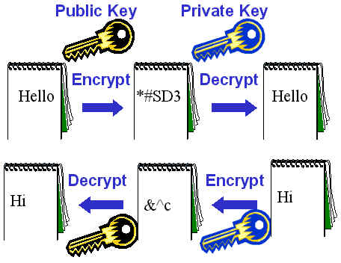
E-Commerce Security Types of Encryption(2) p.543
2. Asymmetric-key Encryption
Also called public-key encryption
There is no shared secret
Two keys are created at the same time:
Public key
Private key – stored on the web server of the key owner
They are mathematically related
Asymmetric-key encryption is much slower than symmetric-key encryption.

Slide 20
E-Commerce Security Types of Encryption(3)
3. Hash Encryption
Make sure the message is not changed / damaged during transmission
A hash algorithm transforms a string of characters into a key called “digest”
A shorter fixed-length value or key that represents the original string
Purpose: verify the integrity of information.

Slide 21
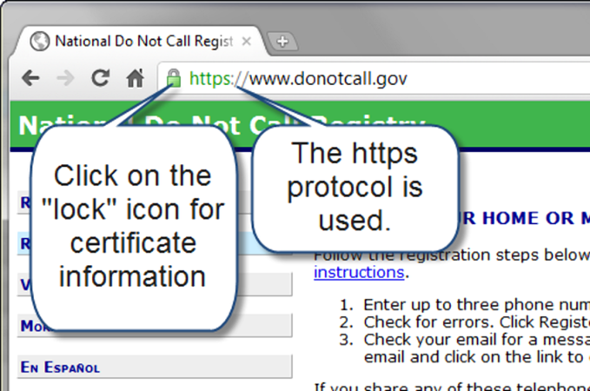
Secure Sockets Layer (SSL)
A protocol that allows data to be privately exchanged over public networks
Developed by Netscape
Encrypts data sent between a client (usually a Web browser) and a Web server.
Utilizes both symmetric and asymmetric keys.
“https” protocol (see https://www.amazon.com/ )
Browsers display a “lock” icon
National Do Not Call Registry =>
https://www.donotcall.gov/
- check with Firefox, Chrome

Slide 22
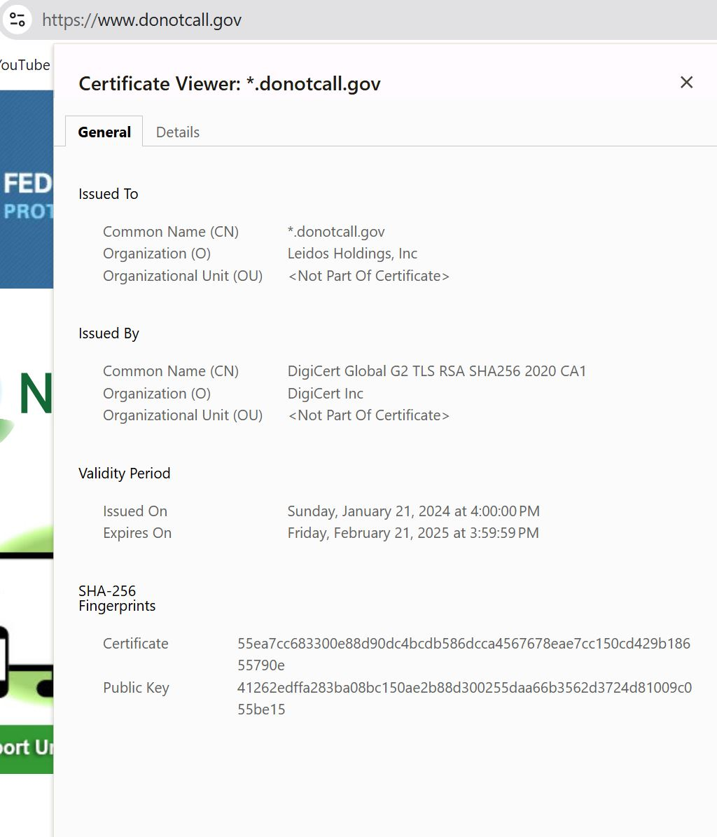

SSL in Action
Chrome ➔

Slide 23
Secure Sockets Layer (SSL)
SSL provides secure communication between a client and server by using:
Server and (optionally) client digital certificates for authentication
Symmetric-key cryptography using a "session key" for bulk encryption
Public-key cryptography for transfer of the “session key”
Message Digests (hash encryption) to verify the integrity of the transmission

Slide 24



SSL & Digital Certificate
Digital Certificate
A form of an asymmetric key
Also contains information about
the certificate,
the holder of the certificate, and
the issuer of the certificate.
Used by SSL to authenticate the identity
of the Web server
Use Firefox and click
on the lock ➔

Slide 25
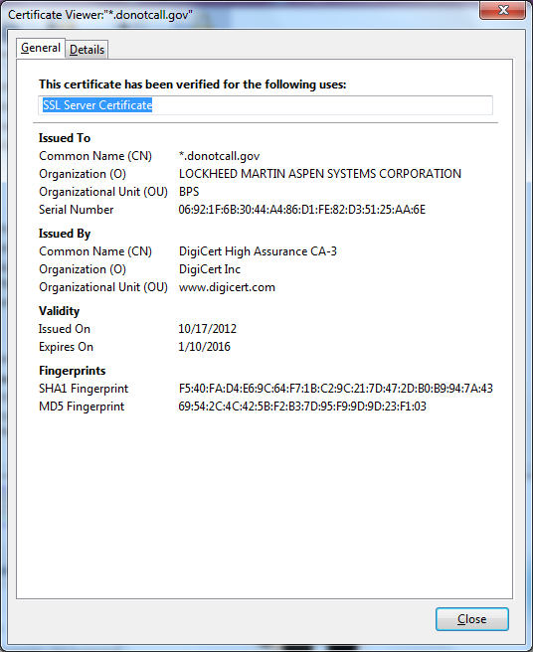
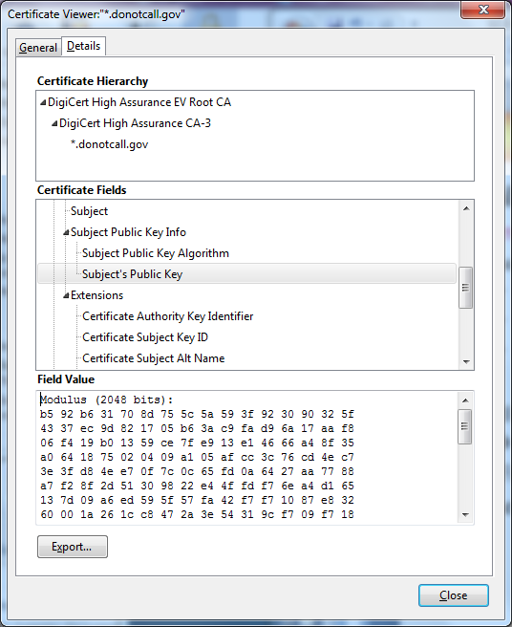
Digital Certificate
The contents of a digital certificate include:
The public key
Effective date of the certificate
Expiration date of the certificate
Details about the Certificate Authority -- the issuer of the certificate
Details about the certificate holder
A digest of the certificate content

Slide 26
Certificate Authority
A trusted third-party organization or company that issued digital certificates:
Well-known Certificate Authorities:
Thawte
http://www.thawte.com
Verisign
http://www.verisign.com
Entrust https://www.entrust.com

Slide 27
Obtaining a Digital Certificate
Request a certificate from a Certificate Authority and pay the application fee.
The Certificate Authority:
verifies your identity,
issues your Certificate,
and supplies you with a public/private key pair.
Store the certificate in your software - such as a web server, web browser, or e-mail application.
The Certificate Authority makes your certificate publicly known.

Slide 28
SSL & Digital Certificates – Tab.12.2 p.546
When you visit an e-commerce site that uses SSL, a number of steps are involved in the authentication process.
The web browser and web server go through initial handshaking steps using the server certificate and keys.
Once trust is established, the web browser encrypts the single secret key (symmetric key) that will be used for the rest of the communication.
From this point on, all data is encrypted using the secret key.

Slide 29
Checkpoint 12.1 p.685
Describe three advantages of e-commerce for an entrepreneur just starting a business.
Describe three risks that businesses face when engaging in e-commerce.
Define SSL. Describe how an online shopper can tell that an e-commerce site is using SSL.

Slide 30
12.7 Order & Payment Processing
E-Commerce Payment Models:
Cash
Check
Credit
Store value card
Smart card
Mobile Payment (m-payment)
NFC – Near Field Communication – a short-range communication
Virtual/digital wallet – purchaser using the Apple Pay and Google Pay digital wallets only have to tap their phone on a compatible NFC device to complete purchase
Digital cash – popular Bitcoin and Ethereum
A peer-to-peer payment network for digital money with no central authority.
A public ledger, called the blockchain, is kept of all crypto transactions.
Bitcoin is accepted by PayPal, Wikipedia, Microsoft, AT&T, Apple, Tesla, Starbucks, Whole Foods, Home Depot, Shopify, Burger King, Gucci, Netflix etc.
Who Accepts Bitcoin in 2025?

Slide 31
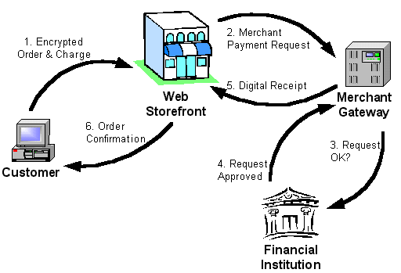
Credit Card Order Processing Flow

Slide 32
12.8 E-Commerce Technology Solutions
1. Instant Online Storefront - no need to install any software
you supply the products – use a template provided by the online storefront and choose features, configure settings, and add your products
Yahoo!, Earthstores, Shopify, BigCommerce – limited templates
2. Off-The-Shelf Shopping Cart Software –
provides a standardized set of e-commerce features (a shopping cart, order processing, and optional credit card payment processing) installed on your web server, and customized:
PayPal, Agoracart, osCommerce, ZenCart, Mercantec Softcart
3. Custom Built Solution from scratch
Use software development tools: Microsoft Azure Commerce, Adobe Commerce Cloud, Adobe Dreamweaver, DBMS, and server-side scripting such as PHP
A commerce server may be required: IBM's WebSphere Commerce Suite, Microsoft's Commerce Server
4. Semi-Custom Built Solutions on a Budget
Pre-written
order processing scripts
shopping cart scripts
Paypal order processing
Google Checkout
E-Commerce add-ons for Dreamweaver

Slide 33
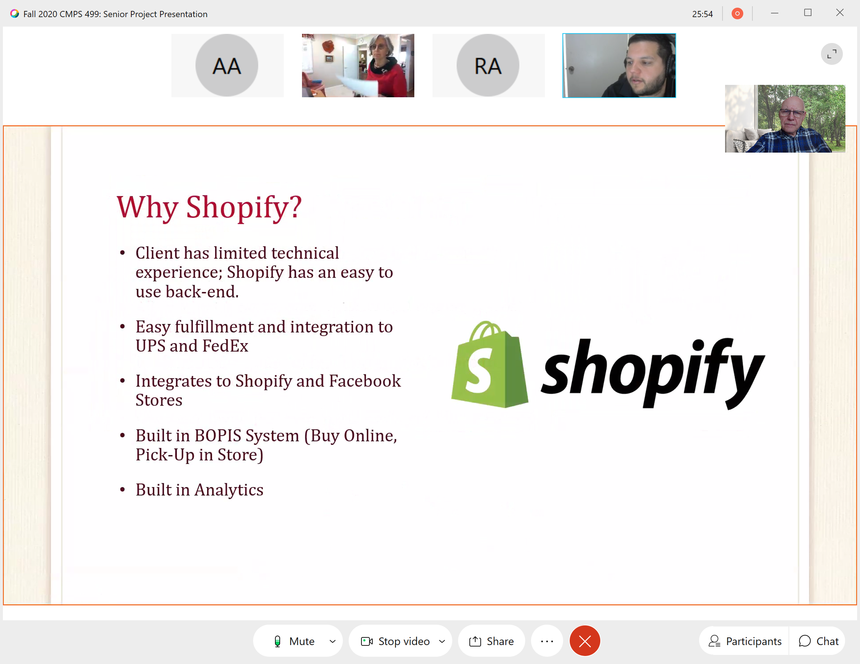
Why Shopify for e-commerce framework

Slide 34
Checkpoint 12.2 p.685
List three payment models commonly used on the Web. Which one is the most popular, why?
2. Have you purchased online? If so, think of the last item that you purchased.
Why did you purchase it online instead of at a store?
Did you check to see if the transaction was secure? Why or why not?
How will your shopping habits be different in the future?
Convenience, lower cost, and ease of shipping
3. Describe 3 types of available e-commerce solutions: The custom solution would be to create your own website but use PayPal to process the shopping cart and credit card transaction

Slide 35
Summary
This chapter introduced you to basic e-commerce concepts and implementations.
Consider taking an E-Commerce course to continue your study of this dynamic and growing area of web development.

Slide 36
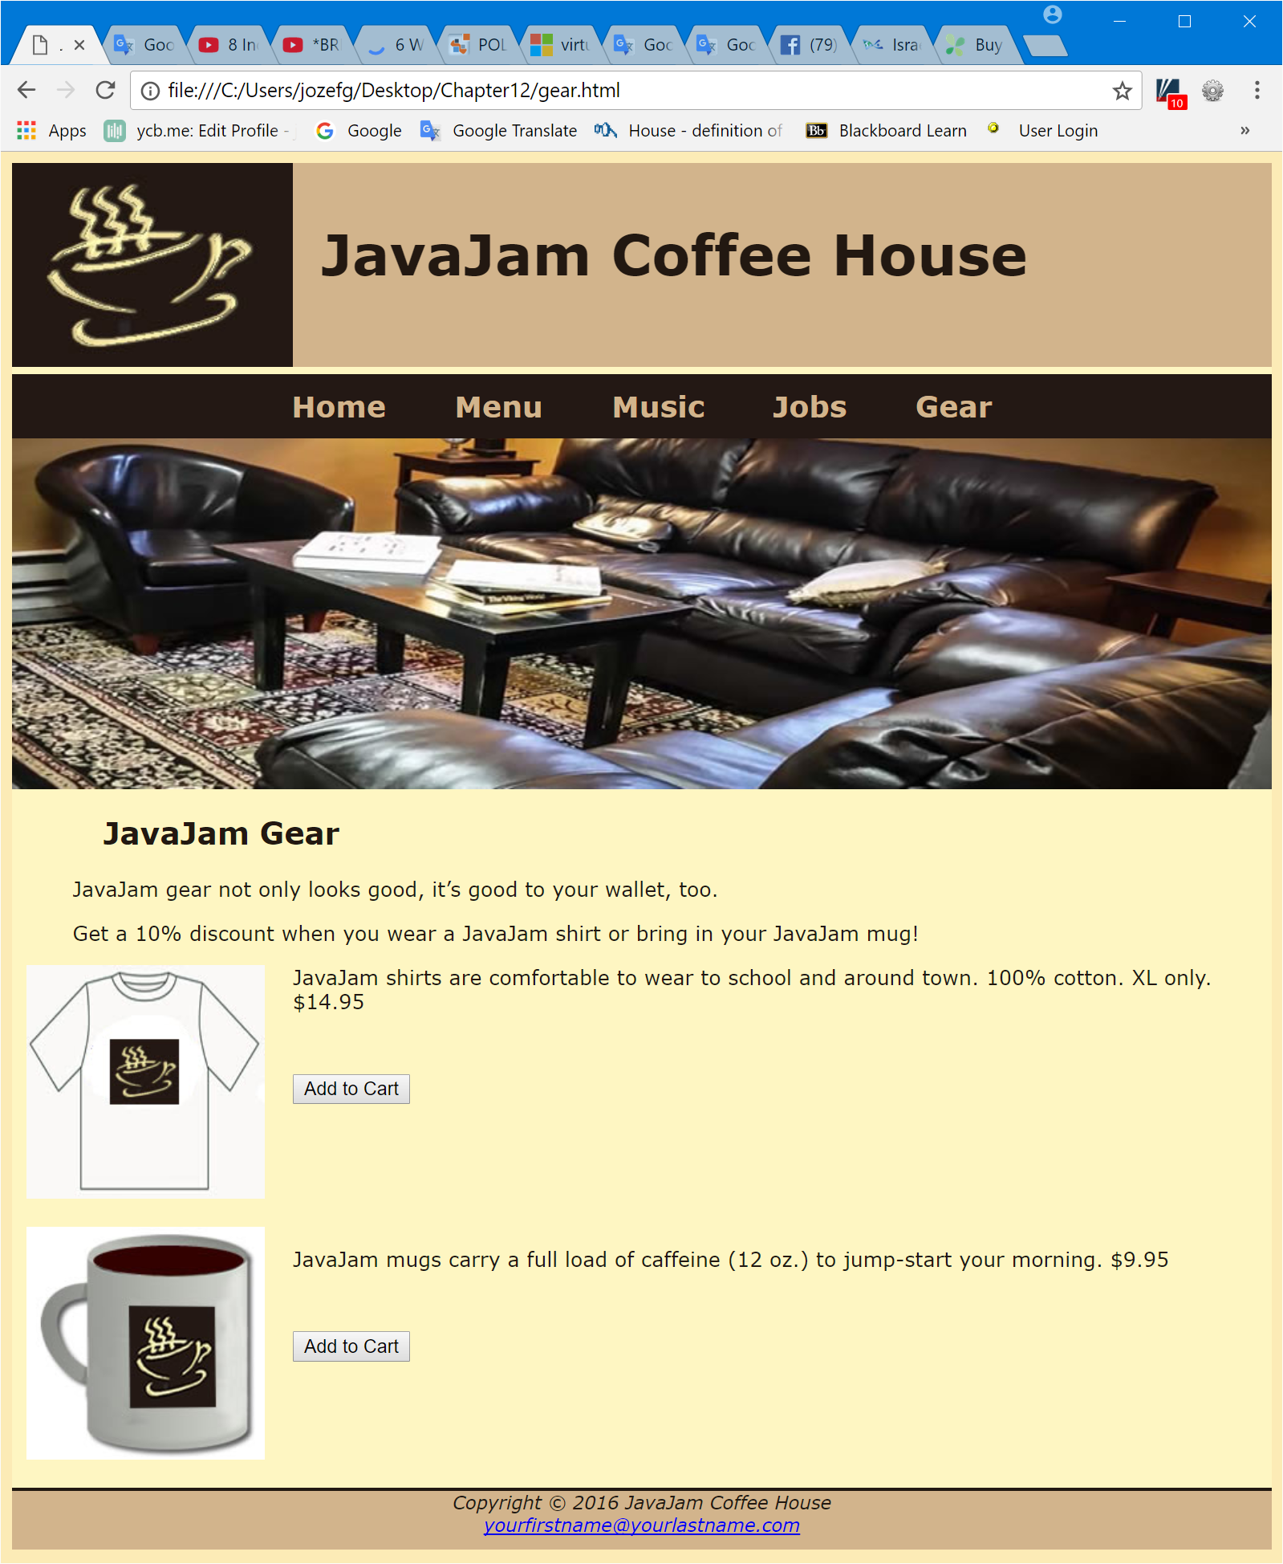
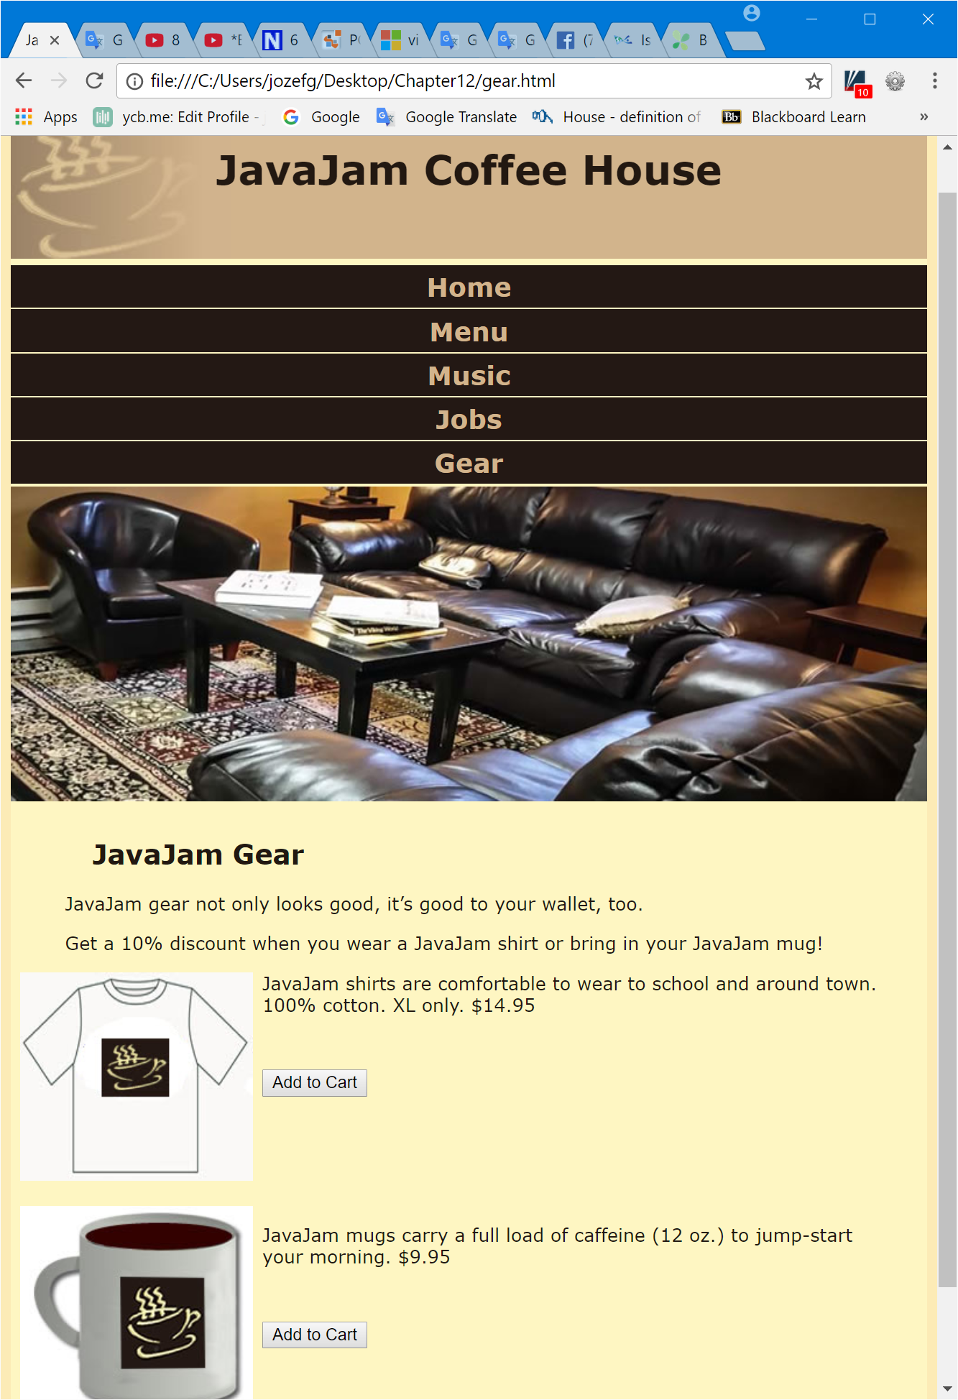
Case Study – Java Jam

Slide 37
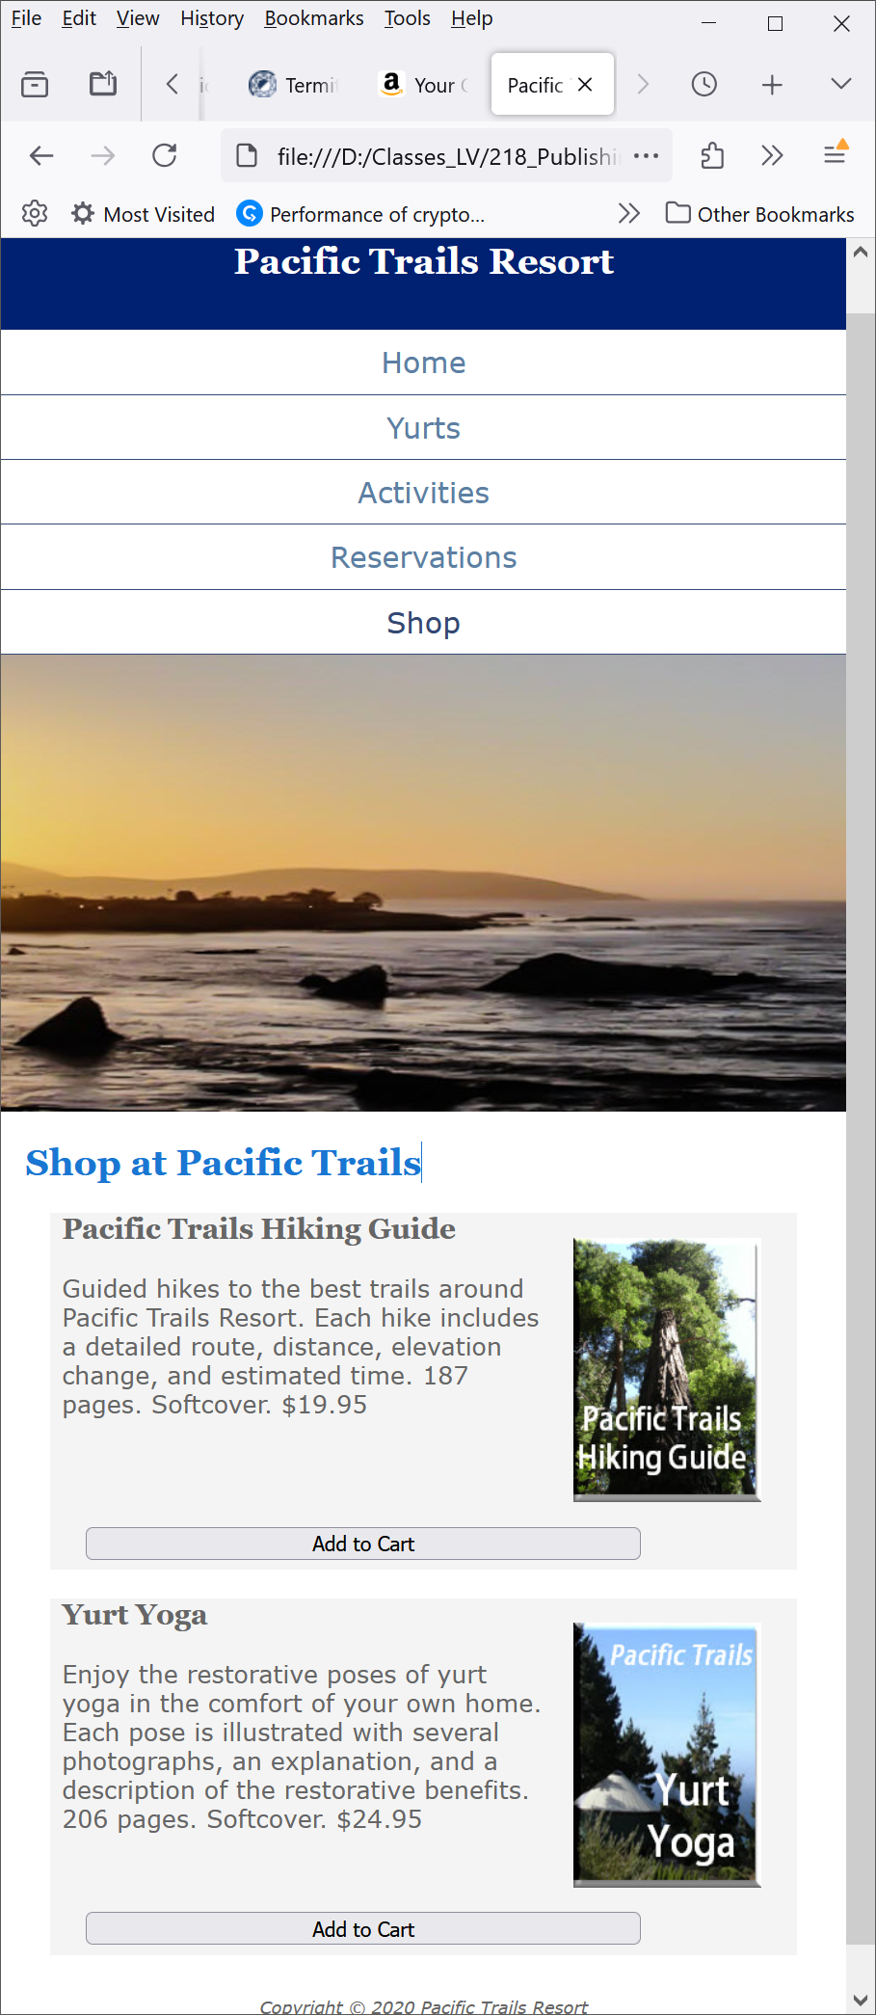
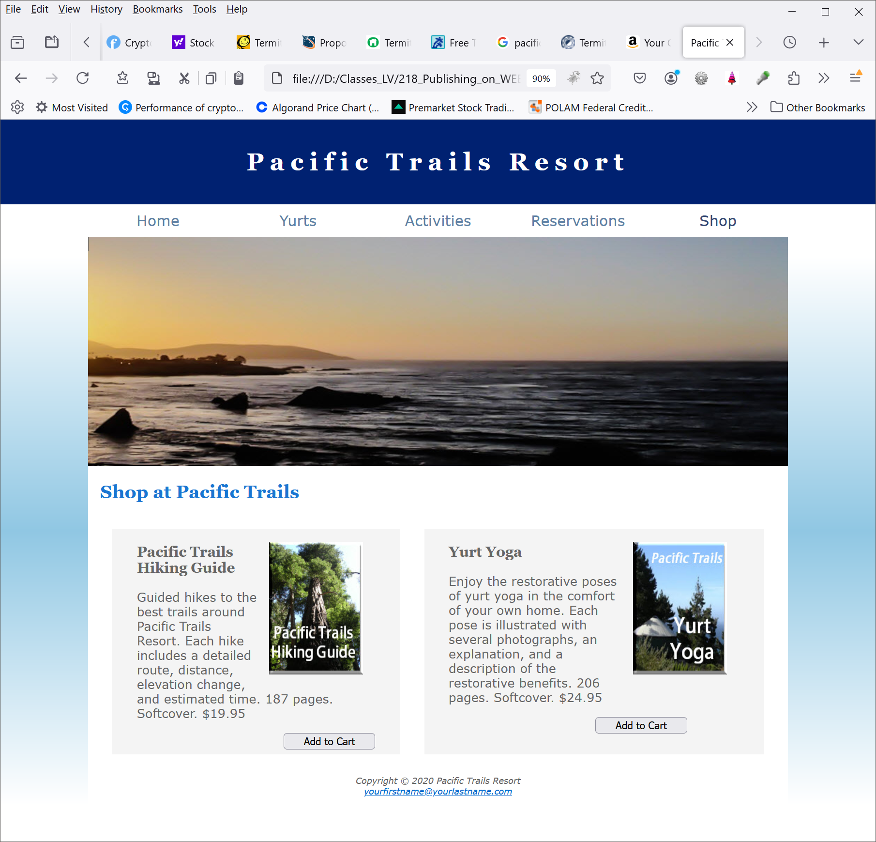

Case Study – Pacific Trails Resort

Slide 38
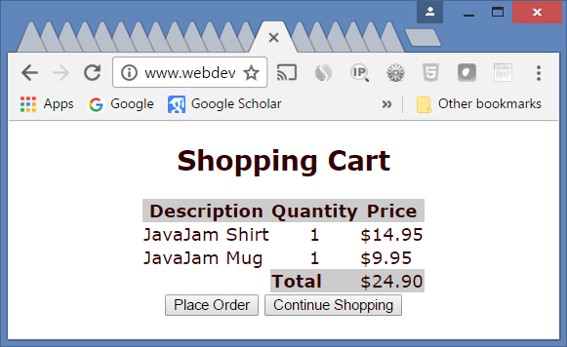
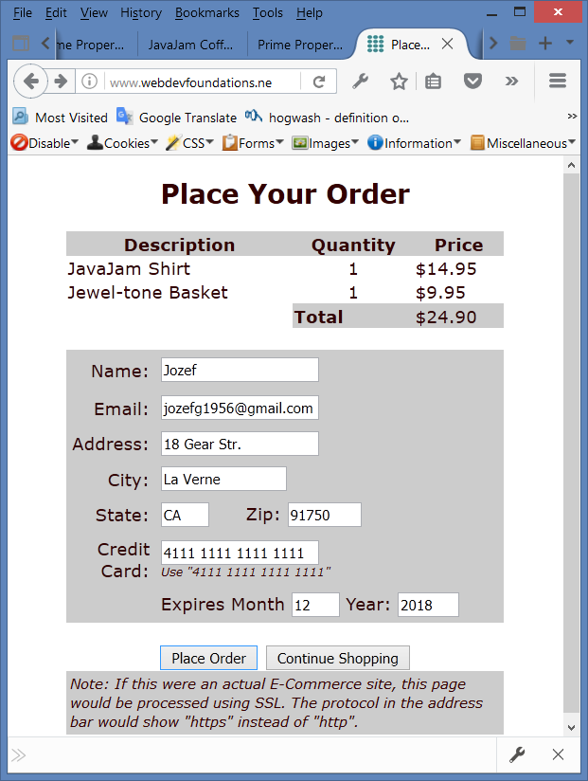
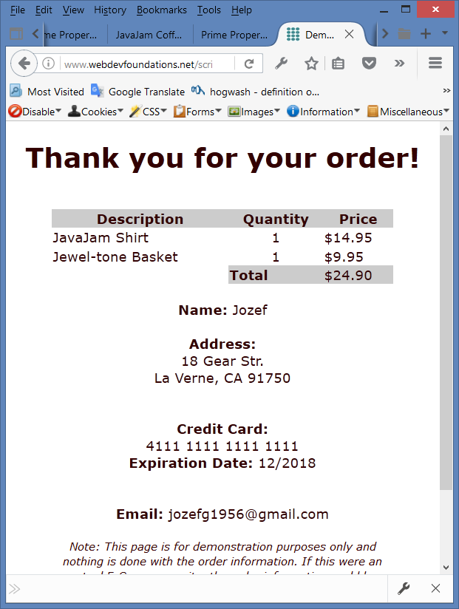
Case Study – Java Jam

Slide 39
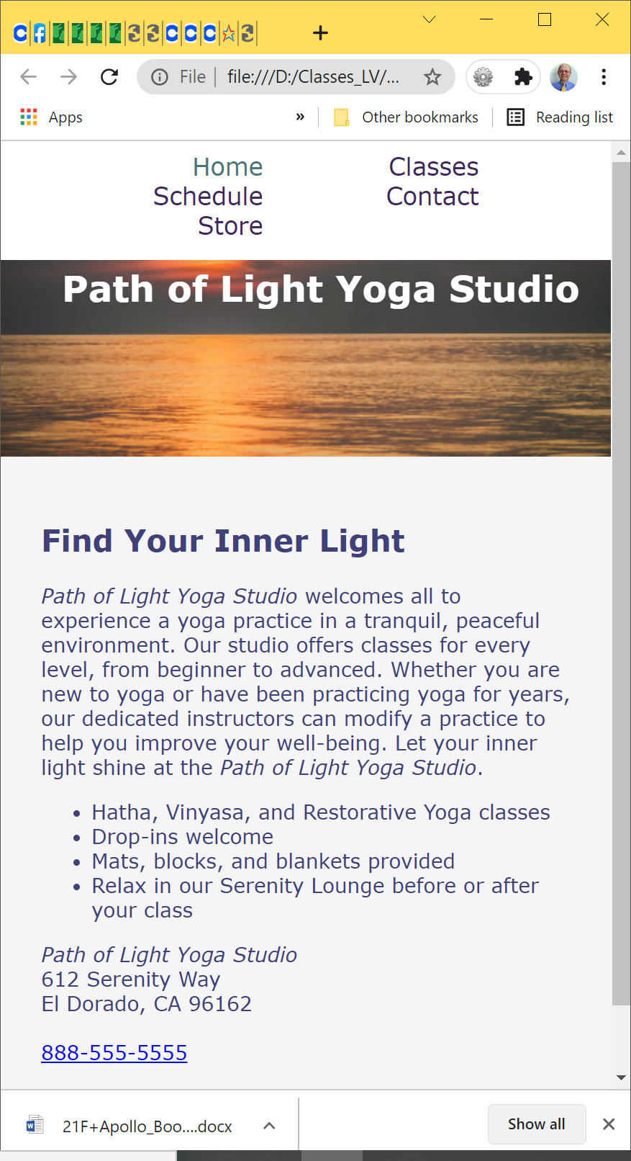
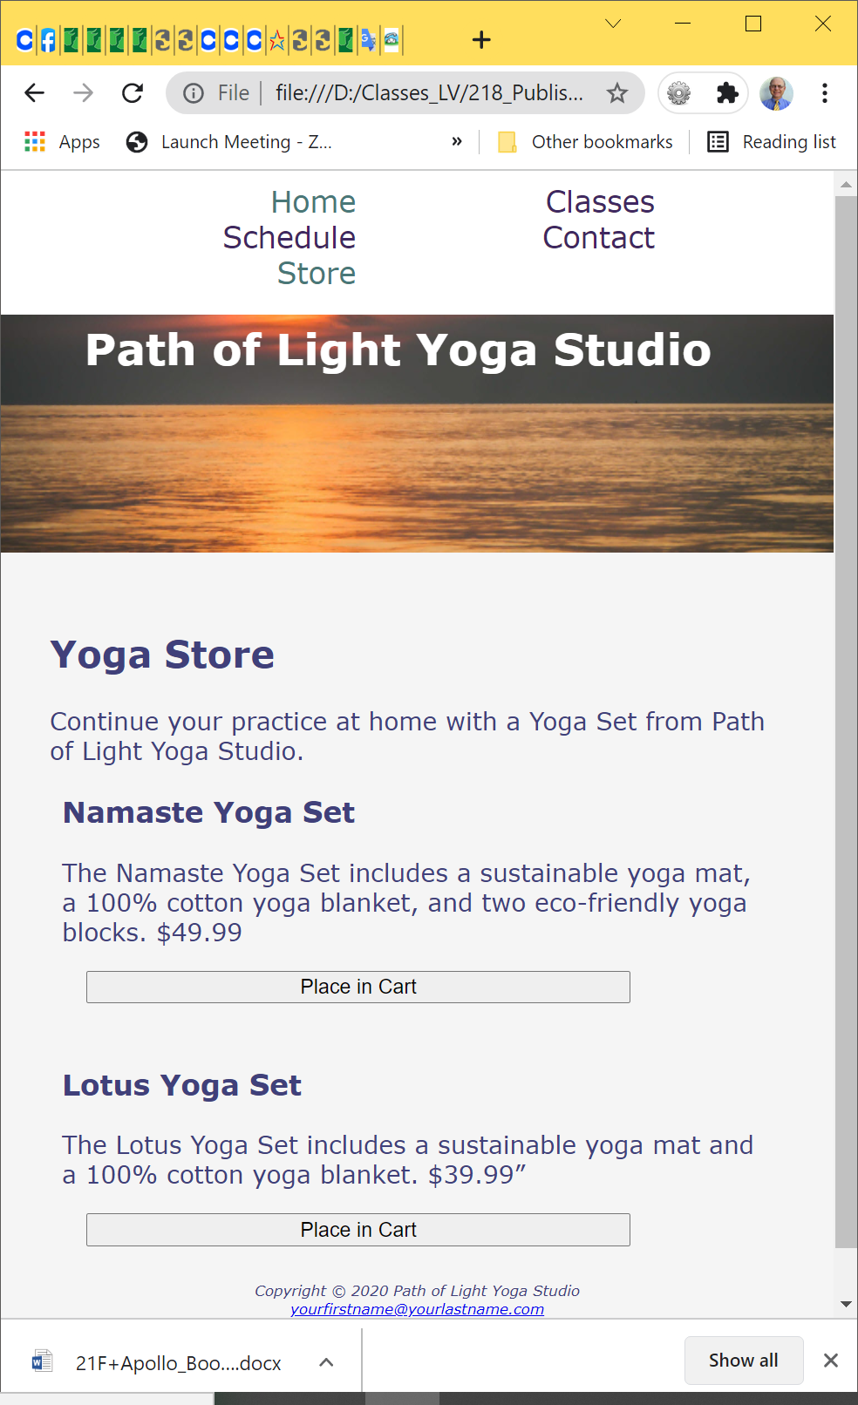
Case Study – Yoga Studio

