Slide 1
Learning Outcomes
HOP 13.1
Input Element Form Controls

Slide 2
Chapter 13
Web Promotion
Copyright (c) 2007Prentice-Hall. All rights reserved.
© 2011-24 Pearson Education

Slide 3

Learning Outcomes
In this chapter, you will learn how to:
  describe the difference between search engines and search indexes (directories)
  describe the components of a search engine
  design web pages that are friendly to search engines
  request that a web site is added to a search engine
  monitor a search engine listing
  describe other web site promotion activities
  configure an inline frame using the <iframe> element

Slide 4
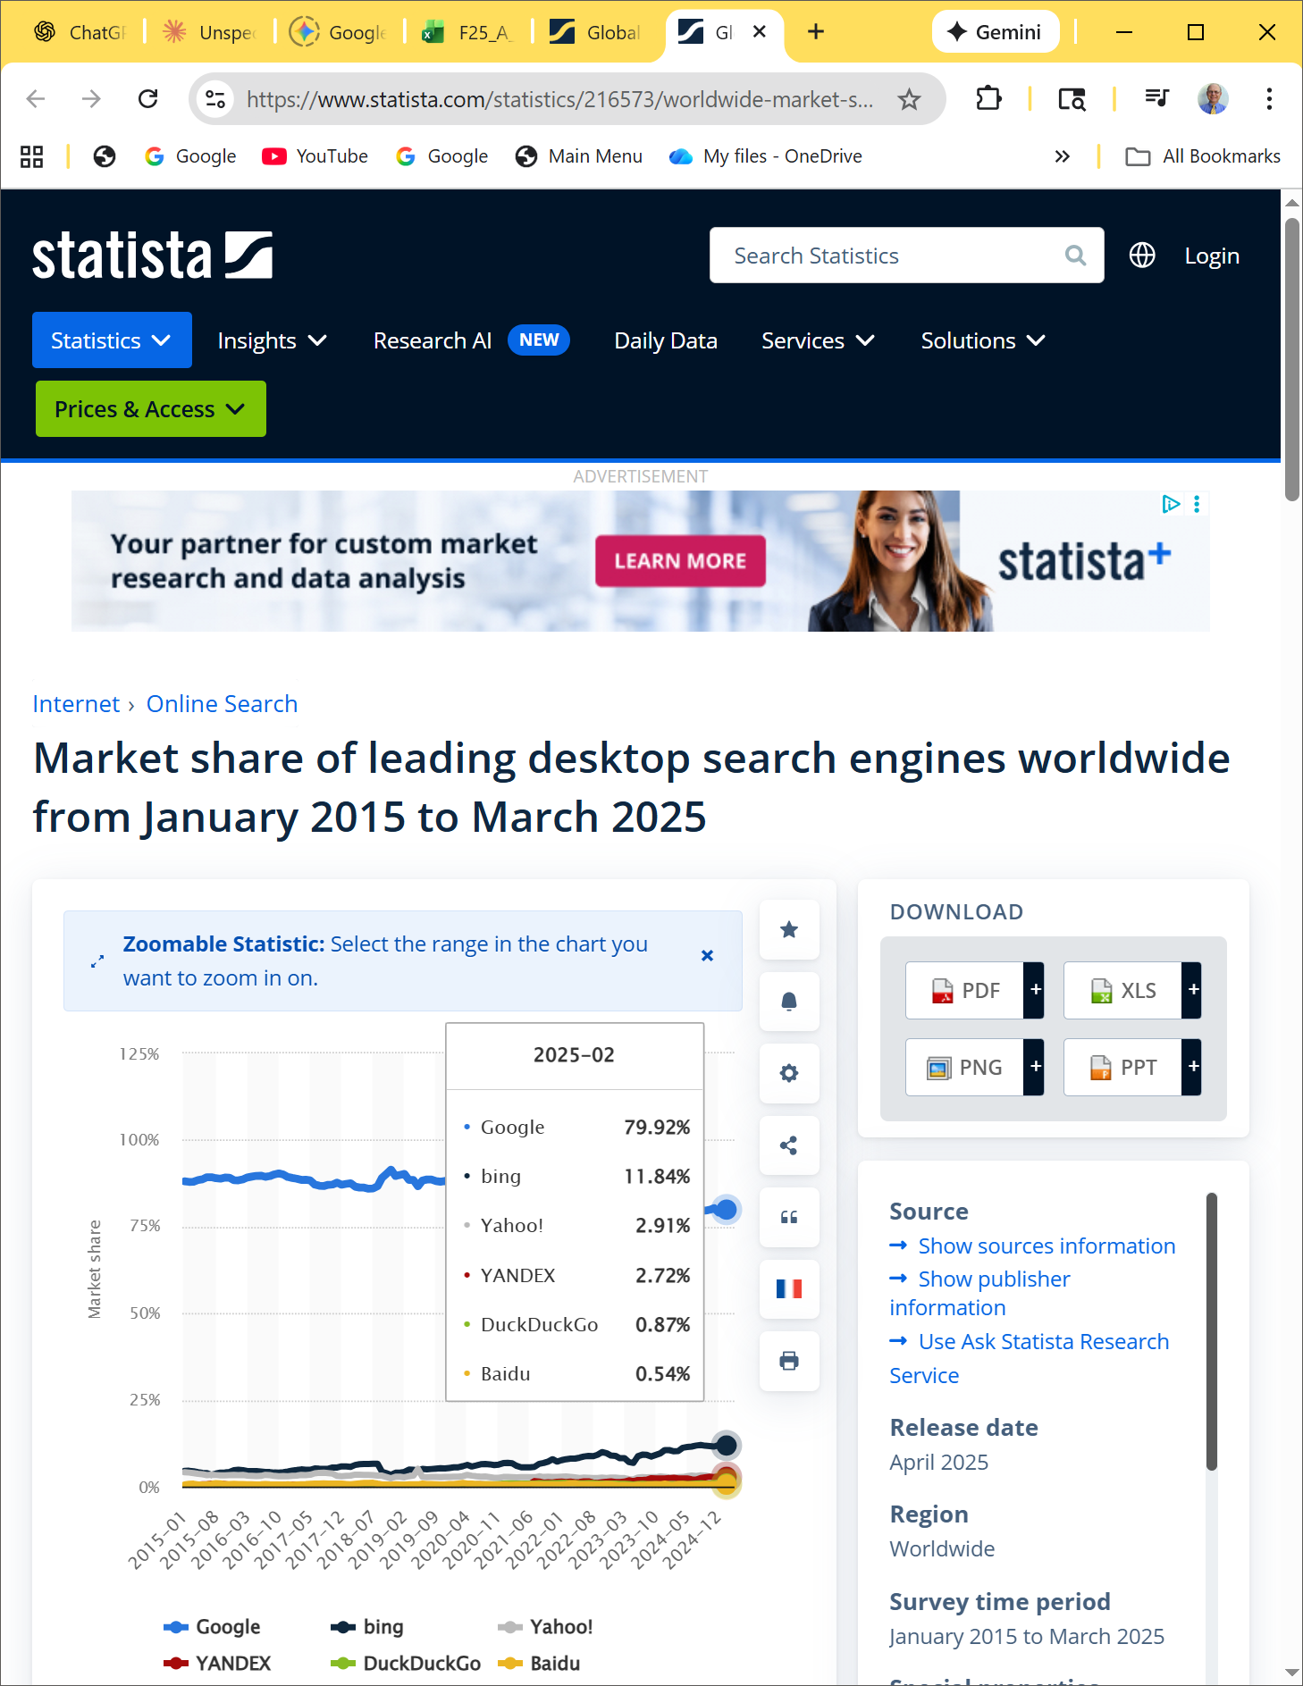
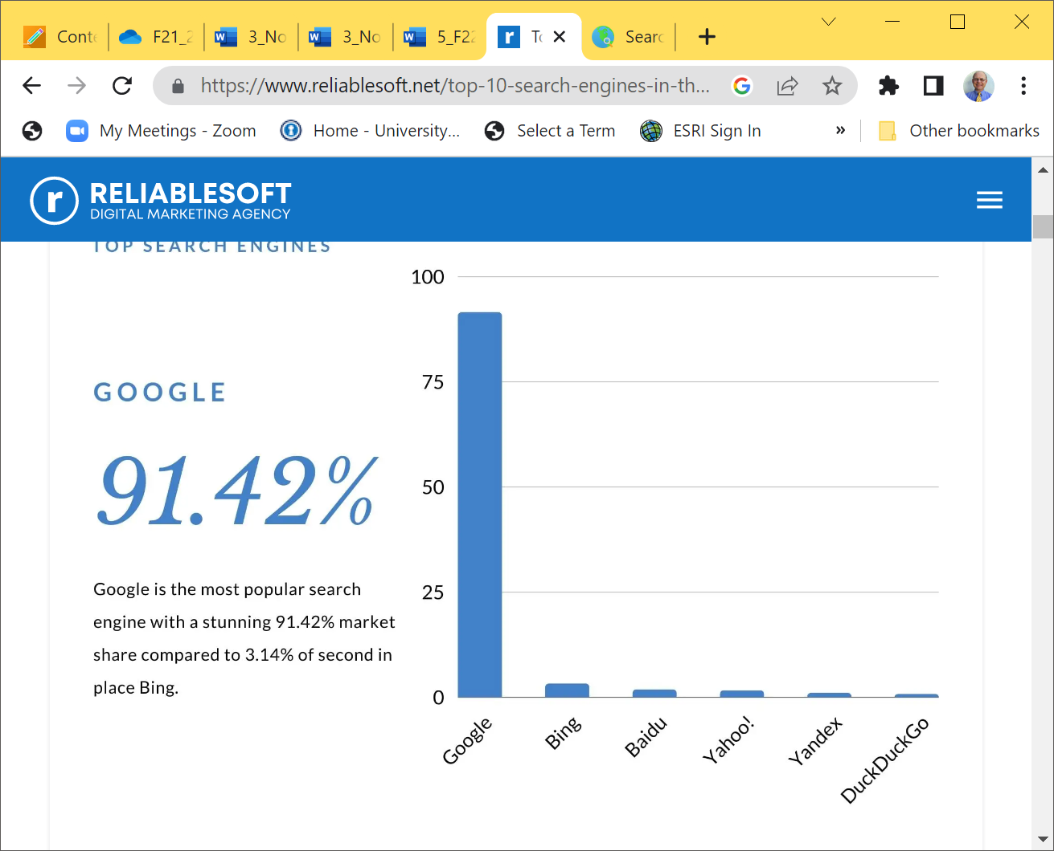


Popular Search Engines & Search Indexes
          The Best Search Engine in The World:
          Search Engine #1. Google.
          Search Engine #2. Bing.
          Search Engine #3.Yahoo!
          Search Engine #3. Baidu.
Google & Bing the two most popular sites used for searching the Web during a recent month
https://www.statista.com/statistics/216573/worldwide-market-share-of-search-engines/+++
Market share of search engines: https://www.stanventures.com/blog/top-search-engines-list/ Dec 2024:
1 | Google 89.73%, 2 | Bing, 3.97% 3 | Yahoo! Search, 2.72% 4 | Baidu, 0.96%

Slide 5
Popular Search Engines & Search Indexes
Search Engines & Search Indexes are very popular ways to navigate the web and find web sites
About 90% American adults use search engines on a typical day
5 times more likely to purchase goods or services as a result of finding a site through a search engine listing than through a banner ad
search engine listing can be an excellent marketing tool for your business

Slide 6
Search Index (aka - also known as: Search Directory)
Popular Search Indexes (or Search Directories):
  Yahoo!Search – a Yahoo! web search provider that uses Microsoft's Bing search engine to power results.
    http://www.yahoo.com
Each site is reviewed by an editor (a human) before accepted into a directory.
They maintain a hierarchical category of topics and places website listings into these categories.
  Search either by typing in a “search” term OR "drilling" down into the hierarchy for relevant sites.
Yahoo was originally a search index.
Yahoo’s main engine is now a search engine.

Slide 7
Search Engine Components
Popular Search Engines are programmatically driven:
  Google http://www.google.com – JavaScript, C++
      Internally Google people use many technologies including PHP, C#, Ruby and Perl
  Microsoft https://www.bing.com – ASP.NET (was http://msn.com)
  How Google Search Works - https://support.google.com/webmasters/answer/70897?hl=en&ref_topic=4558960++
Search engines use the following components:
  Robot or “spider”
  Database (also used by search directories)
  Search form (also used by search directories)

Slide 8
1. Search Engine Robot – crawling, discovering
Also called spiders, crawlers or bots
  A computer program that follows hyperlinks and “walks” (traverse) the Web pages - accessing and documenting Web pages automatically .
  Categorizes the pages and stores information in a database.
May access the following components of Web pages:
  title,
  meta tag keywords & meta tag description
  text in headings
  other text (the 1st few sentences) on the page
  hyperlinks
  spammers use them to scan for email addresses
More details http://www.robotstxt.org :
Use a special HTML <META> tag to tell robots not to go index the content of a page, and/or not scan it for links to follow.
For example:
<html> <head> <title>...</title> <META NAME="ROBOTS" CONTENT="NOINDEX, NOFOLLOW"> </head> …
robots can ignore your <META> tag. Especially malware robots that scan the web for security vulnerabilities, and email address harvesters used by spammers will pay no attention.
  the NOFOLLOW directive only applies to links on this page. It's entirely likely that a robot might find the same links on some other page without a NOFOLLOW (perhaps on some other site), and so still arrives at your undesired page.

Slide 9
2. Search Engine Database
After a page is crawled, Google tries to understand what the page is about.
This stage is called indexing (organizing info) and it includes processing and analyzing the textual content and key content tags and attributes, such as <title> elements and alt attributes, images, videos, and more.
All info is stored in the database.
Database DB:
  A collection of information organized so that its contents can easily be accessed, managed, and updated.
  The result of the search engine is from the DB
Database Management Systems (DBMSs) is used to
  Configure and manage database, such as
    Microsoft SQL Server, Oracle, MySQL, IBM DB2
Search Engine Database
  Contains information about web pages
    AOL and Yahoo! use a DB provided by Google

Slide 10
3. Search Engine Search Form
The part you are most familiar with!
The search form is the GUI graphical user interface that allows a user to request (prompt) a word or phrase to search for.
  It is usually just a text box and a submit button.
The visitor to the search engine types words (called keywords) related to their search into the text box.
When the form is submitted, the data typed into the text box is sent to a server-side script that searches the database using the keywords you have entered.
The search results (also called a result set) is a list that contains information such as the URLs for web pages that meet your criteria.

Slide 11
Search Engine Results Page (SERP)
A list of items that describe Web pages matching the search terms.
  Each item contains a link to a page along with additional information that might include the
    page title,
    a brief description,
    the first few lines of text,
    the size of the page, and so on.
The order the Web page items are displayed in the SERP may depend on:
  paid advertisements
  alphabetical order
  link popularity
Each search engine has their own policy for ordering the search results.
Notes:
When a user enters a query, our machines search the index for matching pages and return the results we believe are the highest quality and
most relevant to the user's query.
Relevancy is determined by hundreds of factors, which could include information such as the user's location, language, and device (desktop or phone).
For example, searching for "bicycle repair shops" would show different results to a user in Paris than it would to a user in Hong Kong.

Slide 12
HTML <meta> tag
The meta element
  A stand-alone tag
  Placed in the head section
  Attributes:
    name
    content
<meta name="value" content="value" >
Meta tags used by search engines:
  name=“keywords”
  name=“description”

Slide 13
Designing Web Pages for Promotion
Keywords
  Terms and phrases that people may use when searching for your site.
  Words or phrases that describe your web site or business.
  Create a list of them.
  Include common misspellings.
  It is highly advised that each page on the website have its own set of keywords to attract visitors
Description
  What is special about your web site that would make someone want to visit?
  25-30 words -- inviting and interesting
  Some search engines will display your description in the SERP

Slide 14
Keywords & Description Meta Tags
Example: “Acme Design”
<meta name="keywords" content="Acme Design web development e-commerce ecommerce consulting consultation maintenance redesign Akme” >
<meta name="description" content="Acme Design, a premier web consulting group that specializes in E-commerce, web site design, web site development, and web site re-design." >
Remember to create keywords and description metatag on each page in your final project.
If you don’t want a search engine to index a page
    designated for a small group of individuals):
<meta name=“robots" content=“noindex,nofollow” >

Slide 15
More about HTML <meta> tag
The meta element
  A stand-alone tag
  Placed in the head section
  Attributes:
    http- quiv
    content
<meta http-equiv=“value" content="value" >
<meta http-equiv=“author" content=“Jon Smith" >
<meta http-equiv=“pragma" content=“no-cache" >
  Prevent the browser from caching the page
<meta http-equiv=“expires" content=“Fri, 04 Apr 2020 23:59:59 GMT" >
  When the page should expire

Slide 16
13.4 Search Engine Optimization (SEO)
Hints on designing your pages for search engines
– a process is called SEO
Search engines are the top method used to drive a traffic to their sites
  66 % of Web marketers rated as the top method
Title element includes the company and/or Web site name
Meta Tags
Heading tags include keywords
Text on page includes keywords
Navigation links can be followed by robot

Slide 17
Search Engine Optimization (SEO)
6. Linking
  Provide text navigation hyperlinks
  Verify that all hyperlinks are functioning
7. Page Layout
  Use CSS for page layout
8. Images & Multimedia
  Configure meaningful alternate text
  Be aware that text and hyperlinks contained within Flash media or use technologies such as Flash and Silverlight may not be accessed by search engine robots

Slide 18
Search Engine Optimization (SEO)
9. Valid Code (if code pass validation test and well structured) more likely help your placement in the search engines result – use validators
  Validate HTML
  Validate CSS
10. Content of Value
  Follow Web Design Best Practices => ch5 & Table 5.1
  Your website should contain
    High-quality, well-organized content that is
    Meaningful & useful to your target audience
https://www.searchenginejournal.com/complete-seo-checklist-for-website-owners/261327/ - SEO Checklist 11/2023

Slide 19
13.5 Submitting your Website to a Search Engine p.570
Wait until your site is finished
Don’t submit “under construction” Web sites!
Visit Search Engine and look for “Add URL” or “Add your Site” or “Submit your Site” as follows:
  http://www.google.com/addurl/
  https://scribeage.com/submit-your-site-to-yahoo/ - Yahoo site submission is powered by Bing’s Search Engine; however, Yahoo controls the design and results displayed on its search engine results pages.
  Free to submit your website URLs to 40+ of the most popular search engines. https://www.free-web-submission.co.uk/index11.html?msclkid=f55704509367148f6b8f610388052794&utm_source=bing&utm_medium=cpc&utm_campaign=Free%20Web%20Sub%20New%20Euro%2B%20Conv%20Kywds&utm_term=submit%20url%20to%20yahoo&utm_content=Ad%20group%20%231
Follow the directions and fill out the form
A robot from the search engine will visit your Web site and index it
  indexing is the process by which search engines organize information before a search to enable super-fast responses to queries
  Allow several weeks and test the search engine to see if your site is listed

Slide 20
Preferential Placement
Free listing
Paying for listing
  refer to as an express submit or express inclusion
Paying for preferential placement
  called sponsoring or advertising
Paying each time a visitor clicks the search engine’s link to your site
Check search engines for current preferential placement options
Promotions vary
  Google’s AdWords (right side of the search result) and AdSense
  Yahoo’s Sponsor Search results are powered by Yahoo!Search Marketing.

Slide 21
Preferential Placement
Commonly used acronyms:
  CPC – Cost Per Click (PPC – Pay Per Click)
  The price you are charged if you have signed up for a paid sponsor or ad program and a visitor clicks on a link to your Web site.
  CPM – Cost Per Impressions
  Your cost for every 1000 times that your ad is displayed on a Web page (whether or not the visitor clicks on your ad).
  CTR – Click Through Rate
  The ratio of the number of times an ad is clicked on to the number of times an ad is viewed.
  For example if your ad was shown 100 times and 20 people clicked on it, your CTR would be 20/100 or 20%.

Slide 22
Mapping Your Site – useful for SEO
HTML Sitemap Web page
  Provide a hierarchical list of links, used by visitors and accessed by search engines.
XML Sitemap file p.571
  Accessed only by search engines
    location of Web pages with URL,
    last date updated,
    frequency of update, and
    priority indicators using XML format
  Automatic generator of XML sitemap is at http://www.xml-sitemaps.com/+ and then upload it to your website and notify Google of its URL
    Go to your Google Webmaster account and add your sitemap URL
    Track your site's search performance with Google Search Console
  See Webmaster Tools at https://www.google.com/webmasters/support/
    I want my site to be in Google search results
    I want my site to rank well on Google Search
    I want Google Search to display my updated content

Slide 23
Checkpoint 13.1 p.686
Describe the three components of a search engine.
  Robot or “spider”
  Database (also used by search directories)
  Search form (also used by search directories)
What’s the purpose of the description meta tag?
Is it beneficial for a business to pay for site submission (Yahoo)? Is it beneficial for a business to pay for preferential listing? Explain.
  To submit a site to Yahoo! is $299.
  Visitors are more likely to find your site if it is listed in the 1st page of search result
  Consider preferential, Yahoo!s Sponsored Search, and Google’s AdWords

Slide 24
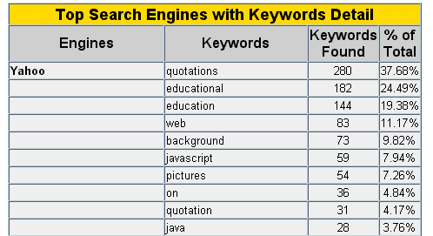
13.6 Monitor Search Engine Listings
Find which keywords work by using method 1 and 2 below
1. Manual Check – visit search engine and type different keywords of your website, then compare, modify your keywords over time
2. Web Analytics p.573:
  "the measurement, collection, analysis and reporting of Internet data for the purposes of understanding and optimizing Web usage.“
Analyze your web site logs (a powerful marketing tool – let you know which set of keywords are working or not), for example:
Then improve the keywords
Run an automated tool:
  Google analytics http://www.google.com/analytics/ to track and analyze visitors, traffic sources, content, keywords and goals
  http://webtrends.com - see benefits

Slide 25
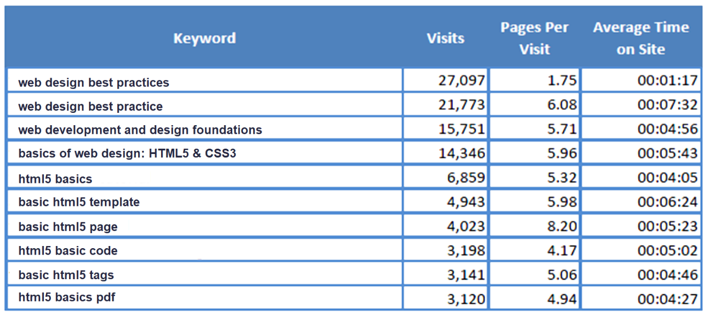

Monitor Search Engine Listings
10 top keywords used by web visitors when searching Google to find particular website
Analyze web site logs

Slide 26
13.7 Link Popularity
A rating determined by a search engine based on:
  the # of sites that link to a particular Web site
  the quality of the sites that the links are from (such as http://www.oprah.com) to your website
The link popularity of your web site can help determine its order in the SERP (Search Engine Results Page)

Slide 27
Checking Link Popularity methods
Analyze your log file
2. Visit a link popularity checking service web site
  http://linkpopularity.com - check http://www.laverne.edu/
  http://www.seochat.com/seo-tools/link-popularity/

Slide 28
Social Media Optimization - SMO
Reach out to your current and potential website visitors with SMO by creating content of value that is easily sharable.
Add your site to social bookmarking sites and social networking sites like Twitter and Facebook:
increase the linkability of the content
more highly visible in social media searches on custom search engines (such as Technorati)
Include relevant posts on blogs, podcasts and embed video (e.g. YouTube) on your site
Go -
5 Rules of Social Media Optimization (SMO) –
http://www.rohitbhargava.com/2006/08/5_rules_of_soci.html +++
https://digitalbrandinginstitute.com/5-rules-of-social-media-optimization-smo/
Notes:
Here are 5 rules we use to help guide our thinking with conducting an SMO for a client's website:
1.Increase your linkability – This is the first and most important priority for websites. Many sites are "static" – meaning they are rarely updated and used simply for a storefront. To optimize a site for social media, we need to increase the linkability of the content. Adding a blog is a great step, however there are many other ways such as creating white papers and thought pieces, or even simply aggregating content that exists elsewhere into a useful format.
2.Make tagging and bookmarking easy – Adding content features like quick buttons to "add to del.icio.us" are one way to make the process of tagging pages easier, but we go beyond this, making sure pages include a list of relevant tags, suggested notes for a link (which come up automatically when you go to tag a site), and making sure to tag our pages first on popular social bookmarking sites (including more than just the homepage).
3. Reward inbound links – Often used as a barometer for success of a blog (as well as a website), inbound links are paramount to rising in search results and overall rankings. To encourage more of them, we need to make it easy and provide clear rewards. From using Permalinks to recreating Similarly, listing recent linking blogs on your site provides the reward of visibility for those who link to you
4. Help your content travel - Unlike much of SEO, SMO is not just about making changes to a site. When you have content that can be portable (such as PDFs, video files and audio files), submitting them to relevant sites will help your content travel further, and ultimately drive links back to your site.
5.Encourage the mashup!!! – In a world of co-creation, it pays to be more open about letting others use your content (within reason). YouTube's idea of providing code to cut and paste so you can imbed videos from their site has fueled their growth. Syndicating your content through RSS also makes it easy for others to create mashups that can drive traffic or augment your content.

Slide 29
SMO Benefits & Methods
Benefits of SMO - Social Media Optimization :
  Increased brand awareness
  Increased inbound links (helpful for SEO)
Methods
  Add your site to:
    Social bookmarking services
    Blogs & RSS feeds
    Social Networking
      Twitter
      Facebook
      LinkedIn
      YouTube etc.
To successfully use Blogging to gain new visitors you should add a blog to your site and feed it regularly with new postings relevant to the content presented on the site;
this not only makes the site more interesting but also what pros call a “sticky factor” gives visitors a reason to check back regularly on your site and therefore ultimately increasing your ranking on popular search engines.

Slide 30
Other Site Promotion Activities p.575-7
There are a # of other ways you can promote your Web site, including:
  QR (Quick Response) Code – next slide
  Affiliate Programs – promotes another website’s product/services in exchange for a commission, my link to amazon.com – if my visitor purchase at amazon.com I will get a commission
  Banner Ads
  Banner Exchange – agree to show banners on both sites
  Reciprocal Link Agreements – agree to link to each other
  Newsletters
  “Sticky” Site Features – keeping the content fresh
  Blogs – journals on the Web
  RSS (Rich Site Summary) Feeds (.rss)
  Personal Recommendations
  Web Rings
  Newsgroup and Website Forum Postings
  Traditional Media Ads – print, TV, radio, business cards etc.
  Leverage Existing Marketing Materials

Slide 31
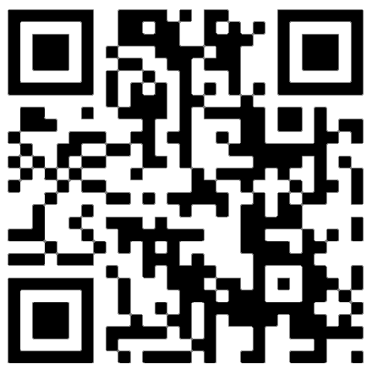
QR (Quick Response) Code p.559
A two-dimensional barcode in a square pattern that is readable by a smartphone camera scan application (ScanLife or QR Code Scanner) or a QR barcode reader
The data encoded can be
  Text
  Tel # r
  URL website (to promote your website or course)
  etc.
Free online QR code generators:
  http://qrcode.kaywa.com
  http://www.qrstuff.com+++ – incorporate QR in your Website
  http://www.labeljoy.com/en/generate-qr-code.html

Slide 32
Checkpoint 13.2 p.686
Are the results returned by various search engines really different?
  Choose a place, music group, or movie to search for.
  Enter the same search terms, such as “Door County” into the following three search engines: Google, Yahoo!, Ask.com.
  List the URLs of the top three sites returned by each.
  Comment on your findings.

Slide 33
Checkpoint 13.2 p.686
2. How can you determine if your web site has been indexed by a search engine?
See Web log reports if website host provides the names of Google’s spider – Googlebot => www.robotstxt.org
How can you determine which search engines are being used to find your site?
  Do experiment
3. List 4 web site promotion methods that do not use search engines.
Which would be your first choice? Why?
  Affiliate Programs
  Banner Ads
  Banner Exchange
  Reciprocal Link Agreements
  Newsletters
  “Sticky” Site Features
  Blogs
  RSS (Rich Site Summary) Feeds (.rss)
  Personal Recommendations
  Web Rings
  Newsgroup and Listserv Postings
  Traditional Media Ads
  Leverage Existing Marketing Materials

Slide 34
Inline (Floating) Frames
<iframe> tag
  Enables you to insert an HTML document in a frame anywhere in another HTML document (Web page)
  Embeds one Web page within another in a scrolling area
  Configure with the <inline> tag
  iframe are not supported by all browsers

Slide 35
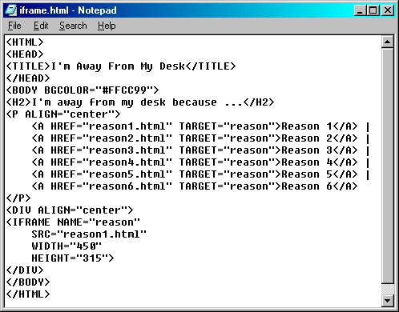
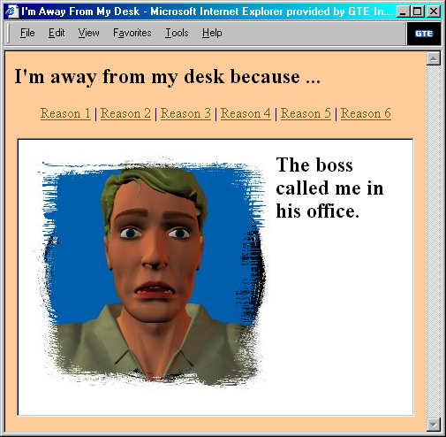

Inline (Floating) Frames
  <!– initially reason1.html will be displayed in the frame-->

Slide 36

Hands-On Practice
HOP 13.1
Follow the directions in your book for the HOP.
START-UP File | chapter2/template.html
SAVE SOLUTION AS | iframe.html

Slide 37
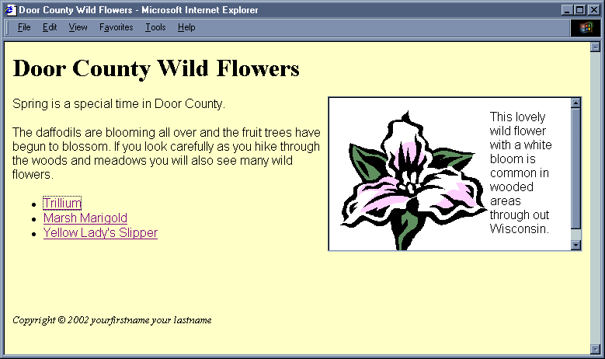

<iframe> tag
The iframe tag
  <iframe src="trillium.htm" title="Trillium Wild Flower" height=“160" align="right" name="flower" width="320">
  Description of the lovely Spring wild flower
  <a href="trillium.htm" target="_blank">Trillium</a></iframe>
  <!– initially trillium.htm will be displayed inline frame-->
src – to be displayed in the inline frame
name is used to configure the default target for all the links on an entire web page
container tag
  use description and link to the actual page between tags for not supported browsers

Slide 38
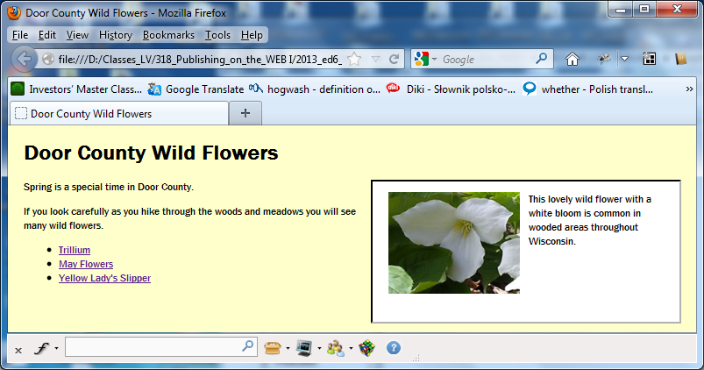
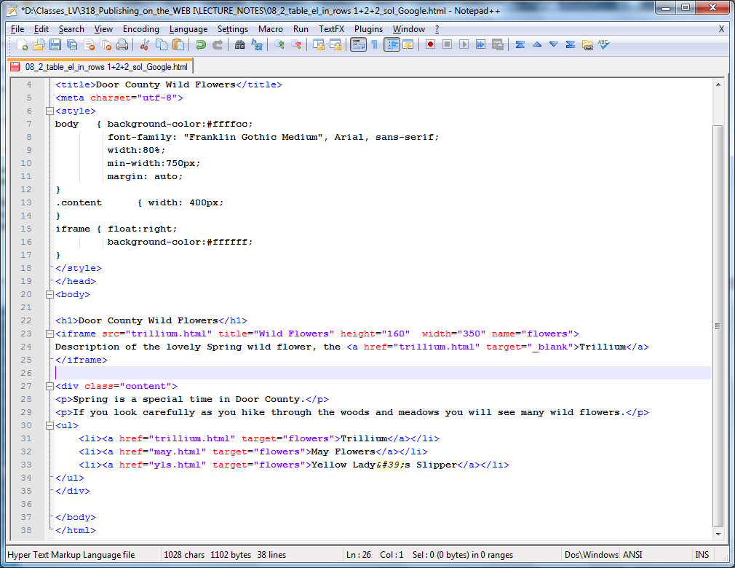
Inline Frames – HOP 13.1A
Inline Frames is also called floating frame
Can be placed in the body of a web page
Exc: Use three html files from chapt13 posted at http://classes.jgspectrum.com/classes/218_F20/examples/ch13/.

Slide 39
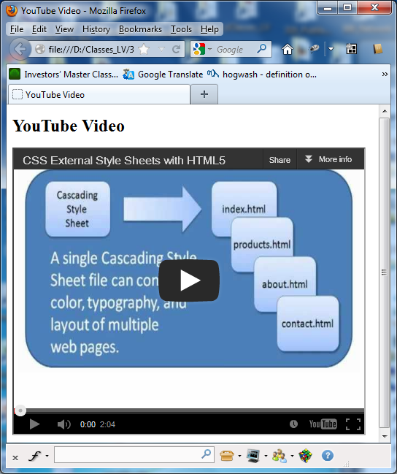
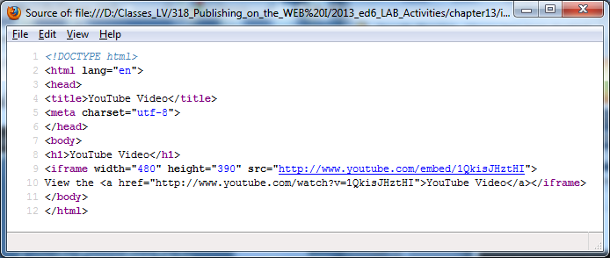
YouTube Video in an Inline Frame – HOP 13.1B p.580

Slide 40
<iframe> tag
Attributes
  name
    name of the frame for linking purposes
  src
    HTML document to be displayed in the frame
  width
    width of the frame
  height
    height of the frame
  align
    right, center, left (default) horizontally
  frameborder
    0 – no frame border,
    1 – yes, display frame borders (default)
  id
    unique id for the frame
  longdesc
    gives URL of Web page text description
    may used by assistive technologies (readers, search engines)
  marginheight
    top and bottom margins of the frame
  marginwidth
    right and left margins of the frame
  scrolling
    values: “yes”, ”no” or “auto” indicates that scrollbars appear when needed (default)
  title
    description of the inline frame that can be used by assistive technologies (readers, search engines) – recommended by W3C to improve accessibility
HTML 5 Attributes optional
  sandbox
    disallow/disable features such as plug-ins, script, forms
  seamless
    seamless=“seamless” to configure the browser to more seamlessly display the inline frame content

Slide 41
Summary
This chapter introduced concepts related to promoting your web site.
The activities involved in submitting web sites to search engines and search directories were discussed along with techniques for making your web site more useful to search engines.
Other web site promotion activities such as banner ads and newsletters were also examined.
At this point, you should have an idea of what is involved in the other side of web site development – marketing and promotion.
You can help the marketing staff by creating web sites that work with search engines and directories by following the suggestions in this chapter.
You learned about the HTML tags needed to create a web site that uses frames and gained some experience with inline frames.

Slide 42
Summary
Style Guide - https://www.w3schools.com/html/html5_syntax.asp
HTML5 introduced a method to let web designers take control over the viewport, through the <meta> tag.
The viewport is the user's visible area of a web page. It varies with the device, and will be smaller on a mobile phone than on a computer screen.
You should include the following <meta> viewport element in all your web pages:
  <meta name="viewport" content="width=device-width, initial-scale=1.0">
  A <meta> viewport element gives the browser instructions on how to control the page's dimensions and scaling.
  The width=device-width part sets the width of the page to follow the screen-width of the device (which will vary depending on the device).
  The initial-scale=1.0 part sets the initial zoom level when the page is first loaded by the browser.

